Slide 1

Unity For Academia
C# Classes
Spring 2025 – Week 3 & 4
Iman Noferesti

Slide 2

What is a Class?
A class is a blueprint for creating objects. It defines properties (variables), methods (functions), and constructors that determine the behavior of objects created from that class.
Think of a class in like a cake recipe.
The recipe gives you a blueprint for creating a delicious cake.
It includes a list of ingredients (properties/variables), instructions on how to combine and bake those ingredients (methods/functions), and the steps to get started (constructors).
When you follow the recipe, you can create multiple cakes, all based on that same recipe. Each cake will have the same characteristics because they come from the same class.
But you can also add your own personal touch to each cake by tweaking the recipe a bit, just like you can customize objects in C# by setting different values for the properties.

Slide 3

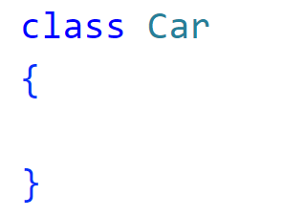
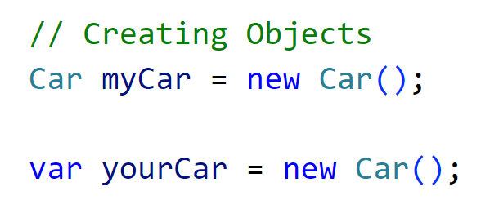
Basics of a Class
Defining a class
To define a new class, you use the class keyword followed by the class name.
By convention, a class name is in the Pascal case, such as SalesPerson.
Creating Objects (Instances)
To use a class, you need to create an object (or instance) of it.
To create a new object from a class, you need to use the new keyword.

Slide 4

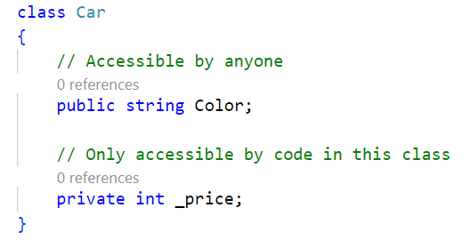
Fields and Properties
Fields are variables inside a class.
Properties provide controlled access to fields.
Access Modifiers
Access to members can be restricted through access modifiers, the two most common ones being:
Public: The member can be accessed by any code (no restrictions).
Private: The member can only be accessed by code in the same class.
Naming Conventions
Public fields are defined in PascalCase.
Private fields are defined in camelCase and prefixed with an underscore (_)
Notes:
If no access modifier -> code will assume it is private

Slide 5
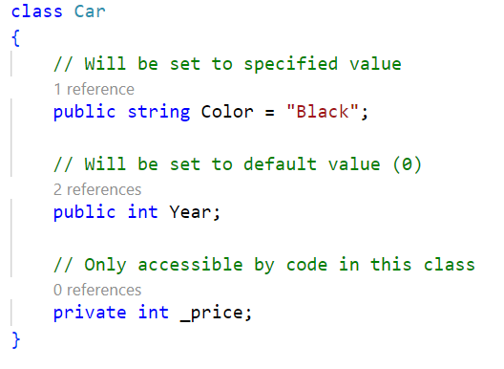
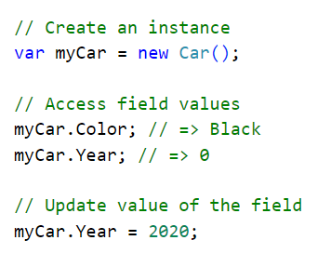
Fields and Properties
You can optionally assign an initial value to a field.
If a field does not specify an initial value, it will be set to its type’s default value.
An instance's field values can be accessed and updated using dot-notation (.).

Slide 6
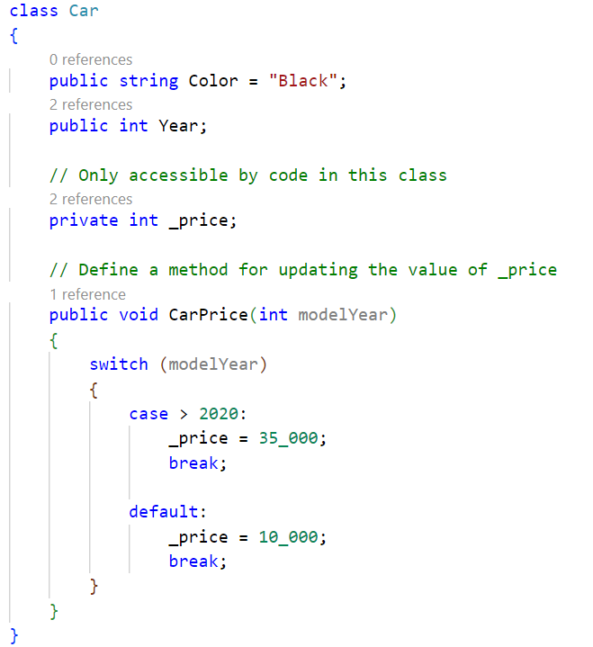
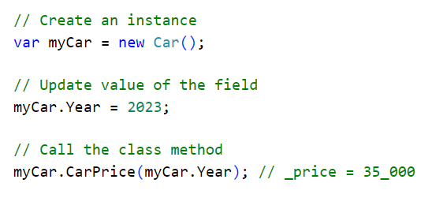
Methods
A method is a function inside a class that defines an action.
Private fields are usually updated as a side-effect of calling a method.

Slide 7
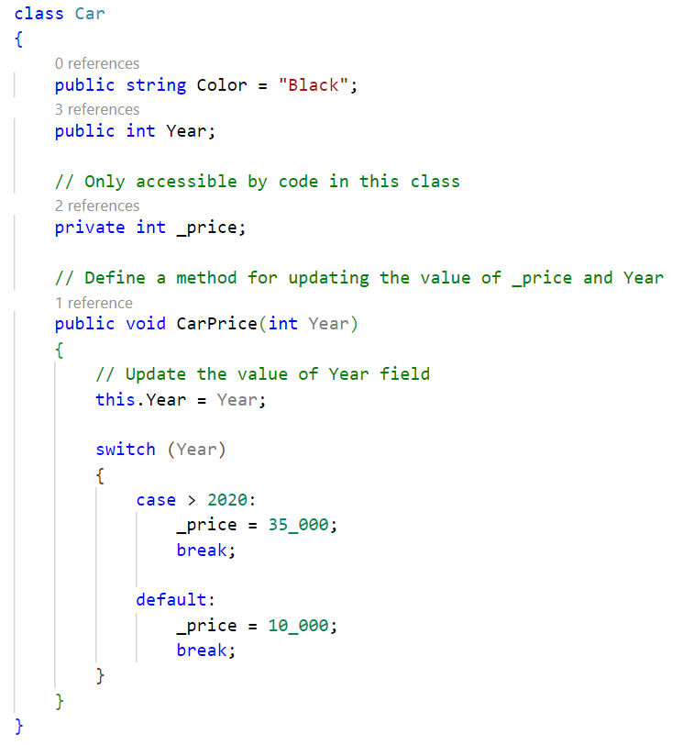
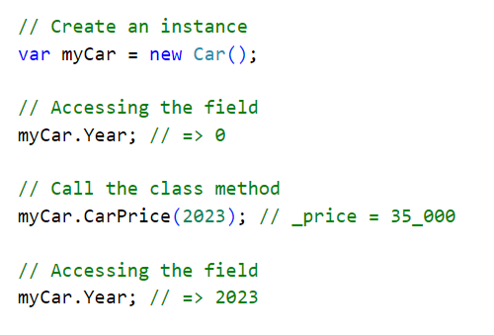
Within a class, the this keyword will refer to the current class.
This is especially useful if a parameter has the same name as a field.

Slide 8
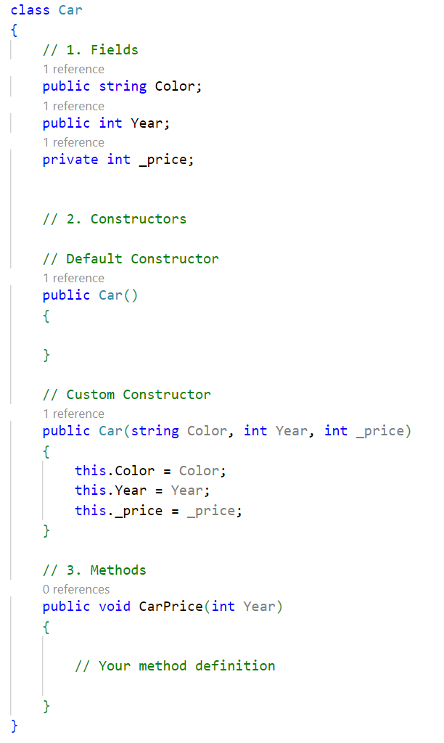
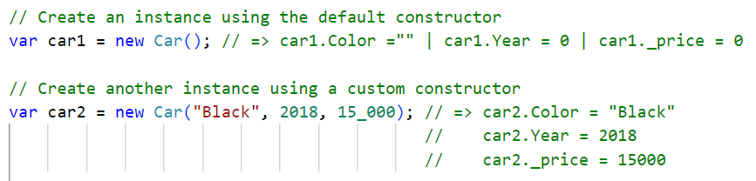
Constructors
A constructor is a special method whose name is the same as the class name.
A constructor doesn’t have the return type.
Typically, you use a constructor to initialize the new object by assigning values to the object’s properties.
Default Constructor
It is a constructor that takes no parameters.
If no constructor is defined, C# automatically provides a default one.
Define Constructor
Like regular methods, constructors can have parameters.
Arguments can be passed to constructors just like passing arguments
to regular methods.
Once you define a custom constructor, the C# compiler doesn’t implicitly add the parameterless constructor to the class.

Slide 9
Encapsulation
Encapsulation refers to restricting direct access to certain details of an object and only allowing controlled interaction through public methods or properties.
Encapsulation is implemented using access modifiers and properties (getters & setters) to control data access.
C# main access modifiers to control the visibility of class members:
Modifier | Description
public | Accessible from anywhere.
private | Accessible only within the same class. (Default for fields)
protected | Accessible within the same class and derived (child) classes.

Slide 10
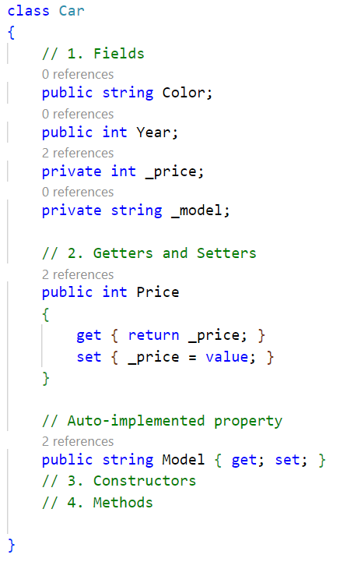
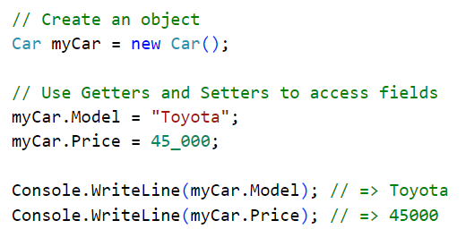
Encapsulation
Instead of exposing fields directly, it's best practice to use properties with get and set methods to control data access.

Slide 11
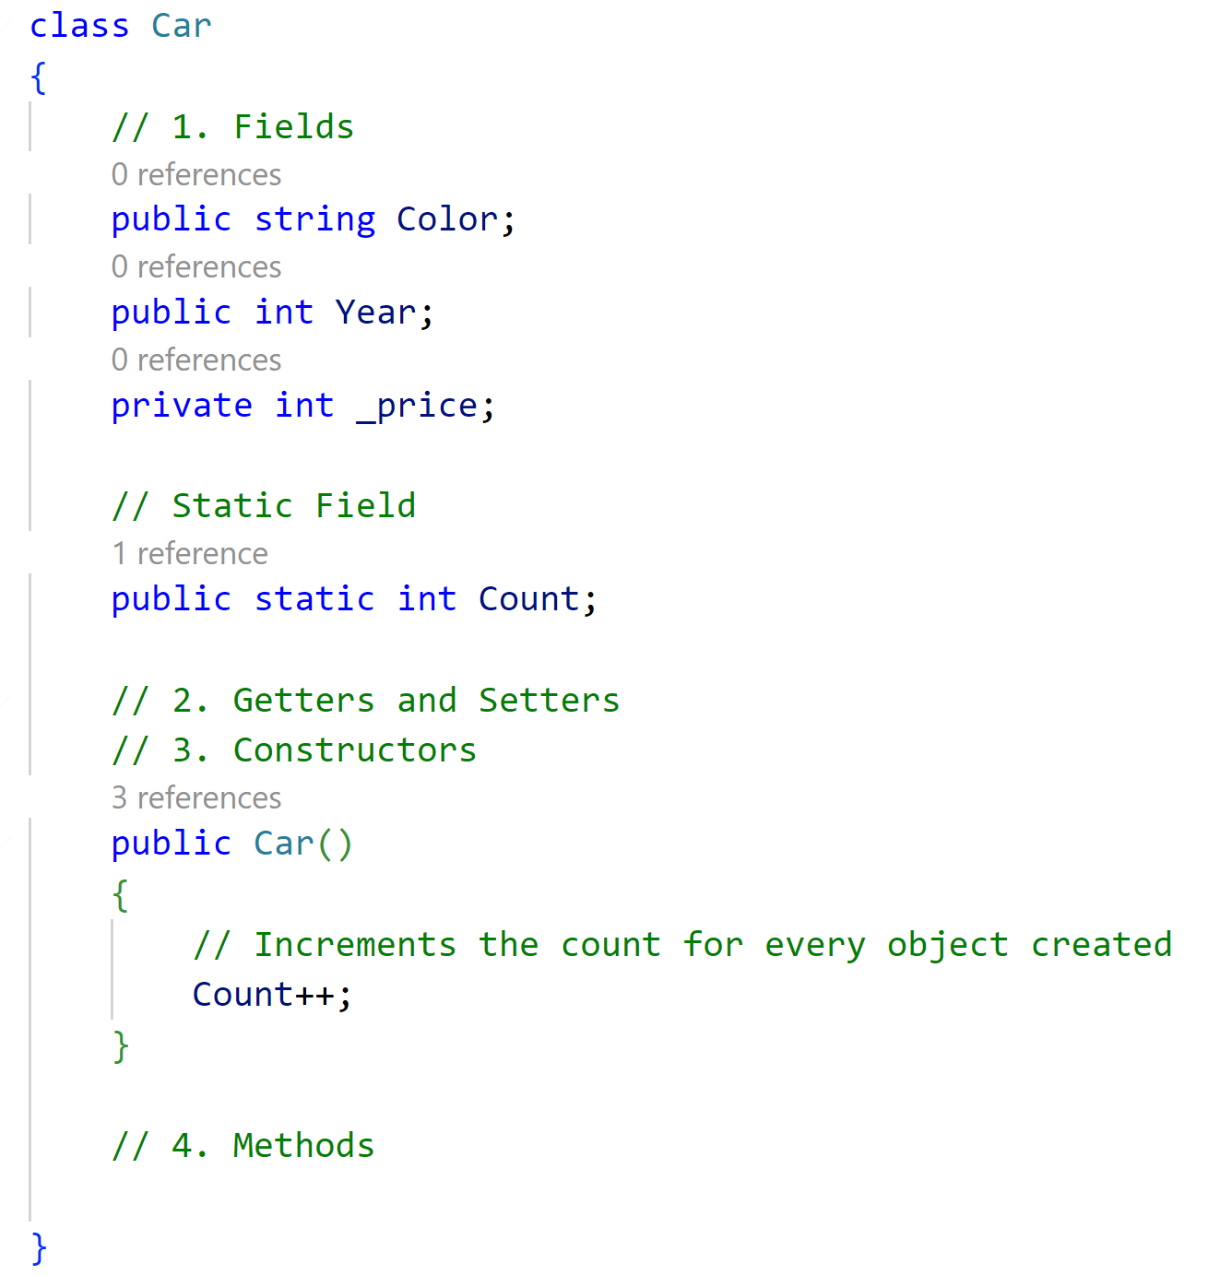
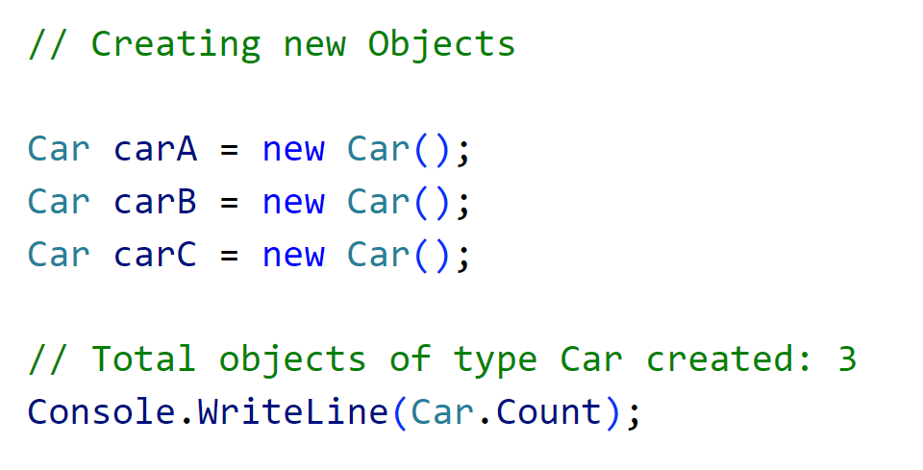
Static Members
Static members belong to the class itself, rather than an instance of the class.
This means that they are shared across all instances of the class and can be accessed without creating an object.
Static members include:
Static Fields
A static field is shared across all instances of a class.
All instances access the same value of the field.

Slide 12
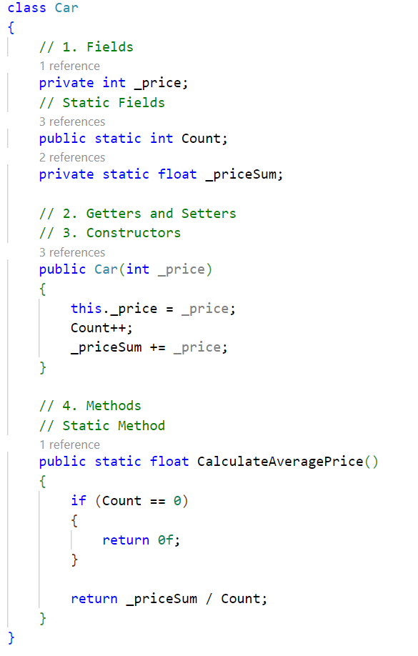
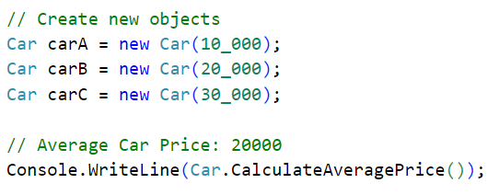
Static Method
A static method can be called without creating an instance of the class.
It can only access other static members of the class.

Slide 13
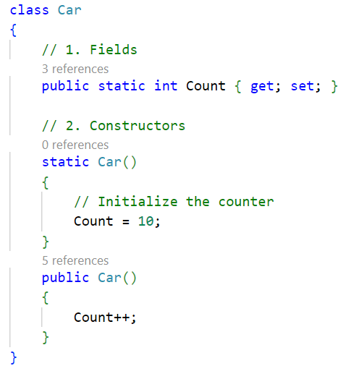
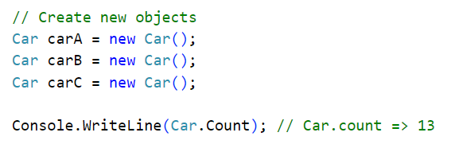
Static Constructors
A static constructor initializes static members of a class.
It runs only once when the class is first used, and it does not take parameters.

Slide 14
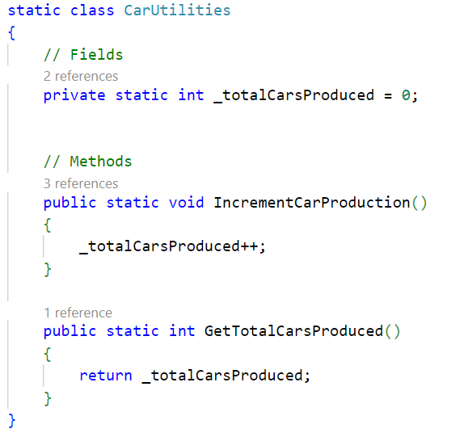
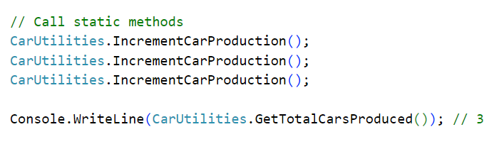
Static Classes
A static class contains only static members.
It cannot be instantiated or have non-static members.

