Slide 1

Unity For Academia
VR & Data Read/Write
Spring 2025 – Week 9
Iman Noferesti

Slide 2
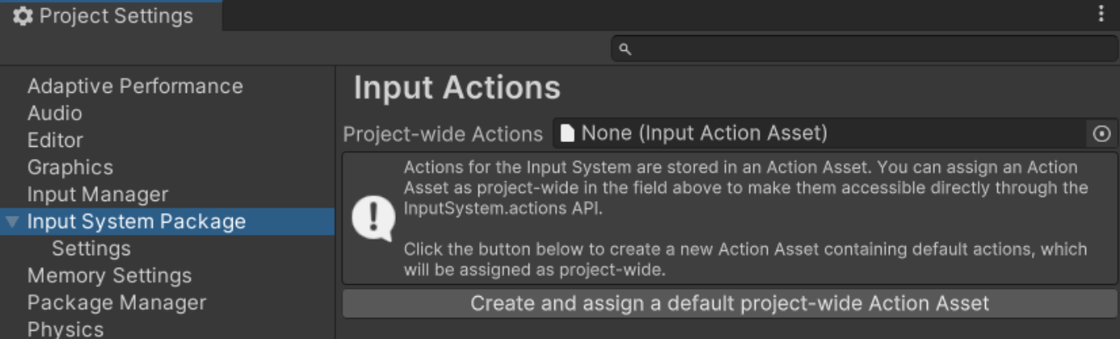
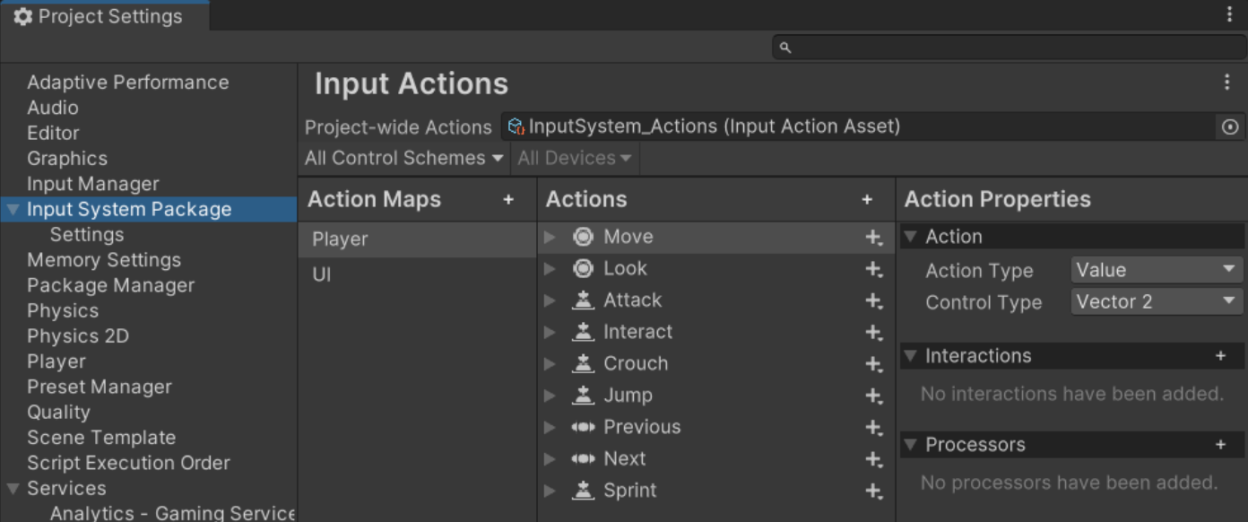
Input System
First, install the Input System package.
After you installed the input system package, you need to set up something called an Actions Asset to store your input settings.
To do this, open your project settings, find the Input System Package section, and go to Input Actions. Then, click the "Create and assign a default Actions Asset” for your project.
The Input Actions Settings window lets you check and adjust your input settings.
In this window, you can look at different Actions to see their names, types of values, and the bindings they are linked to. You can also make changes by editing, removing, or adding new Actions as needed.

Slide 3
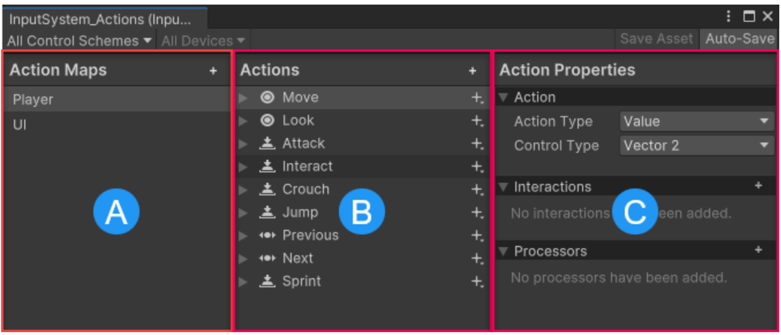
Input System
Name | Description
Action Maps (A) | Shows a list of all the Action Maps that have been set up. Each Action Map is a group of Actions that can be turned on or off together, making it easy to manage input settings for different situations.
Actions (B) | Shows all the Actions that belong to the selected Action Map, along with the bindings that link each Action to specific input controls.
Properties (C) | This panel shows the details of the selected Action or Binding from the Actions panel. Its title changes based on whether you are viewing an Action or a Binding, helping you easily keep track of what you're working with.

Slide 4
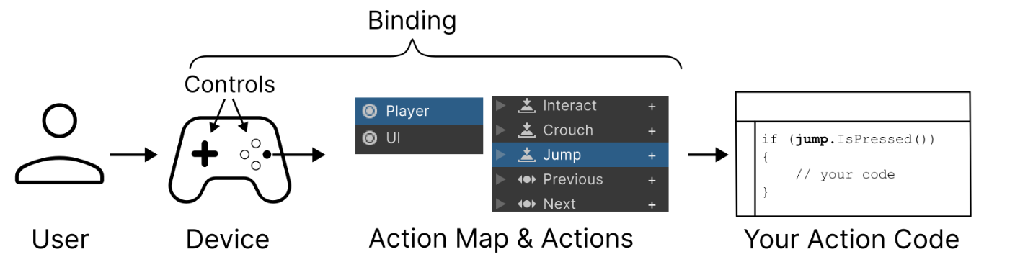
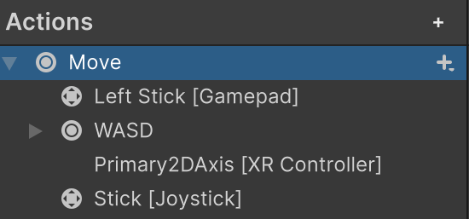
Input System
Action Maps
Action Maps help organize actions into groups that make sense for different situations.
By default, the Input System includes two Action Maps: "Player" and "UI".
The "Player" Action Map covers common gameplay actions like Move, Look, Jump, and Attack.
The "UI" Action Map focuses on user interface interactions like Navigate, Submit, and Cancel.
Each default action is linked to different types of controls. For example:
The "Move" action can be controlled using WASD keys, arrow keys, a gamepad stick, or the primary 2D axis on an XR controller.

Slide 5
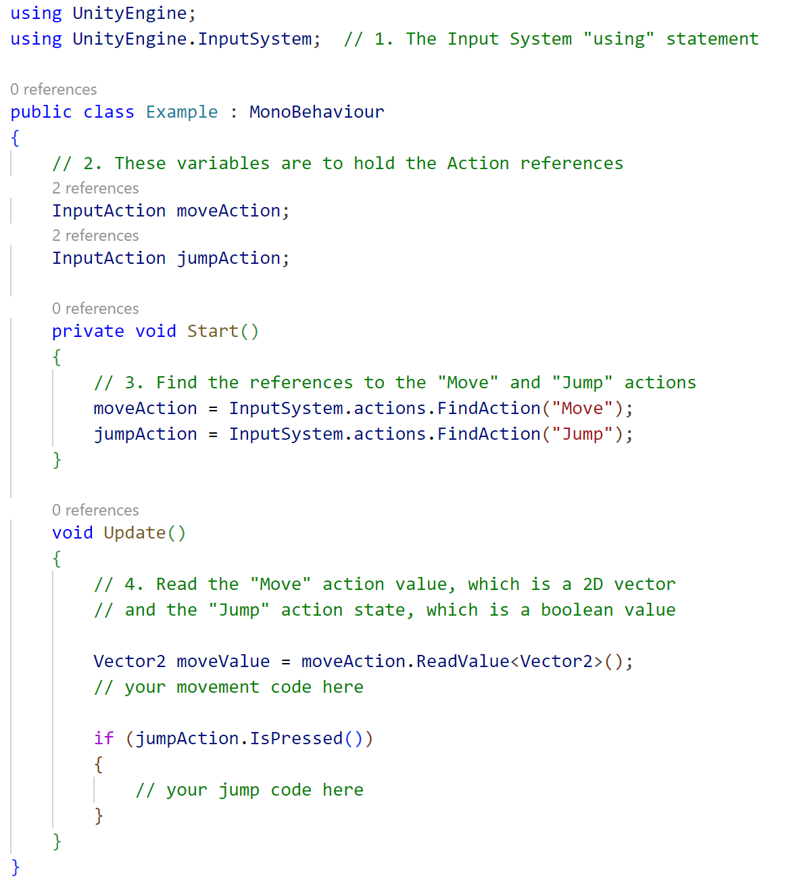
Input System
Read values from the default Actions
The Input System comes with ready-to-use Actions like Move and Jump, which work for many apps and games. These default Actions can read input from various controllers, including Keyboard, Mouse, Gamepad, Touchscreen, and XR, so you can often start scripting without needing extra setup.
Here’s a simple workflow to use the Input System in your script:
Add the Input System "using" statement at the top of your script.
Create variables to store references to Actions.
In the Start method, find and save the Action references.
In the Update method, read values from the Action references and write code to handle them.

Slide 6
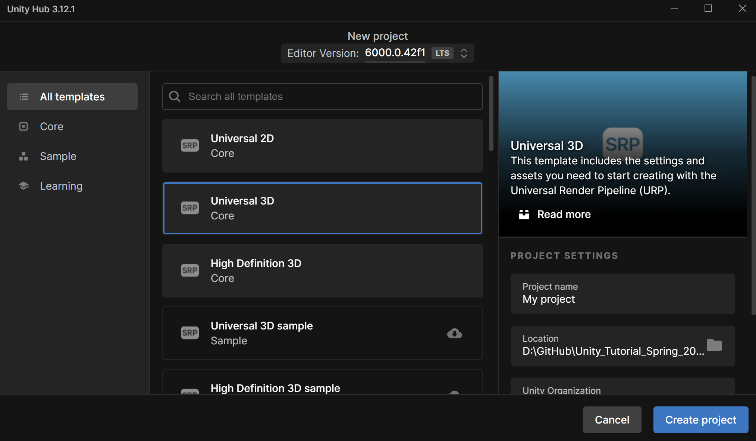
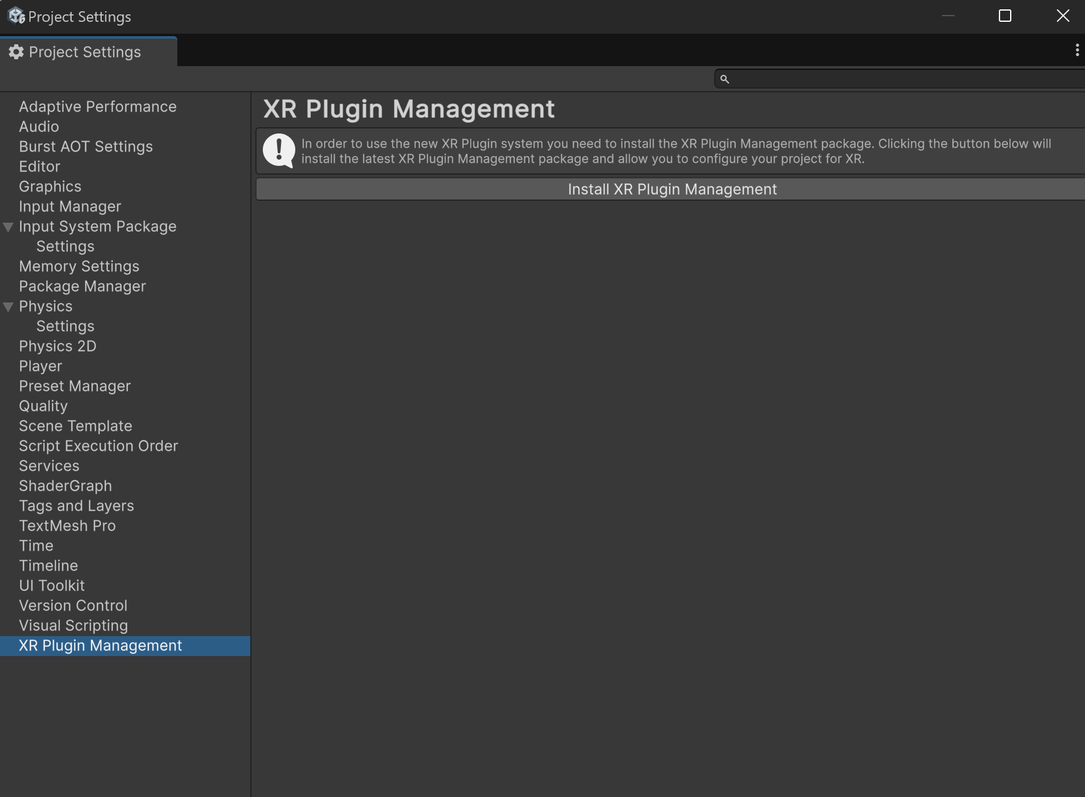
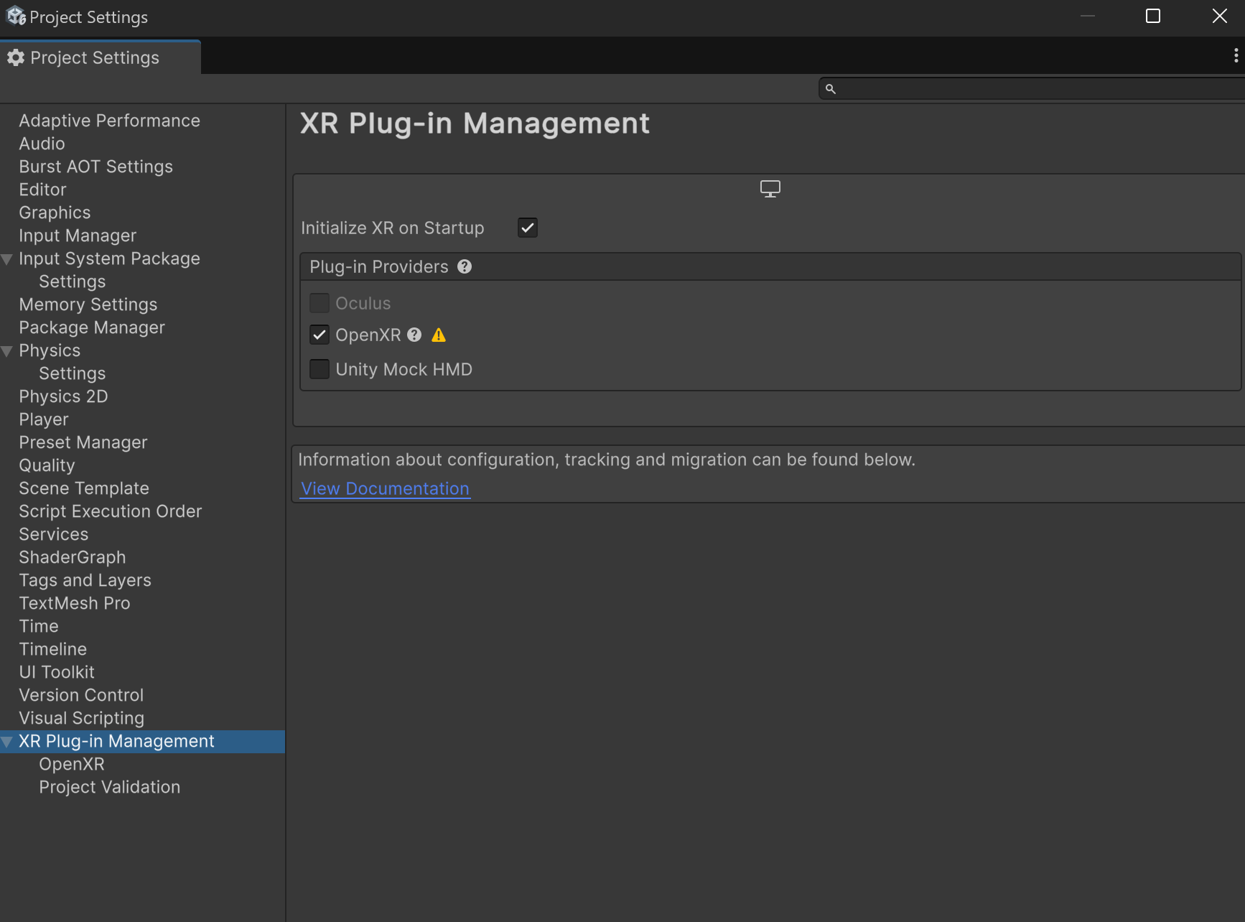
Setup For VR
Create a new URP Project
Open the Projects tab in Unity Hub.
Select New Project.
Make sure the Editor Version of your new project is set correctly.
From the list of templates, select Universal 3D (Core), then set the Project Name, and the Location to save it.
Click Create and wait for your project to open.
Install XR plugin packages.
Enable XR plug-ins:
From the top menu select Edit > Project Settings.
In the XR Plugin Management panel, select the Install XR Plugin Management button.
Install the OpenXR package:
From within the XR Plugin Management panel, in the PC, Mac, Linux & Standalone tab, select OpenXR from the list of available Plug-in Providers to install the plug-in.
This will allow you to publish to a wide range of devices using a single plugin.
If you are prompted to restart your project in order to switch to the new input system, select Yes.

Slide 7
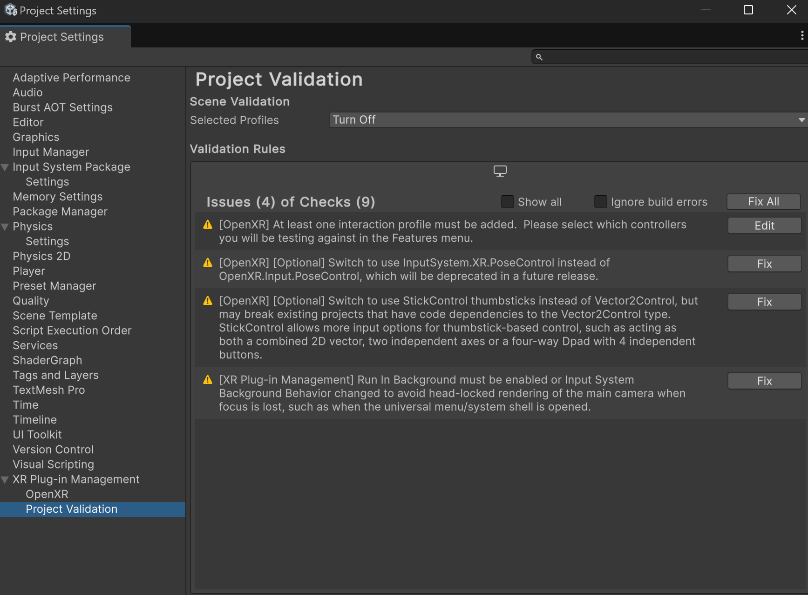
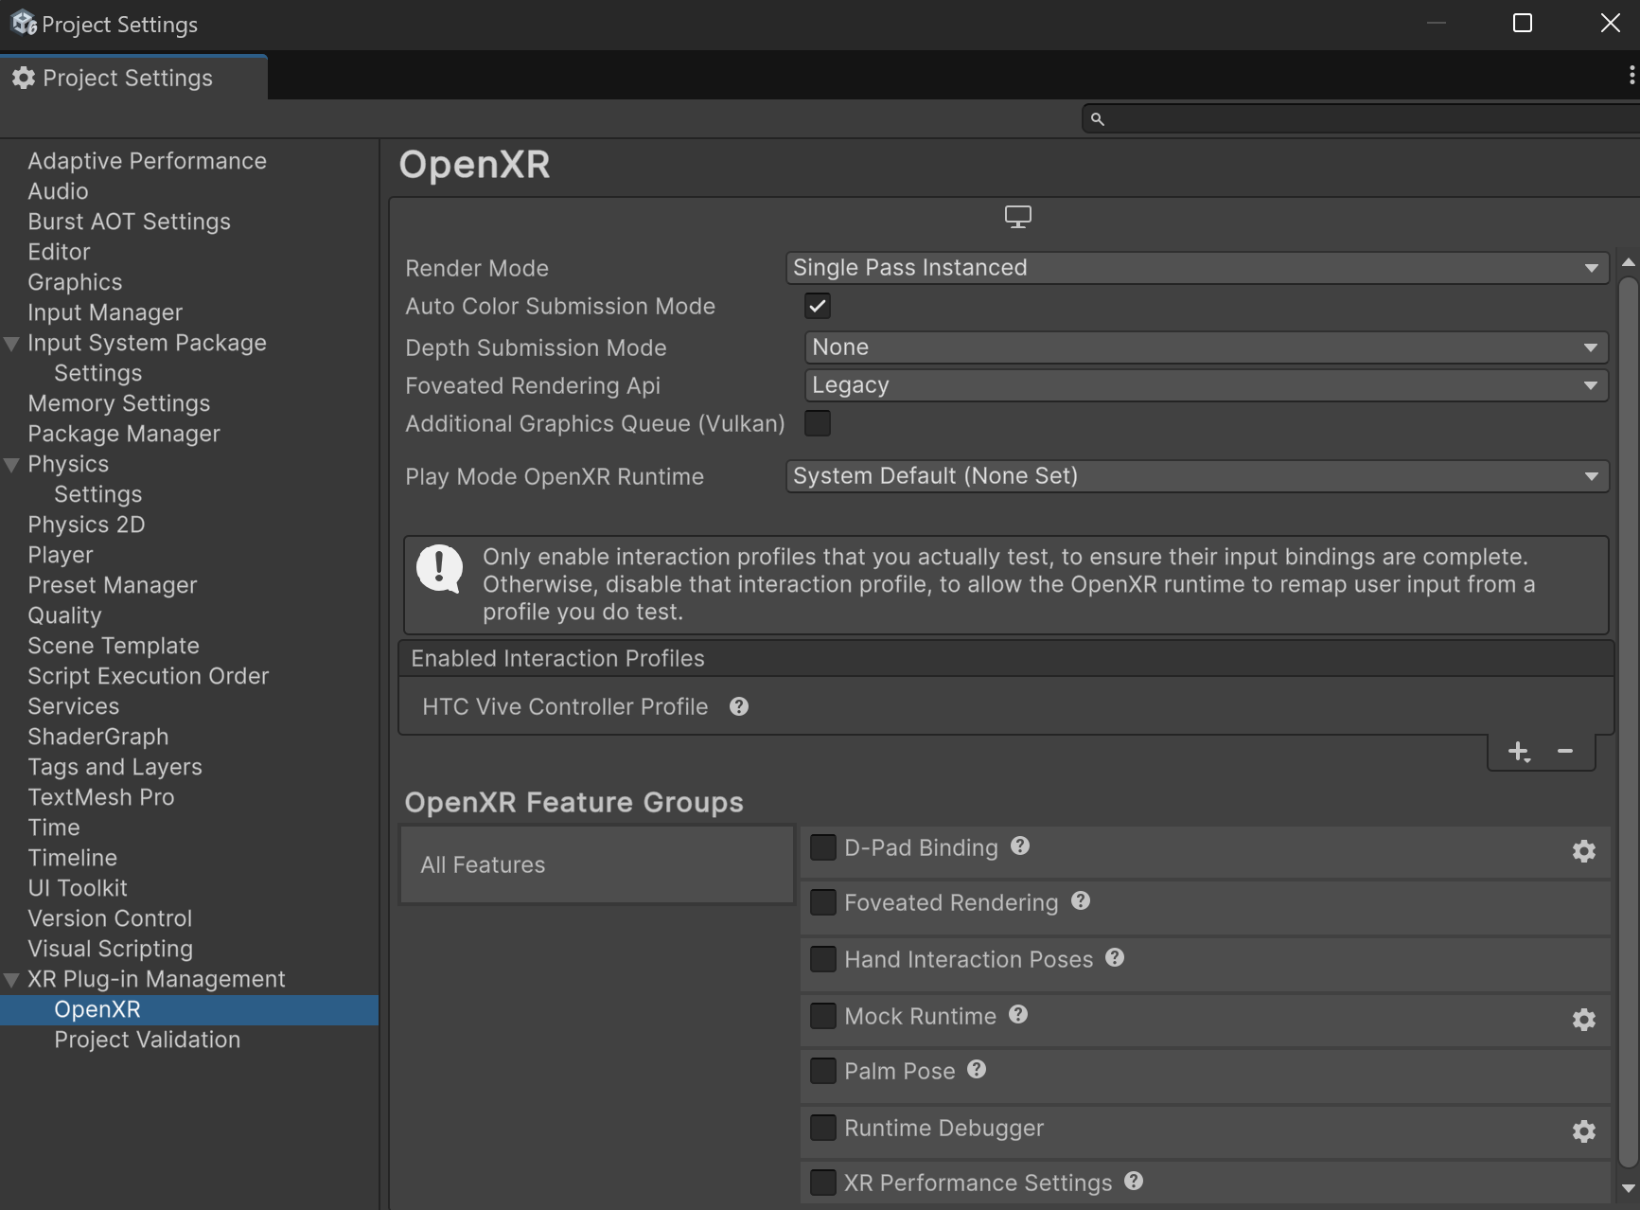
Setup For VR
Resolve warnings by setting up an interaction profile.
After adding the OpenXR plugin, notice the warning or error icon that appears next to the plugin Name
Click on the warning or error icon to open the OpenXR Project Validation window, which will tell you that you need to add an “interaction profile” for the device you’re using, select the Edit button to do that. This will open the OpenXR settings panel.
In the Windows, Mac, Linux tab, make sure the Oculus Touch Controller Profile appears in the list of Interaction Profiles, then enable all available OpenXR Feature Groups.
If you are using a different device, such as the Valve Index or HTC Vive, select that interaction profile instead.
There should no longer be any warnings in the XR Plugin Management panel. If there are, select them and follow the recommended steps to resolve them.

Slide 8
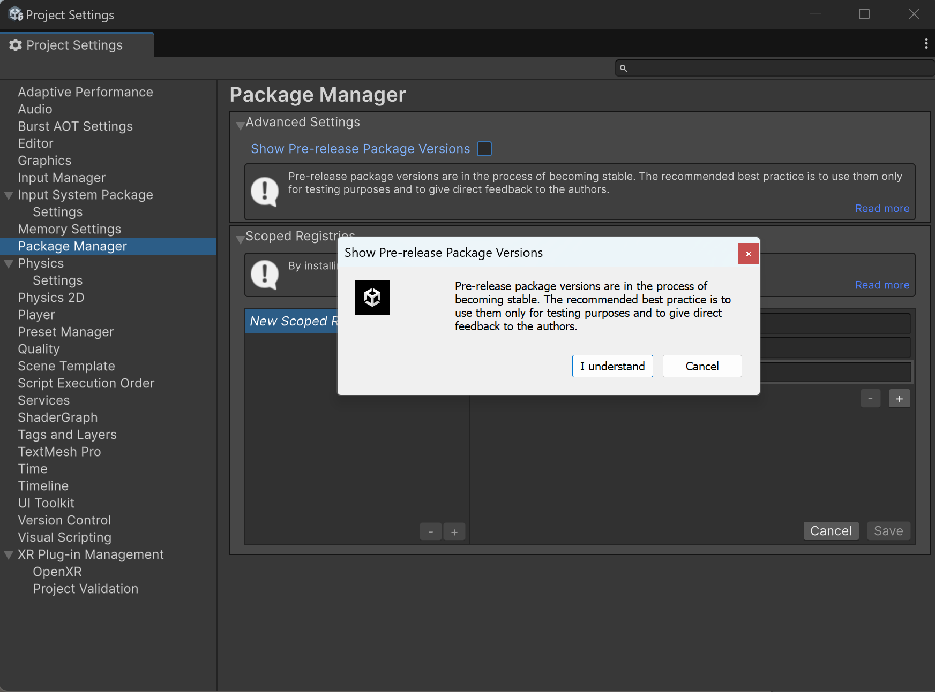
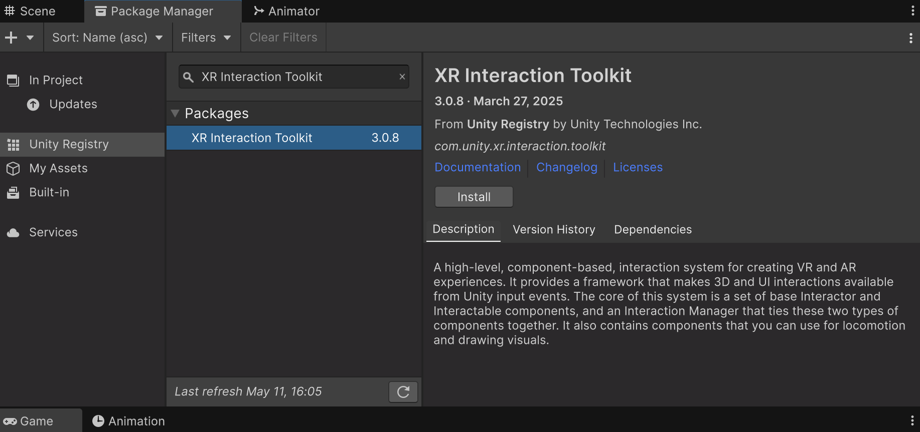
Setup For VR
Install the XR Interaction Toolkit and samples.
Allow the installation of “Pre-release” packages:
In the Project Settings window, in the Package Manager panel, select the option to Enable Pre-release Packages and then select “I Understand”.
Browse preview packages in the Package Manager:
From the top menu, select Window > Package Manager.
To be able to search through all packages, from the drop-down in the top-left, change the scope from “In Project” to “Unity Registry”.
Install the XR Interaction Toolkit package:
Search for and select the XR Interaction Toolkit package. If you don’t see it in the list, you can select the + button and choose to Add Project by Name, then enter “com.unity.xr.interaction.toolkit”.
Click Install.
This will allow you to quickly develop XR interactions.

Slide 9
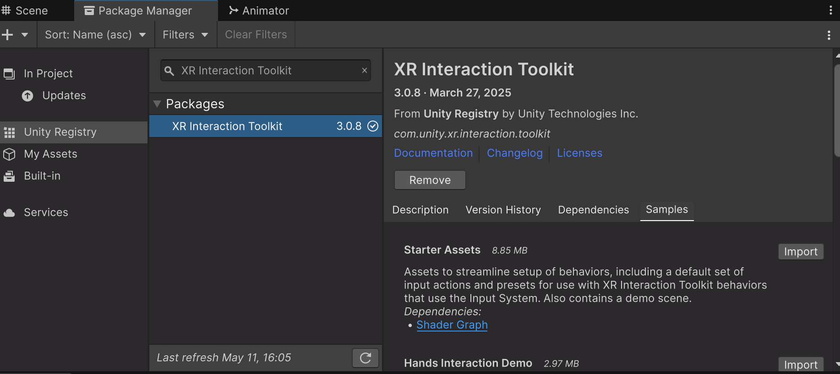
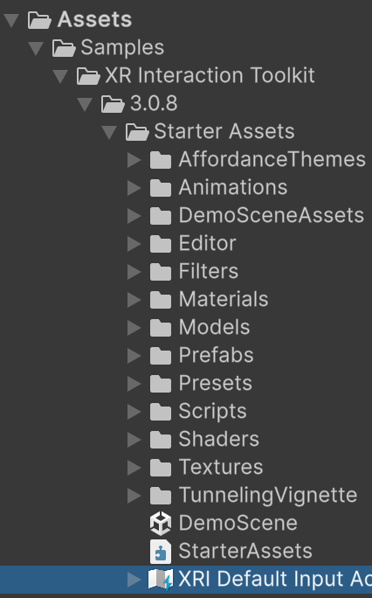
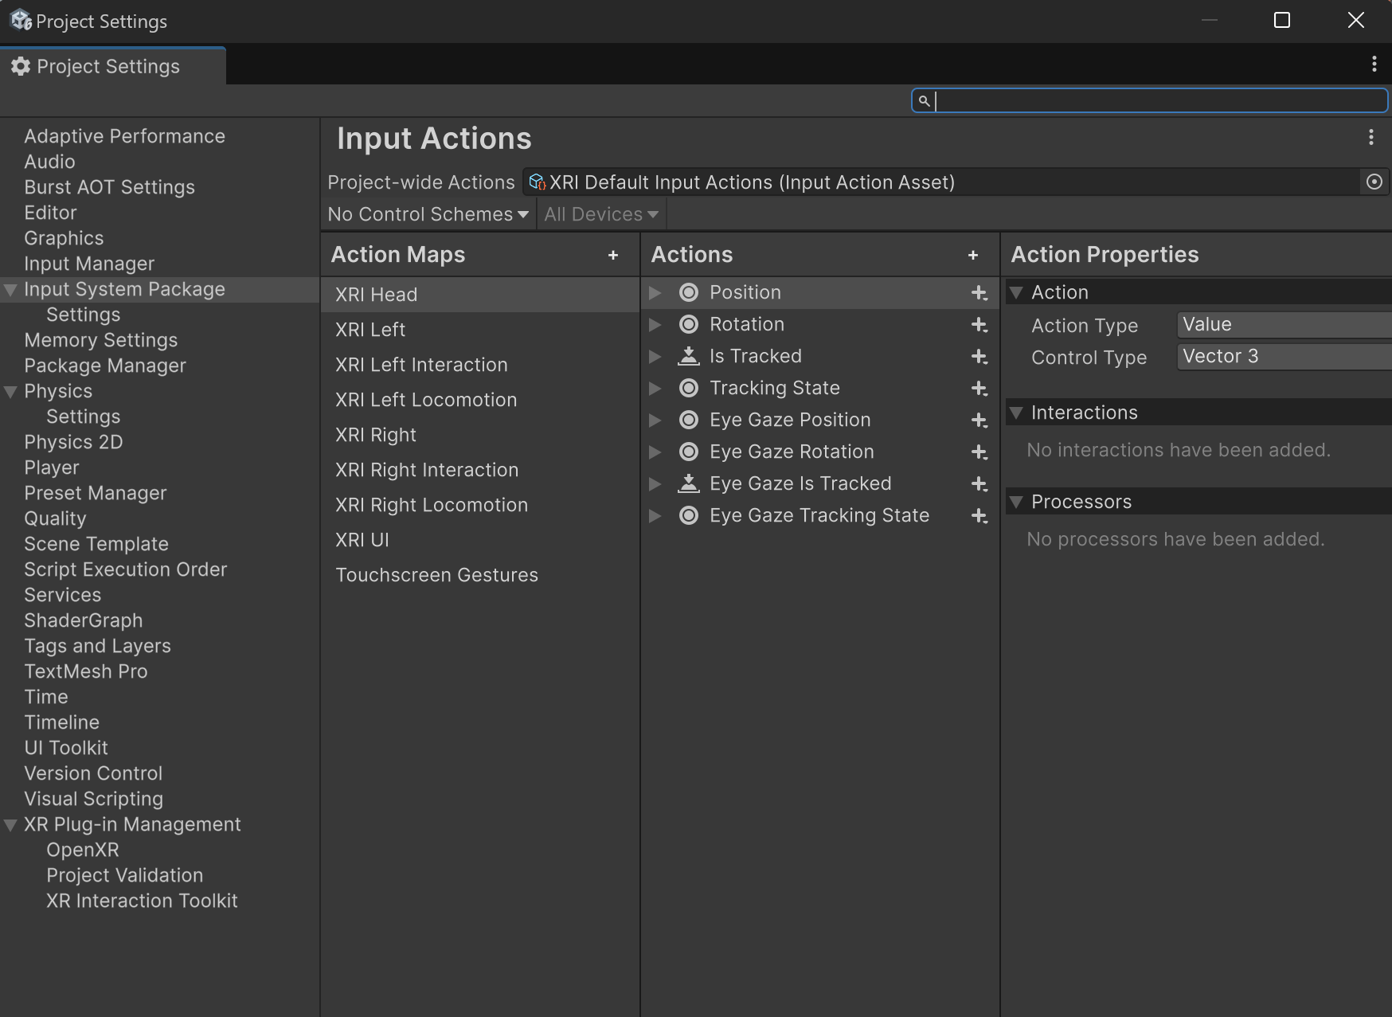
Setup For VR
Install the XR Interaction Toolkit and samples.
Install helpful samples for quick development:
After the XR Interaction Toolkit package has installed, a new Samples fold-out should appear at the bottom of the description.
Click to Import the Starter Assets.
This provides a set of Default Input Action presets for mapping specific buttons to actions using the action-based input system.

Slide 10
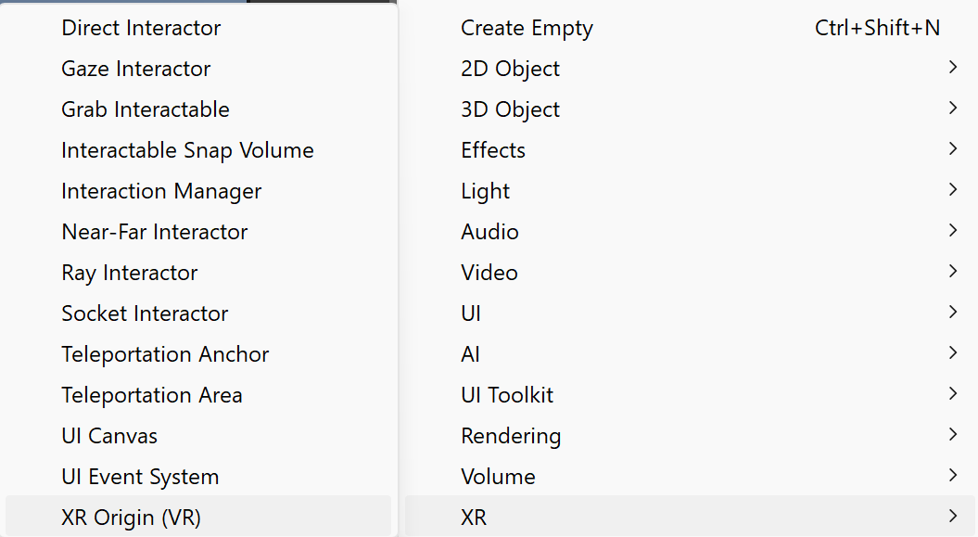
Setup For VR
Add an Action-based XR Origin to the scene.
Add an action-based XR Rig to your scene:
In the Hierarchy, right-click to create an XR > XR Origin (VR).
This object contains the camera.

Slide 11
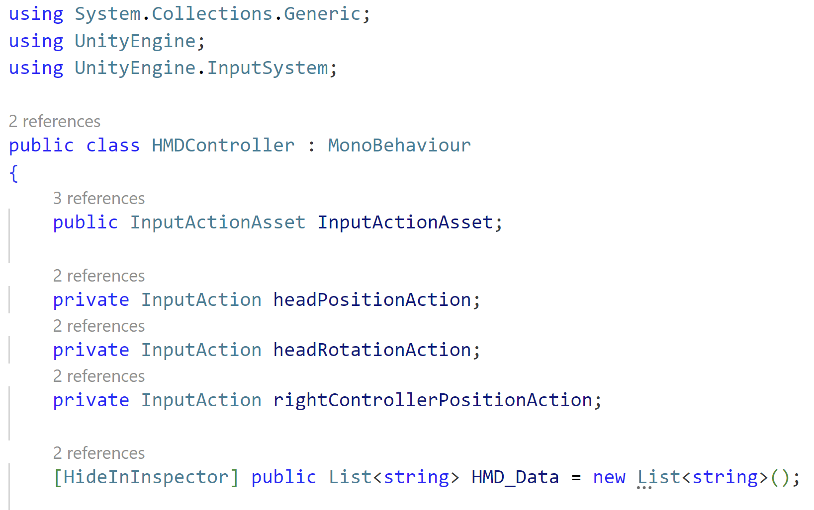
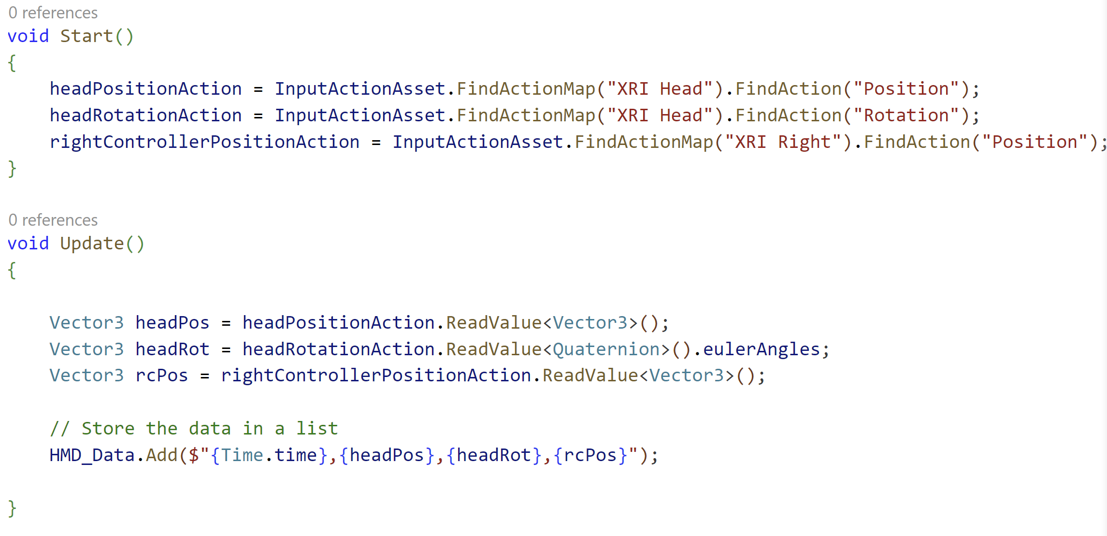
Data
Writing
If you're working in Unity and need to save data every frame while making sure it’s kept when the app closes, here’s how you can approach it:
Gather the data as the game runs (every frame using Update).
Keep it temporarily in memory while the game is running.
Save it permanently to a file when the game shuts down.
Gathering and Saving the data temporarily

Slide 12
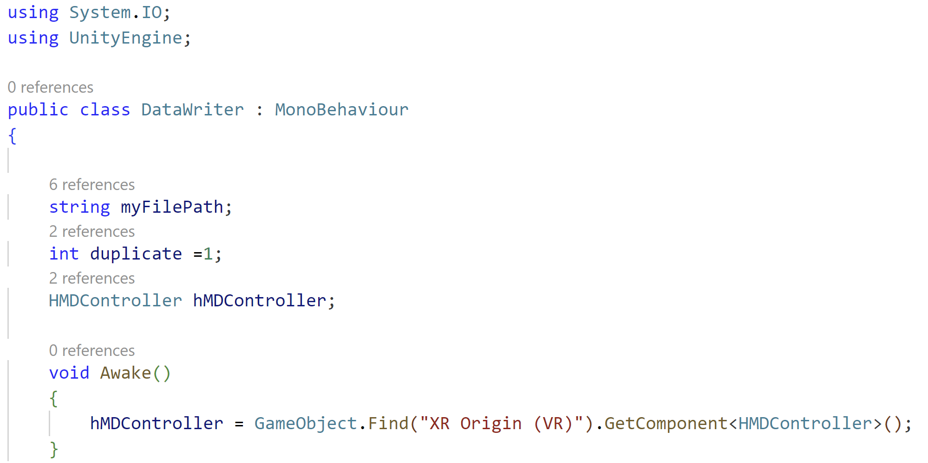
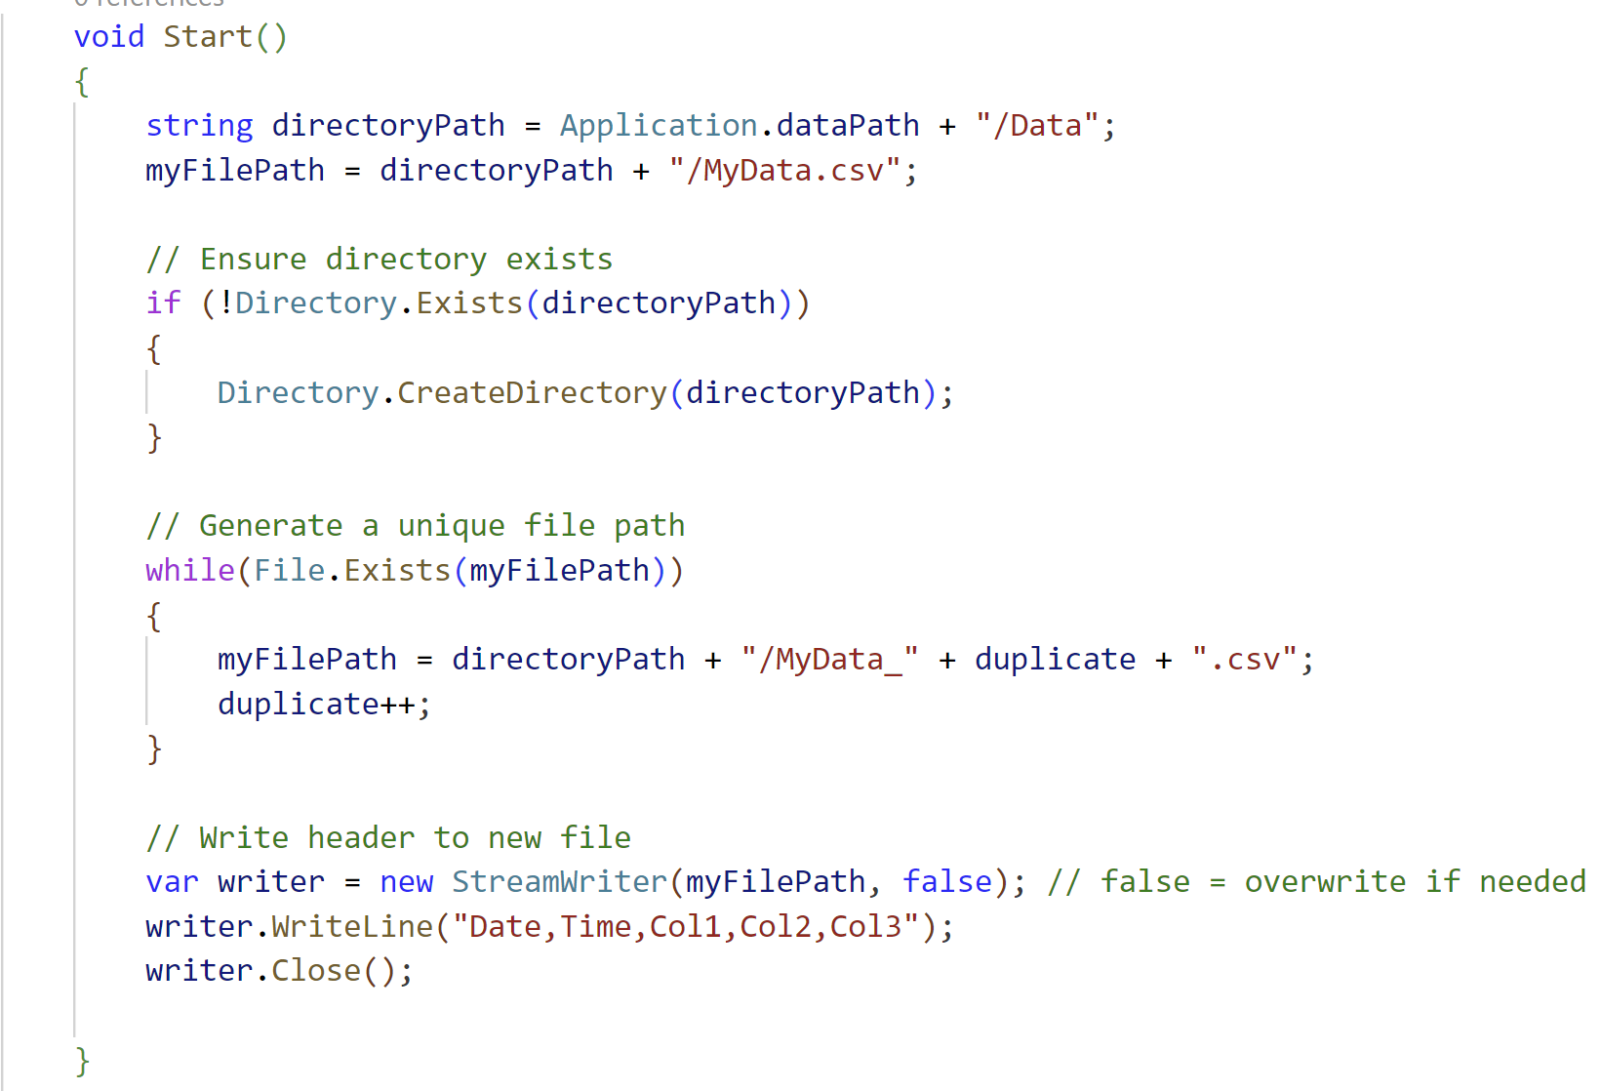
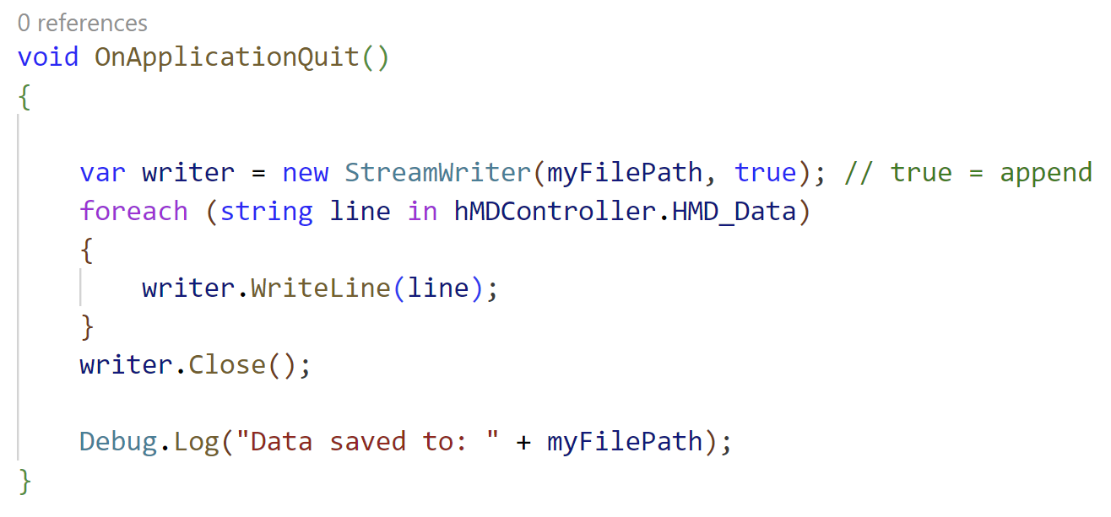
Save it permanently to a file at exit time
A List contains all your data

Slide 13
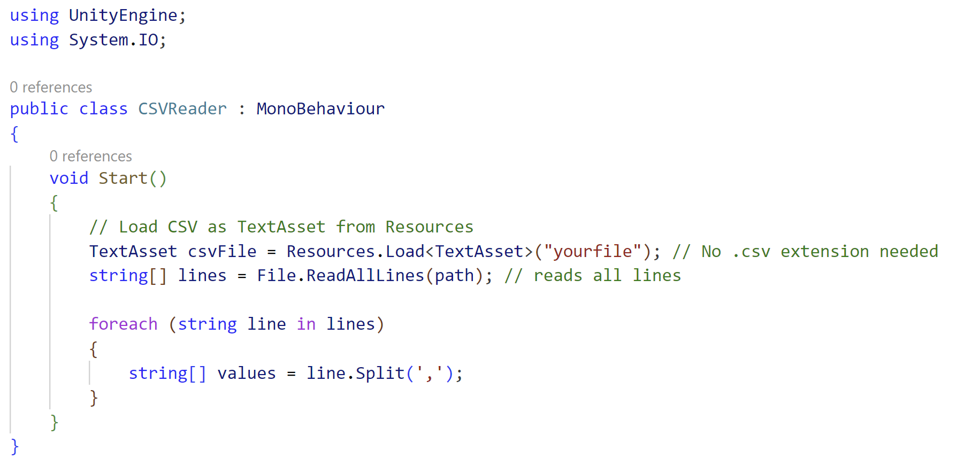
Data Reading
To read lines from a CSV file in Unity, you can use C#'s built-in file reading functions like File.ReadAllLines() in combination with Unity’s TextAsset if the file is bundled with the game (e.g., in Resources).

