Slide 1

Unity For Academia
C# Data Structures & Functions
Spring 2025 – Week 2
Iman Noferesti

Slide 2
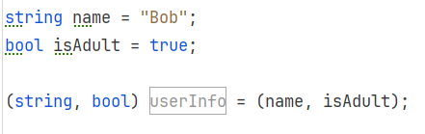
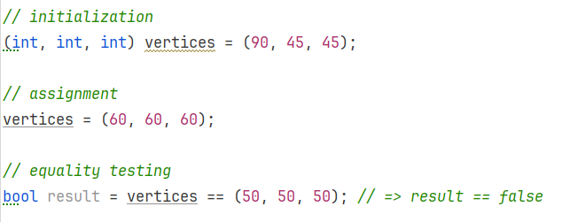
Tuples
A tuple is typically created by placing 2 or more expressions separated by commas, within a set of parentheses.
A tuple, like any other expression, can be used in various ways: for assignments, initializing fields or variables, returning values from methods, and passing as parameters. Tuples can also be tested for equality.

Slide 3
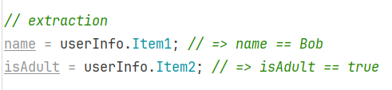
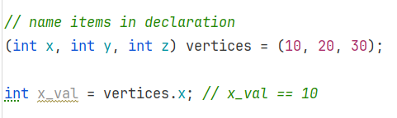
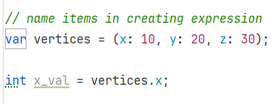
Fields are extracted using dot (.) syntax.
By default, the first field is Item1, the second Item2, etc.
Naming
Field names Item1 etc. don’t make for a readable code. There are 2 ways provide names to the fields:
In the type declaration
In the expression that creates it

Slide 4
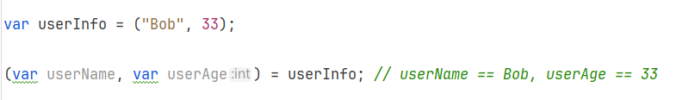
Deconstruction
Sometimes it is convenient to take a tuple and assign the fields to multiple variables and initialize them if appropriate.

Slide 5
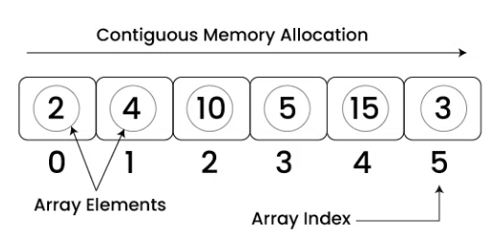
Arrays
An array is a fixed-size, strongly typed collection of elements of the same data type.
Arrays are zero-based, meaning the first element is at index 0.
They are part of the System namespace and are instances of the System.Array class.
Properties and Methods
Property / Method | Description
Length | Returns the total number of elements in the array
Clear(array, start, count) | Sets a range of elements in the array to their default values (null, 0, false, etc.).
Copy(source, dest, length) | Copies elements from one array to another. Both arrays must have compatible types.
CopyTo(destArray, index) | Copies the entire array to another array starting at a specified index.
Exists(array, predicate) | Checks if any element in the array satisfies the given condition (predicate).
Sort(array) | Sorts the array in ascending order.

Slide 6
Property / Method | Description
Find(array, predicate) | Returns the first element that matches a given condition.
FindAll(array, predicate) | Returns all elements that match a given condition as a new array.
FindIndex(array, predicate) | Returns the index of the first element that matches a given condition.
IndexOf(array, value) | Returns the first index of a specified value (or -1 if not found).
TrueForAll(array, predicate) | Returns true if all elements satisfy a given condition.

Slide 7
List<T>
A List represents a dynamically-sized array, allowing you to store objects of a specific type.
Unlike arrays, lists in can grow or shrink in size as elements are added or removed, making them more flexible than static arrays.
Properties and Methods
Property / Method | Description
Capacity | Capacity refers to the number of elements the list can hold before resizing.
Count | Count is the actual number of elements currently stored.
Contains | Checks if an element is present in the list.
Add() | Adds an item to the end of the list.
AddRange() | Adds multiple elements to the end of the list.
Clear() | Removes all elements from the list, making it empty.
Remove() | Removes the first occurrence of a specified element.

Slide 8
Property / Method | Description
RemoveAt() | Removes an element at a specific index.
RemoveAll() | Removes all elements that match a condition.
Insert() | Inserts an element at a specific index in the list.
InsertRange() | Inserts a collection of elements at a specific index.
CopyTo() | Copies the elements of the list to an array.
Exists() | Checks if any element in the list satisfies a condition.
Remove() | Removes the first occurrence of a specified element.
Find() | Finds the first element matching a condition.
FindAll() | Finds all elements that match a condition and returns them in a new list.
FindIndex() | Finds the index of the first element matching a condition.
IndexOf() | Finds the index of the first occurrence of a specified element.
Sort() | Sorts the elements in ascending order.
ToArray() | Converts the list into an array.

Slide 9
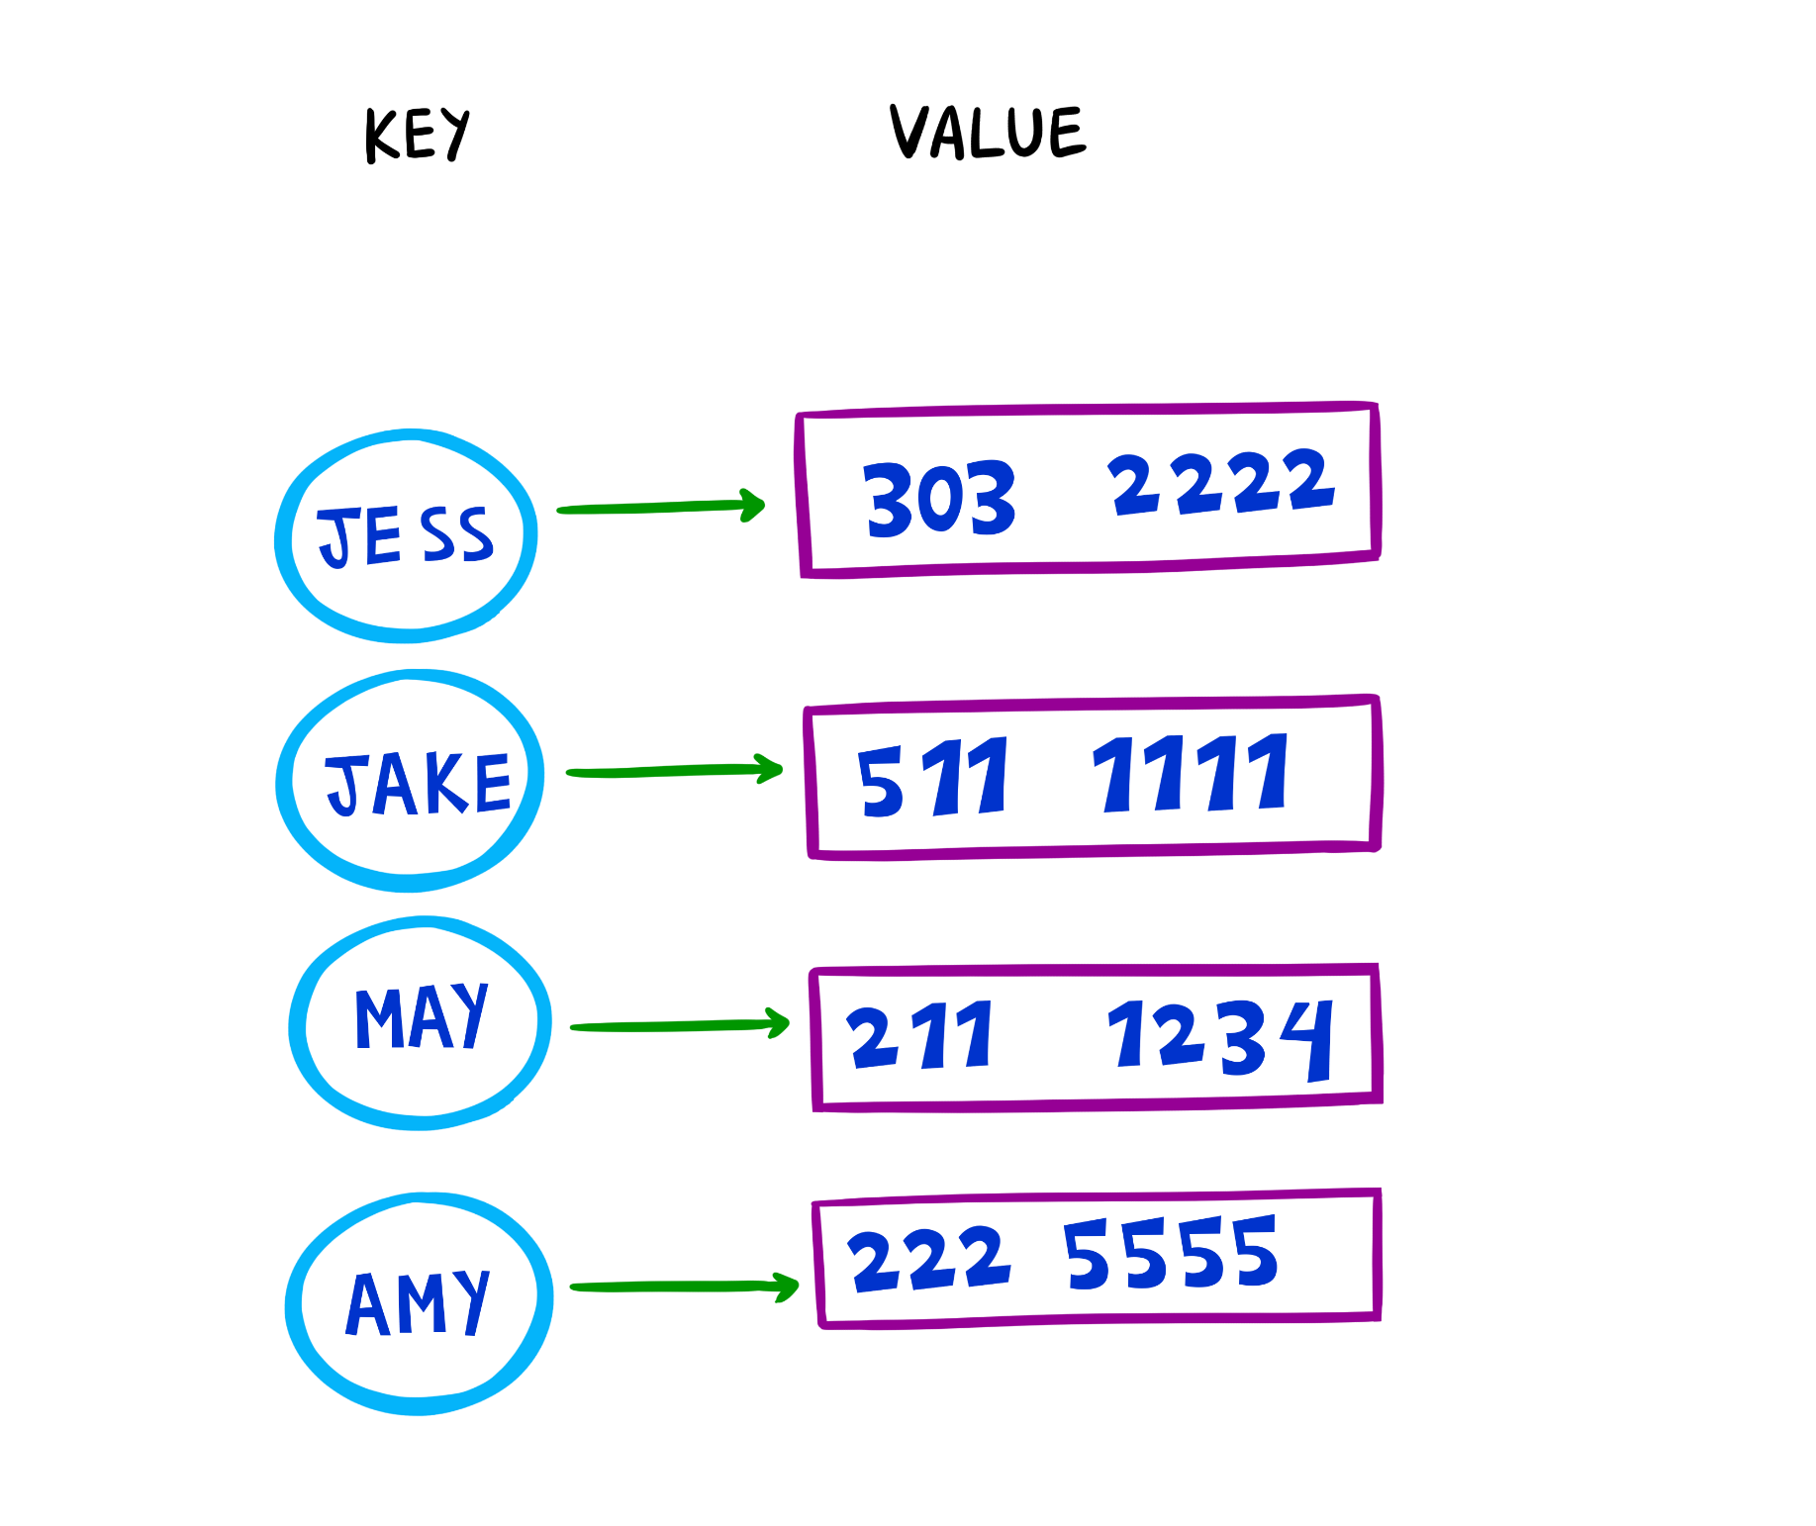
Dictionary<TKey, TValue>
A Dictionary is a collection that stores key-value pairs, providing fast lookups, additions, and removals based on keys.
Each key in a Dictionary must be unique.
Values are accessed efficiently using their associated keys.
The dictionary resizes itself as elements are added.
Properties and Methods
Property / Method | Description
Count | Returns the number of key-value pairs in the dictionary.
Keys | Returns a collection containing all the keys in the dictionary.
Values | Returns a collection containing all the values in the dictionary.
Add(TKey key, TValue value) | Adds a key-value pair to the dictionary; throws an exception if the key already exists.
Clear() | Removes all key-value pairs from the dictionary.
ContainsKey(TKey key) | Checks if the specified key exists in the dictionary.
ContainsValue(TValue value) | Checks if the specified value exists in the dictionary.
Remove(TKey key) | Removes the key-value pair associated with the given key; returns true if successful, and false if the key is not found.

Slide 10
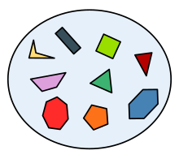
HashSet<T>
A HashSet is a collection that stores unique elements, meaning it does not allow duplicate values.
It does not guarantee any specific order of elements.
Supports mathematical set operations such as:
UnionWith(): Combines two sets, removing duplicates.
IntersectWith(): Keeps only elements that exist in both sets.
ExceptWith(): Removes elements present in another set.
SymmetricExceptWith(): Keeps elements that are unique between two sets.
Properties and Methods
Property / Method | Description
Count | Returns the number of elements in the HashSet.
Add() | Adds an element to the HashSet.
Clear() | Removes all elements from the HashSet.
Contains() | Checks if a specific element exists in the HashSet.
CopyTo(array) | Copies all elements of the HashSet into a specified array.
Remove() | Removes a specific element from the HashSet.

Slide 11
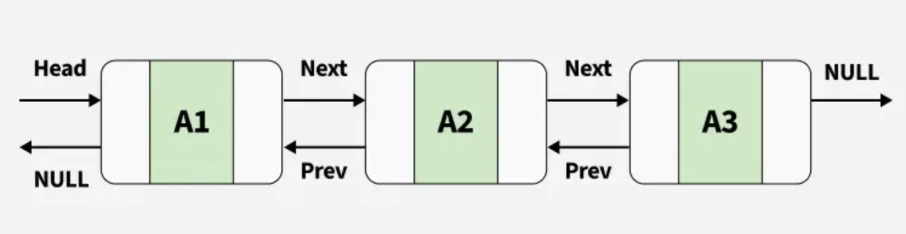
LinkedList<T>
A LinkedList is a way of storing data where each item (called a node) is connected to the next one, like a chain. Each node holds two things:
Data (the actual value).
A pointer (reference) to the next node (and in a doubly linked list, also a reference to the previous node).
Properties and Methods
Property / Method | Description
Count | Gets the number of nodes in the LinkedList.
First | Gets the first node of the LinkedList.
Last | Gets the last node of the LinkedList.
AddAfter(LinkedListNode<T> node, T value) | Adds a new node with the specified value after the given node.
AddBefore(LinkedListNode<T> node, T value) | Adds a new node with the specified value before the given node.

Slide 12
Property / Method | Description
AddFirst(T value) | Adds a new node with the specified value at the beginning of the list.
AddLast(T value) | Adds a new node with the specified value at the end of the list.
Clear() | Removes all nodes from the LinkedList.
Contains(T value) | Checks whether the specified value exists in the LinkedList. Returns true if found, otherwise false.
CopyTo(T[ ] array, int index) | Copies the entire LinkedList<T> to an array starting at the specified index.
Find(T value) | Finds the first node containing the specified value. Returns null if not found.
FindLast(T value) | Finds the last node containing the specified value. Returns null if not found.
Remove(T value) | Removes the first occurrence of the specified value from the LinkedList.
RemoveFirst() | Removes the first node of the LinkedList.
RemoveLast() | Removes the last node of the LinkedList.

Slide 13
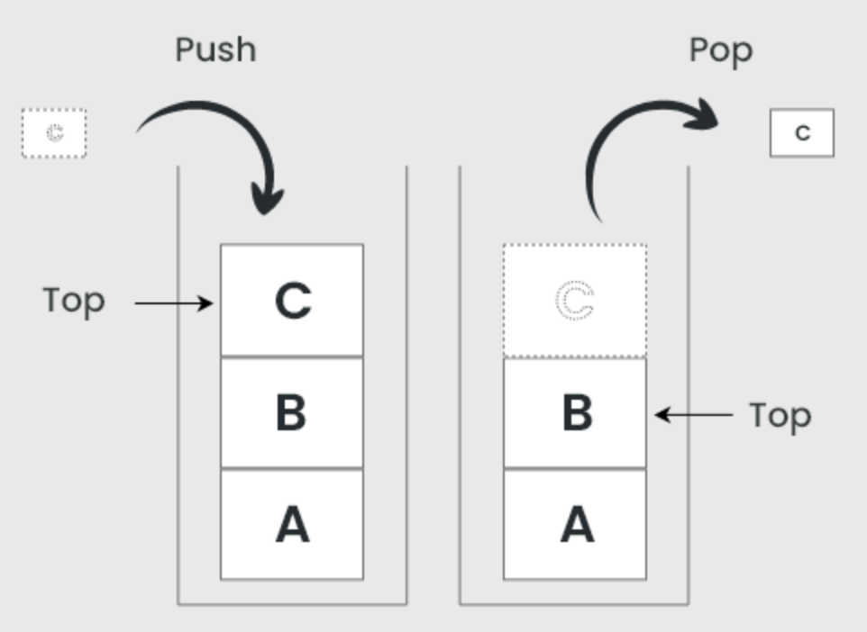
Stack<T>
A stack is a Last In, First Out (LIFO) collection, meaning the last item added is the first one to be removed.
Properties and Methods
Property / Method | Description
Count | Gets the number of elements in the stack.
Clear() | Removes all elements from the stack.
Contains(T item) | Checks if a specific item exists in the stack, returning true if found.
CopyTo(T [ ] array, int index) | Copies the elements of the stack into an existing array starting at the specified index.

Slide 14
Property / Method | Description
Peek() | Returns the item at the top of the stack without removing it.
Pop() | Removes and returns the item at the top of the stack.
Push(T item) | Adds an item to the top of the stack.
ToArray() | Copies the stack elements into a new array in LIFO order.

Slide 15
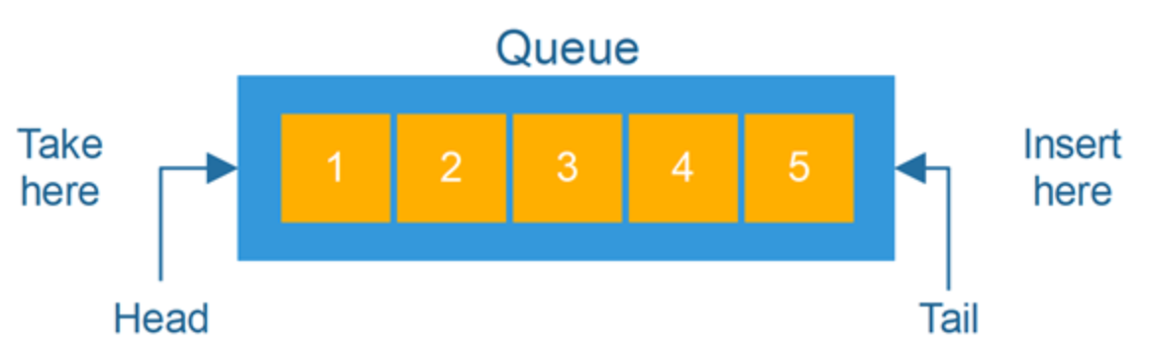
Queue<T>
A Queue is a FIFO (First-In, First-Out) data structure that stores elements in the order they were added.
This means that the first element added to the queue will be the first one removed.
Properties and Methods
Property / Method | Description
Count | Gets the number of elements in the queue.
Clear() | Removes all elements from the queue.
Contains(T item) | Checks if the specified item exists in the queue and returns true or false.
CopyTo(T [ ] array, int index) | Copies the queue elements to an existing array starting at the specified index.

Slide 16
Property / Method | Description
Enqueue(T item) | Adds an item to the end of the queue.
Dequeue() | Removes and returns the item at the front of the queue.
Peek() | Returns the item at the front of the queue without removing it.
ToArray() | Copies the elements of the queue into a new array without modifying the queue.

Slide 17
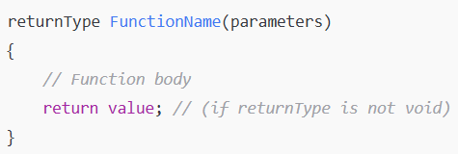
Functions
Sometimes, you want to perform the same task multiple times in a program.
If you find yourself writing the same statements over and over again, you can turn those statements into a function.
Functions help organize code, improve reusability, and make debugging easier.
Defining a Function
Calling a Function
To use a function, call it by its name and provide required parameters
Function Types
Void functions (no return values)
Functions with return values
Functions optional parameters

