Slide 1

Unity For Academia
User Interface
Spring 2025 – Week 8
Iman Noferesti

Slide 2
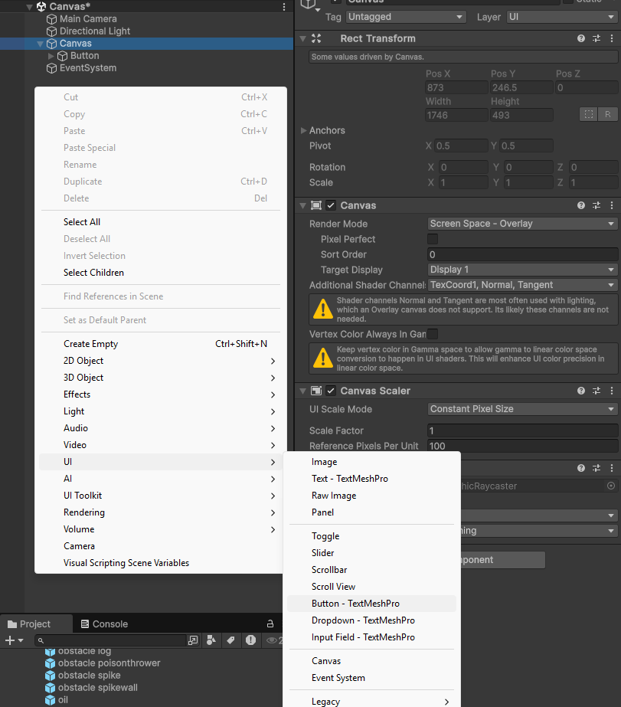
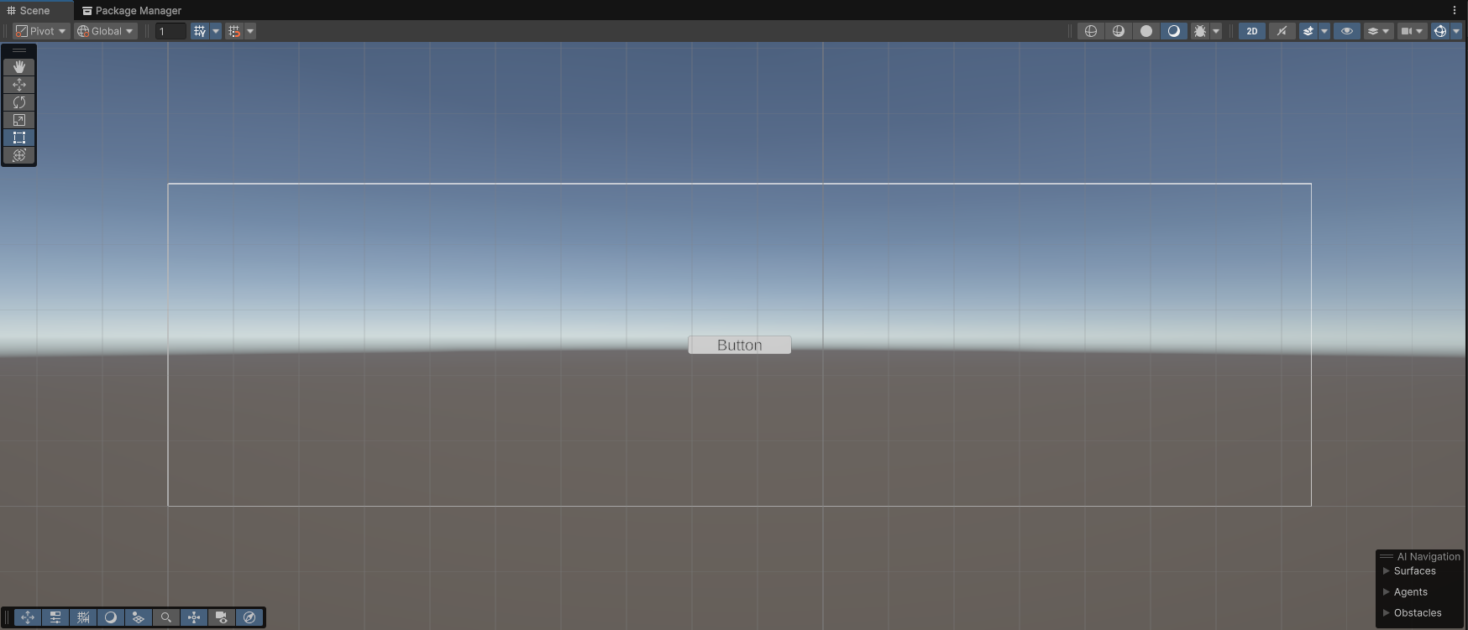
Canvas
The Canvas is where all UI elements belong. It's a Game Object with a Canvas component, and any UI elements need to be its children.
Creating a new UI element will automatically create a Canvas.
In the Scene View, the Canvas appears as a rectangle, allowing you to place UI elements efficiently without constantly referencing the Game View.
UI elements within the Canvas are displayed based on their order in the Hierarchy.
To adjust the layering of elements, you can rearrange them in the Hierarchy by dragging.
Alternatively, you can use scripting methods like SetAsFirstSibling, SetAsLastSibling, and SetSiblingIndex on the Transform component to control their order.

Slide 3

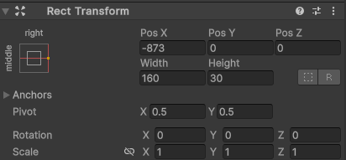
Rect Transform
The Rect Transform is a new transform component that is used for all UI elements instead of the regular Transform component.
Rect Transforms have position, rotation, and scale just like regular Transforms, but it also has a width and height, used to specify the dimensions of the rectangle.
The Rect Tool(keyboard shortcut: T) lets you move, resize, and rotate UI elements.
To move an element, click inside its rectangle and drag.
For resizing, drag the edges or corners.
To rotate, hover near a corner until the cursor changes to a rotation symbol, then click and drag to rotate in either direction.
Rect Transforms use anchors for layout, which appear as four triangular handles in the Scene View and are detailed in the Inspector.
The child UI object can be anchored to its parent Canvas in multiple ways and thus can be moved or stretched in parallel if the canvas position or scale changes.

Slide 4
Common UI Components
Component | Description
Text (TextMeshPro) | Displays readable text
Button | Clickable UI element with events
Image | Displays a sprite or texture
Slider | Lets users choose a value from a range
Input Field | Text input field

Slide 5
Common UI Script Classes
Component | Use
Text | .text for display text
Button | .interactable .onClick.AddListener() to handle clicks
Image | .sprite .color
Slider | .value .onValueChanged.AddListener()
Input Field | .text .onValueChanged

Slide 6
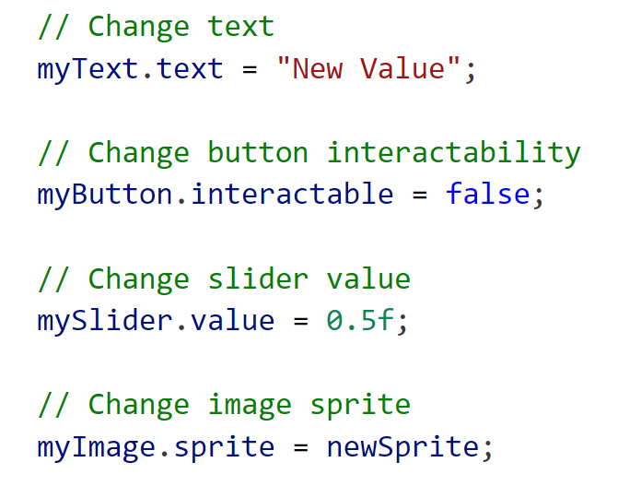
Common UI Values

Slide 7
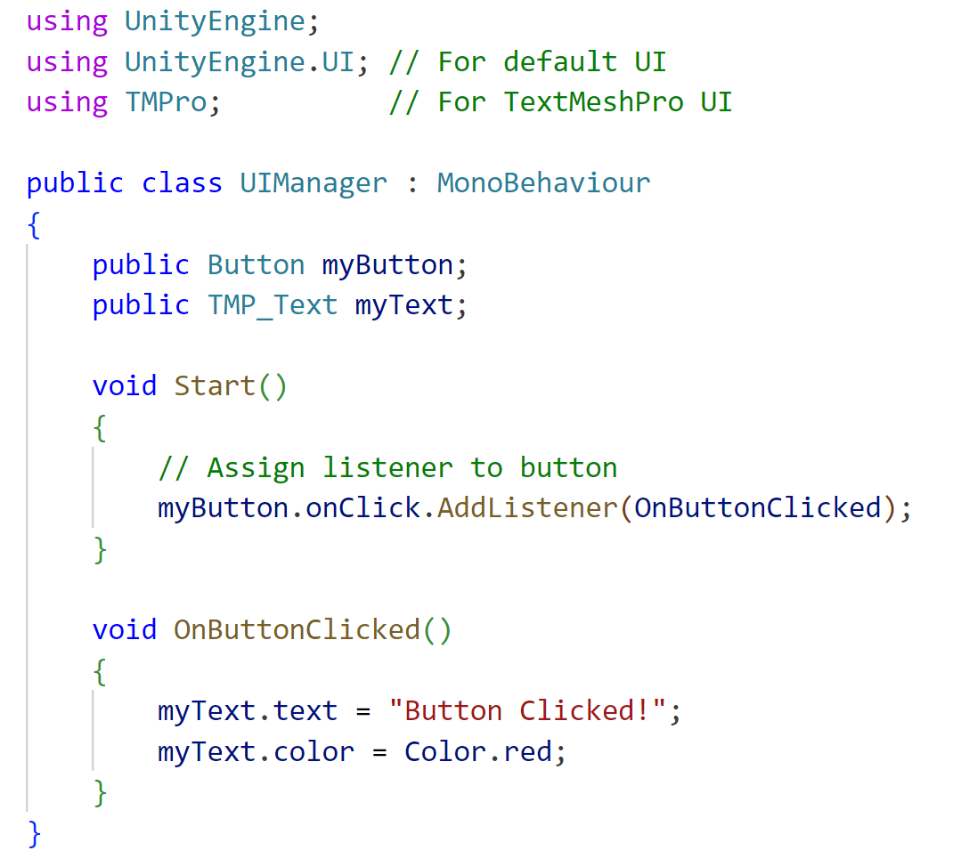
Access and Control UI via Script

