Slide 1
Loading Operating System On RISC-V Simulator
Iman Rasouli Parto Edris Nasihatkon

Slide 2
Outline
Introduction to the Linux Kernel
Using Buildroot for Embedded Systems
Simulating RISC-V with the Spike Simulator
Results and Conclusions

Slide 3
The Linux Kernel: Connecting Software to Hardware
The Core Interface Between OS and Hardware
Enabling Seamless Connection
Core component of the OS
Open-source, Customizable
Key Functions

Slide 4
Key Functions of the Linux Kernel
Process Scheduling
Multitasking
Interrupt Handling
Device Drivers
Memory Management
System Calls
Power Management

Slide 5
Process Scheduling
Efficiently manages and allocates CPU time to running processes.
Ensures fair distribution of CPU resources among multiple tasks.
Implements various scheduling algorithms, such as the Completely Fair Scheduler (CFS) and Round Robin, to meet different workload requirements.

Slide 6
Multitasking: Concurrent Process Execution
Supports concurrent execution of multiple processes, allowing for seamless switching between tasks.
Enables users to run multiple applications simultaneously, enhancing system usability and responsiveness.
Provides process isolation to prevent one misbehaving application from affecting others.

Slide 7
Interrupt Handling: Timely Event Response
Manages hardware and software interrupts, ensuring timely response to events.
Handles asynchronous events, such as hardware device signals and system calls, by interrupting the CPU's current task to service the interrupt.
Guarantees that critical tasks can be addressed promptly, even in a multitasking environment.

Slide 8
Device Drivers: Bridging Software and Hardware
Provides interfaces and drivers for hardware components, enabling communication.
Supports a wide range of hardware devices, including storage controllers, network interfaces, graphics cards, and input devices.
Allows user-level applications to interact with hardware through standardized abstractions.

Slide 9
Memory Management: Efficient Resource Allocation
Allocates and manages system memory, including physical and virtual memory.
Implements virtual memory to isolate processes and provide each with its own memory address space.
Optimizes memory usage through techniques like demand paging, memory swapping, and memory protection

Slide 10
System Calls: User-Kernel Interaction
Offers an interface for user-level applications to request services from the Kernel.
Provides a set of predefined functions that allow user programs to perform privileged operations, such as file I/O, network communication, and process management.
Acts as a bridge between user-level software and Kernel functions.

Slide 11
Power Management: Optimizing Energy Usage
Optimizes power usage through features like CPU frequency scaling and sleep states.
Adjusts CPU clock frequencies and power states based on system load to conserve energy.
Supports power-saving mechanisms to extend battery life in laptops and mobile devices.

Slide 12
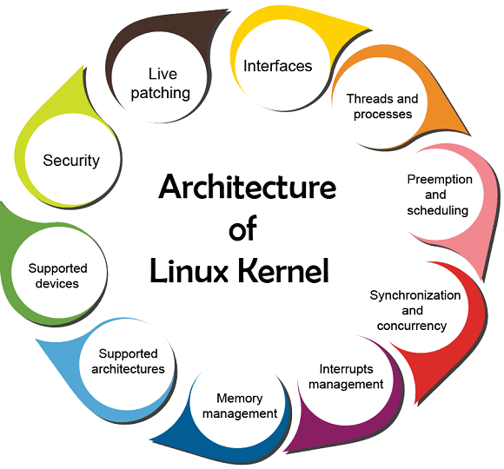
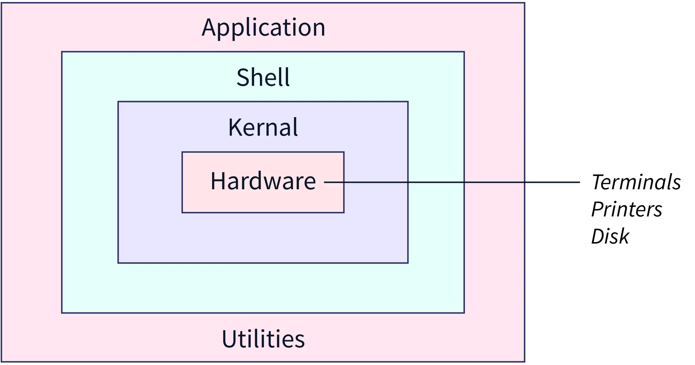

Linux Kernel

Slide 13
Beyond Kernel; Now What?
How System boots?
How to login?
How to access root?
What commands does it support?
How to customize?

Slide 14
Buildroot: Crafting Custom Embedded Linux Systems
Simplifying Embedded OS Development
Tailored Configurations at Your Fingertips
Key Functions

Slide 15
Key Functions of Buildroot
Configuration Management: Allows you to define and customize your embedded system's configuration, including target architecture, kernel version, and software packages.
Cross-Compilation: Compiles software components for your target architecture, ensuring compatibility with your embedded hardware.
Package Management: Provides a package management system for adding, removing, or updating software components in your embedded OS.
Root Filesystem Generation: Generates a root filesystem for your embedded system, including directory structure, configuration files, and libraries.

Slide 16
Key Functions of Buildroot
Bootloader Integration: Supports integration with bootloaders like U-Boot, ensuring a smooth boot process on your embedded device.
Kernel Configuration: Allows you to configure the Linux kernel to match your hardware and project requirements.
Optimization: Streamlines the build process for size and performance, resulting in efficient and customized embedded Linux systems.

Slide 17
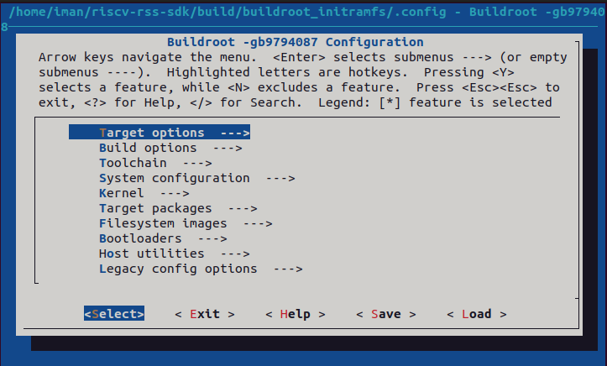
Buildroot: Config Menu

Slide 18
RISC-V Spike simulator: An Overview
The Core Interface Between Software and Hardware
Enabling Seamless Connection
A Core Component of RISC-V Development
Open-Source, Customizable
Versatile Utility
A Simulator (Not an Emulator)

Slide 19
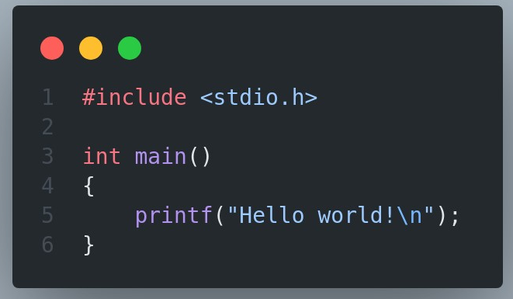
Test
Simple C Code Compilation by GCC and Execution
Compile 32-bit Linux on simulator

Slide 20
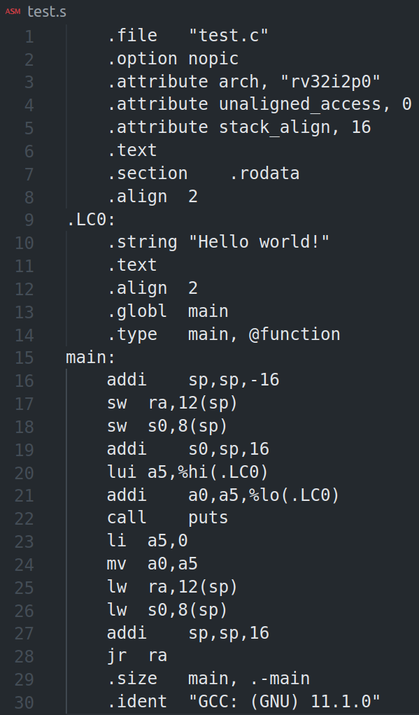
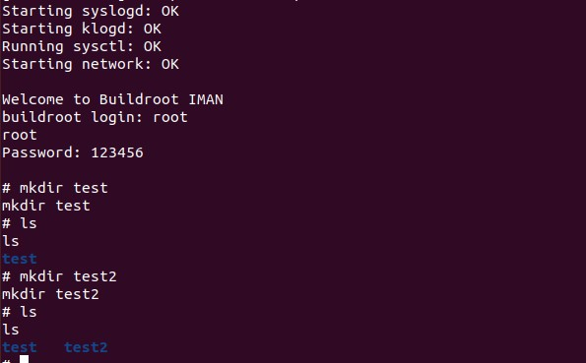
Results

Slide 21
References
www.redhat.com/topics/linux/linux-kernel
https://en.wikipedia.org/wiki/Buildroot
https://chipyard.readthedocs.io/en/latest/Software/Spike.html

Slide 22
Thank you all for your time and attention today.

