Slide 1
Community Portal Project Help (PHP)
Module Project
Start Date :
End Date :
Submission Date :
Learner Name :
Enrollment ID :
Presentation Date :

Slide 2
What is in the Sample ?
Sample contains one sql file
Which create 1 table
1 stored procedure
This stored procedure updates or insert based on whether id is 0 or some integer value
An eclipse project folder which provides sample of
Insert Page
Update Page
Login Mechanism
A Listing Page
You can refer to the organization of classes, files, functions etc
With ideas in this sample, student can complete the community portal project in php

Slide 3
What is not in the Sample
The sample do not contain
Validation
Error Handling
Javascript functions etc
Student need to add them where required

Slide 4
Setting up the Sample
Copy the phpcrudsample folder in the zip file to htdocs folder of your apache installation
Create a database called phpcrudsample
Run the given phpcrudsample.sql on the database to create sample table tb_user and procSaveUser
Change the servername, username, password and dbname as required in the configuration file phpcrudsample.ini which is in the config folder
Access the application using the url http://localhost/phpcrudsample/public/login.php

Slide 5
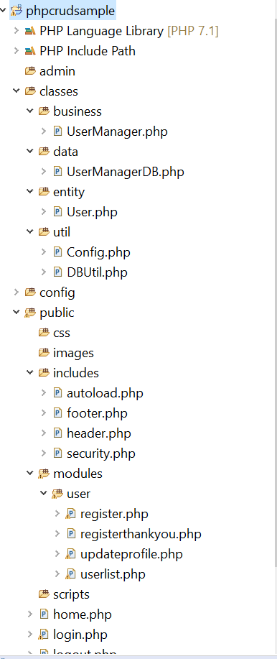
Organize your Folder Structure
All your business tier classes go here
All your data tier classes go here
All your entity classes go here
Organize commonly used functions here
Place your configuration file here
Place your public portal files below this
Place html include files and other files you include in PHP files here
Create one folder for each module here
Place your top level php pages below public folder

Slide 6
Architecture
PHP Page
Business Layer Class
Data Layer Class
Database
Contains include files such as header, footer
Secured pages include security.php

Slide 7
Concepts – Configuration File
Configuration file phpcrudsample.ini
You can read a configuration file such as phpcrudsample.ini by using code as below (Refer to Config.php)
mysqlserver=localhost
mysqluser=root
mysqlpassword=test123
mysqldb=phpcrudsample
public static function getConfig($reload = false){
if(isset($config)==false || $reload==true){
$ini = parse_ini_file(self::getApplicationRoot()."/config/phpcrudsample.ini");
$config=new Config();
$config->mysqlServer=$ini['mysqlserver'];
$config->mysqlUser=$ini['mysqluser'];
$config->mysqlPassword=$ini['mysqlpassword'];
$config->mysqlDB=$ini['mysqldb'];
return $config;
}
return $config;
}
public static function getApplicationRoot(){
$path = $_SERVER['DOCUMENT_ROOT'] . "/phpcrudsample";
return $path;
}

Slide 8
Concepts – Including PHP file
There is a file called autoload.php
This file includes required php class files, if you reference the classes using “use” keyword and use it in your php pages
Include this file in all php pages
Above is the function which is in autoload.php. This function will be invoked when ever php couldn’t find a file
What we have done is find the document root, which your htdocs folder, add the project folder /phpcrudsample/ and add class name along with .php extension (This is the files in classes sub folder)
<?php
spl_autoload_register(function ($class_name) {
include $_SERVER['DOCUMENT_ROOT'] . "/phpcrudsample/" .$class_name . '.php';
});
?>

Slide 9
Concepts – Importing Classes
To import your business layer classes in php pages, use the importing function as below
Example register.php import like below
Take note of the use keyword with the classes you are importing
<?php
require_once '../../includes/autoload.php';
use classes\util\DBUtil;
use classes\business\UserManager;
use classes\entity\User;

Slide 10
Concepts – Including files URL references
While including files we use
../ which means go up one folder
../../ which means go up one folder and again go up one folder
Get a grip of this as you will be referencing files from various folders
Always remember to code the links in files within includes folder using absolute path ex: /phpcrudsample/………up to/somefile.php
This is done because include files may be referenced from pages which are in different folder level, so if you use relative url such as ../../ it wont work in one php page and might work in another php page where it is included

Slide 11
Concepts – Header, Footer File
This are HTML content files with .php extension
You can keep your page header html in header.php
Keep footer html in footer.php
Include in php pages which will need common header & footer

Slide 12
Concepts – Security
When the user login using login.php page we set the session variable “email”
There is a file called security.php under includes folder
Include this page at the top of all the php pages which requires users being logged in (such as Community Dashboard page, update profile page etc..)

Slide 13
Concepts – Enable Output Buffering
Some pages have ob_start(); at the top of them
Include this function to ensure the page is buffered
The page need to be buffered, if you might redirect to another url down the code.
This is required

Slide 14
Concepts – Calling Static & Member Functions
You call the static function by specifying ClassName::functionname()
Example in Business layer class User Manager
You call a member function by first instantiating the class and calling them. Example in register.php
class UserManager
{
public static function getAllUsers(){
return UserManagerDB::getAllUsers();
}
$UM=new UserManager();
$existuser=$UM->getUserByEmail($email);

Slide 15
Concepts – Entity Classes
Entity classes look like below
class User
{
public $id=0;
public $firstName;
public $lastName;
public $email;
public $password;
}

Slide 16
Concepts – Business Layer Class
Business Layer classes look like below
<?php
namespace classes\business;
use classes\entity\User;
use classes\data\UserManagerDB;
class UserManager
{
public static function getAllUsers(){
return UserManagerDB::getAllUsers();
}
public function getUserByEmailPassword($email,$password){
return UserManagerDB::getUserByEmailPassword($email,$password);
}

Slide 17
Concepts – Data Layer Class
Data Layer classes look like below
<?php
namespace classes\data;
use classes\entity\User;
use classes\util\DBUtil;
class UserManagerDB
{
public static function fillUser($row){
$user=new User();
$user->id=$row["id"];
$user->firstName=$row["firstname"];
$user->lastName=$row["lastname"];
$user->email=$row["email"];
$user->password=$row["password"];
return $user;
}
public static function getUserByEmailPassword($email,$password){
$user=NULL;
$conn=DBUtil::getConnection();
$email=mysqli_real_escape_string($conn,$email);
$password=mysqli_real_escape_string($conn,$password);
$sql="select * from tb_user where email='$email' and password='$password'";
$result = $conn->query($sql);
if ($result->num_rows > 0) {
if($row = $result->fetch_assoc()){
$user=self::fillUser($row);
}
}
$conn->close();
return $user;
}

Slide 18
Concepts – MySQL Procedure
Below is the procedure which handle both insert & update
DELIMITER $$
CREATE DEFINER=`root`@`localhost` PROCEDURE `procSaveUser`(id int,firstname varchar(50),lastname varchar(50),email varchar(50),password varchar(20))
BEGIN
if(id=0) then
insert into tb_user(firstname,lastname,email,password) values(firstname,lastname,email,password);
Else
update tb_user set firstname=firstname,lastname=lastname,email=email,password=password where id=id;
end if;
END$$
DELIMITER ;

Slide 19
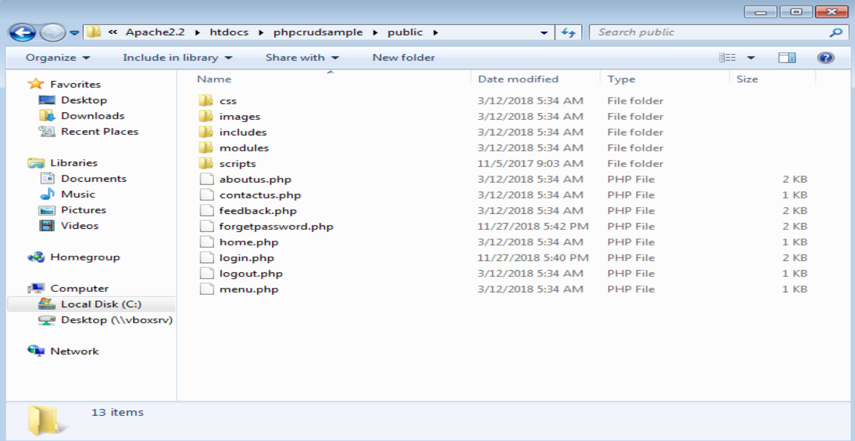
GUI folder

Slide 20
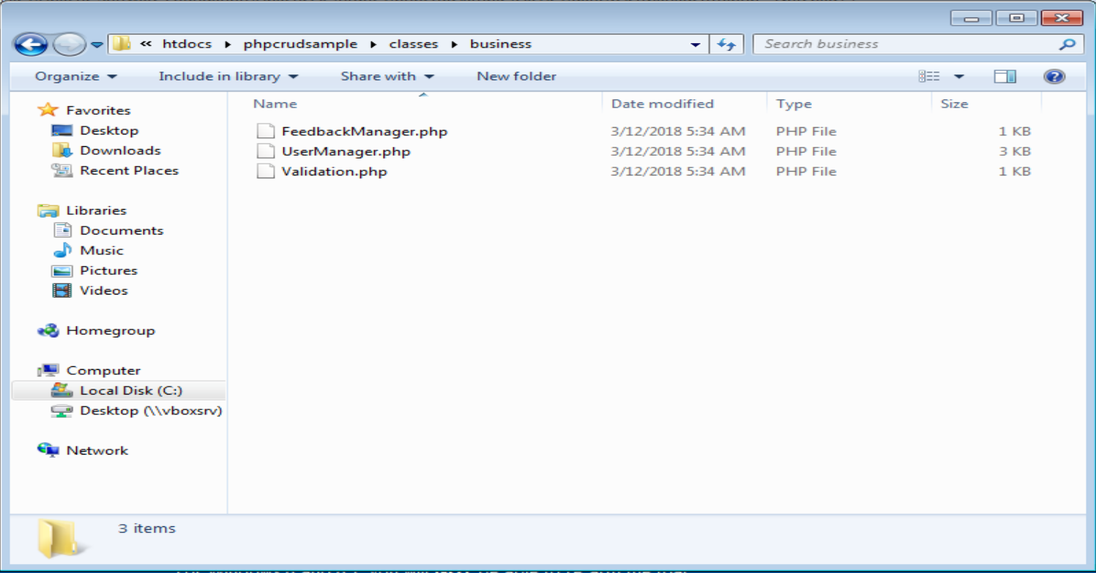
Business logic class folder

Slide 21
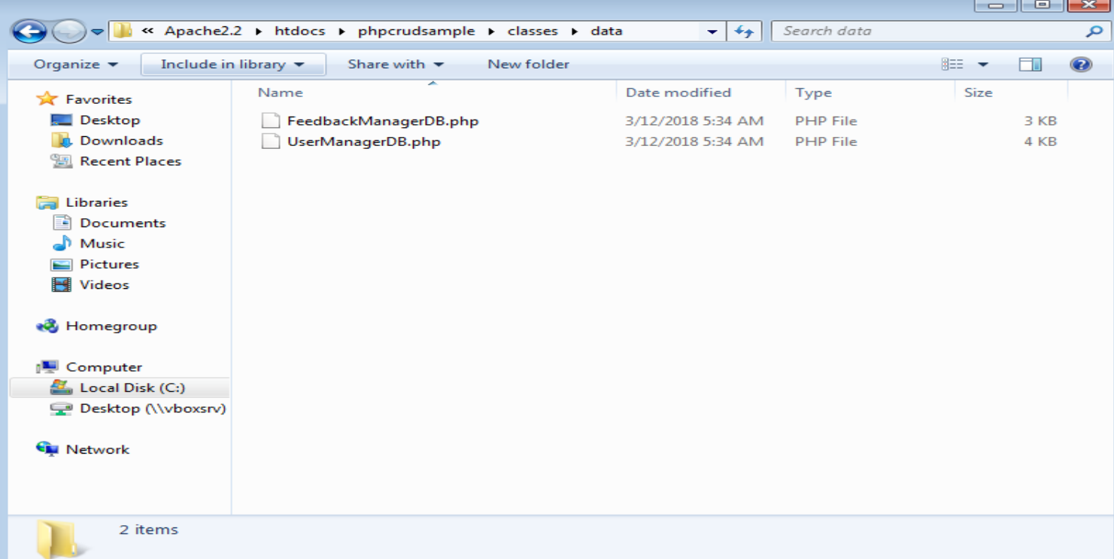
Database connection coding folder

Slide 22
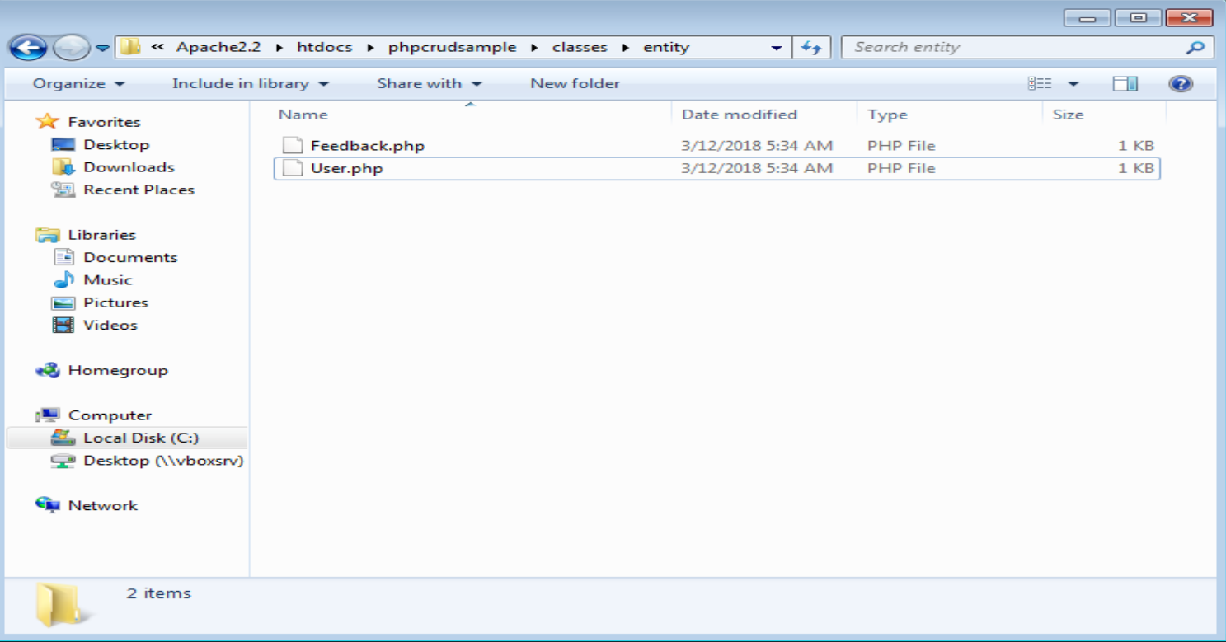
Class entity declaration folder

Slide 23
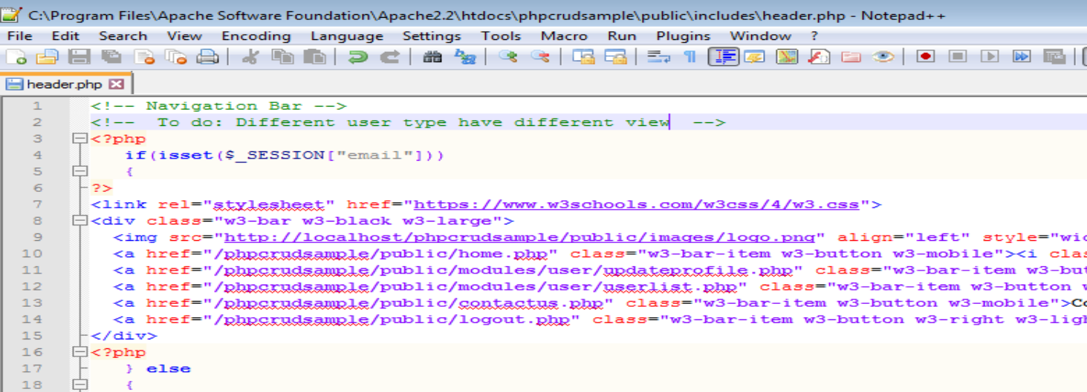
Task

Slide 24
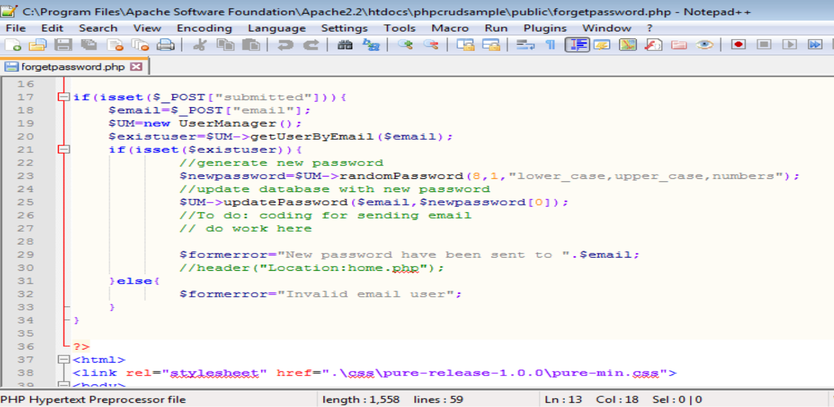
Task

Slide 25
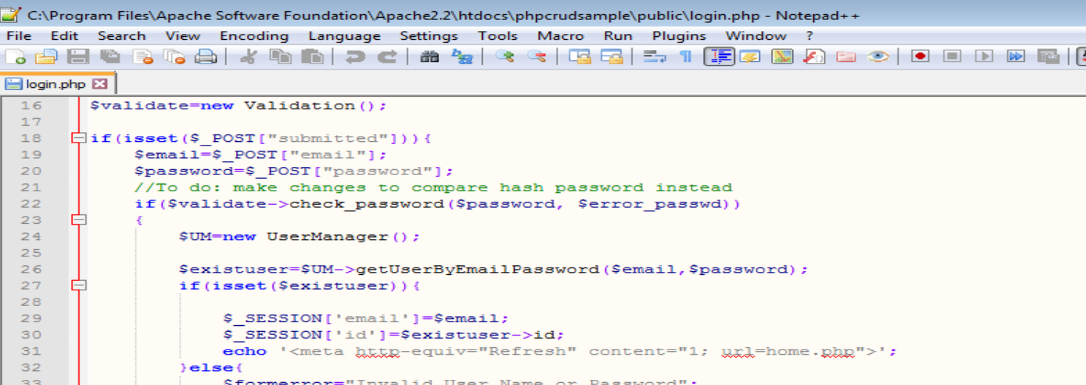
Task

Slide 26
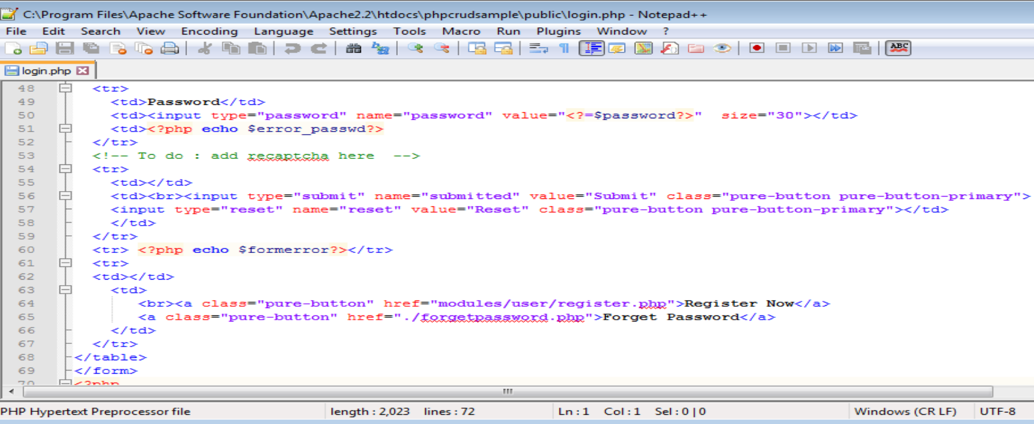
Task

Slide 27
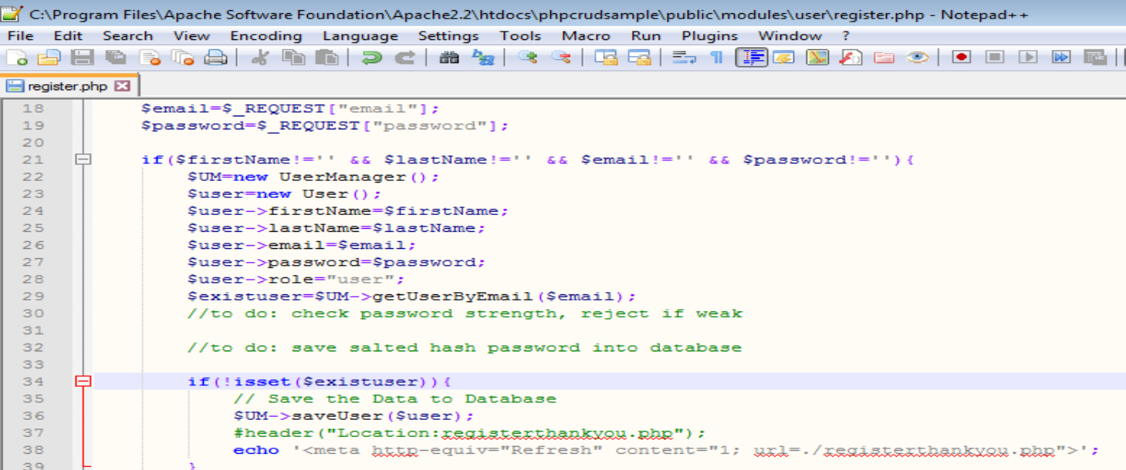
Task

Slide 28
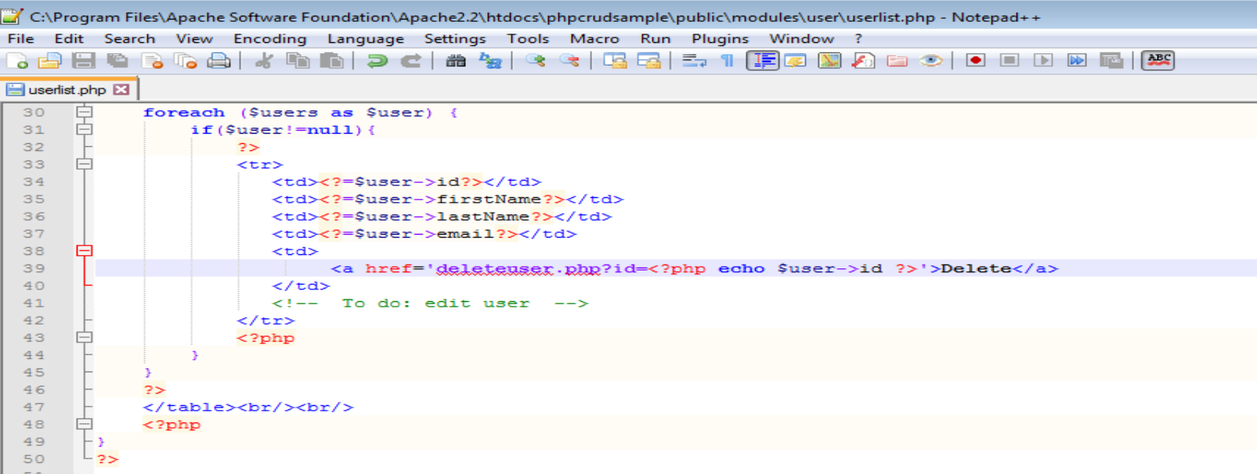
Task

