Slide 1

Named-entity Recognition
Supervisor: Lubomira Lavtchieva
Presenter: Iman YeckehZaare
MS in Information at the University of Michigan, School of Information
BE in Computer Engineering
BE in Information Technology

Slide 2
Agenda
1- Rule-Based Algorithm as a solution for Website/Article Scholarliness problem
2- Data Mining Approaches
3- Feature Extraction: NER Techniques & Wikifiers
4- Recommender Systems
5- Reputation Systems

Slide 3
Rule-Based Algorithm
Feature Set
The Algorithm

Slide 4
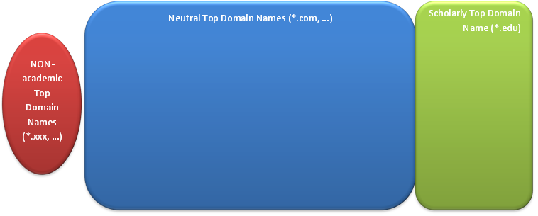
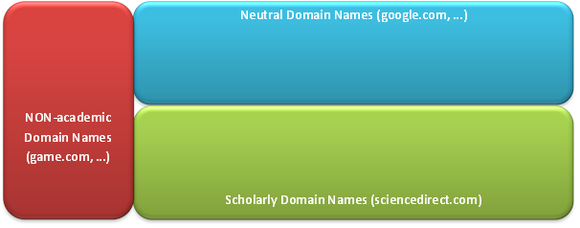

The Rule-Based Algorithm
NON-academic Top domain name, like *.xxx, *.aero, … NON-Scholarly
NON-academic Domain names, like www.game.com, … NON-Scholarly
NON-academic publication ISSN, NON-Scholarly
Scholarly Top domain name, like *.edu, … Scholarly
Scholarly Domain names, like sciencedirect.com, … Scholarly
Scholarly Publication ISSN, Scholarly
?
?

Slide 5
Machine Learning
Field of study that gives computers the ability to learn without being explicitly programmed.
Regression: Predict Continuous valued
output (e.g. price)
Supervised
learning
Classification: Predict Discrete valued
output (0 or 1)
Unsupervised
Learning
ML
Clustering
Recommender Systems
Reinforcement learning

Slide 6
Classification
Class A
Class B

Slide 7
Clustering

Slide 8
Clustering
Cluster A
Cluster B

Slide 9

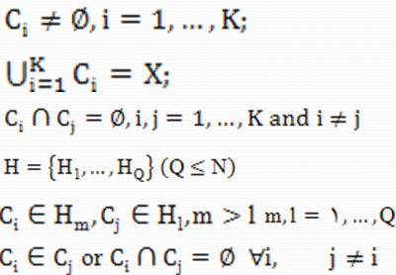
Clustering Algorithms
X_{ji} = Feature, Attribute, Dimention, Variable
Partitioned
Clustering
Hierarchical

Slide 10
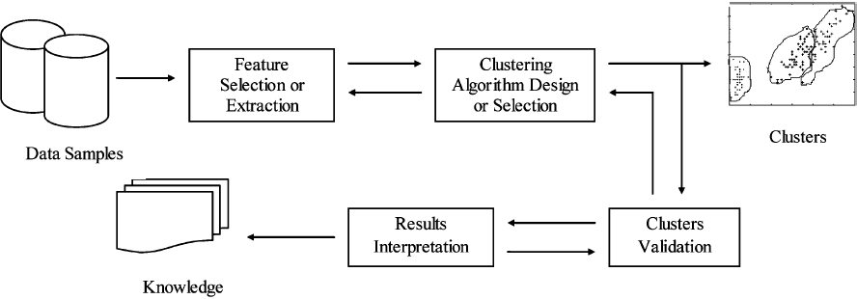
Clustering Algorithms

Slide 11
Classification Algorithms
Linear
Classifiers
Fisher's Linear Discriminant
Logistic Regression
Naive Bayes Classifier
SVM
Perceptron
Quadratic Classifiers
Kernel Estimation
K-nearest Neighbor
Decision Trees
ANN
CBR
Bayesian Networks
HMM
Gene Expression Programming
Learning Vector Quantization

Slide 12
Data Set (Housing Price)
“Input” variables /
Features
“Output” variables /
Targets
Size in Feet² (X₁) | X₂ … | Price ($) in 1000’s (Y)
2104 | … | 460
1416 | … | 232
1534 | … | 315
852 | … | 178
… | … | …
Instances
Training Set (70%)
Data Set
Test Set (20%)
Validation Set (10%)

Slide 13
Classification
Problem
Training Set
Validation Set
Test Set
Learning Algorithm
Feature Set:
X1
X2
X3
.
.
.
Target Set:
Y1
Y2
Y3
.
.
.
>Threshold
~ 100%
Model
New
Instances
Predicts
Targets

Slide 14


Text Analytics = Text Data Mining
Parsing
Structuring
the
Input text
Addition of some derived linguistic feature
Removal of others
Subsequent insertion into a database
Text
Mining
Deriving patterns within the structured data
E$valuation$
$$Interpretation of the Output$$

Slide 15





Text Analytics Tasks
Text Categorization
Text clustering
$$NER$$
Concept/entity Extraction
Typical
Text
Mining
Tasks
$$Wikifiers$$
$$Production of Granular Taxonomies$$
$$Sentiment Analysis$$
$$Document Summarization$$
$$Entity Relation Modeling$$
$$Learning relations between named entities$$

Slide 16




Text Feature Extraction Techniques
Stop Words Weka: 527
Porter’s suﬃx-stripping algorithm
$$Term Strength (TF)$$
Common
approaches
This method estimates term importance based on how commonly a term is likely to appear in “closely-related” documents.
$$tfidf$$
Tf-idf weighs the frequency of a term t in a document d with a factor that discounts its importance with its appearances in the whole document collection.

Slide 17
Feature Extraction NER Algorithms
Persons
Names
Organizations
Locations
Text
Times
Quantities
Expressions
Monetary values
Percentages
…

Slide 18
NER Models
Linguistic Grammar-based Techniques
Statistical Models

Slide 19
NER Problem Domains
NER systems (both rule-based and trainable statistical systems) developed for one domain do not typically perform well on other domains.
The training data should match the data on which the system will be run.
journalistic
military
ACE
genes and
gene products
Telephone
speech
weblogs

Slide 20
Named-entity Types
Rigid designators include proper names as well as certain natural kind terms like biological species and substances.
the year 2001
Rigid Designators
I take my vacations in “June”
BBN
29 types and 64 subtypes.
Named-entity
types
Sekine
200 subtypes.
John J. Smith
People
Locations
lives in
News
Seattle.
Organizations

Slide 21
NER Challenges
The main efforts are directed to:
Reducing the annotation labor;
Robust performance across domains;
Scaling up to fine-grained entity types.

Slide 22
MUC Data Sets
Training
Human Annotators
Dry run test
Formal run test usage
newswire articles for MUC-6
MUC-VI Text Collection
newswire articles for MUC-7
North American News Text Corpora
MUC-3 and MUC-4
FBIS (Federal Broadcast Information Services)
MET 2
US Government

Slide 23
NER Famous Technologies
OpenNLP NameFinder
Illinois NER system
NER
Stanford NER system
Lingpipe NER system

Slide 24
LingPipe Entities Recognizer
Not Open Source
The Open Source version Not Updated since 2007.
Rule-based Named-entity Detection
False
Negatives
Exact Dictionary-based Chunking
New York Times "Topics"
Methods
False
Positives
Approximate Dictionary-Based Chunking

Slide 25
Stanford NER v1.2.7 – 2013-06-20
Licensed under the full GPL.
86.86% F1
CoNLL
Trained
on
MUC6
People
MUC7
Locations
ACE
Organizations
News
Entities
Time
Different Versions
Date
Money
Well Defined API
for Programmatic Use.
Percent

Slide 26
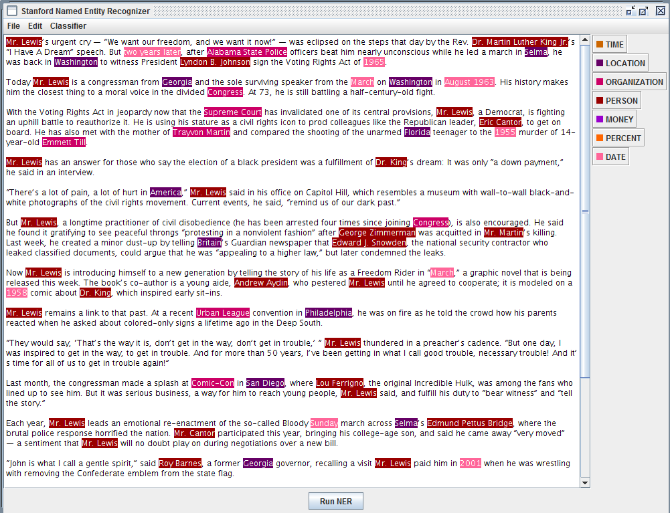
Stanford NER v1.2.7 – 2013-06-20

Slide 27
Illinois Named Entity Tagger
Research and Academic Use License
90.8% F1
People
CoNLL03
shared task data
Locations
Entities
Organizations
Miscellaneous
Recent Ver.
Entities
18-label type set
(based on the OntoNotes corpus)

Slide 28
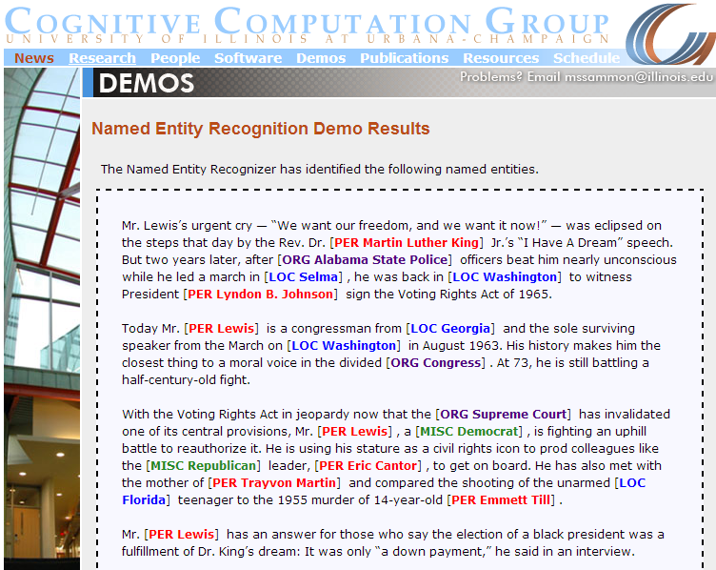
Illinois Named Entity Tagger

Slide 29
Commercial NER Technologies Comparison
BeliefNetworks
AlchemyAPI
OpenAmplify
OpenCalais
Yahoo
Evri
Michael Fagan

Slide 30
Wikification
Identifying "important expressions" in text and cross-linking them to Wikipedia, where the types are the actual Wikipedia pages describing the concepts.
<ENTITY> http://en.wikipedia.org/wiki/Michael_I._Jordan Michael Jordan </ENTITY> is a professor at <ENTITY> http://en.wikipedia.org/wiki/University_of_California,_Berkeley Berkeley </ENTITY>
All main concepts from the article.
More Natural.
Although covering NER, can be combined with it.
Wikipedia dumps

Slide 31
NER Famous Technologies
Illinois Wikification system
Wikification
WM Wikifier
TAGME

Slide 32
WM Wikifier
Not Available.
Publication: Milne, D. and Witten, I.H. (2008) Learning to link with Wikipedia. In Proceedings of the ACM Conference on Information and Knowledge Management (CIKM'2008), Napa Valley, California.
Recall and Precision of almost 75%

Slide 33

TAGME RESTful API
Wikipedia snapshots of July, 2012
As of August 2012
the special parser for Twitter messages
Developed by Paolo Ferragina and Ugo Scaiella at A³ Lab
Dipartimento di Informatica, University of Pisa.

Slide 34
Illinois Wikifier
University of Illinois/NCSA
Open Source License
Publication: Local and Global Algorithms for Disambiguation to Wikipedia L. Ratinov and D. Roth and D. Downey and M. Anderson Proc. of the Annual Meeting of the Association of Computational Linguistics (ACL) - 2011
Main
Decision
What Expressions
Disambiguating
String matching
Lexical similarity
Features
Semantic Similarity
linkage patterns

Slide 35
Various Wikifiers
the corpora they address
Different
Wikifiers
the subset of expressions they attempt to link
linking only
named entities
linking “interesting” expressions
mimicking the link structure found
in Wikipedia
All Wikiﬁcation systems are faced with a key
Disambiguation to Wikipedia (D2W) task.
a former U.S. president
a vehicle manufacturer
Ford
a movie star
a river crossing

Slide 36
Machine Learning Approach
The Entities Extracted by
NERs or Wikifiers or
a combination of them.
Feature Set
Having a pervasive and fully organized Dataset
including both Scholarly and Non-Scholarly
articles, we can use our dataset to design a
Classification Model based on our feature set
to evaluate scholarliness of an Article.

Slide 37
Collaborative Filtering Similarity Measures
8/24/2015

Slide 38
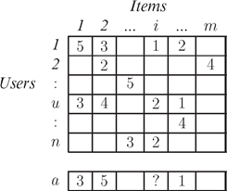
General Overview
r_{u,i} = the rating given to
item i by the user u
Task = predict what rating a user would give to a previously unrated item.
User ratings matrix is typically sparse, as most users do not rate most items.
Active User (a) = The user under current consideration for recommendations.
Typically, ratings are predicted for all items that have not
been observed by a user, and the highest rated items are
presented as recommendations.

Slide 39
Collaborative Filtering (CF)
works by collecting user feedback in the form of ratings for items in a given domain and exploiting similarities in rating behavior amongst several users in determining how to recommend an item.
Neighborhood-based approaches
Model-based = memory-based approaches

Slide 40
Neighborhood-based CF
a subset of users are chosen based on their similarity to the active user, and a weighted combination of their ratings is used to produce predictions for this user.
1. Assign a weight to all users with respect to similarity with the active user;
2. Select k users that have the highest similarity with the active user (the neighborhood);
3. Compute a prediction from a weighted combination of the selected neighbors’ ratings.
Algorithm

Slide 41
Problem Setting
Wikipages
r_{u,i} = the Edit Size to
page i by the user u
Task = Identify similar users based on their edit size on similar pages.
User ratings matrix is typically sparse, as most users do not edit most pages.

Slide 42
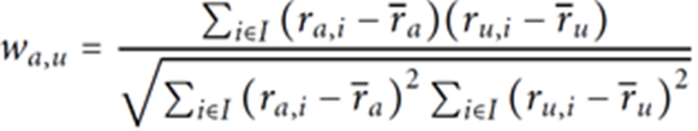
Pearson Correlation Coefficient
The weight w_{a,u} is a measure of similarity between the user u and the active user a.
I: the set of pages edited by both users,
r_{u,i}: the edit size on page i by user u,
$\overline{r_{u}}$: the mean edit size by user u.

Slide 43

Cosine Similarity
Pearson correlation measures the extent to which there is a linear dependence between two variables.
Alternatively, one can treat the ratings of two users as a vector in an m-dimensional space, and compute similarity based on the cosine of the angle between them:
One cannot have Negative Ratings.
Unrated items are treated as having a rating of zero.
But as all ratings will be greater than or equal to zero, it’s better to treat unrated items as having a rating of half of the maximum value of rating.
Notes

Slide 44
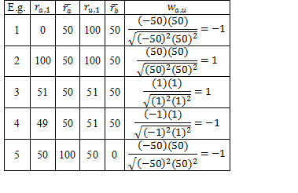
Pearson Correlation Behavior
It uses the average ratings for each user to scale the ratings
based on the whole ratings of each user. So, the resulting
value can be comparable among users.
Always between -1 and 1

Slide 45
Pearson Correlation Main Problem # 1
1- It is not sensitive to the number of similar items.
2- It measures the extent to which there is a linear dependence between two variables.

Slide 46
Cosine Similarity’s Problem
It doesn't regard to the length of vectors and only compares the angle between them.
$$10$$
$$10$$
$$10$$
$$10$$
$$1$$
$1$0

Slide 47

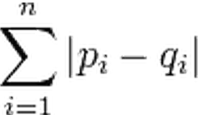
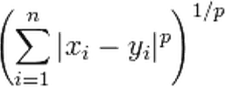

Other Similarity Measures
City-block metric
Euclidean distance
Minkowski distance
Sup distance
$$\max_{1≤l≤d}\left|x_{il}−x_{jl}\right|$$
Mahalanobis distance
Point Symmetry Distance
$$\min_{\begin{aligned}1≤j≤N \\ j≠i\end{aligned}}{\frac{\left\|\left(x_{i}−x_{r}\right)+\left(x_{j}−x_{r}\right)\right\|}{\left\|\left(x_{i}−x_{r}\right)\right\|+\left\|\left(x_{j}−x_{r}\right)\right\|}}$$

Slide 48
Significance Weighting
 | I1 | I2 | I3 | I4 | I5 | I6 | I7 | I8 | I9 | I10 | I11 | I12 | … | Ii | … | Im
U1 | 1 | -1 | 1 |  | -1 | 1 |  | -1
U2
U3 | 1 |  | 1 | 1 | -1 | -1 | 1 |  | -1 | 1 | -1 | -1 |  | 1 |  | -1
…
Uu | 1 |  | -1 | -1 |  | ? | 1 |  | -1 | 1 | 1 | -1 |  | -1 |  | 1
…
Un
These highly correlated neighbors based on a small number of overlapping items tend to be bad predictors.
One approach to tackle this problem is to multiply the similarity weight by a significance weighting factor, which devalues the correlations based on few co-rated items.

Slide 49
Default Voting
 | I1 | I2 | I3 | I4 | I5 | I6 | I7 | I8 | I9 | I10 | I11 | I12 | … | Ii | … | Im
U1 | 1 | -1 | 1 |  | -1 | 1 |  | -1
U2
U3 | 1 |  | 1 | 1 | -1 | -1 | 1 |  | -1 | 1 | -1 | -1 |  | 1 |  | -1
…
Uu | 1 |  | -1 | -1 |  | ? | 1 |  | -1 | 1 | 1 | -1 |  | -1 |  | 1
…
Un
 | I1 | I2 | I3 | I4 | I5 | I6 | I7 | I8 | I9 | I10 | I11 | I12 | … | Ii | … | Im
U1 | 1 | -1 | 1 | 0 | -1 | 1 | 0 | -1 | 0 | 0 | 0 | 0 | 0 | 0 | 0 | 0
U2
U3 | 1 | 0 | 1 | 1 | -1 | -1 | 1 | 0 | -1 | 1 | -1 | -1 | 0 | 1 | 0 | -1
…
Uu | 1 | 0 | -1 | -1 | 0 | ? | 1 | 0 | -1 | 1 | 1 | -1 | 0 | 0 | 0 | 1
…
Un
An alternative approach is to assume a default value for the rating for items that have not been explicitly rated. So, one can now compute correlation using the union of items rated by users being matched as opposed to the intersection.
Such a default voting strategy has been shown to improve collaborative filtering.

Slide 50
Inverse User Frequency
Very similar to idf in tfidf ?
When measuring the similarity between users, items that have been rated by all (and universally liked or disliked) are not as useful as less common items.
n_{i}: the number of users who have rated item i out of the total number of n users
To apply inverse user frequency while using similarity-based CF, the original rating is transformed for i by multiplying it by the factor f_{i}.
The underlying assumption is that items that are universally loved or hated are rated more frequently than others.
$$f_{i}=\log{\frac{n}{n_{i}}}$$

Slide 51
Case Amplification
In order to favor users with high similarity to the active user, we can use amplification which transforms the original weights to:
where ρ is the amplification factor, and ρ ≥ 1

Slide 52
Reputation Systems
Supervisor: Lubomira Lavtchieva
Presenter: Iman YeckehZaare

Slide 53

Website/Article Scholarliness
From another point of view:
TRUST
Whether to a website/article to be scholarly or not?
SiteJabber is a consumer protection service which uses a
to help people avoid fraudulent websites and find ones they can
Reputation System
TRUST

Slide 54
Solution for Article Scholarliness
A Reputation System which is specifically designed to determine scholarliness of websites.
Contributors:
ProQuest Editors, Teachers, Tutors, even students
from all over the United States
and the world.
Advantage
A database of URLs which is being updated dynamically through the collaboration of many users.
Even we should not take care of broken links or similar problems, because the users are dynamically degrading problematic URLs in the database and increasing the ranking of scholarly ones.

Slide 55

Why Reputation Systems?
Howard Rheingold
who coined “virtual communities”
Online reputation systems are 'computer-based technologies that make it possible to manipulate in new and powerful ways an old and essential human trait.
These systems arose as a result of the need for Internet users to gain trust in the individuals they transact with online.

Slide 56












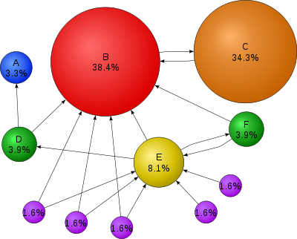
















Applications
Anti-spam
techniques
PageRank
Freelance
Marketplaces

Slide 57



PageRank
Google has publicly warned webmasters that if they are or were discovered to be selling links for the purpose of conferring PageRank and reputation, their links will be devalued (ignored in the calculation of other pages' PageRanks).

Slide 58
Revenue of
$14.07 billion (2012)
The high rate of successful transactions is attributed by eBay to its , called
. (Resnick, P. et. al. 2000)
reputation system
Feedback Forum
“good transaction”
“nice person to do business with”
“would highly recommend”
…
1
0
-1
Rate
Comment
Rating Services for Product Reviewers
offers
(the better the review, the more points the reviewer receives).

Slide 59
Beyond Auction Sites
rates registered retailers by asking consumers to complete a form after each purchase.
Survey
Q&A forums
provide in which self-proclaimed experts provide answers for questions posted by other users in exchange for reputation points and comments.
reputations for stock market analysts
tallies and displays
based on the performance of their picks.
Resnick, P.; Zeckhauser, R.; Friedman, E.; Kuwabara, K. (2000). "Reputation Systems". Communications of the ACM.

Slide 60


Yahoo! Auction, Amazon, and other auction sites
feature reputation systems like eBay’s,
with variations, including:
A rating scale of 1-5
Friendliness
Prompt response
Quality product
Several measures
Averaging instead of total feedback score
Resnick, P.; Zeckhauser, R.; Friedman, E.; Kuwabara, K. (2000). "Reputation Systems". Communications of the ACM.

Slide 61

A social news and entertainment website
- Registered users
submit content in the form of
A link
A text ("self") post
- Other users
vote the submission
Up
Down
Used to
Rank the post
Determine its position on the site's pages and front page
Content entries are organized by areas of interest called Subreddits.

Slide 62
1,700,000 registered users
5,000,000 questions
As of June 2013
Reputation Points
Badges
Users can earn
E.g, a person is awarded 10 reputation points for receiving an "up" vote on an answer given to a question, and can receive badges for their valued contributions, which represents a kind of gamification of the traditional Q&A site or forum.

Slide 63
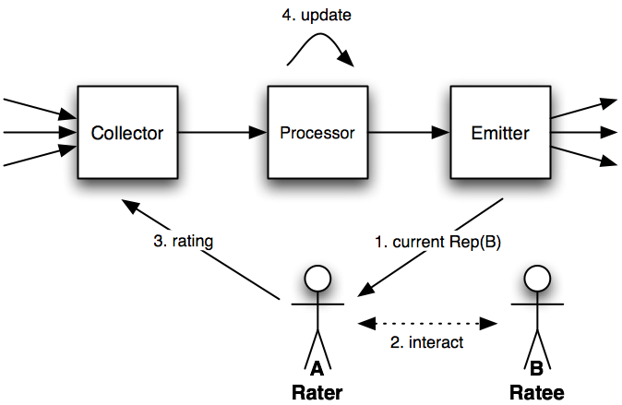
Reputation System
Reputation System uses a specific reputation algorithm to dynamically compute the reputation scores based on the received ratings.
The opinions are typically passed as ratings to a reputation center.
A reputation system computes and publishes reputation scores for a set of objects (e.g. service providers, services, goods or entities) within a community or domain, based on a collection of opinions that other entities hold about the objects.

Slide 64
Gamification on Reputation Systems
The collective opinion in a community determines an object's Reputation Score.
Sanctioning
Praising
Reputation systems represent a form of collaborative
Collaborative
Sanctioning
community perceives
low quality
Low score
High score represents a collaborative praising of an object that the community perceives as having or providing high quality.
Reputation scores change dynamically as a function of incoming ratings.
A high score can quickly be lost if rating entities start providing negative ratings. Similarly, it is possible for an object with a low score to regain a high score.

Slide 65
Shadow of the Future
The expectation of reciprocity or retaliation in future interactions creates an incentive for good behavior.
(Political scientist Robert Axelrod)
For instance, users with high reputation may be granted special privileges, whereas users with low or unestablished reputation may have limited privileges.
Reputation systems may also be coupled with an Incentive System to reward good behavior and punish bad behavior.
Resnick, P.; Zeckhauser, R.; Friedman, E.; Kuwabara, K. (2000). "Reputation Systems". Communications of the ACM.

Slide 66
Reputation Systems Vs. Recommender Systems
Reputation systems are related to recommender systems and collaborative filtering, but with the difference that reputation systems produce scores based on explicit ratings from the community, whereas recommender systems use some external set of entities and events (such as the purchase of books, movies, or music) to generate marketing recommendations to users.
The role of reputation systems is to facilitate trust and often functions by making the reputation more visible.

Slide 67
Types of Reputation Systems
1- Basic
A simple reputation system, employed by eBay, is to record a rating (either positive, negative, or neutral) after each pair of users conducts a transaction. A user's reputation comprises the count of positive and negative transactions in that user's history.
2- Advanced
More sophisticated algorithms scale an individual entity's contribution to other nodes' reputations by that entity's own reputation. PageRank is such a system, used for ranking web pages based on the link structure of the web. In PageRank, each web page's contribution to another page is proportional to its own pagerank, and inversely proportional to its number of outlinks.

Slide 68
Attacks on Reputation Systems
Reputation systems are in general vulnerable to attacks, and many types of attacks are possible.
A typical example is the so-called Sybil attack where an attacker subverts the reputation system by creating a large number of pseudonymous entities, and using them to gain a disproportionately large influence.
Some eBay users are artificially boosting their reputations on the Internet auction Web site by selling items for practically nothing in exchange for positive feedback from the buyer. Sellers with good reputations can seek higher prices on items they sell, according to the study out of the University of California at Berkeley's Haas School of Business.

Slide 69
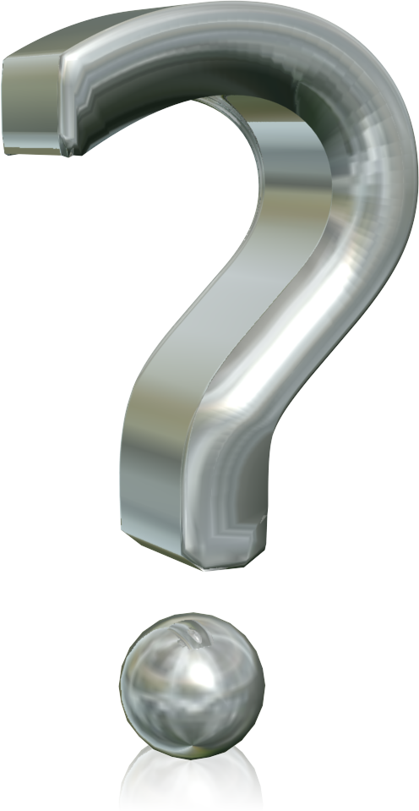
Thank you for your Patience!

