Slide 1
Developing a RESTful API with Flask
By:
Imanat kaur
Member 2
23rd july, 2023

Slide 2
Introduction
Our project involves the development of a RESTful API using Flask, enabling us to perform Create, Read, Update, and Delete (CRUD) operations on a MySQL database.
The primary objective of this project is to showcase our proficiency in building a robust and scalable API to manage student records efficiently.
This application holds real-world significance as it can be adapted for various use cases, such as managing student data in educational institutions, financial transactions, or any other system requiring a database-backed API.

Slide 3
Database Schema
Field | Data Type | Description
student_id | INT | Unique identifier for each student
first_name | VARCHAR | First name of the student
last_name | VARCHAR | Last name of the student
Dob | DATE | Date of birth of the student
amount_due | DECIMAL | Amount due from the student

Slide 4
Technologies Used
Flask: Flask, a lightweight and flexible web framework for Python, served as the backbone of our API, enabling easy routing and handling of HTTP requests.
MySQL: We utilized MySQL, a popular relational database management system, to store and manage student records efficiently.
Python: Python, a versatile and widely-used programming language, was the language of choice for developing the API.
Git: To facilitate collaborative development and version control, we employed Git.
Requests Library: The Requests library was used in Python to send HTTP requests and interact with the API endpoints during testing and development.

Slide 5
Development Process
Database Setup:
Created a MySQL database and defined a table schema to store student records with essential fields.
Flask App Structure:
Developed the basic Flask application by setting up routes and views.
CRUD Endpoints:
Defined specific endpoints for Create, Read, Update, and Delete operations to interact with the database.
Local Testing:
Tested the API locally using Postman to ensure seamless functionality and data integrity.
Version Control:
Established a Git repository to track changes, facilitate collaboration, and maintain code version history.

Slide 6
CRUD Operations
Create (POST)
Endpoint:/students
Method : POST
Sample Request
{ "first_name": "Imanat", "last_name": “Kaur", "dob": "2000-03-08", "amount_due": 1200.50 }
Read (GET)
Endpoint: /students/<student_id>
Method : POST
Sample Response (Status Code 200)
{“student_id": 1 , "first_name": "Imanat", "last_name": “Kaur", "dob": "2000-03-08", "amount_due": 1200.50 }

Slide 7
CRUD Operations
Update (PUT)
Endpoint: /students/<student_id>
Method: PUT
Sample Request:
{"first_name": "Imanat", "last_name": “Kaur", "dob": "2000-03-08", "amount_due": 1500.00 }
Delete (DELETE):
Endpoint: /students/<student_id>
Method: DELETE
Sample Response (Status Code 200):
{
"message": "Student record deleted successfully"
}

Slide 8
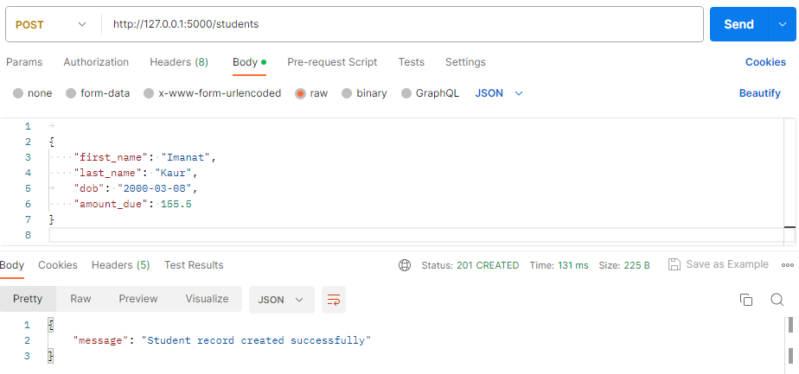
Demonstration
Adding a Student (POST)

Slide 9
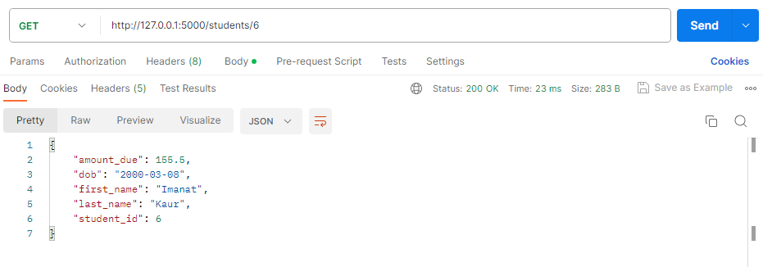
Demonstration
Reading a Student (GET)

Slide 10
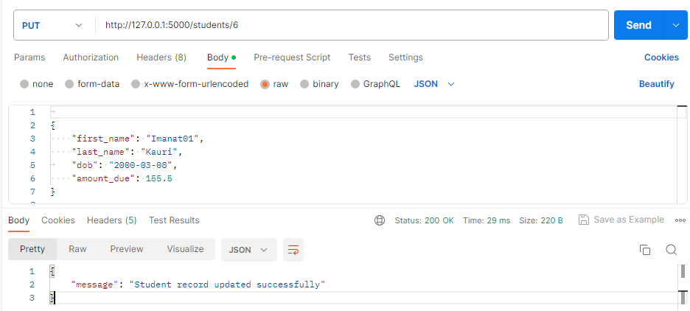
Demonstration
Updating a Student (PUT):

Slide 11
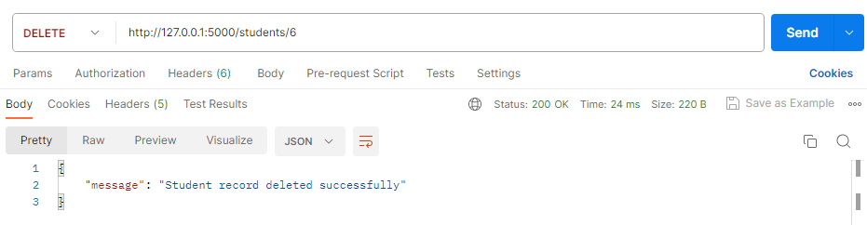
Demonstration
Deleting a Student (DELETE):

Slide 12
Conclusion
In conclusion, our project successfully achieved its objectives of developing a robust RESTful API using Flask for efficient student record management. Through this endeavor, we gained valuable experience in utilizing Flask, MySQL, and Git to create a seamless CRUD API.
Working collaboratively as a team enabled us to leverage each other's strengths and efficiently distribute tasks. The experience of collaborating on a real-world project was both rewarding and insightful.
For future improvements, we plan to enhance the API's security by implementing authentication and authorization mechanisms.
Additionally, we aim to incorporate validation checks to ensure data integrity and improve error handling for a more user-friendly experience

Slide 13
The End
Thank You

