Slide 1

LPIC2

Slide 2
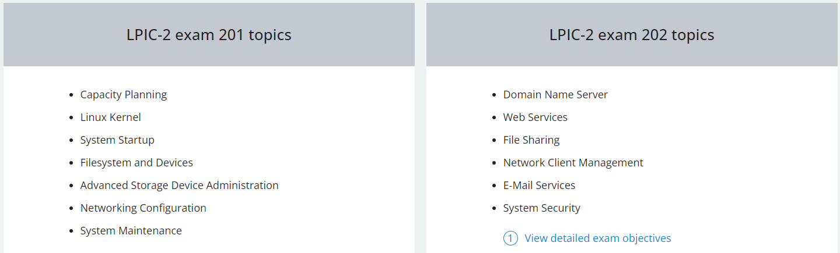
lpic2 topics

Slide 3
boot process
Power on ---→ post ----→ bios ---→mbr ---→ kernel--→systemd(init)
Kernel ring buffer ----→dmesg
This buffer is a temporary storage area in the kernel that holds log messages and other system information
Purpose: The kernel buffer ring is used to store log messages generated by the kernel and various kernel subsystems, as well as messages generated by user-space programs that use the kernel's logging facilities.
Ring Structure: The buffer is typically implemented as a circular buffer, also known as a ring buffer. This means that when the buffer is full, new messages overwrite the oldest messages in a continuous loop.
Access: The kernel buffer ring can be accessed by system administrators and developers to monitor system events, debug issues, and analyze system performance.

Slide 4
boot process
Boot processs issue consist of
1-kernel failure (install new kernel or upgrading kernel) (library change)
fstab corrupt
Delete grub.cfg file
AIDE (Advanced Intrusion Detection Environment) service
2-drive failure (corrupt file system)
xfs_repair fsck for sdc or sdb just umount and after that repair
But for sda or disk inuse you should read-only mode after repair

Slide 5

wall message
command is used to send a message to all users currently logged into the system. The name "wall" stands for "write all". It's often used by system administrators to broadcast messages, warnings, or notifications to all users.
Mesg --→ check wall permission
Who
If you wanna send for specific user write username terminal-id
/etc/issue.net for write banner and after that enable in ssh config
/etc/motd message of day after user login

Slide 6
netcat
nc short for netcat, is a versatile networking utility available in Unix-like operating systems.
nc -l 2000 , nc -l ip 2000
nc -zv ip port

Slide 7
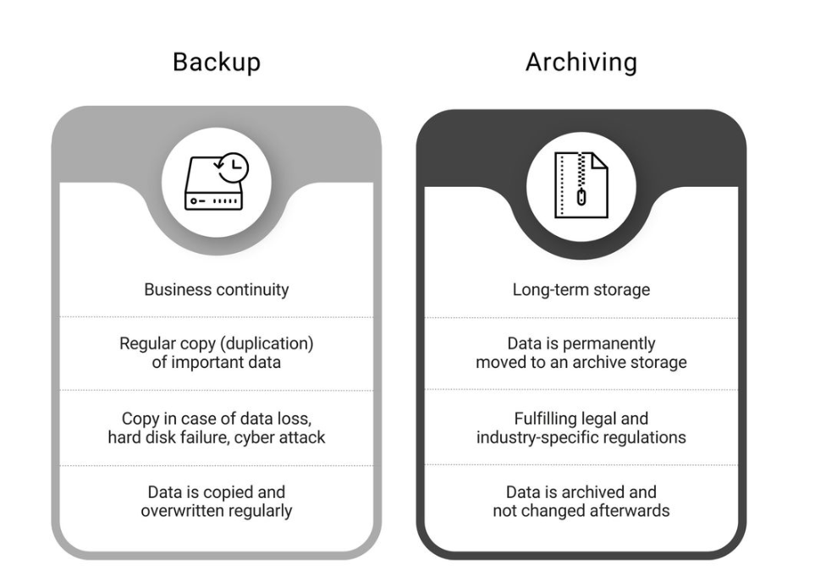
Backup Strategy
Backup (online)vs Archive(offline)

Slide 8
Plan Backup
1)Data Categories ----→ critical important normal
2) Value of each category -------→ negotiate with owner data
3) Maximum Acceptable data inaccessibility (RTO)

Slide 9
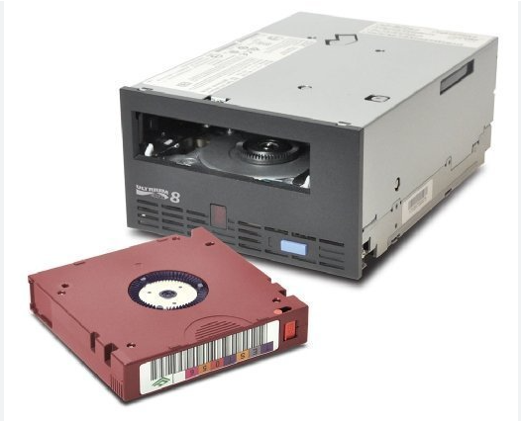
Backup Plan
1) Portability
2) Longevity
3) Cost
Backup media 1)hard external 2)cd 3)magnetic tape 4)nas storage(online)
Type backup 1-online 2-offline 3-offsite

Slide 10
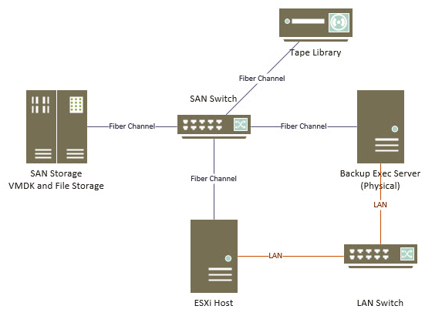
Backup Offline

Slide 11
storage location item
Temperature
Humidity
Fire resistance
Security

Slide 12
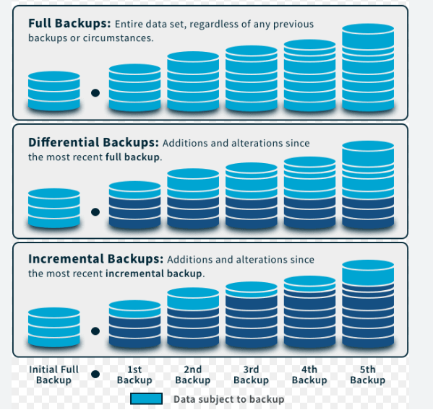
Backup type
Full
Incremental
Differential

Slide 13
linux backup directory
What Directories Should You Backup?
/etc | Stores important configuration files for a system, including user and group information, network settings, application configurations, and startup files. Without it, recovering from an outage or failure would be difficult and time-consuming. Having a backup of /etc is crucial to avoid having to reinstall the system and applications from scratch.
/home | User data, files, documents, pictures, and downloads, are stored in the /home directory under the user's name. Backing up this directory is essential as it's the most important one for users.
/root | Backing up the root user's home directory is crucial. It contains important and unique information, such as downloads, configurations, scripts, and notes, that is essential for the system administrator.
/var | Stores files like databases, web pages, logs, crontabs, and more. It grows daily and requires its own separate storage and disk.
/usr/local/bin | May be empty or contain non-standard scripts and applications. If empty, an empty file (/usr/local/bin/empty) is suggested to be created to avoid backup confusion.
/usr/local/sbin | Likewise, /usr/local/sbin is also important and often empty. An empty file (/usr/local/sbin/empty) can be added in the directory to indicate its status.
/srv | Used for internet-related service files like WWW uploads, FTP files, and CVS, but it may remain empty. Its use is random and uncommon.
/opt | For third-party or separate software. It's useful for testing new software. An empty file (opt/empty) is added if empty.
Shared directories | May be affiliated with /finance, /data, or /hr that have special permissions for a specific group. They must be backed up as they may contain unique corporate data. Only create these directories if needed.

Slide 14

Backup Solution
1) gui or web based : netbackup, veeambackup , Bacula , Amanda
2) command base : tar cp *rsync scp dd
rsync option(ah) (--progress) source destination
cp vs rsync (cp for short file but best practice for huge file rsync)

Slide 15
Install app from src(compile)
1) ./configure ---→ check if dependency need example lib,compiler,
Output this script makefile
2) make ----→ compile source code software with parameters
3)make install -→ install commands
It must be install developments tools in redhatbase and build-essential for debian base

Slide 16
compile apache
1- wget wget https://dlcdn.apache.org/httpd/httpd-2.4.46.tar.gz in /usr/src
2- wget https://dlcdn.apache.org//apr/apr-1.7.4.tar.gz and https://dlcdn.apache.org//apr/apr-util-1.6.3.tar.gz after that extract in /usr/src/httpd/srclib
APR (Apache Portable Runtime) and APR-util (Apache Portable Runtime Utility) are software libraries developed by the Apache Software Foundation. They provide a foundation for building portable and efficient applications, especially within the context of the Apache HTTP Server project.

Slide 17
compile apache
3wget https://kumisystems.dl.sourceforge.net/project/pcre/pcre/8.45/pcre-8.45.zip
4- unzip in /usr/local and mv to pcre
5- mv arp and utils
6- cd /usr/local/pcre and ./configure --prefix=/usr/local/pcre after make and make install
7- in httpd ./configure --prefix=/apache --with-included-apr --with-included-apr-util --with-pcre=/usr/local/pcre
8 make and make install

Slide 18
monitoring os
The iostat command is used for monitoring disk input/output (I/O) device load. This is done by observing the time the devices are active in relation to their average transfer rates. Without any options, the iostat command displays statistics since the last system reboot.
The iotop command is similar to the top command. It shows I/O usage information output by the Linux kernel and displays a table of current I/O usage by processes or threads on the system.
vmstat command reports virtual memory statistics about processes, memory, paging, block I/O, traps, and CPU utilization.
The ss command is used to show socket statistics. It can display stats for PACKET sockets, TCP sockets, UDP sockets, DCCP sockets, RAW sockets, Unix domain sockets, and more. It allows showing information similar to the netstat command, but it can display more TCP and state information.

Slide 19
monitoring os
The iptraf-ng tool is a network monitoring utility for IP networks and can be used to monitor the load on an IP network. It intercepts packets on the network and displays information about the current traffic over it.
The lsof command is used to list information about open files and their corresponding processes. lsof will handle regular files, directories, block special files, character special files, executing text references, libraries, streams or network files. By default, lsof will show unformatted output which might be hard to read but is very suitable to be interpreted by other programs. The -F option plays an important role here.
The sar command collects, reports or saves system activity information.

Slide 20
Capacity planing
Understand Requirements:
Gather requirements from stakeholders, including expected workload, performance expectations, and growth projections.
Identify key applications, services, and workloads that will run on the infrastructure.
Analyze Current Environment:
Assess the current infrastructure, including hardware, software, and network resources.
Collect performance data on CPU, memory, disk I/O, network usage, and other relevant metrics.
Forecast Growth:
Analyze historical data and trends to forecast future growth in demand.
Consider factors such as business expansion, new projects, seasonal fluctuations, and anticipated increases in users or data volumes.
Define Performance Metrics:
Establish performance targets and metrics based on the requirements gathered.
Define key performance indicators (KPIs) to measure the performance of the infrastructure, such as response times, throughput, and resource utilization thresholds.
Identify Bottlenecks:
Identify potential bottlenecks in the current infrastructure that may impact performance.
Determine which components (e.g., CPU, memory, disk I/O, network bandwidth) are likely to be bottlenecks under different scenarios.
Design Scalable Architecture:
Design a scalable architecture that can accommodate future growth and fluctuations in demand.
Consider using technologies such as virtualization, cloud computing, and containerization to dynamically allocate resources as needed.
Allocate Resources:
Determine the appropriate allocation of resources (e.g., CPU, memory, storage) to meet performance requirements.
Balance resource allocation based on workload characteristics and priority of applications.
Plan for Contingencies:
Develop contingency plans to address unexpected spikes in demand or failures in the infrastructure.
Implement strategies such as redundancy, failover, and disaster recovery to ensure continuity of operations.
Regular Monitoring and Optimization:
Implement monitoring tools to continuously monitor the performance and health of the infrastructure.
Analyze performance data regularly and make adjustments to resource allocation as needed to optimize performance and efficiency.
Review and Update:
Regularly review and update the capacity plan based on changes in requirements, technology advancements, and business objectives.
Ensure that the capacity plan remains aligned with the organization's strategic goals and evolving needs.

Slide 21




Monitoring tools
Zabbix
Prometheus
Solarwinds
Prtg
SNMP (Simple Network Management Protocol) is a standard protocol used for monitoring and managing network devices and systems. It is widely used in network management systems (NMS) to collect and organize information from various network device

Slide 22
Mastering the kernel
Kernel main duty :
1- system memory management
2- software program management
3- hardware management
4- file system management

Slide 23
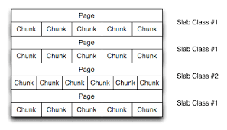
memory management
Memory : physical + virtual
Virtual = physical memory + swap
Swapping in vs Swapping out
Chunk is a smallest unit of memory that size=4K
Page consist of some chunks pmap –x (pid)
make room
Shared page: refers to a memory page that is shared between multiple processes. This sharing mechanism is used to optimize memory usage and improve system performance by allowing multiple processes to access the same physical memory pages

Slide 24
software program management

Slide 25
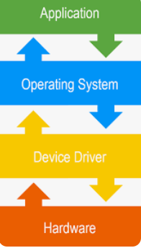
hardware management
App -----→ kernel ------→ device driver ------→ hardware
Device driver ----→ .ko (kernel module)
The major number and minor number tell the kernel how to access the device. ls -l /dev/sd*

Slide 26
hardware management
Virtual File System (VFS) is a layer of abstraction that provides a unified interface for interacting with different types of file systems. It acts as an intermediary between user-space applications and various file systems supported by the Linux kernel

Slide 27
kernel architecture
The Linux kernel was originally designed to be a monolithic kernel. Monolithic kernels contain all drivers for all the various types of supported hardware, regardless if your system uses that hardware. As the list of supported hardware grew the amount of code that was never used on any given system grew too. Therefore a system was introduced that allowed the kernel to load some hardware drivers dynamically. These loadable device drivers were named "kernel modules".

Slide 28
What are kernel modules
Linux kernel modules are object files (.ko files) produced by the C compiler but not linked into a complete executable. Kernel modules can be loaded into the kernel to add functionality when needed. Most modules are distributed with the kernel and compiled along with it. Every kernel version has its own set of modules.

Slide 29
Kernel Parts
1)Kernel binary : bz image , vmlinuz
bzImage:refers specifically to a kernel image format compressed using bzip2 .
vmlinuz:a generic compressed Linux kernel image that is typically used as the default kernel image for booting in Linux systems.
2)Kernel modules (insmod,lsmod,rmmod,modprobe,modinfo,
3)Kernel source code
4)Kernel patch yum update (patching all packages automatic)

Slide 30
file system management
BTFRS : MAXFileSize: 16EiB MAXFSsize:16EiB journaling:support
Cow (copy on write)
CoW ensures data integrity and makes Btrfs suitable for tasks like snapshotting and data protection. Some person write in it and each person can show one view
Blkid = show block id of block device and it is unique for each block device
sync all of buffer write in disk now its umount and eject flash
Superblock: consist of 1-size of fs 2-block size of fs 3- inode of numbers 4- location of indoe table

Slide 31
File system
Memory based linux fs
/proc
/dev
/sys
/swap
These memory-based file systems provide fast access to data stored in memory, making them suitable for various use cases such as temporary storage, caching, and specialized workloads.

Slide 32

BTRFS
) create for handeling huge data
)Performance because use btree alghorithm
) cow
) support its own raid
) data compression and defragmentation

Slide 33
BTRFS
btrfs subvolume list –t BTRFS
btrfs subvolume create BTRFS/vol1,vol2
mount –o subvol=subvol1 /dev/sdb1 /mydata
btrfs filesystem show
genisoimage –o tmp.iso /var/ mount tmp.iso /media

Slide 34
Configuring RAID
What is RAID?
RAID stands for "Redundant Array of Inexpensive Disks". The basic idea behind RAID is to combine multiple small, inexpensive disk drives into an array which yields performance exceeding that of one large and expensive drive. This array of drives will appear to the computer as a single logical storage unit or drive.
Parity:Parity is a concept used to add redundancy to storage. A parity bit is a binary digit which is added to ensure that the number of bits with value of one in a given set of bits is always even or odd. By using part of the capacity of the RAID for storing parity bits in a clever way, single disk failures can happen without data-loss since the missing bit can be recalculated using the parity bit.

Slide 35
RAID levels
RAID levels There are a number of different ways to configure a RAID subsystem - some maximize performance, others maximize availability, while others provide a mixture of both. :
RAID-0 (striping)
RAID-1 (mirroring)
RAID-⅘ Linear mode

Slide 36
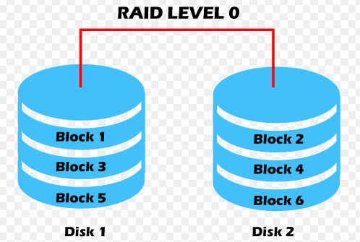
RAID 0
Level 0 RAID 0 striping RAID level 0, often called "striping",
is a performance-oriented striped data mapping technique. This means the data being written to the array is broken down into strips and written across the member disks of the array.
This allows high I/O performance at low inherent cost but provides no redundancy. Storage capacity of the array is equal to the sum of the capacity of the member disks.
As a result, RAID 0 is primarily used in applications that require high performance and are able to tolerate lower reliability.

Slide 37
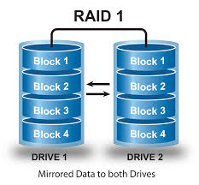
RAID 1
RAID 1 mirroring .has been used longer than any other form of RAID.
Level 1 provides redundancy by writing identical data to each member disk of the array, leaving a mirrored copy on each disk. Mirroring remains popular due to its simplicity and high level of data availability. Level 1 operates with two or more disks that may use parallel access for high data-transfer rates when reading, but more commonly operate independently to provide high I/O transaction rates. Level 1 provides very good data reliability and improves performance for read-intensive applications but at a relatively high cost. Array capacity is equal to the capacity of the smallest member disk.

Slide 38
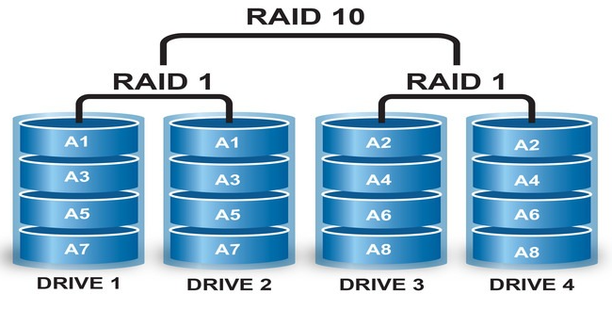
RAID 10

Slide 39
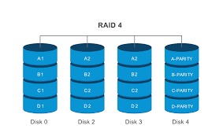
RAID 4
RAID 4 RAID level 4 uses parity concentrated on a single disk drive to protect data. It is better suited to transaction I/O rather than large file transfers. Because the dedicated parity disk represents an inherent bottleneck, level 4 is seldom used without accompanying technologies such as write-back caching. Array capacity is equal to the capacity of member disks, minus the capacity of one member disk.

Slide 40

RAID 5
RAID 5 The most common type of RAID is level 5 RAID. By distributing parity across some or all of the member disk drives of an array, RAID level 5 eliminates the write bottleneck inherent in level 4.
The only bottleneck is the parity calculation process. Because the widespread use of modern CPUs and software RAID that is not really an issue anymore. As with level 4, the result is asymmetrical performance, with reads substantially outperforming writes. Level 5 is often used with write-back caching to reduce the asymmetry. The capacity of the array is equal to the total capacity of all member disks, minus the capacity of one member disk. Upon failure of a single member disk, subsequent reads can be calculated from the distributed parity such that no data is lost. RAID 5 requires at least three disks.

Slide 41
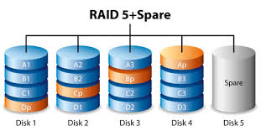
spare part
In IT infrastructure, especially in storage arrays or RAID (Redundant Array of Independent Disks) configurations, spare disks are often used to ensure data availability and fault tolerance

Slide 42
RAID Configuration
Raid after kernel 2.6 enable
/proc/mdstat should be exist if not enable this module modprobe raid1 and show raid support less mdstat
mdadm: Multiple Device Administration. It is a Linux utility used for managing and monitoring software RAID (Redundant Array of Independent Disks) devices
Partitoin type code by default its linux for raiding should choose non-fs data (da)

Slide 43
mdadm
mdadm -C /dev/md0 -l 5 -n 3 /dev/sdb1 /dev/sdc1 /dev/sdd1
md0 is virtual name of raid group -l define raid -n (number)
Now partitioning raid group and mount it
mdadm --misc --detail /dev/md0 show status raid
clean state(okay), degraded state (due to a failed disk), or rebuilding (due to a disk replacement or recovery)

Slide 44
mdadm
commonly Senario
1)mdadm --misc --detail /dev/md0
2)mdadm --manage /dev/md0 -r /dev/sdd1 (remove disk sdd1 from raid group md0)
3) mdadm --manage /dev/md0 -a /dev/sdd1(append or add new disk)
4) mdadm --misc --detail /dev/md0 (check new state for finishing rebuild disk)

Slide 45
mdadm
add spare disk: mdadm --manage /dev/md0 --add /dev/sdf1
Remove raid group
1. umount /dev/md0
2. mdadm --manage --stop /dev/md0
3. mdadm --zero-superblock /dev/sdb1 /dev/sdc1 /dev/sdd1

Slide 46
LVM
LVM stands for Logical Volume Manager. It is a widely used storage management technology in Linux systems that allows users to manage and manipulate storage devices flexibly
1. PV ( Physical Volume )
2. VG ( Volume Group )
3. LV ( Logical Volume )

Slide 47
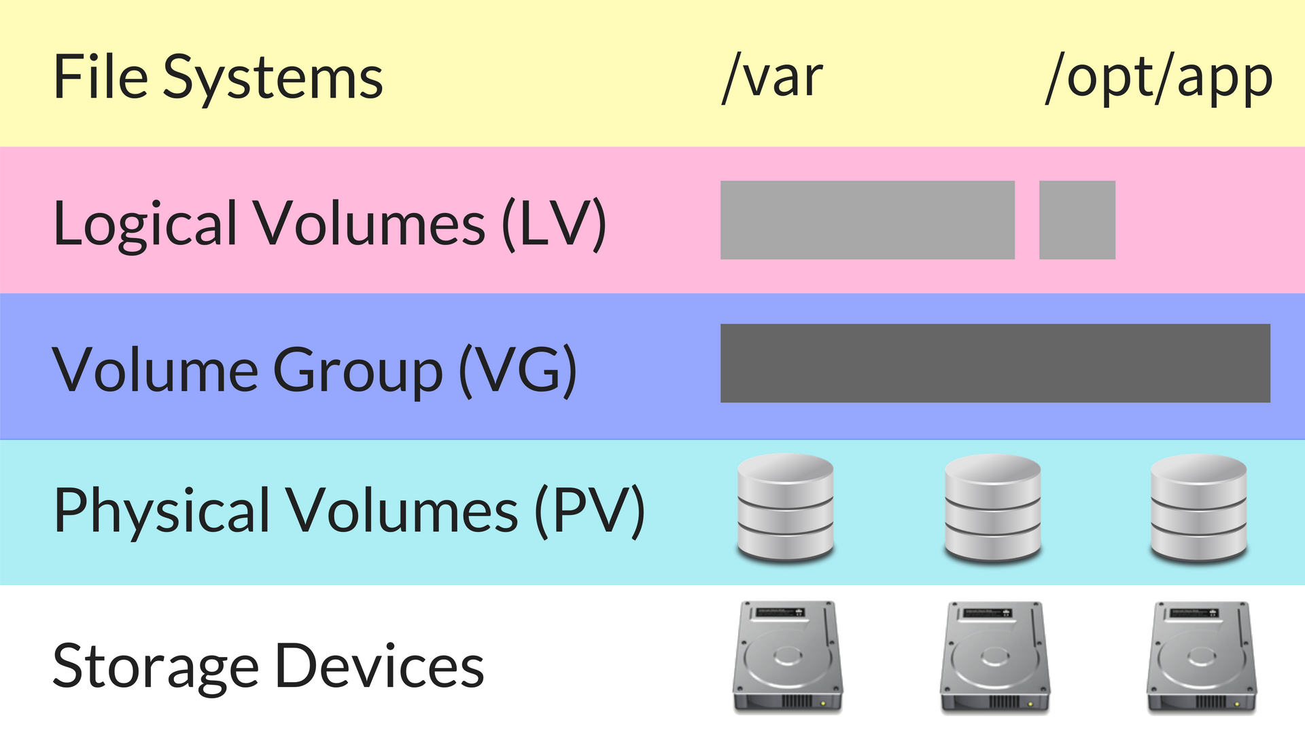
LVM

Slide 48
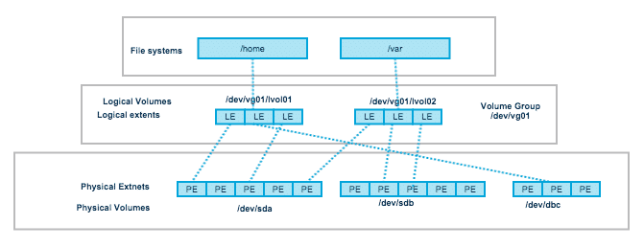
LVM

Slide 49
Create lv
Lv create first partitioning with type lvm
pvcreate /dev/sdb1
vgcreate name(vg) /dev/sdb1 /dev/sdc1
pvdispaly for show physical volume pvs
vgdisplay for show volume group vgs

Slide 50
Create lv
lvcreate -L 4G vg01 --name lv01
lvdispaly lvs
mkfs.ext4 /dev/mapper/vg01-lv01 or /dev/vg01/lv01
mount /dev/mapper/vg01-lv01 /LVMExample

Slide 51
extend lv
pvcreate /dev/sdd1
vgextend vg01 /dev/sdd1
lvextend -L +10G /dev/mapper/vg01-lv01
resize2fs /dev/mapper/vg01-lv01 if xfs fs xfs_growfs

Slide 52
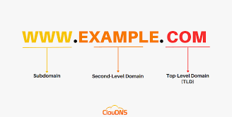
BIND
"bind" typically refers to the Berkeley Internet Name Domain (BIND) software. BIND is the most widely used DNS server software on the Internet. It provides domain name resolution services, translating domain names into IP addresses and vice versa.

Slide 53
FQDN
A fully qualified domain name (FQDN) is the complete address of an internet host or computer. It provides its exact location within the domain name system (DNS) by specifying the hostname, domain name and top-level domain (TLD)

Slide 54
Ns type
1. Primary ( Master ) Server : Authoritative Server
2. Secondary ( Slave ) Server : Authoritative Server
3. Caching Server : NonAuthoritative Server
4. Forwarding Server : NonAuthoritative Server

Slide 55
Primary schema
Root hints
172.20.124.119
client1
TLD
Varzesh3.com
172.20.124.125
client
172.20.124.150
Dns server
Varzash3.com
www

Slide 56
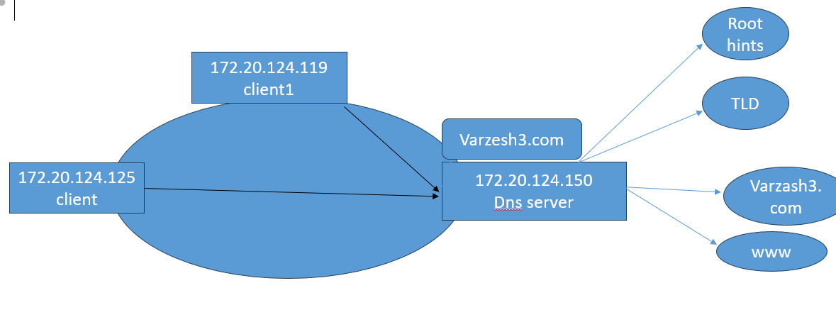
Secondry schema
v

Slide 57
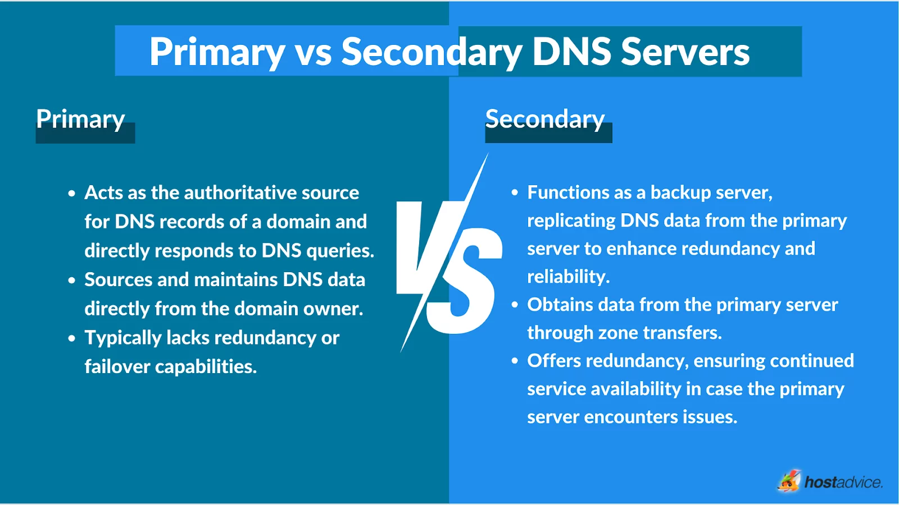
Primary vs secondary

Slide 58
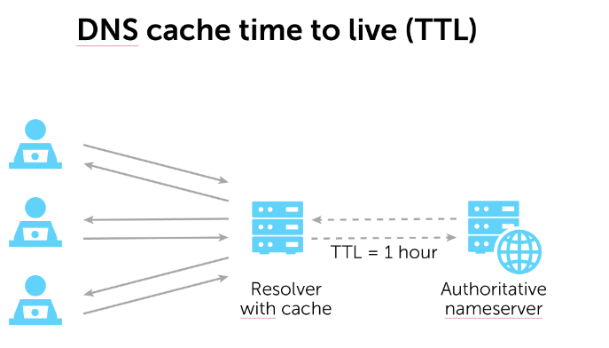
Caching server

Slide 59
Caching server
Generally, we recommend a TTL of 24 hours (86,400 seconds). However, if you are planning to make DNS changes, you should lower the TTL to 5 minutes (300 seconds) at least 24 hours in advance of making the changes. After the changes are made, increase the TTL back to 24 hours.

Slide 60
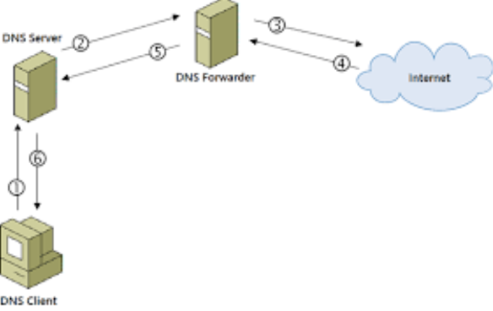
forwarding server
DNS Client name resolution:
1. host file
2. DNS client cache
3. DNS Server

Slide 61
Bind
yum install bind bind-utils
/etc/named.conf
A record:The "A" stands for "address" and this is the most fundamental type of DNS record: it indicates the IP address of a given domain
Ns record: NS stands for 'nameserver,' and the nameserver record indicates which DNS server is authoritative for that domain

Slide 62
Bind
options { global option
listen-on port 53 { ip dns server; };
listen-on-v6 port 53 { ::1; };
directory "/var/named";
dump-file "/var/named/data/cache_dump.db";
statistics-file "/var/named/data/named_stats.txt";
memstatistics-file "/var/named/data/named_mem_stats.txt";
recursing-file "/var/named/data/named.recursing";
secroots-file "/var/named/data/named.secroots";
allow-query { any; }; recursion no because config as primary dns

Slide 63
Bind
zone “iman.com" {
type master;
file "/var/named/iman.db";
allow-update { none; }; because type is master
};

Slide 64
Bind
$TTL 604800
@ IN SOA ns1.iman.com. admin.iman.com. (
5 ; Serial
3600 ; Refresh
1800 ; Retry
604800 ; Expire
86400 ) ; Minimum TTL
iman.com. IN NS ns1.iman.com.
iman.com. IN NS ns2.iman.com.
; set A record
@ IN A 192.0.2.1
ns1 IN A 185.227.136.16
ns2 IN A 185.227.136.16
www IN A 185.227.136.16

Slide 65
Bind
Test config from other client
nslookup server ip-dns-server www.iman.com
Find ns other site nslookup set type=ns
Notice: comment in dns config is ;

Slide 66
config slave
zone “iman.com" {
type master;
file "/var/named/iman.db";
allow-update { none; }; because type is master
allow-transfer {ip other server;};
}; all config on master

Slide 67
config slave
zone “iman.com”;{
type slave;
file “/var/named/iman.com”;
masters “ip master;”;
} pay atthention install bind on slave and config as same as master in global options
rndc reload affect change without restart service
rndc reload iman.com just affect on specific zone

Slide 68
ACL
ACL iman-zone {
localhost;
79.143.84.20;
};
zone "iman.com" {
type master;
file "/var/named/iman.db";
allow-query {iman-zone;};
allow-update { none; };
};
Access Control Lists (ACLs) are address match lists that can be set up and nicknamed for future use in allow-query , allow-recursion , allow-transfer , etc

Slide 69
Caching server
recursion yes
allow-query-cache

Slide 70
Forwarding dns
// Forward DNS queries to these DNS servers
forwarders {
8.8.8.8; // Google's DNS
1.1.1.1; // Cloudflare's DNS
};

Slide 71
http concept
HTTP (Hypertext Transfer Protocol) is a fundamental protocol used for transferring data over the World Wide Web. It's an application layer protocol within the TCP/IP suite, designed for distributed, collaborative, hypermedia information systems.
Html advantages:
1-formatting data
2- linking between file
3- font style
www.w3school.com

Slide 72
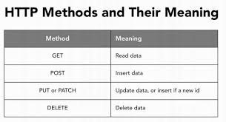
http client request
Get----→ request the specified resource .its very common
Put---→ as the same post send data
as specified location as like upload file
Delete--→delete the specified resource for example delete chat
Post--→ send specified data to the server for processing for example transaction bank,login or register

Slide 73
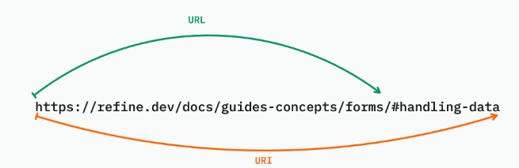
URI vs URL

Slide 74
http server respond(status code)
1- 1XX ---→ informational message
2- 200 -→ okay
3- 3XX --→ redirect
4- 4xx -→ client error or bad request 404 (not found) 403 (forbidden) 401 unauthorized 405 method not allowed 407 proxy authentication required
5- 5xx -→ 500 server error (Internal server error) 502 bad gateway

Slide 75
important code
100 continue
101 switch protocol (http,wss)
102 process in request
301 moved permanently (suitable for seo site)
302 temporary redirect

Slide 76
https
A CRL (Certificate Revocation List) is a list of digital certificates that have been revoked by the issuing Certificate Authority (CA) before their scheduled expiration date. This is typically done due to various reasons, such as a compromise of the private key associated with the certificate, suspicion of fraud, or a change in the certificate's status.
Hsts
Hpkp
ciphersuit

Slide 77

Apache
Loadable dynamic modules such as https or reverse proxy
Limit concurrent session
Bandwidth throttling
Web Caching
Load Balancing
Common Interface Gateway
Virtual Hosting

Slide 78
Apache
apachectl fullstatus for monitor apache
/etc/httpd/conf/httpd.conf
<Location “/status-server”>
SetHandler status-server
</Location>

Slide 79
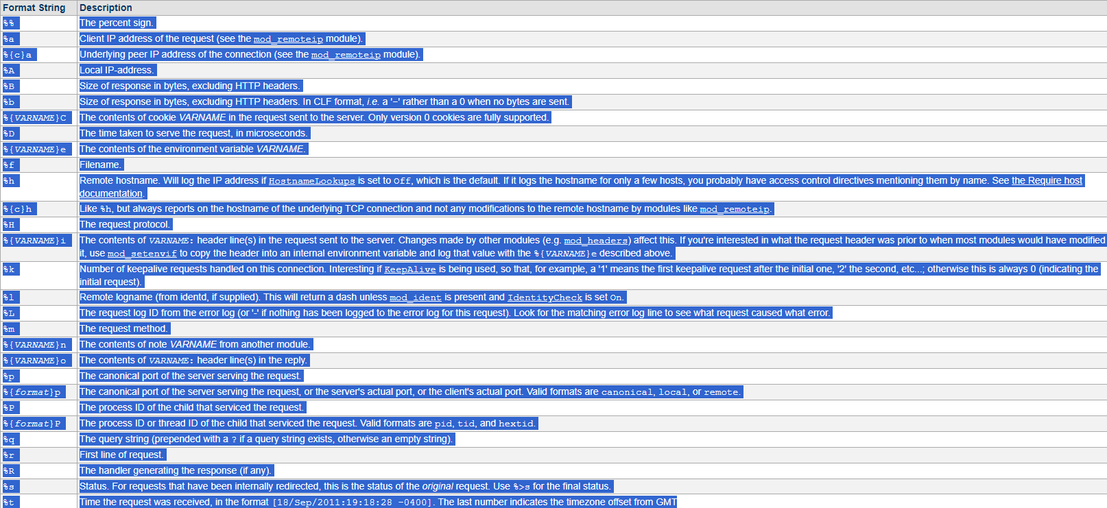
Log format apache

Slide 80
sample apache
<Directory /var/www/html/critical>
allow from ipadd
deny from all
</Directory>
<VirtualHost ip:80>
ServerName example.com
DocumentRoot /var/www/html/example.com
</VirtualHost>

Slide 81
Apache
Show all modules in apache httpd –M
Authenticate in apache
htpasswd -c /var/www/examplecom/password iman

Slide 82
Apache
<Directory /path/to/protected/directory>
AuthType Basic
AuthName "Restricted Area"
AuthUserFile /var/www/examplecom/password
Require valid-user
</Directory>

Slide 83
https on apache
yum install mode_ssl
yum install openssl
openssl genrsa -des3 -out server.key 2048 (private key)
openssl rsa –in server.key -out private.key (apache cannot read priv with pass)
openssl req -x509 -nodes -days 365 -newkey rsa:2048 -keyout private.key -out public.crt

Slide 84
https on apache
<VirtualHost ip:443>
DocumentRoot "/var/www/html"
ServerName www.example.com
SSLEngine on
SSLCertificateFile /etc/httpd/ssl/public.crt
SSLCertificateKeyFile /etc/httpd/ssl/server.key
</VirtualHost>
In virtual 80 notice delete documentroot
Redirect permanent "/" "https://your_domain_or_IP/"

Slide 85

Squid Proxy
server
proxy
client

Slide 86
squid
acl blockuser src (client ip)
http_access deny blockuser
Auth aquid
htpasswd -c /etc/squid/.squid_user username
auth_param basic program /usr/lib/squid/basic_ncsa_auth /etc/squid/passwd
auth_param basic children 5
auth_param basic realm Proxy Authentication Required

Slide 87
Caching and Blocking on squid
cache_dir ufs /var/spool/squid 100 16 256 uncomment
100 means 100mg 16 folder keep 256 second cache valid
acl newsmedia destdomain tasnim.com www.tasnim.com
http_access deny newsmedia

Slide 88
nginx
server {
listen 80;
server_name limo.ir;
return 301 https://limo.ir$request_uri;
}
server {
listen 443 ssl;
ssl_certificate public.crt;
ssl_certificate_key private.key;
location / {
root /usr/share/nginx/html;
index index.html;
}
}

Slide 89
Tuning webserver
Notice tuning first in develop or stage env
Apache tuning (MPM threading)
Prefork (advantage: high security, suitable program needs unique process disadvantag: low performance, high memory usage )
Worker
Event

Slide 90
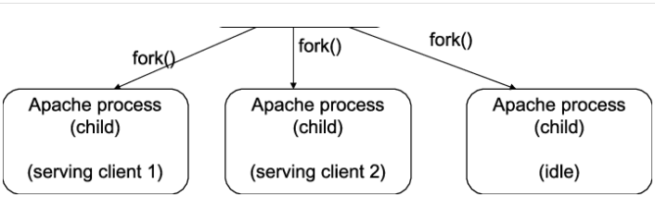
prefork

Slide 91
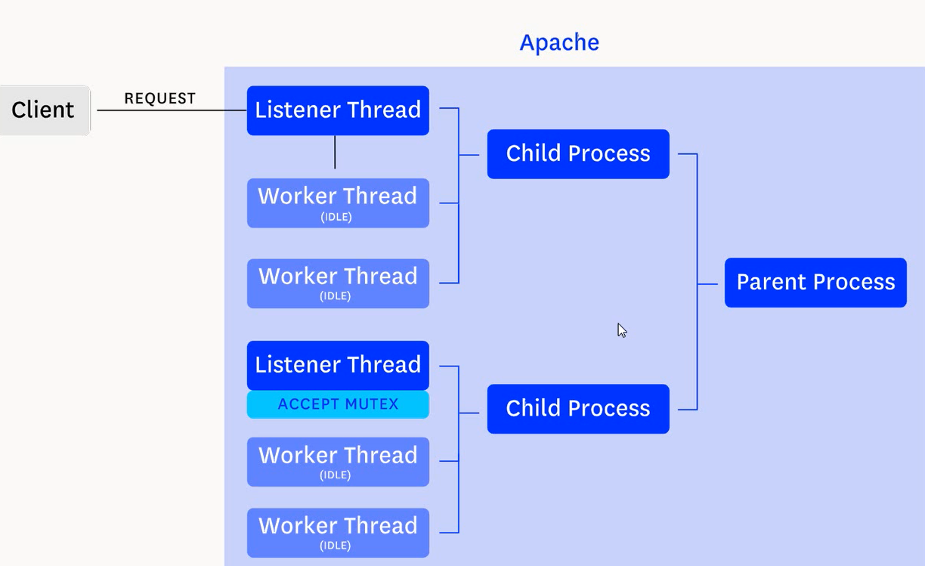
worker

Slide 92
event

Slide 93
firewall
allow port
firewall-cmd --permanent --add-port=8080/tcp
disallow port
firewall-cmd –permanent --remove-port=8080/udp
firewall-cmd –reload
Add service
firewall-cmd --zone=public --add-service=http --permanent

Slide 94
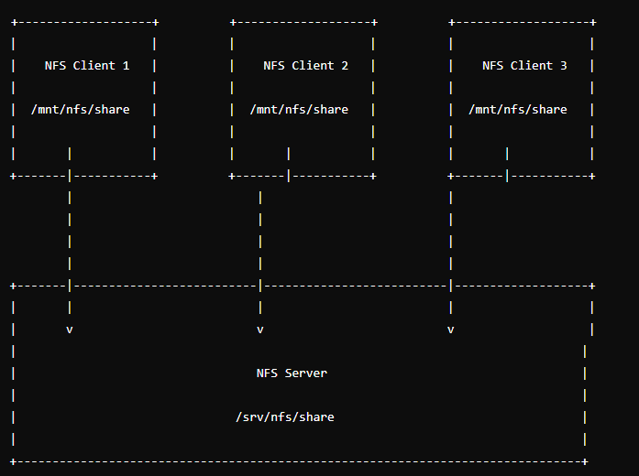
NFS
Network File System (NFS) is a distributed file system protocol that allows you to share directories and files with others over a network.

Slide 95
NFS
yum install nfs-utils
mkdir /mnt/nfs-share
chown -R nfsnobody:nfsnobody /nfs-share/
systemctl start/enable rpcbind (remote procedure call)
systemctl start/enable nfs-server
systemctl start/enable nfs-lock (prevent client conflict access)
/etc/exports
/mnt/nfs-share 192.168.60.0/24(rw,sync,no_root_sqaush,no_all_squash)

Slide 96
NFS
yum install nfs-utils on client
mount -t nfs ipserver:/mnt/nfs-share /nfs-share/
Nfs harden u+s in client and remove no_root_sqaush,no_all_squash
exportfs -v

Slide 97
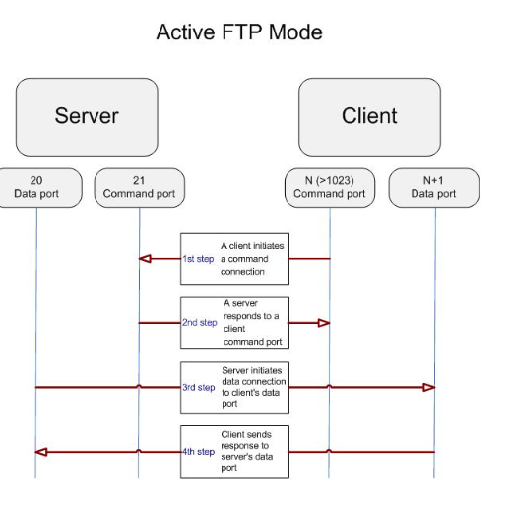
FTP
file transfer protocol
Two type active and passive
Default port 21 ftp://ip
Disadvantage
Client-side Firewall Configuration
Security Concerns

Slide 98
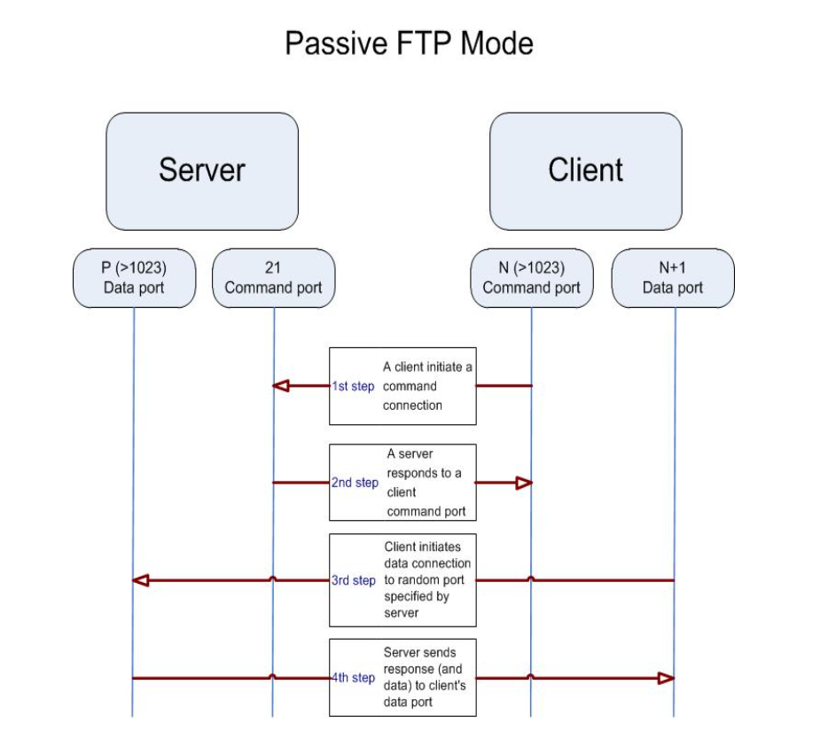
FTP

Slide 99
vsftpd
very secure ftp deamon bydefault active mode
Some ftp in linux pure-ftpd proftpd
yum –y install vsftpd
Config vsftpd /var/ftp/pub ftp ? In windows show
anonymous_enable=NO
local_enable=YES
userlist_enable=YES
userlist_deny=NO
userlist_file=/etc/vsftpd/user_list

Slide 100
vsftpd
Passive mode config
connect_from_port_20=NO
pasv_enable=YES
pasv_max_port=30100
pasv_min_port=30000

Slide 101
samba
open source of smb protocol port 445(tcp) port137,135(UDP)
yum install samba samba-client (samba for server ) client for connect to smb on windows
systemctl start smb.service
systemctl start nmb.service (netbios protocol)
groupadd smbshare
mkdir /samba
chgrp smbshare /samba
useradd -s /sbin/nologin -G smbshare iman
smbpasswd -a iman (set password by smb )
smbpasswd -e iman (enable iman for smb)

Slide 102
samba
Config samba
put bellow configs on /etc/samba/smb.conf
[classshare]
path=/samba
browseable= yes
read only= no
force create mode= 0660
force directory mode= 2770
valid users=@smbshare

Slide 103
samba
smbclient //ip(windows)/TestShare –U user(on windows)
yum install cifs-utils for mounting samba
Mount –t cifs –o username=user //ip/TestShare /Testshare

Slide 104
dhcp
ip assignment
ip static (set BOOTPROT=none or static) for server
ip dynamic for client
Dhcp (dynamic host configuration protocol) for config ntp,gateway ,…
Dora
broadcast L2
ip 192.168.10.50
dhcp request
Client
windows10
Dhcp pool
192.168.10.1/50 gateway 192.168.10.254
Server dhcp
Centos or ubuntu

Slide 105
dhcp
Use dhcp server for some different network
Disadvantage
Dhcp options 1-subnet 2-ntp 3-default gateway 4-dns 5-host name
Dhcp server pool1
pool2
192.168.50.0/24
192.168.10.0/24
R2
R1

Slide 106
dhcp
Dhcpd for server on lniux
dhclinet , pump , dhcpd for client
yum install dhcp
Config dhcp
subnet netmask 192.168.10.0 255.255.255.0 {
option routers 192.168.10.1;(means gateway)
option broadcast-address 192.168.10.255;
range 192.168.10.50 192.168.10.150;
}

Slide 107
dhcp
Log dhcp /var/lib/dhcpd/
global define for dns and domain above config
option domain-name “Lpic2.com”;
option domain-name-servers “8.8.8.8”;
max-lease-time 7200; in lan default 8 days okay but for example aireport time not suitable

Slide 108
dhcp
host manager1 {
hardware ethernet 00:11:22:33:44:55;
fixed-address 192.168.1.100;
option host-name “manager”;
}

Slide 109
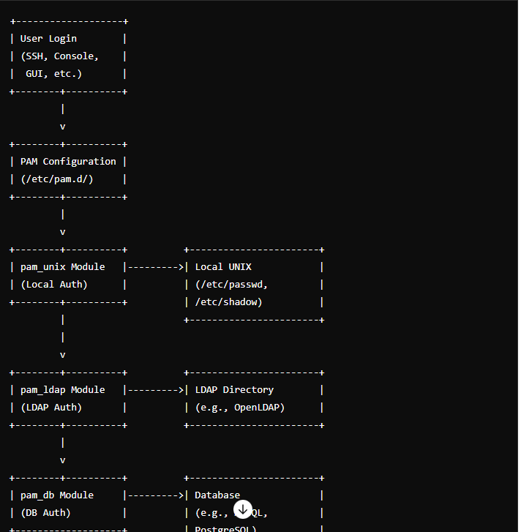
pam
Plugable Authentication Module
pam_krb5.so

Slide 110
Open-LDAP
dc=com
LDAP-Schema
DC=domain context
OU=organizational unit DN:CN=iman,OU=manager,DC=portal,DC=cando,DC=com
CN=common name
DN=distinguished name
dc=cando
dc=portal
cn=iman
Ou=Manager

Slide 111
Open-LDAP
each object has attribute
for example 0bject=name has password,username,creation-date and dn path
DN path access to each object
LDAP (Lightweight Directory Access Protocol)

Slide 112
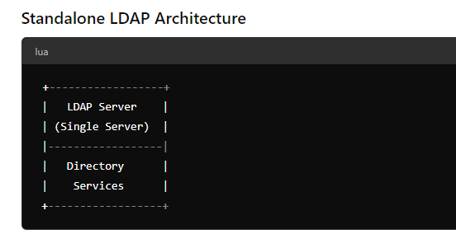
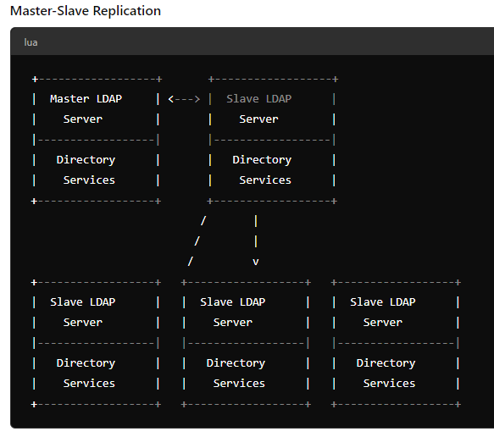
Open-LDAP
type architecture
Standalone
Replication

Slide 113
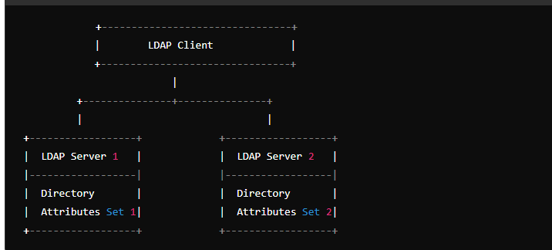
Open-LDAP
Distributed

Slide 114
Open-LDAP
apt install slpad ldap-utils
Set password for ldapadmin
dpkg-reconfigure slapd no after set domain
vi /etc/ldap/ldap.conf
BASE dc=cando,dc=com
URI ldap://ldap.cando.com
restart slapd
ldapsearch -Q -LLL -Y EXTERNAL -H ldapi:///

Slide 115
OpenLdap
Setting Up Base Group
vi base-groups.ldif
dn: ou=People,dc=cando,dc=com
objectClass: organizationalUnit
ou: People
dn: ou=Groups,dc=cando,dc=com
objectClass: organizationalUnit
ou: Groups

Slide 116
Openldap
ldapadd -x -D cn=admin,dc=cando,dc=com -W -f base-groups.ldif
ldapsearch -Q -LLL -Y EXTERNAL -H ldapi:/// show add people in ldap
Vi group.ldif
dn: cn=developers,ou=Groups,dc=cando,dc=com
objectClass: posixGroup
cn: developers
gidNumber: 5000

Slide 117
Openldap
ldapadd -x -D cn=admin,dc=cando,dc=com -W -f group.ldif
ldapsearch -x -LLL -b dc=cando,dc=com '(cn=developers)' gidNumber

