Slide 1
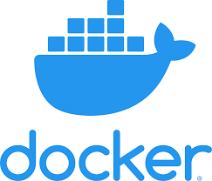

Slide 2
docker overview
Docker is an open platform for developing, shipping, and running applications. Docker enables you to separate your applications from your infrastructure so you can deliver software quickly.
Baremetal vs Vm and efficiency docker in bare 5X

Slide 3
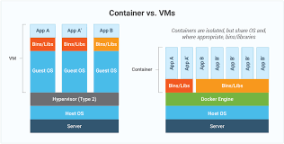
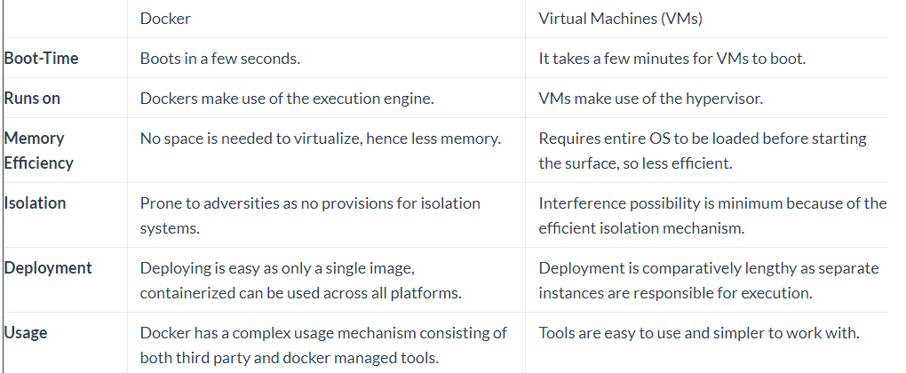
vm vs container

Slide 4
what is image?
A Docker image is a collection of all the files that make up and executable software app.
This collection includes the all the lib,bin,modules and dependency just need to run the app everywhere.
Image is read only

Slide 5
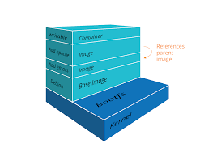
Image architechure
Layer
Layers consist of parent child relation just first layer don’t have parent said base image
Docker image use shared kernel of docker host
Layers are Reusable and Shared
Rebuilding the image will be faster

Slide 6
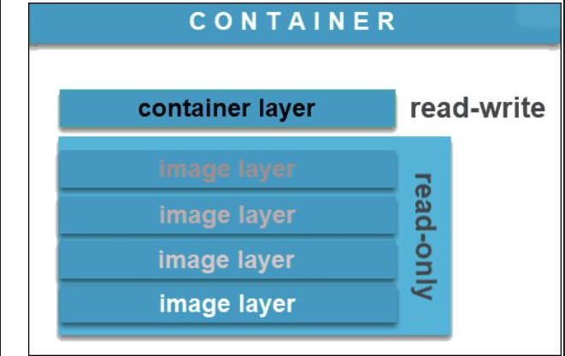
what is container
A Docker container image is a lightweight, standalone, executable package of software that includes everything needed to run an application: code, runtime, system tools, system libraries and settings.
Container is writable.
Image vs container

Slide 7
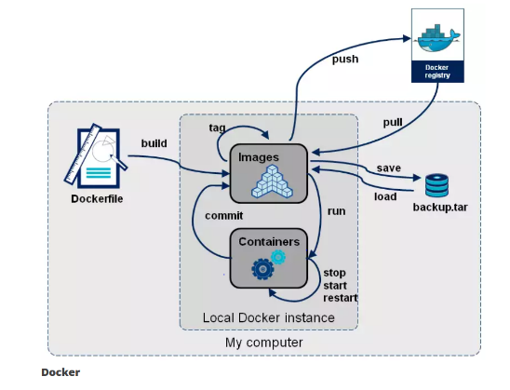
Docker Registry
A Docker Registry is a play that docker images store in it.
Docker Registry consist of public or private
Public DockerHub
Private Harbor or Nexus repo

Slide 8
Installation docker
on linux https://docs.docker.com/engine/install/
On windows
https://docs.docker.com/desktop/install/windows-install/

Slide 9
docker after install
docker version:
Show client version
Show client apiversion
Show server version
Show server api version
Docker written by golang
/var/lib/docker all of docker elements in there
docker info:This command displays system wide information regarding the Docker installation. Information displayed includes the kernel version, number of containers and images. The number of images shown is the number of unique images. The same image tagged under different names is counted only once.

Slide 10
docker pull and push
Download image from repo by pull
Upload image to repo by push
docker images -a list all image –q list image IDs

Slide 11
manage docker
The Docker daemon binds to a unix socket instead of a tcp port.by default unix socket is owned by root .docker daemon always runs as the root user!
Docker Daemon: A persistent background process that manages Docker images, containers, networks, and storage volumes.
Non root use below manual
groupadd docker
usermod –aG docker $USER

Slide 12
some Benefit of Docker container
Speed
Portability
Rapid deployment
Run your app in isolation and independent env

Slide 13
solve some problem by container
Dependencies
Protecting your pc
Easy deploy without huge knowledge about program language
Security and virus jail

Slide 14
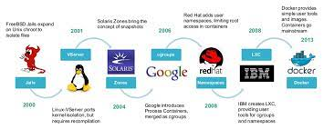
history containers

Slide 15
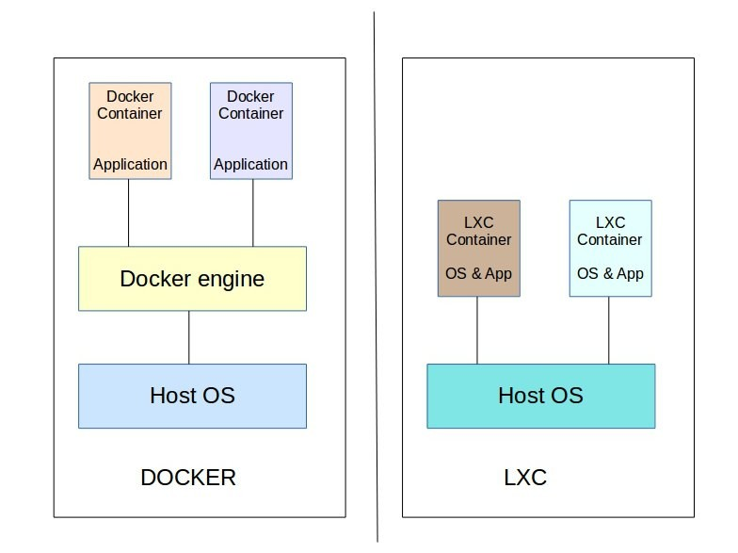
Lxc vs docker

Slide 16
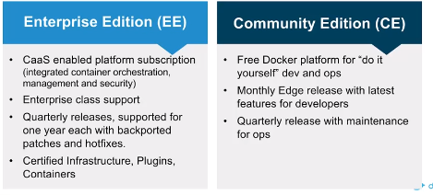
docker company history
Docker ce
Docker inc
Docker ee(free private repo , free tool for scan image)

Slide 17
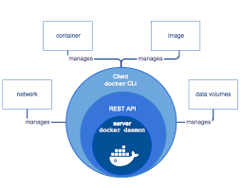
Docker Engine
The Docker engine is the core software that runs and manages containers which follows client-server architecture
Docker engine components:Server,RestAPI,CLI
Server(docker daemon)=(dockerd)
Rest API(control docker daemon what to do)
Cli (docker client)

Slide 18
LXC
In old version docker ,exist lxc (for linux) communicate with kernel
Docker can not work with cg and ns and lxc communicate with them
If docker request to lxc we cannot docker in windows and mac ….
If lxc update ,docker should be update that communicate with docker
Docker create libcontainer

Slide 19
Docker engine architecture
Docker client with api call docker server.
Docker daemon pass to cn to manage container lifecylce
Run create container
Shim keep stout stdin and report the container’s exit status code
Docker client
Docker daemon(server)
containerd
runc
runc
runc
runc

Slide 20
cgroups and ns
Cgroups: (abbreviated from control groups) is a Linux kernel feature that limits, accounts for, and isolates the resource usage (CPU, memory, disk I/O, etc.) of a collection of processes.limitation
Namespace: provide a layer of isolation. Docker uses namespaces of various kinds to provide the isolation that containers need in order to remain portable and refrain from affecting the remainder of the host system.view

Slide 21
run container
docker run –it image:tag shell
Docker run tells daemon to start new container
docker inspect
docker rmi
-i means interative -t means attach our current shell to the container’s terminal
/bin/bash or sh means which process we want run inside container
-d run container in bg --name flag for naming container

Slide 22
Daemonless containers
Enable live restore
Vi /etc/docker/daemon.json
live-restore:true
When docker daemon crash or stop ,yet container working this feature just in linux ☺))

Slide 23
Docker storage
Storage driver(graphdriver) manage read write on disk host
Type of storage 1-aufs 2-overlay 3-devicemapper 4-brtfs 5-Zfs
Change storage driver in daemon.json
Change docker storage is very sensitive
1-docker save 2-push to priv storage 3-change in daemon 4-daemon restart 5-pull image locally 6-restart containers

Slide 24
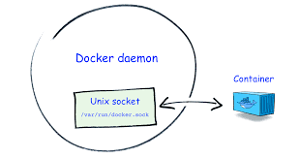
docker.sock
docker.sock is the UNIX socket that Docker daemon is listening to. It's the main entry point for Docker API. It also can be TCP socket but by default for security reasons Docker defaults to use UNIX socket.

Slide 25
list of container
docker ps or docker ps –a
Status up exited
docker ps –f status=up (f means filter) -s means size
docker run –it nginx –m 100M --memory-swap 2G (important for security) means 1.9 for swap
--cpuset-cpus=“1” –storage-opt size=5G
docker stats show container status

Slide 26
dangle image
When image and tag show none:none
docker image prune remove dangle image
Create image with name and same tag and don’t error

Slide 27
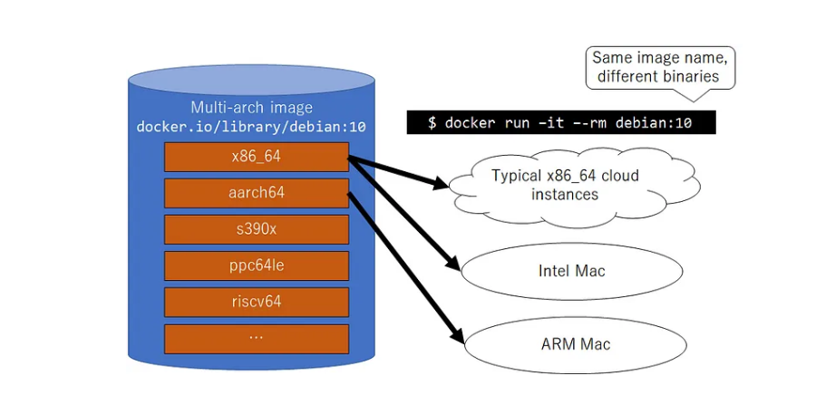
docker diagnostic

Slide 28
docker exec and cp and log
docker exec -e password=123 set enviroument
docker exec –w /tmp direct go to the working directory
docker cp /home/iman container-id:/root
docker cp container-id:/root /home/iman
docker logs –n 100 or –f (follow) id
docker event docker pause

Slide 29
docker commit
Docker commit:It can be useful to commit a container's file changes or settings into a new image.it’s temporary and don’t suitable on production env.
Docker save –o example.tar.gz for save image
Docker load: docker load –i example.tar.gz for load save image in other host

Slide 30
(docker ex and im)
Docker export docker export container-name > example.tar
Docker import docker import example.tar

Slide 31
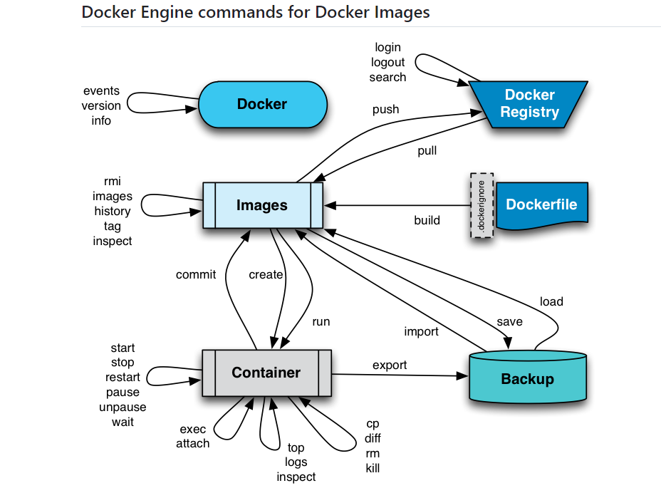
docker diagram

Slide 32
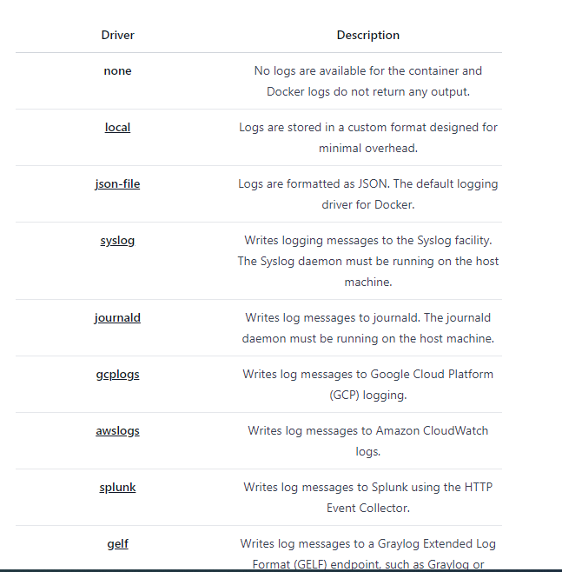
type of logging support

Slide 33
docker volume
Data is very important,in result persist storage with volumes.
docker -v /home:/home for persist data (bind mounts)
When persist after delete container data don’t delete
docker volume create vl1 keep in /etc/var/lib/docker/volumes/vl1
docker –v dockerhost-path:container-path -v vl1:/home:permission(rw,ro) this switch optinal

Slide 34
docker networking
docker run –it –p 80:80 image bash (bind port)
right host port and left port for container
127.0.0.1:80:80 by default expose port and listen on all if you open port in localhost above command use.
Type network 1-bridge 2-host 3-overlay
There are three common Docker network types – bridge networks, used within a single host, overlay networks, for multi-host communication.

Slide 35
docker network
CNM:container network model for design network docker
Libnetwok: implement of the cnm design
Driver: network topology(host,none,macvlan,bridge,overlay)

Slide 36
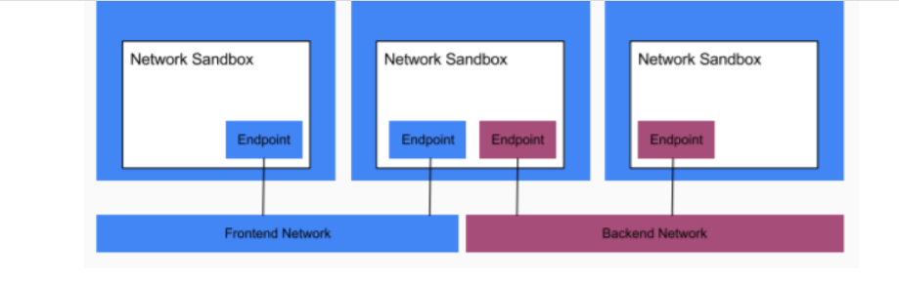
cnm
Sandbox:isolated network stack.consist of ethernet interface,ports,routing and dns
Network: software implementation
Endpoints:virtual network interface.responsible connect sanbox to network

Slide 37
libnetwork
Implementaion of cnm by libnetwork. Dns management and ingress load balancer and network management.
In windows bridge mode called nat
By default installed docker create 3 mode network (bridge,host,none)
Default network in docker is bridge,its condition two container show them with bridge mode

Slide 38
networking
Null or none disable networking of container.
Macvlan:macvlan network allows to admin assign mac address to containers.

