Slide 1
LPIC1

Slide 2
lpic
Lpic 101-500 lpic102-500
Chapter1: linux command line chapter6: sys admin
Chapter 2: managing software and process chapter7:network
Chapter3 : configure hardware chapter 8:script
Chapter 4: managing files chapter9:securing
Chapter 5: booting,initilizing

Slide 3



Famous people in linux

Slide 4
Linux history
Unix
Linux is kernel
Os release
Os=usermode(shell)+kernel+hardware
Shell login(interactive) vs no interactive
Kernel.org
Uname
https://upload.wikimedia.org/wikipedia/commons/1/1b/Linux_Distribution_Timeline.svg

Slide 5




Famous company
At&t bell labs
Debian
Redhat
Linux foundation

Slide 6

Famous universitiy
Berekly bsd os
MIT minix just for education (Andrew tanelban)

Slide 7



Fork concept
Debian (dpkg) 11
ubuntu(22.04 longterm support)
kali linux
Redhat (RHEL) rpm
oracle linux(Enterprise) means for commercial
suse (rpm)
suse(enterprise)
opensuse

Slide 8
Cli vs gui
Type of cli(bash,sh,zsh)
Bash default shell(bourne againe shell)
Sh (bourne shell) older than bash
Zsh (newer spelling correction) and many extension
Built-in support git
Gnome vs gnu ----------→ all packages in linux must be approved by gnu license gnome graphical env

Slide 9
bash
type of bash internal and external
global bash (export) vs local bash ali=m
Example cd and date
root@hostname~# username hostname current directory privilledge
# superuser $normal user

Slide 10
Basic Command
ls used to list the files and directories in a directory
ls –l with long format
ls –lash
Cd change directory in linux . .. ~ cd ~=cd
Pwd print work directory
Some command don’t need – for switch for example ip a
history ! Show with number and content !! Last command
History history –d linenumber history –w(write) -c(delete all)

Slide 11
Command basic
echo ----------→ echo hello ---→ hello
echo $PATH /usr/bin
echo $SHELL
echo $BASH echo $SHLVL
Env enviroument variable means part of memory that create value in there.
In linux $PATH refer to env
printenv show local env in linux
set display active environment variables
which It searches through the PATH directories to find the program. If it locates the program, it displays its absolute directory reference

Slide 12
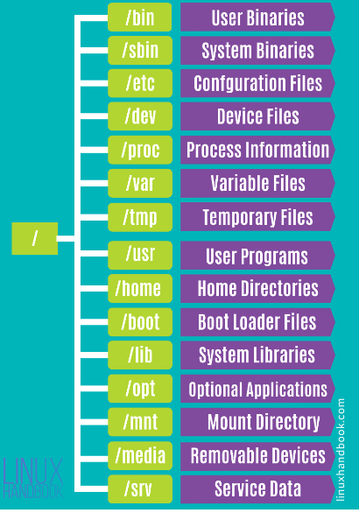
hierarchy in linux

Slide 13
Regular expression
&& \ for ignore what’s your name?
echo -e \\n and \\t
|| []
; “” know as string
*
?
!
^------------------→ begin with
$--------------→ env and end with

Slide 14
navigate
Relative
cd sysconfig
Obsolute
cd /etc/sysconfig

Slide 15

Editor file in linux
Vi vs vim
I begin line G end of file
i insert in file gg move to the first line
O open a new text above cursor
o open a new test below curser
w write touch for create file or text
q quite x
a insert text after
A insert text end of line ctrl v after c
u undo vi buffering
dd %s/a/b/
^ vs $ /
nano

Slide 16
Processing text edit
cat less and more
less better than more
sort -r -n tail
head
paste join file together side by side wc -l
cut –d “,” –f filenumber filename
split -l join file together side by side
uniq prevent repeat line tr translation character tr “” “ ,“

Slide 17
sed and tee and xargs
tee ls | tee files
Xargs execute stdout first command
ls | xargs echo ----→ echo ls
echo ali | xargs -I mamad echo my name is mamad
sed echo “ I like ice” | sed ‘s/icecream/water/’
s means substitute g means global sed -i -d delete
Using sed -e to use multiple scripts sed -e ‘/s/first/last/ ; sed –e /s/one/two’ filename

Slide 18
hashing in linux
md5sum
sha256sum

Slide 19
grep(important)
grep used for filtering and searching
Example grep ^root.*$bash /etc/passwd
grep –v (invert match) grep –v “error” txt.file means all lines don’t match
a specified pattern
fgrep –f (pattern search)
Egrep for complex regex ==grep -e

Slide 20
Usual comand
cat
mv
cp
/dev/null black hole &> (stderror and stdout)
Find find / -name “.txt” –type f or -type d

Slide 21
directory
mkdir
rmdir
rm –rf

Slide 22
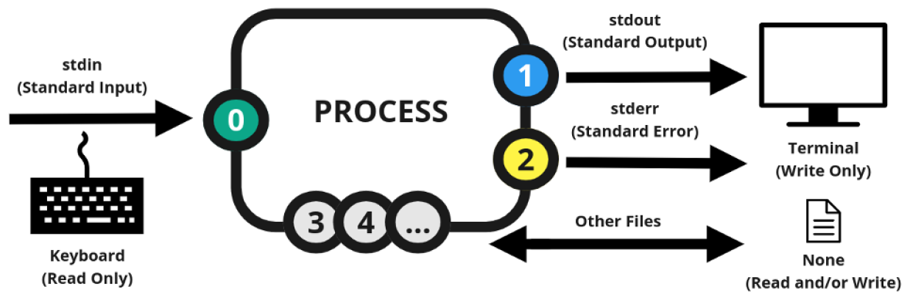
Standard input/output/error

Slide 23
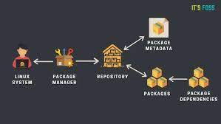
repository
A repository in linux is a location where software packages can be stored and accessed. These packages can be easily installed,updated and removed.
Type of repo: 1-local repo 2- remote server

Slide 24
■ Red Hat package management (RPM)
■ Debian package management (Apt)
Package means: Linux distributions have created a system for bundling already compiled applications for distribution. This bundle is called a package, and it consists of most of the files required to run a single application.

Slide 25
mechanism package database
■ Application files: The package database tracks each individual file as well as the folder where it’s located.
■ Library dependencies: The package database tracks what library files are required for each application and can warn you if a dependent library file is not present when you install a package.
■ Application version: The package database tracks version numbers of applications so that you know when an updated version of the application is available.

Slide 26
Package manager
yum install package-name (redhat base)
apt install package-name (Debian base)
zypper install package-name (opensuse)

Slide 27
important switch rpm
-e --erase Removes the specified package
-F --freshen Upgrades a package only if an earlier version already exists -R discovery requirement dependeny of package
-i --install Installs the specified package
-q --query Queries whether the specified package is installed
-U --upgrade Installs or upgrades the specified package
-V --verify Verifies whether the package files are present and the package’s integrity -v means verbose -h human readable

Slide 28
important switch dpkg
-i OR --install | Install a package using the dpkg command. The command will extract all control files for the specified package, remove any previously installed older instance of the package, and install the new package on our system.
-r OR --remove | Remove an installed package from our system. It removes every file belonging to the specific package except the configuration files. This can be seen as the uninstallation option.
--help | Display the help page for the dpkg command and exit.

Slide 29
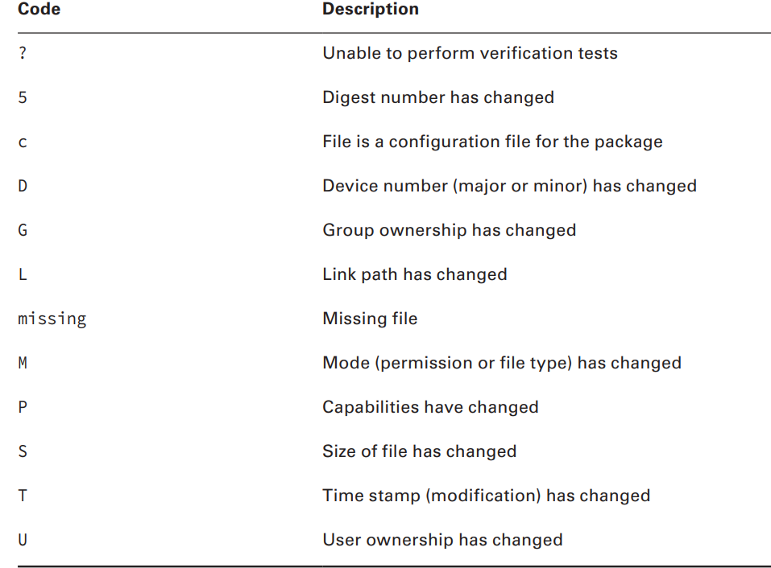
verify package code

Slide 30
Query switch
-qc show the path of config file -Rq show dependencies
-qi show detail information
-qa show just installed package
-lq list all things installed by package
whatprovide show for example /bin/bash with by package installed as the same –fq

Slide 31
cpio and rpm2cpio
Create a cpio archive from rpm package
rpm2cpio
Extracting from the cpio archive
cpio -idv ------------→ v usually means verbose d create subdirectories
i allows copy file from archive

Slide 32
source list
/etc/apt/source.list the list of source for apt
/etc/yum.repos.d/ the list of source for yum
/var/cache the cache of list and package

Slide 33
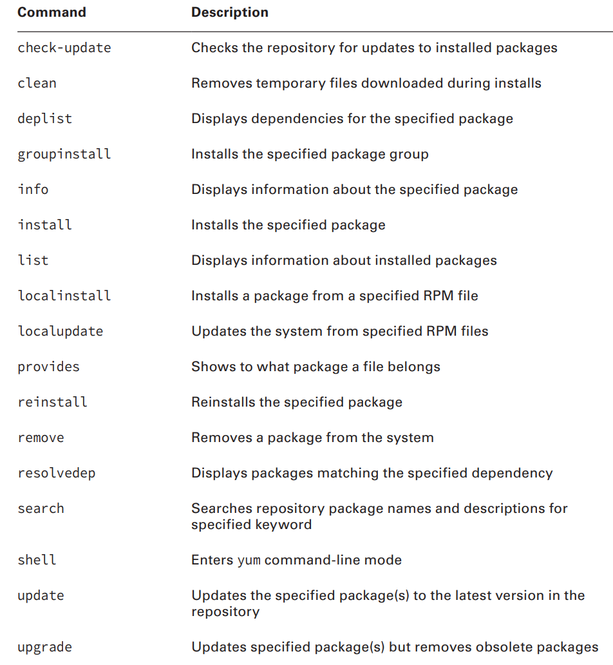
yum

Slide 34
apt
apt purge ____> remove package with config file that say remove from stump
apt vs apt-get apt is newer version of apt-get
apt-cache give usefull information such as dependency and packangename and search packagename match specified keword

Slide 35
same switch in yum and apt
remove just remove package but autoremove remove package with all dependencies
download just download deb package
install –download-only just download with dependencies but not install

Slide 36
library
A system library is a collection of items, such as program functions. Functions are selfcontained code modules that perform a specifi task within an application, such as opening and reading a data file
Type of library ______>1-static library 2-dynamic library(shared library) if work windows dll as the as shared library in linux
lib LIBRARYNAME .so. VERSION format shared library
/usr/lib show library for app /lib -→ show library bultin system

Slide 37
ad and disad
Static library is very huge executable file
If programmer update shared library and you update lib you can use new features of this library and security event deacrese
Static library loads and install very easier than shared library

Slide 38
command library
ldd show app use which libraries need
ldd /usr/sbin/ldconfig ---→ static link because cache shared library for system
ldconfig -v create ld.so.cache
/etc/ld.conf include /etc/ld.conf.d/*

Slide 39
managing process
What is process?
At any given time lots of active programs are running on the Linux system. Linux calls each running program a process . The Linux system assigns each process a process ID (PID) and manages how the process uses memory and CPU time based on that PID
init process? When linux system first boots it starts process that called init process that pid=1

Slide 40
process
ps viewing process in linux by this command
PID TTY TIME
CMD 1615 pts/0 00:00:00
bash 1765 pts/0 00:00:00
TTY:the terminal (TTY) that they were started from and time show how much time process used cpu

Slide 41
ps
ps -ef show every process in linux with uid
ps –aux as the as above command with more detail and outpout format
Uid means wich user responsible for this process
PID process id
PPID parent process id means this process started with other process
C: The processor utilization over the lifetime of the process
■ STIME: The system time when the process was started ■
■ TIME: The cumulative CPU time required to run the process
■ CMD: The name of the program that was started in the process

Slide 42
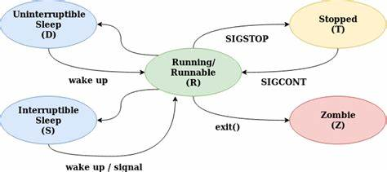
process cycle

Slide 43
type of sleep process
Interruptible: process wating for I/O operation to complete such reading or writing to a file.the process be woken up by a signal or event.
Uninterruptible: process waiting for some hardware resource availbe
Such as disk and network and cannot woken by signal

Slide 44
zombie
If a process has ended but its parent process hasn’t acknowledged the termination signal because it’s sleeping, the process is considered a zombie.
limbo: state between running and terminating until the parent process acknowledges the termination signal.
Kill -9 kill process immediately and don’t allow end task
Kill -15 terminate and allow to process to end task

Slide 45
top
top better used htop
This command used for monitoring process used memory,cpu……
load average in 1minute 5minute 15minute
if cpu core < load average means system is not good situation
Uptime :means how much time server is up
watch each 2s show
free –h show how much memory used in server

Slide 46
foreground and background
Some process take long time for example
Dump from mysql databases
Solution is bg (background)
Jobs : This utility allows you to see any processes that belong to you that are running in background mode

Slide 47
foreground and background
fg(foreground) fg %number of job take job from bg to fg
jobs –ls + top priority
ctrl+c --→cancel ctrl+z→stopped
bg % number of job take job from fg to bg
nohup & continue process although shell exit
Kill %number of job Stopping a background job with the kill
Kill send signal to process

Slide 48
kill
Kill send signal to process
Kill -9 forcefully kill process kill without number by default 15
Kill -15 normal terminatetion request
Hup 1 give information to process that process controlling you terminated
Killall pkill sh menas kill for example each process contains sh kill

Slide 49
screen
Screen better than nohup manage process
Screen –ls list of process in screen
ctrl + a d detach ctrl+A | split page ctrl+A \ delete
Screen –r reattach ctrl+A tab and c (create)

Slide 50
kernel space vs user space
Kernel space is strictly reserved for running a privileged operating system kernel, kernel extensions, and most device drivers. In contrast, user space is the memory area where application software and some drivers execute

Slide 51
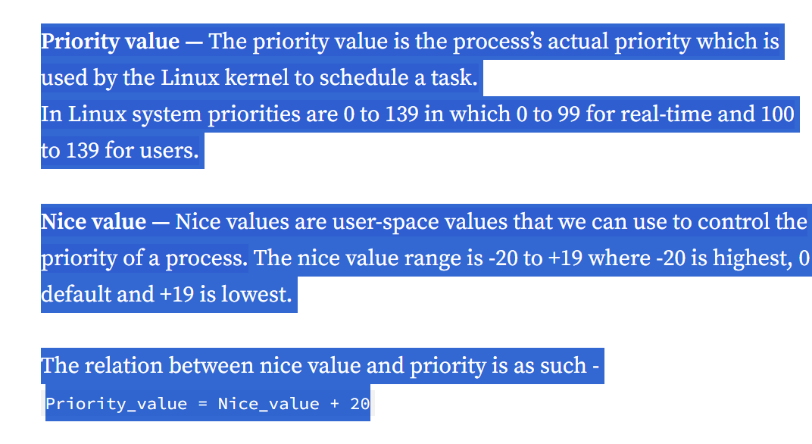
pri vs nice

Slide 52
managing process priority
The scheduling priority for a process determines when it obtains CPU time and
memory resources in comparison to other processes that operate at a different
priority. However, you may run some applications that need either a higher or lower level
of priority.
nice nice –n number command
number between -20 until 19 The lower the number, the higher priority the process receives. The default niceness level is zero
nice command default 10 ps –l show nice
renice for changing priority renice –n number –p (process id)

Slide 53
configuring hardware
Firmware: means when you now typing in keyboard connect with os to write letter on screen.
Old firmware (bios)
New firmware (unified extensible firmware interface)UEFI
PCI: peripheral component interface (location for any card on motherboard) scsi (parallel up to 8) sata(serial up to 4) pata(very old)

Slide 54
sysfs and udev
as like as filesystem or pseudo that exist information about kernel such as subsystem,module,bus,devices…… /sys
/dev as device manager for the linux kernel.
Sda ____>means first hard disk sda1-→ means first partition of first hard disk sda3--→ means third partition of first hard
dbus is a message bus system.is a simple way that application talk to another application

Slide 55
hardware
Information about process for kernel as pseudo file system.
lspci
lsdev lsmod
rmmod modinfo
insmode insert module that because give full path not used instead modprobe
Exapmle for module rmmod ilwifi disconnect an after that modprobe ilwifi
lsusb
lsblk
Module as Driver in linux by default 90% load with kernel

Slide 56
0 until 100 linux boot
1. the bios(input output) firmware(is software that provides basic machine instruction that allow the hardware to communicate with other software running on a device) performs a power-on-self and initilaies the hardware
2.the firmware loads the boot loader,such as GRUB,from boot device
3.the boot loader displayes a menu of available operating systems or kernel to boot
4.the boot loader reads the kernel and initial RAM disk(initrd) from the boot device and load them into memory
5.the kernel initialize the hardware and loads necessary drives.

Slide 57
0 until 100 linux boot
6.the kernel starts the init process which is responsible for starting user-space processes and system services.the init process starts other processes and services such as the display manager and login manager,which allow the user to interact with the system.
7.Once the user is logged in,they can interact with system and run applications.
Summary:1-power on 2-post(power on self test (baby) 3-bios or uefi 4-kernel 5-system(init)

Slide 58
mbr vs esp
Mbr(master boot record):
The MBR is the first sector on the first hard drive partition on the system. There is only one MBR for the computer system.
instead of relying on a single boot sector on a hard drive to hold the boot loader program, UEFI specifies a special disk partition, called the EFI System Partition (ESP), to store boot loader programs. This allows for any size of boot loader program, plus the ability to store multiple boot loader programs for multiple operating systems.

Slide 59
device files
Character device files: Transfer data one character at a time. This method is often used for serial devices such as terminals and USB devices.
usb1=12mbps usb2=480mbps usb3=20Gbps
Block device files: Transfer data in large blocks of data. This method is often used for high-speed data transfer devices such as hard drives and network cards.

Slide 60
hardware
Partition:A partition is a self-contained section within the drive that the operating system treats as a separate storage space. Partitioning drives can help you better organize your data
Sector=512Byte
In bios mbr this method supports only up to four primary partitions on a drive. Each primary partition itself, however, can be split into multiple extended partitions. Systems that use the UEFI boot loader method use the more advanced GUID Partition Table (GPT) method for managing partitions, which supports up to 128 partitions on a drive

Slide 61
structure hard
Hard is blue
Partition is green
Sector is orange
Bootloadr in linux is grub
hard
partition
sector

Slide 62
fdisk
fdisk : fdisk program allows you to create, view, delete, and modify partitions on any drive that uses the MBR method of indexing partitions.
m show the menu to choose action
d delete partition that create
w write partiotin on disk be carfull before this action data in memory and don’t save

Slide 63
fdisk
t Change a partition’s system ID and L show type of file system for example 8e is lvm
q quit without saving
n add a new partition
p displays the current partition scheme on the drive

Slide 64
important
For scan hard don’t reboot system just use from below
echo “- - -” > /sys/class/scsi_host/host0/scan
Primary vs extend----→ bootloader in primary disk
Max partition 4

Slide 65
gdisk
If you’re working with drives that use the GPT indexing method, you’ll need to use the gdisk program:
Fdisk <=2TB
Fat32 vs ntfs support in linux but not used more
Ntfs one file >4G in fat32<=4G

Slide 66
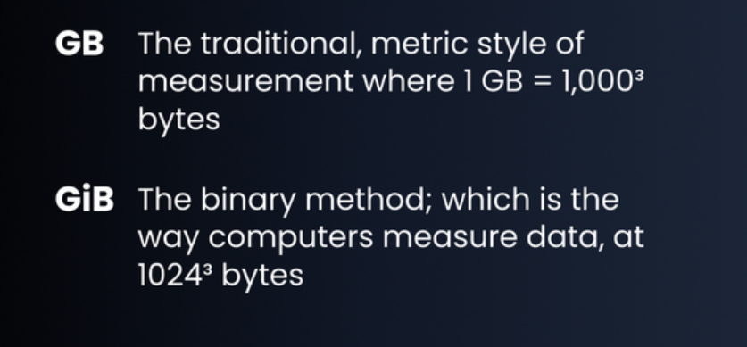
GiB vs GB
That means one GB equals 0.93 GiB

Slide 67
type of filesystem
before you can assign a drive partition to a mount point in the virtual directory, you must format it using a filesystem. There are numerous filesystem types that Linux supports, each with different features and capabilities.
linux supports filesystems of other operating systems
1:Linux file system
Ext3*----→ one file =<2TiB total filesystem=16TiB journaling support
Ext4*-----→ one file=<16TiB total filesystem=1EiB journaling support better performance
Btrfs
swap ----→ in first unix idea /swap paging ability for example 4gb ram and one
App need ram we can use 2gb from storage temporary to prevent crash amout swap *2ram <=8gb in ssd better ram+2gb

Slide 68
partitioning in productio
/boot 100mg until 1gb
/home 100gb
/var 150gb
/swap ? Swap is virtual memory or paging for better performance

Slide 69
type of filesystem
filesystem provides journaling, which is a method of tracking data not yet written to the drive in a log file, called the journal. If the system fails before the data can be written to the drive, the journal data can be recovered and stored upon the next system boot.
Example huge bank transaction
2:non linux file system
NTFS
XFS * one file=<16TiB total file system=<16TiB journaling support
Higher perforamance

Slide 70
creating file system
mkfs
for changing format or overwriting mkfs -f
Mount: when creating partition and formatting now assign real or virtual directory that store and write data on partition this progress as
said mounting for example mkdir /cando and
mount /dev/sb2 /cando this process in windows as same as assign letter to partition such as c d e mount point assign partition to file

Slide 71
monut
mount show list of whole of mount point in linux
In linux maybe / mount to /dev/sda1 but /cando mount to /dev/sb1
df -h show whole of partition and mount point and how much used and available if you show with type filesystem df -hT

Slide 72
umount and fsck
umount remove assign partition to directory but don’t affect to data that exist in directory means don’t remove data just we change
fsck.ext4 repair partition if corrupt
Xfs_reapir just for xfs filesystem

Slide 73
inode(index node)
t is important to know that Linux treats every object as a file
Metadata such as modified file and permission and owner and size …
ls –ali
df -ih
metadata file FILE

Slide 74
soft link vs hard link
The inode is the location of information about a file, and the location of the file is specified with the inode number. The file system is a very large collection of inodes.
There are two types of links. One is a symbolic link, which is also called a soft link. The other is a hard link.
Hard link:A hard link is a file or directory that has one index (inode) number but at least two different filenames. Having a single inode number means that it is a single data file on the filesystem. Having two or more names means the file can be accessed in multiple ways

Slide 75
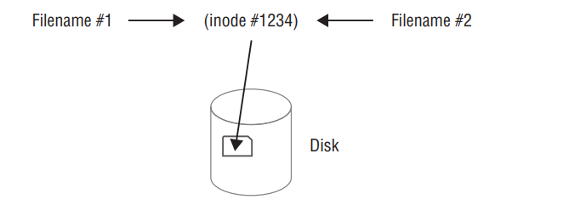
hard link vs soft link
This is often used in file backups where not enough filesystem space exists to back up the file’s data. If someone deletes one of the file’s names, you still have another filename that links to its data
To create a hard link, use the ln command. For hard links, the original file must exist prior to issuing the ln command. The linked file must not exist; it is created when the command is issued

Slide 76
hard link vs soft link
When you create and use hard links, there are a few important items to remember
: ■ The original file must exist before you issue the ln command.
■ The second filename listed in the ln command must not exist prior to issuing the command.
■ An original file and its hard links share the same inode number.
■ An original file and its hard links share the same data.
■ An original file and any of its hard links can exist in different directories.
■ An original file and its hard links must exist on the same filesystem

Slide 77
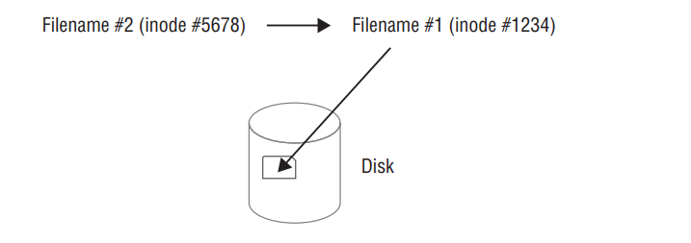
hard link vs soft link
Typically, a soft link file provides a pointer to a file that may reside on another filesystem. The two files do not share inode numbers because they do not point to the same data.
ln –s
Similar to a hard link, the original file must exist prior to issuing the ln -s command. The soft-linked file must not exist.

Slide 78
hard link vs soft link
When creating and using soft links, keep in mind a few important items:
■ The original file must exist before you issue the ln -s command.
■ The second filename listed in the ln -s command must not exist prior to issuing the command.
■ An original file and its soft links do not share the same inode number.
■ An original file and its soft links do not share the same data.
■ An original file and any of its soft links can exist in different directories.
■ An original file and its soft links can exist in different filesystems
The readlink utility will display the final file’s name and directory location.

Slide 79
fstab
For permanent storage devices, Linux maintains the /etc/fstab file to indicate which drive devices should be mounted to the virtual directory at boot time. The /etc/fstab file is a table that indicates the drive device fle (either the raw file or one of its permanent udev fi lenames), the mount point location, the filesystem type, and any additional options required to mount the drive
filesystem mountpoint type options dump pass
/dev/hdb1 /home ext2 defaults 1 0

Slide 80
fstab
Part 4: by default auto means when os boot mount automatically done if you don’t want put noauto.nouser by default means nobody mount file just root if you want other user mount put user .
Ro/Rw in part for bydefault ro means read-only about user but if you other user read and write put rw
Part5:dump tools for backup from filesystem bydeafult 0 but if you want get backup put 1
Part6:fsck for repair filesystem and check health of fs by default o but if you want check put 1

Slide 81
fstab
The first partition is mounted at the /boot/efi mount point in the virtual directory.
The second partition is mounted at the root ( / ) of the virtual directory
The third partition is mounted as a swap area for virtual memory. You can manually add devices to the /etc/fstab fi le so that they are mounted automatically when the Linux system boots.
However, if they don’t exist at boot time, that will generate a boot error

Slide 82
Type file
Directory
Normal file
Link == shortcut in windows
soft link
hard link

Slide 83
compressing file
gzip:
file compression rates of 60–70 percent, gzip has long been a popular data compression utility. To compress a file, type gzip followed by the file’s name. The original file is replaced by a compressed version with a .gz file extension. To reverse the operation, type gunzip followed by the compressed file’s name
Bzip2:
bzip2 utility offers higher compression rates than gzip but takes slightly longer to perform the data compression. The bzip2 utility employs multiple layers of compression techniques and algorithms. Until 2013, this data compression utility was used to compress the Linux kernel for distribution. To compress a file, type bzip2 followed by the file’s name. The original file is replaced by a compressed version with a .bz2 file extension. To reverse the operation, type bunzip2 followed by the compressed file’s name, which decompresses (defl ates) the data
xz:It boasts a higher default compression rate than bzip2
Zip The zip utility is different from the other data compression utilities in that it operates on multiple files. If you have ever created a zip file on a Windows operating system, then you’ve used this file format. Multiple files are packed together in a single file, often called a folder or an archive file, and then compressed. Another difference from the other Linux compression utilities is that zip does not replace the original file(s). Instead, it places a copy of the file(s) into an archive file

Slide 84
compare compressing file
cp /var/log/yum.log test
Cp test test1 test2 test3 test4
Extract gz gunzip
Extract bz2 bunzip
Extact zip unzip yum install unzip
xz –d example.xz

Slide 85
tar
tar as same as archive
tar -cf iman.tar /etc/postfix/ create
tar -tf iman.tar list
tar –xf iman.tar –C /home for creating in other directory and extract
tar –czvf file.tar.gz create tar.gz file for archive and compress together
tar –xzvf file.tar.gz for extract file

Slide 86
dd
It is often used in digital forensics for creating system images, copying damaged disks, and wiping partitions
Wiping delete data although diffrenet formatting
dd if=/dev/sdb1 of=/dev/null for wiping full

Slide 87
permissions
Create user adduser or useradd
su username (switch) su – switch root if have root password
userdel if you are root or have permission as same as root
visudo give root permission to other users
sudo when your user permit to any location
passwd set password
Sudo -i when you set user in visudo you can permit to root user

Slide 88
Managing File Ownership
The core security feature of Linux is file and directory permissions. Linux accomplishes that by assigning each file and directory an owner, and allowing that owner to set the basic security settings to control access to the file or directory.
Assessing File Ownership Linux uses a three-tiered approach to protecting files and directories:

Slide 89
permissions
Owner: Within the Linux system, each file and directory is assigned to a single owner.
Group: The Linux system also assigns each file and directory to a single group of users. The administrator can assign that group specific privileges to the file or directory that differ from the owner privileges. Others: This category of permissions is assigned accounts that are neither the file owner nor in the assigned user group.
For changing ownership use chown for recursively permission use -R

Slide 90
permissions
Changing group use chgrp pay attention for change owner and group you must have root or super user permission newgrp for changing
Default group
If you have super user privileges, the chown command allows you to change both the owner and group assigned to a file or directory at the same time using the format.
chown NEWOWNER:NEWGROUP FILENAMES

Slide 91
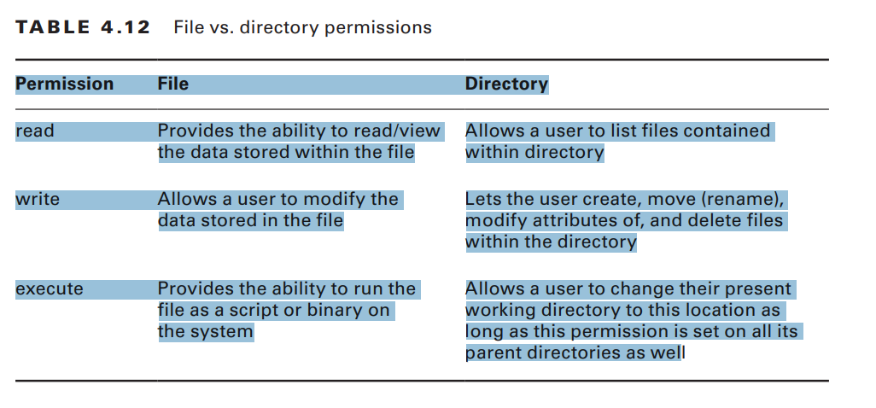
permissions
r= read w =write x=execute
r=4 + w=2 + x=1----→7

Slide 92
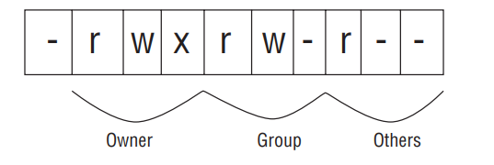
permissions and type of file
- The file is a binary file, a readable file (such as a text file), an image file, or a compressed file. d The file is a directory.
l The file is a symbolic (soft) link to another file or directory.
p The file is a named pipe or regular pipe used for communication between two or more processes.
s The file is a socket file, which operates similar to a pipe but allows more styles of communication, such as bidirectional or over a network.
b The file is a block device, such as a disk drive.
c The file is a character device, such as a point-of-sale device.

Slide 93
permissions
u owner g group o others a all tiers
+ for add - for remove execute in directory means enter to dir
chmod g-w chmod for change file’s mode g-w means remove write permissions from group
Chmod –aG sudo user
0 --- no permissions
--x execute only 1
-w- write only 2
-wx write and execute -----------------→ chmod 777 file it means user and group and other have full permissions that it is very dangerous based on security 775 and 660 are used very much
4 r-- read only
5 r-x read and execute
6 rw- read and write
7 rwx read, write, and execute

Slide 94
Setting the Default Mode
When a user creates a new file or directory, the Linux system assigns it a default owner, group, and permissions. The default owner, as expected, is the user who created the file. The default group is the owner’s primary group.
Umask means umask change the default permissions for all newly files or folders umask default 0002
Formual 666 -002-→664
Chmod set permissions for files and folders that already exist

Slide 95
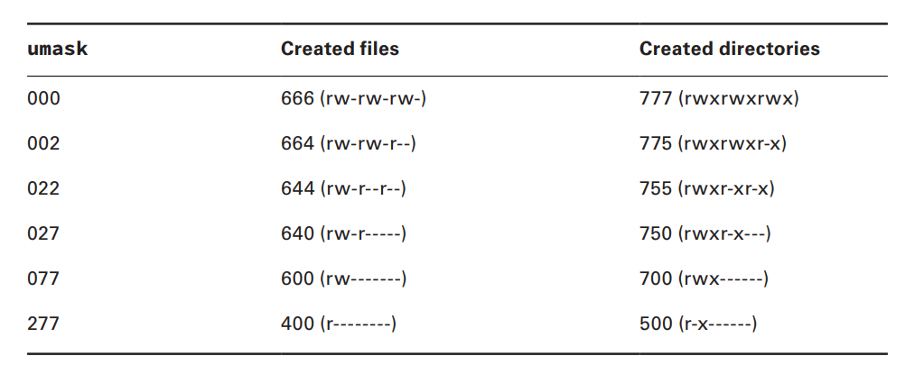
umask

Slide 96
Changing Special AccesModes
Uid or user identifier
Uid root=0 uid user of system:1 until 499
Uid 65534 don’t reserve just for anonymous user
id show the uid guid groups show list of groups
gid vs group group id is a unique identifier assig to group and internally by os .
Cat /etc/passwd show user id group password is hidden and show home directory
Suid /etc/shadow when each file suid enable means rws execute with user that set not user execute /etc/group show list of groups
t stickybit when you don’t allow delete file although have permissions just owner can

Slide 97
Configuring User Accounts
/etc/login.defs File: The /etc/login.defs configuration file is typically installed by default on most Linux distributions. It contains directives for use in various shadow password suite commands. Shadow password suite is an umbrella term for commands dealing with account credentials, such as the useradd,userdel,passwd
Control ssh password length, how long until the user is required to change the account’s password, whether or not a home directory is created by default, and so on. The file is typically filled with comments and commented-out directives
/etc/default/useradd

Slide 98
Configuring User Accounts
/etc/skel files are copied to user account home directories only when the account is created. Such as bashrc and bash_profile
Account information is stored in the /etc/passwd file. Each account’s data occupies a single line in the file. When an account is created, a new record for that account is added to the /etc/passwd file.
1 User account’s username.
2 Password field. Typically this file is no longer used to store passwords. passwords are stored in the /etc/shadow file

Slide 99
Configuring User Accounts
3 User account’s user identification number (UID).
4 User account’s group identification number (GID).
5 Comment field. This field is optional. Traditionally it contains the user’s full name.
6 User account’s home directory.
7 User account’s default shell. If set to /sbin/nologin or /bin/false , then the user cannot interactively log into the system.

Slide 100
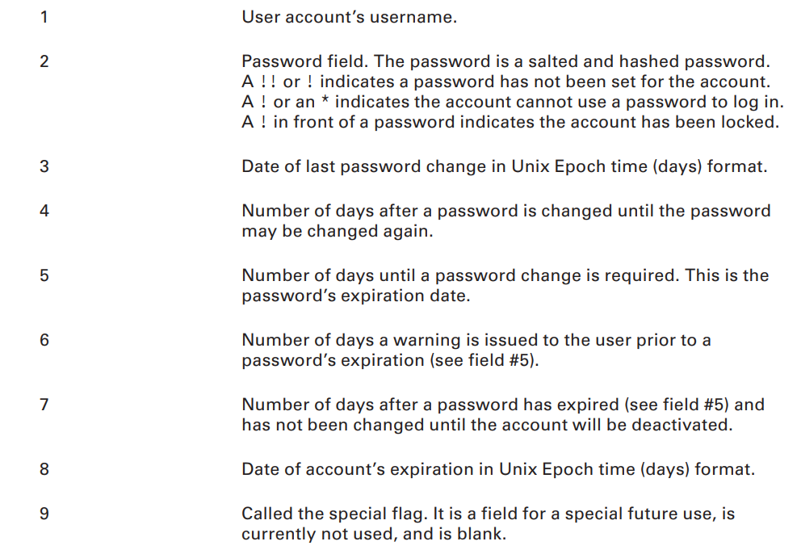
Configuring User Accounts
/etc/shadow File
Using getent to view a user account
getent shadow root
chage -l root

Slide 101
dmseg and journalctl
dmesg tools in unix that prints the message buffer of the kernel.
Journalctl other command to display the kernel ring buffer’s contents
for show boot’s log this path in /var/log
grub.cfg or menu.list in linux for config boot menus in rhel grub.conf
Menus.list in debian

Slide 102
boot
The boot loader program isn’t required to point directly to an operating system kernel file—it can point to any type of program, including another boot loader program. You can create a primary boot loader program that points to a secondary boot loader program, which provides options to load multiple operating systems. This process is called chainloading.
Boot in uefi On Linux systems, the ESP is typically mounted in the /boot/efi/ directory, and the boot loader fi les are commonly stored using the .efi fi lename extension.

Slide 103
boot
If you’re not sure whether your system is using UEFI, you can easily check. After the Linux system boots, issue the command ls /sys/firmware/efi. If you receive a no such file or directory message, then you’re employing BIOS. On the other hand, if you see files, then your system booted using UEFI.
Color
Default
Fallback
Splashimage
timeout

Slide 104
boot
grub-install /dev/sda install grub
grub-install '(hd0)’ means first hard -v show version grub
grub-install 'hd(0,0)’ that used for chainloading and install a copy of GRUB Legacy on the boot sector of a partition instead of to the MBR of a hard drive, you must specify the partition, again using either the Linux or the GRUB format.

Slide 105
boot
grub vs grub2
the legacy version of Grub requires that its config files are manually created, the config files for Grub2 are created automatically by a scripting process
grub2-mkconfig > /boot/grub2/grub.cfg
you don’t need to install GRUB2. All you need to do is to rebuild the main installation file. This is done by running either the grub-mkconfi g or grub2-mkconfi g program. They are essentially equivalent programs but may not both be installed on your system.

Slide 106
Using Alternative Boot Loaders
EXTLINUX: A mini-boot loader for booting from an ext2, ext3, ext4
ISOLINUX: A boot loader for booting from a LiveCD or LiveDVD
PXELINUX: A boot loader for booting from a network server
MEMDISK: A utility for booting older DOS operating systems from the other SYSLINUX project boot loaders

Slide 107
Initialization Process
After your Linux system has traversed the boot process, it enters final system initialization, where it needs to start various services. A service, or daemon, is a program that performs a particular duty.
The initialization daemon ( init ) determines which services are started and in what order. This daemon also allows you to stop and manage the various system services. There are two initialization daemons with which you should be familiar
SysVinit The SysVinit (SysV) was based on the Unix System V initialization daemon. Though it is not used by many major Linux distributions anymore, you still may fi nd it lurking around that older Linux server at your company

Slide 108
Initialization Process
systemd The systemd initialization method is the new kid on the block. Started around 2010, it is now the most popular system service initialization and management mechanism. This daemon reduces initialization time by starting services in a parallel manner.
which init finding init location
utilize the readlink -f command to see if the program is linked to another program
readlink -f /sbin/init pstree -p

Slide 109
unit
A unit is a systemd object that performs or controls a particular task or action. Systemd uses units to start/stop/manage services, organize boot process, maintain tasks and processes, create sockets, mount file-system and initialize hardware. A systemd unit consists of a name, type, and configuration file.

Slide 110
systemctl
The systemctl utility is the main gateway to managing systemd and system services.
/etc/systemd/system.conf
1./etc/system/system/ 2. /run/systemd/system/ 3./usr/lib/systemd/system/ show conf all of service that manage with systemd
init in old distru as like as systemd /etc/init.d/ssh restart

Slide 111
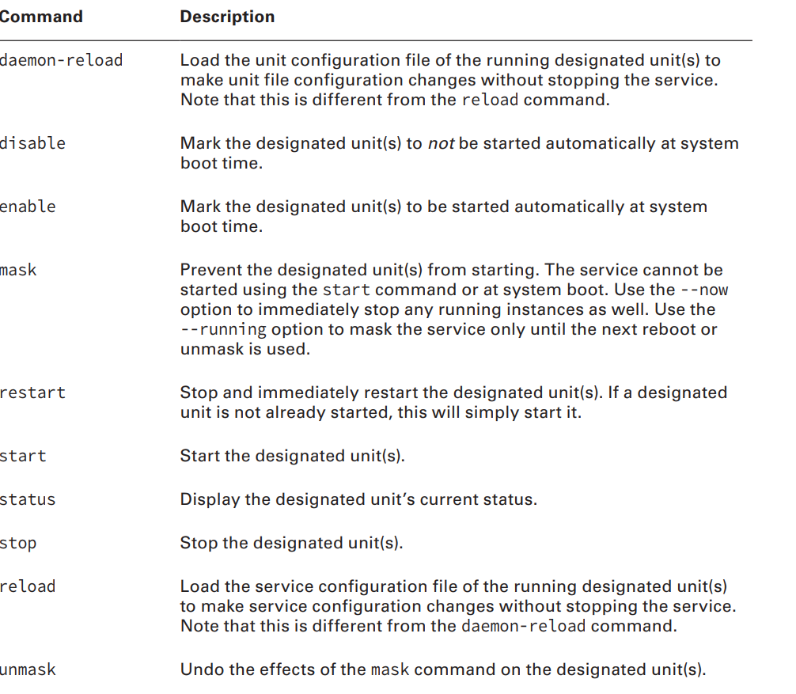
systemctl

Slide 112
systemd unit
After Sets this unit to start after the designated units.
Before Sets this unit to start before the designated units.
Description Describes the unit.
Documentation Sets a list of uniform resource identifiers (URIs) that point to documentation sources. The URIs can be web locations, system files, info pages, and man pages
Conflicts Sets this unit to not start with the designated units. If any of the designated units start, this unit is not started. (Opposite of Requires.

Slide 113
Unit systemd
Requires Sets this unit to start together with the designated units. If any of the designated units do not start, this unit is not started. (Opposite of Conflicts .)
Wants Sets this unit to start together with the designated units. If any of the designated units do not start, this unit is still started

Slide 114
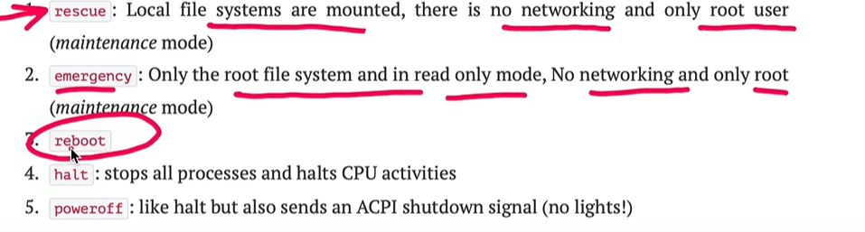
default targetmuti user graphical
Systemctl isolate rescue
systemctl list-units --type=target
systemctl cat multi-user.target

Slide 115
Understanding Runlevels
At system boot time, instead of targets to determine what groups of services to start, SysVinit uses runlevels
0 Shut down the system.
1, s, or S Single-user mode used for system maintenance. (Similar to systemd rescue target.)
2 Multi-user mode without networking services enabled.
3 Multi-user mode with networking services enabled.
4 Custom.
5 Multi-user mode with GUI available.
6 Reboot the system.
/etc/inittab file line that sets the default runlevel Command runlevel
Init for jumping runlevel rc6----→init 6

Slide 116
Stopping the System
Besides the various SysVinit and systemd commands you can use to shut down or reboot a system, there are a few additional utilities you can employ to enact these tasks no matter what system initialization your system uses:
■ halt : Stops all processes and shuts down the CPU.
■ poweroff : Stops all processes, shuts down the CPU, and sends signals to the hardware to power down.
■ reboot : Stops all processes, shuts down the CPU, and then restarts the system
■ shutdown : Stops all processes, shuts down the CPU, and sends signals to the hardware to power down.

Slide 117
upgrade kernel
1-step one uname –a
2- apt update
3- sudo rpm --import https://www.elrepo.org/RPM-GPG-KEY-elrepo.org
4- rpm -Uvh https://www.elrepo.org/elrepo-release-7.0-3.el7.elrepo.noarch.rpm
5- yum list available --disablerepo='*' --enablerepo=elrepo-kernel
6-yum --enablerepo=elrepo-kernel install kernel-lt
7-reboot

Slide 118
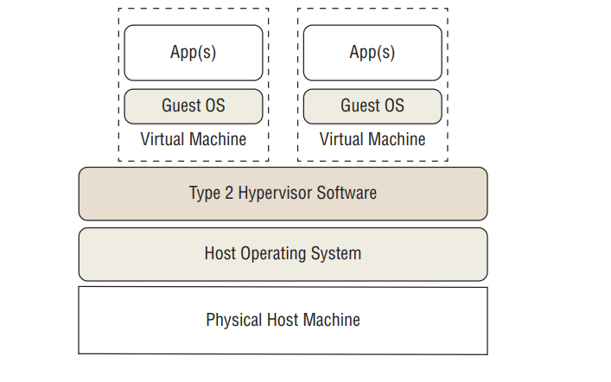
virtualization
Virtual machines (VMs) are simulated computer systems that appear and act as physical machines to their users. The process of creating these virtual machines is called virtualization .

Slide 119
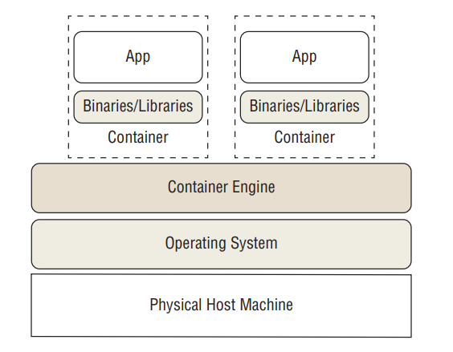
Understanding Containers
Containers are virtual entities, but they are different from virtual machines and serve distinct purposes. Whereas a VM provides an entire guest operating system, a container’s focus is typically on a single app, application stack, or environment. Instead of a hypervisor, a container is managed by a container engine.

Slide 120
Setting the Time and Date
Timedatectl DST daylight saving time
timedatectl set-time "2023-08-02 06:15:00“
Disable ntp timedatectl set-ntp false
Hwclock -s h to s -w s to h hardware clock in cmos battery
Date software clock

Slide 121
ntp server
Atomic clock stratum0
Stratum1 directly connect to stratum0
Stratum 15 read time from stratum 14
ntppool.org yum install ntp /etc/ntp.conf ntpstat
ntpq -p 123 port udp

Slide 122
cups
Fortunately, the Common Unix Printing System (CUPS) solves many of those problems for us. CUPS provides a common interface for working with any type of printer on your Linux system. It accepts print jobs using the PostScript document format and sends them to printers using a print queue system.
/etc/cups lpr -P EPSON_ET_3750_Series file.txt
cupsctl --remote-admin --remote-any --share-printers
The CUPS web interface allows you to define new printers, modify existing printers, and check on the status of print jobs sent to each printer. Not only does CUPS recognize directly connected printers, but you can also configure network printers using several standard network printing protocols, such as the Internet Printing Protocol (IPP) or the Microsoft Server Message Block (SMB) protocol

Slide 123
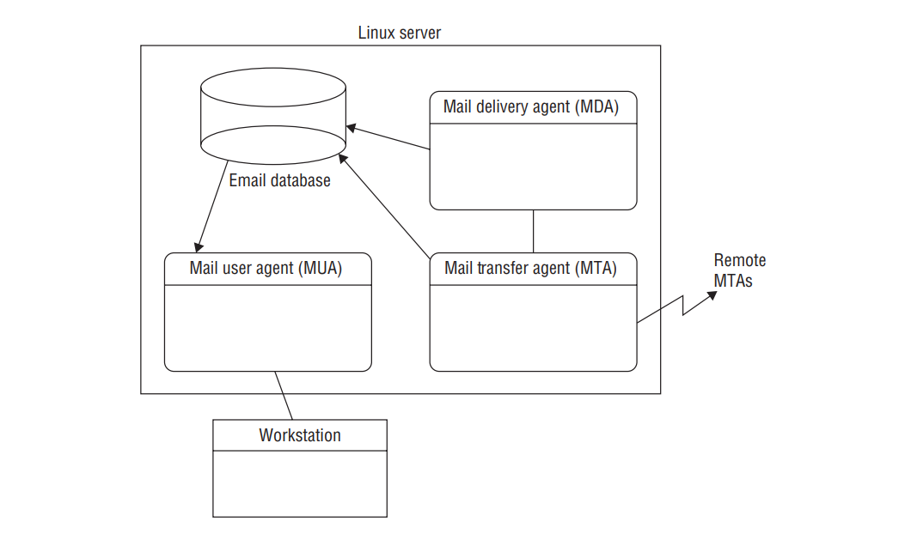
Managing Email
The mail transfer agent (MTA) sends incoming emails (and outgoing emails being delivered locally) to a mail delivery agent (MDA) or local user’s inbox. For outbound messages being transferred to a remote system, the agent establishes a communication link with another MTA program on the remote host to transfer the email.
■ The mail delivery agent (MDA) is a program that delivers messages to a local user’s inbox.
■ The mail user agent (MUA) is an interface for users to read messages stored in their mailboxes. MUAs do not receive messages; they only display messages that are already in the user’s mailbox. The lines between these three functions are often fuzzy. Some Linux email packages combine functionality for the MTA and MDA functions, whereas others combine the MDA and MUA functions

Slide 124
choosing email software
Sendmail
Postfix
Exim

Slide 125
mail
Using mail to send an email message
/var/spool/mail/
Using mailq and sendmail -bp to view the local email queue
mail -s "Test of Mail Queue" aghamohammadiiman@gmail.com if you have mail server

Slide 126
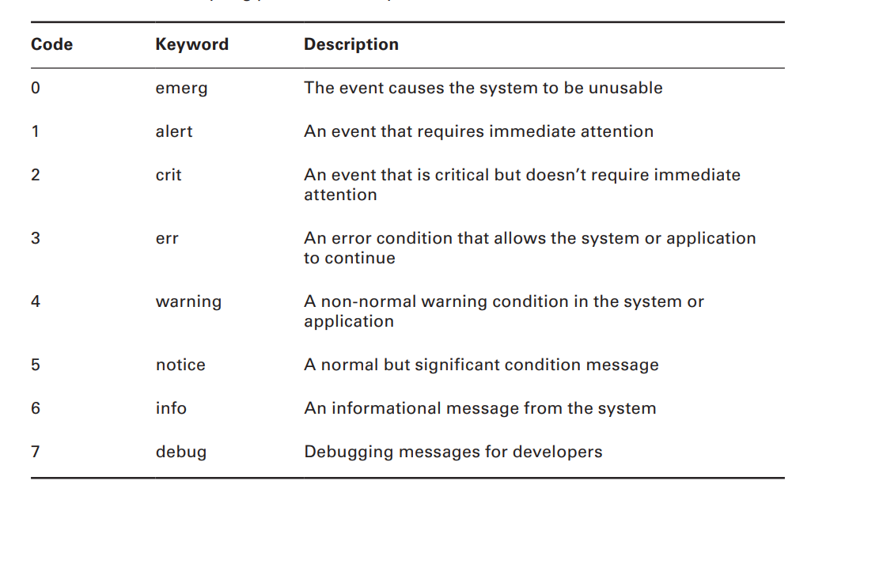
Using Log and Journal Files
Lots of things happen on a Linux system while it’s running. Part of your job as a Linux administrator is to know everything that is happening and to watch for when things go wrong
examining the syslog Protocol
Severity log

Slide 127
syslog
In the mid-1980s Eric Allman defined a protocol for logging events from his Sendmail mail application called syslog. The syslog protocol quickly became a de facto standard for logging both system and application events in Unix, and it made its way to the Linux world.
Syslog facility value user kernel cups mail auth cron(task schedular) Deamon(app run in background)

Slide 128
type of logging tools
■ syslogd-ng: Added advanced features, such as message filtering and the ability to send messages to remote hosts.
■ rsyslog: The project claims the “r” stands for “rocket fast.” Speed is the focus of the rsyslog project, and the rsyslogd application has quickly become the standard logging package for many Linux distributions.
■ systemd-journald: Part of the systemd application for system startup and initialization (see Chapter 5), many Linux distributions are now using this for logging. It does not follow the syslog protocol but instead uses a completely different way of reporting and storing system and application events.

Slide 129
rsyslog
/etc/rsyslog.conf facility.severity
/var/log/messages don’t store log about cron,mail and auth
/var/log/secure log about authentication for example false password
remote-host
Logrotate policy for how much time log exist /etc/logrotate.d/
/etc/logrotate.conf logger create log in messages show

Slide 130
networking
Type ----→ ethernet serial wl ip a ip r s ifup ens160
ifdown ens160
dhclient get ip from dhcp
netstat -ntpln -tuna ss –ntpln yum install bind-utils for dns tools
yum install net-tools network tools
telnet tracroute
ip route show routing in linux /etc/hosts for recognize machine in linux
ip route add 8.8.8.8/32 via 192.168.60.254 dev ens160
ip route del 8.8.8.8/32 via 192.168.60.254 dev ens160
Hostname show hostname dig for showing dns record
Scp for transfer data scp file.txt root@192.168.60.154:/home user@ip:/path
Hostnamectl set-hostname name
ETHERNET WL
BOOTPROTO----→ dhcp static none
Defaultroute------→ gateway
Onboot-----→ autho start yes nslookup
Ifdown ens160 ; ifup ens160 ip route ip neighbor /etc/resolv.conf for setting dns

Slide 131
install graphical
1-yum update
2-yum grouplist
3-yum groupinstall “GNOME Desktop” “Grapical Administration Tools”
4-

Slide 132
bash script
Env local and global
Global with export in current session and all bash and permanent in .bash_profile means all session and bash for specefice user
Profile.d
date;who echo $PATH
In bash script you should global env

Slide 133
bash script
aliases: A command alias allows you to create an alias name for common commands
(along with their parameters) to help keep your typing to a minimum
alias -p active alises in linux
alias mk=‘mkdir’ for create unalise for deleting
Command aliases act like local environment variables. They’re valid only for the shell

Slide 134
basic bash
first line in the file must specify the Linux shell required to run the script.
The Linux world calls the combination of the pound sign and the exclamation symbol
( #! ) the shebang . It signals to the operating system which shell to use to run the shell script
Lines that start with # means comment and don’t affect in script

Slide 135
bash basic
cat test3.sh
#!/bin/bash
# testing variables
days=10
guest=Katie
echo $guest checked in $days days ago

Slide 136
argument
One of the most versatile features of shell scripts is the ability to pass data into the script
when you run it. This allows you to customize the script with new data each time you run it
cat test4.sh
#!/bin/bash
# Testing command line arguments
echo $1 checked in $2 days ago in the $3
./test4.sh iman 10 afternoon

Slide 137
Basic Reading
cat test5.sh bmi
#!/bin/bash
echo -n "what is yor name? “ echo –p(prompt) “how old are you?” old
read name days=$[ old * 365 ]
echo "Hello $name, welcome to my program.“ echo "That makes you over
$days days old!“
In fact, the read command includes the -p option, which allows you to specify a prompt
directly in the read command line if don’t use env store in REPLY

Slide 138
Basic Reading
#!/bin/bash
read -p "what is your name?" first last
echo "checking data for $first and $last"

Slide 139
Advanced Shell Scripting
if in bash scripit : statement
if read -t 5 -p "Please enter your name: " name
Paas to ****
then
echo "Hello $name, welcome to my script"
else
echo "Sorry, too slow!"
fi

Slide 140
The Exit Status
Linux provides us with the special $? variable, which holds the exit status value from the last command that executed. To check the exit status of a command, you must view the $?
variable immediately after the command ends. It changes values according to the exit status
of the last command executed by the shell
Exit code 0 command successfully run
Exit code 127 command not found
Exit code 130 cancel by crt +c
Exit code 126 command don’t have permission
Exit code 148 terminate by ctrl +z

Slide 141
backticks ` this sign when we user command as env for example
var=`date` echo $var
$ (date) = `date`
Sample statement if
-lt less than -qe equal
-ge greater than or equal
-gt greater than -ne not equal

Slide 142
sample if
if [ $1 -eq $2 ]
then
echo "Both values are equal!"
exit
fi
if [ $1 -gt $2 ]
then
echo "The first value is greater than the second"
exit
fi
if [ $1 -lt $2 ]
then
echo "The first value is less than the second"
exit
fi

Slide 143
case variable in
pattern1) commands1;;
pattern2 | pattern3) commands2;;
*) default commands;;
esac
#!/bin/bash
case $USER in
root | iman)
echo "Welcome, $USER"
echo "Please enjoy your visit";;
*)
echo "Sorry, you're not allowed here";;
esac

Slide 144
Loops
When you’re writing scripts, you’ll often find yourself in a situation where it would come in handy to repeat the same commands multiple times, such as applying a command against all of the files in a directory. The Bash shell provides some basic looping commands to accommodate that.
for variable in series ; do
commands
done

Slide 145
for
for file in $(ls | sort) ; do -e means exist
if [ -d $file ] && and || or
then elif
echo "$file is a directory"
fi
if [ -f $file ]
then
echo "$file is a file"
fi
done

Slide 146
The while Loop
Another useful loop statement is the while command. This is its format:
while [ condition ] ; do
commands
Done
number=$1 factorial=1
while [ $number -gt 0 ] ; do
factorial=$[ $factorial * $number ]
number=$[ $number - 1 ]
done
echo The factorial of $1 is $factorial

Slide 147
Scheduling Regular Scripts
Using the at command to schedule a script to run at a preset time is great, but what if you need that script to run at the same time every day or once a week or once a month? Instead of having to continually submit at jobs, you can use another feature of the Linux system.
The Linux system uses the cron program to allow you to schedule jobs that need to run on a regular basis. The cron program runs in the background and checks special tables, called cron tables (also called crontab for short
min hour dayofmonth month dayofweek command
Crontab -l https://crontab.guru/ for setting time

