Slide 1
LPIC1

Slide 2
lpic
Lpic 101-500 lpic102-500
Chapter1: linux command line chapter6: sys admin
Chapter 2: managing software and process chapter7:network
Chapter3 : configure hardware chapter 8:script
Chapter 4: managing files chapter9:securing
Chapter 5: booting,initilizing

Slide 3
Linux history
Unix
Linux is kernel
Os release
Os=usermode(shell)+kernel+hardware
Shell login(interactive) vs no interactive
Kernel.org
Uname
https://upload.wikimedia.org/wikipedia/commons/1/1b/Linux_Distribution_Timeline.svg

Slide 4



Famous people in linux

Slide 5




Famous company
At&t bell labs
Debian
Redhat
Linux foundation

Slide 6

Famous universitiy
Berekly bsd os
MIT minix just for education (Andrew tanelban)

Slide 7



Fork concept
Debian (dpkg) 11
ubuntu(22.04 longterm support)
kali linux
Redhat (RHEL) rpm
oracle linux(Enterprise) means for commercial
suse (rpm)
suse(enterprise)
opensuse

Slide 8
Cli vs gui
Type of cli(bash,sh,zsh)
Bash default shell(bourne againe shell)
Sh (bourne shell) older than bash
Zsh (newer spelling correction) and many extension
Built-in support git
Gnome vs gnu ----------→ all packages in linux must be approved by gnu license gnome graphical env

Slide 9
bash
type of bash internal and external
global bash (export) vs local bash ali=m
Example cd and date
root@hostname~# username hostname current directory privilledge # superuser $normal user

Slide 10
Basic Command
ls used to list the files and directories in a directory
ls –l with long format
ls –lash
Cd change directory in linux . .. ~ cd ~=cd
Pwd print work directory
Some command don’t need – for switch for example ip a
history ! Show with number and content !! Last command
History history –d linenumber history –w (write) -c(delete all)

Slide 11
Command basic
echo ----------→ echo hello ---→ hello
echo $PATH /usr/bin
echo $SHELL
echo $BASH echo $SHLVL
Env enviroument variable means part of memory that create value in there.
In linux $PATH refer to env
printenv show local env in linux
set display active environment variables
which It searches through the PATH directories to find the program. If it locates the program, it displays its absolute directory reference

Slide 12
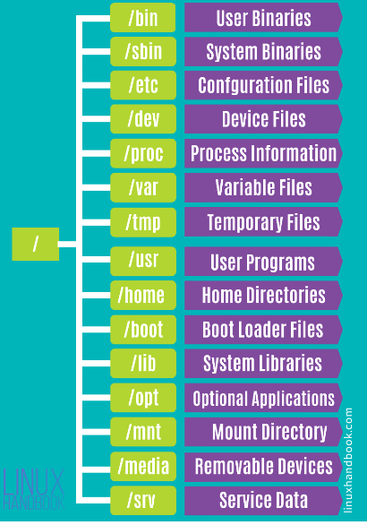
hierarchy in linux

Slide 13
Regular expression
&& \ for ignore what’s your name?
echo -e \\n and \\t
|| []
; “” know as string
*
?
!
^------------------→ begin with
$--------------→ env and end with

Slide 14
navigate
Relative
cd sysconfig
Obsolute
cd /etc/sysconfig

Slide 15

Editor file in linux
Vi vs vim
I begin line G end of file
i insert in file gg move to the first line
O open a new text above cursor
o open a new test below curser
w write touch for create file or text
q quite x
a insert text after
A insert text end of line ctrl v after c
u undo vi buffering
dd %s/a/b/
^ vs $ /
nano

Slide 16
Processing text edit
cat less and more
less better than more
sort -r -n tail
head
paste join file together side by side wc -l
cut –d “,” –f filenumber filename
split -l join file together side by side
uniq prevent repeat line tr translation character tr “” “ ,“

Slide 17
sed and tee and xargs
tee ls | tee files
Xargs execute stdout first command
ls | xargs echo ----→ echo ls
echo ali | xargs -I mamad echo my name is mamad
sed echo “ I like ice” | sed ‘s/icecream/water/’
s means substitute g means global sed -i -d delete
Using sed -e to use multiple scripts sed -e ‘/s/first/last/ ; sed –e /s/one/two’ filename

Slide 18
hashing in linux
md5sum
sha256sum

Slide 19
grep(important)
grep used for filtering and searching
Example grep ^root.*$bash /etc/passwd
grep –v (invert match) grep –v “error” txt.file means all lines don’t match
a specified pattern
fgrep –f (pattern search)
Egrep for complex regex ==grep -e

Slide 20
Usual comand
cat
mv
cp
/dev/null black hole &> (stderror and stdout)
Find find / -name “.txt” –type f or -type d

Slide 21
directory
mkdir
rmdir
rm –rf

Slide 22
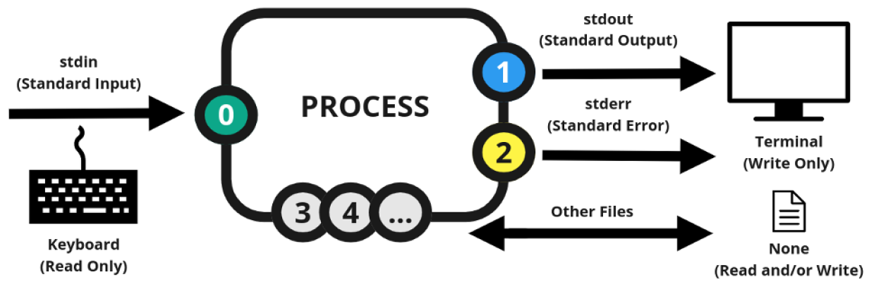
Standard input/output/error

Slide 23
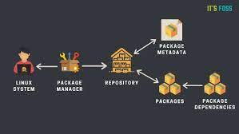
repository
A repository in linux is a location where software packages can be stored and accessed. These packages can be easily installed,updated and removed.
Type of repo: 1-local repo 2- remote server

Slide 24
■ Red Hat package management (RPM)
■ Debian package management (Apt)
Package means: Linux distributions have created a system for bundling already compiled applications for distribution. This bundle is called a package, and it consists of most of the files required to run a single application.

Slide 25
mechanism package database
■ Application files: The package database tracks each individual file as well as the folder where it’s located.
■ Library dependencies: The package database tracks what library files are required for each application and can warn you if a dependent library file is not present when you install a package.
■ Application version: The package database tracks version numbers of applications so that you know when an updated version of the application is available.

Slide 26
Package manager
yum install package-name (redhat base)
apt install package-name (Debian base)
zypper install package-name (opensuse)

Slide 27
important switch rpm
-e --erase Removes the specified package
-F --freshen Upgrades a package only if an earlier version already exists -R discovery requirement dependeny of package
-i --install Installs the specified package
-q --query Queries whether the specified package is installed
-U --upgrade Installs or upgrades the specified package
-V --verify Verifies whether the package files are present and the package’s integrity -v means verbose -h human readable

Slide 28
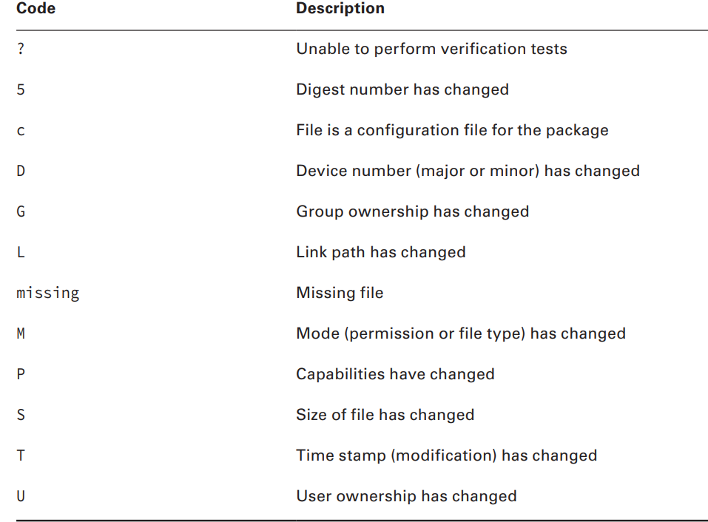
verify package code

Slide 29
Query switch
-qc show the path of config file -Rq show dependencies
-qi show detail information
-qa show just installed package
-lq list all things installed by package
whatprovide show for example /bin/bash with by package installed as the same –fq

Slide 30
cpio and rpm2cpio
Create a cpio archive from rpm package
rpm2cpio
Extracting from the cpio archive
cpio -idv ------------→ v usually means verbose d create subdirectories
i allows copy file from archive

Slide 31
source list
/etc/apt/source.list the list of source for apt
/etc/yum.repos.d/ the list of source for yum
/var/cache the cache of list and package

Slide 32
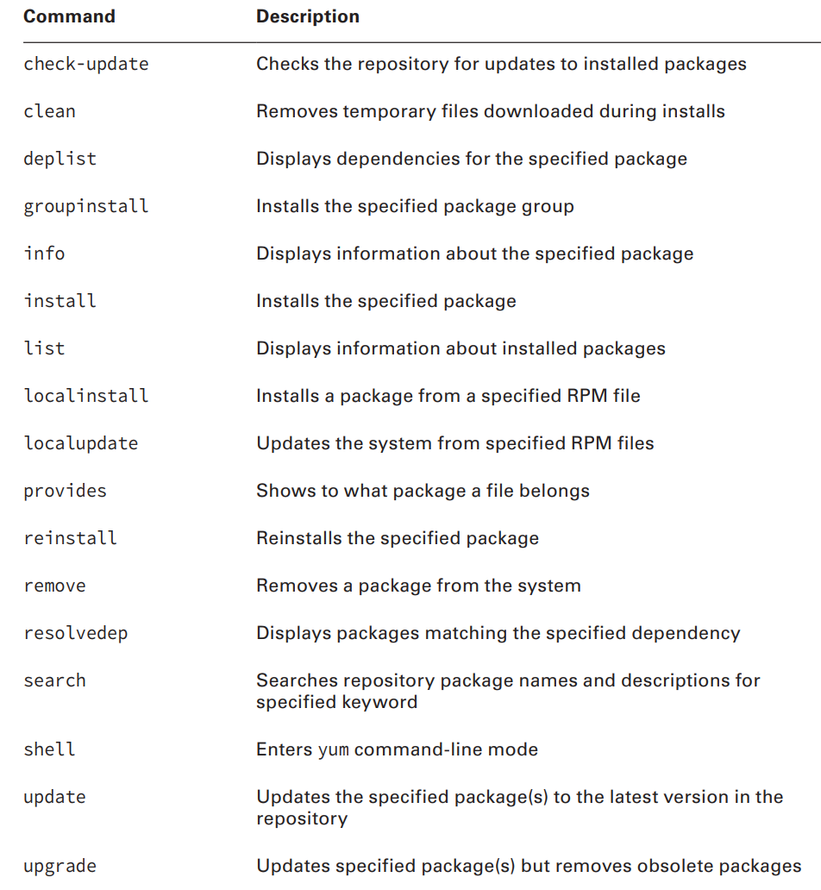
yum

Slide 33
apt
apt purge ____> remove package with config file that say remove from stump
apt vs apt-get apt is newer version of apt-get
apt-cache give usefull information such as dependency and packangename and search packagename match specified keword

Slide 34
same switch in yum and apt
remove just remove package but autoremove remove package with all dependencies
download just download deb package
install –download-only just download with dependencies but not install

Slide 35
library
A system library is a collection of items, such as program functions. Functions are selfcontained code modules that perform a specifi task within an application, such as opening and reading a data file
Type of library ______>1-static library 2-dynamic library(shared library) if work windows dll as the as shared library in linux
lib LIBRARYNAME .so. VERSION format shared library
/usr/lib show library for app /lib -→ show library bultin system

Slide 36
ad and disad
Static library is very huge executable file
If programmer update shared library and you update lib you can use new features of this library and security event deacrese
Static library loads and install very easier than shared library

Slide 37
command library
ldd show app use which libraries need
ldd /usr/sbin/ldconfig ---→ static link because cache shared library for system
ldconfig create ld.so.cache
/etc/ld.conf include /etc/ld.conf.d/*

Slide 38
managing process
What is process?
At any given time lots of active programs are running on the Linux system. Linux calls each running program a process . The Linux system assigns each process a process ID (PID) and manages how the process uses memory and CPU time based on that PID
init process? When linux system first boots it starts process that called init process that pid=1

Slide 39
process
ps viewing process in linux by this command
PID TTY TIME
CMD 1615 pts/0 00:00:00
bash 1765 pts/0 00:00:00
TTY:the terminal (TTY) that they were started from and time show how much time process used cpu

Slide 40
ps
ps -ef show every process in linux with uid
ps –aux as the as above command with more detail and outpout format
Uid means wich user responsible for this process
PID process id
PPID parent process id means this process started with other process
C: The processor utilization over the lifetime of the process
■ STIME: The system time when the process was started ■
■ TIME: The cumulative CPU time required to run the process
■ CMD: The name of the program that was started in the process

Slide 41
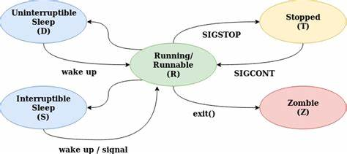
process cycle

Slide 42
type of sleep process
Interruptible: process wating for I/O operation to complete such reading or writing to a file.the process be woken up by a signal or event.
Uninterruptible: process waiting for some hardware resource availbe
Such as disk and network and cannot woken by signal

Slide 43
zombie
If a process has ended but its parent process hasn’t acknowledged the termination signal because it’s sleeping, the process is considered a zombie.
limbo: state between running and terminating until the parent process acknowledges the termination signal.
Kill -9 kill process immediately and don’t allow end task
Kill -15 terminate and allow to process to end task

Slide 44
top
top better used htop
This command used for monitoring process used memory,cpu……
load average in 1minute 5minute 15minute
if cpu core < load average means system is not good situation
Uptime :means how much time server is up
watch each 2s show
free –h show how much memory used in server

Slide 45
foreground and background
Some process take long time for example
Dump from mysql databases
Solution is bg (background)
Jobs : This utility allows you to see any processes that belong to you that are running in background mode

Slide 46
foreground and background
fg(foreground) fg %number of job take job from bg to fg
jobs –ls + top priority
ctrl+c --→cancel ctrl+z→stopped
bg % number of job take job from fg to bg
nohup & continue process although shell exit
Kill %number of job Stopping a background job with the kill
Kill send signal to process

Slide 47
kill
Kill send signal to process
Kill -9 forcefully kill process kill without number by default 15
Kill -15 normal terminatetion request
Hup 1 give information to process that process controlling you terminated
Killall pkill sh menas kill for example each process contains sh kill

Slide 48
screen
Screen better than nohup manage process
Screen –ls list of process in screen
ctrl + a d detach ctrl+A | split page ctrl+A \ delete
Screen –r reattach ctrl+A tab and c (create)

Slide 49
managing process priority
The scheduling priority for a process determines when it obtains CPU time and
memory resources in comparison to other processes that operate at a different
priority. However, you may run some applications that need either a higher or lower level
of priority.
nice nice –n number command
number between -20 until 19 The lower the number, the higher priority the process receives. The default niceness level is zero
nice command default 10 ps –l show nice
renice for changing priority renice –n number –p (process id)

Slide 50
configuring hardware
Firmware: means when you now typing in keyboard connect with os to write letter on screen.
Old firmware (bios)
New firmware (unified extensible firmware interface)UEFI
PCI: peripheral component interface (location for any card on motherboard) scsi (parallel up to 8) sata(serial up to 4) pata(very old)

Slide 51
sysfs and udev
as like as filesystem or pseudo that exist information about kernel such as subsystem,module,bus,devices…… /sys
/dev as device manager for the linux kernel.
Sda ____>means first hard disk sda1-→ means first partition of first hard disk sda3--→ means third partition of first hard
dbus is a message bus system.is a simple way that application talk to another application

Slide 52
hardware
Information about process for kernel as pseudo file system.
lspci
lsdev lsmod
rmmod modinfo
insmode insert module that because give full path not used instead modprobe
Exapmle for module rmmod ilwifi disconnect an after that modprobe ilwifi
lsusb
lsblk
Module as Driver in linux by default 90% load with kernel

Slide 53
0 until 100 linux boot
1. the bios(input output) firmware(is software that provides basic machine instruction that allow the hardware to communicate with other software running on a device) performs a power-on-self and initilaies the hardware
2.the firmware loads the boot loader,such as GRUB,from boot device
3.the boot loader displayes a menu of available operating systems or kernel to boot
4.the boot loader reads the kernel and initial RAM disk(initrd) from the boot device and load them into memory
5.the kernel initialize the hardware and loads necessary drives.

Slide 54
0 until 100 linux boot
6.the kernel starts the init process which is responsible for starting user-space processes and system services.the init process starts other processes and services such as the display manager and login manager,which allow the user to interact with the system.
7.Once the user is logged in,they can interact with system and run applications.
Summary:1-power on 2-post(power on self test (baby) 3-bios or uefi 4-kernel 5-system(init)

Slide 55
mbr vs esp
Mbr(master boot record):
The MBR is the first sector on the first hard drive partition on the system. There is only one MBR for the computer system.
instead of relying on a single boot sector on a hard drive to hold the boot loader program, UEFI specifies a special disk partition, called the EFI System Partition (ESP), to store boot loader programs. This allows for any size of boot loader program, plus the ability to store multiple boot loader programs for multiple operating systems.

Slide 56
device files
Character device files: Transfer data one character at a time. This method is often used for serial devices such as terminals and USB devices.
usb1=12mbps usb2=480mbps usb3=20Gbps
Block device files: Transfer data in large blocks of data. This method is often used for high-speed data transfer devices such as hard drives and network cards.

Slide 57
hardware
Partition:A partition is a self-contained section within the drive that the operating system treats as a separate storage space. Partitioning drives can help you better organize your data
Sector=512Byte
In bios mbr this method supports only up to four primary partitions on a drive. Each primary partition itself, however, can be split into multiple extended partitions. Systems that use the UEFI boot loader method use the more advanced GUID Partition Table (GPT) method for managing partitions, which supports up to 128 partitions on a drive

Slide 58
structure hard
Hard is blue
Partition is green
Sector is orange
Bootloadr in linux is grub
hard
partition
sector

Slide 59
fdisk
fdisk : fdisk program allows you to create, view, delete, and modify partitions on any drive that uses the MBR method of indexing partitions.
m show the menu to choose action
d delete partition that create
w write partiotin on disk be carfull before this action data in memory and don’t save

Slide 60
fdisk
t Change a partition’s system ID and L show type of file system for example 8e is lvm
q quit without saving
n add a new partition
p displays the current partition scheme on the drive

Slide 61
important
For scan hard don’t reboot system just use from below
echo “- - -” > /sys/class/scsi_host/host0/scan
Primary vs extend----→ bootloader in primary disk
Max partition 4

Slide 62
gdisk
If you’re working with drives that use the GPT indexing method, you’ll need to use the gdisk program:
Fdisk <=2TB
Fat32 vs ntfs support in linux but not used more
Ntfs one file >4G in fat32<=4G

Slide 63
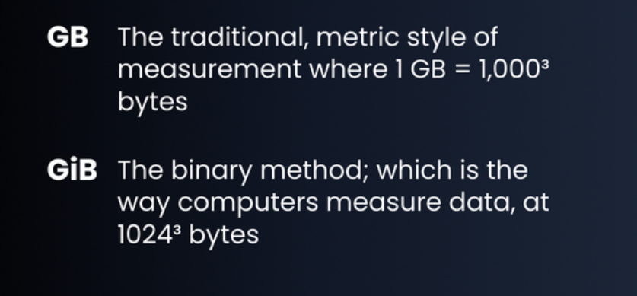
GiB vs GB
That means one GB equals 0.93 GiB

Slide 64
type of filesystem
before you can assign a drive partition to a mount point in the virtual directory, you must format it using a filesystem. There are numerous filesystem types that Linux supports, each with different features and capabilities.
linux supports filesystems of other operating systems
1:Linux file system
Ext3*----→ one file =<2TiB total filesystem=16TiB journaling support
Ext4*-----→ one file=<16TiB total filesystem=1EiB journaling support better performance
Btrfs
swap ----→ in first unix idea /swap paging ability for example 4gb ram and one
App need ram we can use 2gb from storage temporary to prevent crash amout swap *2ram <=8gb in ssd better ram+2gb

Slide 65
partitioning in production
/boot 100mg until 1gb
/home 100gb
/var 150gb
/swap ? Swap is virtual memory or paging for better performance

Slide 66
type of filesystem
filesystem provides journaling, which is a method of tracking data not yet written to the drive in a log file, called the journal. If the system fails before the data can be written to the drive, the journal data can be recovered and stored upon the next system boot.
Example huge bank transaction
2:non linux file system
NTFS
XFS * one file=<16TiB total file system=<16TiB journaling support
Higher perforamance

Slide 67
creating file system
mkfs
for changing format or overwriting mkfs -f
Mount: when creating partition and formatting now assign real or virtual directory that store and write data on partition this progress as
said mounting for example mkdir /cando and
mount /dev/sb2 /cando this process in windows as same as assign letter to partition such as c d e mount point assign partition to file

Slide 68
monut
mount show list of whole of mount point in linux
In linux maybe / mount to /dev/sda1 but /cando mount to /dev/sb1
df -h show whole of partition and mount point and how much used and available if you show with type filesystem df -hT

Slide 69
umount and fsck
umount remove assign partition to directory but don’t affect to data that exist in directory means don’t remove data just we change
fsck.ext4 repair partition if corrupt
Xfs_reapir just for xfs filesystem

Slide 70
inode(index node)
t is important to know that Linux treats every object as a file
Metadata such as modified file and permission and owner and size …
ls –ali
df -ih
metadata file FILE

Slide 71
soft link vs hard link
The inode is the location of information about a file, and the location of the file is specified with the inode number. The file system is a very large collection of inodes.
There are two types of links. One is a symbolic link, which is also called a soft link. The other is a hard link.
Hard link:A hard link is a file or directory that has one index (inode) number but at least two different filenames. Having a single inode number means that it is a single data file on the filesystem. Having two or more names means the file can be accessed in multiple ways

Slide 72
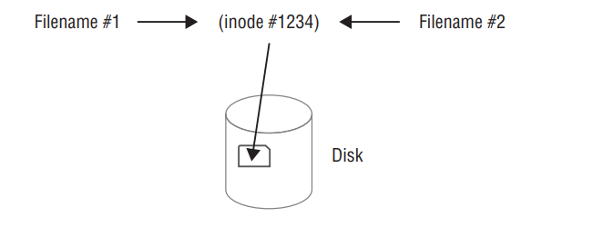
hard link vs soft link
This is often used in file backups where not enough filesystem space exists to back up the file’s data. If someone deletes one of the file’s names, you still have another filename that links to its data
To create a hard link, use the ln command. For hard links, the original file must exist prior to issuing the ln command. The linked file must not exist; it is created when the command is issued

Slide 73
hard link vs soft link
When you create and use hard links, there are a few important items to remember
: ■ The original file must exist before you issue the ln command.
■ The second filename listed in the ln command must not exist prior to issuing the command.
■ An original file and its hard links share the same inode number.
■ An original file and its hard links share the same data.
■ An original file and any of its hard links can exist in different directories.
■ An original file and its hard links must exist on the same filesystem

Slide 74
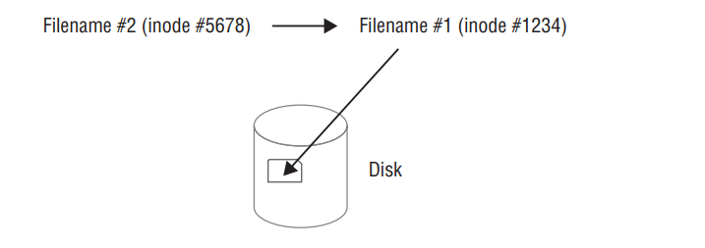
hard link vs soft link
Typically, a soft link file provides a pointer to a file that may reside on another filesystem. The two files do not share inode numbers because they do not point to the same data.
ln –s
Similar to a hard link, the original file must exist prior to issuing the ln -s command. The soft-linked file must not exist.

Slide 75
hard link vs soft link
When creating and using soft links, keep in mind a few important items:
■ The original file must exist before you issue the ln -s command.
■ The second filename listed in the ln -s command must not exist prior to issuing the command.
■ An original file and its soft links do not share the same inode number.
■ An original file and its soft links do not share the same data.
■ An original file and any of its soft links can exist in different directories.
■ An original file and its soft links can exist in different filesystems
The readlink utility will display the final file’s name and directory location.

Slide 76
fstab
For permanent storage devices, Linux maintains the /etc/fstab file to indicate which drive devices should be mounted to the virtual directory at boot time. The /etc/fstab file is a table that indicates the drive device fle (either the raw file or one of its permanent udev fi lenames), the mount point location, the filesystem type, and any additional options required to mount the drive
filesystem mountpoint type options dump pass
/dev/hdb1 /home ext2 defaults 1 0

Slide 77
fstab
Part 4: by default auto means when os boot mount automatically done if you don’t want put noauto.nouser by default means nobody mount file just root if you want other user mount put user .
Ro/Rw in part for bydefault ro means read-only about user but if you other user read and write put rw
Part5:dump tools for backup from filesystem bydeafult 0 but if you want get backup put 1
Part6:fsck for repair filesystem and check health of fs by default o but if you want check put 1

Slide 78
fstab
The first partition is mounted at the /boot/efi mount point in the virtual directory.
The second partition is mounted at the root ( / ) of the virtual directory
The third partition is mounted as a swap area for virtual memory. You can manually add devices to the /etc/fstab fi le so that they are mounted automatically when the Linux system boots.
However, if they don’t exist at boot time, that will generate a boot error

Slide 79
Type file
Directory
Normal file
Link == shortcut in windows
soft link
hard link

Slide 80
compressing file
gzip:
file compression rates of 60–70 percent, gzip has long been a popular data compression utility. To compress a file, type gzip followed by the file’s name. The original file is replaced by a compressed version with a .gz file extension. To reverse the operation, type gunzip followed by the compressed file’s name
Bzip2:
bzip2 utility offers higher compression rates than gzip but takes slightly longer to perform the data compression. The bzip2 utility employs multiple layers of compression techniques and algorithms. Until 2013, this data compression utility was used to compress the Linux kernel for distribution. To compress a file, type bzip2 followed by the file’s name. The original file is replaced by a compressed version with a .bz2 file extension. To reverse the operation, type bunzip2 followed by the compressed file’s name, which decompresses (defl ates) the data
xz:It boasts a higher default compression rate than bzip2
Zip The zip utility is different from the other data compression utilities in that it operates on multiple files. If you have ever created a zip file on a Windows operating system, then you’ve used this file format. Multiple files are packed together in a single file, often called a folder or an archive file, and then compressed. Another difference from the other Linux compression utilities is that zip does not replace the original file(s). Instead, it places a copy of the file(s) into an archive file

Slide 81
compare compressing file
cp /var/log/yum.log test
Cp test test1 test2 test3 test4
Extract gz gunzip
Extract bz2 bunzip
Extact zip unzip yum install unzip
xz –d example.xz

Slide 82
tar
tar as same as archive
tar -cf iman.tar /etc/postfix/ create
tar -tf iman.tar list
tar –xf iman.tar –C /home for creating in other directory and extract

Slide 83
permissions
Create user adduser or useradd
su username (switch)
userdel if you are root or have permission as same as root
visudo give root permission to other users
sudo when your user permit to any location
passwd set password
Sudo -i when you set user in visudo you can permit to root user

Slide 84
User management
Group user id
Detail passwd user:x:0:0:home directory primary group id membership
/bin/bash default shell

