Slide 1
Hotel REservation analysis with sql
BY: WIRAN IMANE
BATCH NAME: MIP-DA-10

Slide 2

OVERVIEW
The hotel industry relies heavily on data to make informed decisions and enhance the guest experience. During this internship, I worked with a comprehensive hotel reservation dataset to uncover insights into guest preferences, booking trends, and key factors influencing hotel operations. Utilizing SQL, I queried and analyzed the data to answer specific questions and provide actionable insights for improving hotel management and strategy.

Slide 3

Objective
The primary objective of this analysis is to leverage data insights from the hotel reservation dataset to optimize hotel operations, enhance guest satisfaction, and inform strategic decision-making.
Through this project, I develop a deeper understanding of how to extract, analyze, and interpret data to generate actionable insights

Slide 4
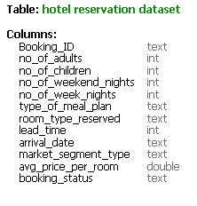
DATASET DETAILS
The dataset we are exploring contains detailed information about hotel reservations, including:
Booking_ID: A unique identifier for each hotel reservation.
no_of_adults: The number of adults in the reservation.
no_of_children: The number of children in the reservation.
no_of_weekend_nights: The number of nights in the reservation that fall on weekends.
no_of_week_nights: The number of nights in the reservation that fall on weekdays.
type_of_meal_plan: The meal plan chosen by the guests.
room_type_reserved: The type of room reserved by the guests.
lead_time: The number of days between booking and arrival.
arrival_date: The date of arrival.
market_segment_type: The market segment to which the reservation belongs.
avg_price_per_room: The average price per room in the reservation.
booking_status: The status of the booking.

Slide 5

QUERY 1
What is the total number of reservations in the dataset?

Slide 6
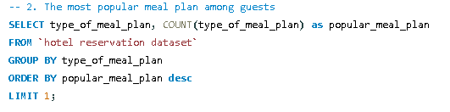

QUERY 2
Which meal plan is the most popular among guests?

Slide 7
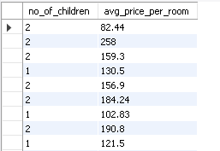

QUERY 3
What is the average price per room for reservations involving children?

Slide 8
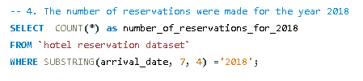

QUERY 4
How many reservations were made for the year 20XX (replace XX with the desired year)?

Slide 9
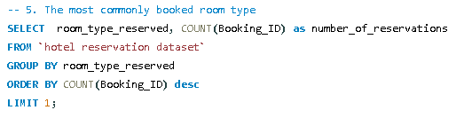

QUERY 5
What is the most commonly booked room type?

Slide 10


QUERY 6
How many reservations fall on a weekend (no_of_weekend_nights > 0)?

Slide 11


QUERY 7
What is the highest and lowest lead time for reservations?

Slide 12
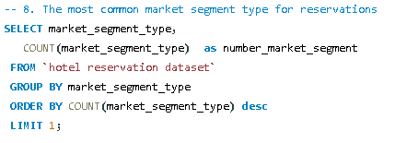

QUERY 8
What is the most common market segment type for reservations?

Slide 13


QUERY 9
How many reservations have a booking status of "Confirmed"?

Slide 14

QUERY 10
What is the total number of adults and children across all reservations?

Slide 15


QUERY 11
What is the average number of weekend nights for reservations involving children?

Slide 16
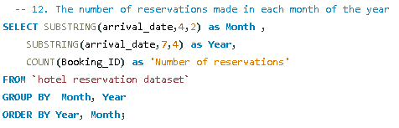
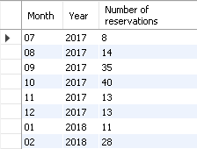
QUERY 12
How many reservations were made in each month of the year?

Slide 17

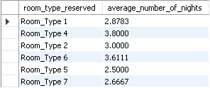
QUERY 13
What is the average number of nights (both weekend and weekday) spent by guests for each room type?

Slide 18
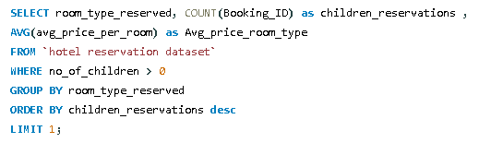

QUERY 14
For reservations involving children, what is the most common room type, and what is the average price for that room type?

Slide 19
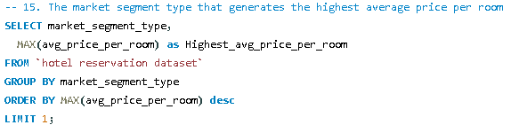

QUERY 15
Find the market segment type that generates the highest average price per room.

Slide 20

CONCLUSION
This internship project offered an in-depth experience in database management, SQL query development, and optimization. Working with a detailed hotel reservation dataset allowed me to gain valuable insights into data analysis and its real-world applications. Through this project, I improved my ability to design and manage databases efficiently, ensuring data integrity and accessibility.

Slide 21

Acknowledgment
I would like to extend my heartfelt appreciation to the entire team for their collaboration and assistance throughout this project. I am also deeply grateful to Mentorness for providing this valuable opportunity and for their guidance and knowledge, which were instrumental in my development.

