Slide 1
Numerical Linear Algebra & Parallel Computing BLAS Library

Slide 2
Introduction
Overview:
The BLAS library, or Basic Linear Algebra Subprograms, is a collection of low-level routines that provide optimized implementations of common linear algebra operations. These operations include matrix-vector multiplication, matrix-matrix multiplication, vector inner products, and more. BLAS is an essential component of many scientific computing and data analysis applications, providing high-performance implementations of these operations that can significantly speed up computations.

Slide 3
Introduction
Background
BLAS was first developed in the 1970s as a collaboration between researchers at Argonne National Laboratory and the University of California, Berkeley. Since then, it has evolved and expanded to include support for a wide range of data types and operations. BLAS is part of the broader ecosystem of numerical computing libraries, which also includes libraries like LAPACK, FFTW, and PETSc. These libraries provide a suite of powerful tools for scientific computing, enabling researchers to solve complex problems in fields like physics, engineering, and data science.

Slide 4
Introduction
Implementation
BLAS routines are implemented using a combination of algorithmic optimizations and hardware-specific optimizations. The algorithms used in BLAS routines are carefully chosen to minimize memory access patterns and maximize arithmetic intensity. BLAS routines can also take advantage of parallelism, either by using multi-threading on a CPU or by using GPUs for massively parallel computation. Some implementations of BLAS also support optimizations like cache blocking and vectorization to further improve performance.

Slide 5
Levels Of BLAS
Level 1
The Level 1 BLAS provide basic vector operations, such as vector addition, scaling, dot product, and vector norms. These operations are usually implemented using a combination of loops and hardware acceleration, such as SIMD instructions. Level 1 BLAS operations have a computational complexity of O(n), where n is the size of the vectors.

Slide 6
Levels Of BLAS
Level 2
The Level 2 BLAS provide matrix-vector operations, such as matrix-vector multiplication, and solve operations, such as linear systems and least-squares problems. These operations are usually implemented using a combination of loops and matrix decompositions, such as LU or QR decomposition. Level 2 BLAS operations have a computational complexity of O(n^2), where n is the size of the matrices.

Slide 7
Levels Of BLAS
Level 3
The Level 3 BLAS provide matrix-matrix operations, such as matrix multiplication and matrix factorization. These operations are usually implemented using a combination of loop tiling, matrix decompositions, and parallelism, such as multi-threading or SIMD instructions. Level 3 BLAS operations have a computational complexity of O(n^3), where n is the size of the matrices.

Slide 8
Naming Convention of BLAS
BLAS functions are typically named with a three-part naming convention:
a prefix
a base name
a suffix

Slide 9
Naming Convention of BLAS
Prefix
The prefix specifies the data type of the operands. There are four possible prefixes:
s: Single precision (float)
d: Double precision (double)
c: Complex single precision (complex float)
z: Complex double precision (complex double)

Slide 10
Naming Convention of BLAS
Base Name
The base Name: The base name describes the operation being performed. For example:
xgemm: General matrix-matrix multiplication
xgemv: General matrix-vector multiplication
xtrmv: Triangular matrix-vector multiplication
xdot: Dot product of two vectors

Slide 11
Naming Convention of BLAS
Suffix
The suffix provides additional information about the operation being performed or the storage format of the matrices. Some common suffixes include:
f: Fortran-style storage (column-major order)
c: C-style storage (row-major order)
t: Transposed operation
n: Non-transposed operation
u: Upper triangular matrix
l : Lower triangular matrix

Slide 12
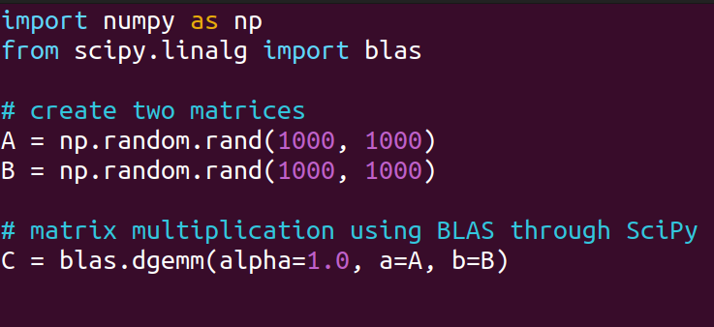
Calling BLAS from Python
SciPy

Slide 13
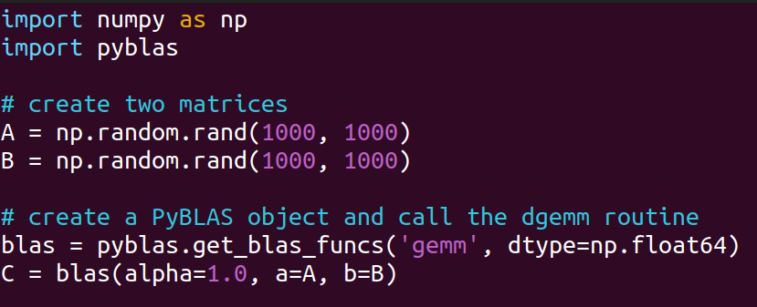
Calling BLAS from Python
PyBLAS

Slide 14
BLAS Documentation
https://netlib.org/blas/

