Slide 1
Numerical Linear Algebra & Parallel Computing
Mohammed VI Polytechnic University
Nouredine Ouhaddou ◾️ Mohamed Jalal Maaouni ◾️ Ibrahim El Mountasser

Slide 2
Introduction
Motivation
Network Analysis:
Social Networks
Biological Networks
Linear Programming:
Machine Learning:
Feature selection
Natural Language Processing

Slide 3
Introduction
Motivation
Network Analysis:
Social Networks
Biological Networks
Linear Programming:
Machine Learning:
Feature selection
Natural Language Processing
Data too large !

Slide 4
Introduction
Motivation
Network Analysis:
Social Networks
Biological Networks
Linear Programming:
Machine Learning:
Feature selection
Natural Language Processing
Data too large !
But many entries are zeros.

Slide 5
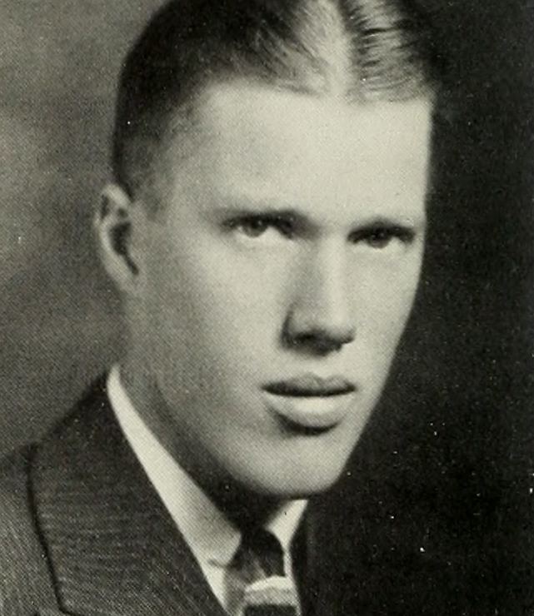
Introduction
History overview
The term "sparse matrix" first used in the 1950s.
George Forsythe is a pioneer in the field with his development of Gaussian elimination for sparse matrices in the 1970s.
More advances have been made since with sophisticated algorithms and techniques for working with sparse matrices, including iterative and direct methods.
George Forsythe

Slide 6
Introduction
Course overview
Preliminaries:
Complexity
Memory
Dense Matrices
BLAS LAPACK
Sparse Matrices as a data structure:
Representation
Storage/ format
Working with sparces matrices:
Basic Operations
Algorithms for sparce matrices
Direct/ Iterative methods.
Eigenvalue Problems

Slide 7
Complexity Analysis

Slide 8
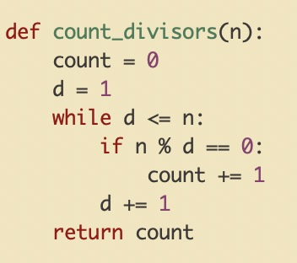
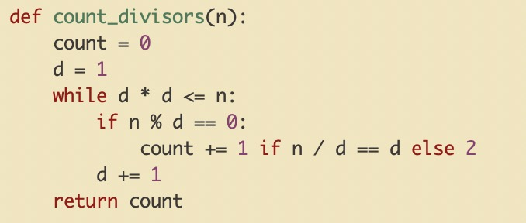
Measuring Efficiency
Problem:
Given an integer n, count the number of its divisors.
Solution 1: Solution 2:

Slide 9
Measuring Efficiency
Solution 1:

Slide 10
Measuring Efficiency
Solution 2:

Slide 11
Measuring Efficiency
We will run the two programs for different values of n and measure which algorithm is faster
n | Solution 1 | Solution 2
10 | seconds | seconds
1000 | seconds | seconds
10000000 | seconds | seconds

Slide 12
Measuring Efficiency
What is the problem with this approach?
Machine dependence
n | Solution 1 | Solution 2
10 | operations | operations
1000 | operations | operations
10000000 | operations | operations

Slide 13

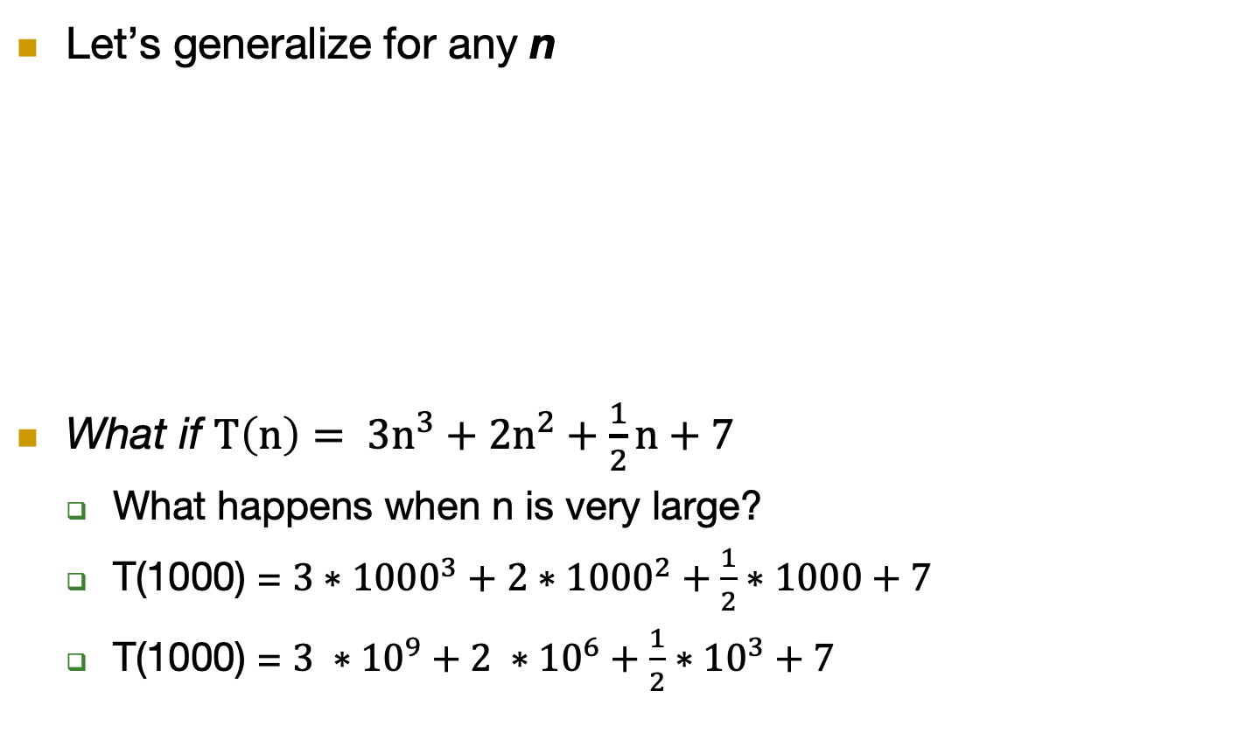
Measuring Efficiency
Let’s generalize for any n
What if $T\left(n\right)= 3n^{3}+2n^{2}+\frac{1}{2}n+7$
What happens when n is very large?
T(1000) = ${3∗1000}^{3}+{2∗1000}^{2}+\frac{1}{2}∗1000+7$
T(1000) = $3 ∗{10}^{9}+2 ∗{10}^{6}+\frac{1}{2}∗{10}^{3}+7$
Solution 1 | Solution 2
T(n) = n operations | operations
T(n) = $√n$

Slide 14

Measuring Efficiency
$\lim_{n→∞}{3n^{3}+2n^{2}+\frac{1}{2}n+7}$

Slide 15
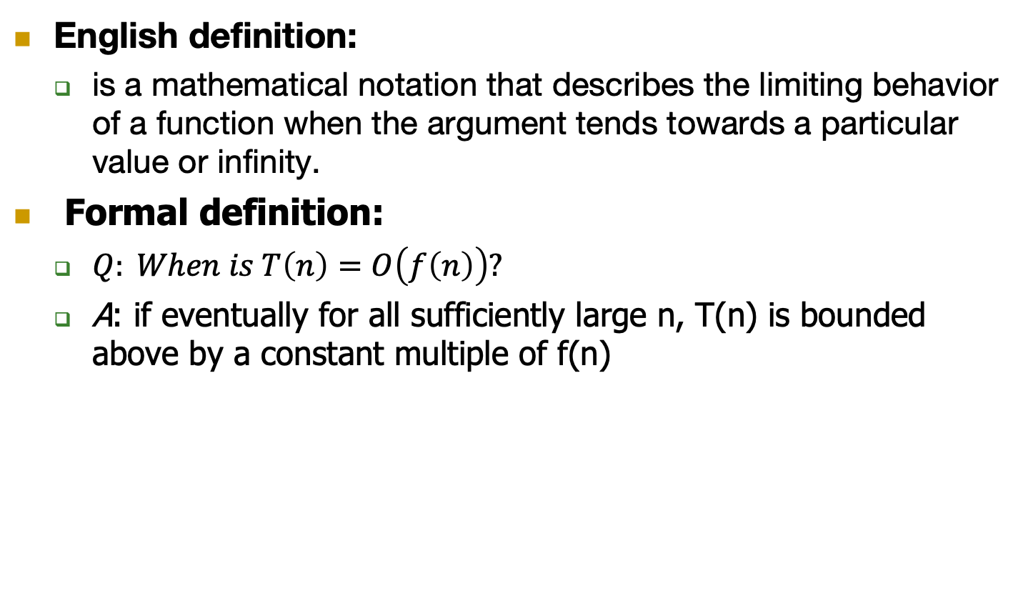
Big-O notation
English definition:
is a mathematical notation that describes the limiting behavior of a function when the argument tends towards a particular value or infinity.
Formal definition:
$Q: When is T\left(n\right)=O\left(f\left(n\right)\right)?$
A: if eventually for all sufficiently large n, T(n) is bounded above by a constant multiple of f(n)

Slide 16
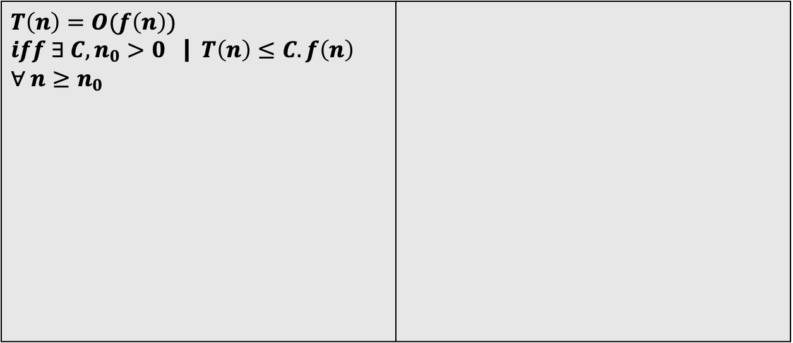

Big-O notation
Formal definition:
$Q: When is T\left(n\right)=O\left(f\left(n\right)\right)?$
A: if eventually for all sufficiently large n, T(n) is bounded above by a constant multiple of f(n)
$T\left(n\right)=O(f\left(n\right))$ $iff ∃ C,n_{0}>0$ | $T\left(n\right)≤C.f\left(n\right)$ $$∀ n≥n_{0}$$

Slide 17

Big-O notation, Example #1
$Claim:if T\left(n\right)={3n^{3}+2n^{2}+\frac{1}{2}n+7} then T\left(n\right)=O\left(n^{3}\right)$

Slide 18

Big-O notation, Example #2
$Claim: ∀ k≥1, n^{k} is not O\left(n^{k−1}\right)$

Slide 19
Case study: merge sort algorithm
Why study merge sort?
Good introduction to recursion, divide and conquer and master theorem.
The sorting problem:
input: array of n numbers
output: the same array sorted in increasing order.

Slide 20
Case study: merge sort algorithm
Example: [5, 3, 2, 7, 1, 6, 4, 8]

Slide 21
Case study: merge sort algorithm
Pseudocode for the merge step:
C = the output array, lenght = n
A = 1st sorted array, lenght = n/2
B = 2nd sorted array, lenght = n/2
i = 1, j = 1
for k = 1 to n
if A[i] < B[j]:
C[k] = A[i]
i+=1
else
C[k] = B[j]
j+=1

Slide 22
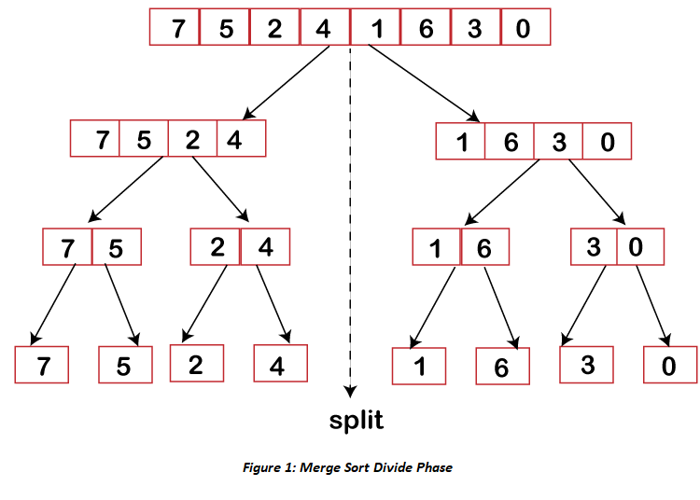
Case study: merge sort algorithm
the divide phase:

Slide 23
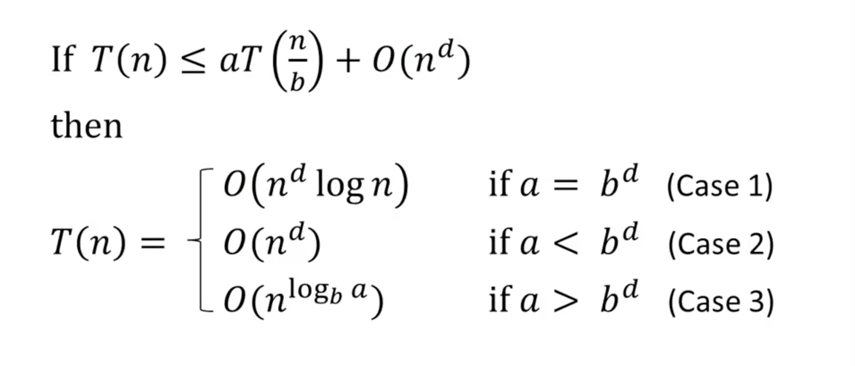
The Master Method
:

Slide 24
The Master Method
Example 1: Merge sort

Slide 25
The Master Method
Example 2: Binary search

Slide 26
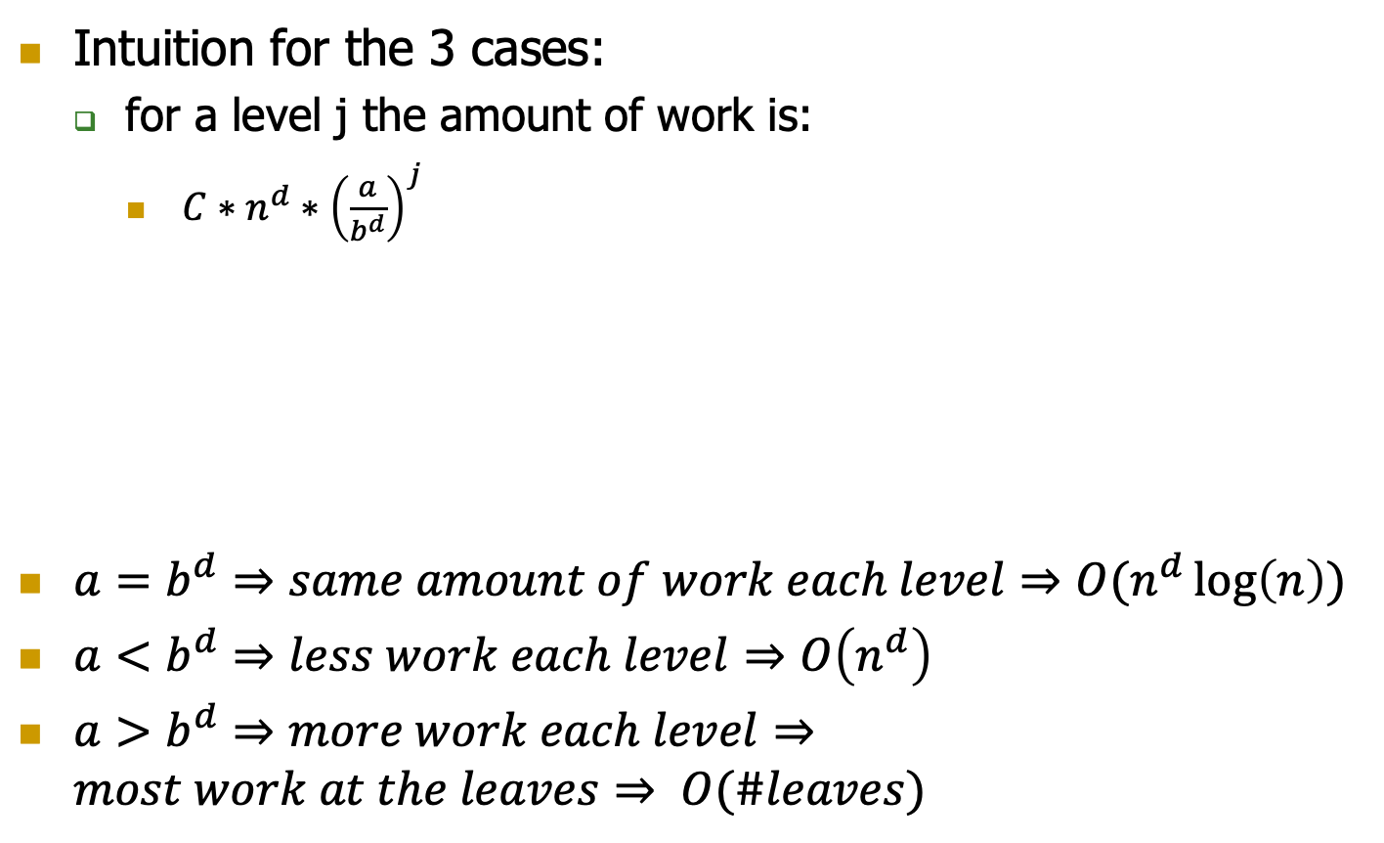
The Master Method
Intuition for the 3 cases:
for a level j the amount of work is:
$C∗n^{d}∗{\left(\frac{a}{b^{d}}\right)}^{j}$
$a=b^{d}⇒same amount of work each level⇒O(n^{d}\log\left(n\right))$
$a<b^{d}⇒less work each level⇒O\left(n^{d}\right)$
$a>b^{d}⇒more work each level⇒most work at the leaves⇒ O(\#leaves)$

Slide 27

The Master Method: Proof case 1
The work for a level j $≤ C∗n^{d}∗{\left(\frac{a}{b^{d}}\right)}^{j}$
The total work $≤ cn^{d}∗ \sum_{j=0}^{\log_{b}n}{{\left(\frac{a}{b^{d}}\right)}^{j}}$
$a=b^{d}⇒cn^{d}∗ \sum_{j=0}^{\log_{b}n}{{\left(\frac{a}{b^{d}}\right)}^{j}=cn^{d}∗ \sum_{j=0}^{\log_{b}n}{{\left(1\right)}^{j}=cn^{d}∗ {(log}_{b}n+ }} 1)$
$⇒O(n^{d}\log\left(n\right))$ $∎$

Slide 28

Recap: basic sums fact
$for r !=1, we have$
$r^{0}+r^{1}+…+r^{k}=\frac{r^{k+1} −1}{r −1}$
$for r<1,$
$\frac{r^{k+1} −1}{r −1}≤\frac{1}{1 − r}$ , CONSTANT
$for r> 1,$
$\frac{r^{k+1} −1}{r −1}≤r^{k}∗\left(1+ \frac{1}{r −1}\right)$
$ex:r=2⇒2^{k}∗\left(1+\frac{1}{2 −1}\right)=2^{k}∗\left(1+1\right)=2^{k+1}>2^{k+1 }−1$

Slide 29

The Master Method: Proof case 2
The work for a level j $≤ C∗n^{d}∗{\left(\frac{a}{b^{d}}\right)}^{j}$
The total work $≤ cn^{d}∗ \sum_{j=0}^{\log_{b}n}{{\left(\frac{a}{b^{d}}\right)}^{j}}$
$a<b^{d}⇒cn^{d}∗ \sum_{j=0}^{\log_{b}n}{{\left(\frac{a}{b^{d}}\right)}^{j}=cn^{d}∗ \sum_{j=0}^{\log_{b}n}{{\left(r\right)}^{j}=cn^{d}∗C. \{r=\frac{a}{b^{d}} <1\}}}$
$⇒O(n^{d})$ $∎$

Slide 30

The Master Method: Proof case 3
The work for a level j $≤ C∗n^{d}∗{\left(\frac{a}{b^{d}}\right)}^{j}$
The total work $≤ cn^{d}∗ \sum_{j=0}^{\log_{b}n}{{\left(\frac{a}{b^{d}}\right)}^{j}}$
$a<b^{d}⇒cn^{d}∗ \sum_{j=0}^{\log_{b}n}{{\left(\frac{a}{b^{d}}\right)}^{j}=cn^{d}∗ \sum_{j=0}^{\log_{b}n}{{\left(r\right)}^{j}=cn^{d}∗r^{\log_{b}n}. \{r=\frac{a}{b^{d}}>1\}}}$
$⇒O(n^{\log_{b}a})$ $∎$

