Slide 1
Graph Theoretic Properties of the Dark web
Iman Emrani
Faramarz Zareian

Slide 2
Content brief
1)Introduction
2)Data Collection
3)Graph-theoretic Results
4)Discussion

Slide 3
Introduction
Why we are interested into dark web?
It’s an interesting unexplored dataset.
The world-wide-web and the dark web are similar and both are browsed through a standard web-browser.
Synonymous with the onion web.

Slide 4
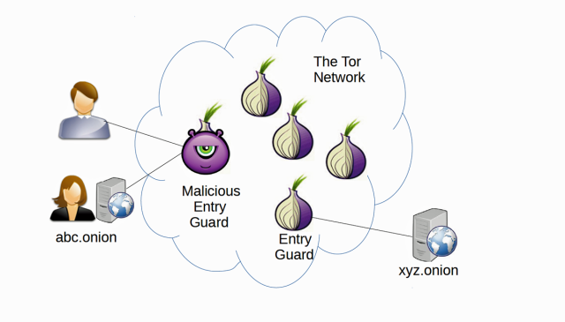
Introduction
What is the onion web?
It is subset of the web.
Identified by a randomly generated 16-character address (a hash fingerprint).
Very difficult to learn the IP number of a website from its hash.
Difficult to trace the geographical origin of a communication.

Slide 5
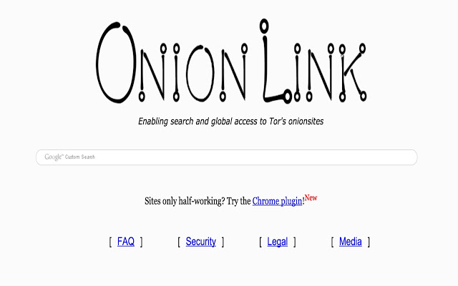
Data Collection
How we can crawling the Darkweb?
Through the popular tor2web proxy onion.link .
Darkweb pages are written in the same HTML language.

Slide 6
Data Collection
Darkweb graph
Each vertex is a domain and every directed edge.
From u -- > v means there exists a page within domain u linking to a page within domain v.
The weight of the edge from u -- > v is the number of pages on domain u linking to pages on domain v.

Slide 7
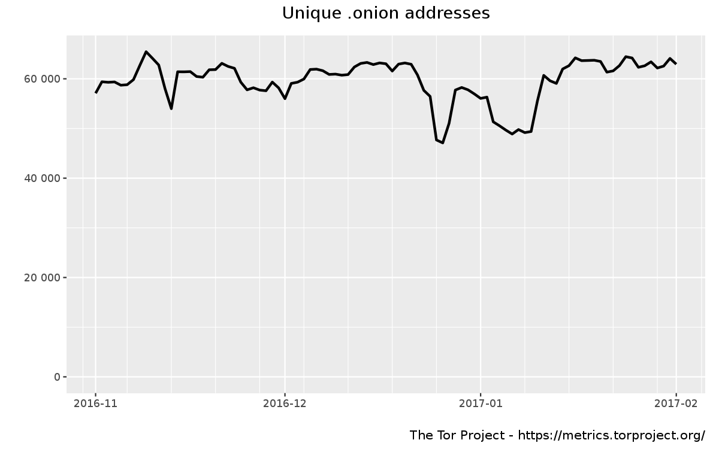
Data Collection
.onion addresses
~60,000 addresses (R.F. creators and custodians)
~7,178 addresses (R.F our analysis)
High-discrepancy?, why?

Slide 8

Data Collection
High-discrepancy due to various messaging services.
Particularly TorChat, Tor Messenger, and Ricochet.
In all of these services, each user is identified by a unique .onion domain.

Slide 9
Data Collection
The darkweb has a notoriously high attrition rate
if we discover a link to a page on domain v, but domain v could not be reached after >10 attempts, we delete node v and all edges to node v. In our analysis, before pruning nonresponding domains we found a graph of 13,117 nodes and 39,283 edges. After pruning, we have a graph of 7, 178 nodes and 25, 104 edges (55% and 64% respectively). In all results, we refer to this graph pruned of nonresponding domains as simply “the darkweb graph”.

Slide 10
Graph-theoretic Results
Analyze the degree distributions
The darkweb graph consists of exactly one weakly connected component (WCC)2 of 7,178 nodes and 25,104 edges.
The first step is to quantitatively analyze the degree distributions.

Slide 11
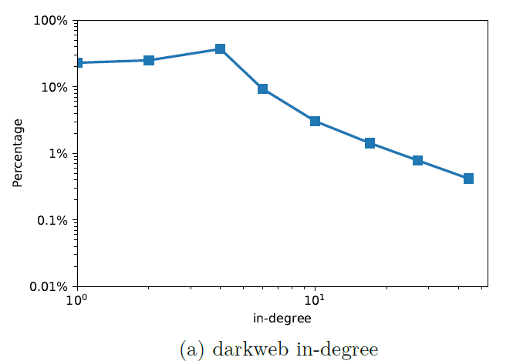
Graph-theoretic Results
~30% of domains have exactly one incoming link of which 62% come from one of the five largest out-degree hubs

Slide 12
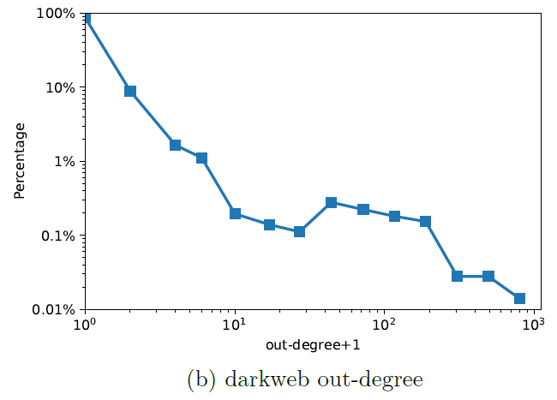
Graph-theoretic Results
Fully 87% of sites do not link to any other site

Slide 13
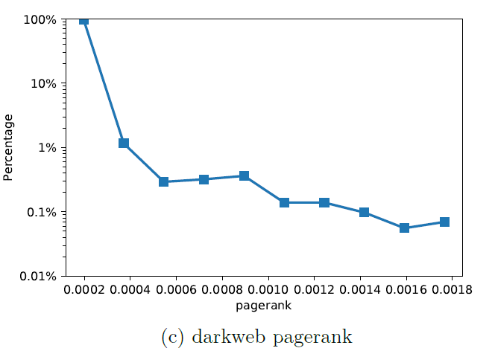
Graph-theoretic Results
>98% of domains are tied for the lowest pagerank of 2.095e-4

Slide 14
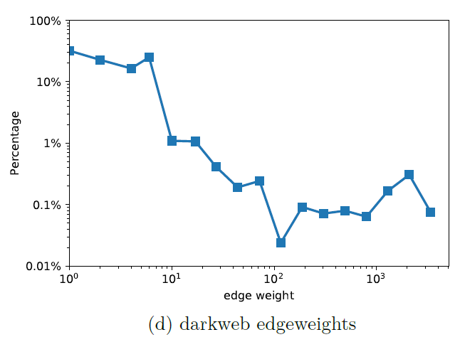
Graph-theoretic Results
When a site does link another, 32% of the time it’s only a single page linking out

Slide 15
Graph-theoretic Results
Bow-tie decomposition
Bowtie decomposition divides the nodes of a directed graph into six disjoint parts
CORE
IN
OUT
TUBES
TENDRILS
DISCONNECTED

Slide 16
Graph-theoretic Results
1.CORE: It’s Largest Strongly Connected Component
2.IN: The set of nodes, excluding those in the CORE, that are ancestors of a CORE node.
3.OUT: The set of nodes, excluding those in the CORE, that are descendants of a CORE node.
4.TUBES: The set of nodes, excluding those in the CORE, IN, and OUT, who have an ancestor in IN as well as a descendant in OUT.
5.TENDRILS: Nodes that have an ancestor in IN but do not have a descendant in OUT. Also, nodes that have a descendant in OUT but do not have an ancestor in IN.
6.DISCONNECTED: Everything else.

Slide 17
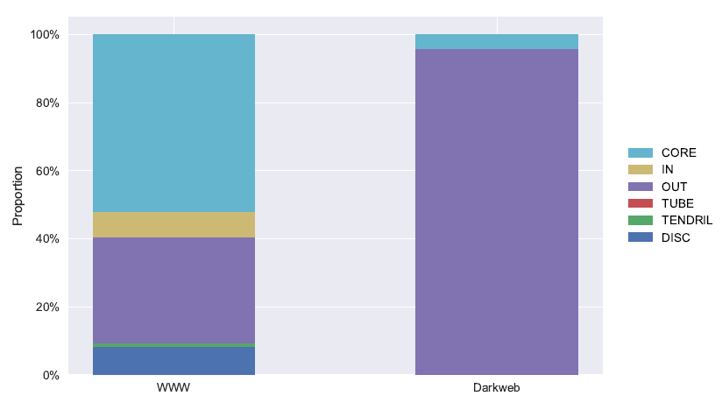
Graph-theoretic Results
Bow-tie decomposition comparing the www versus the darkweb
The most obvious difference between the world-web-web and the darkweb is that the darkweb only contains a CORE and an OUT component

Slide 18
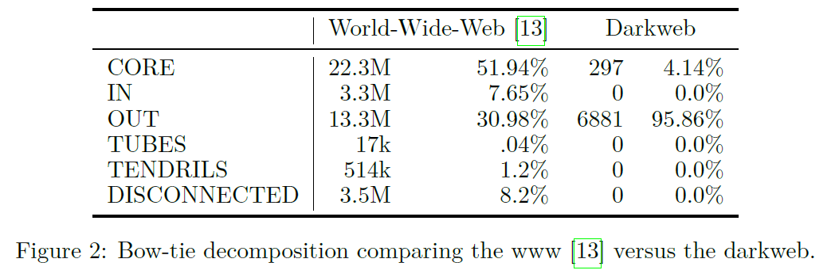
Graph-theoretic Results

Slide 19
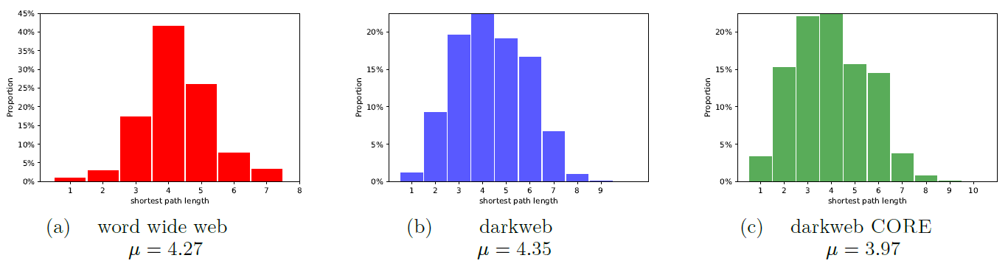
Graph-theoretic Results
Comparing shortest path lengths between the world-wide-web and the darkweb considering directed edges

Slide 20
Graph-theoretic Results
For the all pairs of nodes {u, v} in the darkweb, only 8.11% are connected by a directed path from u -- > · · · -- > v or v -- > · · · -- > u.
In the www 56.65% of node pairs have ∞ path-length (no path connecting them)
In the darkweb 91.89% of node-pairs have no path connecting them.
The darkweb’s average SPL (μ = 4.35) is higher than that of the www
(μ = 4.27). It means darkweb graph is sparse!

Slide 21
Graph-theoretic Results
Robustness and Fragility
In this step we show that how quickly the entire network (WCC) as well as the CORE disintegrates under node removal.

Slide 22
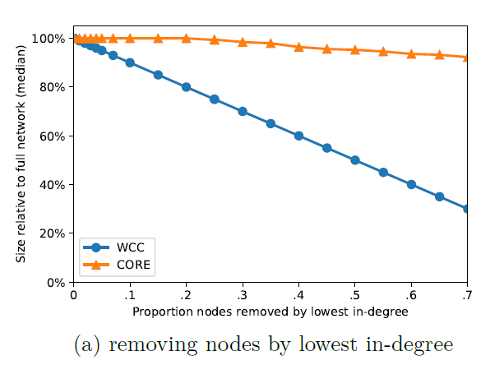
Graph-theoretic Results
The familiar resistance to random failure yoked with fragility to targeted attacks

Slide 23
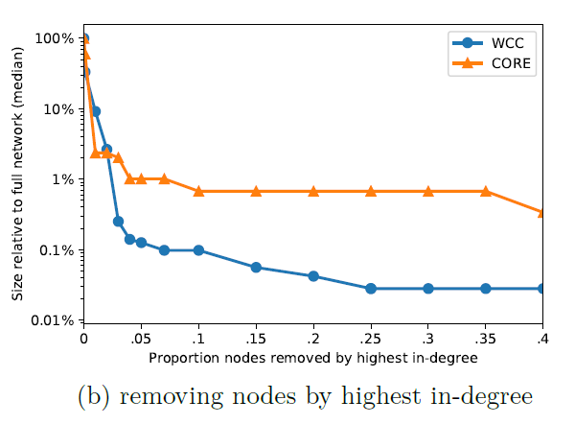
Graph-theoretic Results
Unlike the www, the WCC is more susceptible to high in-degree deletions than the CORE

Slide 24
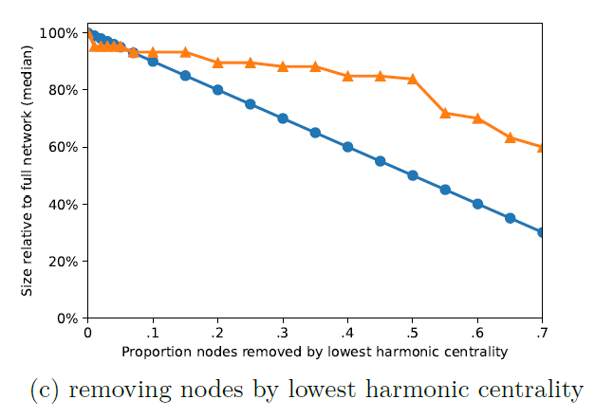
Graph-theoretic Results
Show the breakdown when removing central nodes
The CORE is largely unaffected by low centrality deletions

Slide 25
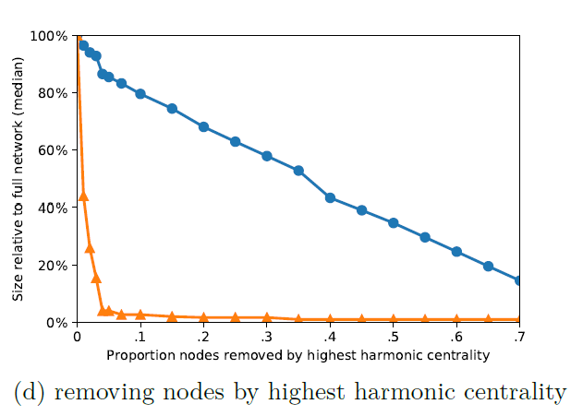
Graph-theoretic Results
Show the breakdown when removing central nodes
The CORE isn’t disproportionately held together by high in-degree nodes, it is controlled by very central nodes

Slide 26
Discussion
Why there’s so little linking in darkweb?

Slide 27
Discussion
Consider two major explanations
The technological explanation. In the darkweb, sites go up and go down all the time.
The social explanation. people who create sites on the darkweb are cut from a different social cloth than those who create sites on the www.

Slide 28
Discussion
Results:
1. The low outbound linking is not due to the notorious impermance of onion sites.
2. If onionsites got drastically more stable, we would still see very low rates of linking.
3. By elimination of the technological explanation, we suggest that people creating darkweb sites are, on average, simply less social than those creating sites on the www.

Slide 29
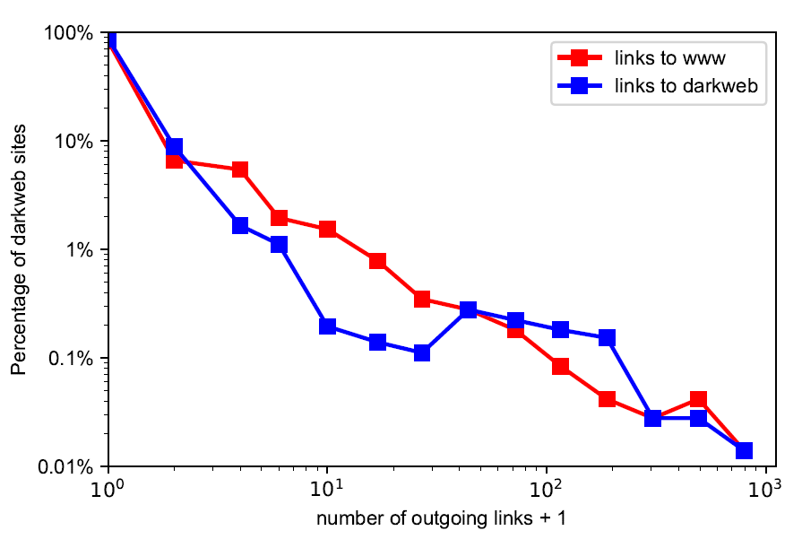
Discussion
Comparing the rates of the darkweb sites linking to the www versus linking to other darkweb sites

Slide 30
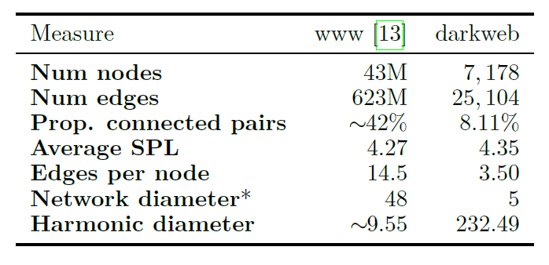
Discussion
Summarized network level properties between the www and the darkweb

Slide 31
The End

