Slide 1
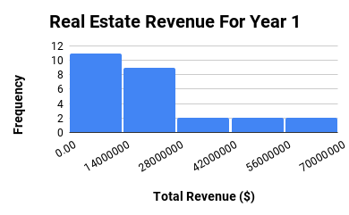
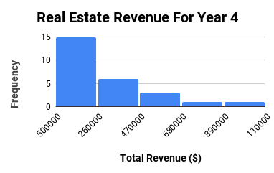
How Does the Real Estate Revenue For Year 1 is Compared to That For Year 4 ?
The tow Histograms shown in the left iilustrate the Total Revenue for Real Estate sector for Years (1 & 4).
Both distributions are right skewed. So, the mean of each one is higher than the median.
The mean for Real Estate for year 1 is about $ 2.12 billion which is increased by 36 % to $ 2.88 billion in year 4. Also the median for year 1 is approximately
Google Sheet Link: https://docs.google.com/spreadsheets/d/12HcaB5Ah9Vn-858EPpV0mqYZLLZEgKiy8x6HNJnFNUU/edit?usp=sharing

Slide 2
How Does the Real Estate Revenue For Year 1 is Compared to That For Year 4 ?
74% of the fourth year ‘s revenue ($ 1.80 billion for year 1 and $ 2.45 billion for year 4).
Although that Real Estate had a higher standard deviation for Year 4 ( $ 2.31b billion) than that of Year 1 ($ 1.68 billion), but by calculating the coefficient of variance for each year ( 0.80 for Year 1 and 0.81 for Year 2) we can see that they have almost the same dispersion regardless how much the values in each.
Google Sheet Link: https://docs.google.com/spreadsheets/d/12HcaB5Ah9Vn-858EPpV0mqYZLLZEgKiy8x6HNJnFNUU/edit?usp=sharing

Slide 3
How Does the Real Estate Revenue For Year 1 is Compared to That For Year 4 ?
The range for Real Estate sector total revenue is at $ 10.10 billion in Year4. This range is higher than that in Year1 which is at only $ 6.10 billion. Therefore, values of Real Estate total revenues are more spread out in Year4. This means that Year 4 had more significant variability in the earnings received.
Google Sheet Link: https://docs.google.com/spreadsheets/d/12HcaB5Ah9Vn-858EPpV0mqYZLLZEgKiy8x6HNJnFNUU/edit?usp=sharing

Slide 4
How Does the Real Estate Revenue For Year 1 is Compared to That For Year 4 ?
Overall, Real Estate had higher earning in Year 4 than Year 1. 25% of total revenues in Year 4 are higher than $ 3.69 billion while 25% of total revenues in Year 1 are higher than $ 2.60 billion.
Google Sheet Link: https://docs.google.com/spreadsheets/d/12HcaB5Ah9Vn-858EPpV0mqYZLLZEgKiy8x6HNJnFNUU/edit?usp=sharing

