Slide 1
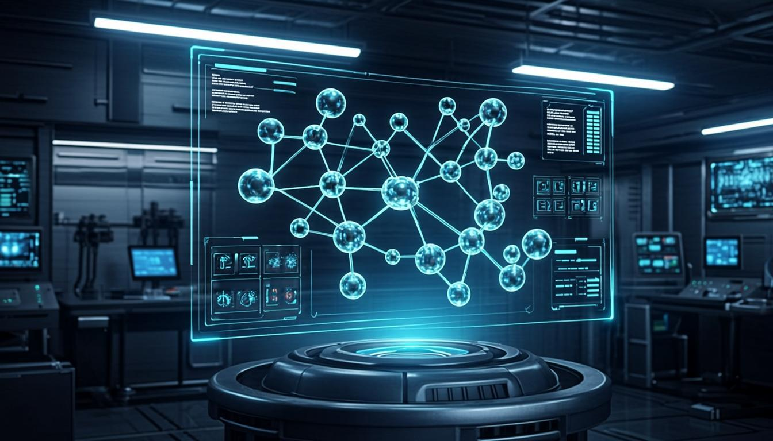
GenAI Research Platform
Demonstrating How AI is Applied to
Chemistry & Biology
Research Presentation 2025

Slide 2
Contents
01
02
03
04
AI & ML Introduction
Data Extraction
Network & Knowledge
Intelligent Bots
Vision-first PDF pipeline
NiCOBot and RAL Bot
Core concepts, ideas and math
Citation & knowledge graphs

Slide 3
AI Fundamentals
Core ideas driving modern AI applications
SECTION 01
Introduction
to AI & ML
Machine Learning
How machines learn from data
Math Visualization
Algorithms behind intelligent systems

Slide 4
What is Artificial Intelligence?
Definition & Scope
AI simulates human intelligence through learning, reasoning, and self-correction, from rule-based systems to neural networks.
Key Subsets: ML, DL, NLP, CV, RL
Major AI branches powering modern applications across industries and scientific research.
AI in Scientific Research
Accelerates drug discovery, material design, and chemical analysis by finding hidden patterns in vast datasets.
Large Language Models (LLMs)
Transformers enable intelligent analysis of research papers, patents, and chemical literature at scale.

Slide 5
Core Machine Learning Concepts
1
2
3
Supervised Learning
Unsupervised Learning
Reinforcement Learning
Learns from labeled data for classification and regression. Used for molecular property prediction and toxicity screening.
Discovers hidden patterns through clustering. Essential for chemical space exploration and reaction grouping.
Agents learn through trial and reward. Applied in molecular optimization and retrosynthesis planning.

Slide 6
Mathematics Behind ML
1
Linear Algebra & Matrix Operations
Vectors, matrices, and tensors form the foundation. Neural network weights are matrices; eigenvalue decomposition drives PCA for feature extraction.
2
Calculus & Optimization
Gradient descent and backpropagation minimize loss functions. Adam and SGD optimizers drive convergence in chemistry AI models.
3
Probability & Information Theory
Bayesian inference, entropy, and cross-entropy measure model quality. Attention mechanisms use softmax to weigh input relevance.

Slide 7
Neural Networks & Deep Learning
Transformer Architecture
Input (Text/Images)
Self-attention captures long-range dependencies
Multi-head attention for parallel context features
Feed-forward layers for non-linear transforms
Layer normalization for training stability
↓
Self-Attention Layer
↓
Feed-Forward + LayerNorm
↓
Foundation of GPT, Claude, Gemini
Output Predictions

Slide 8

SECTION 02
Application of LLM
in Chemistry
Data Extraction | Citation Network | Knowledge Graph | NiCOBot | RAL Bot

Slide 9
GenAI Platform Overview
9+
5
Flask
LLM Providers Integrated
Core Chemistry Modules
Python Web Framework
Multi-Provider Architecture
Modular Backend Design
Supports OpenAI, Anthropic, Google, Mistral, and more through a unified Blueprint factory pattern.
Organized into core, llm, chat, routes, modules directories. Independently maintainable.

Slide 10
PDF Upload & Parsing
Upload chemistry PDFs for automated extraction of figures, tables, and reaction schemes.
Chem
Extract
Vision LLM Analysis
Extracted images sent to GPT-4V, Claude Vision for detailed chemical structure analysis.
Vision-first PDF analysis for chemical literature
Structured JSON Output
Merged results with compound names, yields, reaction conditions, and reagent lists.

Slide 11
Vision-First PDF Pipeline
Embedded Figure Extraction
1
PyMuPDF extracts raster images directly from PDF, preserving resolution for quality analysis.
Vector Scheme Page Detection
2
High vector density pages are flagged and rendered via Playwright for reaction scheme capture.
Vision LLM Analysis
3
Images analyzed by vision LLMs using chemistry prompts to identify compounds and reactions.
Text + Vision Merge
4
Vision data takes priority for structures and reactions, merged with text extraction results.

Slide 12
Citation Network Analysis
Single Paper Network
Cross-Citation Network
Upload PDF to generate citation network
Cytoscape.js interactive force graphs
Visualize cited and citing articles
Color-coded by relevance
Excel bibliography for multi-paper analysis
Build cross-referencing networks
Identify research trend clusters
Export for bibliometric study

Slide 13
Knowledge Graph
Entity Extraction
Graph Visualization
LLMs extract compounds, proteins, genes, diseases, and experimental methods from research text.
Interactive Cytoscape.js display with color-coded nodes and confidence-weighted edges.
Query & Exploration
Relationship Mapping
Discover hidden connections between compounds and diseases, trace reaction pathways.
Connects entities with "inhibits", "synthesizes", "binds to" to form a connected knowledge structure.

Slide 14
NiCOBot
Nickel & Cobalt Chemistry Assistant
1
2
3
Domain Knowledge
Conversational AI
RAG-Augmented
Specialized in Ni/Co chemistry: oxidation states, complexes, catalysis, and extraction processes.
Chat interface for Ni/Co questions with detailed, context-aware explanations and references.
Grounded in verified Ni/Co literature via Retrieval-Augmented Generation from curated data.

Slide 15
RAL Bot - Research Assistant for Literature
Intelligent Literature Analysis
Workflow
Upload papers for instant AI analysis
Extracts key findings and methodology
Structured section-by-section summaries
Multi-turn conversations on content
Suggests related further reading
Upload PDF or paste text
LLM processes with domain context
Structured summary generated
Interactive Q&A on paper content
Export results and citations

Slide 16
Platform Architecture
Presentation Layer
Frontend (HTML/JS)
Cytoscape.js, RDKit, interactive UI
Application Layer
Flask Routes (Blueprints)
Blueprint routes for extraction, network, chat
Core Services (Config/Utils)
Service Layer
Config, utilities, session management
LLM Providers (9+ Integrations)
AI Provider Layer
Unified interface: OpenAI, Anthropic, Google, etc.

Slide 17
Supported LLM Providers
Provider
Models
Vision
Use Case
OpenAI
GPT-4o, GPT-4V
Yes
Vision analysis
Anthropic
Claude 3.5 Sonnet
Yes
PDF analysis, chat
Google
Gemini 1.5 Pro
Yes
Multi-modal tasks
Mistral / Cohere
Mistral Large, Command R+
No
Text analysis
Ollama (Local)
Llama 3, Mixtral
No
Private data, on-premise
+ 4 more
HuggingFace, Groq...
Varies
Extensible via config

Slide 18
Impact & Benefits of AI in Chemistry
Research Speed
90%
Extraction Accuracy
85%
Literature Coverage
78%
Cost Reduction
72%
Knowledge Discovery
65%

Slide 19
"AI is not replacing chemists; it empowers them to solve previously unsolvable problems."
Future Directions
Multi-Modal AI
Automated Labs
Drug Discovery
Text + vision + molecular data in unified models
AI-driven autonomous experiment design
End-to-end AI from target to candidate

Slide 20
Thank You
GenAI Research Platform
Showcasing the Power of AI in Chemistry & Biology

