Slide 1
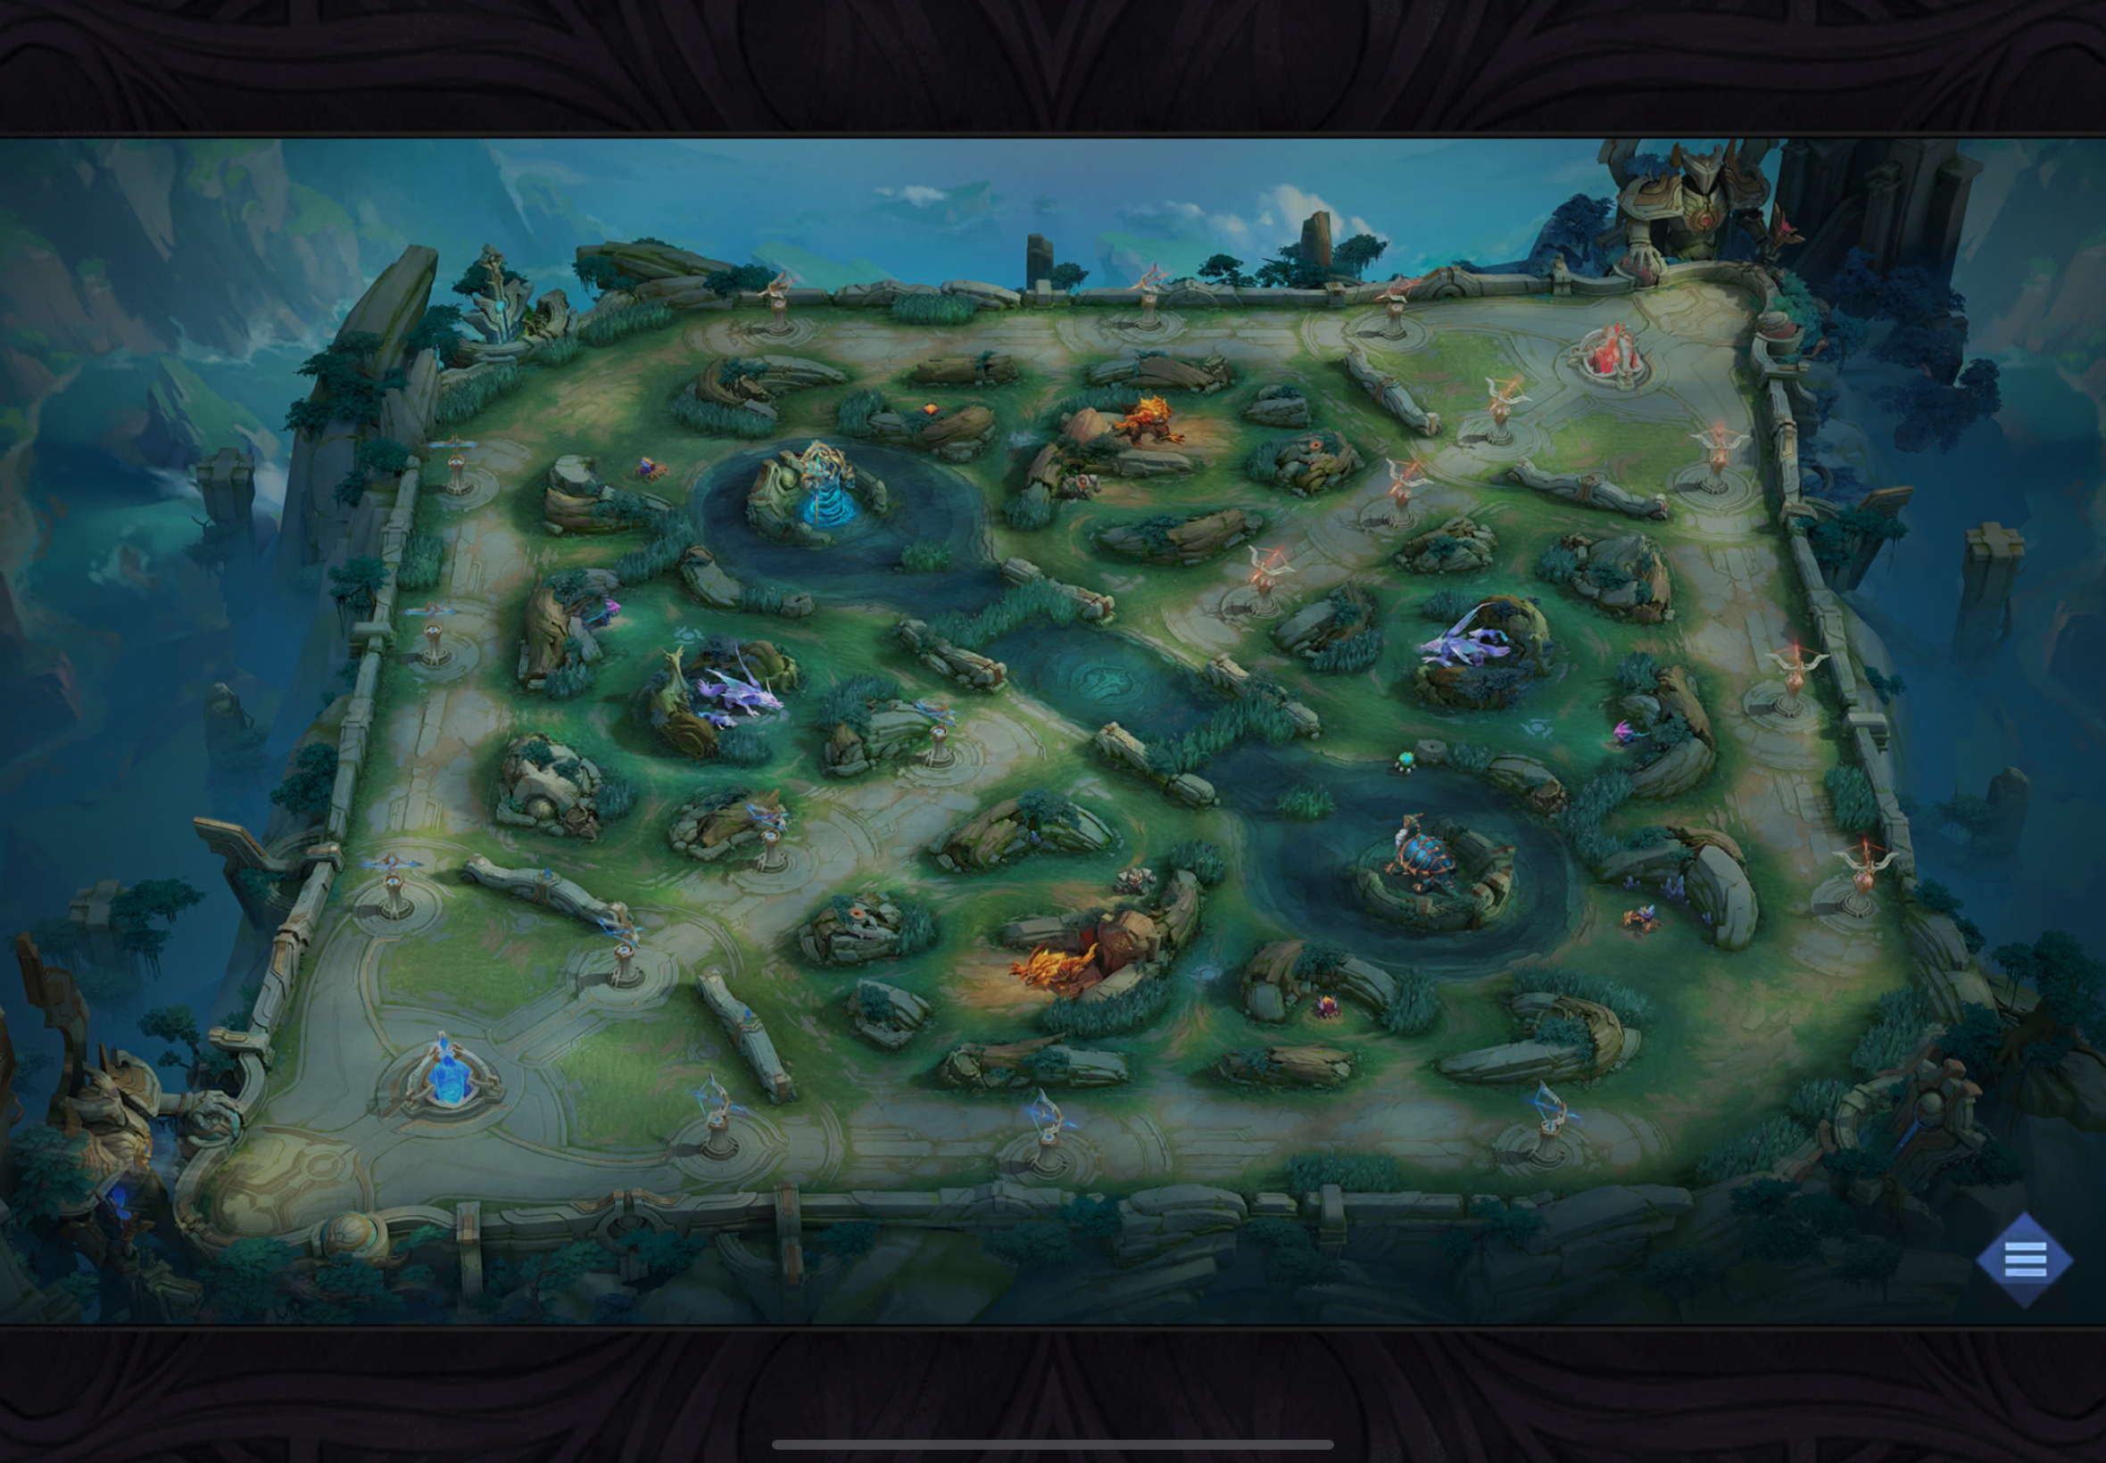
Map

Slide 2


Mini Map
L
T

Slide 3
Map
Side
Long
Crammer
L-Bush
Golem
PH
Dot
Tri-Bush
S-Bush
Lizard
Ambush
Purple
Small
George
Red

Slide 4
Turret Priority
CONDITIONS
Flanking Position
Long Zone (1-D)
+1 Damage (Pos 1/2)
+1 Body (Pos 3/5)
1
3
CONDITIONS
No Enemy Frontliner
+2 Body (Pos 3 & 5)
+1 Damage (Pos 1/2)
+1 CC (Pos 4)
5
4
2

Slide 5
Heavy Objective Set Up
Exp
Obj
Dmg
Roam
Roam
Obj
Exp
Dmg

Slide 6
Ideal War Position
Front
Press
Flanking
Front
Press
Conditional
Front
Press
Flanking
Conditional
Flanking

