Slide 1

STUDENT PRODUCTIVITY MANAGEMENT SYSTEM
A Mini Project by
SAMI ANSARI | (23106093)
JEET JAIN | (23106029)
SHASHANK IYER | (23106056)
TANISHQ BIRJE | (23106106)
Under the guidance of
PROF. POONAM TIWARE

Slide 2
Presentation Outline:
Introduction
Literature Survey of existing systems
Limitations in existing systems
Problem Statement
System Design
Technologies & Methodologies
Implementation Screenshots
Conclusion
References

Slide 3
Introduction:
Students face overwhelming challenges juggling academics, extracurriculars, and personal life. The Student Productivity Management System (SPMS) offers a comprehensive solution to help students manage their time, resources, and priorities effectively.
SPMS is designed to be accessible and user-friendly
Enhanced Academic Performance
Stronger Community
Improved Student Experience
Comprehensive Academic Resources
Personal Development Support

Slide 4
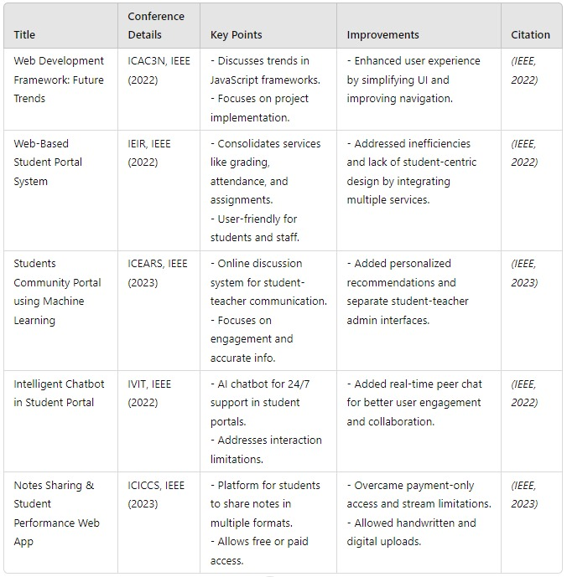
Literature survey:

Slide 5
Limitations in existing systems:
Poor Connectivity: Existing systems may experience delays due to connectivity issues. Our model ensures better connectivity for smoother, faster access to data.
Inefficient Note Sorting: Notes are poorly organized in many systems. Our Model provides better notes sorting, making it easier to find relevant materials quickly.
Outdated Updates: Many platforms miss important updates due to weak notification systems. Our model provides a better update system with real-time notifications and alerts.
Fragmented systems: There doesn’t exists a single system that contains everything. Our model provides access to most of the academic needs that can be provided by an institute in one seamless system.

Slide 6
Problem Statement:
Students in educational institutions face fragmented access to academic resources, inefficient task management, and communication challenges due to the absence of a centralized platform. This results in disorganization, difficulty accessing materials, and poor communication with faculty and peers.

Slide 7
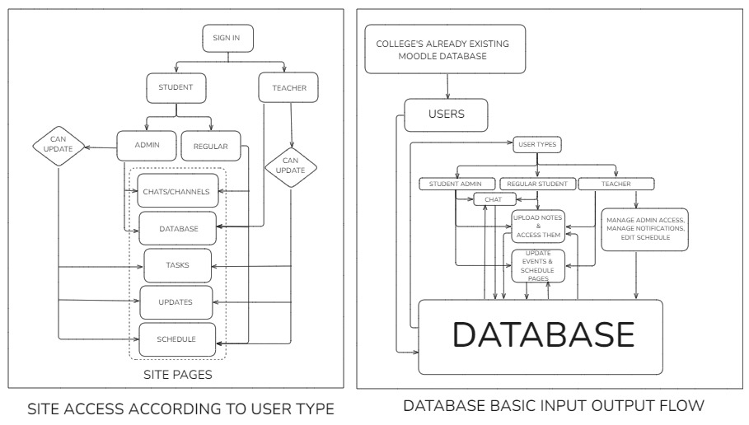
System Design:

Slide 8
Technologies & Methodologies:
Database: Firebase , Firestore, Firebase-storage.
Development tools: Visual Studio code(IDE), Live server extension, Google chrome.
Frontend: HTML and CSS
Backend: Vanilla Javascript

Slide 9
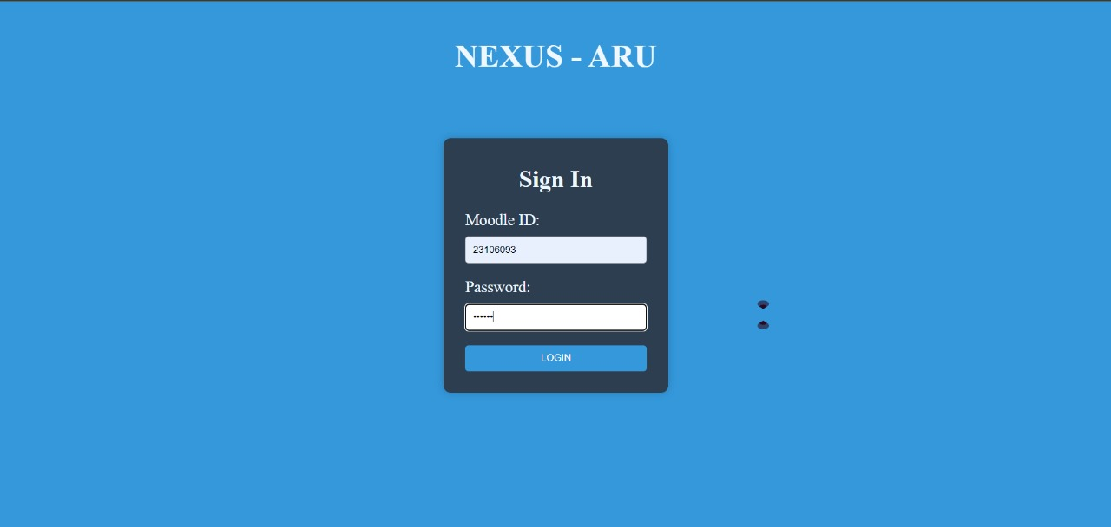
Implementation: (Implemented)

Slide 10
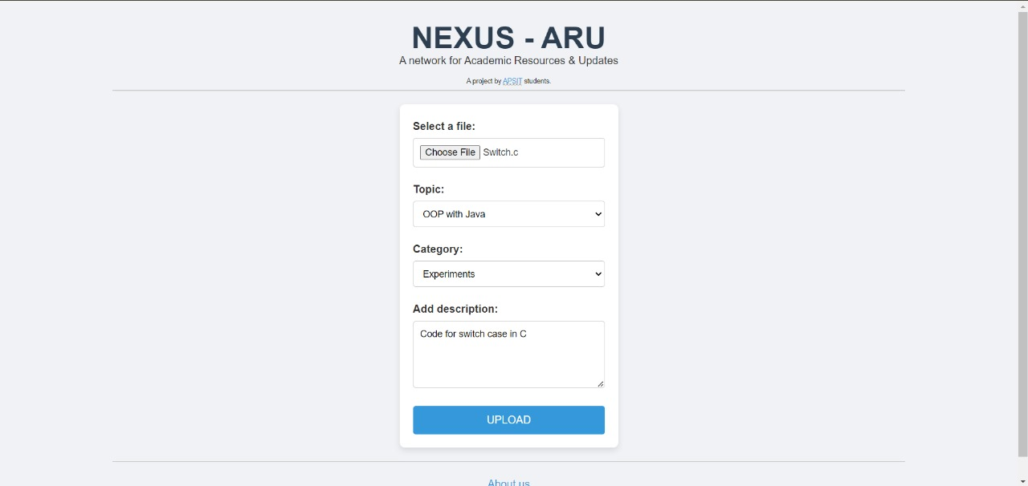
Implementation: (Implemented)

Slide 11
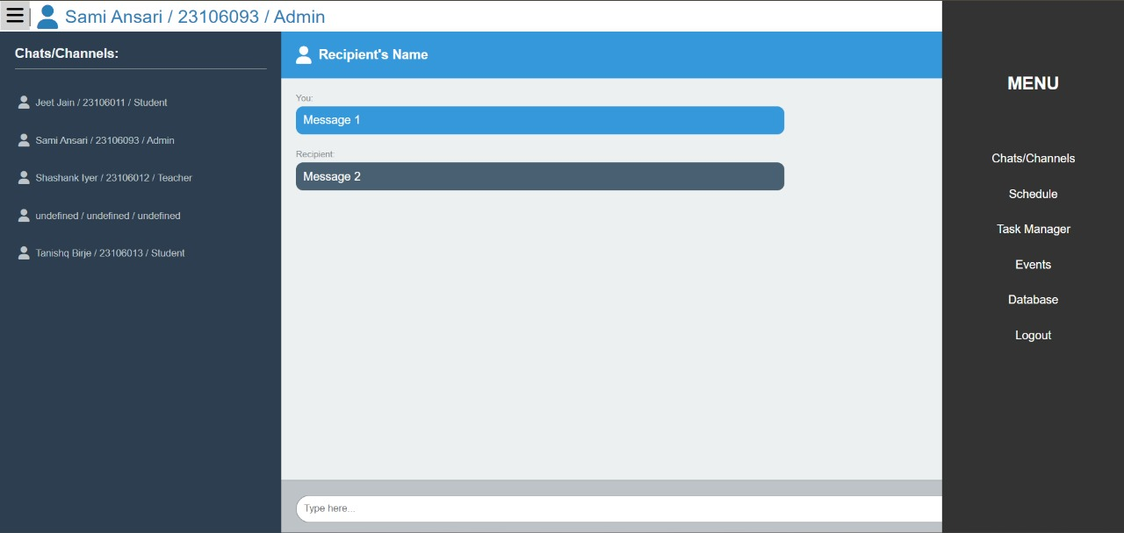
Implementation: (Implemented)

Slide 12
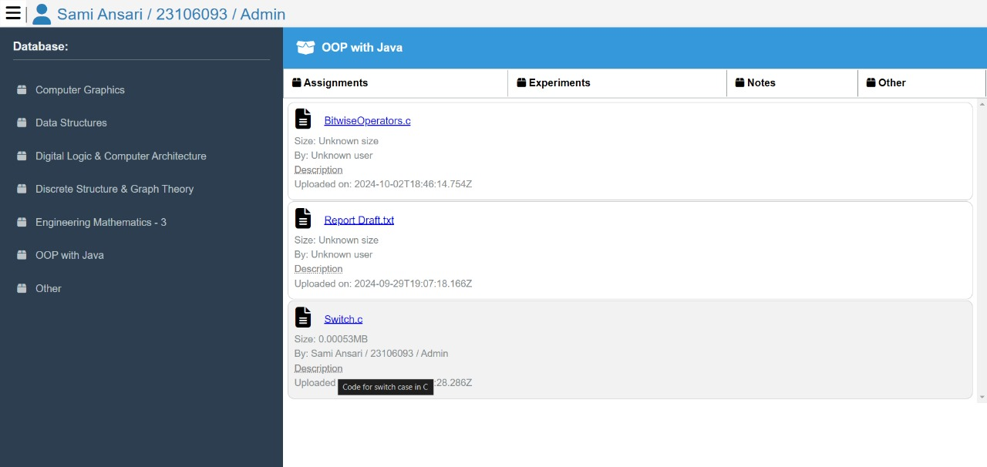
Implementation: (Implemented)

Slide 13
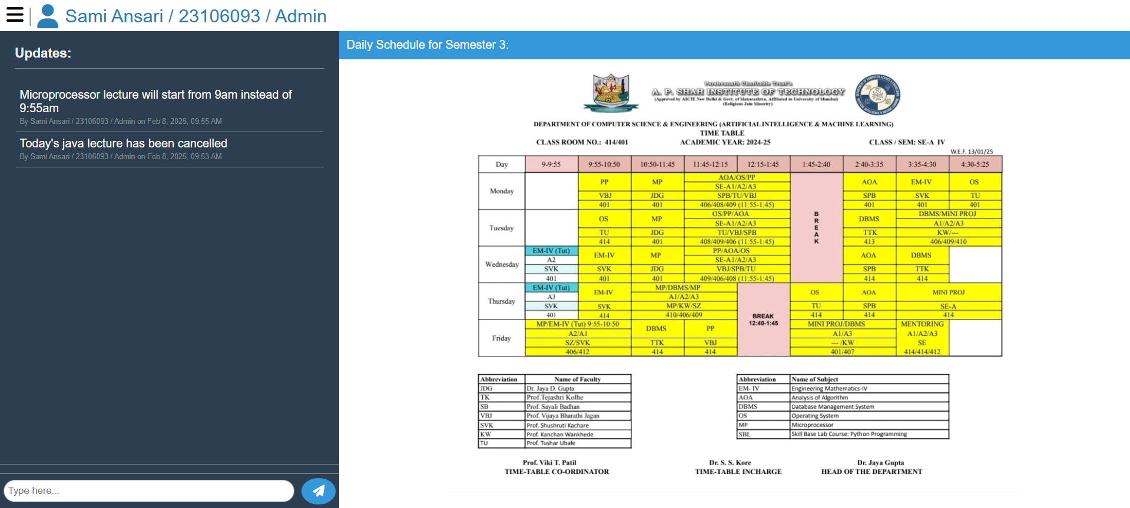
Implementation: (Implemented)

Slide 14
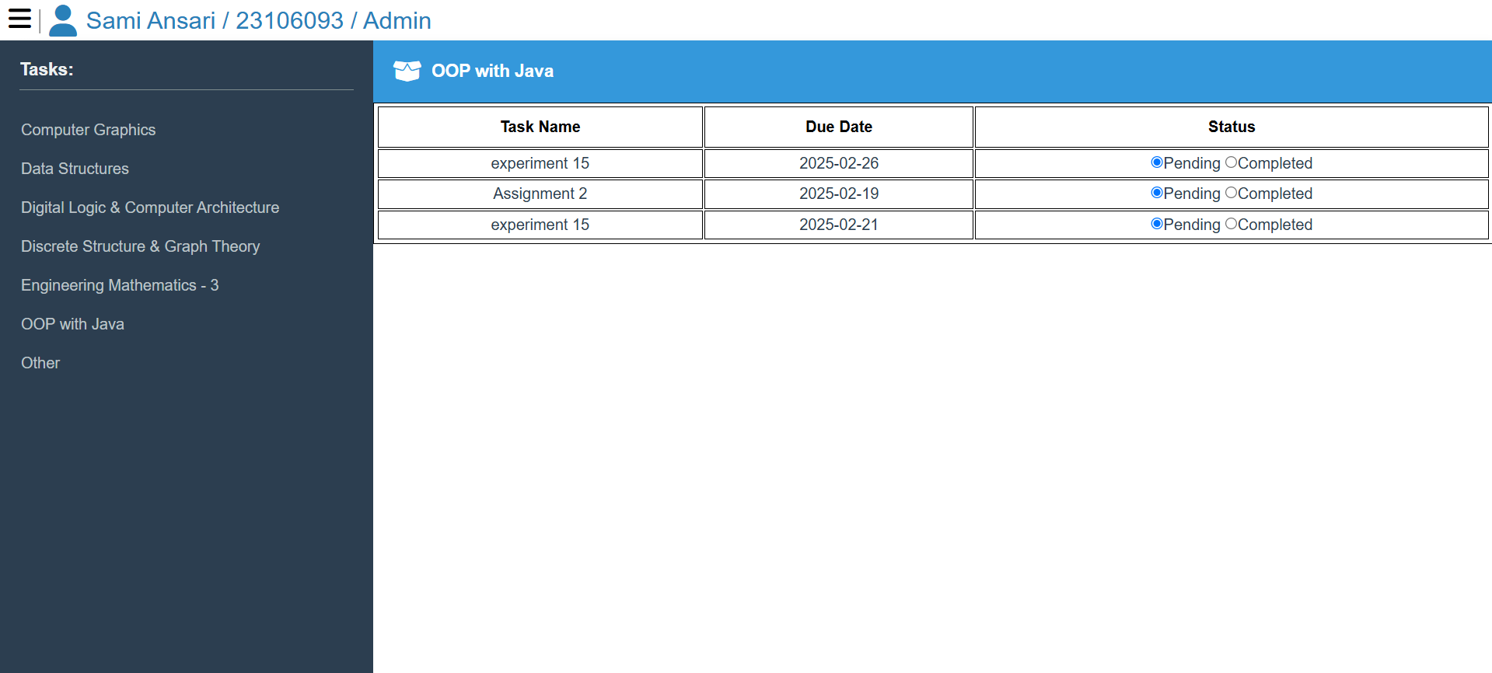
Implementation: (Implemented)

Slide 15
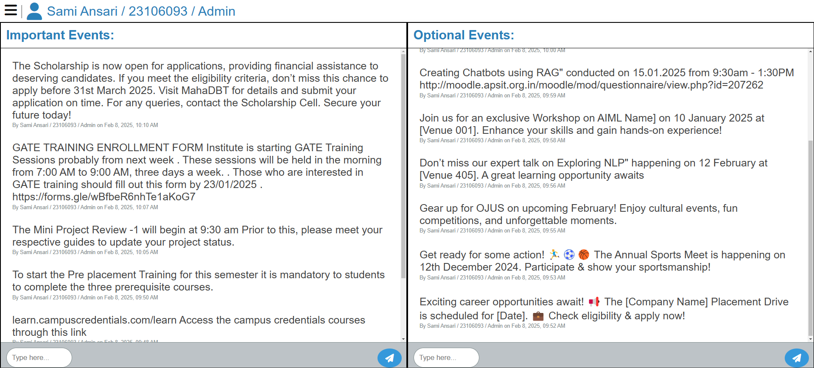
Implementation: (Implemented)

Slide 16
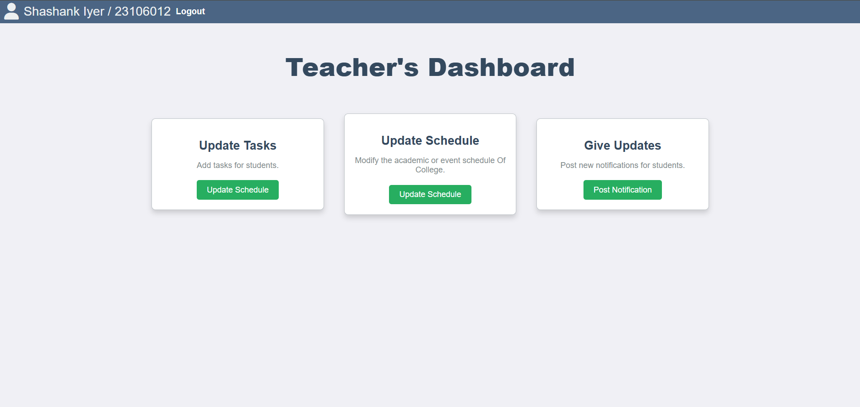
Implementation: (Half-Implemented)

Slide 17
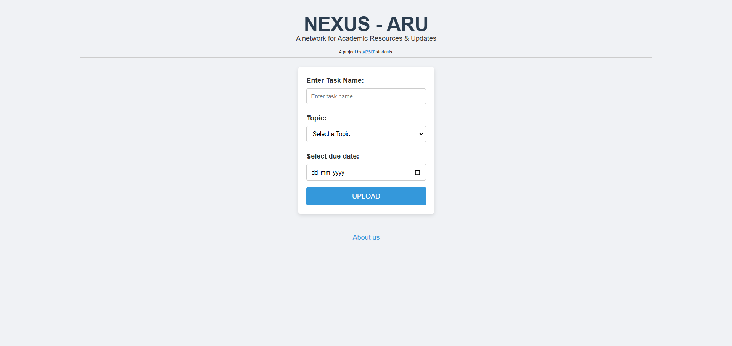
Implementation: (Implemented)

Slide 18
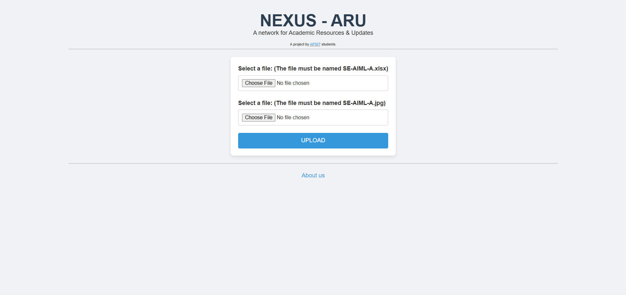
Implementation: (Implemented)

Slide 19
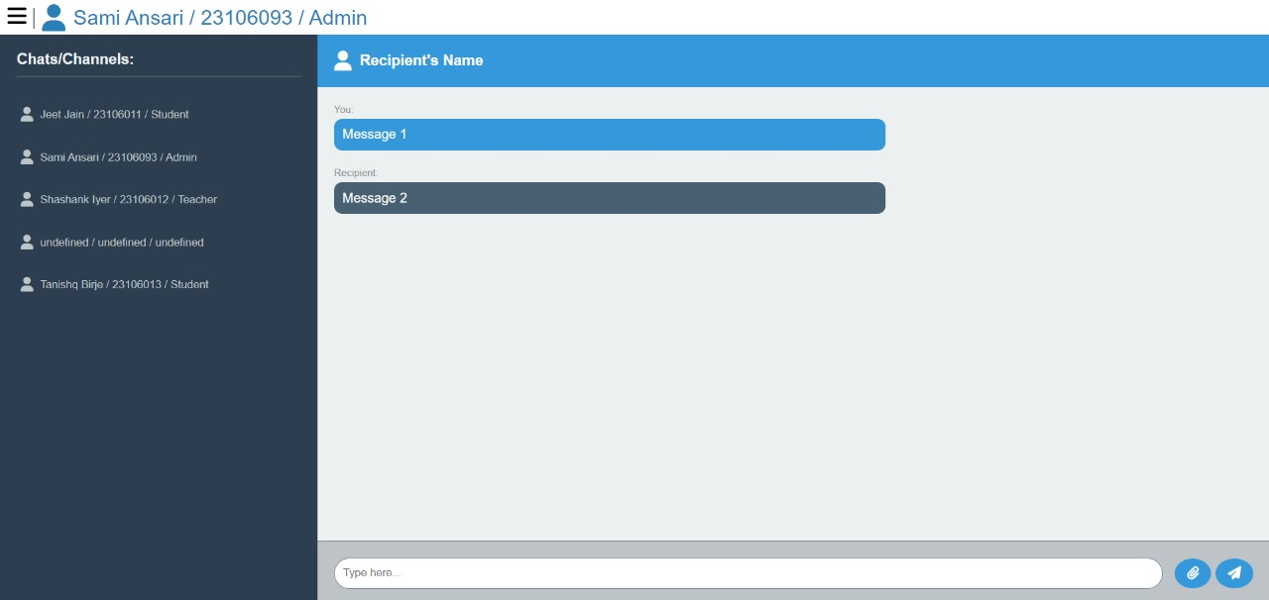
Implementation: (Yet to be Implemented)

Slide 20
Conclusion:
The first phase of development has been successfully completed, including system design, database setup, front-end development, and a functional notes section. The platform now enables easy sharing and access to academic materials, promoting better organization and collaboration.
In the next phase, we will implement key features such as task management, real-time chat, schedule notifications, and event coordination to enhance communication and productivity.

Slide 21
References
https://docs.phpmyadmin.net/en/latest/require.html#php
https://www.apachefriends.org/docs/hosting-xampp-on-aws.html
https://youtu.be/at19OmH2Bg4
Used AI (Gemini, ChatGPT) for code suggestions, corrections and implementation ideas.
Used Figma to create the initial concept design of the pages.
Made the system design diagram using Excalidraw.
Research papers as listed in the literature survey part of presentation.

