Slide 1

STUDENT PRODUCTIVITY MANAGEMENT SYSTEM
A Mini Project by
SAMI ANSARI | (23106093)
JEET JAIN | (23106029)
SHASHANK IYER | (23106056)
TANISHQ BIRJE | (23106106)
Under the guidance of
PROF. POONAM TIWARE

Slide 2
Presentation Outline:
Introduction
Literature Survey of existing systems
Limitations in existing systems
Problem Statement
System Design
Technologies & Methodologies
Implementation Screenshots
Conclusion
References

Slide 3
Introduction:
Students face overwhelming challenges juggling academics, extracurriculars, and personal life. The Student Productivity Management System (SPMS) offers a comprehensive solution to help students manage their time, resources, and priorities effectively.
It is designed to be accessible and user-friendly
Enhanced Academic Performance
Stronger Community
Improved Student Experience
Comprehensive Academic Resources
Personal Development Support

Slide 4
Literature survey:
Title | Conference Details | Key Points | Improvements | Citation
Notes Sharing & Students Performance Web App | ICICCS, IEEE (2023) | - Platform for students to share notes in multiple formats. - Allows free or paid access. | - Overcame payment-only access & stream limitations. - Allowed handwritten & digital uploads. | (IEEE, 2023)
Students Community Portal using Machine Learning | ICEARS, IEEE (2023) | - Online discussion system for student-teacher communication. - Focuses on engagement & accurate info | - Added personalized task management and separate student-teacher interfaces. | (IEEE, 2023)
Web Development Framework: Future Trends | ICAC3N, IEEE (2022) | - Discusses trends in Javascript frameworks. - Focuses on project implementation | - Enhanced user experience by simplifying UI & improving navigation | (IEEE, 2022)
Web-Based Student Portal System | IEIR, IEEE (2022) | - Consolidates services like grading, attendance & assignments. - User-friendly for students & staff | - Addressed inefficiencies & lack of student centric design by integrating multiple services. | (IEEE, 2022)
Intelligent Chatbot in Student Portal | IVIT, IEEE (2022) | - AI chatbot for 24/7 support in student portals. - Addresses interaction limitations. | - Added real-time peer chat for better user engagement & collaboration | (IEEE, 2022)

Slide 5
Limitations in existing systems:
Poor Request Management: Existing systems experience delays in fulfillment of requests due to communication issues. Our system keeps forums for requests for resources.
Inefficient Note Sorting: Notes are poorly organized in many systems. Our Model provides better notes sorting, making it easier to find relevant materials quickly.
Outdated Updates: Many platforms miss important updates due to weak notification systems. Our model provides a better update system with real-time notifications and alerts.
Fragmented systems: There doesn’t exists a single system that contains everything. Our model provides access to most of the academic needs that can be provided by an institute in one seamless system.

Slide 6
Problem Statement:
Students in educational institutions face fragmented access to academic resources, inefficient task management, and communication challenges due to the absence of a centralized platform. This results in disorganization, difficulty accessing materials, and poor communication with faculty and peers.

Slide 7
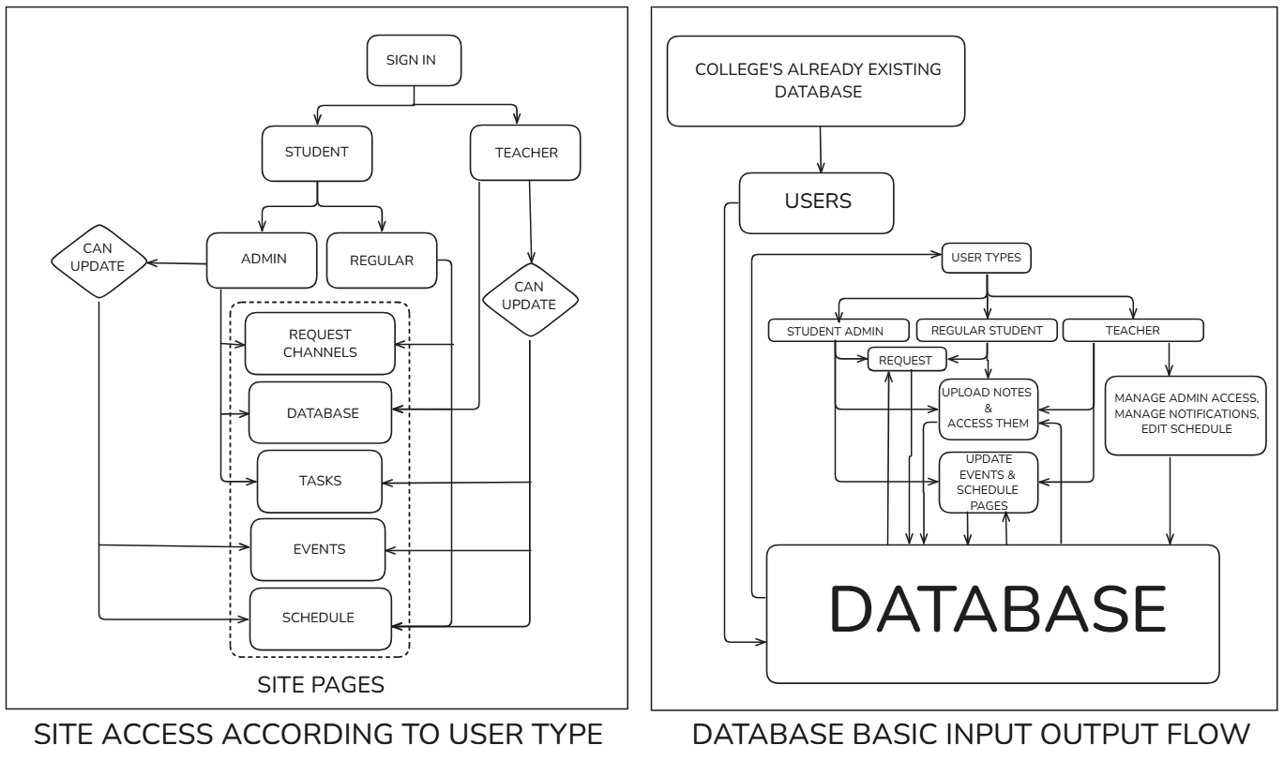
System Design:

Slide 8
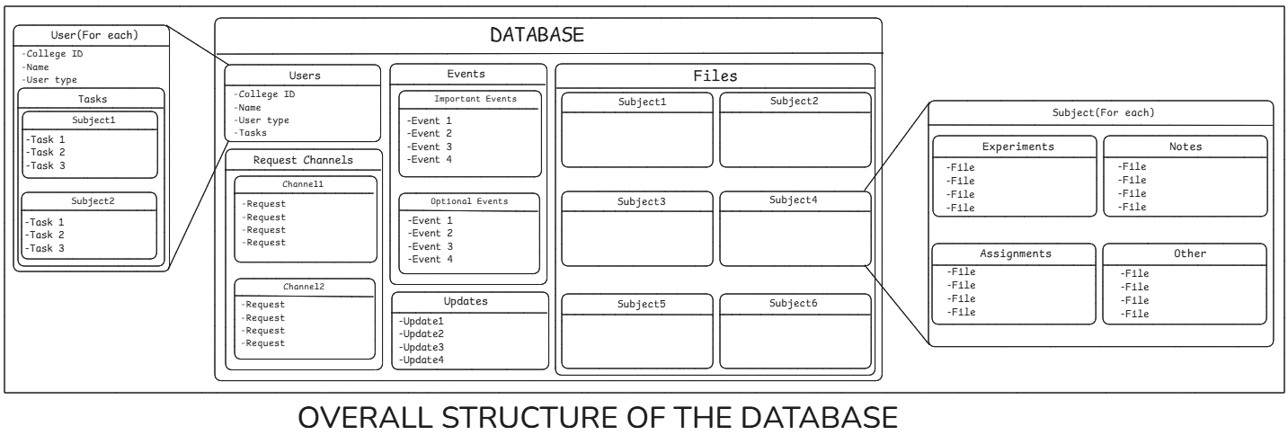
Database Design:

Slide 9
Technologies & Methodologies:
Database: Firebase , Firestore, Firebase-storage.
Development tools: Visual Studio code(IDE), Live server extension, Google chrome.
Frontend: HTML and CSS
Backend: Vanilla Javascript

Slide 10
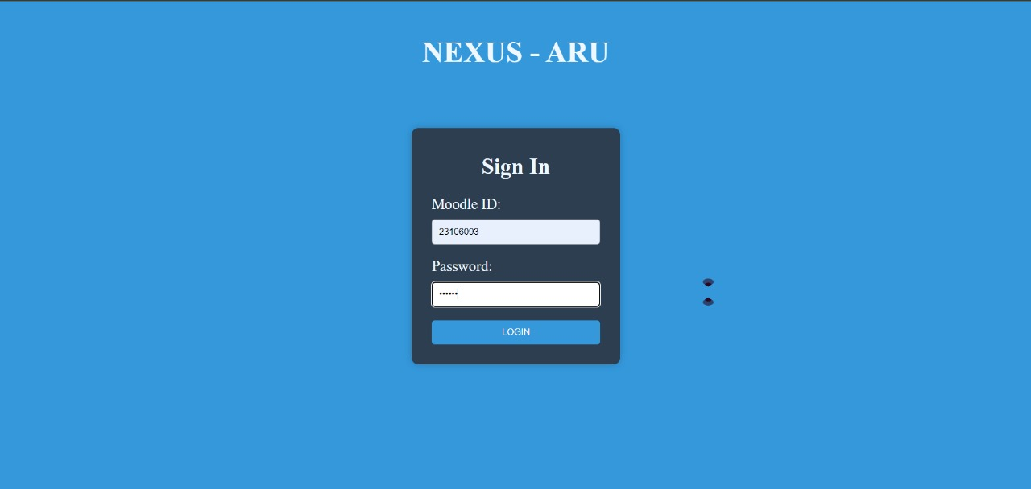
Implementation:

Slide 11
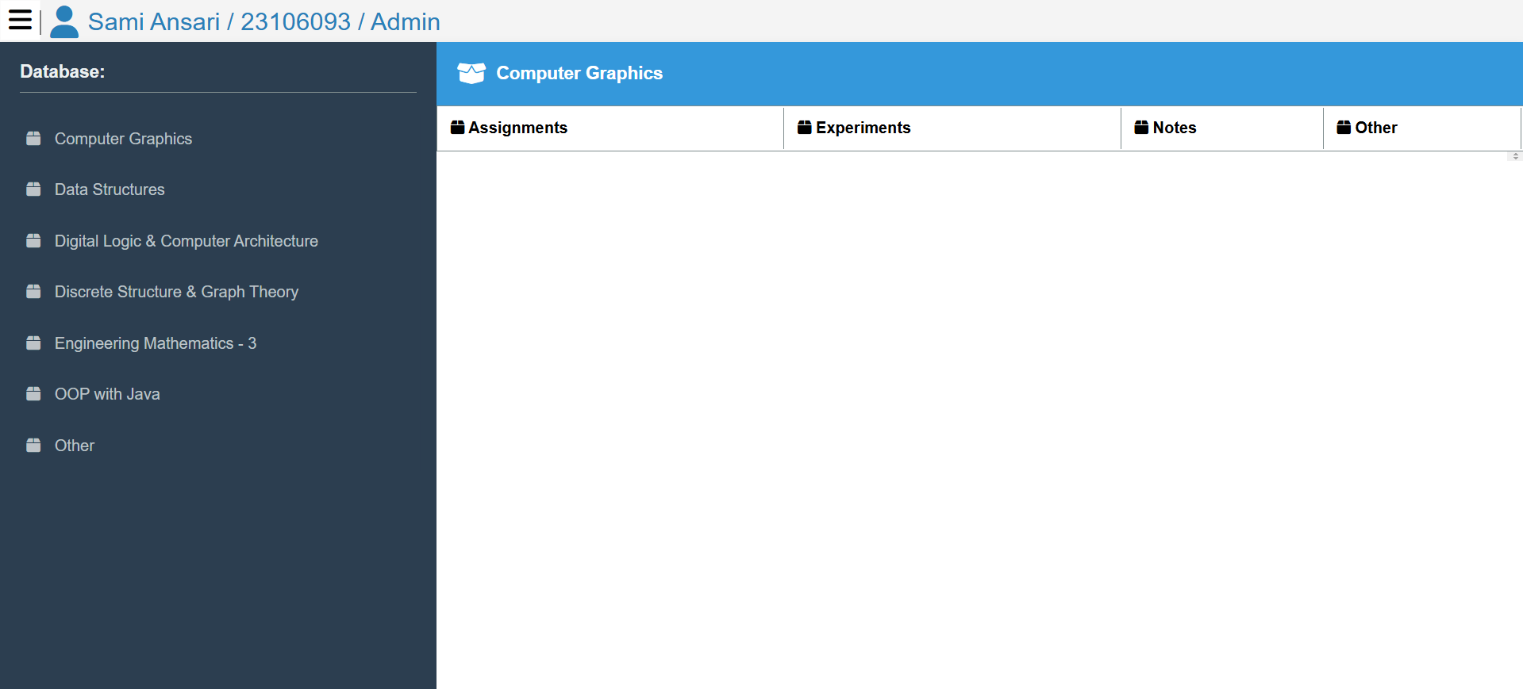
Implementation:

Slide 12
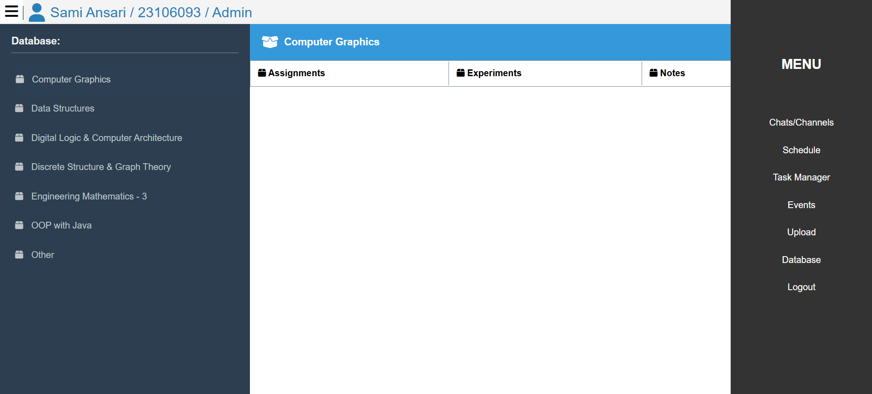
Implementation:

Slide 13
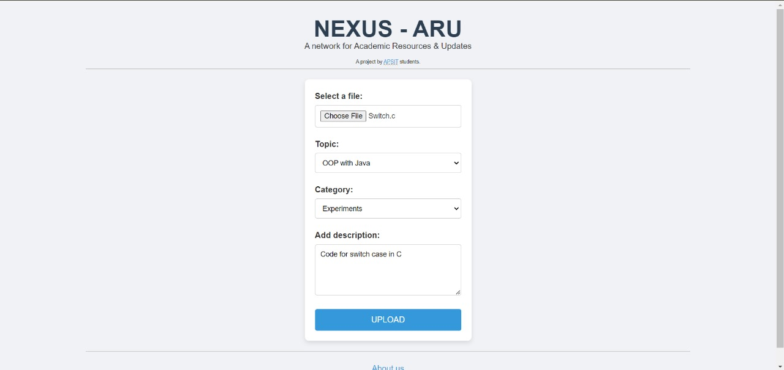
Implementation:

Slide 14
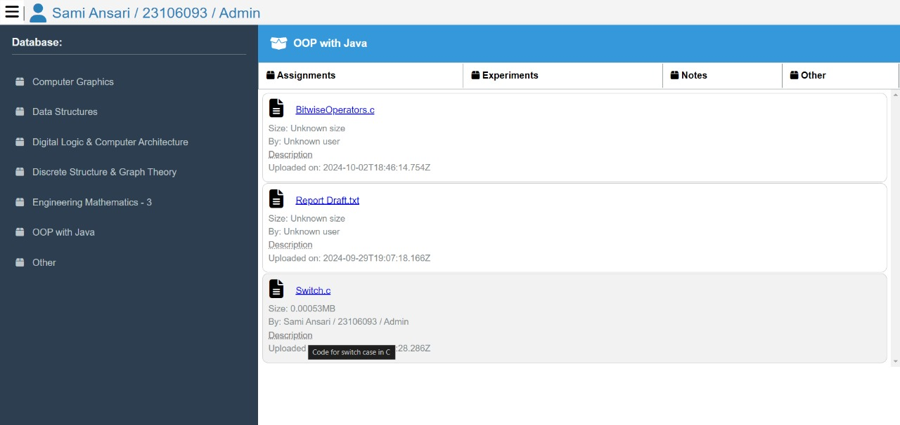
Implementation:

Slide 15
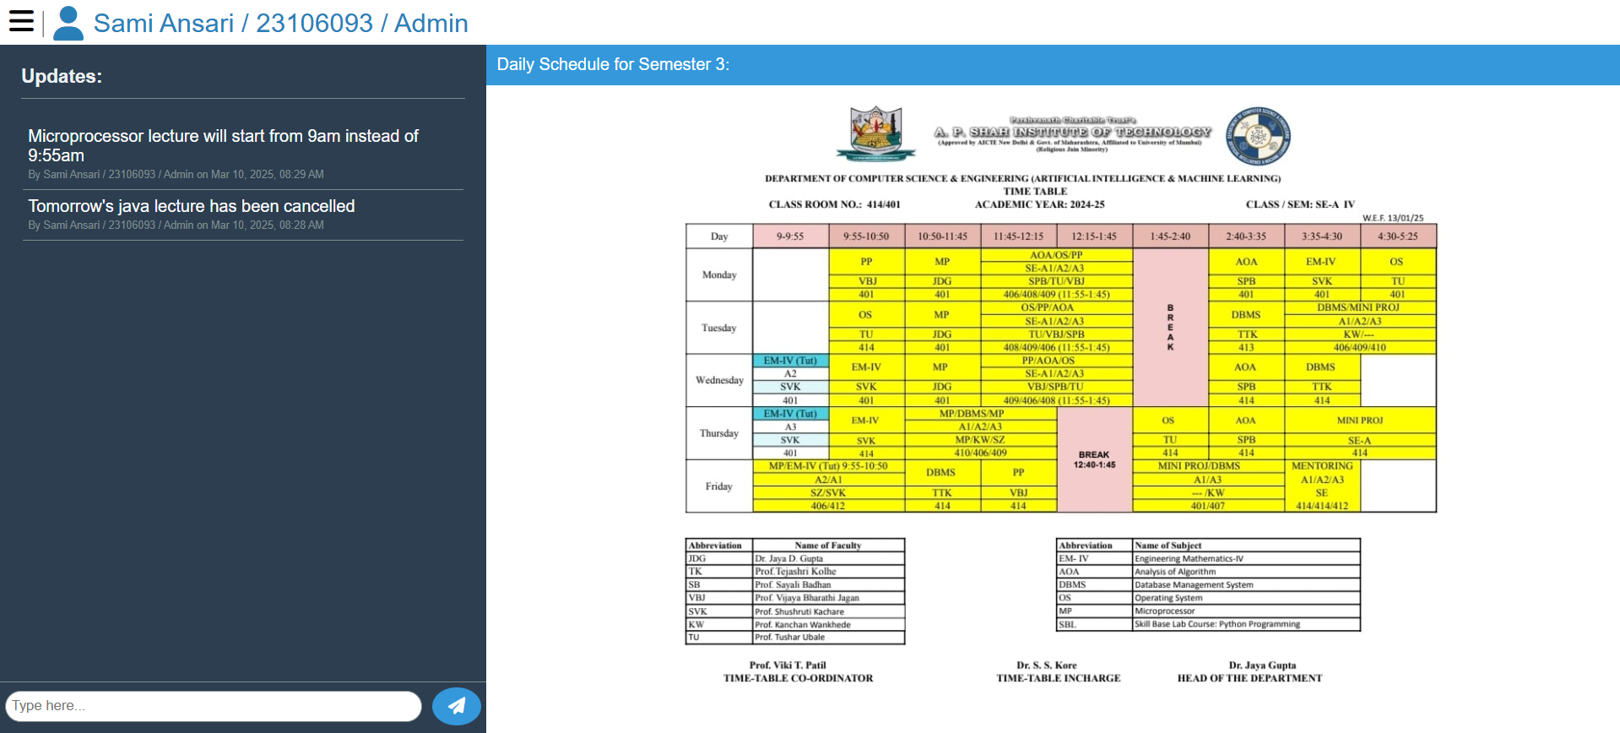
Implementation:

Slide 16
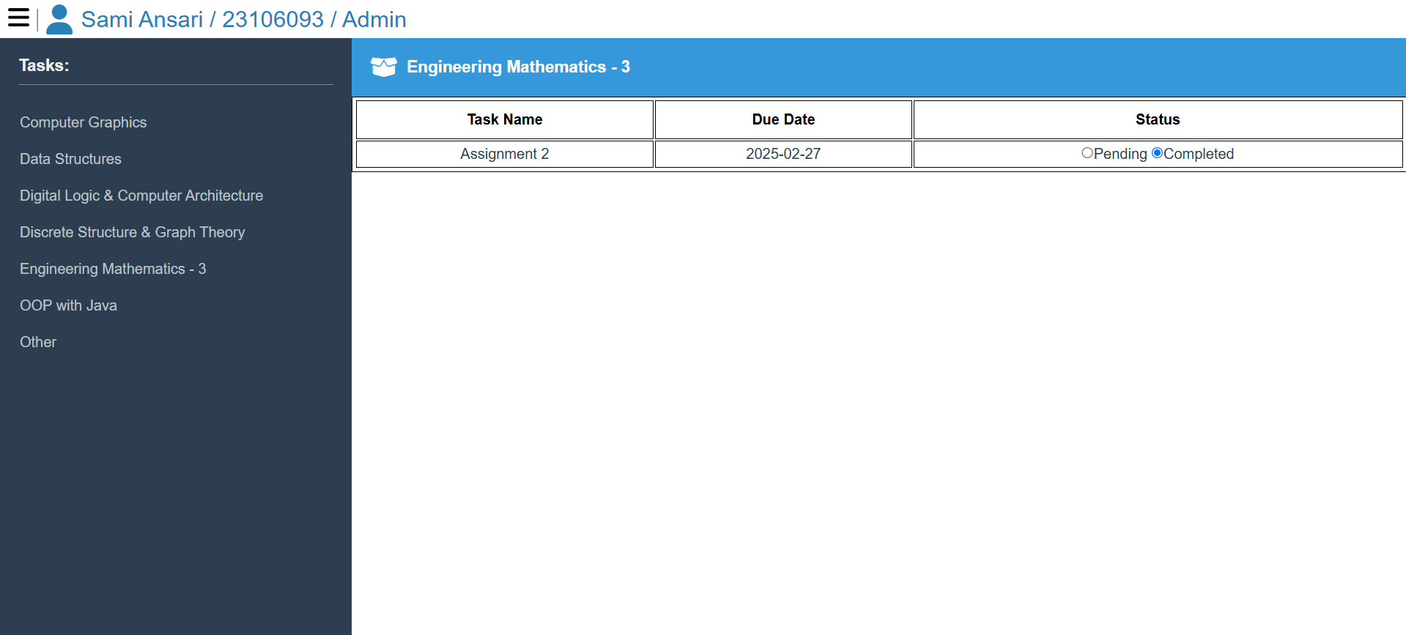
Implementation:

Slide 17
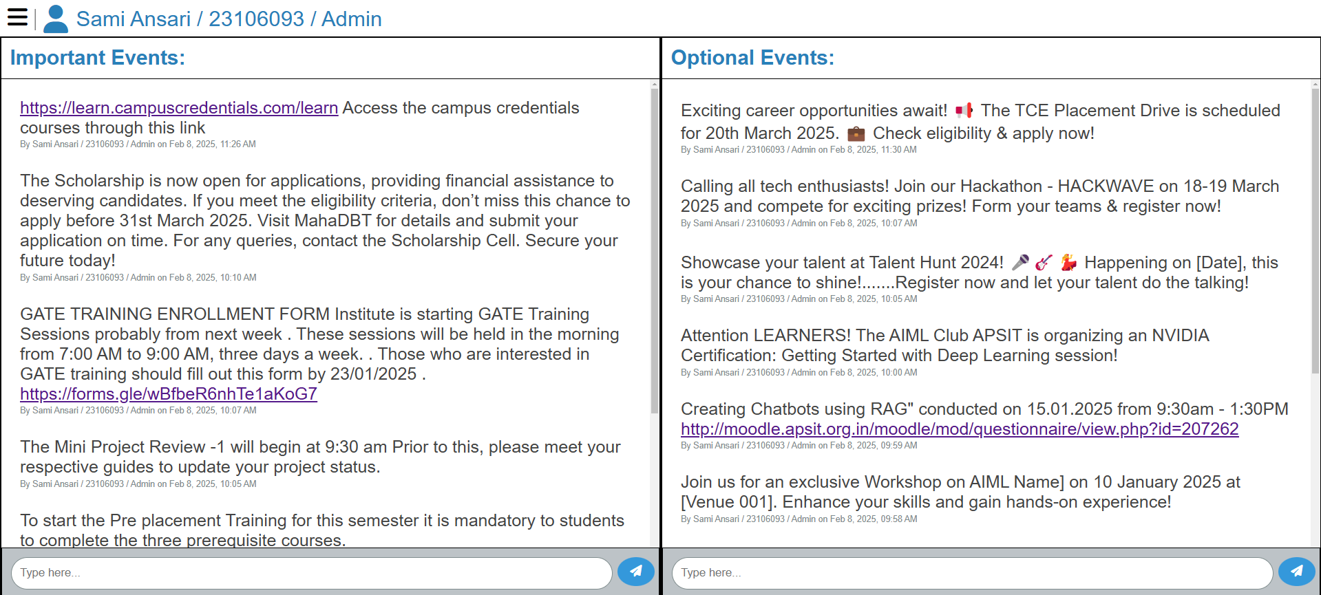
Implementation:

Slide 18
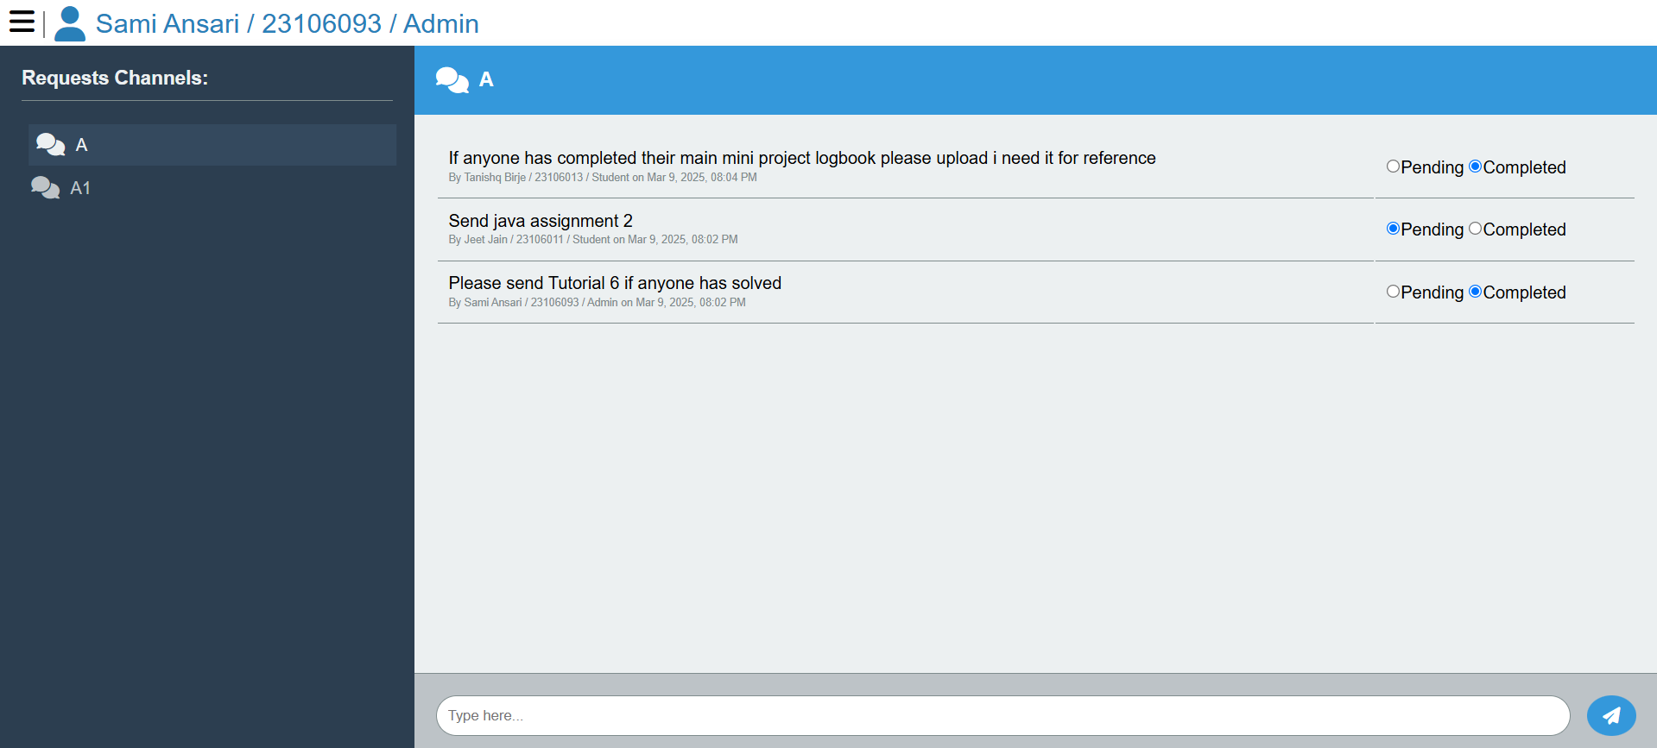
Implementation:

Slide 19
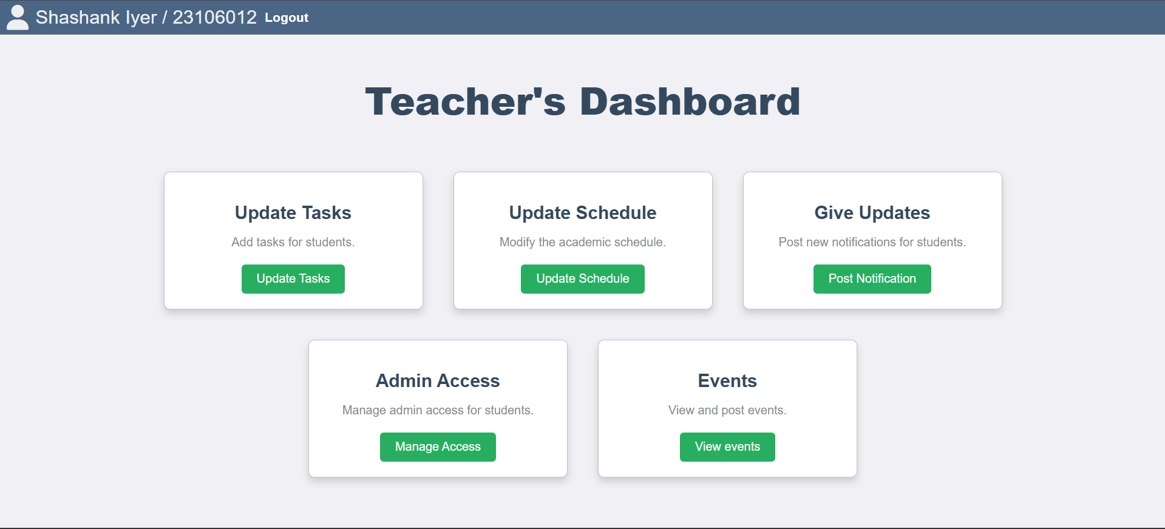
Implementation:

Slide 20
Conclusion:
Successfully developed an efficient and user-friendly system for improved interaction and organization.
Utilized cloud-based solutions and real-time data management for scalability and seamless performance.
Overcame challenges in data synchronization and optimization through iterative improvements.
Achieved all key objectives while creating a foundation for future enhancements like automation and analytics.
Demonstrates the impact of well-structured digital solutions and offers valuable insights for future projects.

Slide 21
References & Resources
https://docs.phpmyadmin.net/en/latest/require.html#php
https://www.apachefriends.org/docs/hosting-xampp-on-aws.html
https://www.youtube.com/@phoebeyutbt/videos
Used AI (Gemini, ChatGPT) for code suggestions, corrections and implementation ideas.
Used Figma to create the initial concept design of the pages.
Made the diagrams using Excalidraw.
Research papers as listed in the literature survey part of presentation.

