Slide 1
Week 2 Project Update
Data Exploration

Slide 2

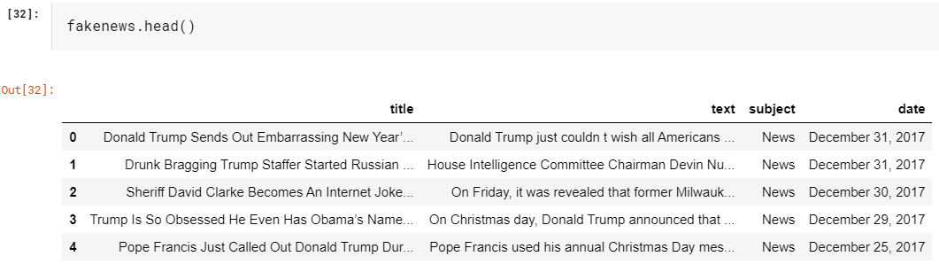
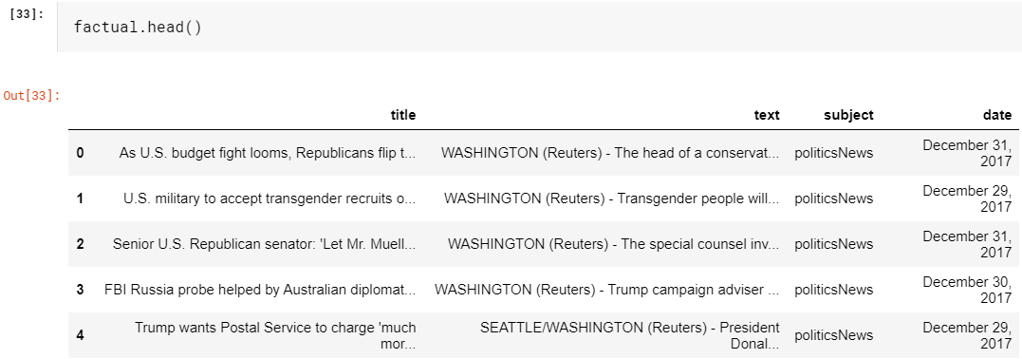
Data
In the first step we need to import the data in Kaggle
Next, we can look at the data with a couple of quick commands

Slide 3


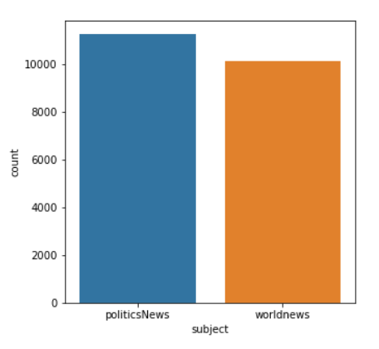
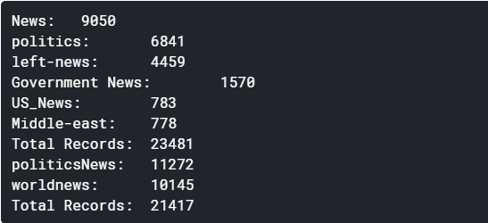
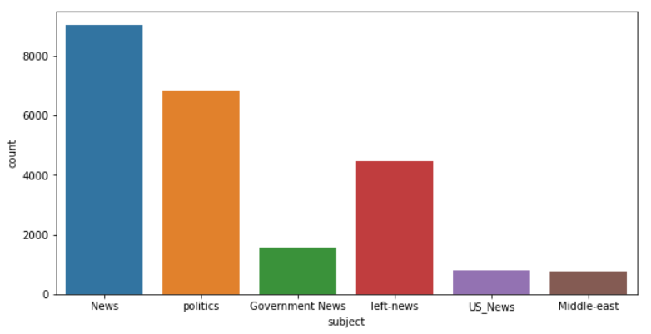
Exploration
Graphing the data

Slide 4
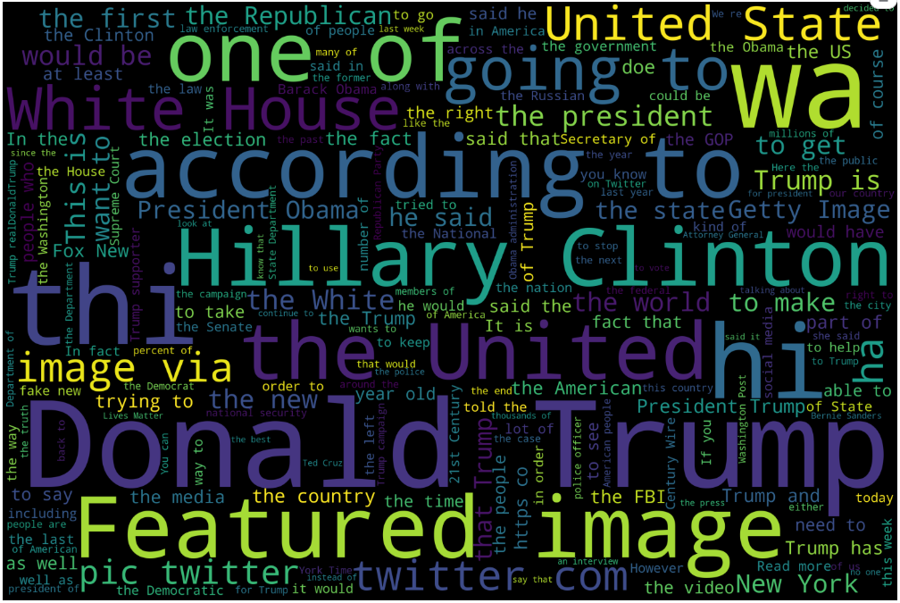
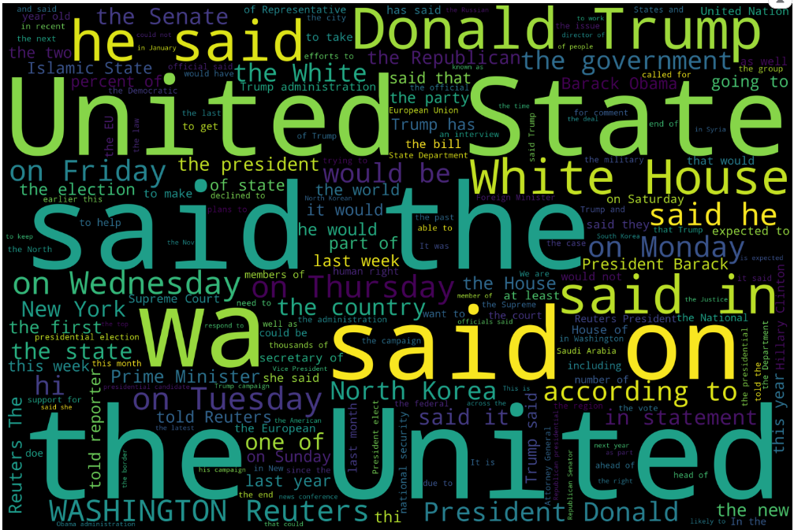
Exploration
Fake News Word Cloud
Factual News Word Cloud

Slide 5
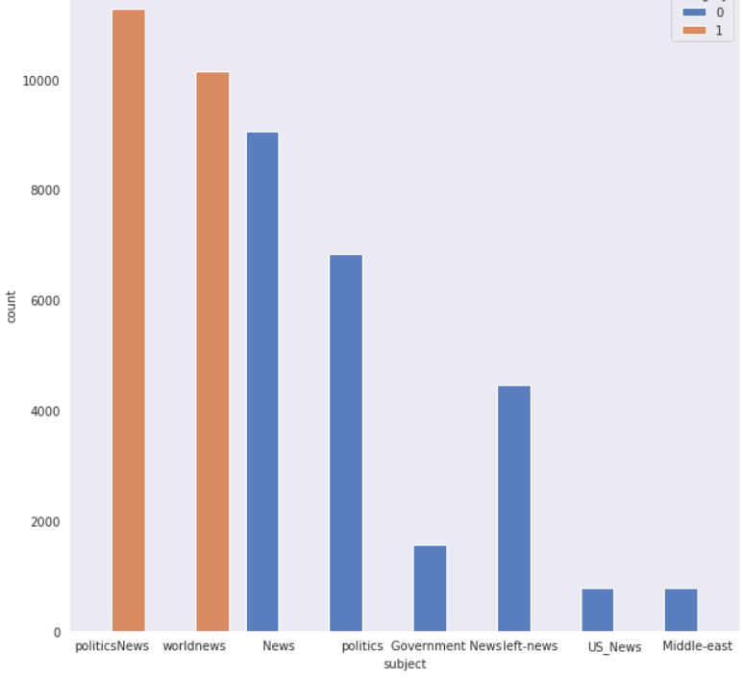
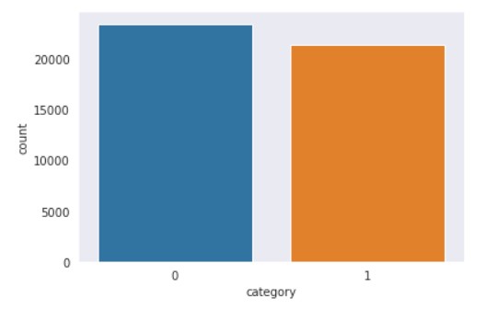

Exploration
Merging the data and graphing the results

