Slide 1
Matt Menefee
Week 2 Progress report
Project Proposal
Detecting fake news using machine learning and neural networks

Slide 2
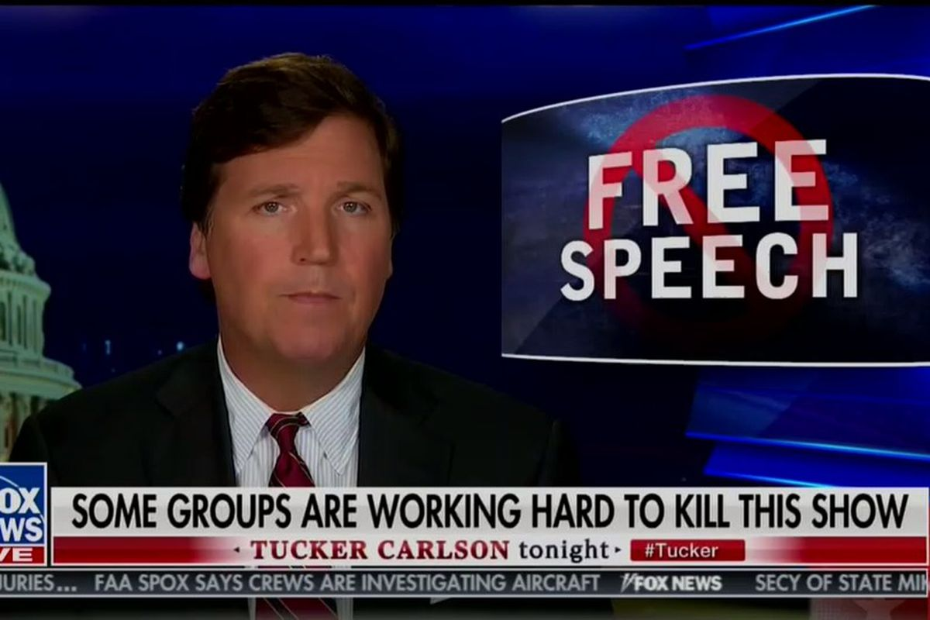
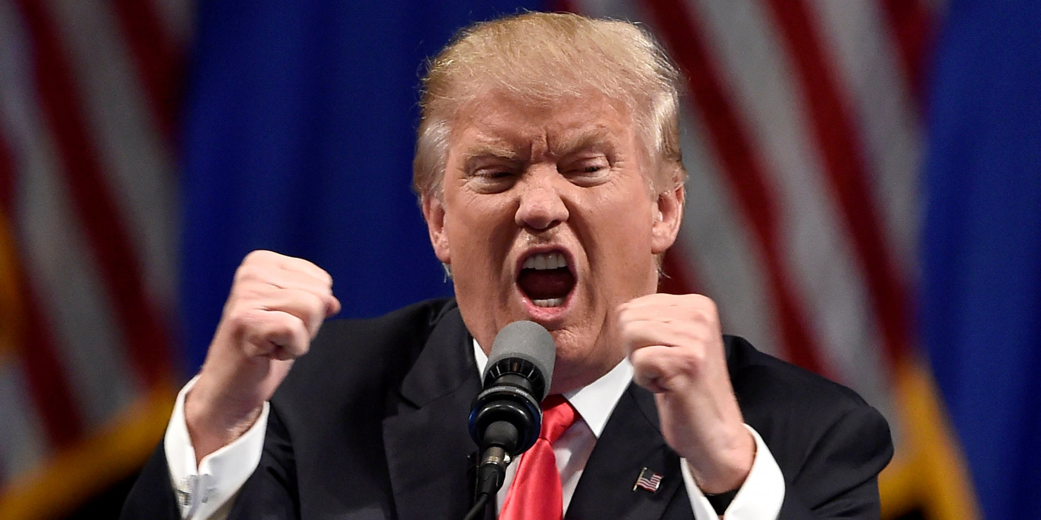
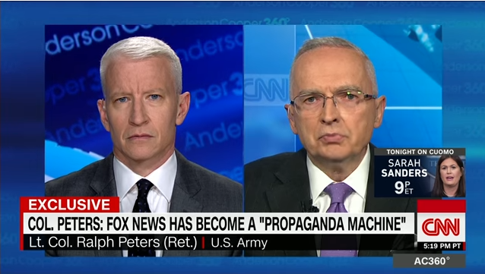
Objectives:
The purpose of this study is to design an algorithm that can detect if a given news article should be classified as real or fake news.
Secondary Objective:
To learn new methods of text analysis using python, and to determine if news articles can truly be classified as fake.
This Photo by Unknown Author is licensed under CC BY-NC-ND
This Photo by Unknown Author is licensed under CC BY-SA
This Photo by Unknown Author is licensed under CC BY-NC

Slide 3
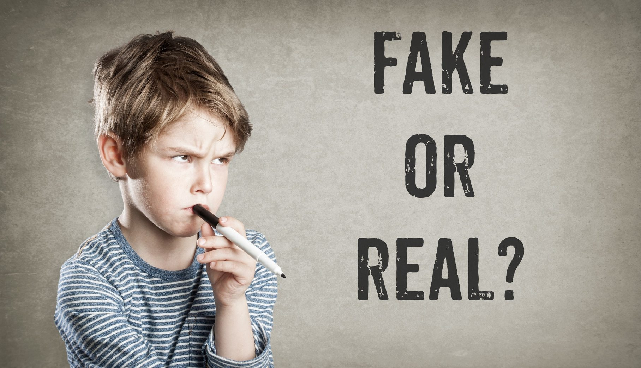
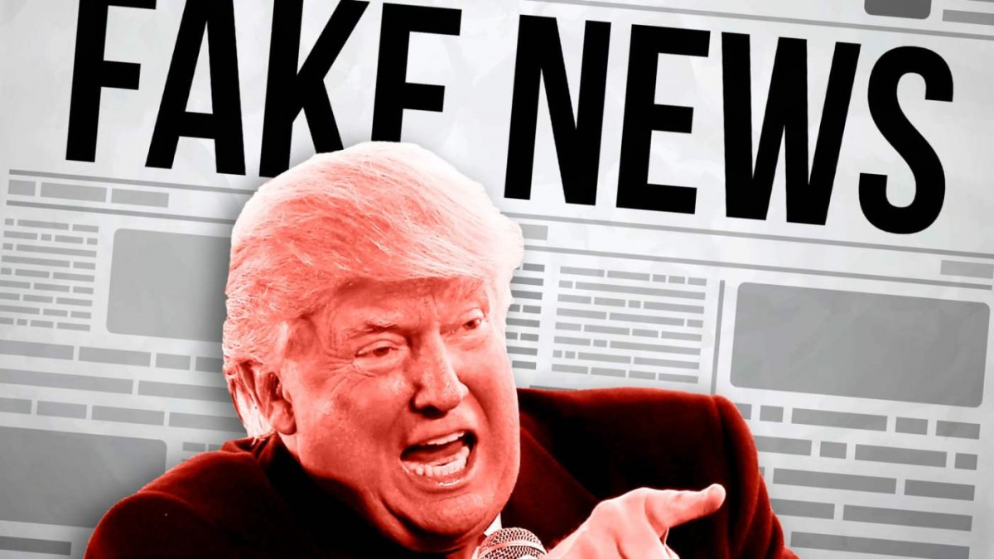
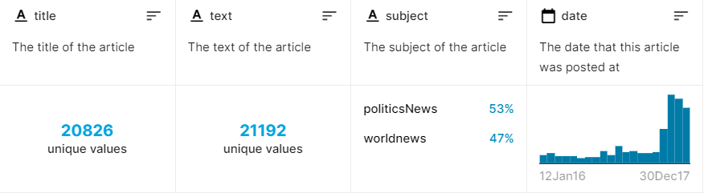
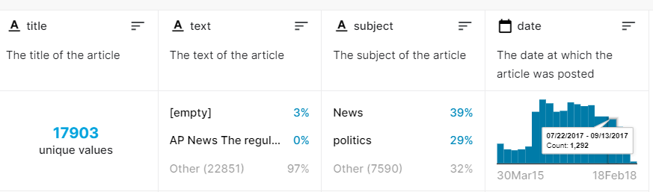
Data:
The first set of data for the model is from the Kaggle dataset Fake and real news dataset.
This data set contains 17903 fake news and 20826 True news articles.
The data ranges from 2015 to 2017
Topics include world news, politics, U.S. News, Government news, and Middle-East news.
To test the algorithm further I have obtained news articles from the BBC
This dataset has 2225 unique articles
Topics include tech, sports, politics, business, and entertainment.
TRUE NEW ARTICLES
FAKE NEWS ARTICLES
This Photo by Unknown Author is licensed under CC BY-SA-NC
This Photo by Unknown Author is licensed under CC BY-SA-NC

Slide 4
Analysis:
In the first phase I will be exploring the Kaggle data using word clouds, and histograms
Next, I will create a neural network to analyze the Kaggle data set using various layers, regularization methods, and optimizers to analyze and classify the data into fake or true news stories.
Finally, I will test the Kaggle dataset and graph the results.
After analyzing the Kaggle set I will need to clean the BBC news articles by removing punctuation, special characters and removing all uppercase letters. I will then tokenize the data to prepare it for analysis.
Next, I will explore the BBC dataset using the word clouds, and histograms
Then I will test the BBC data set on the model used to analyze the Kaggle dataset
Finally, I will use a transfer learning method and employ the GloVe algorithm to compare my results to a pretrained network

Slide 5


Obstacles:
Refamiliarizing myself with text analysis
Idioms, expressions, nuance, sarcasm, may adversely effect the analysis
Are their different levels of fake news? Should an article be considered fake news even if most of it is true?
How much of an article needs to be fabricated for it to be considered fake?
This Photo by Unknown Author is licensed under CC BY

