Slide 1

Week 4 Progress Report
Data Cleaning and initial Model

Slide 2


This week Focus
The focus of this week’s work was on the following:
Data cleaning
Tokenization
Creating the initial model
Results of the initial model

Slide 3
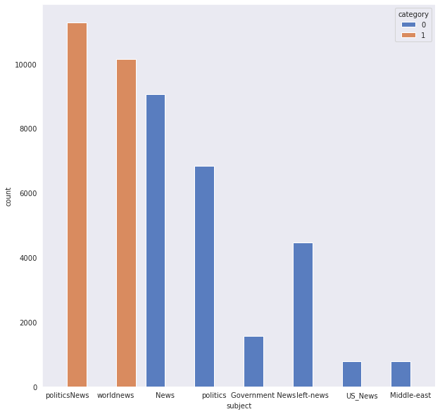
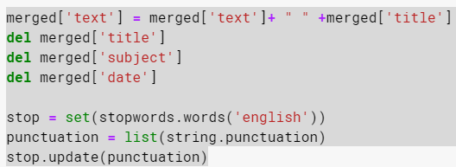
Data cleaning
After last week, the true and false data sets were merged.
For the classification to work the categories need to be removed.
The title and date were also unnecessary for determining if a story was true or false so they were removed as well
The date column of the data also was unnecessary and so it was removed from the set.

Slide 4
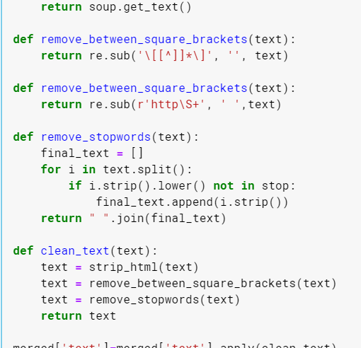
Data Cleaning
Stop words are the most common words in a language and in the process of natural language processing they can slow down our analysis.
Upper case letters, brackets, special characters and other punctuation are all removed from the corpus to make it more uniform.

Slide 5

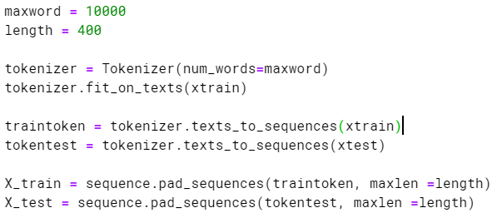
Tokenization
Tokenization is the process of vectorizing the corpus into a list of integers.
The data is tokenized so that it can be embedded into the model.
The embedding layer creates a geometric embedding space where the structure of the corpus can be mapped.

Slide 6
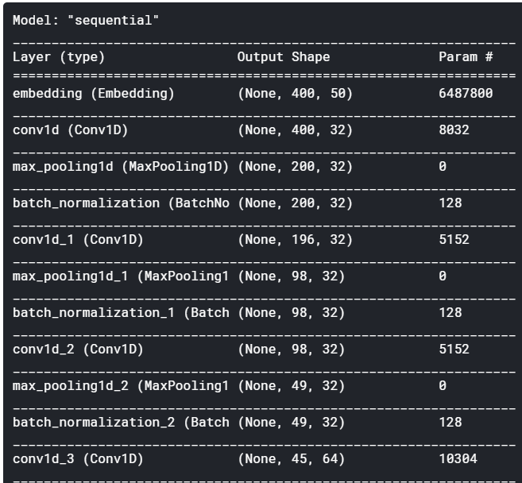
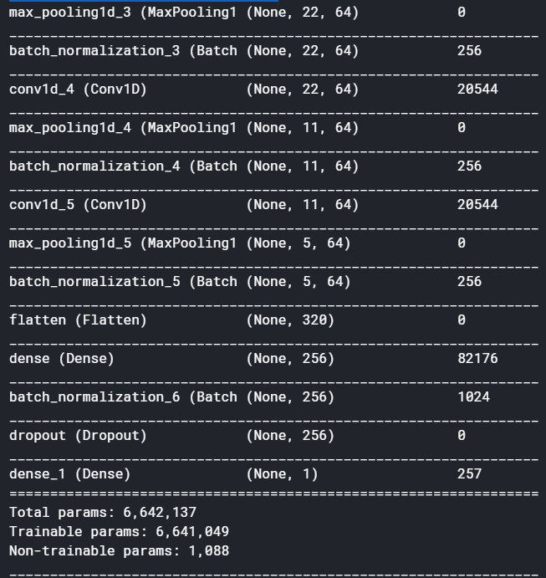
The Initial Model
The initial model I have created consists of 1D convolutional layers and 1D max pooling layers. These layers are better equipped for analyzing one dimensional data.
Additionally, I used batch normalization in the model to regularize the data.

Slide 7
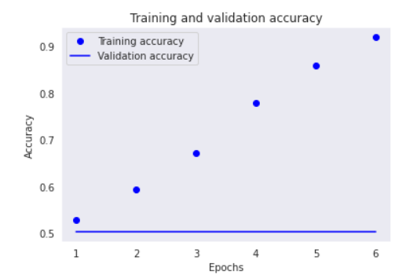
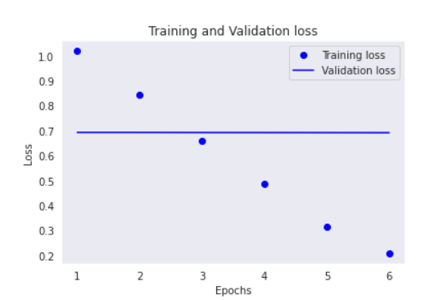
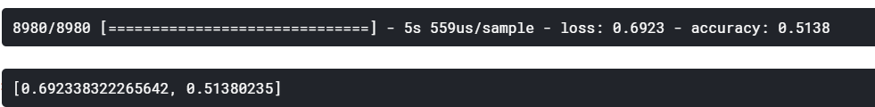
Model’s initial results
The initial model created has not preformed all that well

