Slide 1
SNAP
Smart Notification and Application Prevention

Slide 2
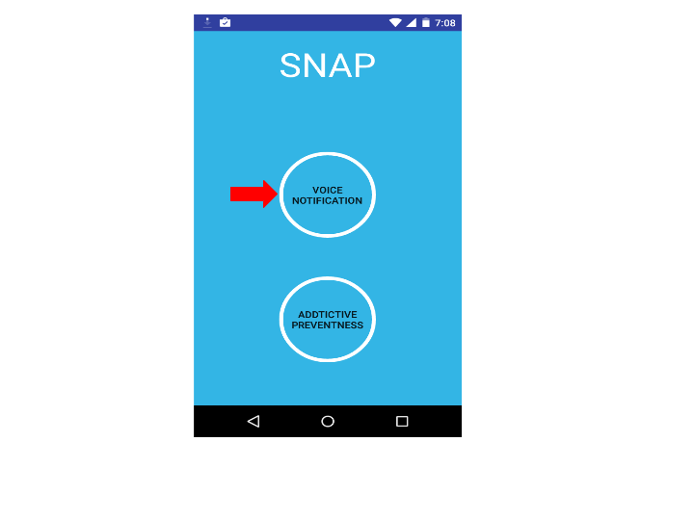
The Starting interface comprises of two modules namely Voice notification , Additive preventness.
Clicking Voice notification button invoke the next interface shown below,

Slide 3
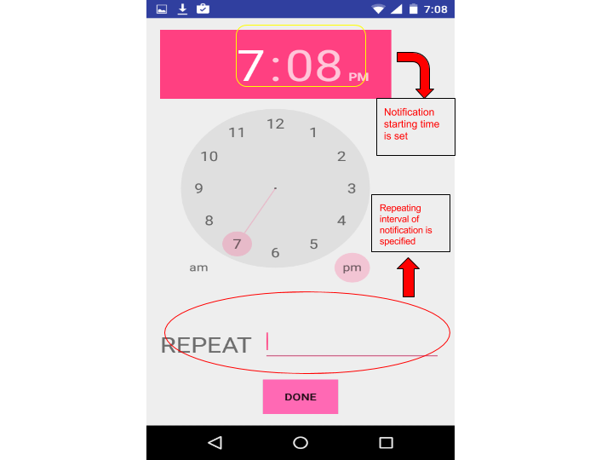

Slide 4
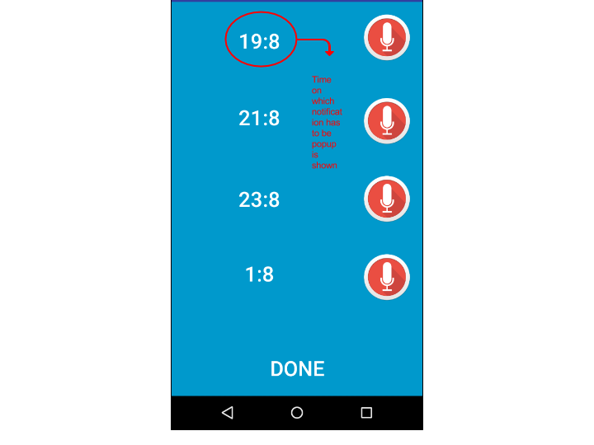

Slide 5
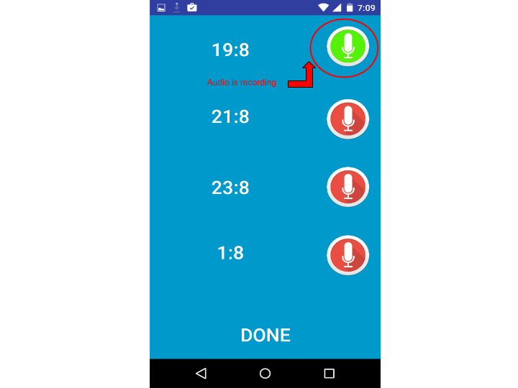

Slide 6
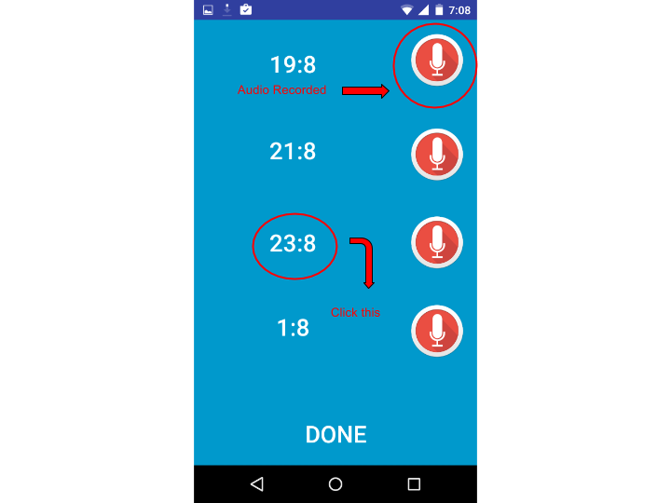
Clicking this time will open the below interface where time can be edited and stored manually
instead of above generated automatic time interval according to user convince.

Slide 7
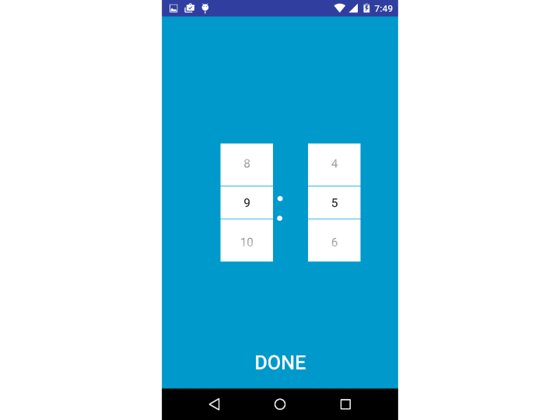

Slide 8
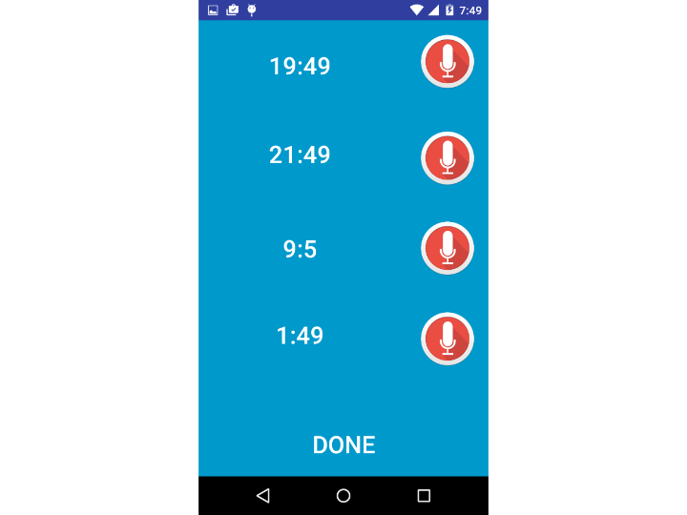
Notification along with Voice pops up on the selected time.

Slide 9
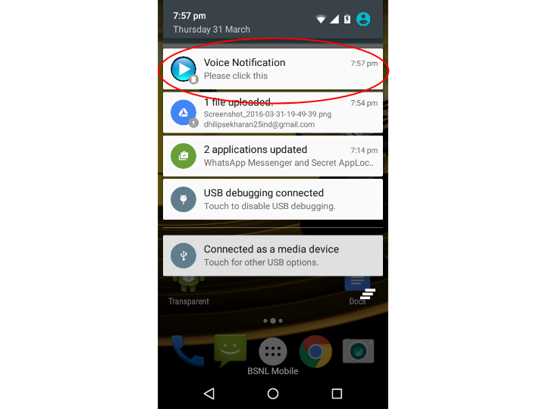
Click on this notification with start the following activity where the audio can be played again.

Slide 10
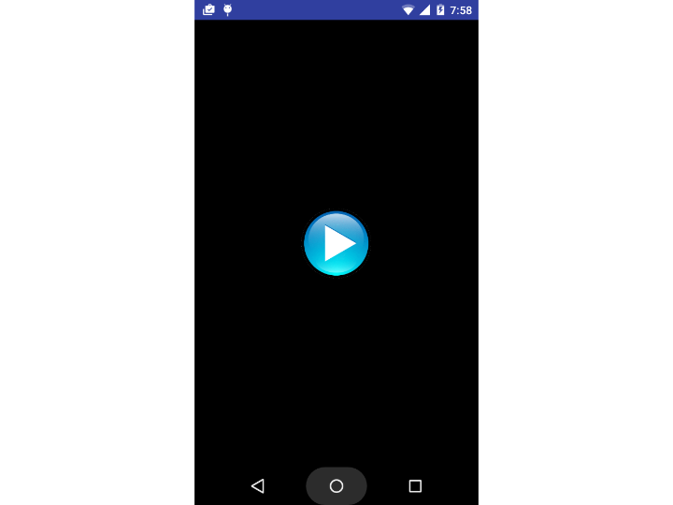

Slide 11
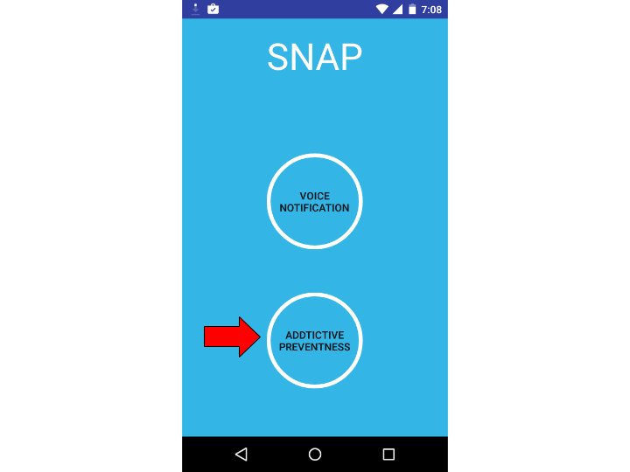

Slide 12
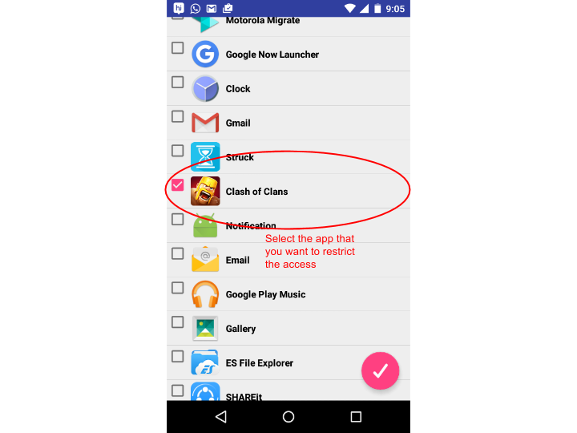

Slide 13
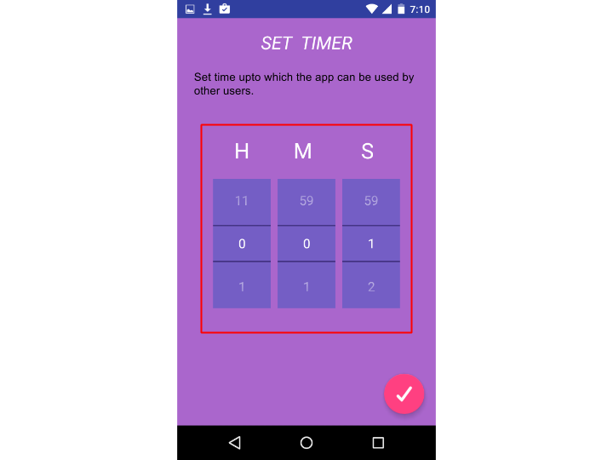

Slide 14
After Saving your settings this app will check the foreground running apps for every one second.
If the selected app is opened then the timer will start to run on the thread.
Once the desired time is reached by thread it appends the app by introducing the blank interface.
Thus further access of the app is restricted.
This app is more useful for kids who can be guided using voice notification and can be prevent from addiction towards gaming as well as social networking apps .

