Slide 1

Smart Gym
Training in an intelligent environment

Slide 2
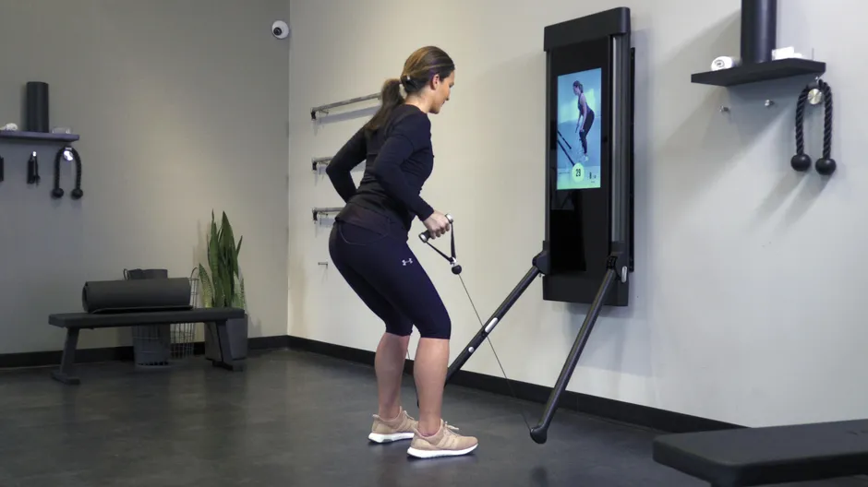
The idea
The awareness of the users inside the gym and in the single rooms is taken through sensors.
The training machines are active, they use actuators to guide in the training and adapt themselves actively depending user
Information regarding the training (for every user) is provided by trainers, stored in the system and used by the intelligence as input
Information about body movements and executions are acquired in real-time and stored in the system
An alert is sent to both user and the most appropriate trainer that is present on a specific day, in case of a critical situation
Data are stored to obtain a single history of the improvements

Slide 3
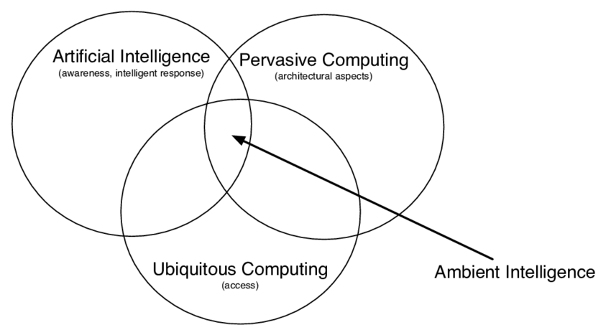
Why ambient intelligence?
It is not composed only of sensors
Ubiquity computing uses sensors, a calculus system, and memory
They are embedded in the environment (in a unobtrusive way)
It has context awareness and makes possible personalization
It is smart in the pre-responsive

Slide 4
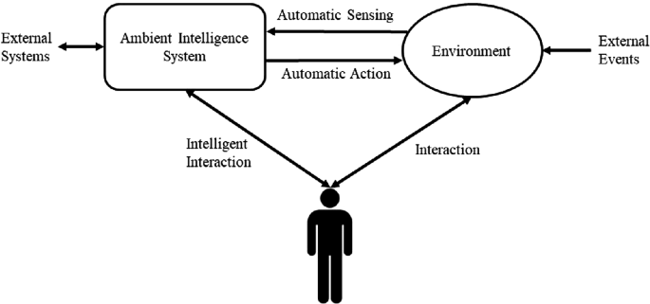
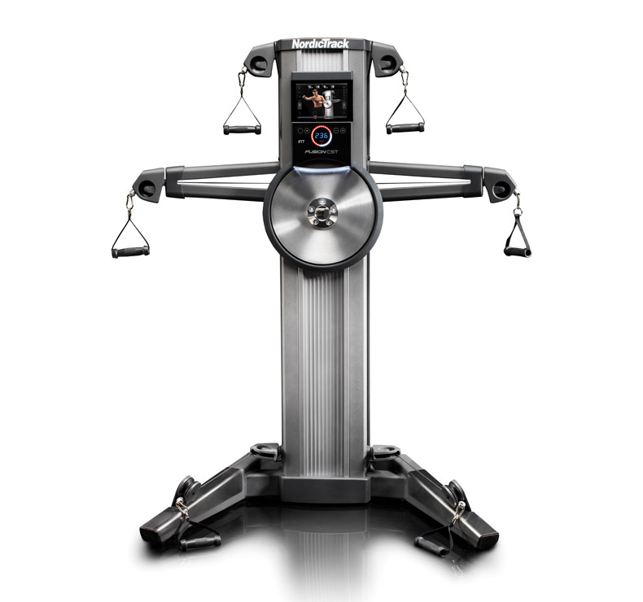
Interactions
Sensors are used for automatic sensing
Smartphones and displays are used to provide intelligent interaction
The ambient intelligence system acts through active machines inside the gym
Intelligent interaction is natural and noninvasive (eg. Smartwatch and beacons )
Interaction with the environment must be reliable and safe

Slide 5
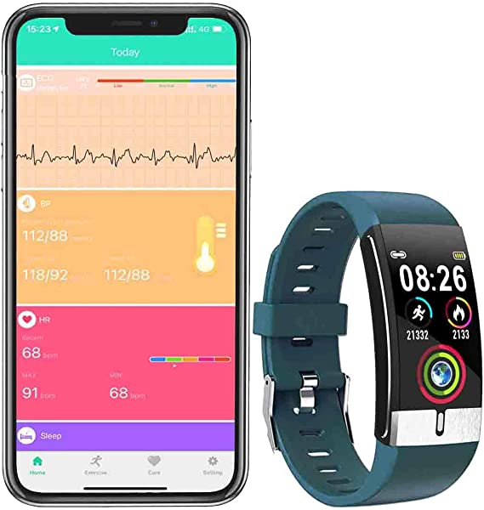

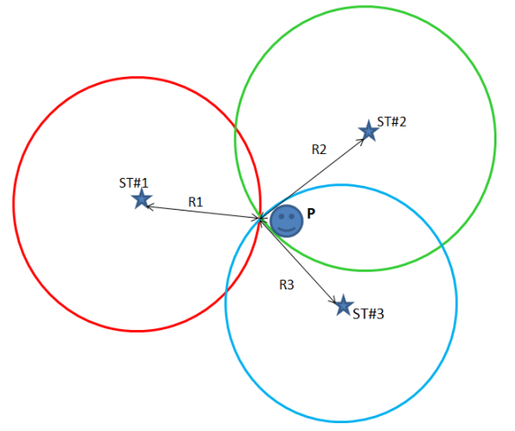
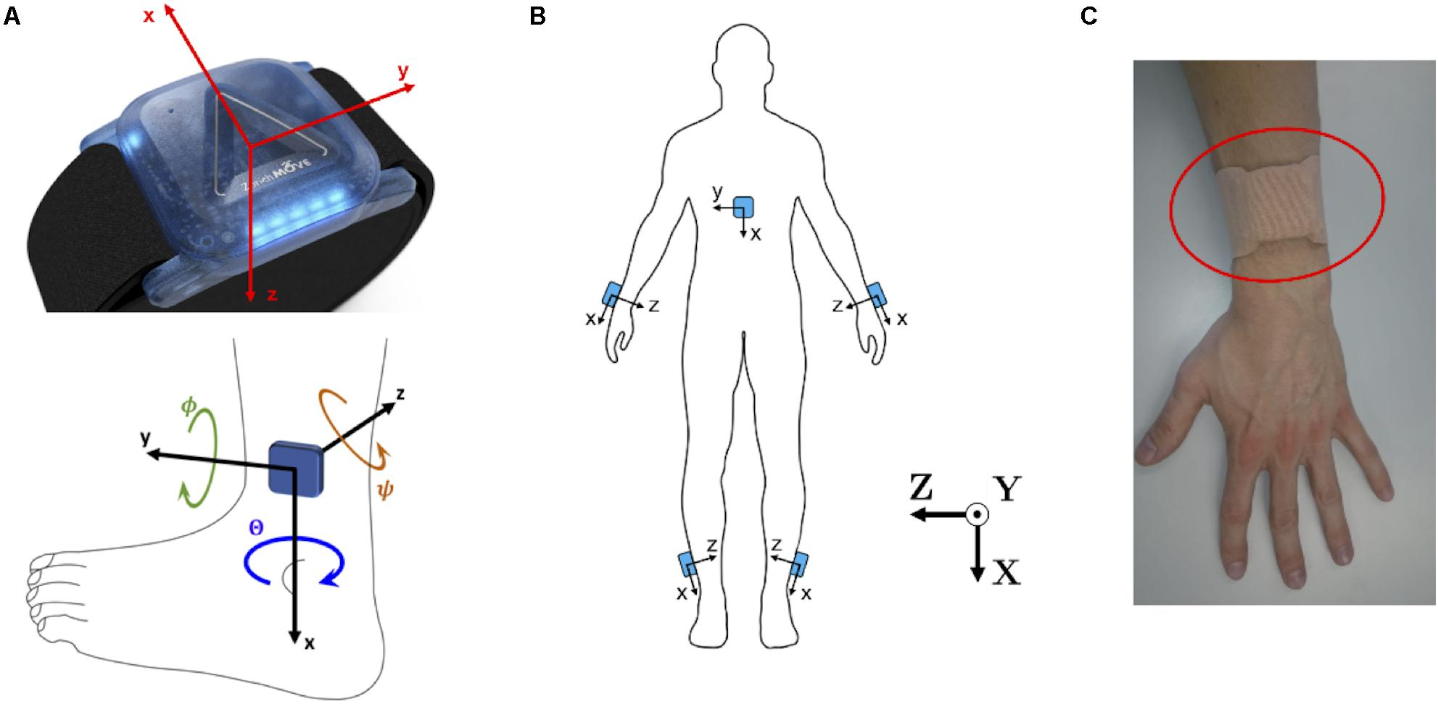
Sensors
They catch different nature of information like position in the environment, health status, and position of the body’s part
Inertial measurement units (in some specific cases) for the body movements tracking
Fitness tracker for measuring body parameters (eg. heart rate and spo2)
RFID for bound the user with a specific machine (es. NFC).
Localization in the rooms using BlueTooth beacons
They have different resolutions and invasiveness

Slide 6
The benefits
Smart management of the people inside the gym
Reducing the number of the trainers
Reducing injuries
Improving the results of the training
Granular tracking of the results

Slide 7
Thanks for your attention

