Slide 1
Simulation of Model Salt in Liquid Ar
Imesh Chamara
S14216
CH 3032

Slide 2
Objectives
To develop a MD program for liquid Ar
To calculate radial distribution function for liquid Ar.
To assign 10 atoms positive, 10 atoms negative and other atoms as neutral atoms in MD simulation.
To calculate electrostatic forces in MD simulation.
To calculate radial distribution function for salt in liquid Ar.
To plot radial distribution function vs distance and find the temperature for a homogeneous solution.

Slide 3
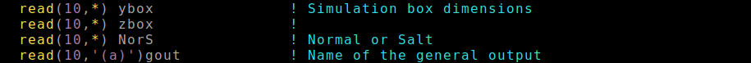
Shifting Between Two Systems
Extra variable – to run on both liquid Ar and salt in liquid Ar systems.
NorS = 1 liquid Ar
NorS = 0 salt in liquid Ar
Figure 01: Code to read NorS variable from armd.dat file

Slide 4
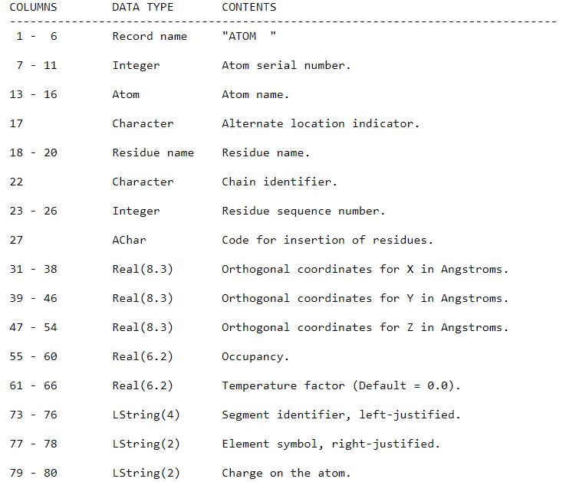
Assigning Charges
PDB file format
Figure 02: Format of the PDB file

Slide 5
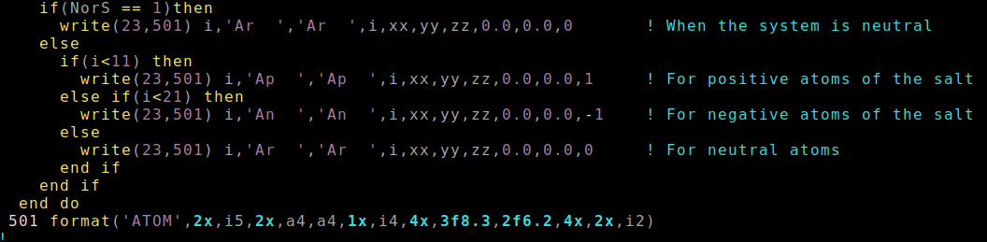
Assigning Charges
Figure 03: Code to assign charges for atoms

Slide 6
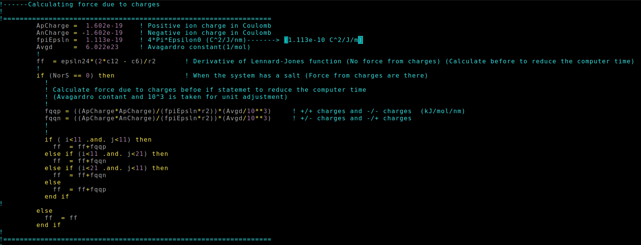

Electrostatic Force Calculation
Calculate electrostatic forces.
$$F=\frac{q_{1}q_{2}}{4πεr^{2}}$$
Figure 04: Code to calculate electrostatic forces between charged atoms

Slide 7
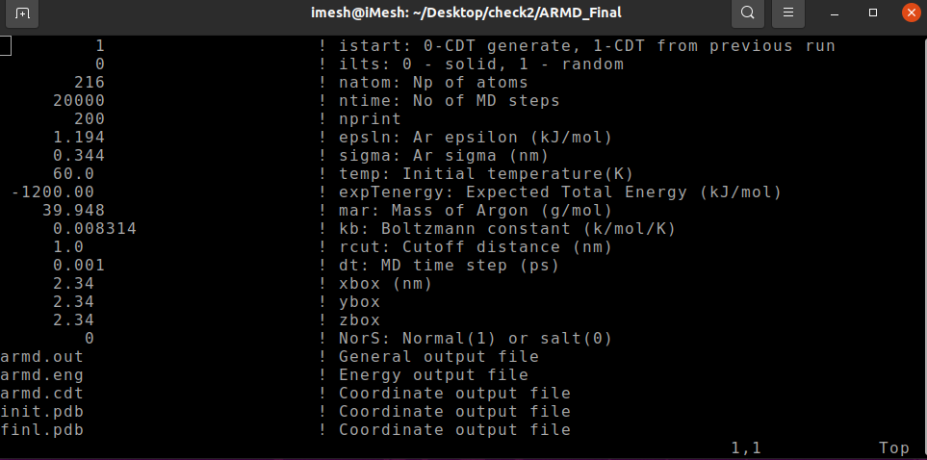
Running the MD Program
Figure 05: Armd.dat file

Slide 8
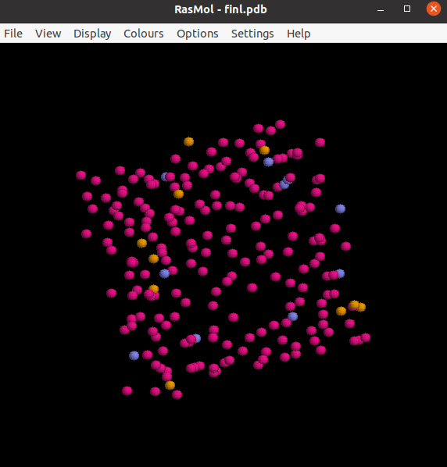
Rasmol View of the Final PDB File
Figure 06: Rasmol view of the final PDB file

Slide 9
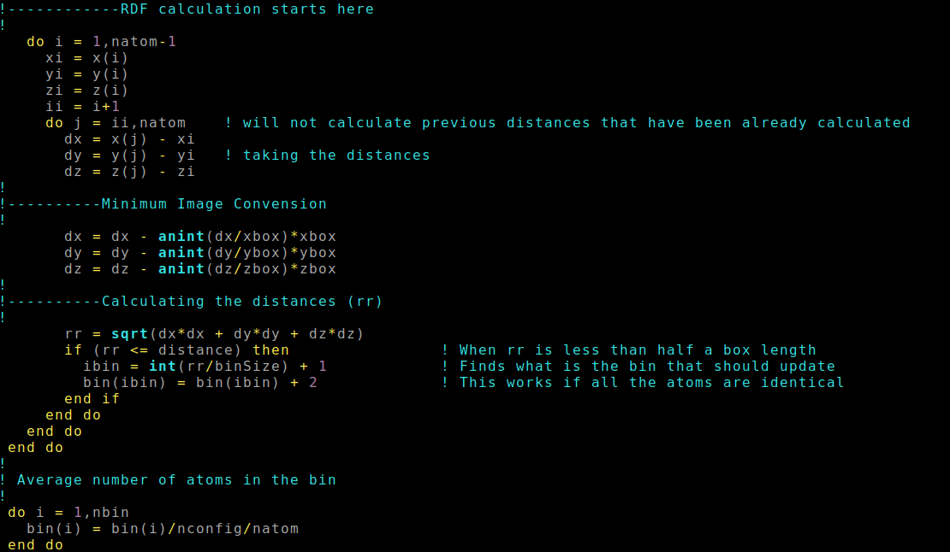
Calculate Radial Distribution Function
Liquid Ar
Figure 07: Code of the rdf.f95 program for liquid Ar

Slide 10
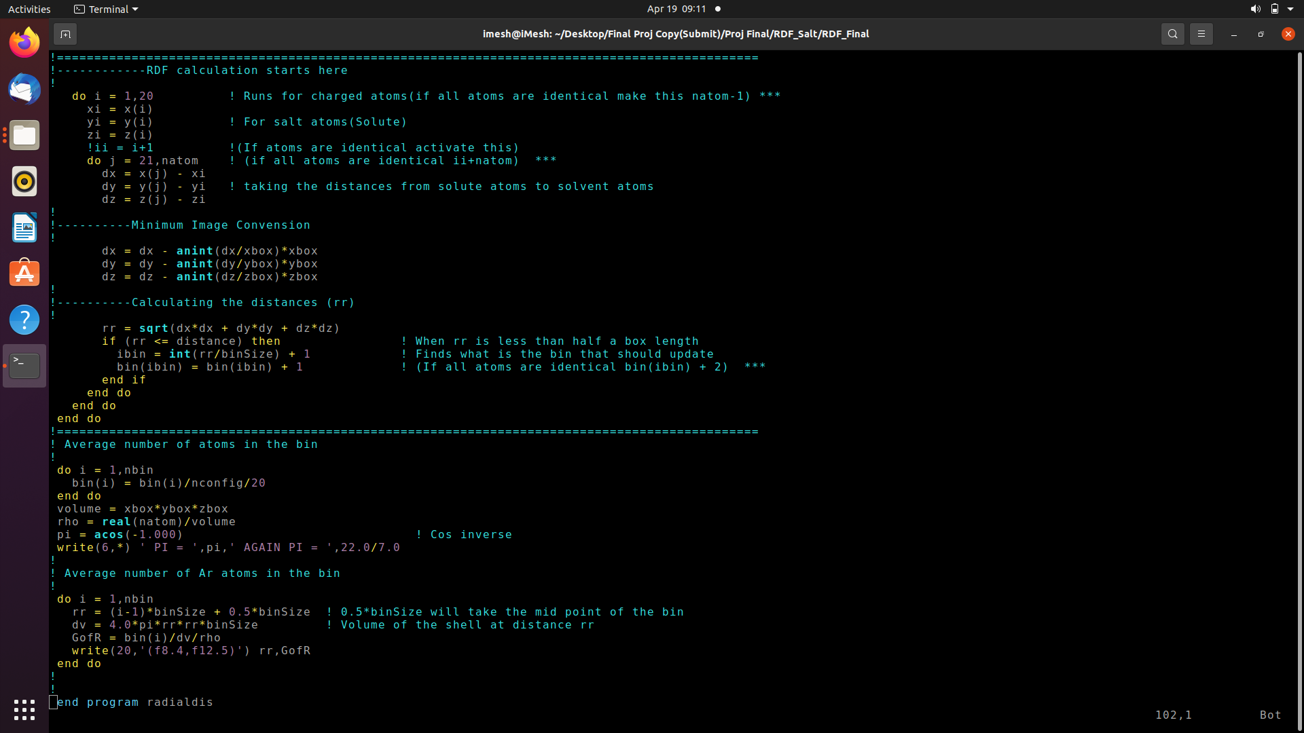
Calculate Radial Distribution Function
Salt in liquid Ar
Figure 08: Code of the rdf.f95 program for the salt in liquid Ar

Slide 11
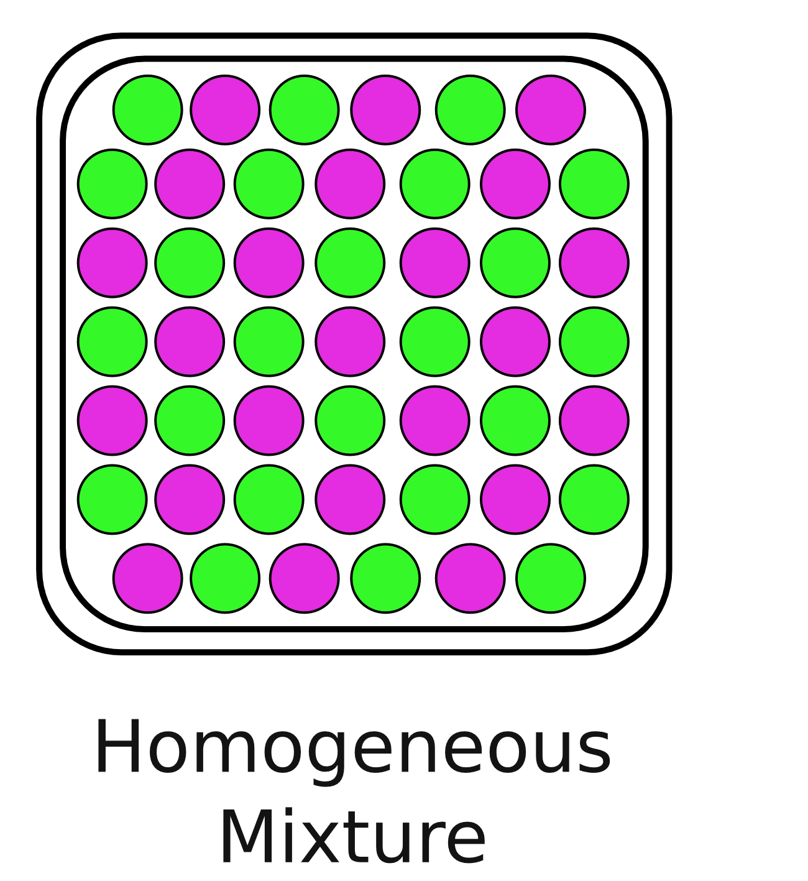
A Homogeneous Solution
A solution with,
uniform composition
uniform properties
Figure 09: Atomic view of a homogeneous solution

Slide 12
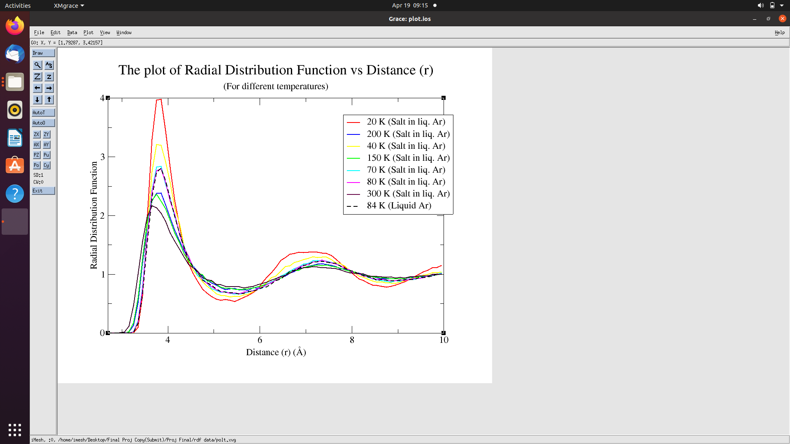
Temperature for a Homogeneous Solution
Homogeneous
at 80 K
Figure 10: The plot of radial distribution function vs distance (r) (for different
Temperatures)

Slide 13
Conclusions
Temperature for a homogeneous solution for the model salt in liquid Ar is 80 K.
At low temperatures – solid characters in radial distribution function
At high temperatures – gas characters in radial distribution function

Slide 14
References
Coordinate File Description (PDB Format) https://zhanggroup.org/SSIPe/pdb_atom_format.html (accessed 2022 -03 -08).
Bevc, S.; Junghans, C.; Kremer, K.; Praprotnik, M. Adaptive Resolution Simulation of Salt Solutions. New Journal of Physics 2013, 15 (10), 105007. https://doi.org/10.1088/1367-2630/15/10/105007 (accessed 2022 -04 -10).
Wardle, K. E.; Carlson, E.; Henderson, D.; Rowley, R. L. Molecular-Dynamics Simulation of the Effect of Ions on a Liquid-Liquid Interface for a Partially Miscible Mixture. The Journal of Chemical Physics 2004, 120 (16), 7681–7688. https://doi.org/10.1063/1.1669374 (accessed 2022 -05 -01).
‌

Slide 15
Thank You !

