Slide 1


Higher Institute of Applied Sciences
and Technology of Sousse
Hosting Company
End of Studies Project Presentation
October 22nd, 2021
Designing and developing an automated
QA tool for frontend testing
Elaborated by :
Academic advisor:
Internship duration:
Imen Jaballi
Mrs. Jihen Malek
Mr. Sami Achour
From 02/23/2021
To 09/04/2021
Notes:
Hello everyone,
Ladies and gentlemen of the jury,
I have the honor to present to you my graduation project entitled "Designing and developing an automated quality assurance tool for frontend testing". This project is carried out within Harvest Group under the supervision of Mrs. Jihen Malek and Mr. Sami
Achour, who kindly took over the academic supervision of this work, and with their advice and collaboration, ensured the smooth running of this project.

Slide 2
01
Context and scope of the project
02
Needs and business analysis
Table of Content
03
Design and Implementation
04
Presenting the solution
05
Conclusion and perspectives
Notes:
Our presentation revolves around the following plan:
We will start by presenting the context of the project.
Then we will continue with the analysis and specification of the needs to be satisfied.
Followed by the design phase and the choice of architecture,
Then the realization phase which will describe the solution implemented
to finish with the conclusion and the perspectives envisaged.

Slide 3
Context and scope of the project
01
02
Design and Implementation
04
Conclusion and perspectives
03
05
Needs and business analysis
Presenting the solution
Notes:
We will start by introducing the general context of the conducted work

Slide 4





Hosting Company ^{1/2}
Foreman
Lantern
Rogers, Arkansas, USA
+100 Projects
June 2006
219 Employees
Notes:
This project has been achieved within Harvest Group
-) Harvest Group is an eCommerce and retail growth agency founded in June 2006, located in Rogers, Arkansas, USA.
-) Harvest Group has a team of more than 219 employees.
-) Harvest Group has been focusing on developing high-quality software solutions:
-) Lantern: A platform for item content creation from its genesis to upload. Lantern begins with initiating an item into the flow, then walking through each step chronologically: keywording, copywriting, editing, validating, client approval, and finally uploading the product to the Walmart system.
-)Foreman: An automated platform to get and manage Harvest Group clients’ data, such as names, credentials to fetch customer’s and retailers’ data, then generate, retrieve, and process reports for them such as retailer reports or sales reports.

Slide 5
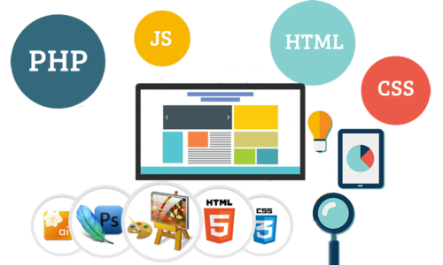





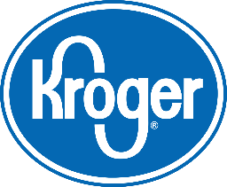
Hosting Company ^{1/2}
Web Development
Reporting and analytics
CPG companies
Notes:
-) Harvest Group is proud to provide a rare omnichannel solution by offering entirely services of a multi-functional team of retail experts leveraging advanced reporting and analytics and first-class systems and technologies to fight for CPG (Consumer Packaged Goods) companies doing business with retailers and looking to expand their businesses at Walmart, Walmart.com, Sam’s Club, Kroger, and Target.

Slide 6







General Introduction ^{1/2}
Most modern businesses depend heavily on information systems, from employee e-mail to database management to e-commerce Web sites.
Medicine
Economic
Education
Finance
What if these systems turn out to be defective. We all know that one tiny potentially cause monetary and human damage, and history is full of such examples.
Notes:
Most modern businesses depend heavily on information systems, from employee e-mail, database management to e-commerce Web sites.
What if these systems turn out to be defective. We all know that one tiny bug cpotentially cause monetary and human damage, and history is full of such examples.
In May of 1996, a software bug caused the bank accounts of 823 customers of a major US bank to be credited with 920 million US dollars.
China Airlines Airbus A300 crashed due to a software bug on April 26, 1994, killing 264 innocents live.
Nissan cars recalled over 1 million automobiles from the market due to software failure in the airbag sensor. There has been reported two accidents due to this software failure.

Slide 7
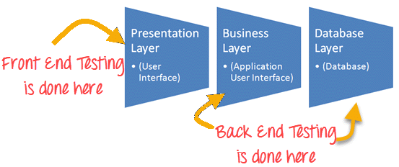
General Introduction ^{1/2}
To deliver a quality product, we need to test it in the software development process.
Notes:
To deliver a quality product, we need to test it in the software development process. Generally, a web-based application is a three-tier architecture application, as shown in figure 1.
The first layer is the presentation layer known as Front-end, the second layer is the business, and the third layer is the database layer known as the backend. That’s why testing can be either frontend, backend, or both, depending on your release. Frontend testing is the type of software testing used to evaluate the presentation layer of a three-tier architecture in a web application. Another part of software testing is backend testing used to test the application and database layer.

Slide 8
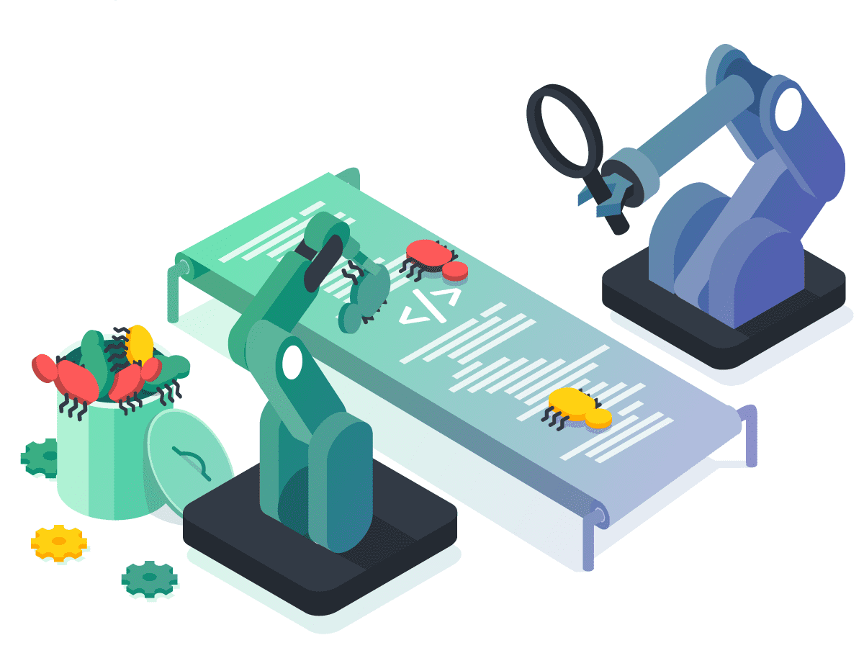
Project Goals
Design and develop an automated quality assurance tool for frontend testing.
Notes:
As a final graduation project, elaborated within Harvest Group, we accomplished the study, design, and development of a backend app called Foreman QA Standalone, which is a quality assurance tool for frontend testing used by Harvest Group developers to improve the customer experience and ensure the best development experience for developers.

Slide 9
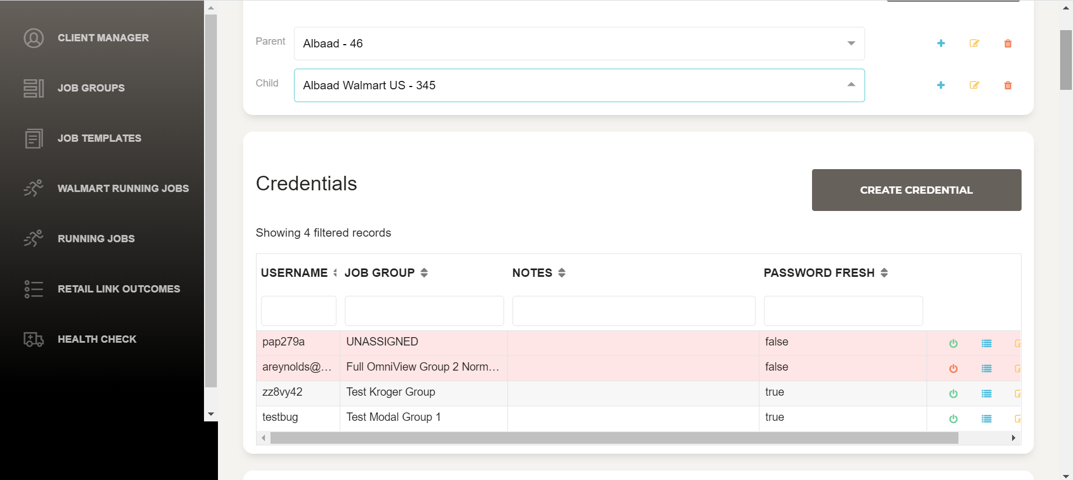
Motivations
Notes:
Imagine a Harvest Group employee called Imen, the first day as a QA software, was introduced to an application to be tested called Foreman. Foreman is an application with hundreds of forms and thousands of reports.

Slide 10



Day 1
Day 3
1 week later
Imen is very happy. She found a bug and reported it in the bug management system.
Imen should test the same form again to confirm no regression issues are found, Now she's a little bored.
She started feeling angry, tired and she started skipping steps and only filling in 50% of the total fields.
Notes:
She started her exploratory tests by opening a form that contained about fifty different fields. She tried entering random data in that form, which took about 10 minutes. Then she hit Submit. An error message has appeared that looks like an unhandled exception. Imen became very happy. She proudly noted the steps and reported the bug in the bug management system. Great effort, She felt confident and energetic. The next day, a \textit{Harvest Group} developer fixed the issue and released a new version of the build. Imen tested the same form with the same steps and found the error resolved, so she marked the bug as fixed. Great effort. She just contributed to the quality of the product by identifying this bug.Now comes the third day, a developer has again released a newer version. Imen should now test the form again to confirm no regression issues are found, another 10 minutes. Now she's a little bored.Now imagine that new versions are constantly coming out, and with every release, she has to test that long-form plus 100 other forms like this to verify there is no regression. She started feeling angry, tired and she started skipping steps and only filling in 50\% of the total fields. One day, the customer reported the same bug in the same form. Now Imen is feeling pathetic and insecure. She thinks she is not competent enough. Managers question her ability. Unfortunately, that's the story of 90\% of manual testers. She is no different. Regression problems are the most painful problems. We are humans, and we can't do the same thing with the same energy, the same speed, and the same accuracy every day. That's what machines do and why automation is needed.

Slide 11

Motivations
Problems ^{1/2}
After analyzing the existing solution, we found out that:
Slow and expensive, almost never guarantees that there are no issues and they don't scale well
1
Manual Testing
Batch Testing
2
Batch testing is not possible, since every test execution requires a user intervention
Notes:
After analyzing the existing solution, we found out that:
• We use manual testing to disclose many hidden errors, but this methodology never garantees that there are no errors. It is only used to identify known errors. It never gives any information about the flaws that remain uncovered.
• Manual testing is slow and expensive since covering all areas in an application requires more testing, and creating all possible test cases and executing them, resulting in project delays and unfinished testing.
• Manual tests don’t scale well. As the complexity of the software increases, the complexity of the testing problem increases exponentially, which leads to an increase in the total cost and total time spent on testing.
• Manual tests are not consistent or reproducible. Variation in the way tests is performed inevitably leads to different results on the same test. • Graphical UI objects size difference and color combinations are not easy to find in manual testing.
• Batch testing is not possible since, in every test execution, human user interaction is mandatory.
• Performance testing is impractical in manual testing since organizing thousands of machines, computers, and human users is unrealistic.
• Manage testing process is complicated since tests have to be planned, bugs have to be tracked, and reliability analysis has to be accomplished.
• The cost of manual testing is dependent upon the human resources deployed in testing.
• Less accuracy since testers are humans and can make mistakes. For every release, testers must rerun the same set of tests, which is tiresome, leads developers to skip tests and release faulty software.
• Agile methodologies recommend sprints that usually run for 2-3 weeks. Each sprint focused on developing a small set of features but must deliver a functional system at its end. Without proper testing, the risk of releasing a fully operational system without breaking a previously working feature is high. That’s why an entire testing process should be repeatedly run each time a change is made to a part of the software to ensure that changes made to a segment do not affect others.

Slide 12
Problems ^{2/2}
Is impractical in manual testing since organizing machines, computers and users together is unrealistic
3
Performance Testing
Manage Testing
4
Is complicated, there are tests to be planned, bugs to be tracked, and reliability analysis to be accomplished
Testers are humans and can make mistakes or skip tests which is more prone to failure
5
Less Accuracy

Slide 13
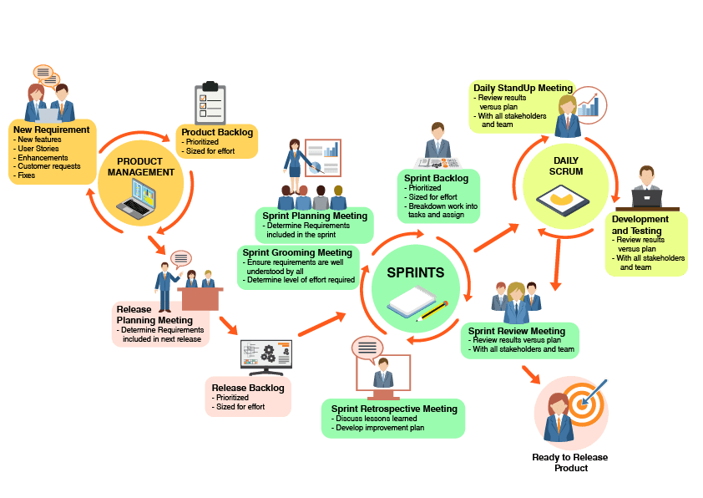
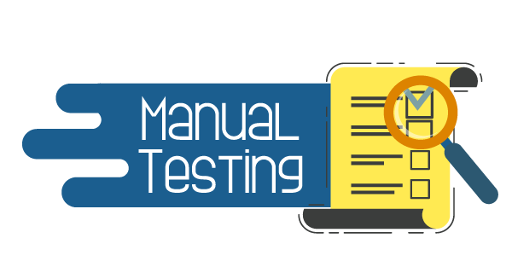


Project Goals
Notes:
At Harvest Group, we have found that DevOps combined with Scrum, which is an agile methodology, is the most suitable methodology for our project. It has dictated how our project should perform, including preparing, planning, monitoring, and controlling the activities needed to finish the required tasks. This choice is based on the need to deliver releases regularly, the requirement for periodic feedback, and the changes in the project’s requirements over time. Our goal is to make sure that our test automation solution delivers quality at speed within sprints and improve communication with other departments like marketing, design, or product owners who rely on the results of these tests.
Releasing a new product or an update can be stressful because you’re excited about your release, but at the same time, you feel nervous about potential bugs or issues that can arise at any moment. To prepare yourself, you need to thoroughly test your application to ensure minimal to no problems with a product launch or at any point afterward as that would jeopardize your customers trust in you.
Our solution entitled “Foreman QA Standalone” will provide the company’s developers with a better experience since it will become possible to identify any bugs, errors, and missing requirements easily and quickly.
Foreman QA Standalone helps reduce the feedback cycle and bring faster validation in the development and testing cycles. Every commit to the code base will be tested automatically. The results will be reported back to the developer, who will be capable of identifying and prioritizing fixing any of the bugs, errors, or missing requirements easily and quickly. That will allow companies to bring their products to the market faster.

Slide 14



Project Goals
Faster feedback cycle
Improved Accuracy
Team saves time
Less stress on QA team
Reduced Business Expenses
Eliminate human error
…
Higher test coverage
Reusability of Test Suite
Faster Time to Market
Better Insights
Notes:
Our project firstly aims to correct the problems detected in other applications, so we try to offer a complete solution that combines all the functionality of the other solutions.

Slide 15
Project Goals
Foreman QA Standalone
1
6
Detecting Client-Side Performance Issues
Verifying integration of Third-Party Services
2
5
Validating Application Behavior on Different Browsers and Systems
check whether the look and feel of the website are aligned with the requirements
3
4
Improving Quality of User Interaction and Experience
Identifying Potential User-based Problems
Notes:
, also we are trying to offer new functionality such as:
The tool offers a backend application that will evaluate the product from a user perspective, validate the functioning and responsiveness of the application over different system architectures, check whether the look and feel of the website are aligned with the client’s requirements, and make sure the user interface is error-free and responsive as it’s supposed to. So elements on the screen should work as specified and match the design requirements. It checks the website for any errors, and potential points of failure before it goes live or becomes available to end users.

Slide 16
Needs and business analysis
01
02
Design and Implementation
04
Conclusion and perspectives
03
05
Context and scope of the project
Presenting the solution
Notes:
This section is dedicated to study and investigate the topic and give a clear picture of the physical system by identifying the main actors who interact with our tool and specifying the application’s functional and non-functional requirements.

Slide 17



Actors' specifications
A Harvest Group Developer
Azure Pipelines
Microsoft Teams
Notes:
Actors specifications An actor represents a role played by a person, a group of individuals, or another system. Three types of actors are involved in our app: • DevOps Team: They are in charge of debugging and fixing errors and potential points of failure found in the company’s apps before they go live and become available to the end-user. They are also responsible for checking the ”Foreman Frontend QA Regression” team notifications in the Microsoft Teams app to ensure no regression issues exist after deploying a new frontend code. If any errors or bugs exist when using the Foreman QA Standalone app, developers will get insights about failed tests such as error messages, stack traces, logs of the console, and attachments to make the fix easier. • Azure DevOps: Run the Foreman QA Standalone application whenever a new frontend code is deployed. • Microsoft Teams: Receive deployment results.

Slide 18


Functional Requirements
Azure DevOps
Developer
Microsoft Teams
Run
Consult
Get
Foreman QA Standalone app
Deployment insights from Azure Pipelines
Foreman frontend QA Regression” team notifications about the deployment result
Deployment results from Azure Pipelines
Notes:
Capturing functional needs consists of identifying the different use cases by its actors to describe them, organize them and define the classes of the system. The requirements that are mandatory in our application are presented as follows: • Foreman QA Standalone app should be running each time a new Foreman frontend code is deployed. 12 CHAPTER 1. GENERAL PRESENTATION, REQUIREMENT SPECIFICATION, AND PROJECT INITIATION • The application should allow developers to consult deployment tests results on Microsoft Teams. • The system also offers the developers the possibility to consult Azure DevOps details about the failed tests.

Slide 19
Non-functional Requirements
01
Reliability
The application must perform the expected functions with the required precision and authenticity.
02
Scalability
The app must be scalable. So when the system resources increase, we can also increase and add more tests.
03
Maintainability
The application must manage the addition of features not defined in the initial specifications.
Efficiency & performance
04
The application must ensure fast processing of user requests and relatively low wait times.
Security
05
The application must provide flexible security allowing access with different levels of granularity to system functionalities according to user rights.
Notes:
Non-functional requirements In this subsection, we will define the non-functional specifications, in other words, technical and software. These are features that the system will provide to the user regardless of the business or functional term. It is essential to meet the following requirements to design a reliable solution: • Reliability: The application performs the expected functions with the required precision and authenticity. When the QA tool tells the user that their application has no bugs, there should be none. It must be reliable or dangerous events may occur. • Scalability: The Foreman QA Standalone app must be scalable. So when the system resources increase, we can also increase and add more tests. • Maintainability: The application must manage the addition of features not defined in the initial specifications. • Efficiency and performance: The application must ensure fast processing of user requests and relatively low wait times. • Security: The application must provide flexible security allowing access with different levels of granularity to system functionalities according to user rights.

Slide 20
Design and Implementation
02
03
04
Conclusion and perspectives
Context and scope of the project
01
05
Needs and business analysis
Presenting the solution
Notes:
Let me start by giving you some background information..........

Slide 21
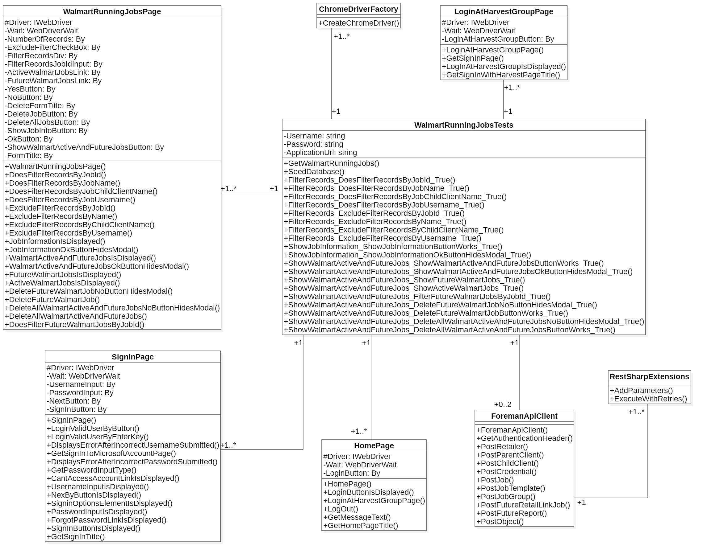
Walmart Class Diagram
Notes:
Class diagrams represent the key entities within the business and technical domain. They are highly structural and static in nature, with no behavioral content. Class Diagrams can show business-level and technical classes as well as relationships between them. The entire description of the classes and the relationships that they will have with each other is static. Foreman Walmart Running Jobs page UI tests Class diagrams Figure 5.6 illustrates the UI tests of the Walmart Running Jobs page in a form of a class diagram
2.3.1 PageObjects package Description PageObjects package is the set of page object classes that are object-oriented classes and serve as an interface to an AUT (Application Under Test), in our case, the Foreman or the Lantern UI. For each Foreman page, we created a page object class. The page object class will identify the web elements on that web page and the methods that perform operations on those web elements. The name of these methods must be given according to the task they perform. In other words, the page object will contain the representation of a page and the services it provides via methods, but no code related to what is being tested should be within the page object. Architecture The PageObject package contains the classes presented in figure 2.12. Here is a brief description of those classes: • HomePage: Page object class that serves as an interface to the Home page in the Foreman app. It identifies the web elements on that page and contains methods that perform operations on those web elements, for example, checking that the login button is displayed.
The package Tests uses the methods of the PageObject package whenever it needs to interact or test a UI of a Foreman page. The Tests package classes themselves do not need to change. Only the code in the PageObject package does. Also, all verifications or assertions should always be within this package. LoginTests: Under the Tests folder, test scripts that are related to different modules should be separate. In this case, the login functionality UI tests are added to the “LoginTest.cs” file.
The Utilities package is one of the necessary packages that all the other packages and classes use. It provides a class to manage the Chrome WebDriver instances. The other class helps use the AKV (Azure Key Vault) to safeguard and control cryptographic keys and other secrets required to test the apps. • ChromeDriverFactory: Class helps to create, reuse and dismiss Chrome WebDriver instances, then navigate to the web app we’re going to test. • ConfigurationUtilities: Class required to provide security for the applications under test. It uses AKV to securely store and manage sensitive information such as keys, passwords, certificates, URLs (Uniform Resource Locator), etc., in centralized storage protected by standard algorithms, key lengths, and even hardware security modules.

Slide 22
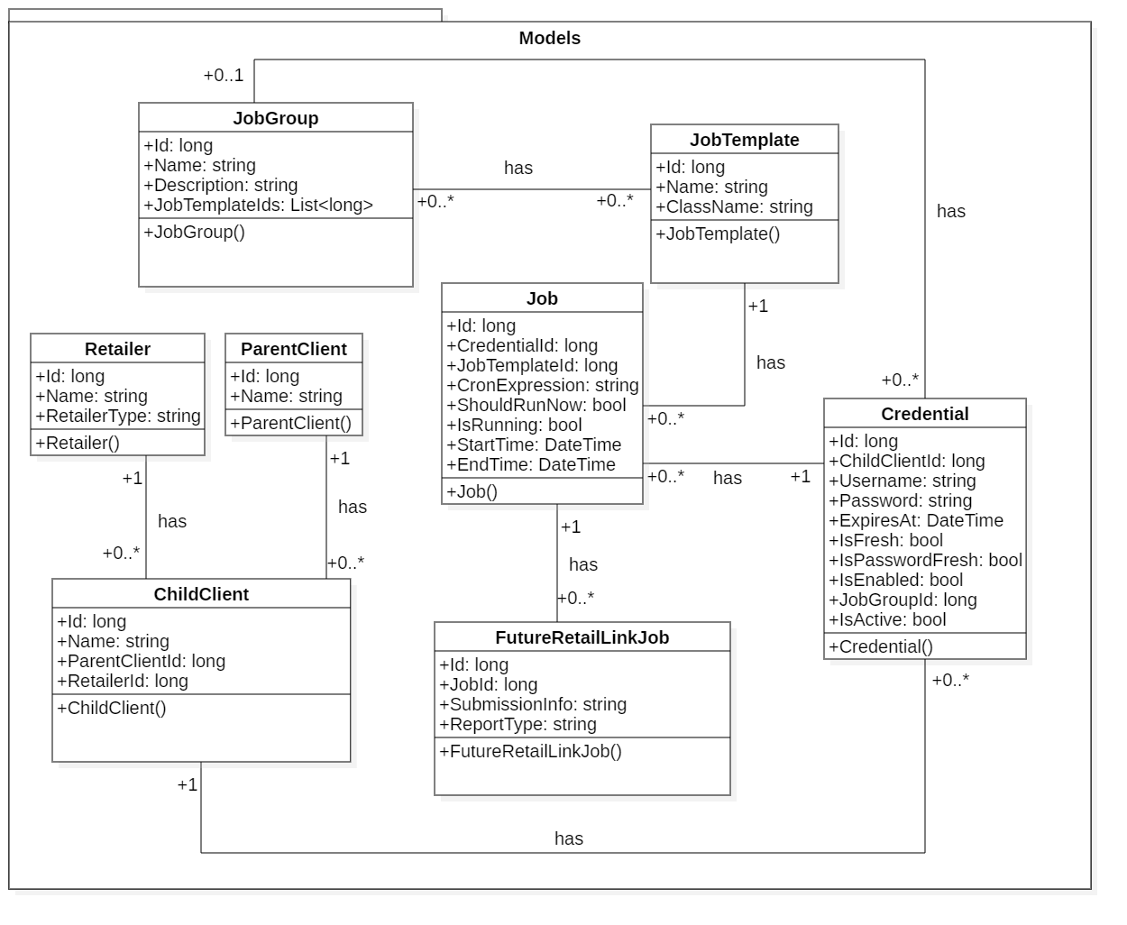
Walmart Model Tests
Class Diagram
Notes:
Figure 5.20 illustrates the Foreman Running Jobs page UI tests Models package Class diagram.
5.4.4 Models package Description The Models package contains the Foreman application main model classes such as Parent Client, Child Client. It is used by the Utilities package when sending or getting data to and from the Harvest Group server to create or update the Foreman resources. Architecture The Models package contains the classes and models presented in figure 5.29. Here is a brief description of those components: • ParentClient: As a retail growth agency whose mission statement revolves around CPG brands looking to grow their businesses at Walmart, Walmart.com, Sam’s Club, Kroger, and Target, we needed to store and manage the details of our clients. The ParentClient class is a blueprint used to define all objects of a client type, for example, Organic Valley. • ChildClient: Since Harvest Group clients deal with different retailers, this is basically what the ChildClient class represents. It is necessary to separately manage customer data for each retailer, for example, Organic Valley on Walmart.com. 90 CHAPTER 5. FOURTH SPRINT Figure 5.29: Models package components • Credential: A class used by Foreman to store and manage client credentials such as username and password. Thus, it can automatically access its servers to obtain data and then generate reports with it. • Job: A class used to define a running Job or report. • JobGroup: A class used to define a group of Jobs. When adding a new client to Foreman, we noticed that it is inconvenient and tedious to go through all the Job Templates just to assign some to a client. Instead, we decided to create the Job Group page, so that we can easily assign a group of Jobs to a customer by simply mentioning the customer’s category when adding it. • JobTemplates: A class used to define a Job Template. A Job Template is a definition and set of parameters for running a Job. Job templates are useful to execute the same job many times. • Retailer: A class used to define a Retailer, for example, Walmart. • FutureRetailLinkJob: A class used to define Walmart or Walmart.com clients’ future Jobs. • FutureReport: A class used to define Sam’s Club, Kroger, and Target clients’ future Jobs.

Slide 23
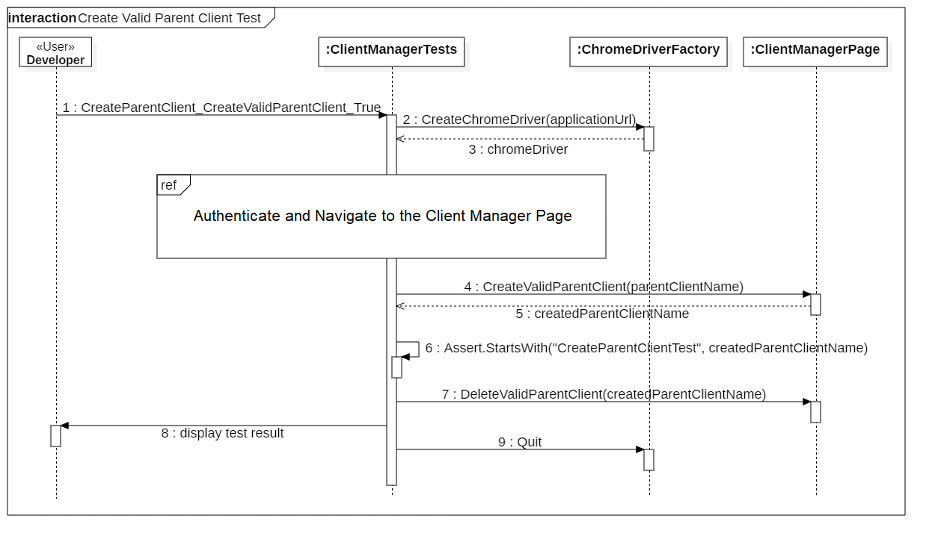
Sequence Diagram

Slide 24
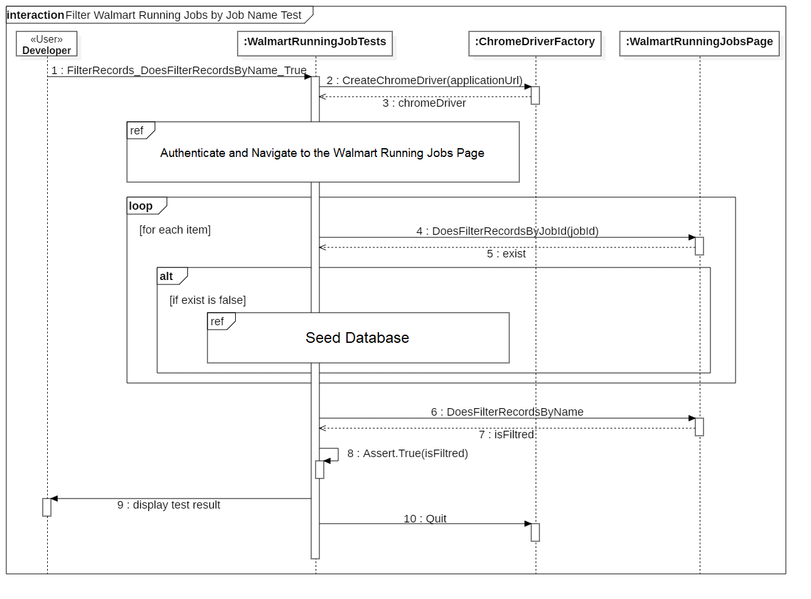
Sequence Diagram

Slide 25
Presenting the solution
02
Design and Implementation
04
Conclusion and perspectives
Context and scope of the project
01
Needs and business analysis
03
05
Notes:
and all the technical tools used to build our application

Slide 26
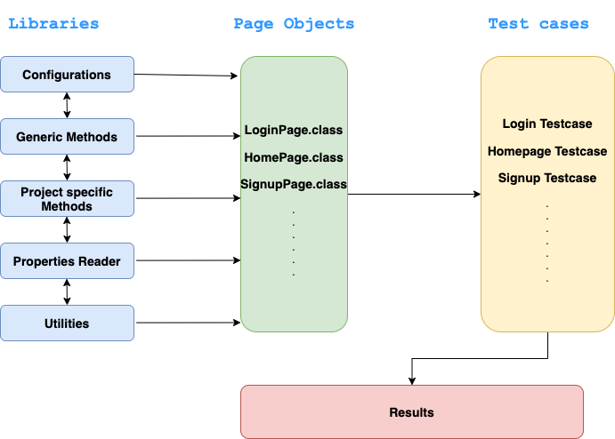
Global Architecture
Notes:
Because we believe that every powerful project is built on solid grounds, we have allocated an important amount of time reshaping and enhancing the architecture of the automated frontend testing tool. The last version, as we believe, is the best until now in terms of flexibility, separation of concerns, security, and scalability. The POM (Page Object Model) is a design pattern that has become popular in test automation for enhancing test maintenance and reducing code duplication. A page object is an object-oriented class that serves as an interface to a page of an application. The tests then use the methods of the page object classes whenever they need to interact with the UI of the application pages. The benefit is that if the UI changes for the page, the tests themselves don’t need to change, only the code within the page object needs to change. Subsequently, all changes to support that new UI are going to be in one place[13]. Figure 1.6 gives a glance at the Page Object Model architecture.

Slide 27






Used Tools and Technologies
Software environment
Programming
language and frameworks
Source code management and version control tools
Notes:
Microsoft Visual Studio is an IDE (Integrated Development Environment) made by Microsoft suite for Windows and Mac OS and used for different types of software development such as computer programs, websites, web apps, web services, and mobile apps.
StarUML is an open-source software modeling tool that supports UML.
Overleaf is an online LaTeX and Rich Text collaborative writing and publishing tool that makes the whole process of writing, editing, and publishing scientific documents much quicker and easier.
Azure DevOps is a SaaS (Software as a Service) platform from Microsoft. It provides developer services for support teams to plan work, collaborate on code development, and build and deploy applications, supports culture and a set of processes that bring developers, project managers, and contributors together to complete software development, and allows organizations to create and improve products faster than they can with traditional software development approaches.[17]. Azure DevOps provides integrated features that you can access through your web browser or IDE client. You can use one or more of the following standalone services based on your business needs[17]: • Azure Repos provides Git repositories or TFVC (Team Foundation Version Control) for source control of your code. • Azure Pipelines provides build and release services to support continuous integration and delivery of your applications. • Azure Boards delivers a suite of Agile tools to support planning and tracking work, code defects, and issues using Kanban and Scrum methods. • Azure Test Plans provides several tools to test your apps, including manual/exploratory testing and continuous testing. Azure Artifacts allows teams to share packages such as Maven, npm, NuGet, and more from public and private sources and integrate package sharing into pipelines.
C# is a general-purpose, modern, object-oriented, and type-safe programming language derived from C and C++. C# popularity lies in its use for the following tasks: • Backend Services • Windows Application • Website Development • Game Development
Selenium is a free and open-source automated testing framework used to validate web applications across different browsers and platforms. You can use multiple programming languages like Java, C#, Python, and others to create Selenium Test Scripts. Selenium provides extensions to emulate user interaction with browsers, a distribution server for scaling browser allocation, and an infrastructure for implementations of the W3C (World Wide Web Consortium) WebDriver specification that lets you write interchangeable code for all major web browsers[19].
GitHub is a website and cloud-based service that helps developers store, manage, track, and control changes to their code. To understand GitHub, you must first have an understanding of Git and Version control. Git is a distributed version control system means that the entire codebase and history is available on every developer’s computer, which allows for easy branching and merging. Ask for Version control it helps developers track and manage changes to a software project’s code.

Slide 28
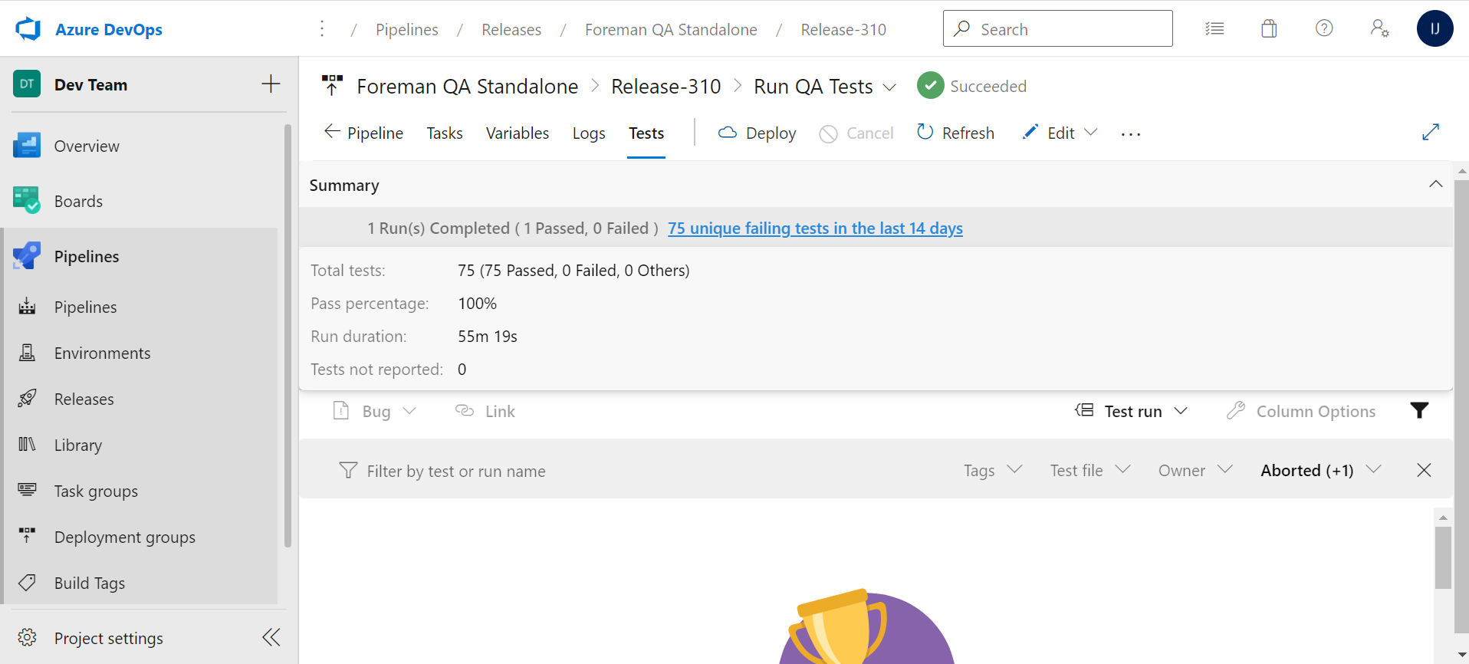
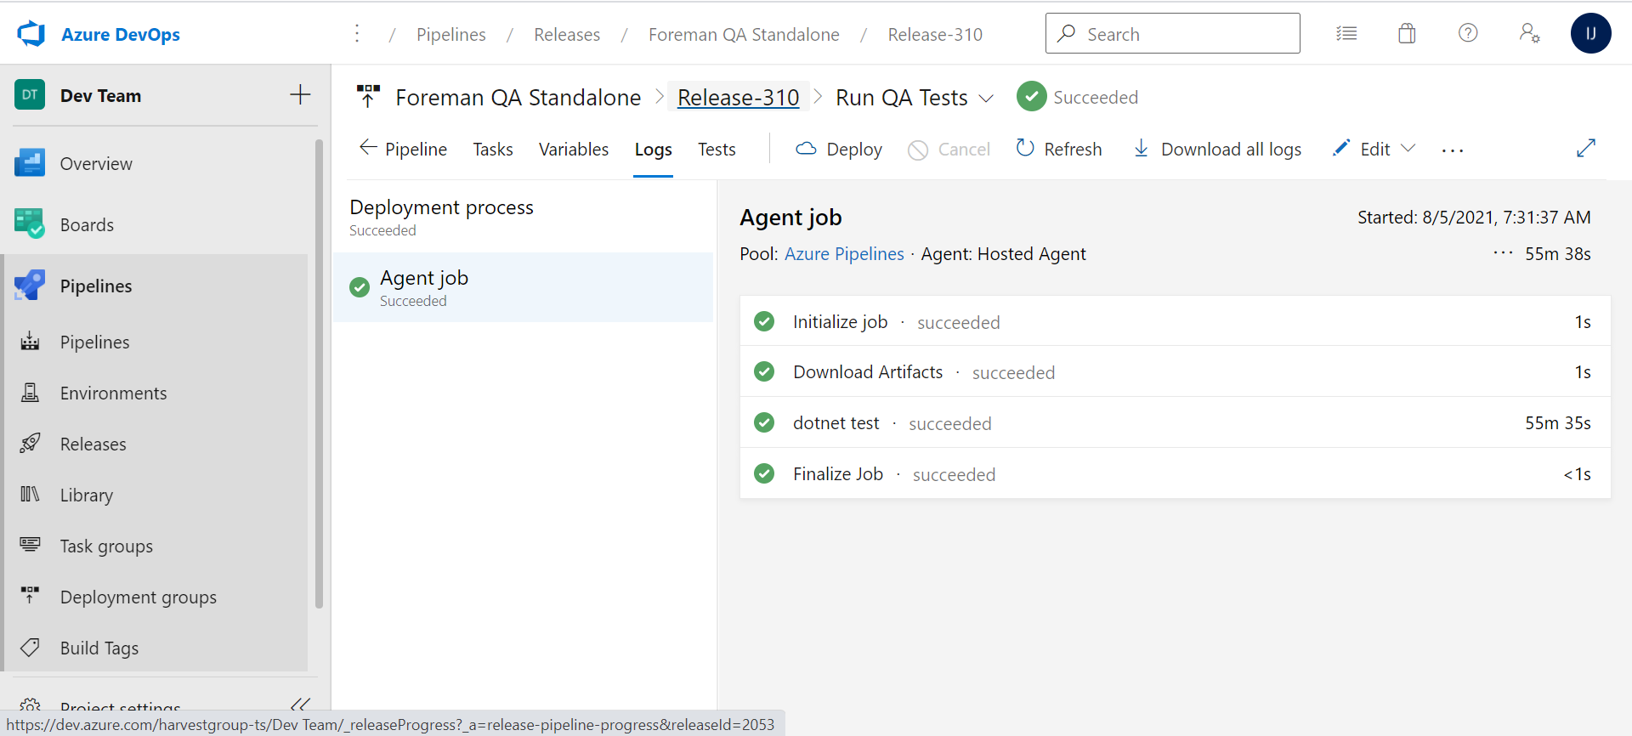
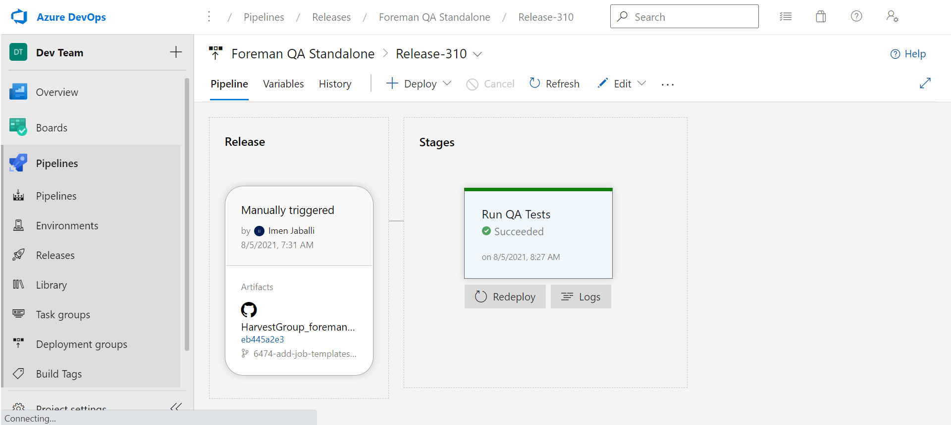
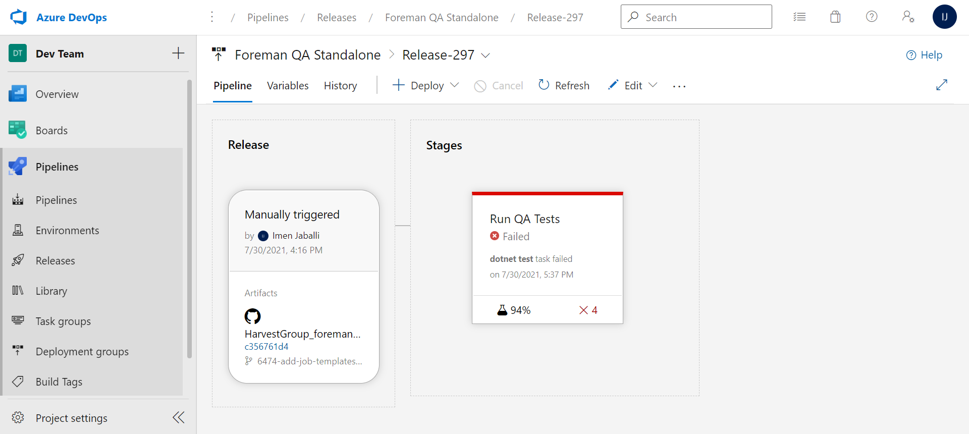
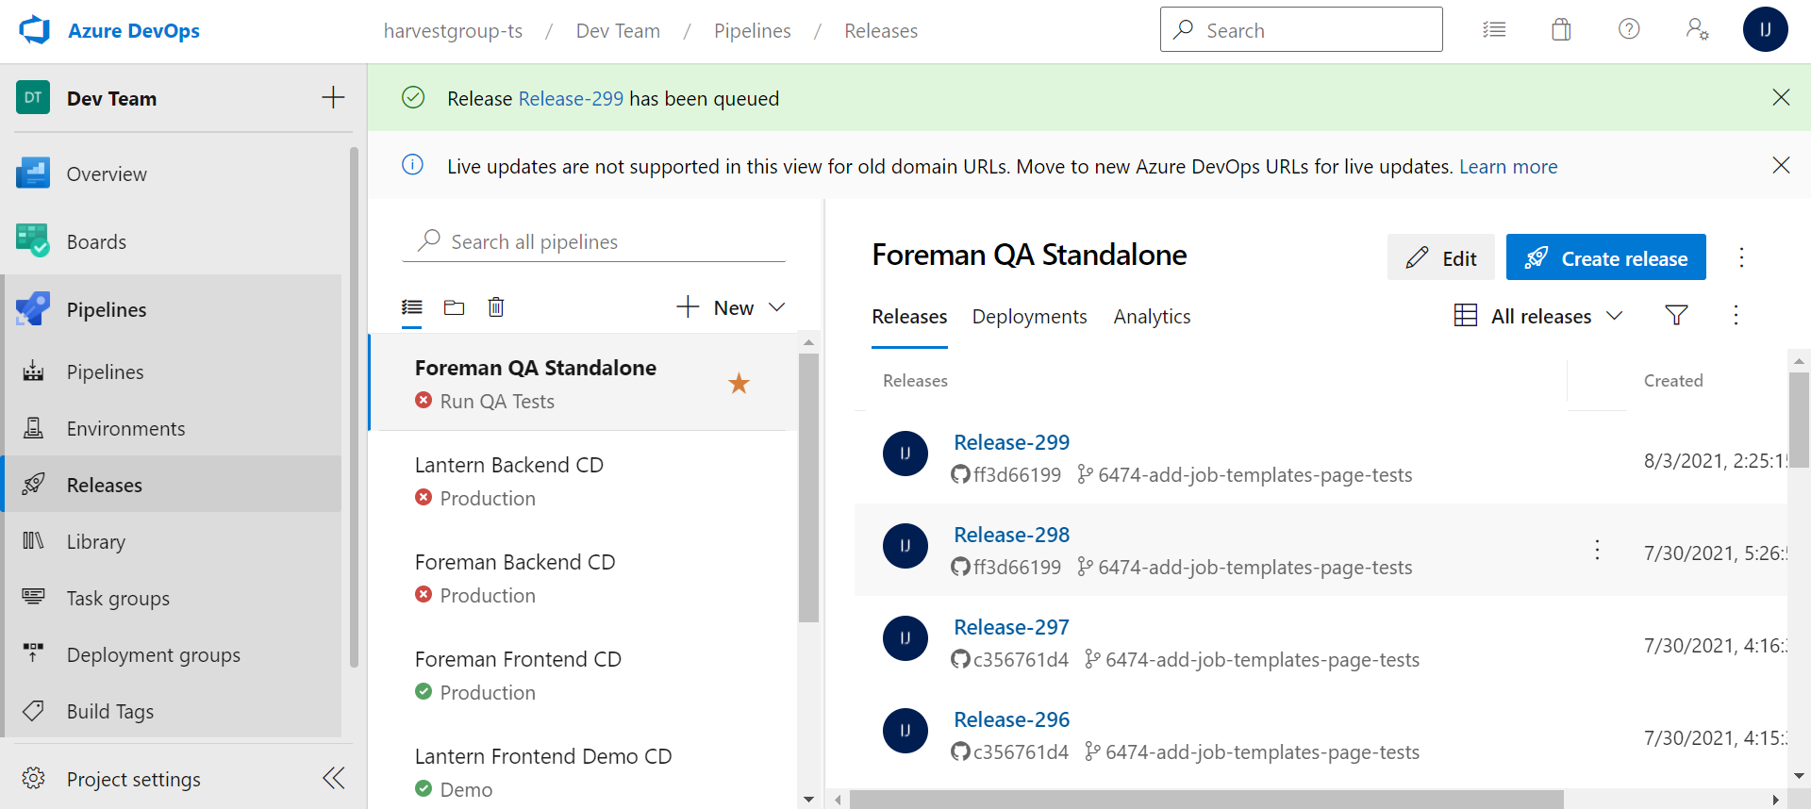
Foreman QA Standalone
Azure DevOps
Notes:
The Foreman QA Standalone app will be used as a validation step in our post-build process after the new frontend code is deployed on GitHub to validate that the change made to one part of the software does not affect the other parts. Figure 1 illustrates how to run a release pipeline? As the release pipeline is deployed, we can inspect the progress and see the changes in real-time
Test reports provide an effective and consistent way to view the results of the tests executed, measure pipeline quality, review traceability, troubleshoot failures, and drive failure ownership. In addition, it provides many advanced reporting capabilities explored in the following figures.
In the pipeline view, we can see all the stages and associated tests. The view provides a test results summary as a measure of pass percentage, along with indicators for failures and aborts if these exist. These indicators are the same as in the build timeline view, giving a consistent experience across build and release[6]. Figure 6.4 represents the Foreman QA Standalone test results view in release. 6.3.3 Tests tab Both the build and release summaries provide details of test execution. We can choose Test summary to view the details in the Tests tab. The Tests tab has the following sections[6]: • Summary: provides key quantitative metrics for the test execution such as the total test count, failed tests, pass percentage, and more. It also provides differential indicators of change compared to the previous execution. • Results: provides a list of all executed and reported tests as a part of the current build or release. The default view shows only the failed and aborted tests to focus on tests that require attention. However, we can choose other outcomes using the filters provided. • Details: provides a list of tests that we can sort, group, search, and filter to find the test results we need. Figure 6.5 represents the Foreman QA Standalone Tests tab. We can select any test run or result to view the details pane that displays additional information required for troubleshooting, such as the error message, stack trace, attachments, work items, historical trend, and more[6].
View execution of in-progress tests Tests, such as integration and functional tests, can run for a long time. Therefore, it is important to see the current or near real-time status of test execution at any given time, even for cases of quick tests. The in-progress view eliminates the need to wait for test execution to finish. Results 97 CHAPTER 6. FIFTH SPRINT Figure 6.8: Test error messages and stack traces [6] 98 CHAPTER 6. FIFTH SPRINT are available in near real-time as execution progresses, helping us to take actions faster. We can debug a failure, file a bug, or abort the pipeline[6]. Figure 6.9 represents an execution view of in-progress tests. The view below shows the in-progress test summary in a release, reporting the total test count and the number of test failures at a given point in time. The test failures are available for troubleshooting, creating bug(s), or taking any other appropriate action[6]. Figure 6.10 represents in-progress tests summary in a release.

Slide 29
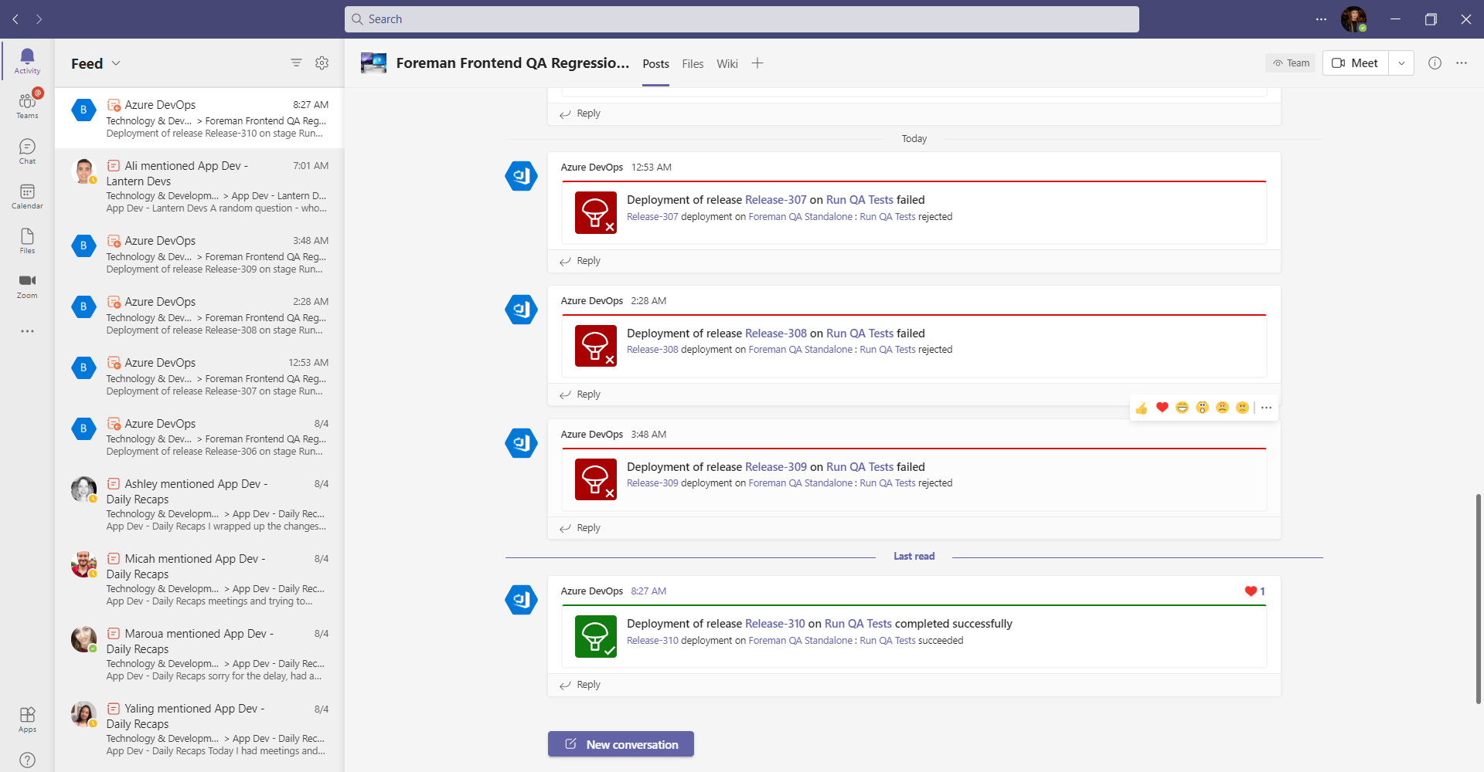
Foreman QA Standalone
Microsoft Teams
Notes:
Microsoft Teams ”Foreman Frontend QA Regression” team For a better user experience, we have created the “Foreman Frontend QA Regression” team in Microsoft Teams, where developers can receive Azure DevOps notifications on whether or not there are regression issues after deploying a new Foreman frontend code. These notifications contain a link to the release pipeline executed by Azure DevOps in case developers want to analyze the results or view the release logs. Figure 6.11 illustrates the Microsoft Teams ”Foreman Frontend QA Regression” team.

Slide 30
Conclusion and perspectives
02
Design and Implementation
04
05
Context and scope of the project
01
Needs and business analysis
03
Presenting the solution
Notes:
Let me start by giving you some background information..........

Slide 31
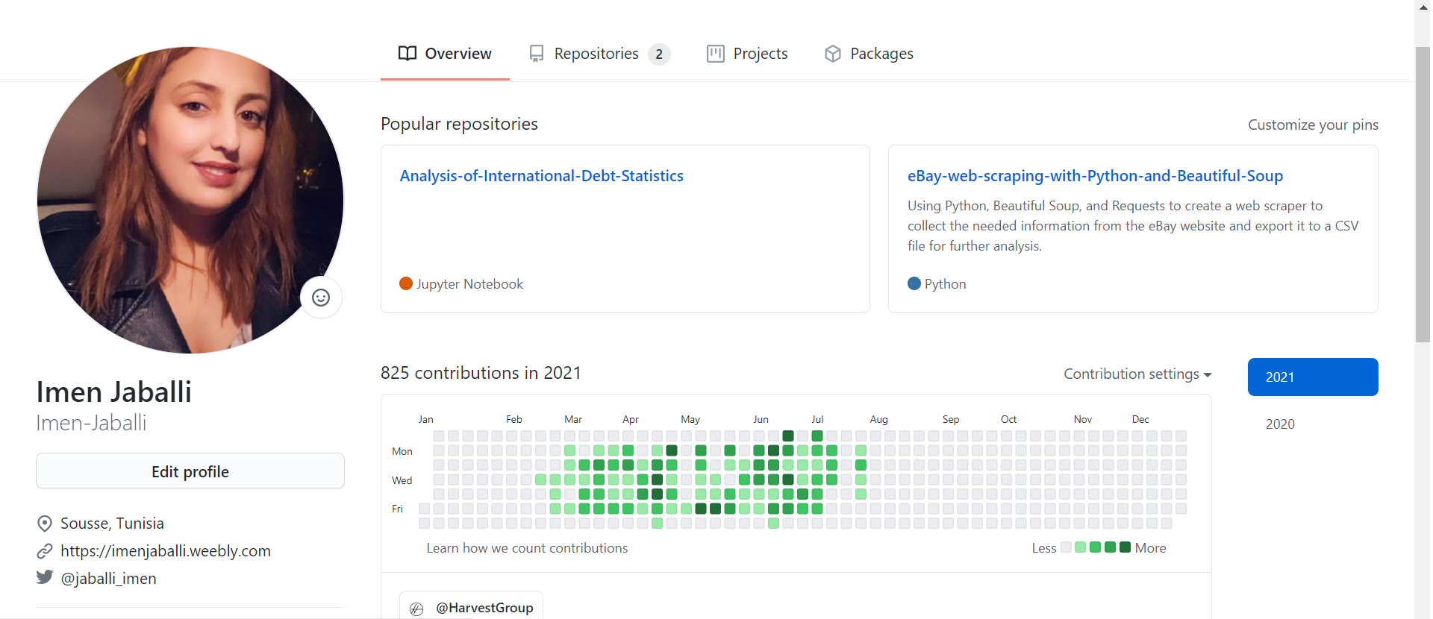
Conclusion
Personal contribution:
Boost my versatility.
Enhance my technical and soft skills.
Enhance my ability to turn with ease from one thing to another.
Made me fully understand the workflow within software companies.
Enabled me to develop our communication skills and ability to work in a team.
Notes:
This internship was beneficial to us and of considerable importance as it gave us the chance to boost our versatility, enhance our technical and soft skills, and enhance our ability to turn with ease from one thing to another. It allowed us to work with the different teams of different branches in the company that made us fully understand the workflow within software companies. This internship also gave us the possibility to interact with professionals in the office, hear their feedback which enabled us to develop our communication skills and ability to work in a team, and above all else, gain a real-world experience that we would never acquire through classes

Slide 32
Perspectives:
Project One
Project Two
90%
15%
Foreman QA Standalone
Lantern QA Standalone
Upgrade the Foreman QA Standalone app
Finish developing the Lantern QA Standalone.
We will get more opportunities in the future to update the automated tests and add others that address the new functionalities.
Notes:
The achieved work is a good step for Harvest Group to put into work such an apps, a promising project that will be enriched further by several enhancements. Regarding the prospects, we intend to: • Work on upgrading Foreman QA Standalone app. We will get more opportunities to update our automated tests by adding small tests that address new functionalities. • We will be working on finishing the Lantern QA Standalone app that we started during the first sprint, but kept it on hold because Harvest Group decided to create a new Lantern app. • After working on testing the Foreman and Lantern apps, we noticed that the login and logout testing workflows were the same, so we decided to mark the Login and logout UI tests that we created as generic automated tests that can be used to test all the Harvest Group apps login and logout functionalities.

Slide 33


Thank You
Thanks for listening to us, now you can ask your questions.

