Slide 1

Checkpoint: introduction to databases
Student: Imene Bel Hadj Hammouda

Slide 2

DataBase definition:
Structured set of information designed and produced to be easily accessed, managed and modified by several users.
DataBase Management System (DBMS) definition:
is used to store information in a database.
Using a DBMS, we can find, sort, transform and select information stored in database.

Slide 3
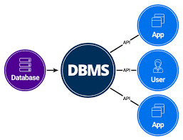
Using RDBMS allows us to:
No Data redundancy
Data Consistency and Integrity
Easy access to data
More flexibility than files
Recovery process

Slide 4

Relational Database management systems:
MySQL:
(RDBMS) based on the SQL (Structured Query Language) queries. It is one of the most popular languages for accessing and managing the records in the table. MySQL is open-source and free software under the GNU license. Oracle Company supports it.

Slide 5
Advantages/disadvantages of mysql:
Advantages:
1) Easy to use, High Performance.
2) It is secure, Speed.
3) Free to download…
Disadvantages:
MySQL version less than 5.0 doesn't support ROLE, COMMIT, and stored procedure.
does not support a very large database size as efficiently.
is accused that it doesn't have a good developing and debugging tool compared to paid databases.
doesn't support SQL check constraints.

Slide 6

2) PostgreSQL:
PostgreSQL is a powerful, open source object-relational database system that uses and extends the SQL language combined with many features that safely store and scale the most complicated data workloads.
The origins of PostgreSQL date back to 1986 as part of the POSTGRES project at the University of California at Berkeley and has more than 30 years of active development on the core platform.
PostgreSQL comes with many features aimed to help developers build applications, administrators to protect data integrity and build fault-tolerant environments, and help you manage your data no matter how big or small the dataset

Slide 7
Advantages/disadvantages of PostgreSQL :
1) Advantages:
is an open source SQL database that is not controlled by any corporation. It is typically used for web application development.
shares many of the same advantages of MySQL. It is easy to use, inexpensive, reliable and has a large community of developers. It also provides some additional features such as foreign key support without requiring complex configuration.
2) disadvantages:
The main disadvantage of PostgreSQL is that it can be slower in performance than other databases such as MySQL. It is also slightly less popular than MySQL.

Slide 8
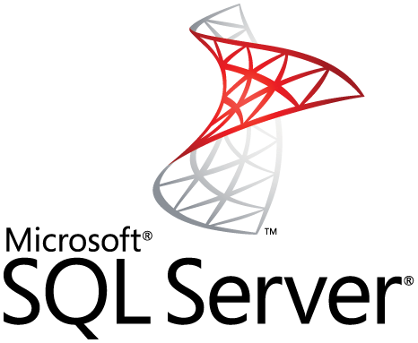
3) SQL SERVER:
Microsoft owns SQL Server. Like Oracle DB, the code is close sourced.
Large enterprise applications mostly use SQL Server.
Microsoft offers a free entry-level version called Express but can become very expensive as you scale your application.

Slide 9
Advantages/disadvantages of SQL Server :
1) Advantages:
It provides enterprise features such as security, scalability, and support for more automation through a command-line interface, as well as direct access over the web.
Teams can use stored procedures to do data extraction, transform, and load between systems
2) disadvantages:
supports stored procedures, which is a more complex programming language built on top of SQL

Slide 10
KEY DIFFERENCE:
PostgreSQL is an Object Relational Database Management System (ORDBMS) whereas MySQL is a community driven DBMS system.
PostgreSQL support modern applications feature like JSON, XML etc. while MySQL only supports JSON.
PostgreSQL performance well when executing complex queries whereas MySQL performs well in OLAP & OLTP systems.
PostgreSQL is complete ACID compliant while MySQL is only ACID compliant when used with InnoDB and NDB.
PostgreSQL supports Materialized Views whereas MySQL doesn’t supports Materialized Views.

Slide 11
KEY DIFFERENCE:
PostgreSQL, MySQL, and SQLite use very similar syntax, with some notable differences highlighted below. Microsoft SQL Server has the greatest contrast in SQL syntax, as well as a wide variety of functions not available in other platforms.
The table below highlights some examples of basic differences between SQL platforms:

Slide 12
