Slide 1

ZENMORA
Calm mind happy life

Slide 2
Group Members
Registration Number | Name
254114J | K.L. Vihara Dewmini Kodithuwakku
254223R | R.P. Kavindu Lakshan Thilakarathna
254096D | Uthpala Dasunpriya Jayasinghe
255109G | K.W. Imesh Thiwanka
254243D | M.Yanushan

Slide 3
Introduction
Stress, anxiety, and sleep disorders are common real-world problems.
Continuous stress or irregular sleep can affect mental health, focus, and overall well-being.
There is a need for a smart device that detects stress and helps the user relax and sleep
better automatically.
ZENMORA is a heart-rate-based adaptive relaxation system that:
Monitors physiological signals (heart rate, skin response, movement)
Plays calming music / sounds to reduce stress
Automated fan and light control
Helps users fall asleep naturally
Automatically stops music when the body reaches a calm state

Slide 4
Problem In Brief
People often cannot detect stress in themselves until it becomes severe.
Some people have no stress but have sleeping disorders.
Many rely on manual methods: breathing exercises, apps, music.
Lack of a real-time, automatic system that reacts based on actual body signals.
Poor sleep quality due to undetected stress.

Slide 5
Project Objective
Detect human stress using physiological signals:
Skin response (GSR)
Temperature
Heart rate
Automatically help user relax through:
Calming music / sound
Mobile app guidance
Smart auto-off feature when user is calm.
Automatic fan based on temperature.
Automatic light based on brightness.
LED Panel for show the stress levels. (Red for high stress, Green for calmness.)

Slide 6
Proposed Solution
Sensor Holding Wristband Design
Sensors integrated in a comfortable wristband.
Wristband placement for:
Pulse sensor (MAX30102)
GSR electrodes
Optional: MPU6050 motion sensor
Wristband connected to RASPBERRY PI for data processing.
Power supply: USB for demo, battery for portable use.
Soft padding ensures comfortable and continuous monitoring.

Slide 7
Proposed Solution
Environmental Sensing & Automation system
Monitors body temperature and environment.
Automatically turns the fan ON/OFF based on temperature thresholds .
Uses a light sensor to detect ambient brightness.
Automatically controls lighting based on light conditions.
Controlled by a Raspberry Pi for real-time processing.

Slide 8
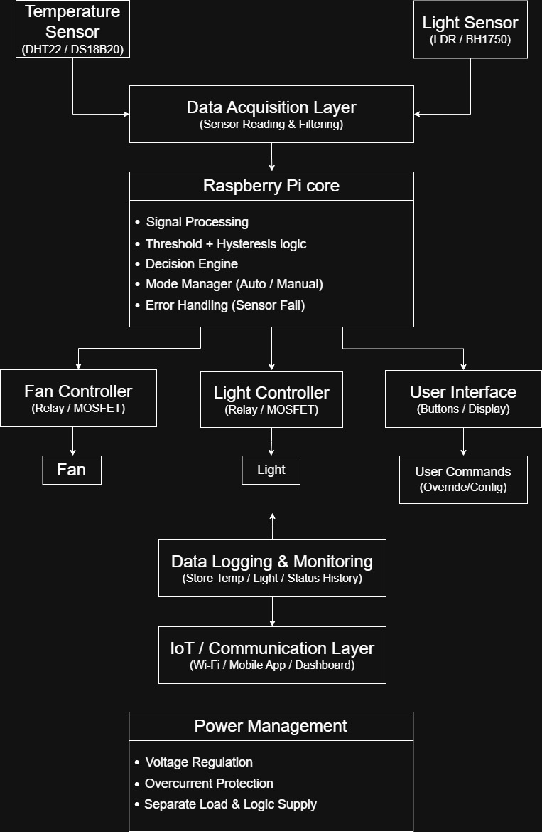


Block Diagram

Slide 9
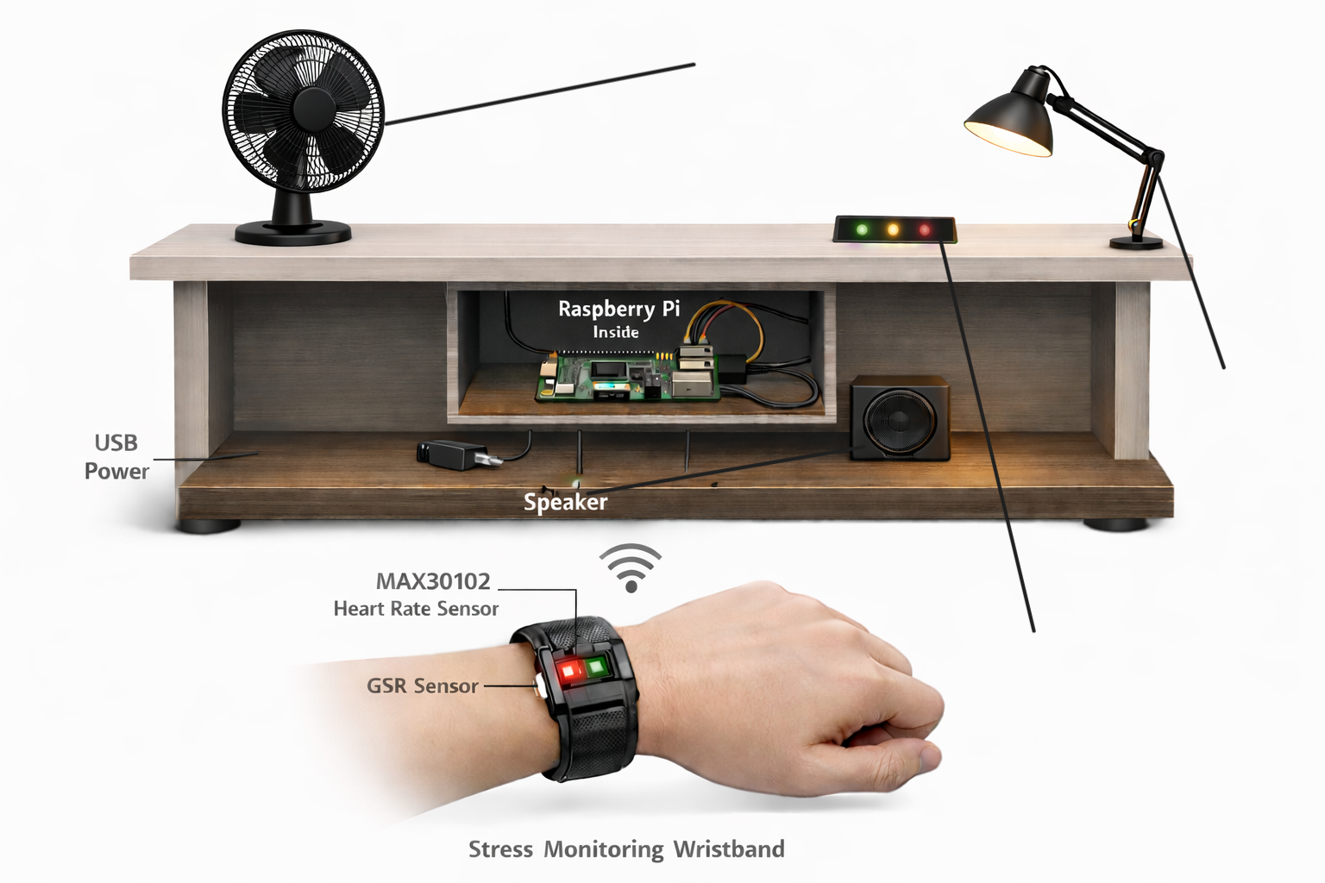
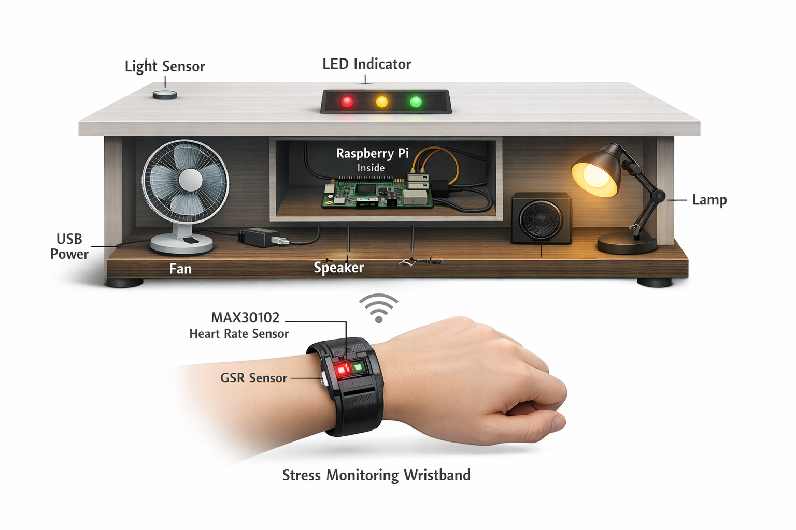
System Overview
Fan
Table Lamp
LED Indicator

Slide 10
Hardware and Software Components
Hardware:
Software:
Arduino IDE
Python
GPIO Libraries (RPi.GPIO/GPIO Zero)
Sensor Libraries (MAX30102,GSR,
DFPlayer Mini
Optional: Mobile app platform (MIT
App Inventor / Android Studio)
Control Logic (Threshold + Hysteresis)
Audio Control Libraries (DFPlayer Mini)
Raspberry Pi 5
MAX30102 Pulse Sensor(Heart Rate)
Temperature Sensor (DHT22/DS18B20)
Light Sensor (LDR / BH1750)
Relay Module / MOSFET Driver
GSR Sensor (Skin Response)
LEDs (Red, Yellow, Green)
Mini Speaker / DFPlayer Mini
Wristband components
Battery / USB power
Fan

Slide 11
Work Distribution
Member 1 – Project Management
Planning and coordination
Documentation
Final integration
Member 2 – Stress Detection
MAX30102 and GSR sensors
Stress analysis
Member 3 – Environmental Monitoring
DS18B20 temperature sensor
Light sensor
Member 4 – Control System
Fan control
Light control
LED indicators

Slide 12
Member 5 – Software & Audio
Python programming
Decision logic
Audio system

Slide 13
Project Timeline
Phase 1 (Month 1–2): Research
Problem identification
Requirement analysis
Phase 2 (Month 3–4): Design
Block diagram
Circuit design
Phase 3 (Month 5–7): Development
Sensor modules
Control modules
Software coding
Phase 4 (Month 8–9): Integration
Combine modules
System testing
Phase 5 (Month 10–11): Testing
Performance testing
Error fixing
Phase 6 (Month 12): Finalization
Report
Presentation
Demo

Slide 14
Estimated Budget
Component | Estimated Cost (LKR)
Raspberry Pi 5 | 25,000
MAX30102 Sensor | 2,500
GSR Sensor | 1,500
DS18B20 | 800
Light Sensor | 500
Relay Module | 1,000
Fan | 3,000
LED Light | 1,000
DFPlayer + Speaker | 2,000
Misc (wires, board) | 2,000
Total Estimated Cost: 39,000

Slide 15
Expected Results
Real-time stress detection
Automatic fan and light control
Calming audio activation
Improved user comfort

Slide 16
Innovation
Integration of physiological sensing + environment control
Fully automated stress response system
Real-time decision-making
Multi-output smart system

Slide 17
Future Improvements
Mobile app integration
Cloud data storage
AI-based stress prediction
Wearable compact design
Personalized settings

Slide 18
Conclusion
ZENMORA is an intelligent system that combines stress detection and environmental automation to improve user comfort and relaxation.
By integrating physiological sensors and smart control systems, the project demonstrates a practical solution for stress management and smart living environments.
This system highlights the potential of embedded systems and automation in improving human well-being.

Slide 19
References
Raspberry Pi Foundation – https://www.raspberrypi.org
MAX30102 Datasheet – Maxim Integrated
DS18B20 Datasheet – Maxim Integrated
GSR Sensor – DFRobot Documentation (https://www.dfrobot.com)
IEEE Papers on Stress Detection – IEEE Xplore (https://ieeexplore.ieee.org)
Smart IoT Systems – International Journal of Engineering Research

Slide 20
Thank You.

