Slide 1
Deep Learning Batch Selection Algorithms
Made by: Dóra Cziborová, Tamás Imets, Péter Gábor Kacsó

Slide 2
Introduction
The problem with DL: learning takes a lot of time
Current solution: better hardware
Batch selection is still done by random shuffling
Possibility of improvements to accelerate learning
New approaches in batch selection algorithms
Create and test them

Slide 3
Main Steps of Our Work
Construct multiple deep learning models
Write our own training loop
Run benchmark tests on the models using random shuffling
Create new batch selection algorithms
Run tests with our algorithms
Compare and analyse results

Slide 4
Models
The goal was to cover many different network architectures
From simple to advanced
Fully connected FFW models
Convolutional neural networks
Word2Vec supported LSTM model
Custom training loop
Batch selection method is inaccessible when using the default training loop provided by Keras

Slide 5
Our Batch Selection Algorithms
Windowed
A window of predefined length moving through the dataset
Next batch: the largest loss inside the window
Sorting
Sorts the batches by their losses at the beginning of epochs
Next batch: next in descending order of losses

Slide 6
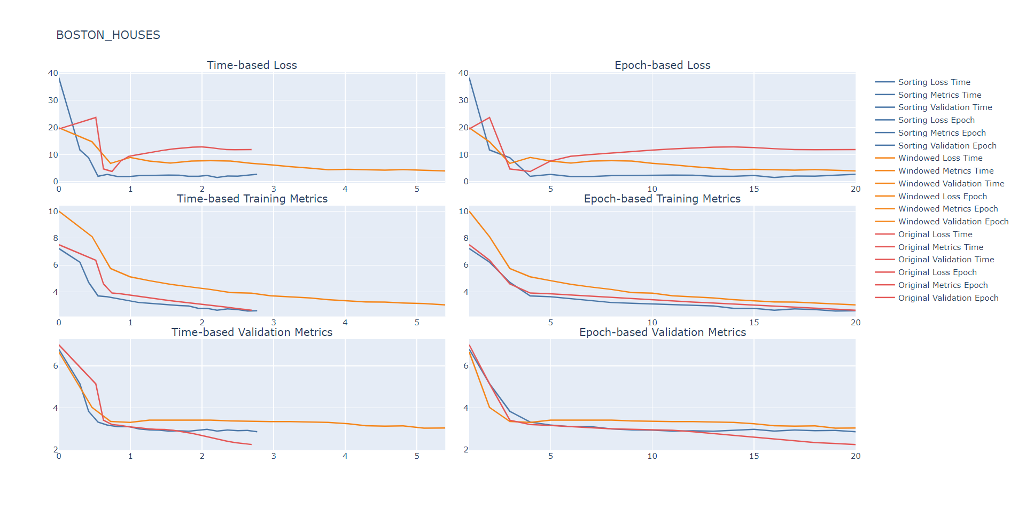
Results on Boston House Prices Prediction

Slide 7
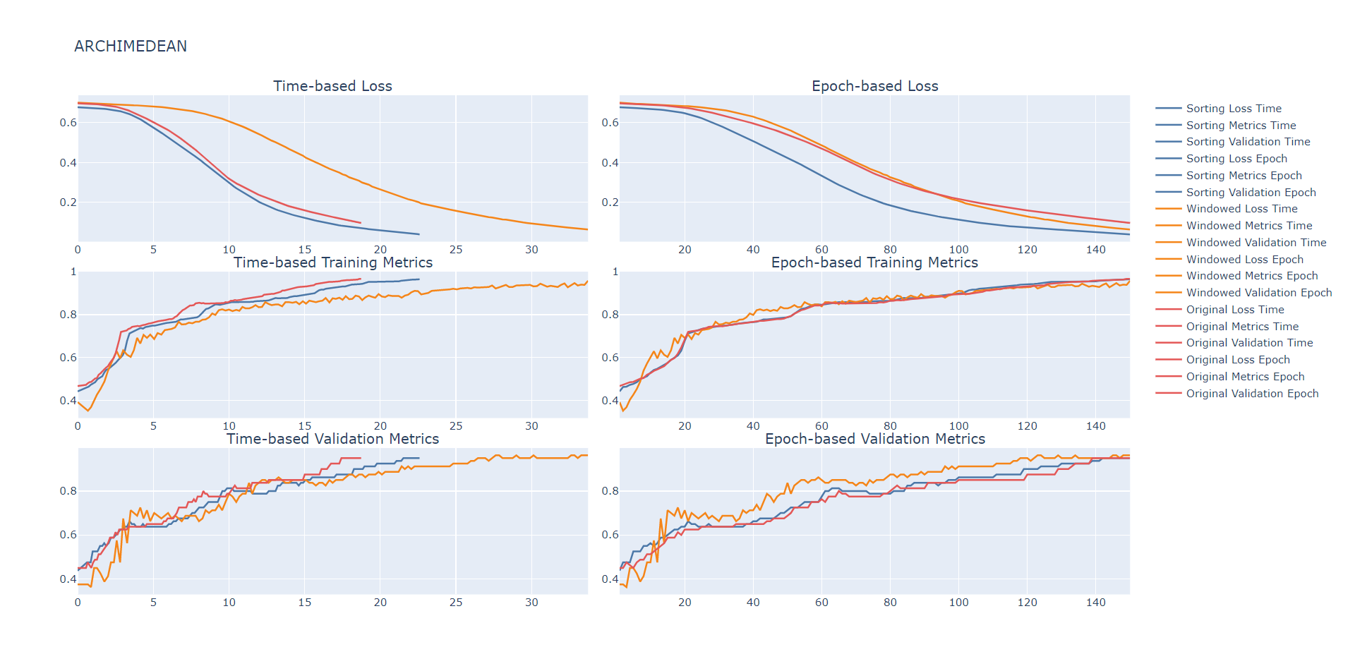
Results on Archimedean Spiral Classifier

Slide 8
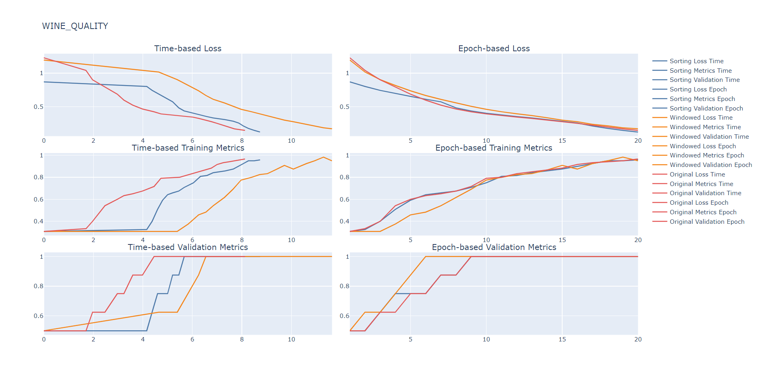
Results on Wine Recognition Classifier

Slide 9
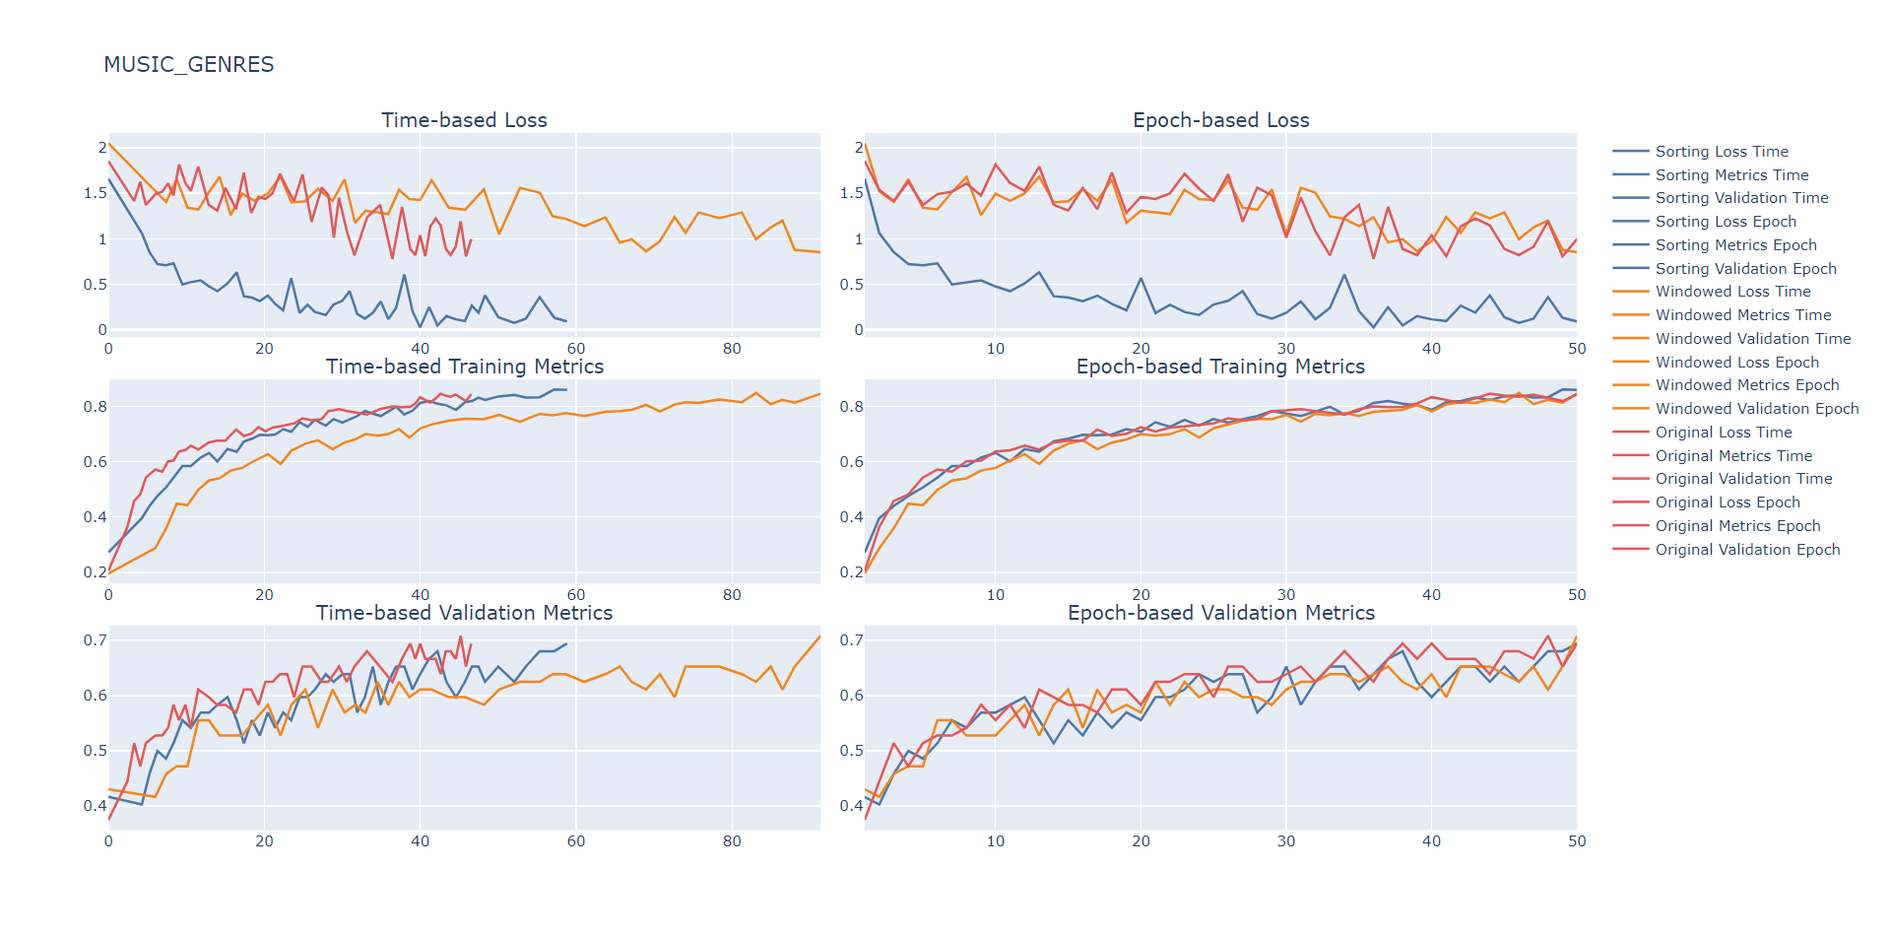
Results on Music Genres Classifier

Slide 10
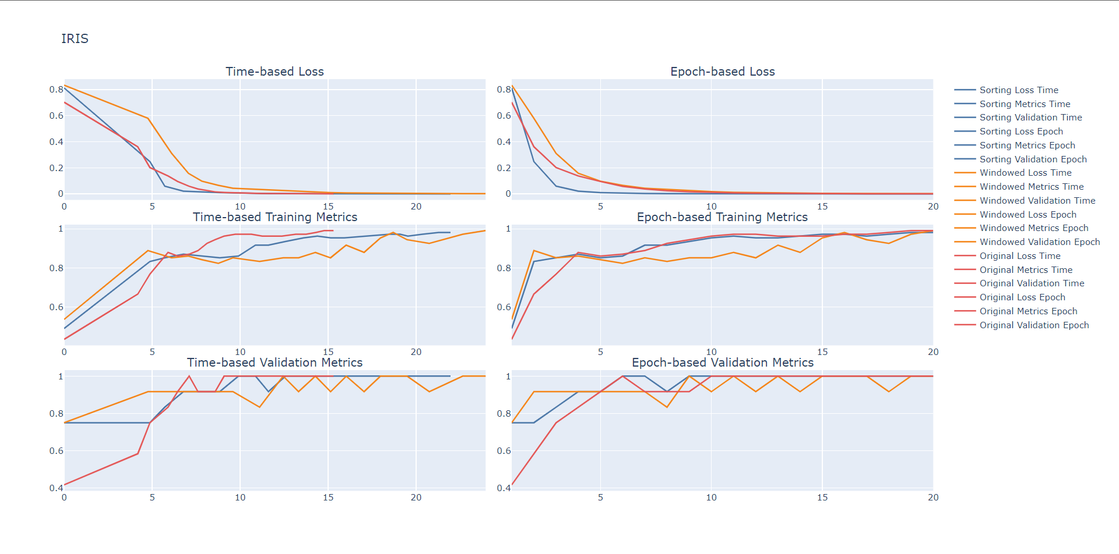
Results on Iris Classifier

Slide 11
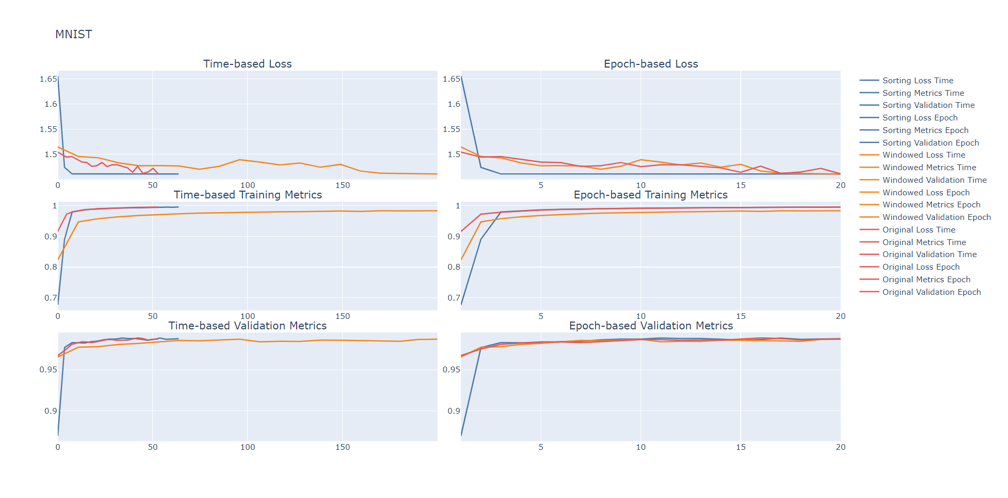
Results on MNIST Classifier

Slide 12
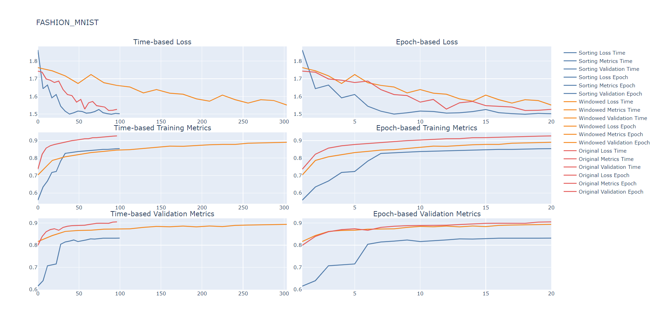
Results on Fashion-MNIST Classifier

Slide 13
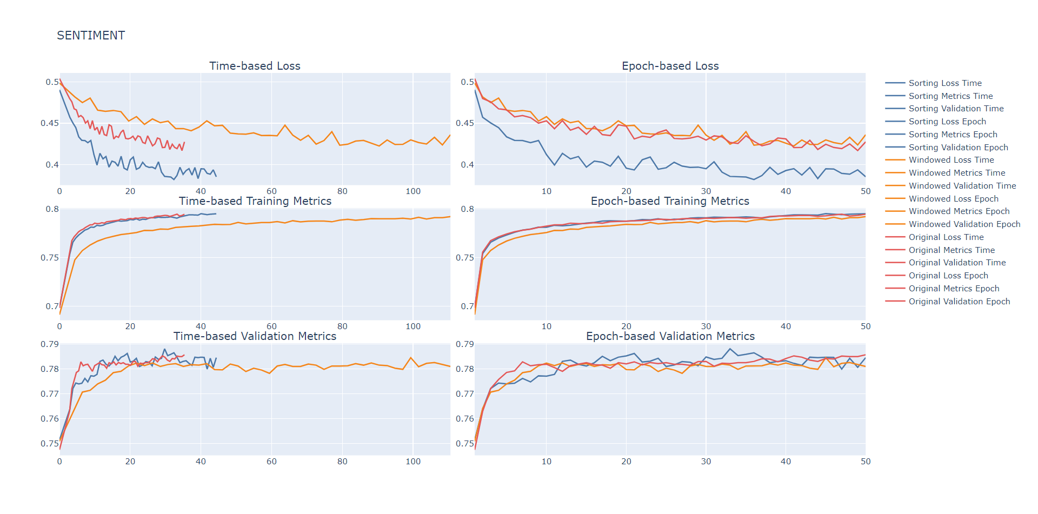
Results on Sentiment Analysis with LSTM

Slide 14
Batch Selection Performance
Category | Algorithms
 | Random | Sorting | Windowed
Train Accuracy | 3 | 3 | 3
Validation Accuracy | 6 | 4 | 3

Slide 15
Batch Selection Efficiency
Category | Algorithms
 | Random | Sorting | Windowed
Train Accuracy (Epoch) | 5 | 1 | 2
Validation Accuracy (Epoch) | 3 | 3 | 3
Training Loss (Epoch) | 1 | 7 | 0
Train Accuracy (Time) | 8 | 0 | 0
Validation Accuracy (Time) | 6 | 2 | 0
Training Loss (Time) | 2 | 6 | 0
Total Score | 25 | 19 | 5

