Slide 1
AP RESEARCH • ORAL DEFENSE • 2025-26
Teaching the Machine
to Teach Us
Prompt-engineering instruction, AI reasoning, and literacy in PAUSD
Jerry Yan • Palo Alto Unified School District • apr-sooty.vercel.app
Notes:
Open strong. One question: can a short lesson change how students think with AI?

Slide 2
01 • WHY THIS MATTERS
2 / 24
We are inside an AI paradigm shift
LLMs are already shaping student cognition.
STAT OF THE DAY
✦ 72% of U.S. teens already use AI companions
72%
◆ Heaviest users show the lowest critical-thinking scores
◉ Cognitive offloading and thinking scores: r = -0.75
➤ Without intervention, this scales into workforce habits
of U.S. teens use AI
as a companion.
Common Sense Media, 2025 • Gerlich, Societies, 2025
Notes:
Three in four teens already use AI. The intervention question is urgent, not theoretical.

Slide 3
01 • MECHANISM
3 / 24
Two modes of AI use
SUBSTITUTIVE
COMPLEMENTARY
AI replaces student thinking
AI scaffolds student thinking
✦ No attempt first
✦ Explain-first prompts
◆ Lower understanding
◆ Higher comprehension gains
◉ Weaker EEG coupling
◉ Prompt quality mediates effect
➤ Higher dependence
➤ Better transfer
Lehmann et al., 2025 • Kosmyna et al., 2024 • Eltahir & Babiker, 2024
Notes:
Contrast substitution vs complementarity clearly. Prompting skill is the dial between them.

Slide 4
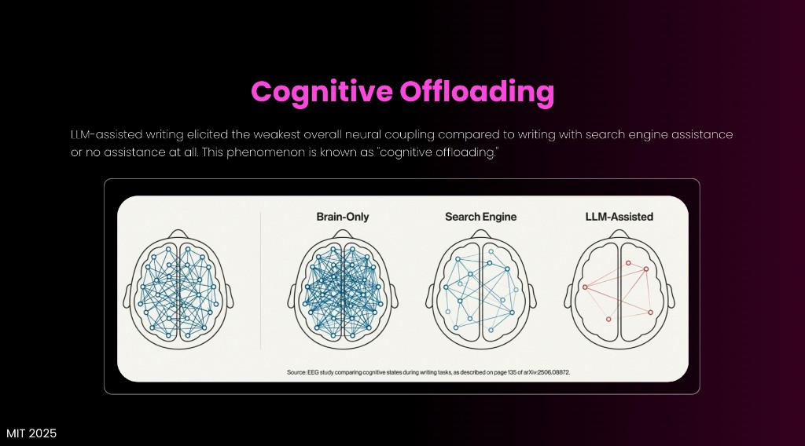
01 • NEUROSCIENCE
4 / 24
Cognitive debt is measurable
MIT EEG (n = 55): LLM-assisted writing showed the weakest neural coupling.
MIT EEG
83.3%
✦ Signal drop appears after one session
◆ Recall quality falls immediately after assisted writing
less unaided recall
after AI-assisted
writing.
◉ Pattern aligns with offloading literature
Concept visualization from cited EEG-style comparison graphic
Kosmyna et al., 2024
Notes:
Pause at 83.3%. Frame cognitive debt as compounding cost.

Slide 5
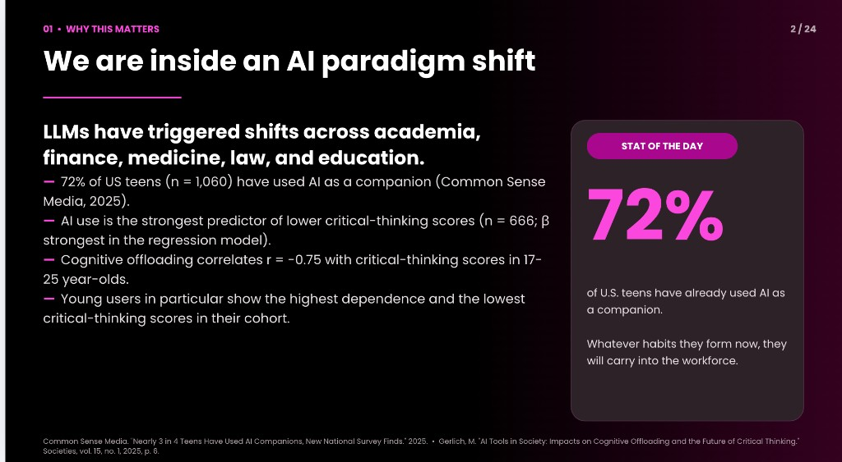
Literacy is the dial
between AI harm and AI help.
Notes:
This is your visual breath slide. One sentence only; let it land.

Slide 6
01 • THE LEVER
6 / 24
Prompt engineering = programmable language
✦ Role: define who the model should be
◆ Context: include constraints and audience
◉ Task: specify artifact and format
➤ Verify: check claims before acceptance
Role
Context
Task
Verify
KEY SIGNAL
KEY SIGNAL
KEY SIGNAL
Role
Context
Task
MIT Sloan, 2025 • Dennison et al., 2024 • Park & Choo, 2024 • Chang et al., 2025
Notes:
Walk across Role, Context, Task, Verify. Keep this practical.
Core beats for "Prompt engineering = programmable language":
- Role: define who the model should be
- Context: include constraints and audience
- Task: specify artifact and format
- Verify: check claims before acceptance
Delivery cue: land one bullet per beat, pause briefly, then bridge forward.

Slide 7
01 • GAP
7 / 24
Curricula exist, evidence is thin
✦ Strong frameworks already exist (CRAFT, Prompty, IDEA/PARTS)
STUDY LANDSCAPE
◆ Few K-12 studies run controlled classroom comparisons
◉ Prompt transparency is often missing
28
➤ Restrictive-policy districts are understudied
18
2
Real K-12
No classroom
No prompts
KEY SIGNAL
KEY SIGNAL
KEY SIGNAL
Strong frameworks already exist
Few K-12 studies run
Prompt transparency is often
Chen et al., 2024 • Dennison et al., 2024 • Gogan, 2024
Notes:
Locate your contribution in one sentence: scored, real-student, controlled data.
Core beats for "Curricula exist, evidence is thin":
- Strong frameworks already exist (CRAFT, Prompty, IDEA/PARTS)
- Few K-12 studies run controlled classroom comparisons
- Prompt transparency is often missing
- Restrictive-policy districts are understudied
Delivery cue: land one bullet per beat, pause briefly, then bridge forward.

Slide 8
02 • RESEARCH QUESTION
8 / 24
One question, three measurable outcomes
✦ RQ1: Substitutive-use behavior index
◆ RQ2: Prompt-quality rubric pass rates
◉ RQ3: Hallucination detect-and-correct accuracy
KEY SIGNAL
KEY SIGNAL
KEY SIGNAL
RQ1
RQ2
RQ3
Notes:
Read the RQ slowly; then tap each pillar.
Core beats for "One question, three measurable outcomes":
- RQ1: Substitutive-use behavior index
- RQ2: Prompt-quality rubric pass rates
- RQ3: Hallucination detect-and-correct accuracy
Delivery cue: land one bullet per beat, pause briefly, then bridge forward.

Slide 9
02 • HYPOTHESES
9 / 24
Directional predictions with falsifiers
✦ H1: Treatment lowers substitutive-use index
◆ H2: Treatment raises rubric pass rates (largest in Background/Elaboration)
◉ H3: Treatment improves hallucination detection and correction
➤ Each hypothesis has an explicit null/falsifier test
KEY SIGNAL
KEY SIGNAL
KEY SIGNAL
H1
H2
H3
Notes:
State falsifiers out loud. That signals rigorous design.
Core beats for "Directional predictions with falsifiers":
- H1: Treatment lowers substitutive-use index
- H2: Treatment raises rubric pass rates (largest in Background/Elaboration)
- H3: Treatment improves hallucination detection and correction
- Each hypothesis has an explicit null/falsifier test
Delivery cue: land one bullet per beat, pause briefly, then bridge forward.

Slide 10
03 • DESIGN
10 / 24
Two-arm asynchronous quasi-experiment
✦ Volunteer sample; deterministic assignment via participant sequence
◆ Control: matched-length digital literacy reading
◉ Treatment: PE module + scenario tasks
➤ Total session time <= 60 minutes
KEY SIGNAL
KEY SIGNAL
KEY SIGNAL
Volunteer sample; deterministic assignment
Control
Treatment
Notes:
Emphasize isolation: only one middle block differs.
Core beats for "Two-arm asynchronous quasi-experiment":
- Volunteer sample; deterministic assignment via participant sequence
- Control: matched-length digital literacy reading
- Treatment: PE module + scenario tasks
- Total session time <= 60 minutes
Delivery cue: land one bullet per beat, pause briefly, then bridge forward.

Slide 11
03 • INTERVENTION
11 / 24
Three scenarios map to three RQs
✦ S1 Ethical use -> RQ1 behavior
◆ S2 Iteration -> RQ2 prompt quality
◉ S3 Verification -> RQ3 hallucination handling
➤ Common scoring pipeline across all scenarios
KEY SIGNAL
KEY SIGNAL
KEY SIGNAL
S1 Ethical use ->
S2 Iteration -> RQ2
S3 Verification -> RQ3
Notes:
The mapping is the spine. Keep this clean and fast.
Core beats for "Three scenarios map to three RQs":
- S1 Ethical use -> RQ1 behavior
- S2 Iteration -> RQ2 prompt quality
- S3 Verification -> RQ3 hallucination handling
- Common scoring pipeline across all scenarios
Delivery cue: land one bullet per beat, pause briefly, then bridge forward.

Slide 12
03 • RUBRIC
12 / 24
How prompts become numbers
✦ Six binary dimensions (Xiao et al.)
PASS-FAIL AGREEMENT
◆ GPT-4o judge, temperature 0, JSON-only output
◉ Scenario-aware system prompt, fixed grading instructions
98
85
93
96
90
88
➤ Dimension-level pass rates feed inferential tests
Rel
Clr
Con
Bkg
Elab
NoAns
KEY SIGNAL
KEY SIGNAL
KEY SIGNAL
Six binary dimensions (Xiao
GPT-4o judge, temperature 0,
Scenario-aware system prompt, fixed
Xiao et al., 2025
Notes:
Explain calibration choice and consistency benefits.
Core beats for "How prompts become numbers":
- Six binary dimensions (Xiao et al.)
- GPT-4o judge, temperature 0, JSON-only output
- Scenario-aware system prompt, fixed grading instructions
- Dimension-level pass rates feed inferential tests
Delivery cue: land one bullet per beat, pause briefly, then bridge forward.

Slide 13
03 • INSTRUMENTS
13 / 24
Pre/post measurement battery
✦ Knowledge checks (T/F + open responses)
◆ Hallucination subtest with planted errors
◉ Confidence battery for placebo/familiarity control
➤ CRAFT task logs live behavior with AI
KEY SIGNAL
KEY SIGNAL
KEY SIGNAL
Knowledge checks (T/F +
Hallucination subtest with planted
Confidence battery for placebo/familiarity
Notes:
Behavioral logs are key: not just self-report.
Core beats for "Pre/post measurement battery":
- Knowledge checks (T/F + open responses)
- Hallucination subtest with planted errors
- Confidence battery for placebo/familiarity control
- CRAFT task logs live behavior with AI
Delivery cue: land one bullet per beat, pause briefly, then bridge forward.

Slide 14
03 • PLATFORM
14 / 24
Built end-to-end for replication
✦ Next.js frontend + Supabase backend
◆ Typed API route for auto-grading
◉ SQL views flatten event logs for analysis
➤ Open-source workflow for district replication
KEY SIGNAL
KEY SIGNAL
KEY SIGNAL
Next.js frontend + Supabase
Typed API route for
SQL views flatten event
Notes:
Replication is a research value proposition, not a side note.
Core beats for "Built end-to-end for replication":
- Next.js frontend + Supabase backend
- Typed API route for auto-grading
- SQL views flatten event logs for analysis
- Open-source workflow for district replication
Delivery cue: land one bullet per beat, pause briefly, then bridge forward.

Slide 15
04 • VALIDATION
15 / 24
Can the model judge accurately?
✦ 15% stratified human audit sample
◆ Inter-rater target: kappa >= 0.80
◉ Auto-vs-gold target: kappa >= 0.92
➤ Preliminary overall agreement meets deployment threshold
KEY SIGNAL
KEY SIGNAL
KEY SIGNAL
15% stratified human audit
Inter-rater target
Auto-vs-gold target
Xiao et al., 2025
Notes:
Acknowledge weakest rubric dimension and ongoing calibration.
Core beats for "Can the model judge accurately?":
- 15% stratified human audit sample
- Inter-rater target: kappa >= 0.80
- Auto-vs-gold target: kappa >= 0.92
- Preliminary overall agreement meets deployment threshold
Delivery cue: land one bullet per beat, pause briefly, then bridge forward.

Slide 16
04 • RESULTS
16 / 24
RQ1 — Results placeholder: Substitutive use
[ FIGURE PLACEHOLDER ]
SPEAK TRACK
Insert bar chart + Welch t + Cohen d
Direction
Effect size
Uncertainty
Implication
Notes:
On defense day: fill with final stats. Lead with effect size, not just p-values.

Slide 17
04 • RESULTS
17 / 24
RQ2 — Results placeholder: Prompt quality
[ FIGURE PLACEHOLDER ]
SPEAK TRACK
Insert radar/line chart + mixed ANOVA
Direction
Effect size
Uncertainty
Implication
Notes:
On defense day: fill with final stats. Lead with effect size, not just p-values.

Slide 18
04 • RESULTS
18 / 24
RQ3 — Results placeholder: Hallucination handling
[ FIGURE PLACEHOLDER ]
SPEAK TRACK
Insert confusion grid + proportion tests
Direction
Effect size
Uncertainty
Implication
Notes:
On defense day: fill with final stats. Lead with effect size, not just p-values.

Slide 19
05 • ARGUMENT
19 / 24
Evidence -> conclusion -> consequence
✦ Evidence: substitution hurts, complementarity helps
◆ Mechanism: prompt skill shifts use mode
◉ Conclusion: short PE instruction can move behavior
➤ Consequence: literacy-first policy outperforms blanket bans
KEY SIGNAL
KEY SIGNAL
KEY SIGNAL
Evidence
Mechanism
Conclusion
Notes:
Run this as a logic chain, not as isolated claims.
Core beats for "Evidence -> conclusion -> consequence":
- Evidence: substitution hurts, complementarity helps
- Mechanism: prompt skill shifts use mode
- Conclusion: short PE instruction can move behavior
- Consequence: literacy-first policy outperforms blanket bans
Delivery cue: land one bullet per beat, pause briefly, then bridge forward.

Slide 20
05 • IMPLICATIONS
20 / 24
What changes if findings hold
✦ PAUSD: pilot short PE modules in ELA/history
◆ Schools: low-cost open-source intervention template
◉ Research: reusable scoring protocol + comparable metrics
KEY SIGNAL
KEY SIGNAL
KEY SIGNAL
PAUSD
Schools
Research
Notes:
Close each implication with a concrete implementation action.
Core beats for "What changes if findings hold":
- PAUSD: pilot short PE modules in ELA/history
- Schools: low-cost open-source intervention template
- Research: reusable scoring protocol + comparable metrics
Delivery cue: land one bullet per beat, pause briefly, then bridge forward.

Slide 21
05 • LIMITATIONS
21 / 24
Boundaries and next studies
✦ Single district and volunteer sampling
◆ Limited power for arm-specific effects
◉ Optional retention follow-up risks attrition bias
➤ Next: n ~ 90 multi-district replication
KEY SIGNAL
KEY SIGNAL
KEY SIGNAL
Single district and volunteer
Limited power for arm-specific
Optional retention follow-up risks
Notes:
Explicit limits increase credibility. Keep tone confident.
Core beats for "Boundaries and next studies":
- Single district and volunteer sampling
- Limited power for arm-specific effects
- Optional retention follow-up risks attrition bias
- Next: n ~ 90 multi-district replication
Delivery cue: land one bullet per beat, pause briefly, then bridge forward.

Slide 22
06 • REFLECTION
22 / 24
How my thinking evolved
✦ From ban-first intuition to literacy-first framing
◆ From descriptive concern to measurable intervention
◉ From prompt tips to auditable rubric logic
➤ Current stance: teach the dial, not the fear
KEY SIGNAL
KEY SIGNAL
KEY SIGNAL
From ban-first intuition to
From descriptive concern to
From prompt tips to
Notes:
This slide earns reflection points. Be personal, but concise.
Core beats for "How my thinking evolved":
- From ban-first intuition to literacy-first framing
- From descriptive concern to measurable intervention
- From prompt tips to auditable rubric logic
- Current stance: teach the dial, not the fear
Delivery cue: land one bullet per beat, pause briefly, then bridge forward.

Slide 23
07 • CLOSING
23 / 24
We do not ban literacy. We teach it.
✦ 72% are already using AI
WHY THIS MATTERS
◆ Your study tests a practical, replicable intervention
◉ Open stack + clear metrics make scaling realistic
100
72
1
Use
Need
Scale
KEY SIGNAL
KEY SIGNAL
KEY SIGNAL
72% are already using AI
Your study tests a
Open stack + clear
Notes:
Pause, then invite questions. End on agency.
Core beats for "We do not ban literacy. We teach it.":
- 72% are already using AI
- Your study tests a practical, replicable intervention
- Open stack + clear metrics make scaling realistic
Delivery cue: land one bullet per beat, pause briefly, then bridge forward.

Slide 24
08 • WORKS CITED
24 / 24
MLA sources supporting claims
• Chang et al. (2025), npj Digital Medicine
• Chen et al. (2024), K-12 PE systematic review
• Common Sense Media (2025), teen AI use survey
• Dennison et al. (2024), Prompty / AAAI
• Eltahir & Babiker (2024), e-learning outcomes
• Gerlich (2025), critical thinking & offloading
• Gogan (2024), Gen/ReGen log
• Kosmyna et al. (2024), MIT EEG cognitive debt
• Lehmann et al. (2025), AI in classroom harm conditions
• MIT Sloan (2025), prompt essentials
• Park & Choo (2024), educator PE strategies
• Shojaee et al. (2025), reasoning limits
• Singhal et al. (2023), clinical knowledge in LLMs
• Xiao et al. (2025), rubric-anchored LLM-as-judge
Notes:
Keep on screen for panel verification. Do not read aloud.

