Slide 1
SQL PROJECT INDIAN GENERAL ELECTION RESULT ANALYSIS 2024
PROBLEM STATEMENT
Total seats
What are the total no of seats available for elections in each state?
Total Seats Won by NDA Alliance
Total Seats Won by I.N.D.I.A Alliance parties
Add new column field in table partywise_results to get the Party Alliance as NDA, I.N.D.I.A and OTHER
Which alliance (NDA, I.N.D.I.A and OTHER) won the most seats across all states?
Winning Candidate’s name, their party name, total votes, and the margin of victory for a specific state and constituency?

Slide 2
SQL PROJECT INDIAN GENERAL ELECTION RESULT ANALYSIS 2024
PROBLEM STATEMENT
What is the distribution of EVM votes versus postal votes for candidates in a specific constituency?
Which parties won the most seats in a state and how many seats did each party won?
What is the total no of seats won by each alliance (NDA, I.N.D.I.A and OTHER) in each state for the Indian elections 2024?
Which candidate received the highest no of EVM votes in each constituency (Top 10)?
Which candidate won and which candidate was the runner-up in each constituency of state for the 2024 election?
For the state of Maharashtra, what are the total no of seats, total no of candidates, total no of parties, total votes (including EVM and postal), and the breakdown of EVM and postal votes?

Slide 3
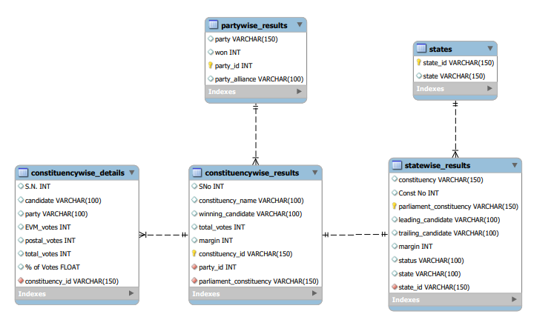
SQL PROJECT INDIAN GENERAL ELECTION RESULT ANALYSIS 2024
ENTITY RELATIONSHIP DIAGRAM (ERD)

Slide 4
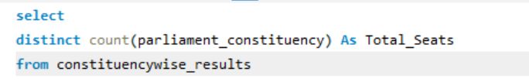

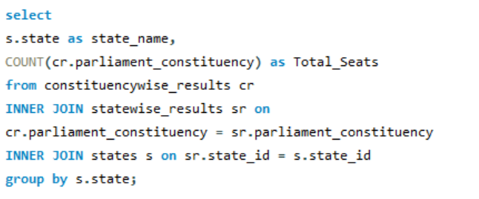
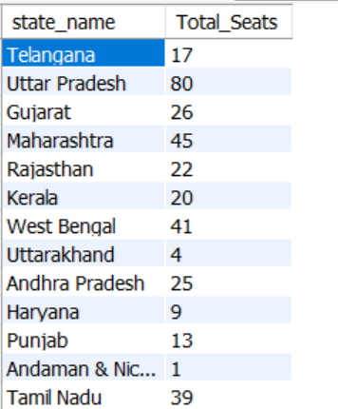
Total seats
What are the total no of seats available for elections in each state?

Slide 5
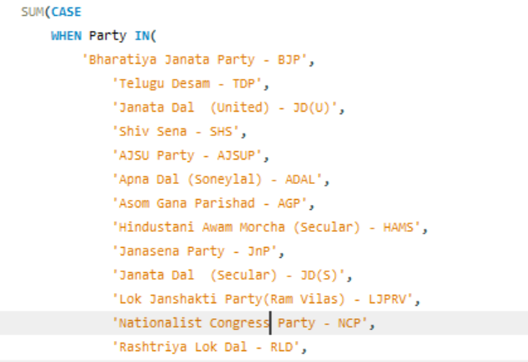
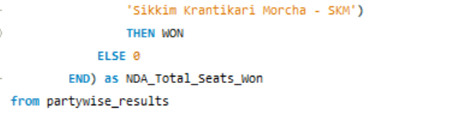

Total Seats Won by NDA Alliance

Slide 6
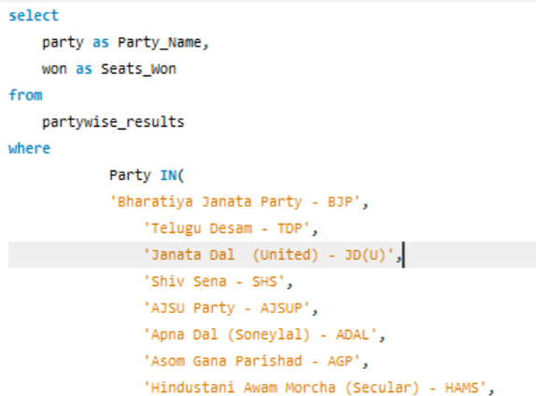
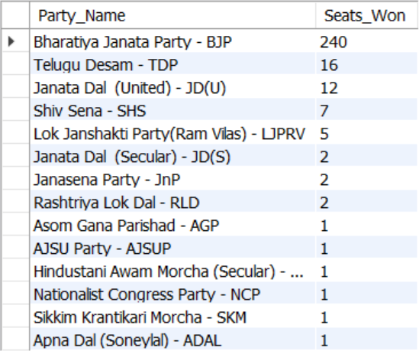
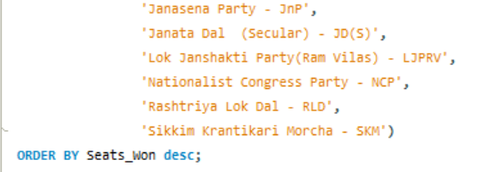
Seats Won by NDA Alliance Parties

Slide 7
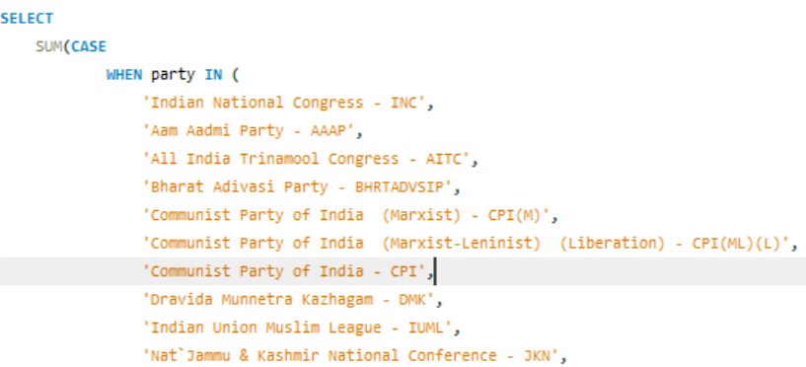
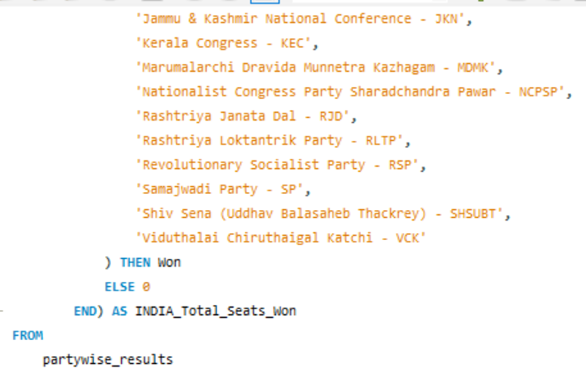

Total Seats Won by I.N.D.I.A Alliance

Slide 8
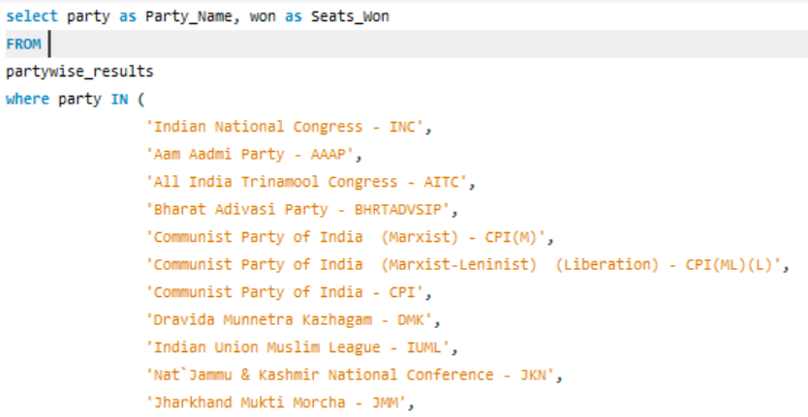
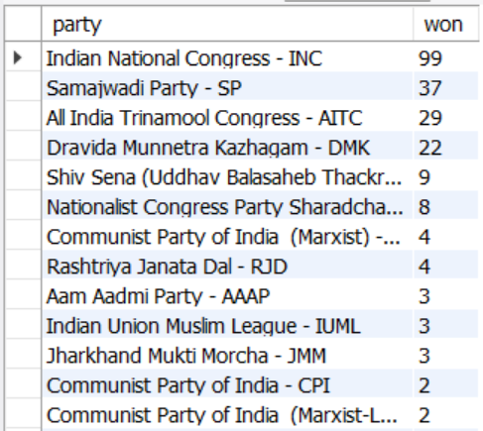
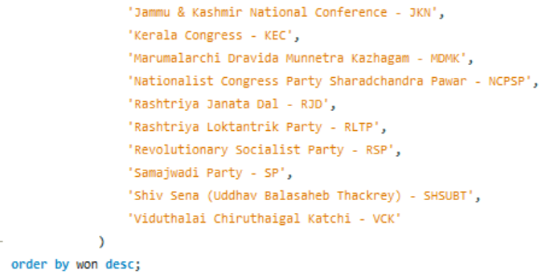
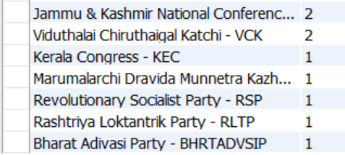
Seats Won by I.N.D.I.A Alliance Parties

Slide 9

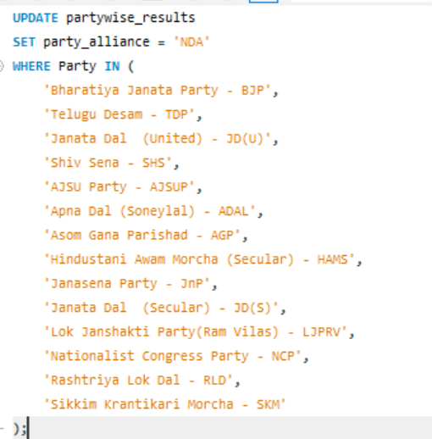
Add new column field in table partywise_results to get the Party Allianz as NDA, I.N.D.I.A and OTHER.

Slide 10
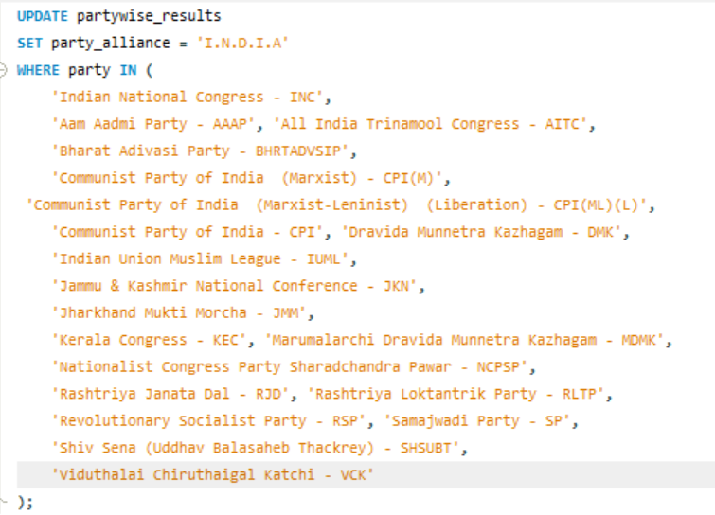
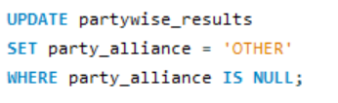
Add new column field in table partywise_results to get the Party Allianz as NDA, I.N.D.I.A and OTHER.
party | won | party_id | party_alliance
Aam Aadmi Party - AAAP | 3 | 1 | I.N.D.I.A
Asom Gana Parishad - AGP | 1 | 83 | NDA
All India Majlis-E-Ittehadul Muslimeen - AIMIM | 1 | 118 | OTHER
All India Trinamool Congress - AITC | 29 | 140 | I.N.D.I.A
AJSU Party - AJSUP | 1 | 160 | NDA
Bharatiya Janata Party - BJP | 240 | 369 | NDA
Communist Party of India - CPI | 2 | 544 | I.N.D.I.A
Communist Party of India (Marxist-Leninist) (Liberation) - CPI(ML)(L) | 2 | 545 | I.N.D.I.A
Communist Party of India (Marxist) - CPI(M) | 4 | 547 | I.N.D.I.A
Dravida Munnetra Kazhagam - DMK | 22 | 582 | I.N.D.I.A
Hindustani Awam Morcha (Secular) - HAMS | 1 | 664 | NDA
Indian National Congress - INC | 99 | 742 | I.N.D.I.A
Independent - IND | 7 | 743 | OTHER
Indian Union Muslim League - IUML | 3 | 772 | I.N.D.I.A
Janata Dal (Secular) - JD(S) | 2 | 804 | NDA
Janata Dal (United) - JD(U) | 12 | 805 | NDA
Jammu & Kashmir National Conference - JKN | 2 | 834 | I.N.D.I.A
Jharkhand Mukti Morcha - JMM | 3 | 852 | I.N.D.I.A
Janasena Party - JnP | 2 | 860 | NDA
Kerala Congress - KEC | 1 | 911 | I.N.D.I.A
Marumalarchi Dravida Munnetra Kazhagam - MDMK | 1 | 1046 | I.N.D.I.A
Nationalist Congress Party - NCP | 1 | 1142 | NDA
Rashtriya Janata Dal - RJD | 4 | 1420 | I.N.D.I.A
Rashtriya Lok Dal - RLD | 2 | 1458 | NDA
Revolutionary Socialist Party - RSP | 1 | 1534 | I.N.D.I.A
Shiromani Akali Dal - SAD | 1 | 1584 | OTHER
Sikkim Krantikari Morcha - SKM | 1 | 1658 | NDA
Samajwadi Party - SP | 37 | 1680 | I.N.D.I.A
Telugu Desam - TDP | 16 | 1745 | NDA
Viduthalai Chiruthaigal Katchi - VCK | 2 | 1847 | I.N.D.I.A
Yuvajana Sramika Rythu Congress Party - YSRCP | 4 | 1888 | OTHER
United PeopleÃ¢â‚¬â„¢s Party, Liberal - UPPL | 1 | 1998 | OTHER
Apna Dal (Soneylal) - ADAL | 1 | 2070 | NDA
Rashtriya Loktantrik Party - RLTP | 1 | 2484 | I.N.D.I.A
Zoram PeopleÃ¢â‚¬â„¢s Movement - ZPM | 1 | 2757 | OTHER
Aazad Samaj Party (Kanshi Ram) - ASPKR | 1 | 2989 | OTHER
Lok Janshakti Party(Ram Vilas) - LJPRV | 5 | 3165 | NDA
Shiv Sena (Uddhav Balasaheb Thackrey) - SHSUBT | 9 | 3369 | I.N.D.I.A
Voice of the People Party - VOTPP | 1 | 3388 | OTHER
Bharat Adivasi Party - BHRTADVSIP | 1 | 3482 | I.N.D.I.A
Shiv Sena - SHS | 7 | 3529 | NDA
Nationalist Congress Party Sharadchandra Pawar - NCPSP | 8 | 3620 | I.N.D.I.A

Slide 11
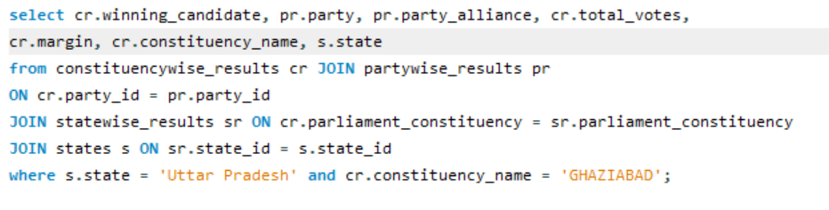
Winning Candidate’s name, their party name, total votes, and the margin of victory for a specific state and constituency?

Slide 12
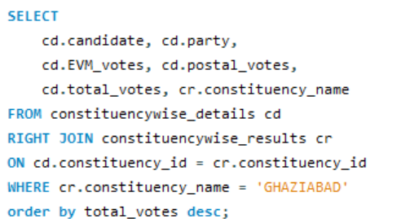
What is the distribution of EVM votes versus postal votes for candidates in a specific constituency?
candidate | party | EVM_votes | postal_votes | total_votes | constituency_name
ATUL GARG | Bharatiya Janata Party | 853036 | 1134 | 854170 | GHAZIABAD
DOLLY SHARMA | Indian National Congress | 516699 | 506 | 517205 | GHAZIABAD
NAND KISHOR PUNDIR | Bahujan Samaj Party | 79387 | 138 | 79525 | GHAZIABAD
NOTA | None of the Above | 8195 | 16 | 8211 | GHAZIABAD
RAVI KUMAR PANCHAL | Independent | 1965 | 1 | 1966 | GHAZIABAD
ANAND KUMAR | Rashtra Nirman Party | 1174 | 4 | 1178 | GHAZIABAD
NATTHUSINGH CHAUDHARY | Independent | 1159 | 3 | 1162 | GHAZIABAD
AURANGJEB | Independent | 1120 | 0 | 1120 | GHAZIABAD
NAMAHA | Samaj Vikas Kranti Party | 1079 | 1 | 1080 | GHAZIABAD
AVDESH KUMAR | Independent | 1037 | 6 | 1043 | GHAZIABAD
POOJA SAXENA | Right to Recall Party | 874 | 4 | 878 | GHAZIABAD
KAVITA | Independent | 772 | 3 | 775 | GHAZIABAD
ANSUL GUPTA | Rashtriya Jan Karmath Party | 763 | 1 | 764 | GHAZIABAD
DHIRENDRA SINGH BHADAURIYA | Subhashwadi Bhartiya Samajwadi Party (Subhas Party) | 696 | 4 | 700 | GHAZIABAD
ABHISHEK PUNDIR | Independent | 652 | 1 | 653 | GHAZIABAD

Slide 13
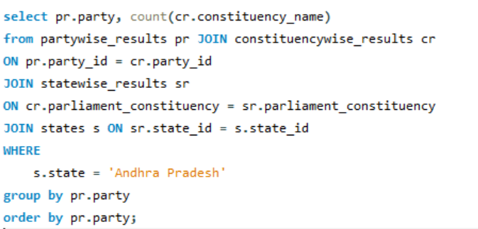
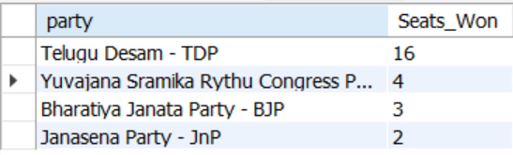
Which parties won the most seats in a state and how many seats did each party won?

Slide 14
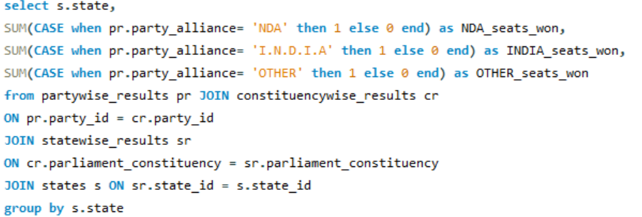
What is the total no of seats won by each alliance (NDA, I.N.D.I.A and OTHER) in each state for the Indian elections 2024?
state | NDA_seats_won | INDIA_seats_won | OTHER_seats_won
Andhra Pradesh | 21 | 0 | 4
Arunachal Pradesh | 2 | 0 | 0
Assam | 9 | 3 | 1
Bihar | 30 | 9 | 1
Goa | 1 | 1 | 0
Gujarat | 25 | 1 | 0
Haryana | 4 | 5 | 0
Himachal Pradesh | 4 | 0 | 0
Karnataka | 19 | 9 | 0
Kerala | 1 | 19 | 0
Madhya Pradesh | 29 | 0 | 0
Maharashtra | 16 | 28 | 1
Manipur | 0 | 2 | 0
Meghalaya | 0 | 1 | 1
Mizoram | 0 | 0 | 1
Nagaland | 0 | 1 | 0
Odisha | 20 | 1 | 0
Punjab | 0 | 10 | 3
Rajasthan | 13 | 9 | 0
Sikkim | 1 | 0 | 0
Tamil Nadu | 0 | 39 | 0
Tripura | 2 | 0 | 0
Uttar Pradesh | 36 | 43 | 1
West Bengal | 12 | 29 | 0
Chhattisgarh | 9 | 1 | 0
Jharkhand | 9 | 5 | 0
Uttarakhand | 4 | 0 | 0
Telangana | 8 | 8 | 1
Andaman & Nicobar Islands | 1 | 0 | 0
Chandigarh | 0 | 1 | 0
Dadra & Nagar Haveli and Daman & Diu | 1 | 0 | 1
Delhi | 5 | 0 | 0
Lakshadweep | 0 | 1 | 0
Puducherry | 0 | 1 | 0
Jammu and Kashmir | 2 | 1 | 1
Ladakh | 0 | 0 | 1

Slide 15
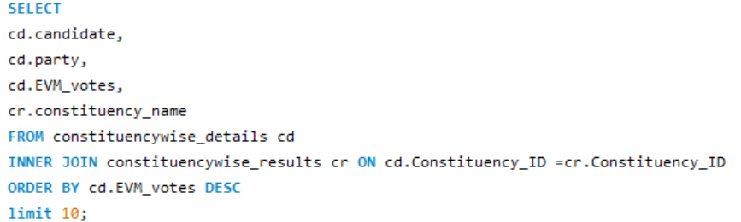
Which candidate received the highest no of EVM votes in each constituency (Top 10)?
candidate | party | EVM_votes | constituency_name
RAKIBUL HUSSAIN | Indian National Congress | 1468549 | DHUBRI
SHANKAR LALWANI | Bharatiya Janata Party | 1223746 | INDORE
SHIVRAJ SINGH CHOUHAN | Bharatiya Janata Party | 1111556 | VIDISHA
DR C N MANJUNATH | Bharatiya Janata Party | 1075553 | BANGALORERURAL
BRIJMOHAN AGRAWAL | Bharatiya Janata Party | 1047447 | RAIPUR
ABHISHEK BANERJEE | All India Trinamool Congress | 1043493 | DIAMONDHARBOUR
C R PATIL | Bharatiya Janata Party | 1023366 | NAVSARI
AMIT SHAH | Bharatiya Janata Party | 999984 | GANDHINAGAR
SHOBHA KARANDLAJE | Bharatiya Janata Party | 982805 | BANGALORENORTH
EATALA RAJENDER | Bharatiya Janata Party | 980712 | MALKAJGIRI

Slide 16
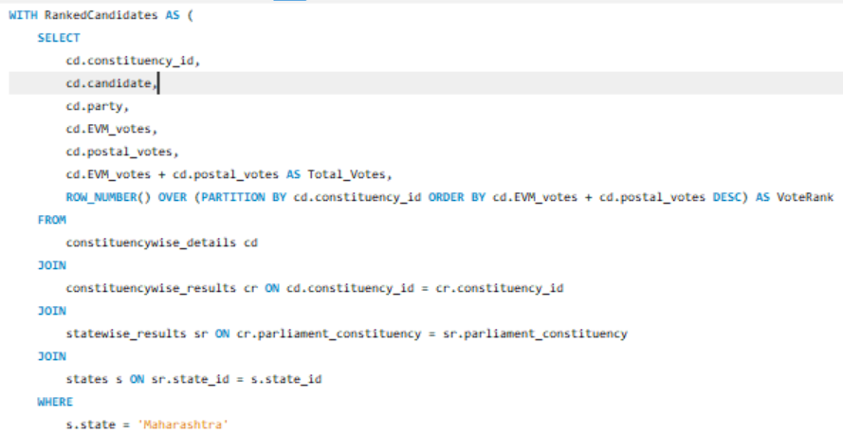
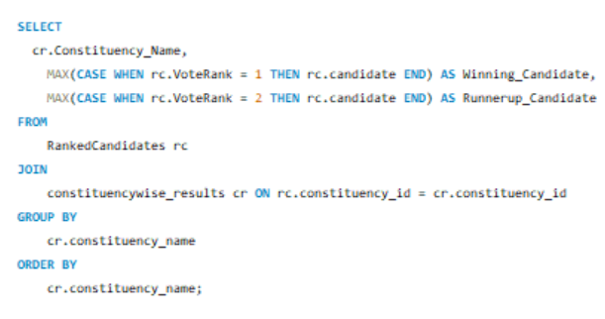
Which candidate won and which candidate was the runner-up in each constituency of state for the 2024 election?

Slide 17
Which candidate won and which candidate was the runner-up in each constituency of state for the 2024 election?
Constituency_Name | Winning_Candidate | Runnerup_Candidate
AHMEDNAGAR | NILESH DNYANDEV LANKE | DR. SUJAY RADHAKRISHNA VIKHEPATIL
AKOLA | ANUP SANJAY DHOTRE | ABHAY KASHINATH PATIL
AMRAVATI | BALWANT BASWANT WANKHADE | NAVNEET RAVI RANA
AURANGABAD | BHUMARE SANDIPANRAO ASARAM | IMTIAZ JALEEL SYED
BARAMATI | SUPRIYA SULE | SUNETRA AJITDADA PAWAR
BEED | BAJRANG MANOHAR SONWANE | PANKAJA GOPINATHRAO MUNDE
BHANDARAGONDIYA | DR. PRASHANT YADAORAO PADOLE | SUNIL BABURAO MENDHE
BHIWANDI | BALYA MAMA - SURESH GOPINATH MHATRE | KAPIL MORESHWAR PATIL
BULDHANA | JADHAV PRATAPRAO GANPATRAO | NARENDRA DAGDU KHEDEKAR
CHANDRAPUR | DHANORKAR PRATIBHA SURESH ALIAS BALUBHAU | MUNGANTIWAR SUDHIR SACCHIDANAND
DHULE | BACHHAV SHOBHA DINESH | BHAMRE SUBHASH RAMRAO
DINDORI | BHASKAR MURLIDHAR BHAGARE | DR. BHARATI PRAVIN PAWAR
HATKANANGALE | DHAIRYASHEEL SAMBHAJIRAO MANE | SATYAJEET BABASAHEB PATIL (AABA) SARUDKAR
HINGOLI | AASHTIKAR PATIL NAGESH BAPURAO | BABURAO KADAM KOHALIKAR
JALGAON | SMITA UDAY WAGH | KARAN BALASAHEB PATIL - PAWAR
JALNA | KALYAN VAIJINATHRAO KALE | DANVE RAOSAHEB DADARAO
KALYAN | DR SHRIKANT EKNATH SHINDE | VAISHALI DAREKAR - RANE
KOLHAPUR | CHHATRAPATI SHAHU SHAHAJI | SANJAY SADASHIVRAO MANDLIK
LATUR | DR. KALGE SHIVAJI BANDAPPA | SUDHAKAR TUKARAM SHRANGARE
MADHA | MOHITE-PATIL DHAIRYASHEEL RAJSINH | RANJEETSINGH HINDURAO NAIK NIMBALKAR
MAVAL | SHRIRANG APPA CHANDU BARNE | SANJOG BHIKU WAGHERE PATIL
MUMBAINORTH | PIYUSH GOYAL | BHUSHAN PATIL
MUMBAINORTHCENTRAL | GAIKWAD VARSHA EKNATH | ADV UJWAL NIKAM
MUMBAINORTHEAST | SANJAY DINA PATIL | MIHIR CHANDRAKANT KOTECHA
MUMBAINORTHWEST | RAVINDRA DATTARAM WAIKAR | AMOL GAJANAN KIRTIKAR
MUMBAISOUTH | ARVIND GANPAT SAWANT | YAMINI YASHWANT JADHAV
MUMBAISOUTHCENTRAL | ANIL YESHWANT DESAI | RAHUL RAMESH SHEWALE
NAGPUR | NITIN JAIRAM GADKARI | VIKAS THAKRE
NANDED | CHAVAN VASANTRAO BALWANTRAO | CHIKHALIKAR PRATAPRAO GOVINDRAO
NANDURBAR | ADV GOWAAL KAGADA PADAVI | DR HEENA VIJAYKUMAR GAVIT
NASHIK | RAJABHAU (PARAG) PRAKASH WAJE | GODSE HEMANT TUKARAM
OSMANABAD | OMPRAKASH BHUPALSINH ALIAS PAVAN RAJENIMBALKAR | ARCHANA RANAJAGJITSINH PATIL
PALGHAR | DR. HEMANT VISHNU SAVARA | BHARTI BHARAT KAMDI
PARBHANI | JADHAV SANJAY ( BANDU ) HARIBHAU | JANKAR MAHADEV JAGANNATH
PUNE | MURLIDHAR MOHOL | DHANGEKAR RAVINDRA HEMRAJ
RAIGAD | TATKARE SUNIL DATTATREY | ANANT GEETE
RAMTEK | Shyamkumar (Babalu) Daulat Barve | RAJU DEONATH PARVE
RAVER | KHADSE RAKSHA NIKHIL | SHRIRAM DAYARAM PATIL
SANGLI | VISHAL (DADA) PRAKASHBAPU PATIL | SANJAY (KAKA) PATIL
SATARA | SHRIMANT CHH UDAYANRAJE PRATAPSINHAMAHARAJ BHONSLE | SHASHIKANT JAYVANTRAO SHINDE
SHIRDI | BHAUSAHEB RAJARAM WAKCHAURE | LOKHANDE SADASHIV KISAN
SHIRUR | DR. AMOL RAMSING KOLHE | ADHALRAO SHIVAJI DATTATREY
SOLAPUR | PRANITI SUSHILKUMAR SHINDE | RAM VITTHAL SATPUTE
THANE | NARESH GANPAT MHASKE | RAJAN BABURAO VICHARE
WARDHA | AMAR SHARADRAO KALE | RAMDAS CHANDRABHAN TADAS

Slide 18
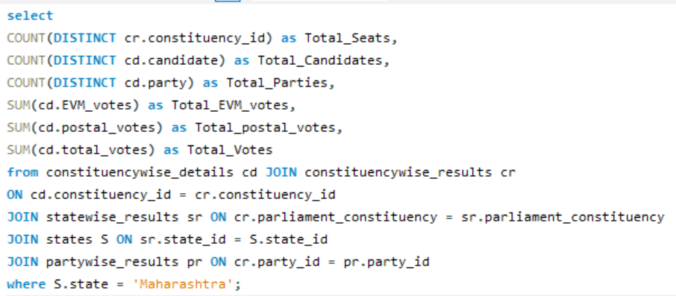
For the state of Maharashtra, what are the total no of seats, total no of candidates, total no of parties, total votes (including EVM and postal), and the breakdown of EVM and postal votes?
Total_Seats | Total_Candidates | Total_Parties | Total_EVM_votes | Total_postal_votes | Total_Votes
45 | 1078 | 123 | 53682213 | 190992 | 53873205

