Slide 1
Vidyapun

Slide 2
Overall SEO | May | June | July | Aug
Sitemap updated | Fixed | Fixed | Updated | Updated
Domain Authority Score | 13 | 13 | 11 | 11
Spam Score | 47 | 47 | 1 | 1
Top Organic Keywords | 277 | 534 | 1172 | 3600
Organic Traffic | 410 | 608 | 1471 | 1734
Backlinks | 756 | 431 | 444 | 536

Slide 3
UI/Ux Changes
online MBA page
Content section on pages
FAQ section on MBA page

Slide 4
Activity Done
Content section optimizations
348 Server error fixed
30- 404 error pages changes
77 page with wrong canonical tags Fixed
Reducing spam score
Blogs Updated
Pages updated

Slide 5
 | Content | Meta Title | Meta Description | keywords | Status
https://www.vidyapun.com/blogs/top-10-reasons-to-pursue-master-of-laws | Done | Done | Done |  | Live
https://www.vidyapun.com/blogs/things-to-know-about-online-mba | Done | Done | Done |  | Live
https://www.vidyapun.com/online-mba-in-india | Done | Done | Done |  | Live
https://www.vidyapun.com/blogs/6-benefits-of-an-online-mba-degree | Done | Done | Done |  | Live
https://www.vidyapun.com/blogs/complete-guide-on-masters-in-law-degree | Done | Done | Done |  | Live
https://www.vidyapun.com/blogs/tips-to-crack-online-mba-entrance-exams | Done | Done | Done |  | Live
Faqs on Online MBA page | Done | Done | Done |  | Live

Slide 6
Results

Slide 7
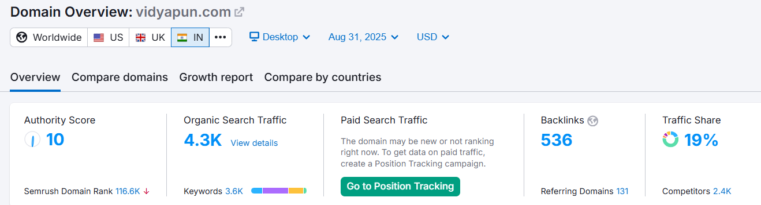

Slide 8
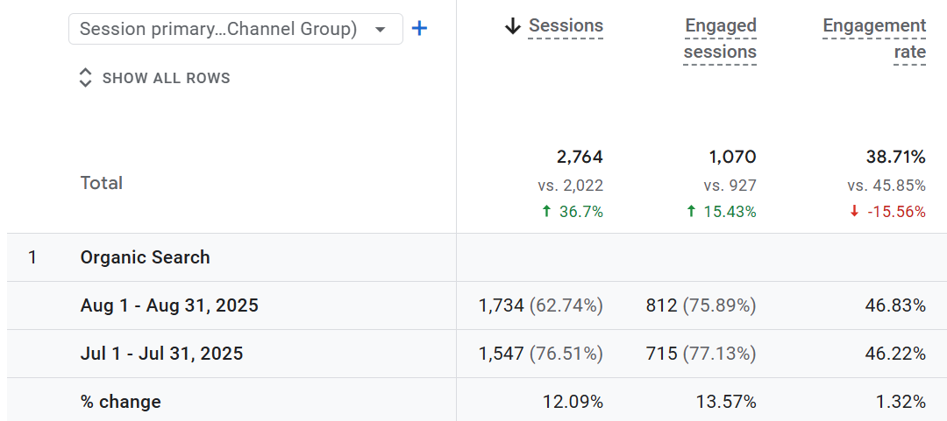

Slide 9
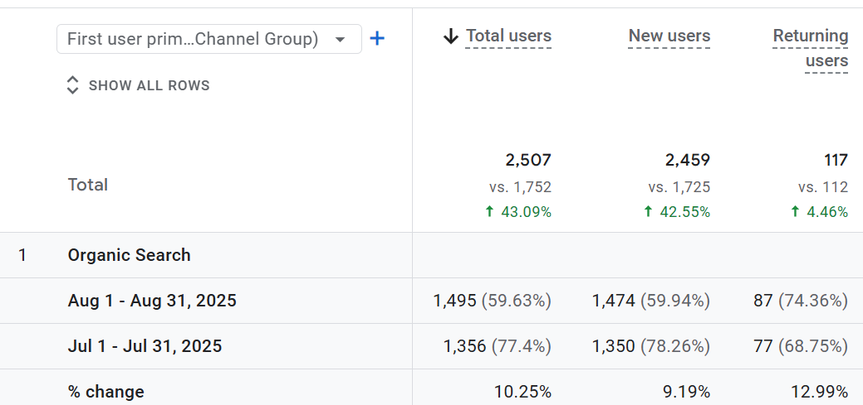

Slide 10
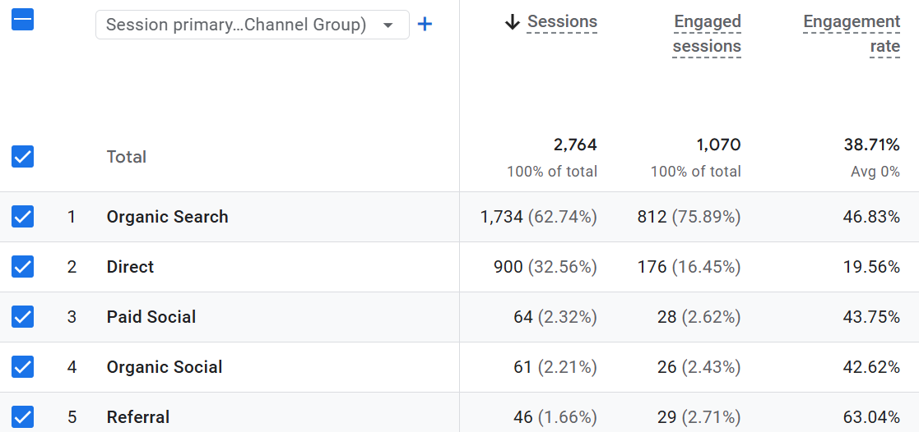

Slide 11
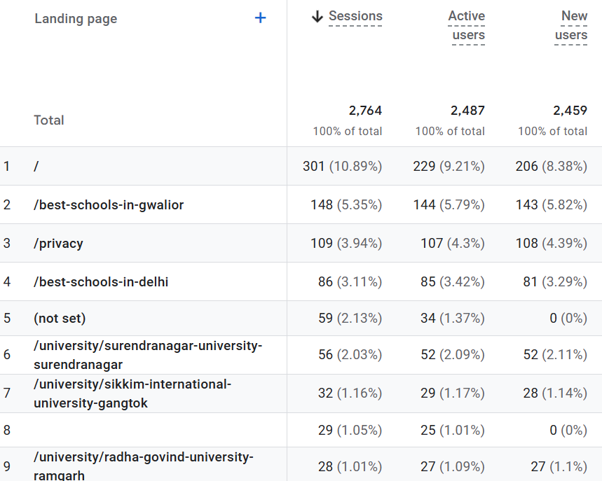

Slide 12
Thanks

