Slide 1

OPTIX
Optimized & interactive Platform for TP&O cases eXecution
- A Transformation Initiative to Drive TP&O Efficiency
10th July 2026

Slide 2
Agenda
Optix Recap
Current Progress & Updates
The Way Forward
OPTIX 3.0 Demo
Optix Team

Slide 3
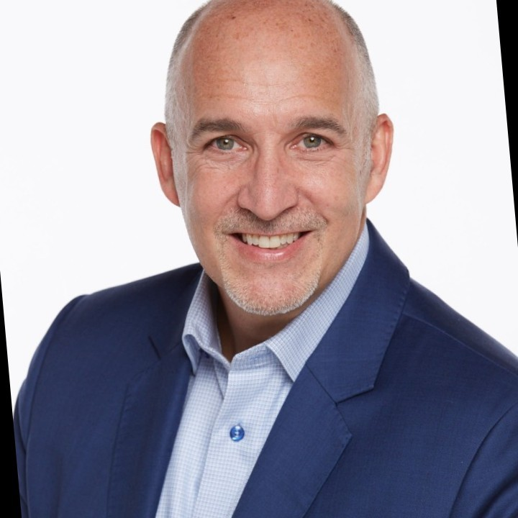
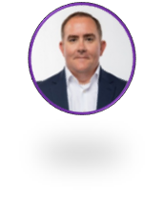
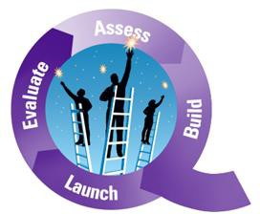
OPTIX Recap:
OPTIX has been selected as a premiere AI use case for the TP&O team, directly driving our "Do More with Less" strategic mandate. By streamlining TP&O-related workflows to deliver a seamless, superior sales experience, OPTIX actively advances our Revenue Quality Purple Chip.
1. OPTIX Summary
2. Action items Status
3. Highlights
95% TP&O cases/month requires multi-system navigation for business rules validation and third-party research
Consumes 5–10 min per case; manual form-filling drives SLA risk & data errors​
Following action items were identified from last meeting (18/3)
GSO Townhall (29/06)
Mark Colombo (04/06)
Chris Nichols (07/05)
Problem
Demo Session
1 | 95% Case category Inclusion | Live
2 | Owning Sales Feedback Form Process | WIP
3 | Agents of Change Workstream (US) | WIP
4 | iSell API integration | WIP
5 | Cloud Hosting | WIP
Rule-based Python engine for intelligent case resolution recommendations
AI-powered third-party research using Gemini
Automated CSV generation to complete the resolution workflow
PPQA
Reached Semi-finals
Solution
APAC (Gemini capabilities)
Pricing (AI Hackathon kickoff)
CHM (Streamlit expertise)
Cross collab
4. OPTIX Versions
OPTIX 1.0
OPTIX 2.0
OPTIX 3.0
OPTIX 4.0
Sep’25- Dec’25 | Dec’25-Apr’26 | Apr’26-Jul’26 | Jul’26-TBD
Live for Prospecting and ATC cases | Live for DM/HQ, OOB, USI field, Attribute updates (preliminary) Feedback Form & AUR Automation (partial) | Feedback Form & AUR Automation GE Agents for OOB, DM/HQ, Attribute & WWS seg update OPTIX cloud hosting | Integrate Gemini API into OPTIX code Zero-touch resolution via iSell Chatbot with Human-in-the-Loop governance
Notes:
Policy guide: Territory Planning & Optimization (TP&O) Policy and Procedure Guide (U.S. Sales) | Highspot
Streamlit UI

Slide 4
Current Progress & Updates
Since our last update on 18/3, we have achieved several key milestones, including scaling OPTIX across most case categories, developing AI agents as an alternative to the Gemini API, incorporating the latest policy updates, and representing the TP&O workstream within the Agent of Change initiative.
Case Category
Agent Creation
Agents of change Workstream
US SAM Lift Off
Following case categories are automated through the rules engine and form submission:
Adjust Potential (52%)
Out of Business (8%)
Prospecting (14%)
Others (26%)
Catchall – Fraud
USI Field
WWS Segmentation
DM/HQ change
Built iSell Validation Assistant GE 4 case categories – WWS Segmentation, DM/HQ, ATC Attribute Update, and Out of Business.
Accelerated Third-Party Research with every recommendation backed by evidence, source & reasoning.
Enhanced User Experience: One assistant and interface comprising all validation workflows.
TO-BE Process Flow documentation leveraging Agentic AI for all case types
Dependency documentation
Gemini API – 3rd party research and attachment processing
iSell API to access real time data
Enabling Approval workflow in iSell
Integrated policy changes due to SAM Lift-Off (merger of DS and FS into SAM)
Adjust Potential | LIVE
Catchall (Fraud) | LIVE
Catchall (OOB) | LIVE
DM/HQ Change | LIVE
WWS Segmentation | LIVE
USI Field | LIVE
Prospecting | WIP
Business Impact (Annual)^{1,3} :
Total cases: 17k+
Manual time²: 3.6k+ hrs
OPTIX Time²: 1k+ hrs
Time saved: 2.6k+ hrs (72 % efficiency gained)
Business Impact (Annual)³ :
Total cases: 17k+
Manual time²: 3.6k+ hrs
OPTIX Time²: 600+ hrs
Time saved: 3k+ hrs (83 % efficiency gained)
Business Impact:
Establishing the groundwork for an Agentic AI vision through comprehensive process and dependency documentation.
Annual figures calculated basis 6 months (Jan-Jun’26)
Time added in hours is calculated annually based on 6 months data.
Attaching Excel file link for reference. Optix_time_saving_ppt.xlsx
Notes:
Policy guide: Territory Planning & Optimization (TP&O) Policy and Procedure Guide (U.S. Sales) | Highspot
Streamlit UI

Slide 5
The Way Forward
The team is continuously Elevating themselves by expanding OPTIX features and scope, incorporating feedback from senior stakeholders to drive ongoing improvements and deliver greater business value
Sales Feedback
Form + AUR Automation
Deployment Details
User Feedback Feature
Purpose: Update customer attributes in iSell & segmentation in Atlantis through ATC and AUR form
Current State:
US team owns loading ATC feedback from TPO specialist into the backend database post business validation.
TPO specialist manually submits AUR into Atlantis.
Future State:
End-to-end ownership of the ATC upload process including data transformation and validation
Automated workflow enabling TPO specialist to AUR request in real time (under discussion)
Business Impact:
Reduce ATC update turnaround time from 7 days to ~24 hours.
Eliminate manual intervention, improving process efficiency and data accuracy.
Purpose: Capture structured analyst feedback on OPTIX outputs to identify discrepancies and drive continuous model improvement.
Current State:
Analyst resolutions (Accept/Reject) are compared with OPTIX outputs to identify discrepancies.
Manual review with analysts to understand decision discrepancies.
Future State:
Enable analysts to provide direct, in-workflow feedback on OPTIX recommendations.
Capture error reasons and analyse feedback to drive continuous model improvement.
Business Impact:
Automated monthly OPTIX performance tracking
Continuous code improvement via feedback loop.
Enhanced user experience and output quality
Purpose: Host OPTIX over cloud for ease of access to all the TP&O team members
Activity | Status
Creation of EAI | Completed
Python Server setup | Completed
FIRST process (Info sec team) | WIP
Code Deployment on Python Server | TBD
Gemini API key: pending AI Labs team prioritization | TBD
Business Impact:
Centralized OPTIX access for all TP&O team members.
OPTIX deployment with Gemini API integration is projected to deliver a 69% improvement in time efficiency over the local hosted version
Live by Jul’26
Live by Jul’26
Live by Aug’26
Note: Code Deployment on Python Server is dependent on completion of First process.

Slide 6
Demo :
Notes:
Policy guide: Territory Planning & Optimization (TP&O) Policy and Procedure Guide (U.S. Sales) | Highspot
Streamlit UI

Slide 7


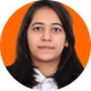


Meet our OPTIX Team!
Akshay
The Doc Wizard
Avishkar
The Developer
Deeksha
The Creative Head
Nayan
The Logic Whisperer
Runal
The Metrics Maestro
“Led the creation, structuring, and refinement of OPTIX presentation documentation”
“Led the conceptualization of an end-to-end automation process for TP&O case resolution and independently architected, coded the application”
“Led future-state envisioning for Optix and communicated it through a high-impact leadership video”
“Architected the business logic that forms the foundation of the Optix logic engine”
“Defined key metrics to provide visibility into Optix performance, quality, and scalability”
Team Capabilities - Python, SQL, System Design, Web Development, Git and GitHub, Linux, Vertex AI, Data Analytics,Canva.

Slide 8
Thank You!

Slide 9

Plans ahead
Live by Jul’26
Live by Jul’26
Live by Aug’26
Sales Feedback
Form + AUR Automation
Deployment Details
User Feedback Feature
Purpose: Update customer attributes in iSell & segmentation in Atlantis through ATC and AUR form
Current State:
US team owns loading ATC feedback from TPO specialist into the backend database post business validation.
TPO specialist manually submits AUR into Atlantis.
Future State:
End-to-end ownership of the ATC upload process including data transformation and validation
Automated workflow enabling TPO specialist to AUR request in real time (under discussion)
Business Impact:
Reduce ATC update turnaround time from 7 days to ~24 hours.
Eliminate manual intervention, improving process efficiency and data accuracy.
User Input:
Captures user feedback (Like/ Dislike) on OPTIX output and collects specific details on any identified inaccuracies.
Impact:
Monthly OPTIX performance tracking
Continuous improvement of code via feedback loop
Enhanced user experience and output quality
Ongoing server deployment and environment setup in collaboration with Chuck
Activity | Status
Creation of Enterprise Application I'd
Python Server setup
FIRST process (Info sec team)
Code Deployment on Python Server
Gemini API key: pending AI Labs team prioritization
Completed
Completed
In progress
TBD
TBD
Note: Code Deployment on Python Server is dependent on completion of First process.

Slide 11
OPTIX Recap:
“do more with lesss” “elevate”
Problem Statement
Discussed action items from 18/03
Highlights
2,538 TP&O cases/month requiring navigation between Atlantis, iSell, CHT
5–8 min per case; manual form-filling drives SLA risk & data errors​
Analyst capacity consumed by repetitive tasks, limiting strategic bandwidth​
Demo showcase
95% Case category Inclusion
Owning Feedback Process | In progress
Agents of Change Workstream (US) | In progress
iSell API integration | In progress
Cloud Hosting | In progress
LIVE
GSO Townhall (29/06)
Mark Colombo (04/06)
Chris Nicholas (07/05)
Solutions Implemented
Nominated Optix for PPQA
Rule-based Python engine auto-resolves cases with predefined business logic
Multi-source data ingestion & automated parsing ensures clean, validated inputs​
Auto-generated CSVs file to close resolution loop
Cross Collaboration
CHM
DART
APAC
Progress Timeline
Optix 2.0
Optix 3.0
Optix 4.0
Optix 1.0
Sep’25
Nov’25
Dec’25
Mar’26
Apr’26
May’26
Jul’26
TBD
TBD
Optix Kick Off
Live for Prospecting cases
Live for Adjust Potential cases
Live for cases²:
DM/HQ, OOB, USI field, Attribute updates
Feedback Form & AUR Automation
GE Agents for OOB, DM/HQ, Attribute & WWS seg update
Cloud Hosting:
Deployment of Optix on python server
Integrate Gemini API into OPTIX code
Zero-touch resolution via iSell Chatbot with Human-in-the-Loop governance
Live
In Progress
Not Started
Note :
Optix code undergoing updates post TP&O policy and case intake form changes
These case categories are live for research-only processing, with end-to-end resolution enabled after Gemini-API integration
Efficiency gain calculated for only Prospecting and Adjust Potential cases in Dec’25
Gemini API integration dependent on AI-UC prioritization
11

Slide 12
OPTIX Recap:
OPTIX has been selected as a premiere AI use case for the TP&O team, directly driving our "Do More with Less" strategic mandate. By streamlining TP&O-related workflows to deliver a seamless, superior sales experience, OPTIX actively advances our Revenue Quality Purple Chip.
Problem Statement
1. OPTIX Summary
2. Action items Status
3. Highlights
95% TP&O cases/month requires multi-system navigation for business rules validation and third party research
Consumes 5–10 min per case; manual form-filling drives SLA risk & data errors​
Following action items were identified from last meeting (18/3)
GSO Townhall (29/06)
Mark Colombo (04/06)
Chris Nicholas (07/05)
Problem
Demo Session
1 | 95% Case category Inclusion | Live
2 | Owning Sales Feedback Form Process | WIP
3 | Agents of Change Workstream (US) | WIP
4 | iSell API integration | WIP
5 | Cloud Hosting | WIP
Rule-based Python engine for intelligent case resolution recommendations.
AI-powered third-party research using Gemini.
Automated CSV generation to complete the resolution workflow.
PPQA
Reached Semi-finals
Solution
Cross collab
CHM (Streamlit expertise)
DART (First process)
APAC (Gemini capabilities)
OPTIX 1.0
OPTIX 2.0
OPTIX 3.0
OPTIX 4.0
Sep’25- Dec’25 | Dec’25-Apr’26 | Apr’26-Jul’26 | Jul’26-TBD
Live for Prospecting and ATC cases | Live for DM/HQ, OOB, USI field, Attribute updates (preliminary) Feedback Form & AUR Automation (partial) | Feedback Form & AUR Automation GE Agents for OOB, DM/HQ, Attribute & WWS seg update OPTIX cloud hosting | Integrate Gemini API into OPTIX code Zero-touch resolution via iSell Chatbot with Human-in-the-Loop governance
4. Version
12

Slide 13
OPTIX Recap:
“do more with lesss” “elevate”
Problem Statement
1. OPTIX Summary
2. Action items Status
3. Highlights
95% TP&O cases/month requires multi-system navigation for business rules validation and third party research
Consumes 5–10 min per case; manual form-filling drives SLA risk & data errors​
Following action items were identified from last meeting (18/3)
GSO Townhall (29/06)
Mark Colombo (04/06)
Chris Nicholas (07/05)
Problem
Demo Session
1 | 95% Case category Inclusion | Live
2 | Owning Sales Feedback Form Process | WIP
3 | Agents of Change Workstream (US) | WIP
4 | iSell API integration | WIP
5 | Cloud Hosting | WIP
Rule-based Python engine for intelligent case resolution recommendations.
AI-powered third-party research using Gemini.
Automated CSV generation to complete the resolution workflow.
PPQA
Reached Semi-finals
Solution
Cross collab
CHM (Streamlit expertise)
DART (First process)
APAC (Gemini capabilities)
OPTIX 1.0
OPTIX 2.0
OPTIX 3.0
OPTIX 4.0
Sep’25- Dec’25 | Dec’25-Apr’26 | Apr’26-Jul’26 | Jul’26-TBD
Live for Prospecting and ATC cases | Live for DM/HQ, OOB, USI field, Attribute updates (preliminary) Feedback Form & AUR Automation (partial) | Feedback Form & AUR Automation GE Agents for OOB, DM/HQ, Attribute & WWS seg update OPTIX cloud hosting | Integrate Gemini API into OPTIX code Zero-touch resolution via iSell Chatbot with Human-in-the-Loop governance
4. Version
13

Slide 14
OPTIX Recap:
“do more with lesss” “elevate”
Problem Statement
Action items Status
Highlights
95% TP&O cases/month requires multi-system navigation for business rules validation and third party research
Consumes 5–10 min per case; manual form-filling drives SLA risk & data errors​
Following action items were identified from last meeting (18/3)
GSO Townhall (29/06)
Mark Colombo (04/06)
Chris Nicholas (07/05)
Demo Session
1 | 95% Case category Inclusion | Live
2 | Owning Sales Feedback Form Process | WIP
3 | Agents of Change Workstream (US) | WIP
4 | iSell API integration | WIP
5 | Cloud Hosting | WIP
Solutions Implemented
PPQA
Reached Semi-finals
Rule-based Python engine for intelligent case resolution recommendations.
AI-powered third-party research using Gemini.
Automated CSV generation to complete the resolution workflow.
Cross collab
CHM (Streamlit expertise)
DART (First process)
APAC (Gemini capabilities)
Progress Timeline
Optix 2.0
Optix 3.0
Optix 4.0
Optix 1.0
Sep’25
Nov’25
Dec’25
Mar’26
Apr’26
May’26
Jul’26
TBD
TBD
Optix Kick Off
Live for Prospecting cases
Live for Adjust Potential cases
Live for cases²:
DM/HQ, OOB, USI field, Attribute updates
Feedback Form & AUR Automation
GE Agents for OOB, DM/HQ, Attribute & WWS seg update
Cloud Hosting:
Deployment of Optix on python server
Integrate Gemini API into OPTIX code
Zero-touch resolution via iSell Chatbot with Human-in-the-Loop governance
Live
In Progress
Not Started
Note :
Optix code undergoing updates post TP&O policy and case intake form changes
These case categories are live for research-only processing, with end-to-end resolution enabled after Gemini-API integration
Efficiency gain calculated for only Prospecting and Adjust Potential cases in Dec’25
Gemini API integration dependent on AI-UC prioritization
14

Slide 15
OPTIX Recap:
OPTIX has been selected as a premiere AI use case for the TP&O team, directly driving our "Do More with Less" strategic mandate. By streamlining TP&O-related workflows to deliver a seamless, superior sales experience, OPTIX actively advances our Revenue Quality Purple Chip.
Problem Statement
1. OPTIX Summary
2. Action items Status
3. Highlights
95% TP&O cases/month requires multi-system navigation for business rules validation and third party research
Consumes 5–10 min per case; manual form-filling drives SLA risk & data errors​
Following action items were identified from last meeting (18/3)
GSO Townhall (29/06)
Mark Colombo (04/06)
Chris Nicholas (07/05)
Problem
Demo Session
1 | 95% Case category Inclusion | Live
2 | Owning Sales Feedback Form Process | WIP
3 | Agents of Change Workstream (US) | WIP
4 | iSell API integration | WIP
5 | Cloud Hosting | WIP
Rule-based Python engine for intelligent case resolution recommendations.
AI-powered third-party research using Gemini.
Automated CSV generation to complete the resolution workflow.
PPQA
Reached Semi-finals
Solution
Cross collab
CHM (Streamlit expertise)
DART (First process)
APAC (Gemini capabilities)
OPTIX 1.0
OPTIX 2.0
OPTIX 3.0
OPTIX 4.0
Sep’25- Dec’25 | Dec’25-Apr’26 | Apr’26-Jul’26 | Jul’26-TBD
Live for Prospecting and ATC cases | Live for DM/HQ, OOB, USI field, Attribute updates (preliminary) Feedback Form & AUR Automation (partial) | Feedback Form & AUR Automation GE Agents for OOB, DM/HQ, Attribute & WWS seg update OPTIX cloud hosting | Integrate Gemini API into OPTIX code Zero-touch resolution via iSell Chatbot with Human-in-the-Loop governance
4. Version
Notes:
Policy guide: Territory Planning & Optimization (TP&O) Policy and Procedure Guide (U.S. Sales) | Highspot
Streamlit UI

Slide 16
OPTIX Recap:
“do more with lesss” “elevate”
Problem Statement
1. OPTIX Summary
2. Action items Status
3. Highlights
95% TP&O cases/month requires multi-system navigation for business rules validation and third party research
Consumes 5–10 min per case; manual form-filling drives SLA risk & data errors​
Following action items were identified from last meeting (18/3)
GSO Townhall (29/06)
Mark Colombo (04/06)
Chris Nicholas (07/05)
Problem
Demo Session
1 | 95% Case category Inclusion | Live
2 | Owning Sales Feedback Form Process | WIP
3 | Agents of Change Workstream (US) | WIP
4 | iSell API integration | WIP
5 | Cloud Hosting | WIP
Rule-based Python engine for intelligent case resolution recommendations.
AI-powered third-party research using Gemini.
Automated CSV generation to complete the resolution workflow.
PPQA
Reached Semi-finals
Solution
Cross collab
CHM (Streamlit expertise)
DART (First process)
APAC (Gemini capabilities)
OPTIX 1.0
OPTIX 2.0
OPTIX 3.0
OPTIX 4.0
Sep’25- Dec’25 | Dec’25-Apr’26 | Apr’26-Jul’26 | Jul’26-TBD
Live for Prospecting and ATC cases | Live for DM/HQ, OOB, USI field, Attribute updates (preliminary) Feedback Form & AUR Automation (partial) | Feedback Form & AUR Automation GE Agents for OOB, DM/HQ, Attribute & WWS seg update OPTIX cloud hosting | Integrate Gemini API into OPTIX code Zero-touch resolution via iSell Chatbot with Human-in-the-Loop governance
4. Version
16

Slide 17
OPTIX Recap:
“do more with lesss” “elevate”
Problem Statement
Action items Status
Highlights
95% TP&O cases/month requires multi-system navigation for business rules validation and third party research
Consumes 5–10 min per case; manual form-filling drives SLA risk & data errors​
Following action items were identified from last meeting (18/3)
GSO Townhall (29/06)
Mark Colombo (04/06)
Chris Nicholas (07/05)
Demo Session
1 | 95% Case category Inclusion | Live
2 | Owning Sales Feedback Form Process | WIP
3 | Agents of Change Workstream (US) | WIP
4 | iSell API integration | WIP
5 | Cloud Hosting | WIP
Solutions Implemented
PPQA
Reached Semi-finals
Rule-based Python engine for intelligent case resolution recommendations.
AI-powered third-party research using Gemini.
Automated CSV generation to complete the resolution workflow.
Cross collab
CHM (Streamlit expertise)
DART (First process)
APAC (Gemini capabilities)
OPTIX 1.0
OPTIX 2.0
OPTIX 3.0
OPTIX 4.0
Sep’25- Dec’25 | Dec’25-Apr’26 | Apr’26-Jul’26 | Jul’26-TBD
Live for Prospecting and ATC cases | Live for DM/HQ, OOB, USI field, Attribute updates (preliminary) Feedback Form & AUR Automation (partial) | Feedback Form & AUR Automation GE Agents for OOB, DM/HQ, Attribute & WWS seg update OPTIX cloud hosting | Integrate Gemini API into OPTIX code Zero-touch resolution via iSell Chatbot with Human-in-the-Loop governance
17

Slide 18
OPTIX Recap:
“do more with lesss” “elevate”
Problem Statement
OPTIX Summary
Action items Status
Highlights
95% TP&O cases/month requires multi-system navigation for business rules validation and third party research
Consumes 5–10 min per case; manual form-filling drives SLA risk & data errors​
Following action items were identified from last meeting (18/3)
GSO Townhall (29/06)
Mark Colombo (04/06)
Chris Nicholas (07/05)
Demo Session
Problem
1 | 95% Case category Inclusion | Live
2 | Owning Sales Feedback Form Process | WIP
3 | Agents of Change Workstream (US) | WIP
4 | iSell API integration | WIP
5 | Cloud Hosting | WIP
Rule-based Python engine for intelligent case resolution recommendations.
AI-powered third-party research using Gemini.
Automated CSV generation to complete the resolution workflow.
PPQA
Reached Semi-finals
Solution
Cross collab
CHM (Streamlit expertise)
DART (First process)
APAC (Gemini capabilities)
OPTIX 1.0
OPTIX 2.0
OPTIX 3.0
OPTIX 4.0
Sep’25- Dec’25 | Dec’25-Apr’26 | Apr’26-Jul’26 | Jul’26-TBD
Live for Prospecting and ATC cases | Live for DM/HQ, OOB, USI field, Attribute updates (preliminary) Feedback Form & AUR Automation (partial) | Feedback Form & AUR Automation GE Agents for OOB, DM/HQ, Attribute & WWS seg update OPTIX cloud hosting | Integrate Gemini API into OPTIX code Zero-touch resolution via iSell Chatbot with Human-in-the-Loop governance
18

Slide 19
OPTIX Recap:
OPTIX is a Human-in-the-Loop AI tool designed to accelerate TP&O case research by 1) consolidating data from multiple systems, 2) performing validation checks, and 3) recommending case resolutions. Once integrated with AgenticAI in iSell, Sales Reps can raise cases via the chatbot to get the required details updated in the systems.
(95%) All case categories covered in TP&O CoE scope are now live
Feedback form process owning & optimization – in progress, team is coordinating with US stakeholder – Ashwini
Agents of Change – Further building Agentic AI use case that will utilize optix logic to enable zero touch resolution, case process flow documentation completed
End to end approval?
Problem Statement
Highlights
~51% of TP&O cases (≈2538/month) in Prospecting & Potential categories require analysts to navigate 3+ enterprise systems (Atlantis, iSell, CHT)
Manual processing time: 5–8 minutes per case — response time directly tied to volume, creating SLA risk
Manual form filling and case comments increases probability of data entry errors
Analyst capacity consumed by repetitive, rule-based tasks — limiting bandwidth for complex, judgment-intensive cases.
Solutions Implemented
Last Meeting – 18th Mar
Demo -
Mark Colombo – As part of GSO AI Use case ( 4th Jun)
Chris Nicholas – As part of GSO AI Use case ( 7th May), further suggested iSell API integration for real time data – in progress
Managers (Mariano) – 29th Jun
GSO Townhall – 29th Jun
2. Nominated Optix for PPQA Awards
3. Opportunity Unlocked –capabilities are attracting interest from other teams, enabling cross-functional collaboration.
Multi-Source Data Ingestion: Automated the consolidation of live case data from iSell, Atlantis, and CHT.
Automated Parsing & Validation: Built validation protocols to identify active cases, categorize requests, and ensure data hygiene pre-processing.
Rules based engine: Applied predefined business logic using python to determine correct resolutions.
Automated Output Workflows: Auto-generated final resolutions and CSV files (Sales Feedback & AUR) to close the resolution loop.
Progress Timeline
Optix 1 – Prospecting & ATC
Optix 2 – All case types
Apr’26
Optix 3.0 -
TBD
Sep’25
Nov’25
Dec’25
Mar’26
Jul’26
TBD
Optix Kick Off
Live for Prospecting cases
Live for Adjust Potential cases
Live for cases²:
DM/HQ, OOB, USI field, Attribute updates
Feedback Form & AUR Automation
Cloud Hosting:
Deployment of Optix on python server
Integrate Gemini API into OPTIX code
Zero-touch resolution via iSell Chatbot with Human-in-the-Loop governance
Live
Not Started
In Progress
Note :
Optix code undergoing updates post TP&O policy and case intake form changes
These case categories are live for research-only processing, with end-to-end resolution enabled after Gemini-API integration
Efficiency gain calculated for only Prospecting and Adjust Potential cases in Dec’25
Gemini API integration dependent on AI-UC prioritization
19

Slide 20
Progress made so far
Adjust Potential | LIVE
Catchall (Fraud) | LIVE
Catchall (OOB) | LIVE
DM/HQ Change | LIVE
WWS Segmentation
Prospecting
USI Field
In progress
In progress
In progress
Case Category
Agent Creation
US SAM Lift-Off
Agents of Change Workstream
Out of Business (xx%)
Adjust Potential
DM/HQ change
Prospecting
Catchall – Fraud
USI Field
WWS Segmentation
Impact hrs/%
Built iSell Validation Assistant GE: Unified 4 specialized AI validation agents into one intelligent assistant.
Accelerated Third-Party Research
Frictionless User Experience: One assistant. One interface. All validations.
Rapid Time-to-Insight: Faster, evidence-based decisions with minimal manual effort.
Trusted Results: Every recommendation includes evidence, sources, and reasoning.
Policy changes status for each case type
Process flow documentation for all case types (current and future state)
Documents Dependency requirements – Gemini API , isell API (in talks with business architecture team)

Slide 21
OPTIX VIDEO

Slide 22
OPTIX VIDEO

Slide 23
OPTIX reduces case handling time by ~64%, while maintaining 97% accuracy
The current process for solving prospecting and potential cases takes 5-8 minutes/case which can be reduced to 2 minutes/case after implementing Optix research solution
Optix Performance (Duration- 1st -31st Dec’25)
Business Impact
1
Faster, High-Quality Execution
Delivers same diligence as TPO Analysts
97% Optix accuracy
2
Scalable & Future-Ready Operations Handles case surges without added headcount
3
Intelligent Case Filtering
Edge cases -> TPO Analyst
In-Scope Cases: 65%
# of Users: 19
Avg. time saving / case: 3-6 min
4
Proactive Data Validation
Missing/incorrect inputs are flagged upfront
Notes:
Data Issue: Cases are being dropped due to data quality issues—insufficient case details, incorrect input templates, and cases not raised at the EAN level. The model response rate% can go increase to 65% from current 58% if data issue gets resolved
Total Cases indicate number of cases which fall under CoE purview in Dec’25
5
64% Time efficiency¹
8% Bandwidth unlocked
Metrics calculated based on Dec’25 data for prospecting and potential case categories

Slide 24
Opportunities to improve OPTIX Scalability (1/2)
Cloud access constraints, lack of real-time data, and data quality issues are restricting full-scale OPTIX usage in the current state
Description
Action Plan
Current Status
Progress
1. OPTIX Hosting | Local Hosting Limits Scale: Optix’s laptop-based hosting restricts access and disables team-wide automation for AUR and Sales feedback. | Deploy on a Python server for immediate team access—no cloud approval delays. | Discussions ongoing with the sales agility team to deploy application on a python server. | Status: In-progress Timeline: 03/31/26
2.Document & Data Intelligence | End-to-end case resolution requires integrating external data and validating approvals from emails and attachments. | API-driven data access (e.g., ZoomInfo, Google) with LLM-powered approval validation (emails, attachments). | Exploring SideKick API (to be sunset) functionalities for mail analysis | Status: In-progress Timeline: TBD
3. Non-standardized processes for Other Regions | Non-US TP&O processes are not standardized; only ATC cases are currently centralized in the COE. |  | TP&O process globalization initiative currently in progress | Status: In-progress Timeline: TBD
Technology
Process
Notes:
Use azure cloud services when access becomes available to scale solution and leverage AI capabilities.

Slide 25
Opportunities to improve OPTIX Scalability (2/2)
Cloud access constraints, lack of real-time data, and data quality issues are restricting full-scale OPTIX usage in the current state
Description
Action Plan
Current Status
Progress
4. Case description not updated properly | Inconsistent case template usage by sales reps is impacting Optix output quality (287 cases). | Educate sales reps on SOP-based case creation and standardize iSell inputs through structured data capture. | iSell enhancements were proposed to standardize case formatting [9/25] | Status: Not started Timeline: TBD
5. Cases raised at Country/ Facility level | Per SOP, cases must be raised at EAN level; Optix does not support non-EAN cases (81 cases). | Standardize case creation at EAN level per SOP and enhance SQL to enable country/facility-level joins, with performance validation pending. | No Action yet | Status: Not started Timeline: TBD
People
Note: Management support may be required at key junctures to proactively address and resolve bottlenecks, particularly those involving sales team dependencies, access to systems, or decisions that require leadership alignment and prioritization.
Notes:
Use azure cloud services when access becomes available to scale solution and leverage AI capabilities.

Slide 26
Shaping the Future: OPTIX Driving Speed, Scalability & Smart Integration
Expanding the scope to include additional case types, broadening geographic coverage, and automating document analysis can further improve OPTIX performance
TBD
Integration into iSell
TBD
Intelligent Research (SideKick API)
Integrate Optix into iSell chatbot to auto-resolve SOP aligned cases.
Enable no-touch processing, reducing turnaround time, and enhancing sales experience.
Live by Apr’26
Globalization¹
Automated data retrieval via ZoomInfo, Google, and others
Leveraging the Sidekick API to interpret intent and content of emails and attachments.
Live by Mar’26
Expanding beyond the US to other geographies.
Case volumes in Canada and LAC are trending upward (≈30 cases per day).
Field BDS end to end
Live by Mar’26
Automating assignment, real-time decisioning and comps verification.
Reduce turnaround time from 1-2 days to real time.
Case categories inclusion²
Prospecting: 27%
Adjust potential: 26%
BDS fields: 18%
DM/HQ : 14%
Out of Business: 10%
Others: 5%
Timeline dependent on the Globalization initiative in progress
Some cases will undergo research-only processing initially, with end-to-end resolution enabled after API integration in Milestone 4
Notes:
Agentforce (SF) integration into iSell
ATC cases: adjust potential + attribute cases

Slide 27





OPTIX Vision Solution Overview
Key Impacts
Automated input data validation reducing repeated clarification
24/7 real-time responses for Sales Representatives
Accelerated case resolution with only true edge cases routed to TP&O
Improved sales experience and overall TP&O productivity
Reduced onboarding and training time for new Sales Representatives
Bringing the TP&O vision to life through Agentic AI–powered automation and guided reasoning with Human in the Loop framework
Knowledge repository Data
Job Aids
TP&O Policies
Foundational Catalyst for Agentic AI
Request sales rep for additional details
Validate details against iSell/Atlantis
Execute business logic
Lift–transform–shift ready foundation for rapid enablement of agentic AI models
Pre-built business logic reusable across case categories
Production-tested with feedback loop for continuous refinement
Potential reduction in development and iteration time for new agentic models
Case accepted
Fill Sales Feedback form and AUR
Case creation and closure with comments
Case rejected
Ask for more document
Case creation with rejection reason routed to TP&O
Enterprise Data
External data
Data update forms
Atlantis
iSell
CH Tool
Sidekick¹ / 3rd party
AUR & Feedback forms
With Sidekick being sunset, a replacement application will be evaluated for its external data fetching capabilities.
Notes:
Agentforce (SF) integration into iSell
ATC cases: adjust potential + attribute cases
Planner — “What needs to be done Orchestrator — “In what order and under what control” Reasoning — “So what does this mean?”

Slide 28




Plans ahead
Sales Feedback
Form + AUR Automation
User Feedback
Feature
Deployment Details
Purpose: Update customer attributes in iSell & segmentation in Atlantis.
Current State:
US team loads ATC feedback received by TPO specialist into the backend database after applying business validation.
TPO specialist manually submits AUR into Atlantis.
Future State:
End-to-end ownership of the ATC upload process.
Automated workflow enabling TPO specialist to view/edit & submit ATC/AUR request in real time.
Perform automated data transformation & load validated data into the L1 table.
Business Impact:
Reduce ATC update turnaround time from 7 days to ~24 hours.
Eliminate manual intervention, improving process efficiency and data accuracy.
User Input:
Captures user feedback (Like/ Dislike) on OPTIX output and collects specific details on any identified inaccuracies.
Impact:
Monthly OPTIX performance tracking
Continuous improvement of code via feedback loop
Enhanced user experience and output quality
Ongoing server deployment and environment setup in collaboration with Chuck
Activity | Status
Creation of Enterprise Application I'd | Completed
Python Server setup | Completed
FIRST process (info sec team) | In progress
Code Deployment on Python Server | TBD
Gemini API key: pending AI Labs team prioritization | TBD
Live by Jul’26
Live by Jul’26
Live by Jul’26
Note: Code Deployment on Python Server is dependent on completion of First process.

Slide 29
OPTIX Vision Video
Notes:
Agentforce (SF) integration into iSell
ATC cases: adjust potential + attribute cases

Slide 30

Key Enablers for OPTIX Vision
Operational Efficiency
Future-State Infrastructure
Policy Compliance
Cases should be raised as per SOP by Sales Rep for auto-resolution
Agentic AI Environment Access
LLM platform, GPU/CPU, data storage, Agent orchestration
Non-US Process Standardization
Standardizing the TP&O process to non-US region for better scalability
Other Licenses
License for sales rep access to Agent
External data API license (e.g., Zoominfo)

Slide 31
Meet our OPTIX Team!
Akshay
The Doc Wizard
Avishkar
The Developer
Deeksha
The Creative Head
Nayan
The Logic Whisperer
Runal
The Metrics Maestro
“Led the creation, structuring, and refinement of OPTIX presentation documentation”
“Led the conceptualization of an end-to-end automation process for TP&O case resolution and independently architected, coded the application”
“Led future-state envisioning for Optix and communicated it through a high-impact leadership video”
“Architected the business logic that forms the foundation of the Optix logic engine”
“Defined key metrics to provide visibility into Optix performance, quality, and scalability”
Team Capabilities - SQL, Python, Data Analytics, Business Intelligence, System Design and Web Development.

Slide 32
OPTIX VIDEO

Slide 33
OPTIX Sales Feedback Form automation

Slide 34
Feedback process
-

Slide 35
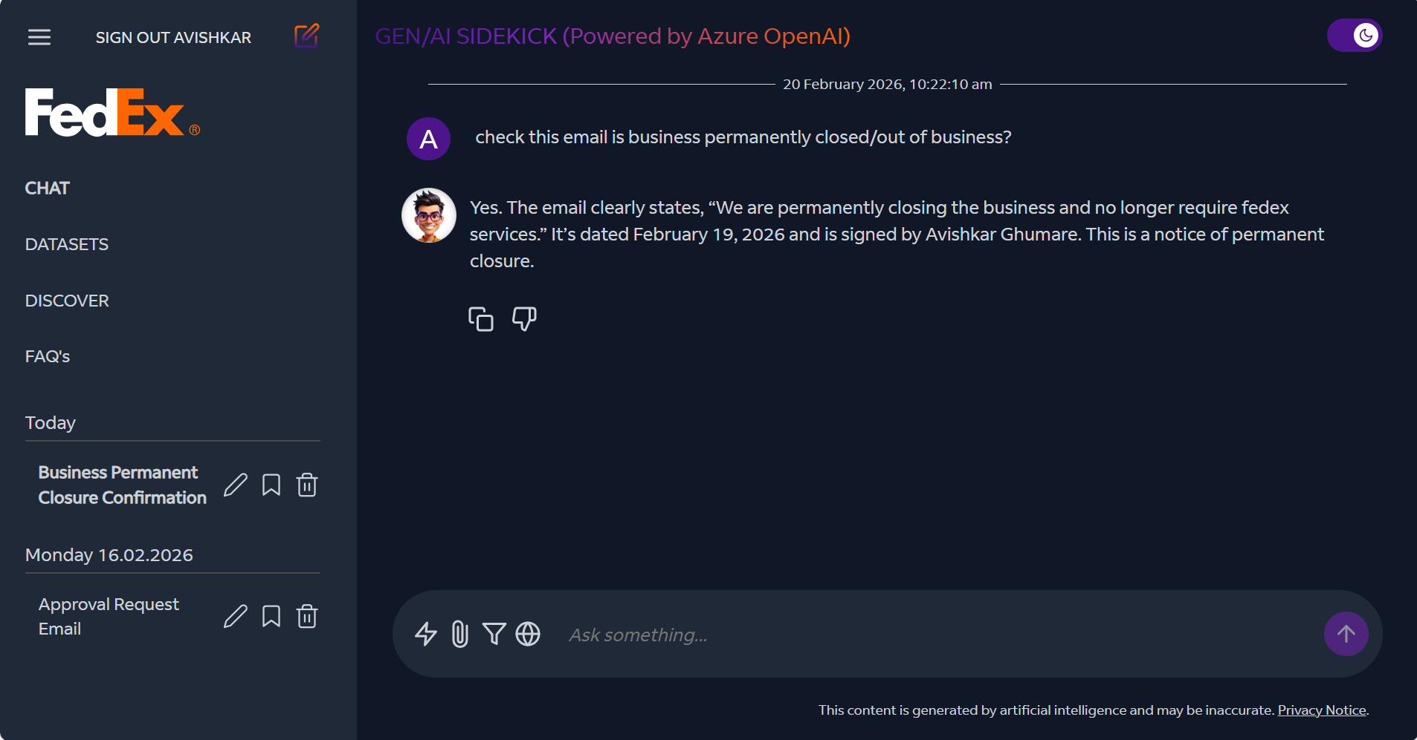
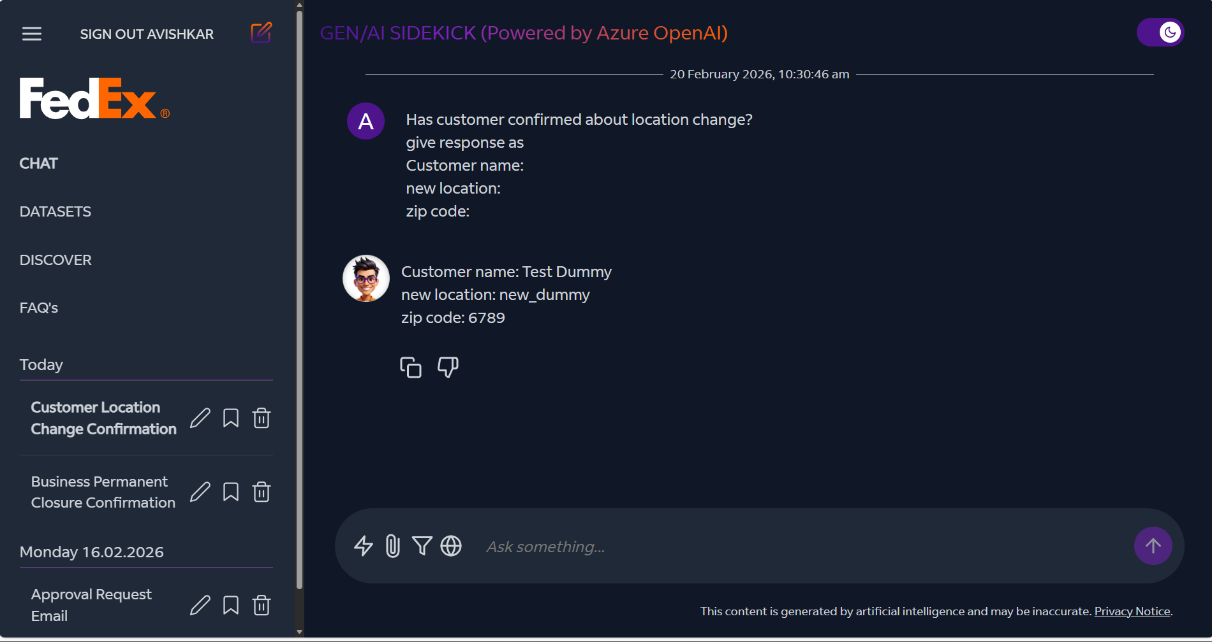
Attachment Analysis
Out of Business:
DM/HQ

Slide 36
OPTIX Timeline
Ph | Details | JAN’26 | FEB’26 | MAR’26 | APR’26 | MAY’26 | JUN’26 | JUL’26 | AUG’26 | SEP’26 | OCT’26 | NOV’26 | DEC’26
0. CIP | 0.0 Continuous Improvement plan
1. Case Category Inclusion | 1.1 Adjust Potential
 | 1.2 BDS fields
 | 1.3 DM/HQ
 | 1.4 Out of Business
 | 1.5 Attribute updates
 | 1.6 USI Field
2. Field BDS | 2.0 Field BDS end-to-end handling
3. Globalization¹ | 3.1 Canada
 | 3.2 LAC
 | 3.3 EU
 | 3.4 APAC
 | 3.5 MEISA
Globalization workstream has a dependency on the ongoing “Globalization initiative” . Currently, only ATC cases are processed for these regions

Slide 37
Plans ahead
Sales Feedback
Form Automation
Feedback Automation
Framework
Deployment Status
Purpose: Used for updating attributes in iSell
Current State: US team loads ATC feedback (from??) into the backend database after business validation
Automation Implemented (WIP): Built a workflow for real-time ATC data view, edit, and submission by TPO Specialists.
Future State (Target: Jul '26): End-to-end ownership of the ATC upload process, from data
Built automated workflow for real-time ATC data view, edit, and submission by TPO Specialists (Completed)
(I transformation to L1 table loading
Business Impact: Reduce ATC update turnaround time from 7 days to ~24 hours.
Created EAI enterprise Application I'd(1)
Successful set up of Python Server.(2)
Deployment on python server – TBD.(4)
Gemini API key – TBD as project prioritization is done by AI labs team.(5)
FIRST process (info sec team) (3)
Stakeholder: Chuck
Input & Rule Processing
Captures user inputs and applies rule-based logic for categorization.
Feedback Capture & Structuring
Collects dynamic feedback and stores it in a structured format.
Insights & Continuous Improvement
Generates insights for dashboards and drives continuous tool improvement.
Live by Jul’26
Live by Jul’26
Live by Jul’26

