Slide 1
Today’s topic

Slide 2
The Stupid content tracker

Slide 3
Contents:
Version Control system (VCS).
SDLC
Types of VCS.
VCS tool - Git.
Stages in Git.
Setting up Git.
Setting up GitHub.
Commands in Git.
Branching and Merging.

Slide 4

What is Version control ?
Version control is a system that records changes to a file or set of files over time so that you can recall specific versions later.

Slide 5
Why do we need it?
Initial file
……..
…….
…..
Last save
…………….
…………
……….
……..
Current file
…………….
……………
………….
……….
……..
…..

Slide 6
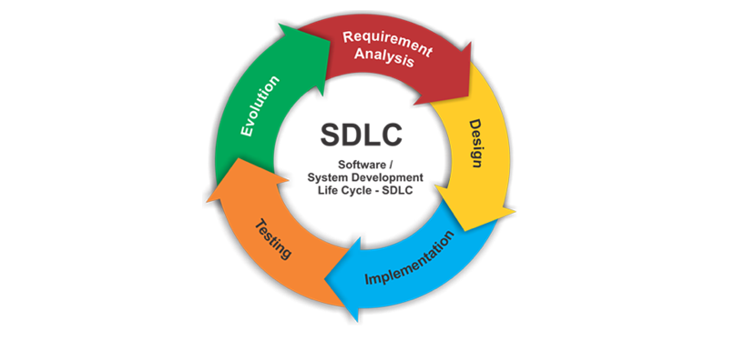
SDLC
Version control

Slide 7
Types of version control

Slide 8
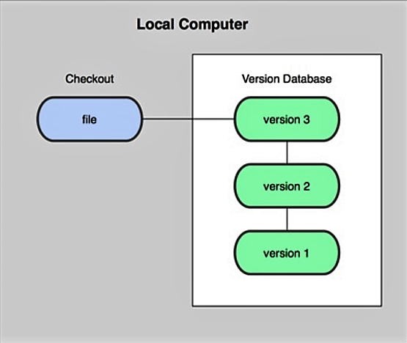
Local version control system

Slide 9
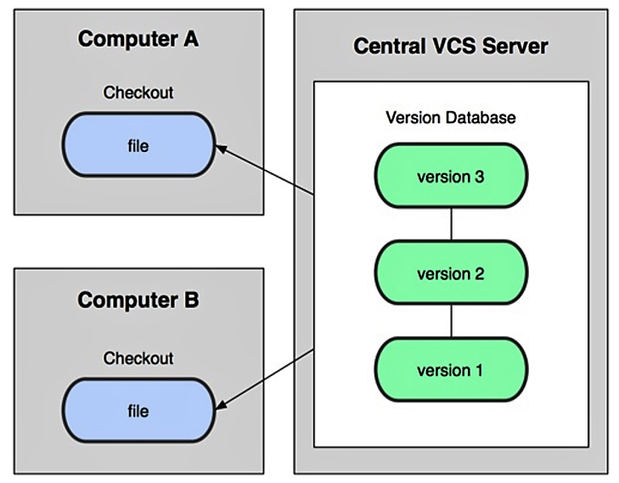
Centralized Version control system

Slide 10
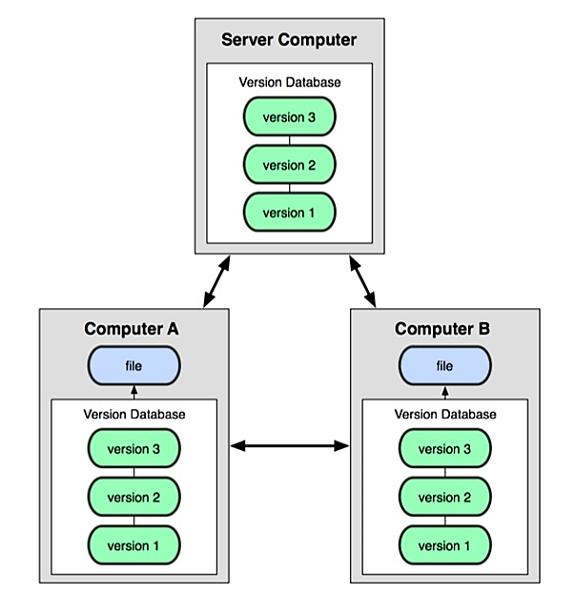
Distributed Version control system

Slide 11

GIT A Version Control tool

Slide 12
What is git ?
Created by Linus Torvalds in 2005 for development of the Linux kernel.
Distributed version control system.
Its under GNU general public license.

Slide 13
How GIT works ?

Slide 14
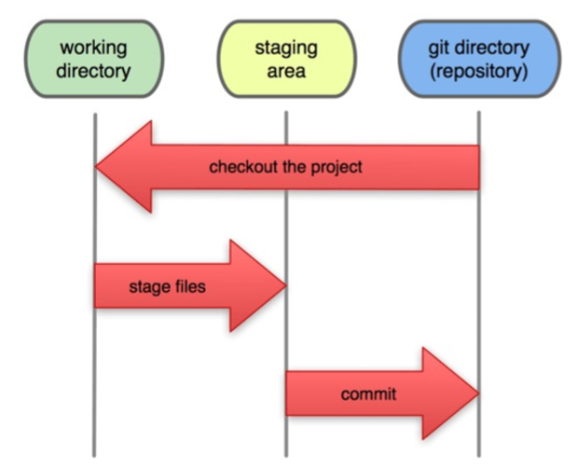
The three states

Slide 15

Getting started – Installing git

Slide 16
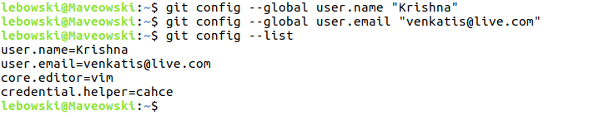
Setting up the Git

Slide 17
Finding help
$ git help <command>
$ git <command> --help
$ man git-<command>

Slide 18
Setting up Github

Slide 19
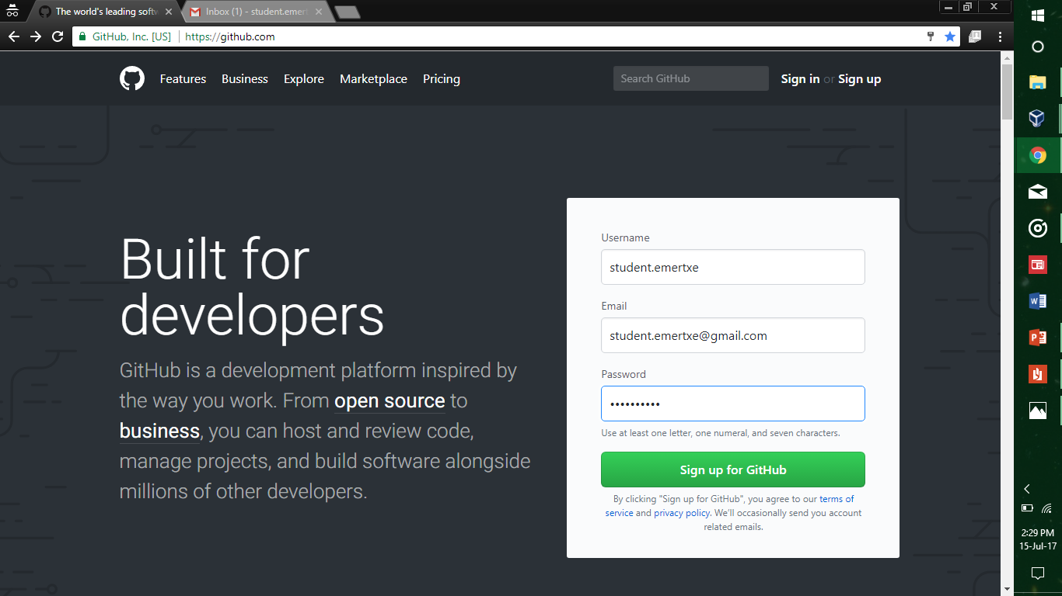

Slide 20
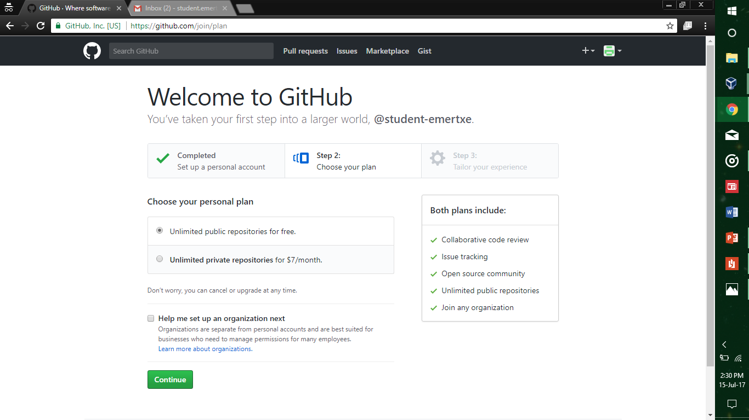

Slide 21
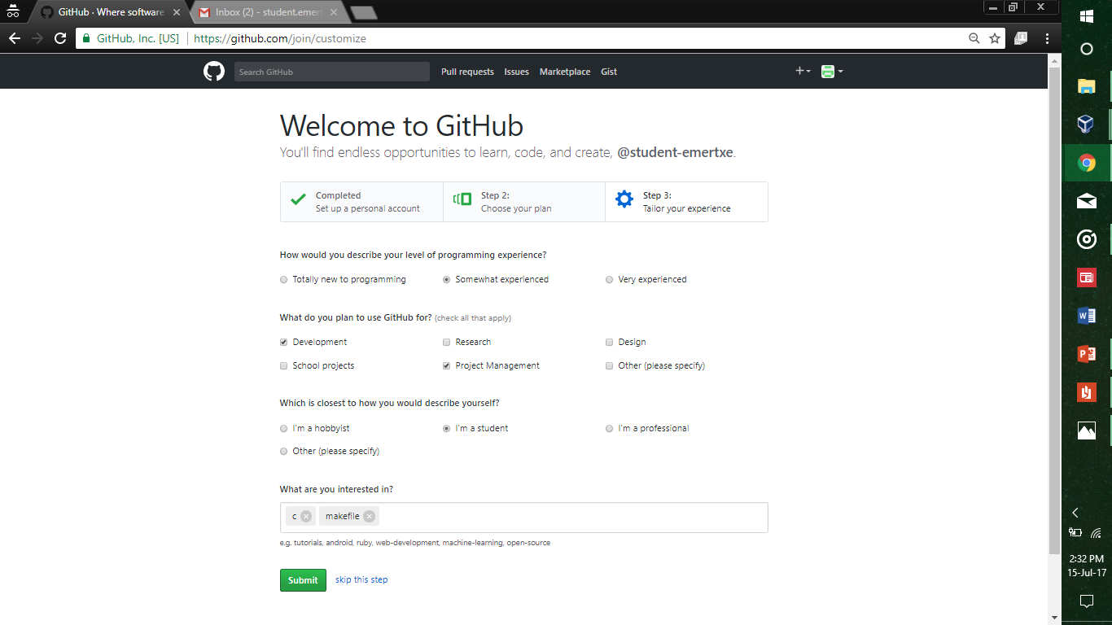

Slide 22
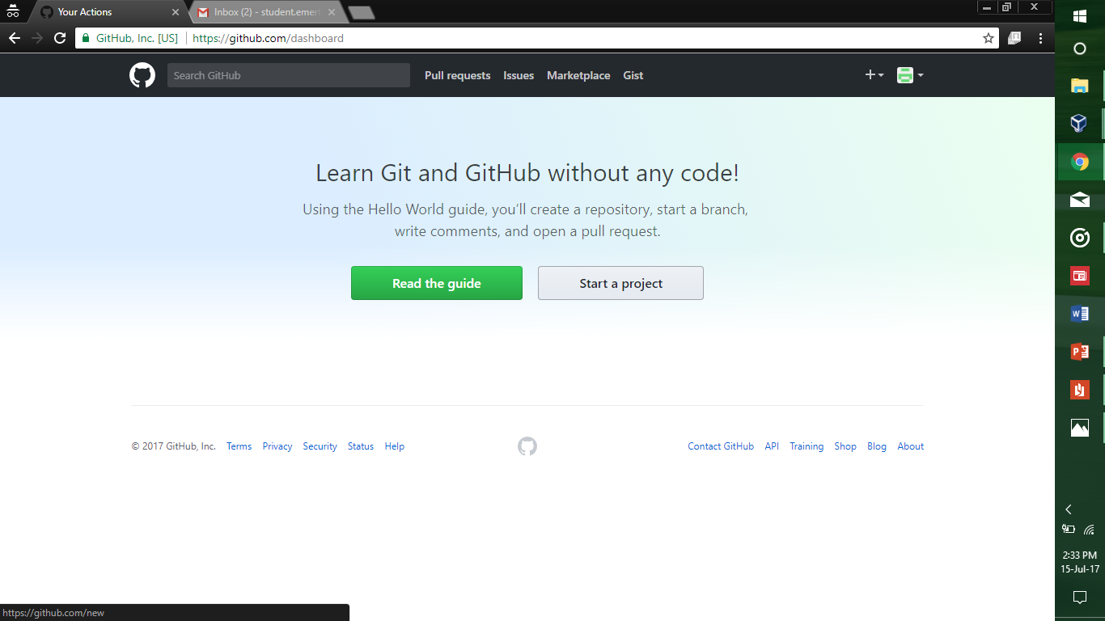

Slide 23
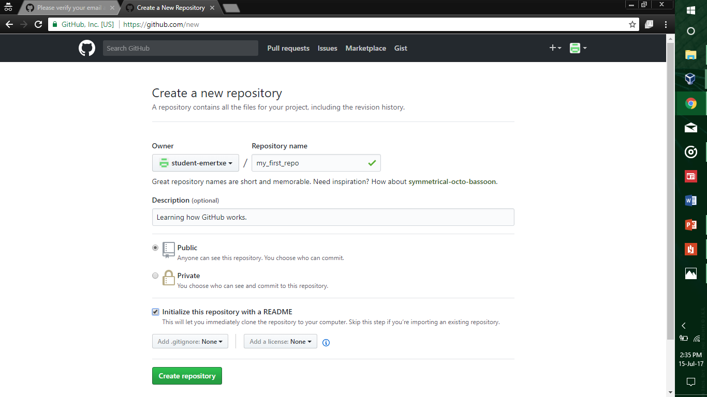

Slide 24
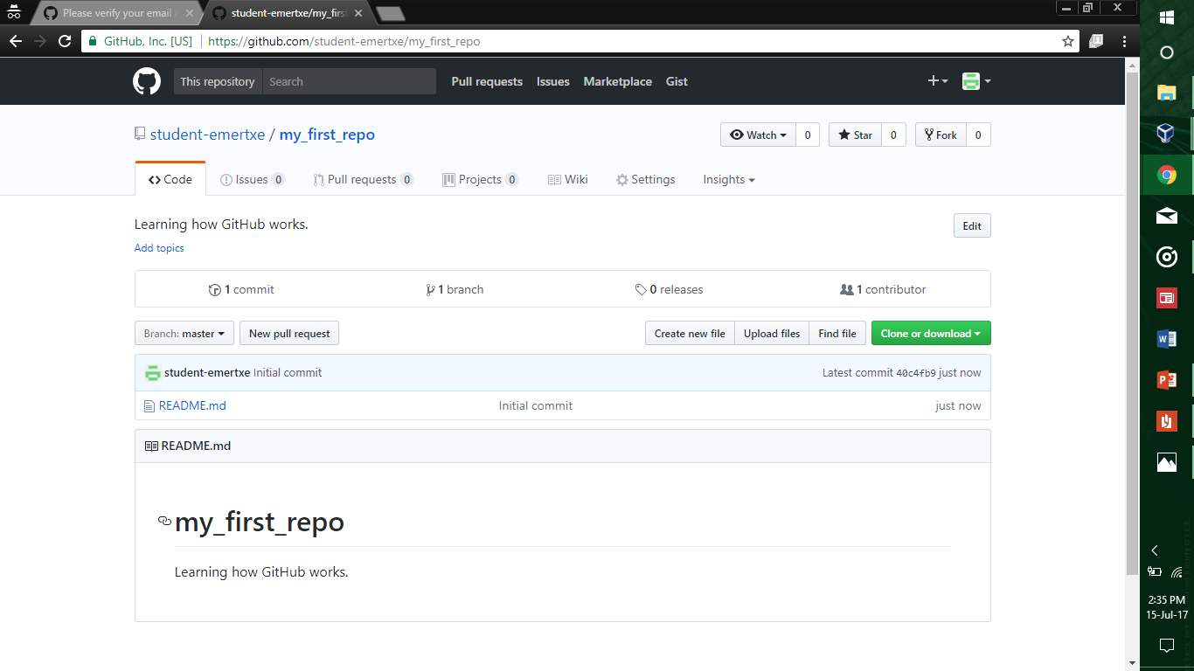

Slide 25
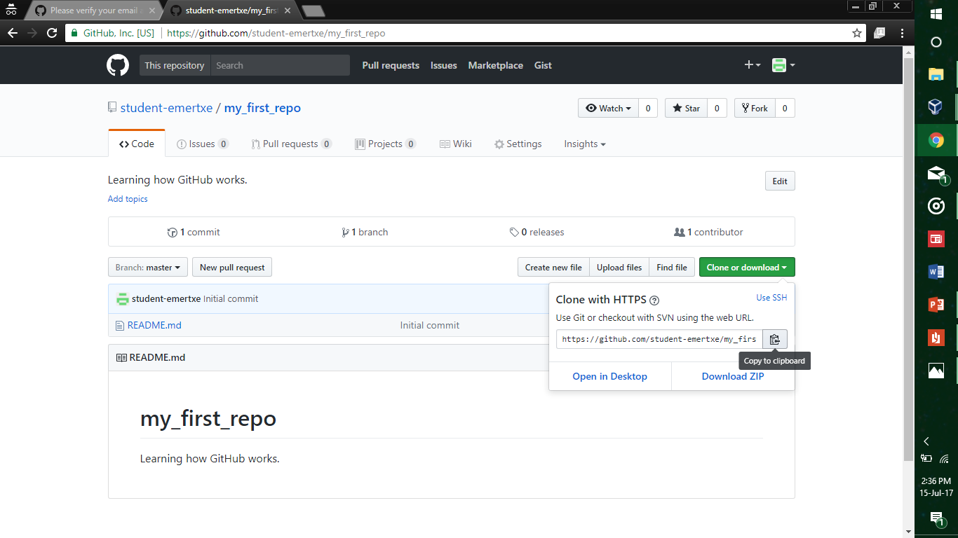

Slide 26

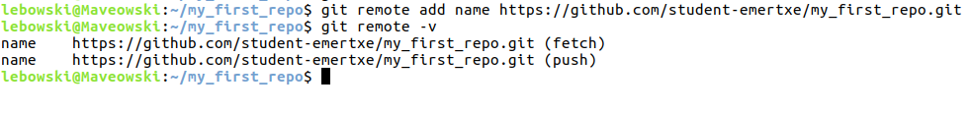
Create a local repository cmd: init
Adding remote repo cmd: remote, add

Slide 27
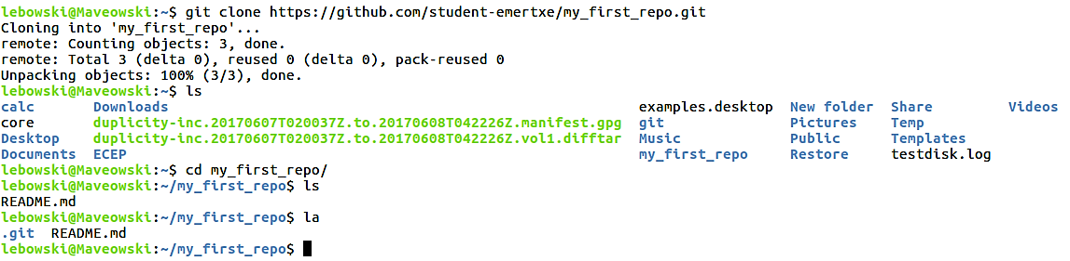
Clone a remote repository cmd: clone

Slide 28
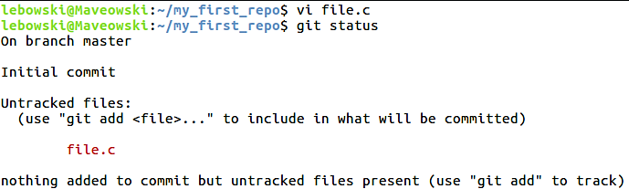
Check status of files cmd : status

Slide 29
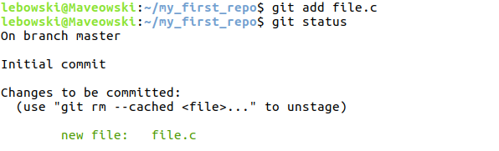
Tracking new files cmd: add

Slide 30
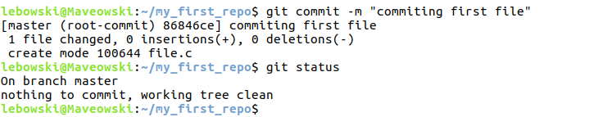
Staging modified files cmd: commit

Slide 31

Pulling from remote cmd: pull

Slide 32
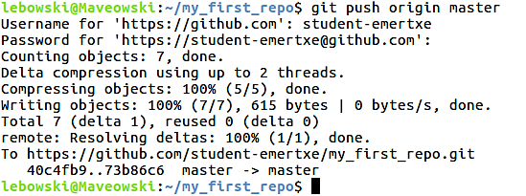
Pushing to remote cmd: push

Slide 33
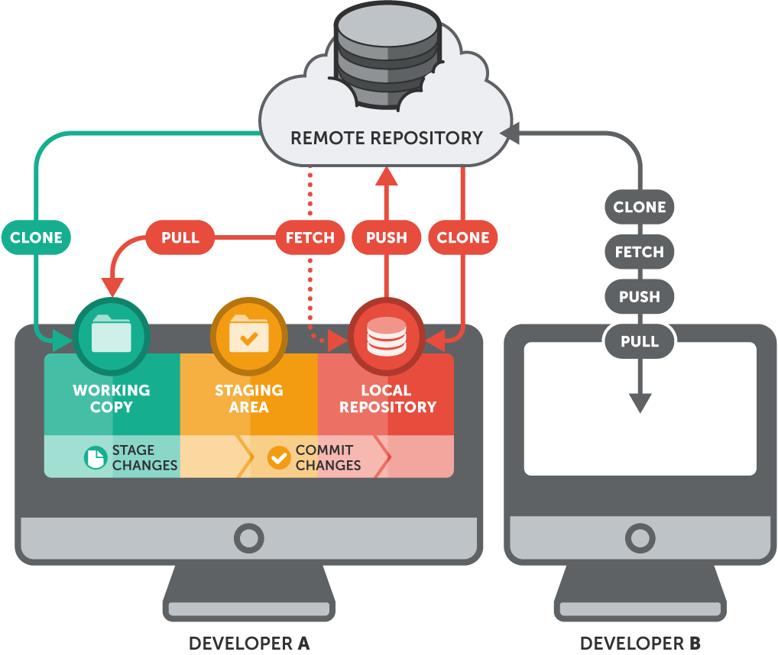

Slide 34
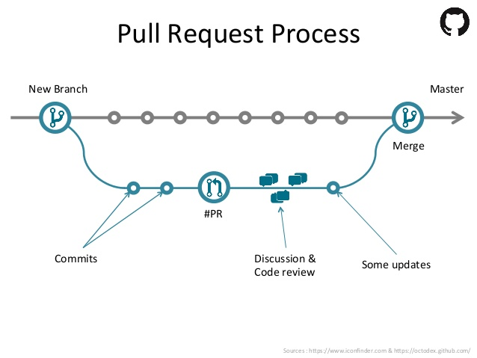
Branch – The Killing feature

Slide 35
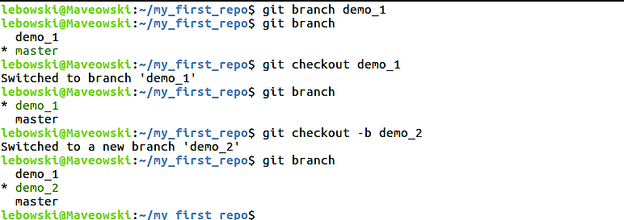
Branching cmd: branch, checkout

Slide 36
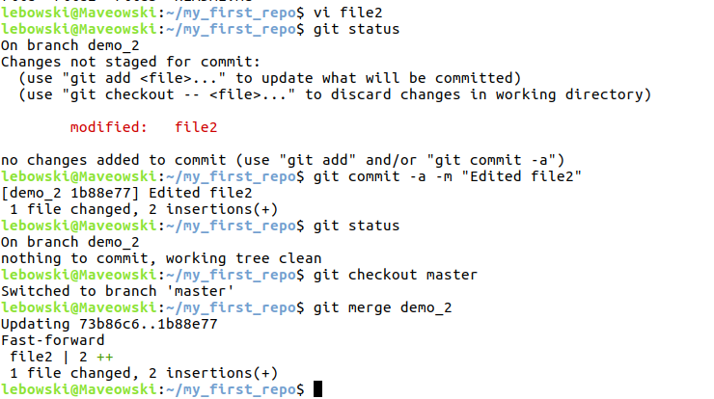
Merging branches cmd: merge

Slide 37
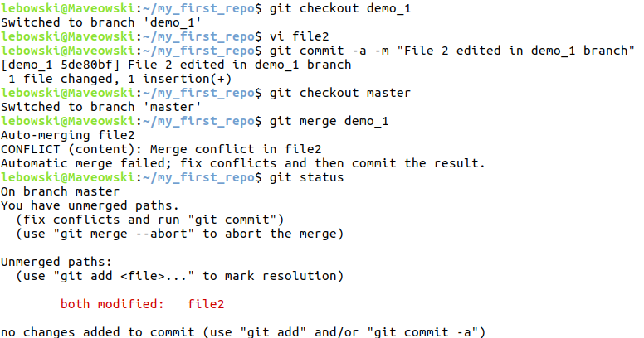
Merge conflicts

Slide 38
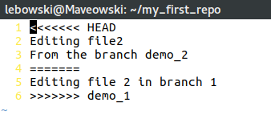
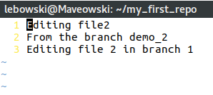
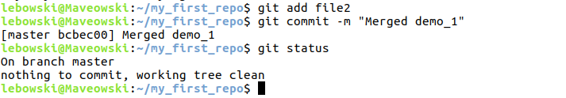

Slide 39
Miscellaneous commands
git rm – delete a file.
git log – shows the commit logs.
git reset – reset staged changes.
git fetch – fetch all the changes in the remote repo.
git diff – gives the difference in files
git tag – tags a commit.
gitk – graphical interface for the local repo.

Slide 40
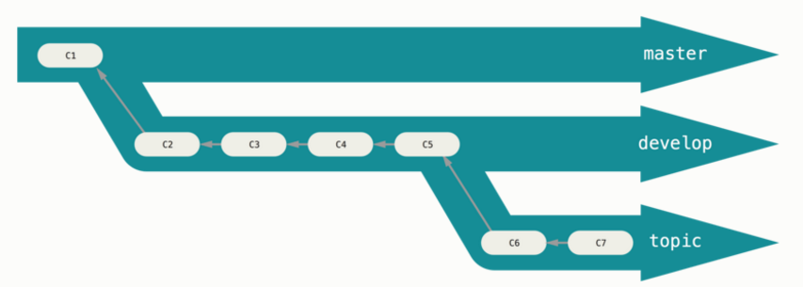
Workflows

Slide 41
Distributed Workflows

Slide 42
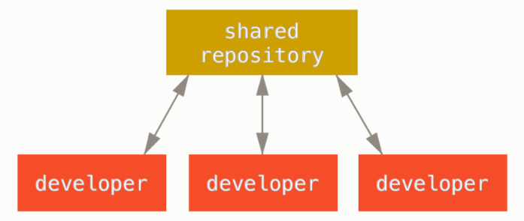
Centralized workflow

Slide 43
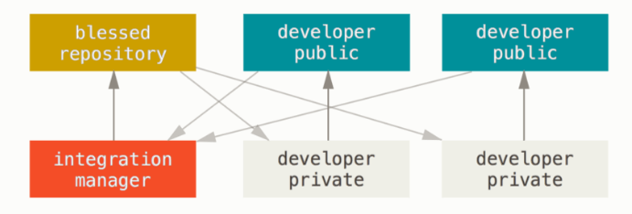
Integration-Manager workflow

Slide 44
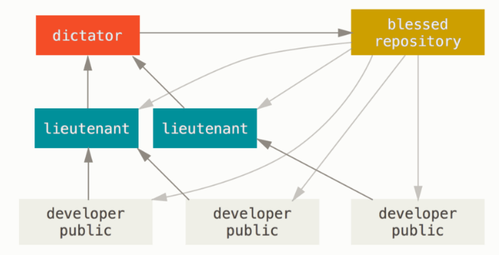
Dictator and Lieutenants workflow

Slide 45
Our Experience

Slide 46
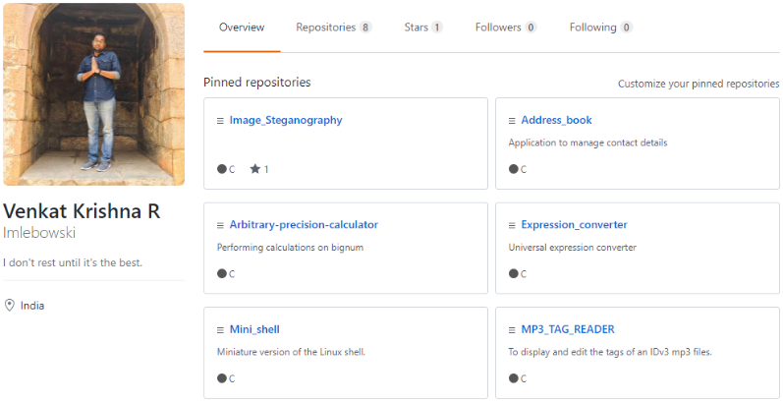
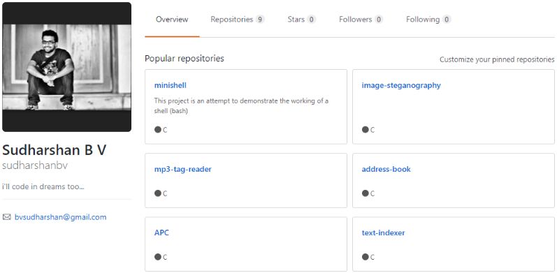
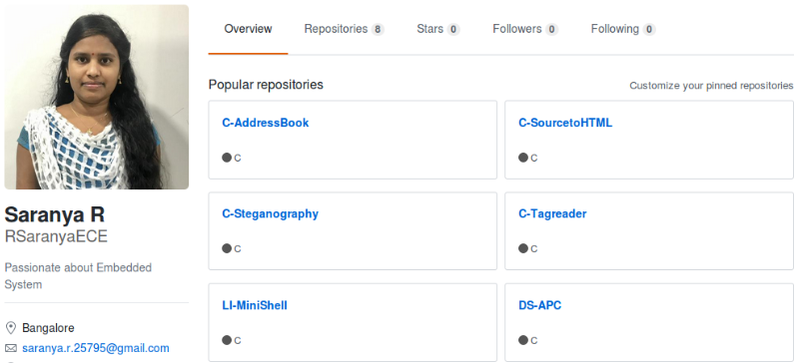
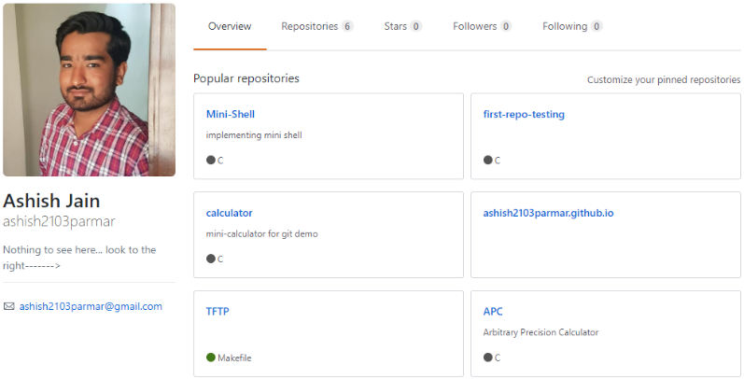

Slide 47
References:
https://git-scm.com/book/en/v2

Slide 48
Thank You

