Slide 1





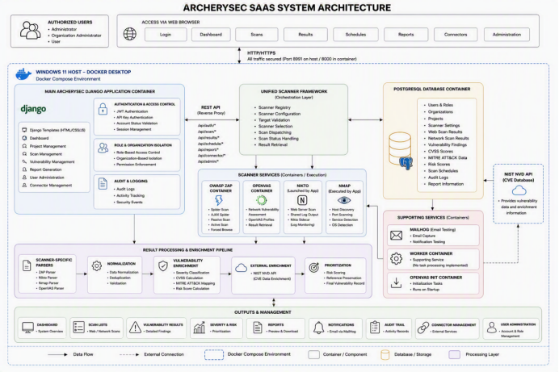
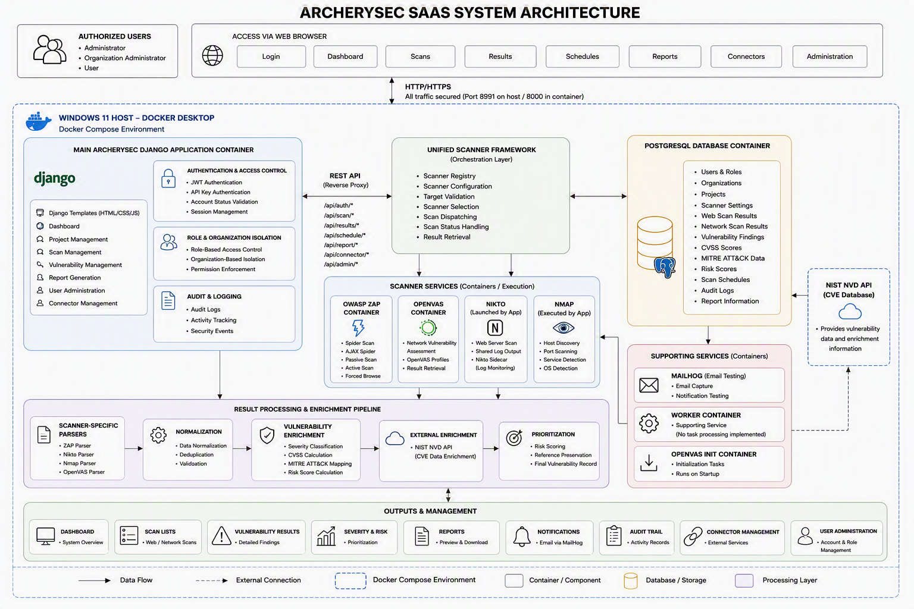
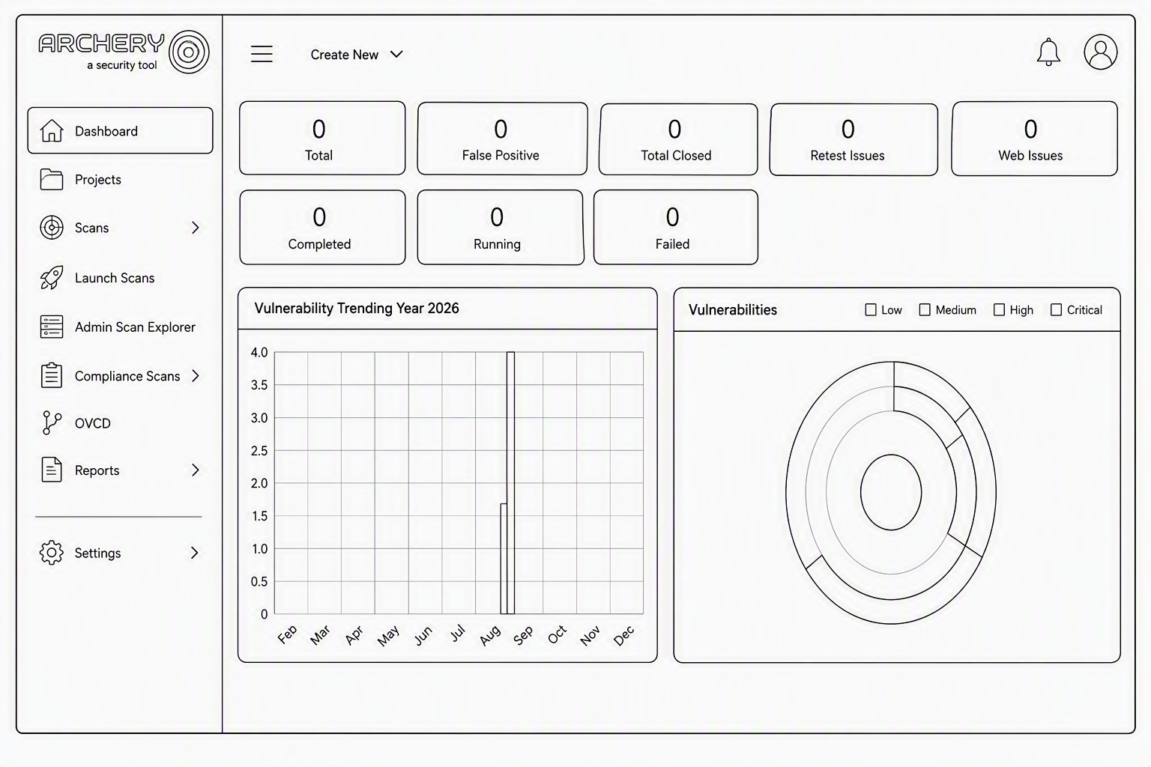
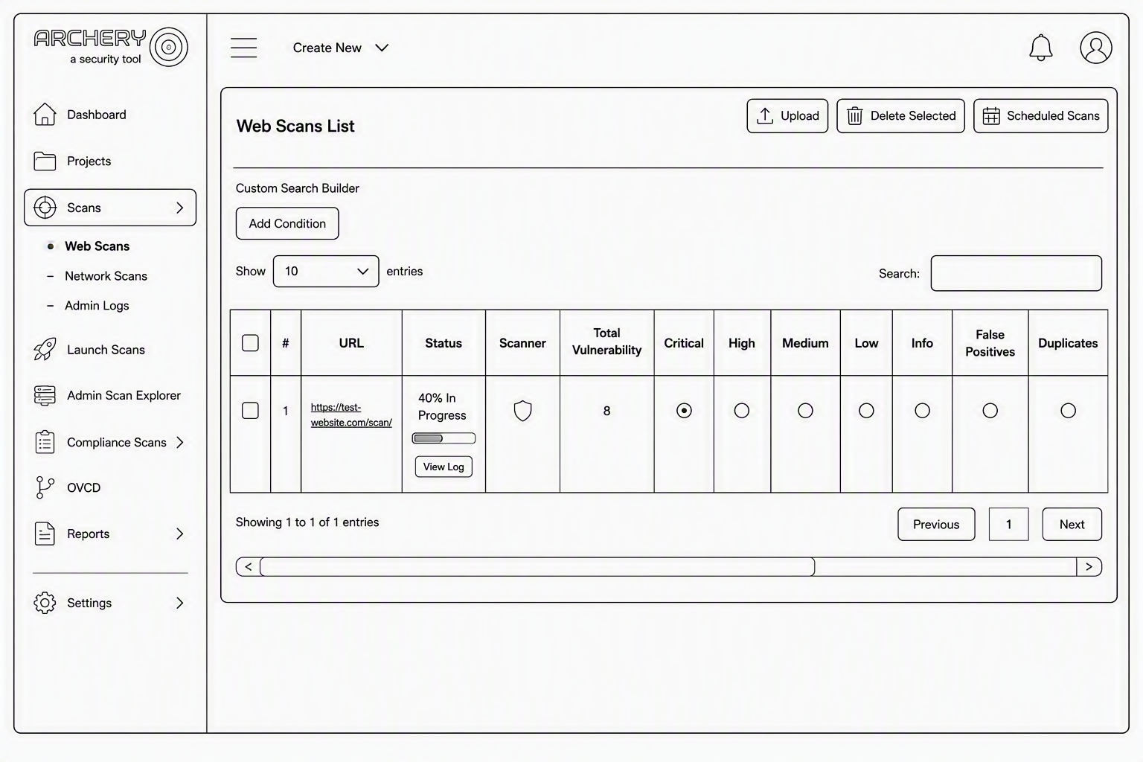
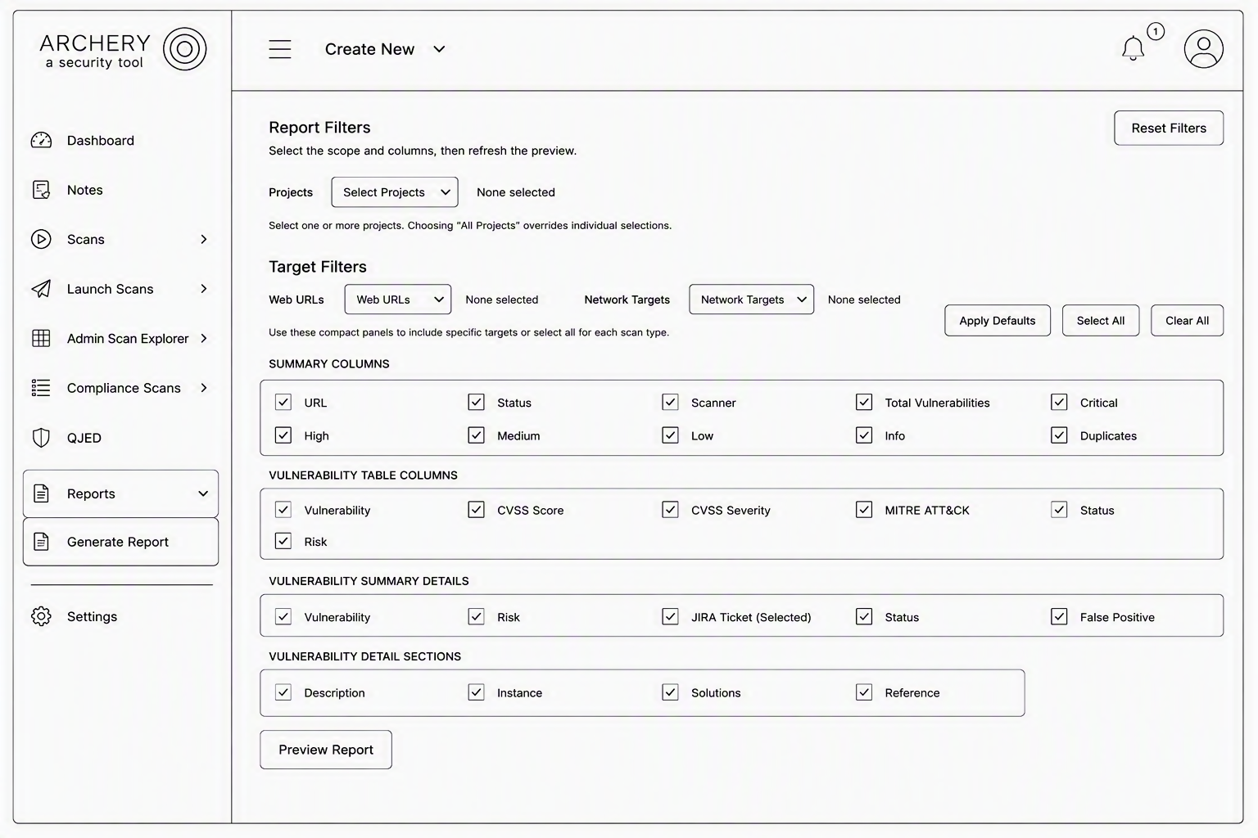
ArcherySec: Enhanced
Containerized Vulnerability
Assessment & Scanning Platform
Multi-Scanner Orchestration, Automated Scheduling & Transparent Risk Prioritization
Immanuel Milad Moawad Indrawes | TP077928 | APU3F2601CS(CYB)
Supervisor: Ms. Noris Ismail | 2nd Marker: Dr. Julia Juremi | 2026
PROBLEM STATEMENT
PROJECT AIM
Traditional vulnerability management relies on isolated web and network scanners that produce inconsistent outputs. This causes duplicate findings, manual triage, fragmented reporting and uneven prioritization. Inconsistent deployment and limited access governance further reduce reliability. ArcherySec SaaS addresses these issues through centralized orchestration, secure multi-tenant access, automated scheduling and transparent risk analysis.
To modernize ArcherySec into a reliable, containerized and governance-focused vulnerability management platform that unifies scanner execution, scheduling, secure access, result processing and structured reporting in alignment with SDG 9.
CONCLUSION
The platform centralizes web and network scanning, RBAC, enrichment, prioritization and reporting. All 25 functional checks passed, all 9,000 stress-test requests completed with no HTTP failures, and all three UAT participants accepted the system. The result was Pass with Performance Limitations because p95 reached 1.15 seconds at 50 virtual users.
OBJECTIVES
Containerized Architecture: Reproducible Docker Compose deployment for the application, PostgreSQL and scanner services.
Scanner Orchestration: Coordinate OWASP ZAP, Nikto, Nmap and OpenVAS through one workflow.
Automation: Support configurable web and network scan scheduling.
Governance: Apply JWT, API-key authentication, RBAC and organization isolation.
Risk Analysis and Reporting: Apply CVSS, MITRE ATT&CK, NVD context and rule-based prioritization.
SYSTEM ARCHITECTURE
VERIFIED EVALUATION RESULTS
25 / 25
9,000
0.00%
1.15 s
3 / 3
UNIT TESTS
REQUESTS
HTTP FAILURES
P95 AT 50 VUS
UAT ACCEPTED
SYSTEM INTERFACE & KEY FEATURES
Unified Vulnerability Dashboard
Automated Scan Scheduling
Configurable Report Generation
Centralized scan summaries, severity distribution, trends and visibility across authorized projects.
Configure authorized targets, projects, execution time, recurrence and scanner settings.
Select report scope, fields and output options before previewing structured vulnerability reports.
SDG 9 CONTRIBUTION: Secure, centralized and extensible vulnerability management supports more resilient digital infrastructure.
ARCHERYSEC SAAS | FINAL YEAR PROJECT 2026
IMMANUEL MILAD MOAWAD INDRAWES • TP077928
Notes:
[Sources]
- User-provided ArcherySec logo, architecture diagram, and interface screenshots.
- Claims and results summarized from the user-provided FYP report.
[/Sources]

