Slide 1

Telco Customer Churn Analysis
A Business Analytics Case Study
AHANONU IMMANUEL | ANALYSTLAB AFRICA | WEEK 1

Slide 2
Table of Contents
01.
02.
Organizational Context
Data & Methodology
Framing the customer retention problem and setting analytical goals.
Data description, analytical approach, and methods for uncovering drivers of churn.
03.
04.
Key Findings
Practical Recommendations
Data-driven findings from a comprehensive churn investigation.
Strategic recommendations for reducing churn and improving customer loyalty through data-driven insights.

Slide 3
01.
Organizational Context
Framing the customer retention problem and setting analytical goals.

Slide 4
Why Should Stakeholders be Concerned?
BUSINESS PROBLEM
Customer churn is a major challenge in the telecommunications industry because losing existing customers directly affects revenue and increases the cost of acquiring new ones.
Out of 7,043 customers, the company has a churn rate of about 26% and up to $139k of monthly revenue lost. Customer retention is significantly more cost-efficient than acquisition (by a factor of 5 to 25x) underscoring churn reduction as a strategic imperative.
In the absence of data-driven intervention, continued churn threatens to erode both the customer base and the organization's competitive position.
PROJECT OBJECTIVES
EXPECTED OUTCOMES
Examine customer churn patterns within a telecommunications company.
Identify the key factors that influence customer attrition.
Segment customers based on their churn behavior.
Generate practical business insights and recommend data-driven strategies that can improve customer retention and also support informed decision-making

Slide 5
02.
Data & Methodology
Data description, analytical approach, and methods for uncovering drivers of churn.

Slide 6
Dataset Overview
VARIABLE CATEGORIES
Category | Variables | Description
Demographics | gender, SeniorCitizen, Partner, Dependents | Customer personal and household characteristics
Contract and Billing | PhoneService, MultipleLines, InternetService, OnlineSecurity, OnlineBackup, DeviceProtection, TechSupport, StreamingTV, StreamingMovies | Subscribed telecom and value-added services
Services | Contract, PaperlessBilling, PaymentMethod, MonthlyCharges, TotalCharges, tenure | Contract terms, payment preferences, and billing details
Target Variable | Churn (Yes / No) | Whether the customer left within the last month
7,043
21
Total Customers
Variables
1,869
26.5%
Churned Customers
Churn Rate
$139.1K
Monthly Revenue Lost

Slide 7
End-to-End Analysis Pipeline: Three Phases from Raw Data to Insights
03.
01.
Key Insights
Data Cleaning & Preparation
Extracted key practical business insights from the emerging patterns in the data.
Checked for duplicates and found none in the dataset.
02.
Handled missing values that were found in the ‘TotalCharges’ column.
Exploratory Data Analysis
From those insights, I formulated actionable recommendations for the company.
Converted text data type to numerical in the same column after handling missing values.
Univariate analysis for understanding each variable distribution and customer segments.
Bivariate analysis for comparing each variable to churn to identify key drivers of customer attrition.
Drill-down analysis to understand churn by contract (month-to-month), internet service and payment method.

Slide 8
03.
Key Findings
Data-driven findings from a comprehensive churn investigation.

Slide 9
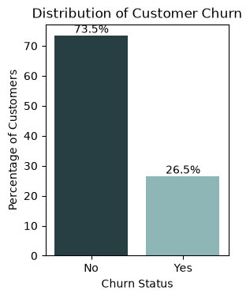
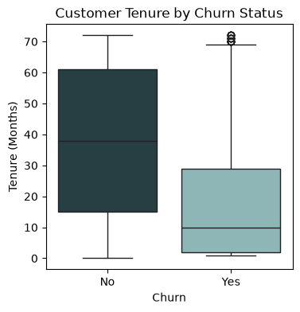
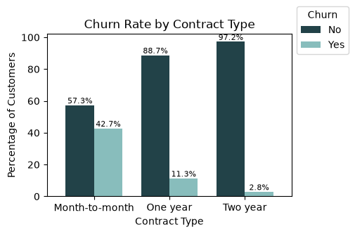
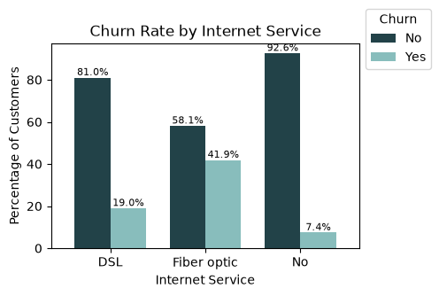
A churn rate of 26.5% shows that roughly one out of four customers are leaving the company.
26.5%
Churn distribution shows that roughly one out of four customers are leaving the company.
(Churn Rate)
10
Customers with shorter tenures (median of 10 months) are at higher risk of churning although a few long-tenure customers also churn as shown by the outliers.
(Median Tenure)
42.7%
Month-to-Month Contract customers exhibit the highest churn rate, while those on one-year and especially two-year contracts have much lower churn rates. This suggests that longer contract commitments are associated with stronger customer retention.
(Churn Rate)
41.9%
Fiber Optic internet customers exhibit a noticeably higher churn rate (more than double the rate of DSL customers) than those using DSL or those without internet service.
(Churn Rate)

Slide 10
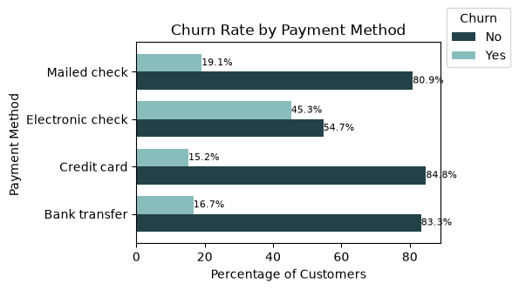
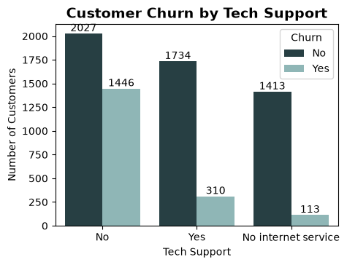
Electronic Check Payment Method and Customers without Tech Support Amplify Churn Risk
CHURN RATE BY PAYMENT METHOD
CHURN RATE BY TECH SUPPORT
45.3%
In contrast, customers using Bank transfer and Credit card experience the lowest churn rates, while Mailed check customers show a moderate level of churn. These findings suggest that payment method is associated with customer retention, and promoting automatic or more convenient payment options may help reduce churn
1,446
This suggests that the presence of tech support is associated with meaningfully better retention, and that customers lacking this service are considerably more likely to churn, indicating that expanding tech support adoption could be an effective lever for reducing churn among at-risk segments..
Churn rate for customers who use the Electronic Check payment method.
Customers who have no Tech Support contribute to churn

Slide 11
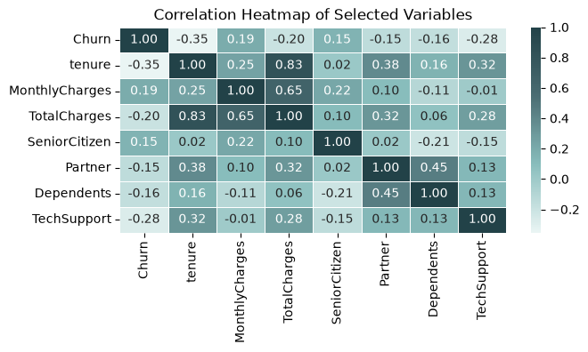
Monthly Charges and Senior Citizen status exhibit weak positive correlations with Churn
CORRELATION HEATMAP
SOME CORRELATION FINDINGS
-0.35
The correlation heatmap indicates that tenure has the strongest negative relationship with churn, suggesting that customers who stay longer are less likely to leave.
Tech Support also shows a moderate negative correlation with churn, while Monthly Charges and Senior Citizen status exhibit weak positive correlations.
-0.28
+0.83
Additionally, Tenure and Total Charges are strongly positively correlated, reflecting that customers with longer tenures naturally accumulate higher total charges.
While some variables exhibit moderate correlations, no extremely strong correlations are observed, suggesting that multiple factors collectively influence customer churn.

Slide 12
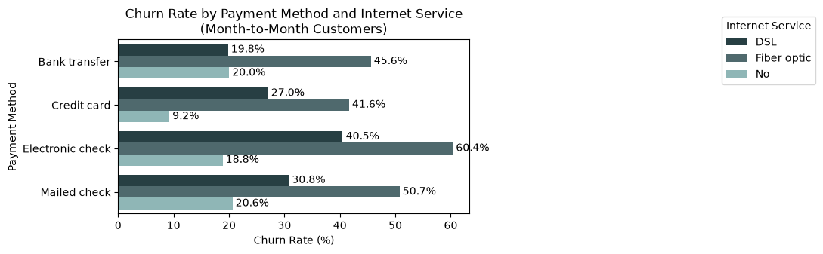
Drill-down Analysis
60.4%
The combined analysis of month-to-month contract type, payment method, and internet service reveals that customers on month-to-month contracts who use Fiber Optic internet and pay via Electronic Check exhibit the highest churn rate (60.4%). High churn is also observed among month-to-month Fiber Optic customers using Mailed Check (50.7%) and Bank Transfer (45.6%). These findings suggest that contract type remains the strongest determinant of retention, while Fiber Optic service and Electronic Check further increase churn risk within the month-to-month customer segment.
Churn Rate of Fiber optic customers on a month-to-month contract and use an electronic check payment method

Slide 13
04.
Practical Recommendations
Strategic recommendations for reducing churn and improving customer loyalty through data-driven insights.

Slide 14
Six Strategic Actions to Reduce Churn and Enhance Retention
02.
Review the Fiber Optic service offering
01.
Focus on converting month-to-month customers to longer-term contracts
by resolving service quality issues and introducing competitively priced tiers or loyalty bundles to close the retention gap with DSL customers.
03.
Promote automatic payment methods
by offering discounts, loyalty rewards, or bundled packages to substantially reduce churn among month-to-month subscribers and improve recurring revenue stability.
by encouraging customers who use Electronic Check to switch to bank transfer or credit card payments through incentives and awareness campaigns. .
05.
Increase adoption of value-added services
04.
Invest heavily in the first few months of a customer’s journey
06.
Build a churn-risk scoring system for early intervention
such as Tech Support and Online Security, through bundled plans and promotional campaigns to improve customer satisfaction and retention.
by making onboarding more personal and anticipatory through schedule check-ins, offering timely help, and presenting relevant upgrades or loyalty incentives early on..
by combining tenure, contract type, and payment method into a risk score that flags customers before cancellation intent forms, triggering proactive outreach.

Slide 15
From Insights to Impact
By translating customer data into actionable insights, this study highlighted how analytics empowers smarter strategy and stronger customer loyalty.
THANK YOU
A Business Analytics Case Study
AHANONU IMMANUEL | ANALYSTLAB AFRICA | WEEK 1

