Slide 1



EMPLOYEE MANAGEMENT
MENTOR : Dr.S.ANANDAMURUGAN
MEMBERS: IMMANUVEL R (22ITR035)
KRITTIKA R (22ITR053)
BARATH KUMAR R (22ITL121)

Slide 2
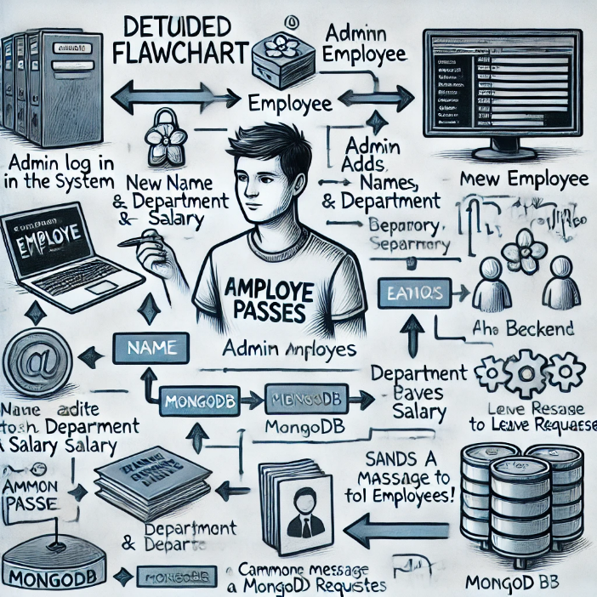
PROBLEM STATEMENT
Managing employee data and administrative tasks manually can be time-consuming and prone to error. The Employee Management System (EMS) provides a streamlined solution for HR departments to automate employee records, attendance, and payroll management with role-based access for security and efficiency.

Slide 3
PROJECT DESCRIPTION
Comprehensive Employee Management: A web application for managing employee data, attendance, and roles.
User-Friendly Interface: Intuitive design for ease of use by admins and employees.
Secure Access: Role-based access control to protect sensitive information.
Real-Time Updates: Live updates on employee status, attendance, and records.
Scalable Architecture: Designed to support growing organizations and additional features.

Slide 4
OBJECTIVE
Efficient Employee Data Management: Enable organizations to easily manage employee information.
Full-Stack Development: Utilizing modern technology stacks for seamless interaction.
User-Centric Design: Focus on ease of navigation and data management.
Scalability: Capable of handling more users and future feature integrations.

Slide 5
MODULE DESCRIPTION
User Authentication: Secure login and registration for different roles (Admin, Employee).
Employee Management: Add, edit, delete, and view employee details.
Attendance Tracking: Manage employee attendance records and view logs.
Role-Based Access Control: Admin access to specific features, limited access for regular employees.
Admin Dashboard: Overview of employee statistics, departments, and system analytics.

Slide 6
SAMPLE MODULES
Login
Admin Dashboard
Employee Dashboard
Leave form
Attendance tracking
Information Passing

Slide 7
TECHNOLOGY USED
FRONT-END:
ReactJS
BACK-END:
Express.js
MongoDB
Twilio
Render

Slide 8
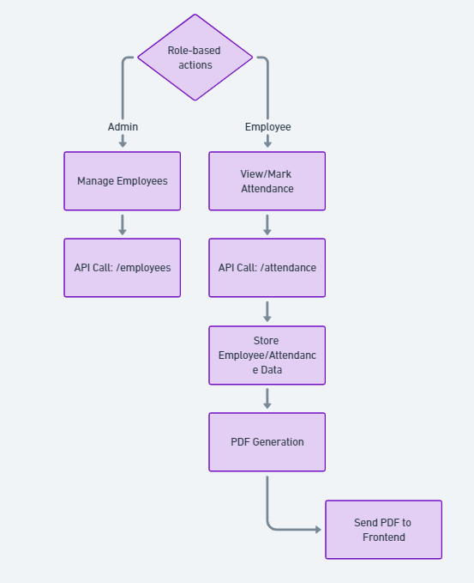
ARCHITECTURE

Slide 9
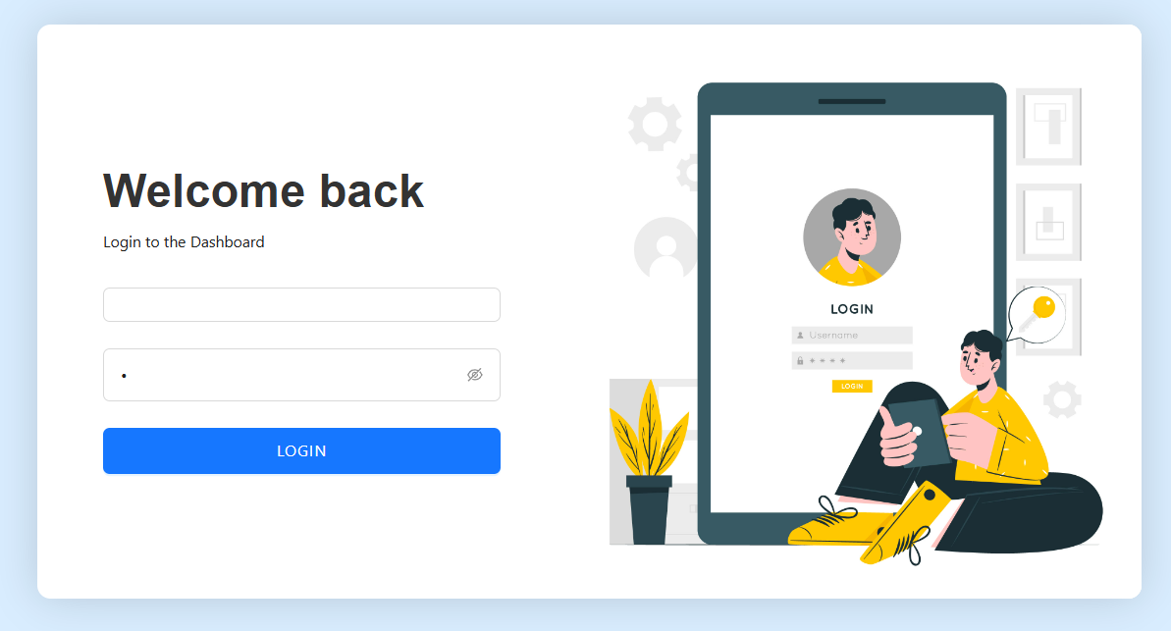
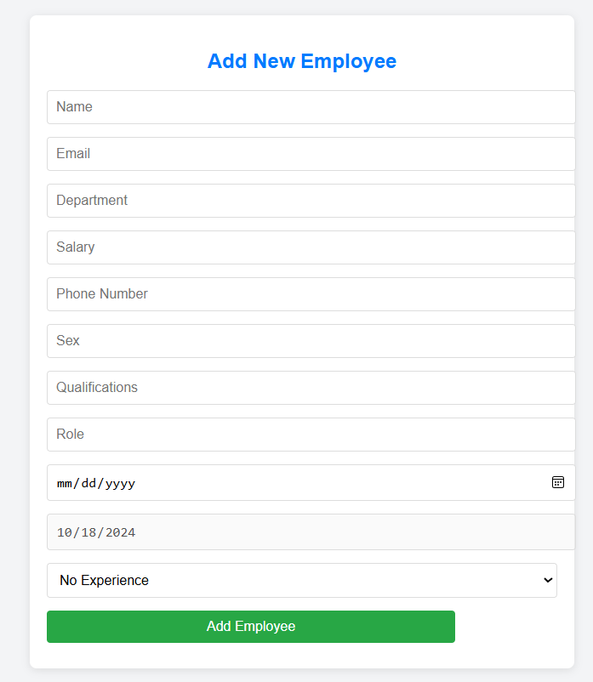
OUTPUT SCREENSHOT

Slide 10
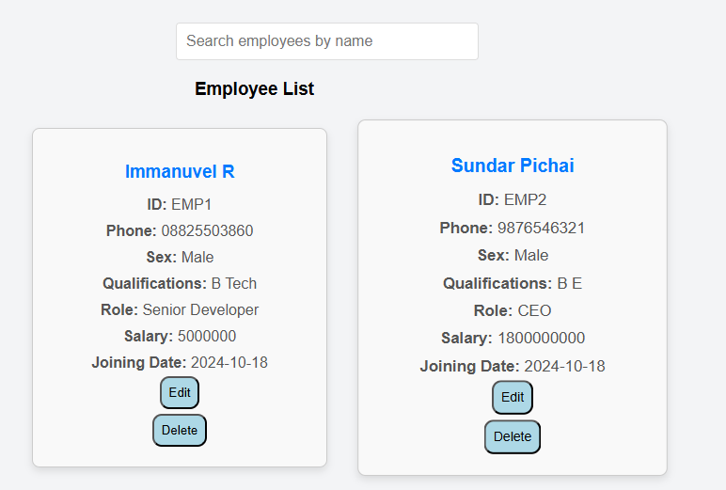
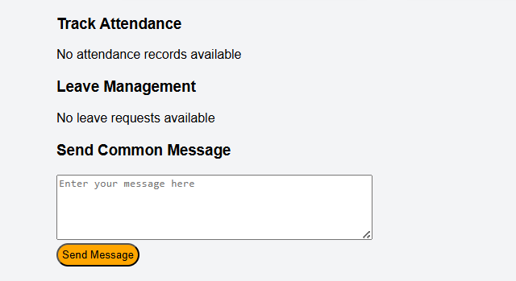

Slide 11
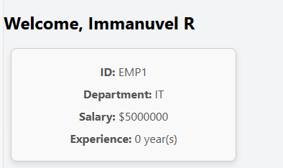
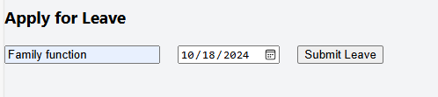


Slide 12
THANK YOU

