Slide 1



LEDGER MANAGEMENT SYSTEM FOR
SIVASAKTHI STORES
PROJECT GUIDE : Dr.S.ANANDAMURUGAN
MEMBERS: IMMANUVEL R (22ITR035)
KRITTIKA R (22ITR053)
BARATH KUMAR R (22ITL121)

Slide 2
COMPANY DETAILS
NAME : SIVASAKTHI STORES
ADDRESS : 1/376 , THEERTHAM ROAD ,
VEPPANAPALLI ,
KRISHNAGIRI – 635 121
MOBILE No. : +91 9080660749
EMAIL : madhuguna1982@gmail.com
REQUIREMENT: DIGITAL APPLICATION FOR CUSTOMER MANAGEMENT

Slide 3
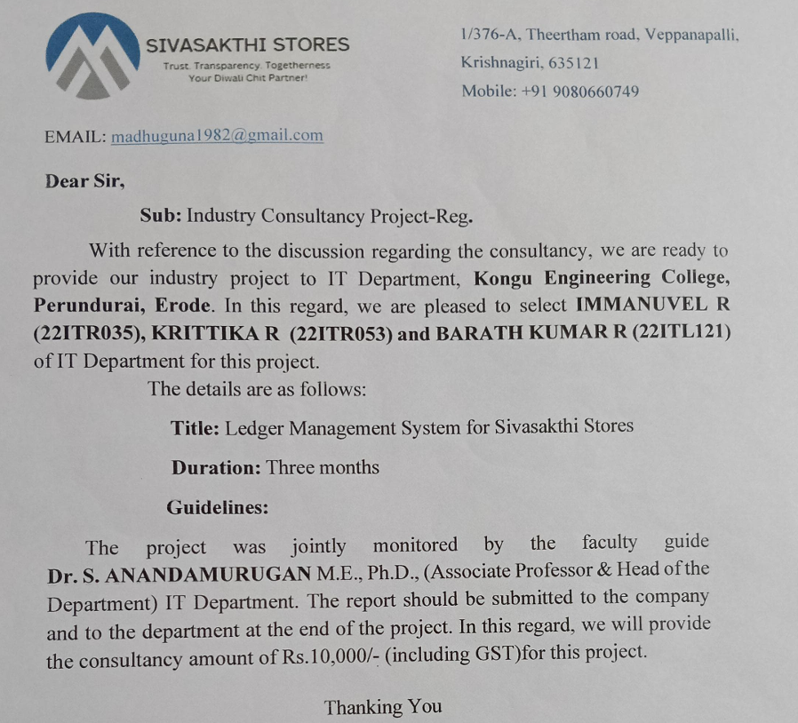
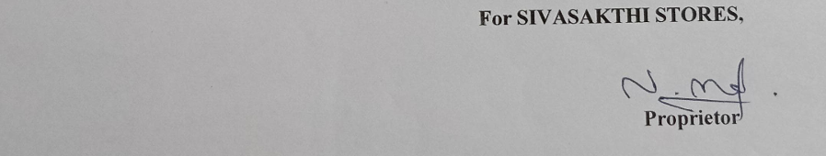
APPROVAL LETTER

Slide 4
PROBLEM IDENTIFIED
Sivasakthi Stores, a local retail establishment in Veppanapalli, Krishnagiri, has been managing its Diwali chit fund through traditional paper-based methods. This approach has led to several challenges:
1. Inefficient Record Keeping
2. Limited Accessibility
3. Scalability Issues
4. Lack of Real-time Updates
5. Data Security Concerns
6. Reporting Challenges

Slide 5
REQUIREMENTS GATHERED
Multiple chit categories
(Gold: ₹500/month, Silver:₹300/month)
Detailed product inventory management
Secure user authentication and admin panel
Payment tracking and history
Customer profile management
Search and filter user data
Database integration

Slide 6
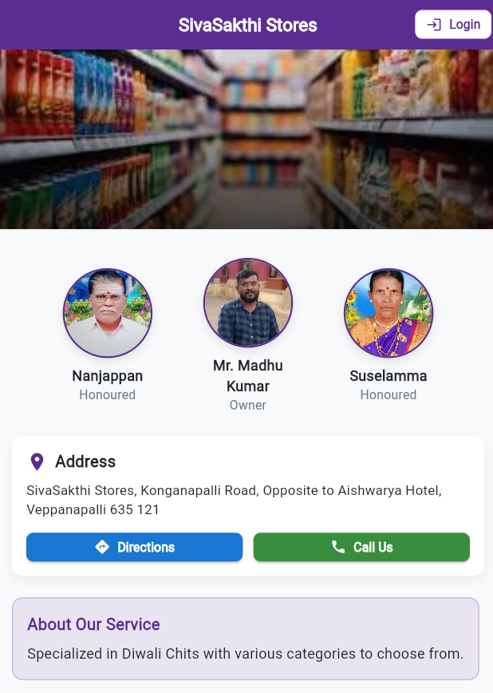
OBJECTIVE
Digitize traditional chit fund management system
Implement secure user authentication system
Streamline customer processes
Provide real – time payment history access
Payment Integration

Slide 7



SOLUTION
So based on the problem, we have come up with an App which helps in Chits management

Slide 8

METHODOLOGIES
Front-End: Flutter/Dart
Back-End: Node.js with Express
Database: MongoDB to store user data securely

Slide 9
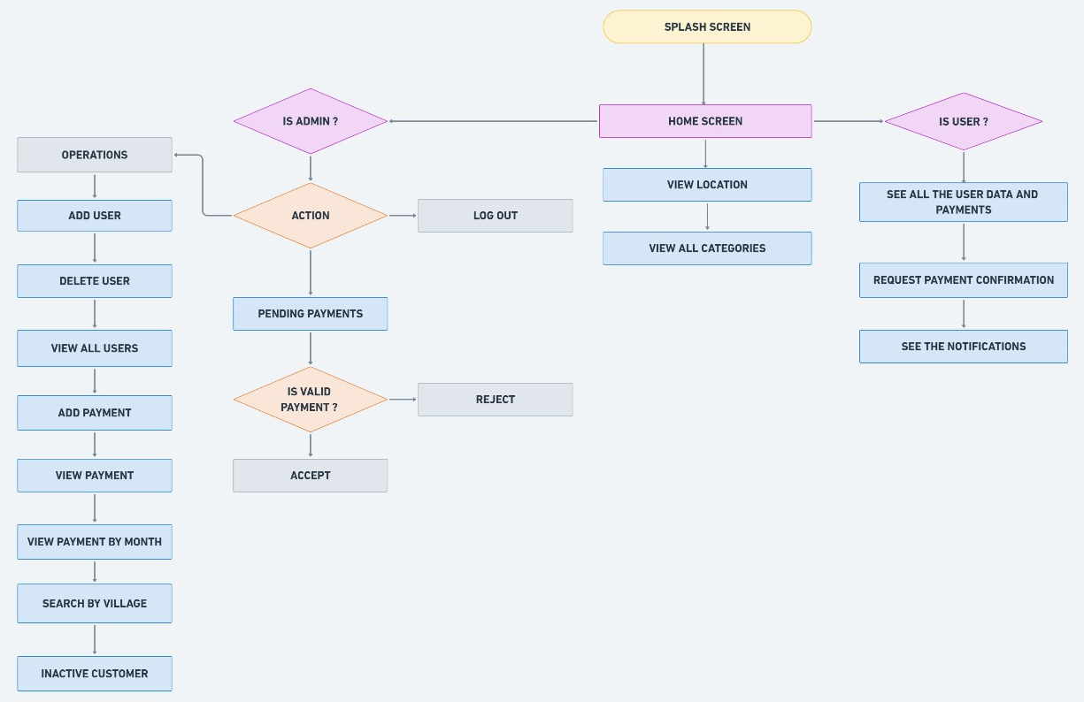
WORK FLOW

Slide 10
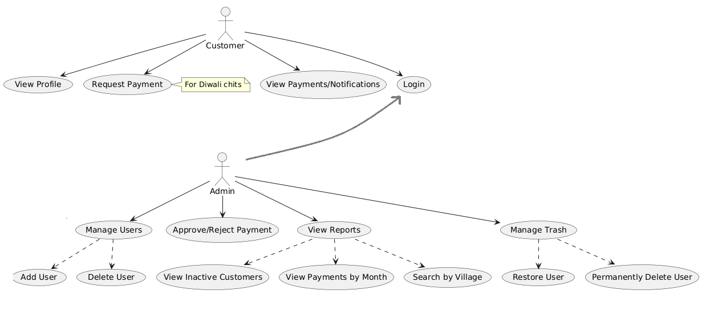
USE CASE DIAGRAM

Slide 11
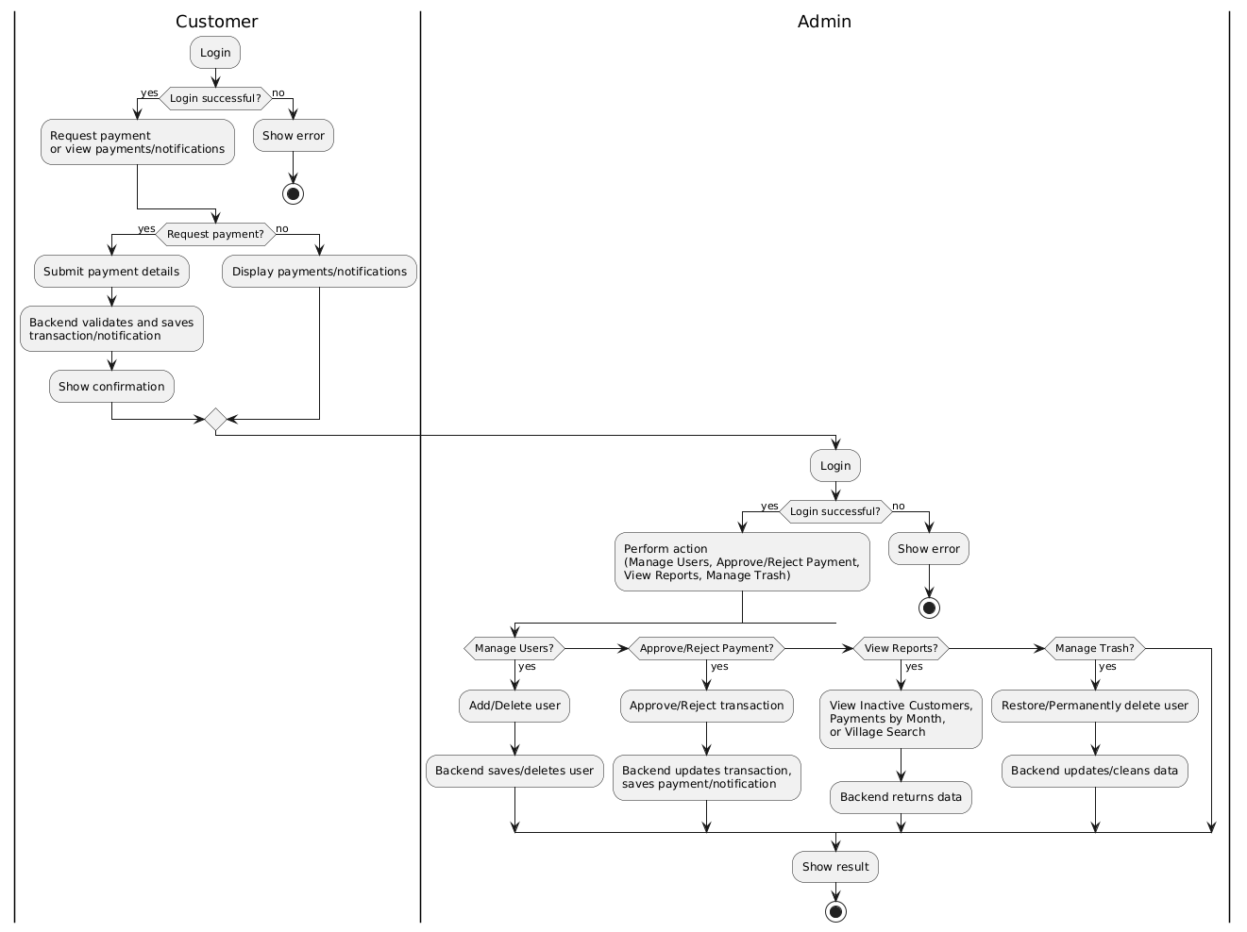
ACTIVITY DIAGRAM

Slide 12
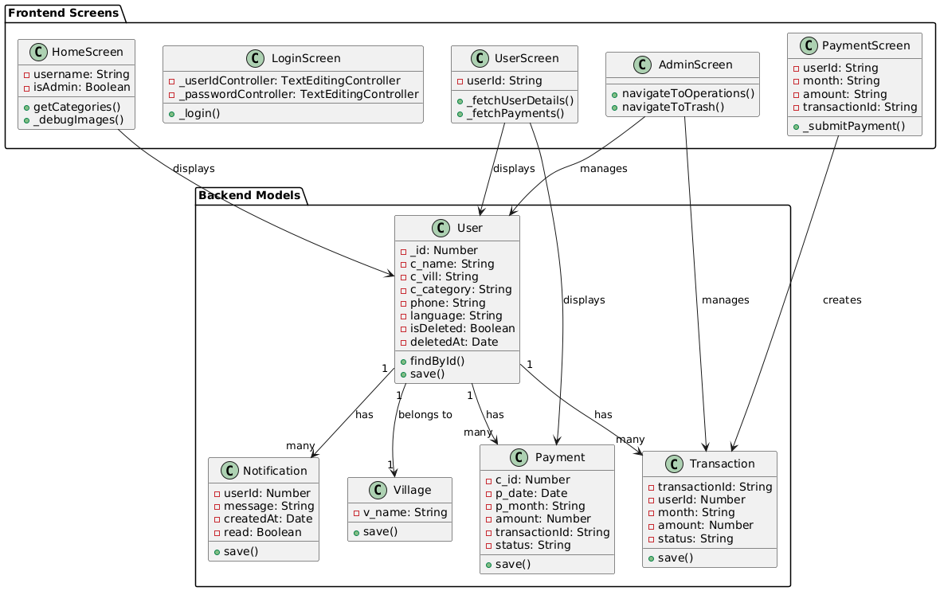
CLASS DIAGRAM

Slide 13
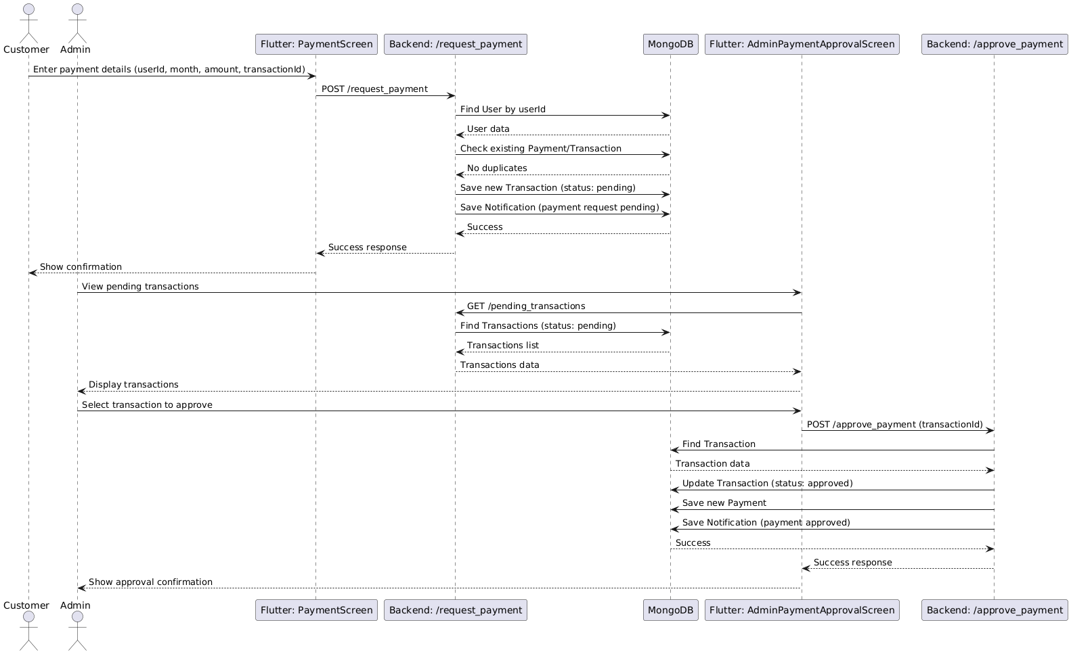
SEQUENCE DIAGRAM

Slide 14
DATABASE SCHEMA
const userSchema = new mongoose.Schema({
_id: Number,
c_name: String,
c_vill: String,
c_category: String,
phone: String,
isDeleted: { type: Boolean, default: false },
deletedAt: { type: Date, default: null },
})
const paymentSchema = new mongoose.Schema({
c_id: Number,
p_date: Date,
p_month: String,
amount: Number,
transactionId: String,
status: { type: String, enum: ["pending", "approved", "rejected"], default: "pending" },
})
const villageSchema = new mongoose.Schema({
v_name: String,
})
const notificationSchema = new mongoose.Schema({ userId: Number,
message: String,
createdAt: { type: Date, default: Date.now },
read: { type: Boolean, default: false },
})
const transactionSchema = new mongoose.Schema({
transactionId: String,
userId: Number,
month: String,
amount: Number,
status: { type: String, enum: ["pending", "approved", "rejected"], default: "pending" },
})

Slide 15
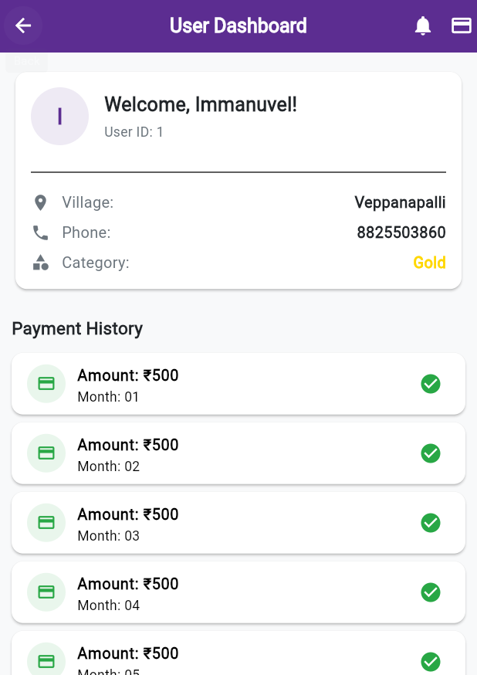
MODULES
Authentication Module
User Management Module
Payment Management Module
Village Management Module
Notification Module
Trash Management Module

Slide 16
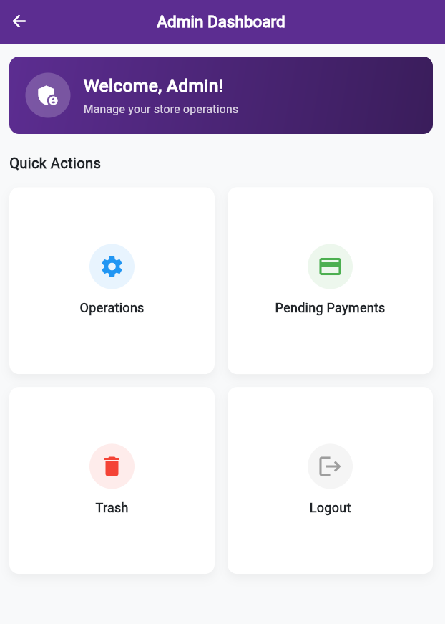
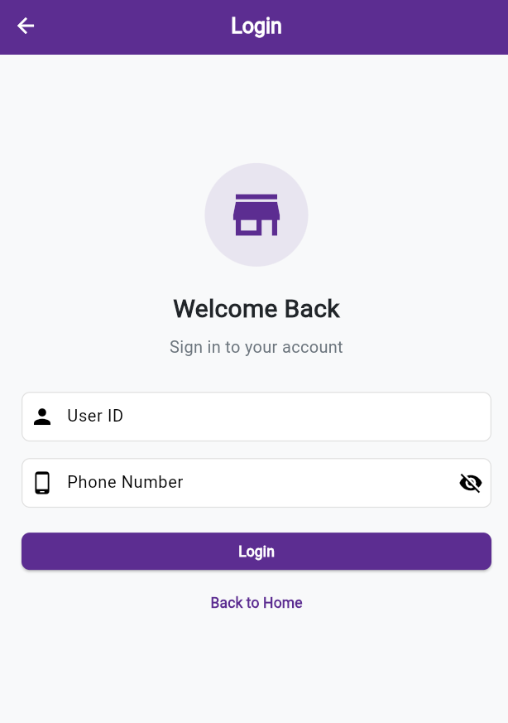
IMPLEMENTATIONS
1. Digitize traditional chit fund management system

Slide 17
IMPLEMENTATIONS
2.Implement secure user authentication system

Slide 18
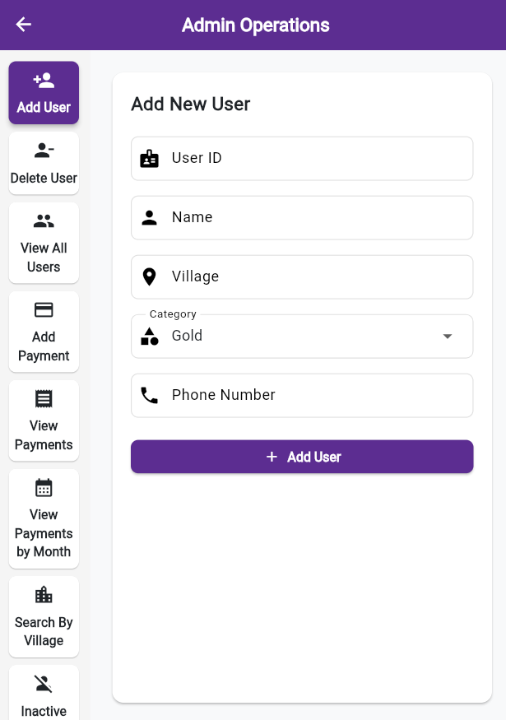
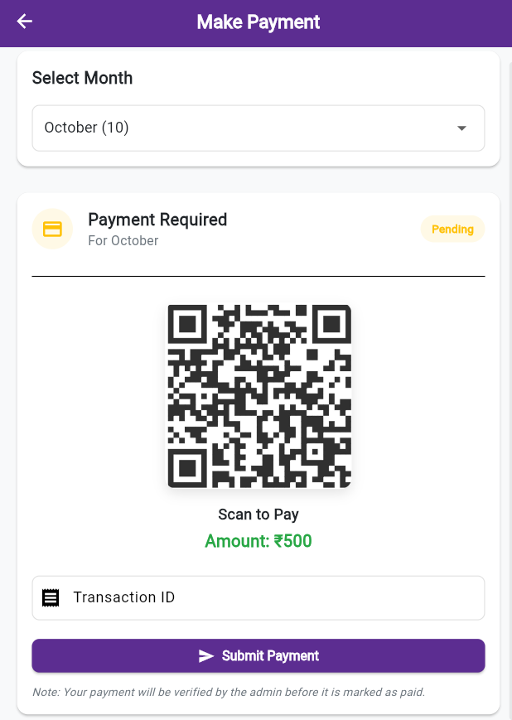
IMPLEMENTATIONS
3. Streamline customer processes

Slide 19
IMPLEMENTATIONS
4. Provide real-time payment functionality and history access

Slide 20
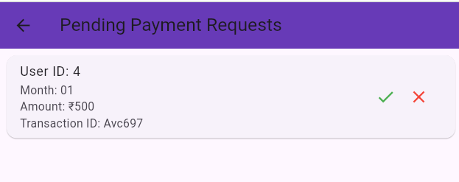
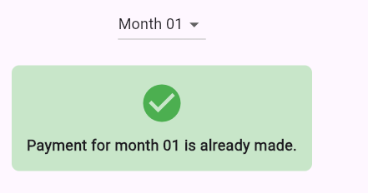
IMPLEMENTATIONS
5. Payment Integration

Slide 21

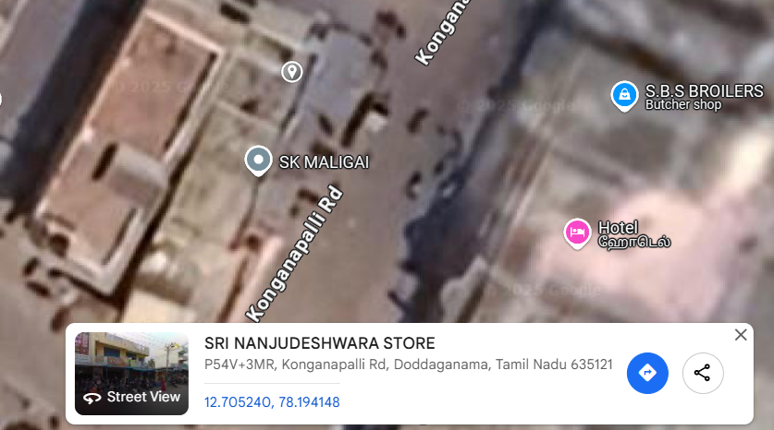
SHOP LOCATION
Provide a map to the store

Slide 22
SHOP LOCATION
Provide a map to the store

Slide 23
THANK YOU!!

