Slide 1
IT Ideathon 2024
Tech Innovators
IT
Ideathon
2k24
Problem Statement Title: Online Chatbot based ticketing system for museum
Theme: Travel and tourism
PS Category- Software/Hardware Software
Team ID: IT42
Team Members Name : Immanuvel R
Jothi Sree R S
Karthikeyan R

Slide 2
Museum Ticket Booking
IT
Ideathon
2k24
Tech Innovators
Problem statement
Visitors to museums often face several significant challenges due to manual ticket booking systems.
One prominent issue is the inefficiency and time consumption associated with the process.
Long queues are common, especially during peak hours, weekends, or special exhibitions, leading to frustration and impatience among visitors.

Slide 3
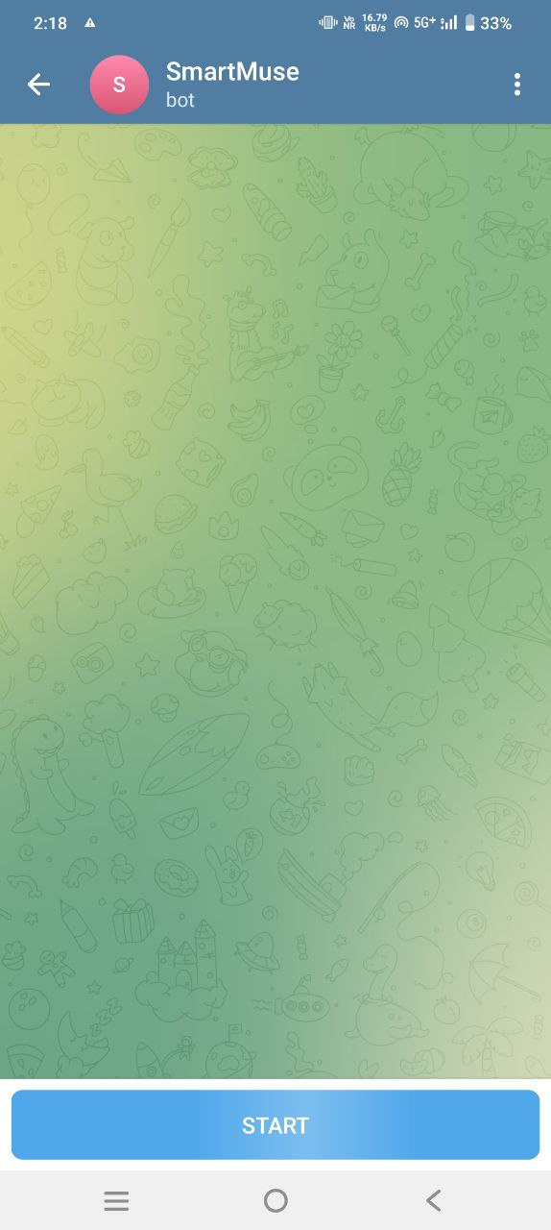
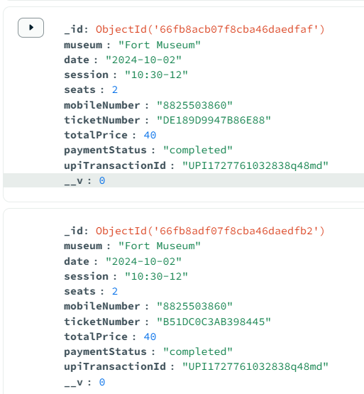
Multi-Lingual Telegram Bot
IT
Ideathon
2k24
Tech Innovators
Proposed Solution
Develop a multilingual, chatbot-based ticketing system that automates the entire booking process, including payments and analytics.
Enhance visitor satisfaction by reducing wait times, minimizing errors, and providing 24/7 customer support in multiple languages.

Slide 4
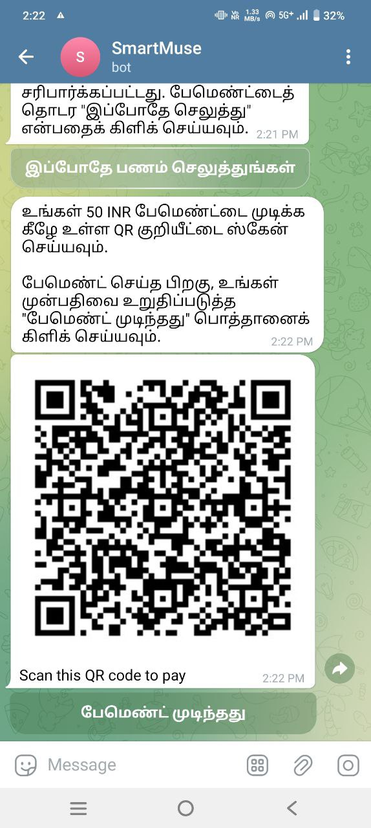
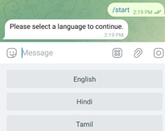
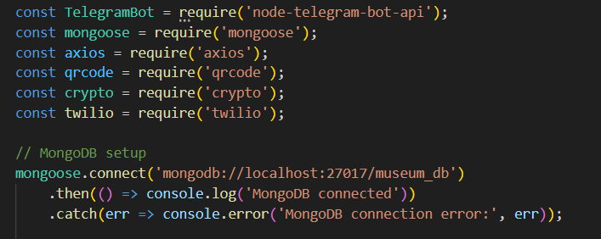
TECHNICAL APPROACH
Tech Innovators
IT
Ideathon
2k24
1.Chatbot Framework:
Telegram Bot Framework for developing the chatbot
2. Backend Development:
Node.js for server-side logic and API integration.
3. Database:
MongoDB for managing bookings and user data.
4. Payment Gateway Integration:
UPI for processing payments.
5. Front-end Development:
React.js for creating user interfaces.
7.Cloud Hosting:
Render for deploying and managing the application.
9. Multilingual Support:
Google Translate API for real-time language translation.

Slide 5
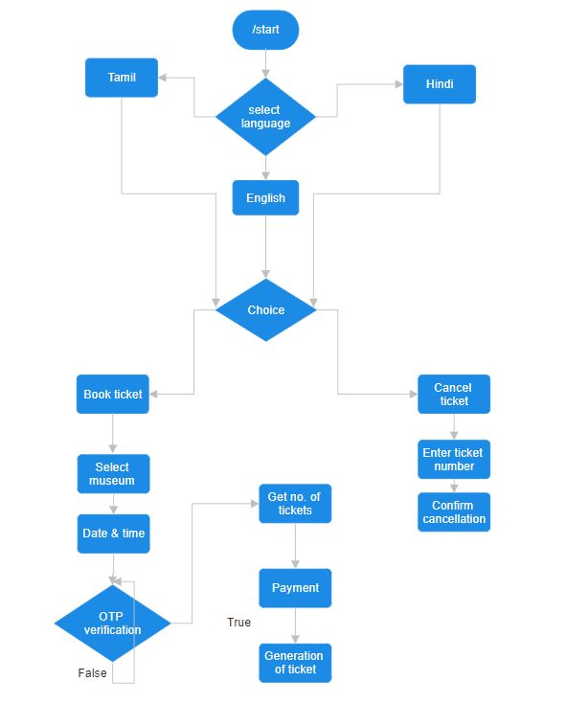
WORK FLOW
Tech Innovators
IT
Ideathon
2k24
Available

Slide 6
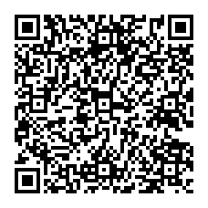
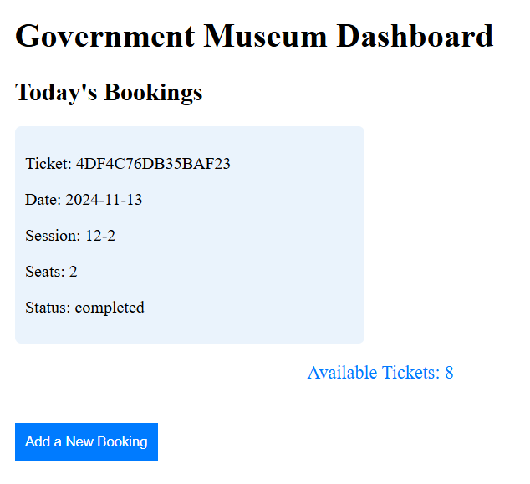
IMPACT AND BENEFITS
Tech Innovators
IT
Ideathon
2k24
The chatbot ticketing system will make it easier and faster for visitors to book tickets, leading to higher satisfaction and potentially increasing the number of visitors to the museum.
Cuts down on paper usage by eliminating physical tickets, helping the museum be more eco-friendly.
Makes the museum more accessible to everyone, including non-English speakers and people with disabilities.
17C354AC182F4107

Slide 7
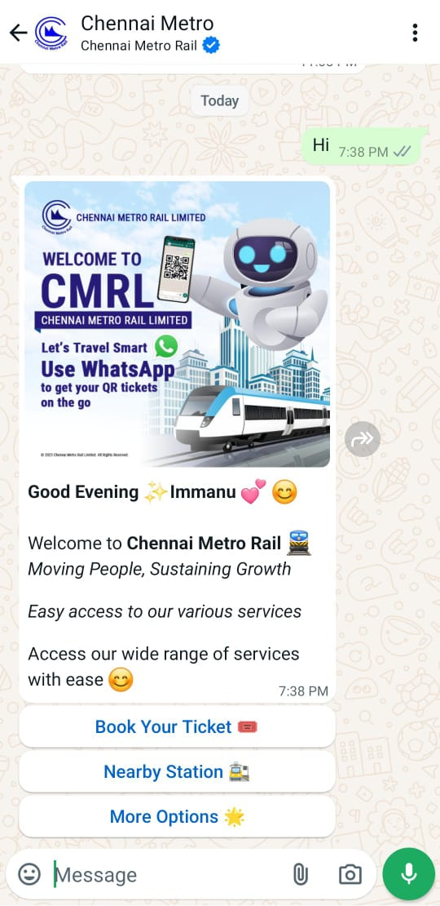
RESEARCH AND REFERENCES
Tech Innovators
IT
Ideathon
2k24
https://youtu.be/F2-RuyIroFw?feature=shared
https://core.telegram.org/bots/api
https://react.dev/
https://www.twilio.com/docs
https://nodejs.org/docs/latest/api/

