Slide 1
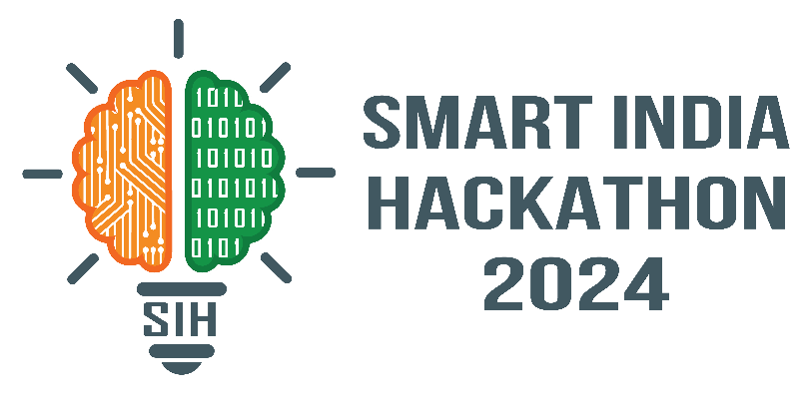
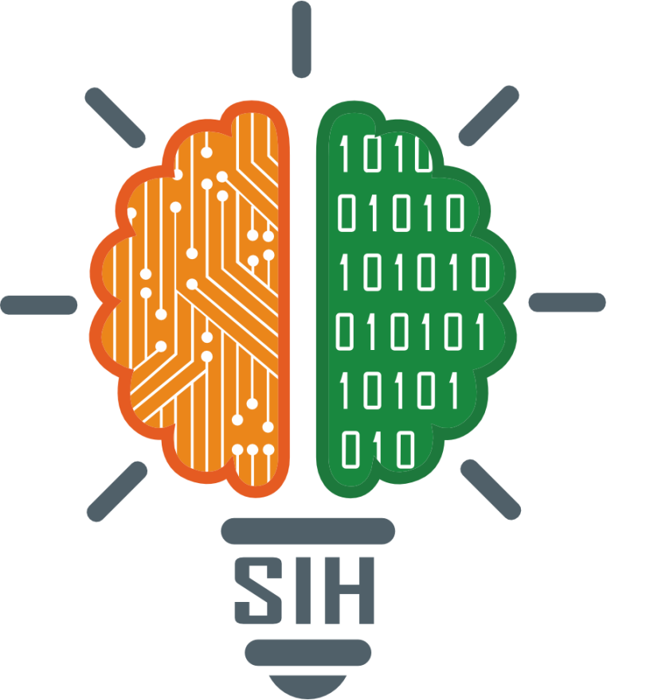
SMART INDIA HACKATHON 2024
Problem Statement ID –1648
Problem Statement Title-Online Chatbot Ticketing System
Theme-Travel & Tourism
PS Category- Software
Team ID- IT04
Team Name

Slide 2
PROBLEM DESCRIPTION
Background: Visitors to museums often face several significant challenges due to manual ticket booking systems. One prominent issue is the inefficiency and time consumption associated with the process. Long queues are common, especially during peak hours, weekends, or special exhibitions, leading to frustration and impatience among visitors. Besides the wait times, the manual system is prone to errors, such as incorrect ticket issuance, double bookings, or lost records, which can cause further delays and inconvenience. Overall, these challenges associated with manual ticket booking systems significantly detract from the visitor experience, reducing satisfaction and potentially impacting the museum's reputation and visitor numbers. Description: The implementation of a chatbot for ticket booking in a museum addresses several critical needs, enhancing the overall visitor experience and streamlining museum operations. Here are the key reasons for adopting a chatbot ticket booking system:
1.Improved Customer Service
2. Efficient Handling of High Volumes
3.Cost-Effective Solution
4. Data Collection and Analysis
5. Accessibility
6. Reduced Human Error
7. Multilingual Support
8. Enhanced Marketing and Promotion
Expected Solution: An efficient and responsive multilingual chatbot based ticketing system that can handle all kinds of bookings from gate entry to shows. Payment gateway should also be integrated to make it fully free from human intervention. It will also provide analytics to aid in more efficient decision making process.

Slide 3
SmartMuse: AI-Powered Multilingual Ticketing Chatbot for Museums
Hexalite
Proposed Solution (Prototype)
Develop a multilingual, chatbot-based ticketing system that automates the entire booking process, including payments and analytics.
Enhance visitor satisfaction by reducing wait times, minimizing errors, and providing 24/7 customer support in multiple languages.

Slide 4
TECHNICAL APPROACH
Hexalite
1.Chatbot Framework:
Telegram Bot or Azure bot framework for developing the chatbot.
2. Backend Development:
Node.js for server-side logic and API integration.
3. Database:
MongoDB for managing bookings and user data.
4. Payment Gateway Integration:
Razorpay/Paypal for processing payments.
5. Analytics:
Power BI for tracking user behavior and generating reports.
6.Cloud Hosting:
Azure for deploying and managing the application.
7. Natural Language Processing (NLP):
Google Cloud Natural Language API for enhancing chatbot's language understanding.
8. Multilingual Support:
Google Translate API for real-time language translation.

Slide 5
FEASIBILITY AND VIABILITY
Hexalite
Feasibility Analysis:
feasible due to the availability of mature AI technology, ease of integration with existing systems, and its scalability. The system can enhance visitor experience, reduce operational costs, and provide valuable data insights for the museum.
Potential Challenges and Risks:
Technical Issues: Integration difficulties with existing museum systems and potential bugs in the chatbot could disrupt operations.
User Resistance: Visitors, especially those less tech-savvy
Cybersecurity Risks: The system could be vulnerable to data and cyber-attacks.
Initial Costs: High upfront investment for implementation might strain the budget.
Strategies for Overcoming Challenges:
Thorough Testing and Iteration
User Training and Support
Robust Security Measures
Phased Implementation

Slide 6
IMPACT AND BENEFITS
Hexalite
Potential Impact on the Target Audience:
The chatbot ticketing system will make it easier and faster for visitors to book tickets, leading to higher satisfaction and potentially increasing the number of visitors to the museum.
Benefits of the Solution:
Social: Makes the museum more accessible to everyone, including non-English speakers and people with disabilities.
Economic: Saves money by reducing the need for manual ticketing staff and minimizing errors.
Environmental: Cuts down on paper usage by eliminating physical tickets, helping the museum be more eco-friendly.

Slide 7
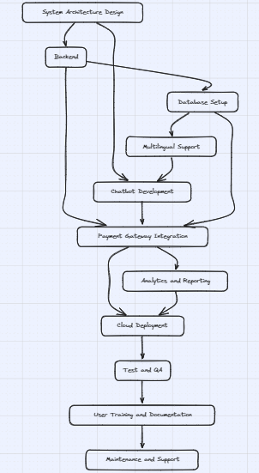
Hexalite

Slide 8
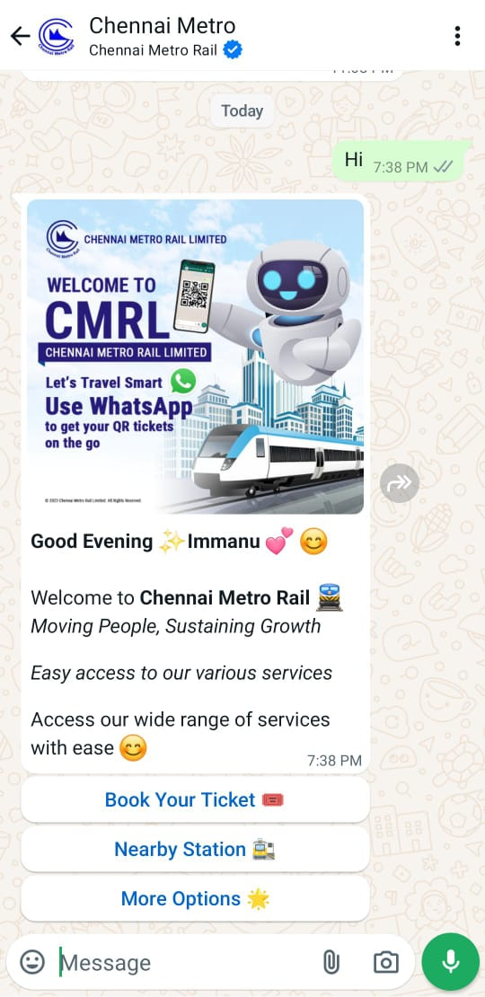
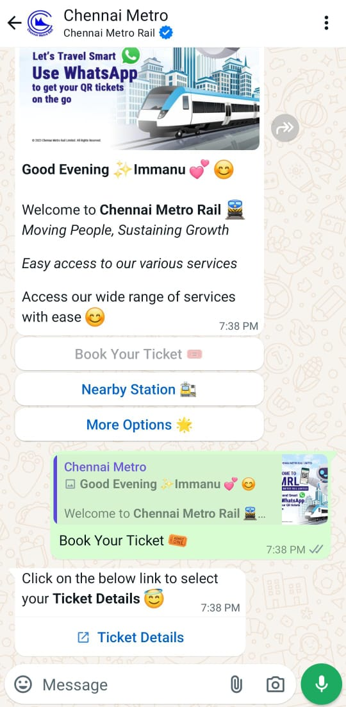
RESEARCH AND REFERENCES
Hexalite
https://youtu.be/Ytb91sx7TmM?si=nhPFQ4Xg9uHM6VW5
https://youtu.be/gHofNP2zefk?si=zrZJRpx6CrE2hYUM
"Tromsø"

Slide 9
Thank You!!
Hexalite

