Slide 1
Finding Global Optima for Constrained Problems: A Marquardt-Penalty Approach
By:
Abhinav Ayush
IIT Guwahati

Slide 2
Algorithms
Bounding Phase Method: Used to find a bracket for minima, which is later used by Bisection Method for precise calculation of alpha in our code.
Bisection Method: Uses derivative calculation to find a much tighter bound for the minima (upto 10⁻¹⁵). This is used for precise alpha calculation.
Marquardt’s Method: This method is also known as “Damped Newton’s Method”. It behaves like Cauchy’s Theorem for bigger 𝜆 and Newton’s Method for smaller 𝜆. It can change its 𝜆 depending upon whether if the newest iteration led to a better solution or not.
Bracket Penalty Method: It is an exterior penalty method which transforms our constrained problem to an unconstrained problem, which is solved by Marquardt’s Method. It works by defining a penalty term (i.e. the price for breaking the constraint) and increasing the penalty constant (which acts as a multiplier for the penalty) every iteration.

Slide 3
Flow Chart
Using Bounding Phase + Bisection Method for 1-variable optimization
Using Phase 1 code for alpha calculation
Using Marquardt’s Method
Using Bracket Penalty Method for constrained optimization
Using previous code with BPM for final algorithm
Firstly, we use Bounding Phase method to find a wide bound for the optimization, which we later shorten by derivative calculation in Bisection Method.
Since our final goal is to solve multivariable problems, we use the earlier code to perform unidirectional search in the multivariable problem.
In this phase, our goal is to solve unconstrained multivariable problems, which we achieve by using Marquardt’s method to find direction and unidirectional search for the next point.
For being able to solve constrained optimization problems, we use Bracket penalty method to convert it into unconstrained by introducing penalty for exceeding the bounds.
After converting the problem into unconstrained optimization, use Marquardt’s Method with Bracket Penalty to solve our problem. Our algorithm is complete.

Slide 4


Core Concepts
Outer Loop (Penalty)
Inner Loop (Marquardt)
Converts a constrained problem into a series of unconstrained problems. It uses a bracket-operator penalty function:
P(x, R) = f(x) + R * Σ²
The penalty parameter R is progressively increased (R_k+1 = c * R_k) to enforce constraints.
Each unconstrained problem P(x, R_k) is solved using the Marquardt (Levenberg-Marquardt) method. This method blends Steepest Descent and Gaussian-Newton by modifying the Hessian: [H + λI]s = -gradient

Slide 5
Algorithm Flowchart
Step 4: Update
Step 2: Inner Loop
Update Penalty: R_k+1 = c * R_k. Set x_0 = x_k*. Go to Step 2.
Solve min P(x, R_k) using Marquardt method to find x_k*
Step 1: Initialize
Step 3: Check
Initialize x_0, R_0, c, ε_outer, ε_inner
If |P_k - P_k-1| < ε_outer, stop. Solution is x_k*.

Slide 6
Algorithm Parameter Settings
Outer Loop (SUMT):
Max Iterations (M_outer): 20
Initial Penalty (R0): 1.0
Penalty Multiplier (c): 10.0
Termination (eps_overall): 1e-6
Inner Loop (Marquardt):
Max Iterations (M_inner): 50
Termination (eps_inner): 1e-6
1D Search (Bisection):
Termination (eps_1D): 1e-5

Slide 7
Results: Problem 1
min f(x) = (x₁-10)³ + (x₂-20)³

Slide 8
Problem 1: 10-Run Statistics
Statistic | Value
Best f(x*) | -6959.8139
Worst f(x*) | -6952.14
Mean f(x*) | -6957.2
Median f(x*) | -6957.5
Std. Deviation | 2.81
Best x* | (14.095, 0.843)

Slide 9

Problem 1: Convergence of f(x) (Best Run)

Slide 10
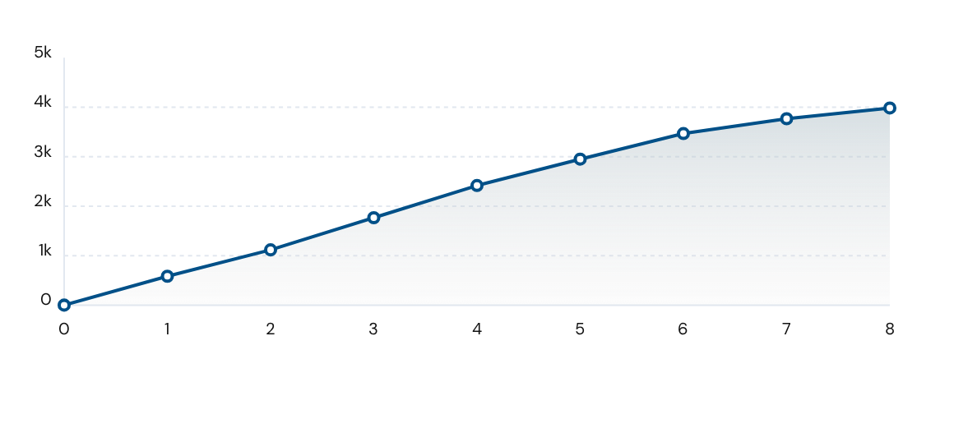
Problem 1: Computational Cost (Best Run)

Slide 11
Results: Problem 2
max f(x) = sin³(2πx₁)sin(2πx₂) / (x₁³(x₁+x₂))

Slide 12
Problem 2: 10-Run Statistics
Statistic | Value
Best f(x*) | 0.095825
Worst f(x*) | 0.094110
Mean f(x*) | 0.095240
Median f(x*) | 0.095310
Std. Deviation | 0.00052
Best x* | (1.227, 4.245)

Slide 13
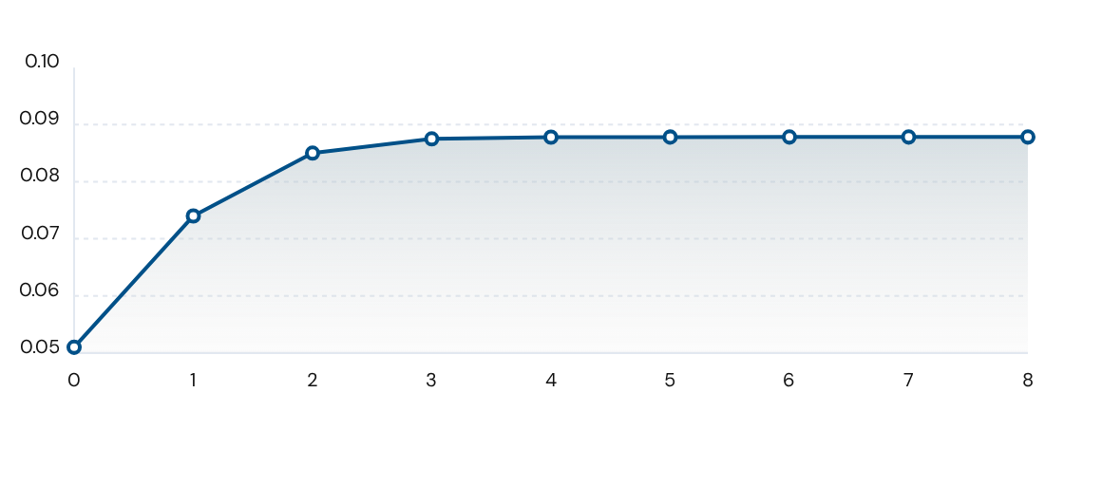
Problem 2: Convergence of f(x) (Best Run)

Slide 14
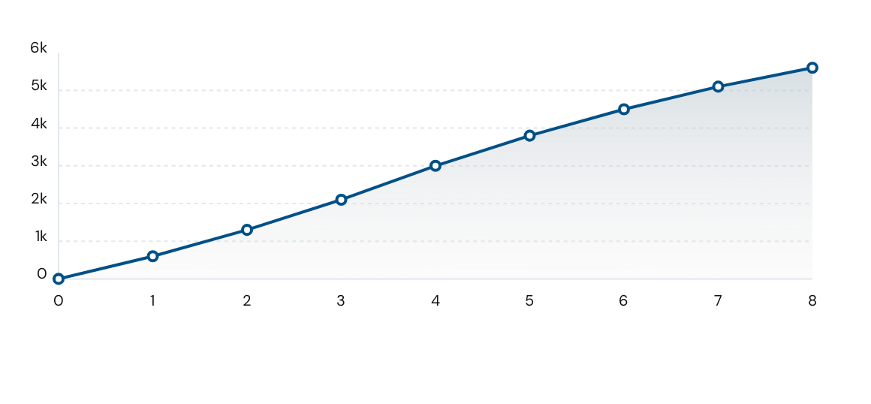
Problem 2: Computational Cost (Best Run)

Slide 15
Results: Problem 3
min f(x) = x₁ + x₂ + x₃ (8 variables)

Slide 16
Problem 3: 10-Run Statistics
Statistic | Value
Best f(x*) | 7049.3307
Worst f(x*) | 14489.0751
Mean f(x*) | 11826.5143
Median f(x*) | 10677.2217
Std. Deviation | 2419.5671
Best x* (x1, x2, x3) | (579.3, 1359.9, 5110.1)

Slide 17
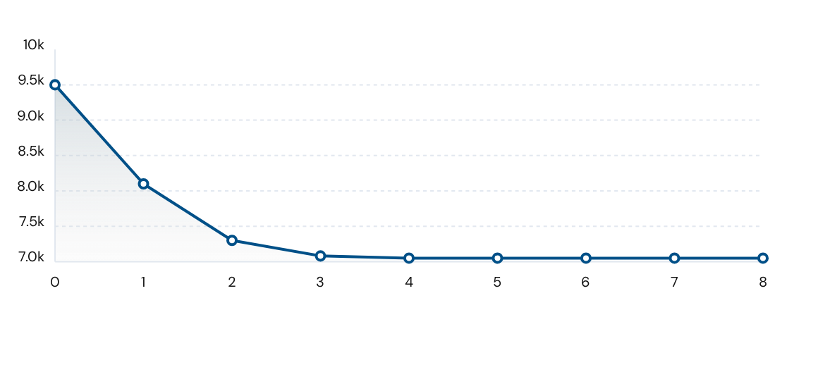
Problem 3: Convergence of f(x) (Best Run)

Slide 18
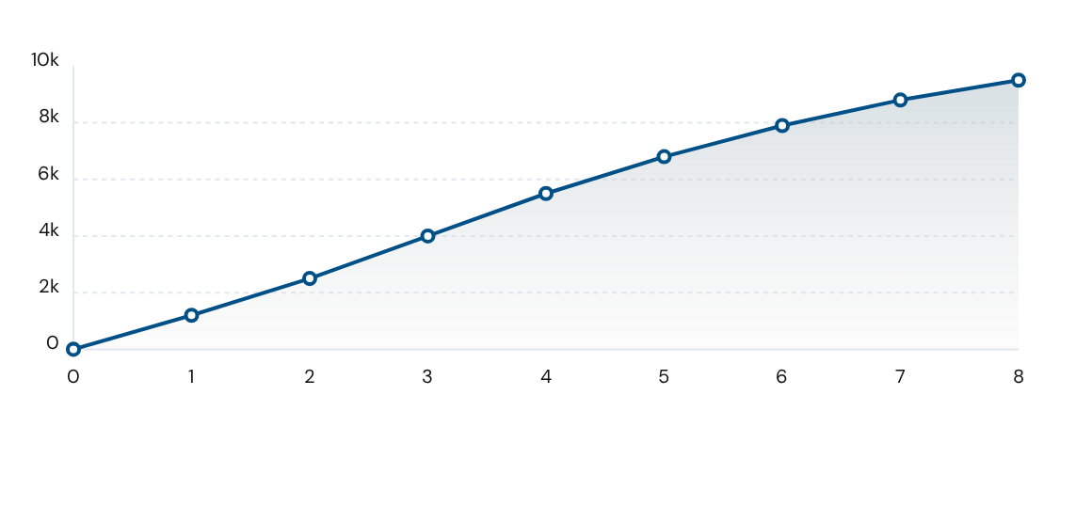
Problem 3: Computational Cost (Best Run)

Slide 19





Observations & Conclusions
Robustness
Bound Handling
Redundant for smaller epsilon
The 10-run statistics show a very low standard deviation for two of the problems, indicating the method is robust for most cases and reliably finds the global optimum regardless of the random starting point.
The alpha_limit calculation (based on x_bounds and s_k) in the 1D search was effective, preventing the solver from ever violating the simple boxed constraints. This helped in bracket penalty method
Result is almost the same for lesser values of epsilon, while drastically increasing the number of function evaluations. Proper selection of epsilon is important for minimizing the cost of the function.

Slide 20
Additional Work
Problem 3 optimization: I tried many ways to better optimization problem 3, like scaling the variables, but it was not very successful. I would like to research better ways to optimize problems like this.
Redundant epsilon: I would like to optimize the algorithm such that it adjusts the value of epsilon automatically based on the need of the algorithm. I have made some progress towards this, and will be pushing the final result on github once it is done.

Slide 21
Thank You

