Slide 1
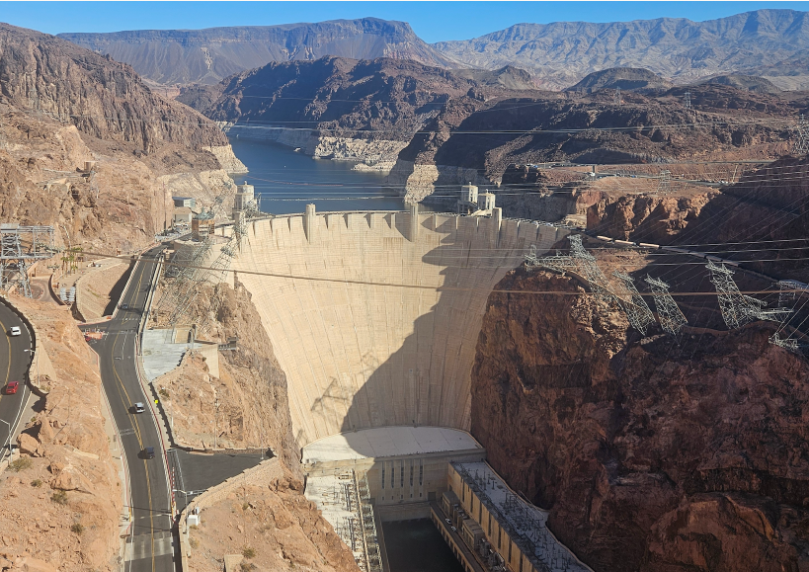
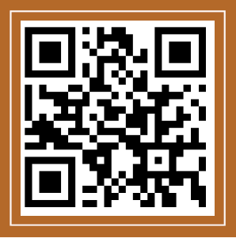

Help Improve NOAA Tools to Manage Risks of Water Shortages?
Join an immersive online model session.
Adapt strategies with extreme low inflow and storage.
Give users more autonomy and flexibility to manage their differing interests.
Fun
Friendly
2-hour time commitment
No prior modeling experience needed.
CONTACT
Anabelle Myers: a02369941@usu.edu, 385-208-8248.
David Rosenberg: david.rosenberg@usu.edu, 435-797-8689
Project #IRB-14808
OUR RECENT WORK
rosenberg.usu.edu

