Slide 1
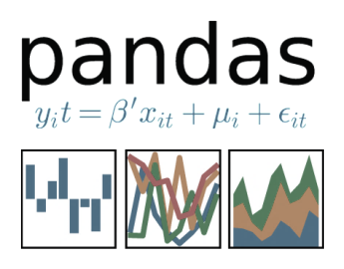








Tutorial by
Julia Berezutskaya
Language in Interaction

Slide 2
Python intro
Python versions: 2. vs 3. python, current: 3.7.2

Slide 3
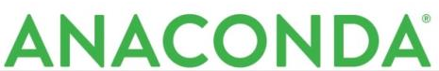
Python intro
Python versions: 2. vs 3. python, current: 3.7.2
Anaconda/conda: working Python with all dependencies and basic packages

Slide 4
Python intro
Python versions: 2. vs 3. python, current: 3.7.2
Anaconda/conda: working Python with all dependencies and basic packages
Conda virtual environment
> conda create –n myenv anaconda

Slide 5
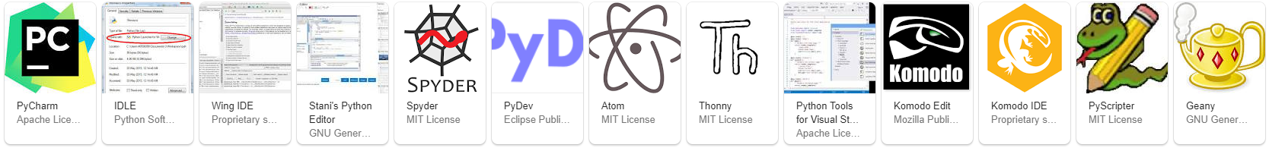
Python intro
Python versions: 2. vs 3. python, current: 3.7.2
Anaconda/conda: working Python with all dependencies and basic packages
Conda virtual environment
Multiple IDEs
> conda create –n myenv anaconda

Slide 6
Python intro
Python versions: 2. vs 3. python, current: 3.7.2
Anaconda/conda: working Python with all dependencies and basic packages
Conda virtual environment
Multiple IDEs
Interactive console vs running scripts
> conda create –n myenv anaconda

Slide 7

Python intro
Python versions: 2. vs 3. python, current: 3.7.2
Anaconda/conda: working Python with all dependencies and basic packages
Conda virtual environment
Multiple IDEs
Interactive console vs running scripts
Jupyter notebook: web-application. Can add code, text, figures. Great for demos and tutorials
> conda create –n myenv anaconda

Slide 8
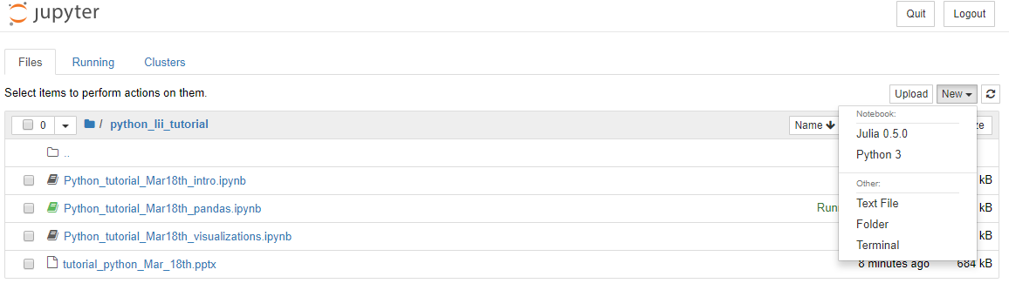

Jupyter notebook
> jupyter notebook

Slide 9
Jupyter notebook
> jupyter notebook
Kernels: language-specific engines to execute code
Running processes

Slide 10
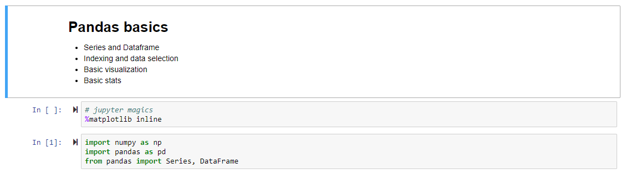
Jupyter notebook
Cells

Slide 11
Jupyter notebook
Cells
Jupyter key shortcuts Cmd + Shift + P
Command mode (Esc) vs edit mode (Enter)
Markdown (M) vs code (Y)
markdown
code

Slide 12
Jupyter notebook
Cells
Jupyter key shortcuts Cmd + Shift + P
Command mode (Esc) vs edit mode (Enter)
Markdown (M) vs code (Y)
IPython Magics (%): shortcut enhancements
markdown
code
all magics
%run %timeit %matplotlib inline %conda %cd %history

Slide 13
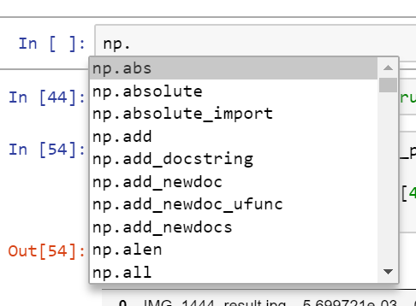
Jupyter notebook
Cells
Jupyter key shortcuts Cmd + Shift + P
Command mode (Esc) vs edit mode (Enter)
Markdown (M) vs code (Y)
IPython Magics (%): shortcut enhancements
markdown
code
%config IPCompleter.greedy=True
to enable intellisense
all magics
%run %timeit %matplotlib inline %conda %cd %history
Shift + Tab
for function arguments

Slide 14
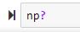
Jupyter notebook
Cells
Jupyter key shortcuts Cmd + Shift + P
Command mode (Esc) vs edit mode (Enter)
Markdown (M) vs code (Y)
IPython Magics (%): shortcut enhancements
Doc on code: ?
markdown
code
%config IPCompleter.greedy=True
to enable intellisense
all magics
%run %timeit %matplotlib inline %conda %cd %history
Shift + Tab
for function arguments

Slide 15
Python basics
Object-oriented programming
Limited set of built-ins, most functionality through imported modules

Slide 16
Python basics
Object-oriented programming
Limited set of built-ins, most functionality through imported modules
Built-in data types: list, tuple, set, dictionary, string, function, object

Slide 17


Python basics
Object-oriented programming
Limited set of built-ins, most functionality through imported modules
Built-in data types: list, tuple, set, dictionary, string, function, object
Numpy to work with arrays and matrices
Scipy for stats, linear algebra, signal processing and more

Slide 18
Data handling
lists, numpy arrays, dictionaries, objects

Slide 19
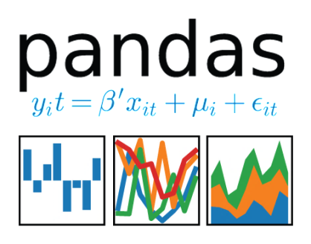
Data handling
lists, numpy arrays, dictionaries, objects
pandas for convenient data storage, access and visualization

Slide 20

Data handling
lists, numpy arrays, dictionaries, objects
pandas for convenient data storage, access and visualization
Covered in tutorial:
pandas.Series and pandas.Dataframe
data indexing filtering
loading & writing data
data visualization
data processing

Slide 21
Data visualization
matplotlib
pandas + seaborn
pandas + ggplot
bokeh
mayavi

Slide 22

Data visualization
matplotlib
pandas + seaborn
pandas + ggplot
bokeh
mayavi
Covered in tutorial:
seaborn styles and context
distribution plots
density estimation plots
joint plots

Slide 23

Machine learning tools
Sklearn
NLTK
Gensim
Deep learning: tensorflow, pytorch, chainer

Slide 24
Neuroscience tools
pyMVPA
nipype
nilearn
pyCortex
nipy

Slide 25
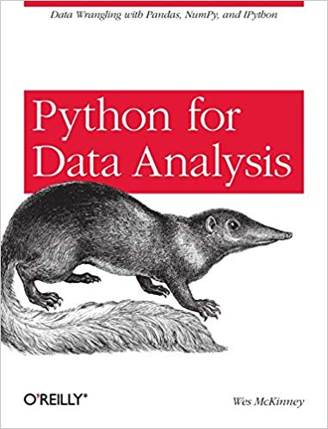
Sources
Jupyter cheat sheet
Jupyter cheat sheet II
Jupyter tips & tricks
Pandas cheat sheet
Pandas tutorials
KDnuggets intro to Pandas
Seaborn cheat sheet
Visualization with seaborn
Seaborn docs

