Slide 1
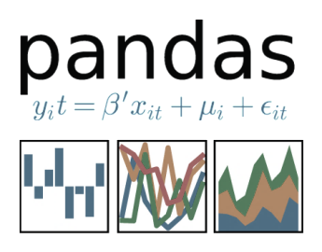





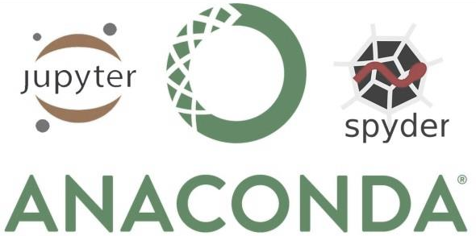


Julia Berezutskaya
Dirk Keller
AI for Cognitive Neuroscience 2024

Slide 2
Session 2. Python practical
Overview
Jupyter notebooks & Pycharm
Python basics
Python datatypes
Python programming
Numpy

Slide 3
Learning goals
Get familiar with basics of Python programming
Get hands-on experience with Python code

Slide 4
Python intro
Python versions: 2. vs 3. python, current: 3.12.2

Slide 5
Python intro
Python versions: 2. vs 3. python, current: 3.12.2
Anaconda/conda: working Python with all dependencies and basic packages
MINICONDA

Slide 6
Python intro
Python versions: 2. vs 3. python, current: 3.12.2
Anaconda/conda: working Python with all dependencies and basic packages
Conda virtual environment
MINICONDA
> conda create –n myenv python

Slide 7
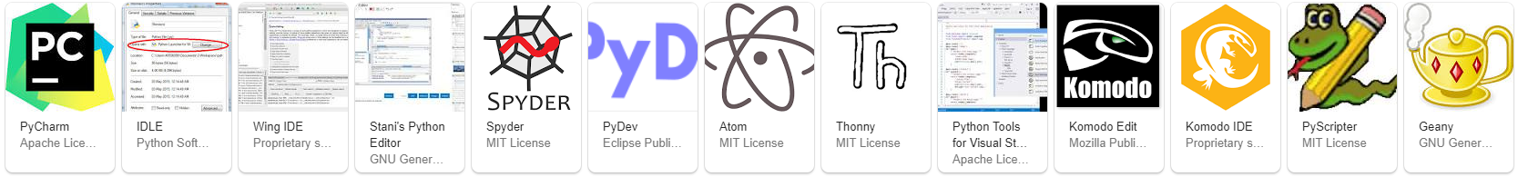
Python intro
Python versions: 2. vs 3. python, current: 3.12.2
Anaconda/conda: working Python with all dependencies and basic packages
Conda virtual environment
Multiple IDEs
MINICONDA
> conda create –n myenv python

Slide 8
Python intro
Python versions: 2. vs 3. python, current: 3.12.2
Anaconda/conda: working Python with all dependencies and basic packages
Conda virtual environment
Multiple IDEs
Interactive console vs running scripts
MINICONDA
> conda create –n myenv python

Slide 9
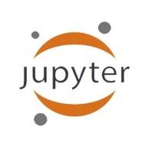
Python intro
Python versions: 2. vs 3. python, current: 3.12.2
Anaconda/conda: working Python with all dependencies and basic packages
Conda virtual environment
Multiple IDEs
Interactive console vs running scripts
Jupyter notebook: web-application. Can add code, text, figures. Great for demos and tutorials
MINICONDA
> conda create –n myenv python

Slide 10
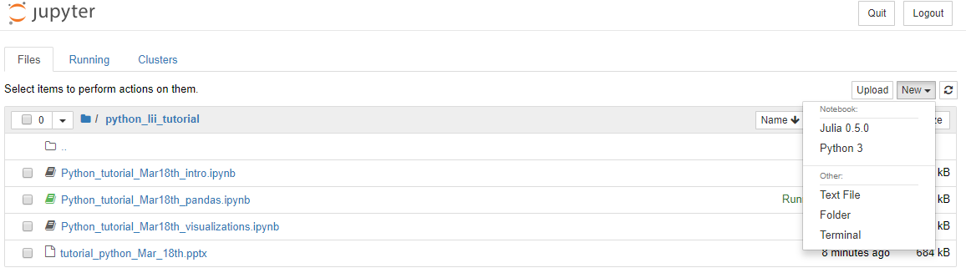
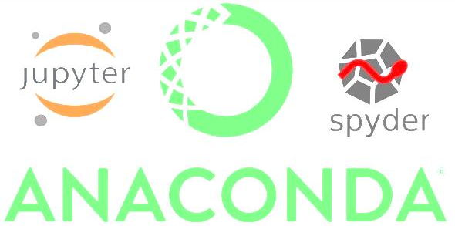
Jupyter notebook
> jupyter lab

Slide 11
Jupyter notebook
> jupyter lab
Kernels: language-specific engines to execute code
Running processes

Slide 12
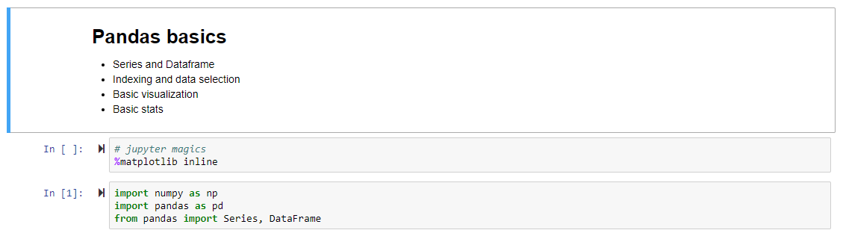
Jupyter notebook
Cells

Slide 13
Jupyter notebook
Cells
Jupyter key shortcuts Cmd + Shift + P
Command mode (Esc) vs edit mode (Enter)
Markdown (M) vs code (Y)
markdown
code

Slide 14
Jupyter notebook
Cells
Jupyter key shortcuts Cmd + Shift + P
Command mode (Esc) vs edit mode (Enter)
Markdown (M) vs code (Y)
IPython Magics (%): shortcut enhancements
markdown
code
all magics
%run %timeit %matplotlib inline %conda %cd %history

Slide 15
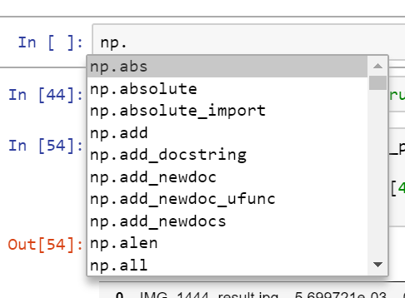
Jupyter notebook
Cells
Jupyter key shortcuts Cmd + Shift + P
Command mode (Esc) vs edit mode (Enter)
Markdown (M) vs code (Y)
IPython Magics (%): shortcut enhancements
markdown
code
%config IPCompleter.greedy=True
to enable intellisense
all magics
%run %timeit %matplotlib inline %conda %cd %history
Shift + Tab
for function arguments

Slide 16
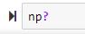
Jupyter notebook
Cells
Jupyter key shortcuts Cmd + Shift + P
Command mode (Esc) vs edit mode (Enter)
Markdown (M) vs code (Y)
IPython Magics (%): shortcut enhancements
Doc on code: ?
markdown
code
%config IPCompleter.greedy=True
to enable intellisense
all magics
%run %timeit %matplotlib inline %conda %cd %history
Shift + Tab
for function arguments

Slide 17
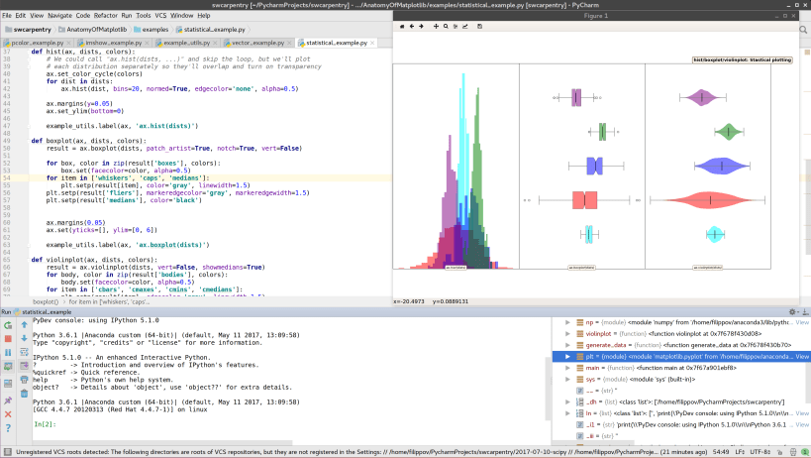
Pycharm

Slide 18
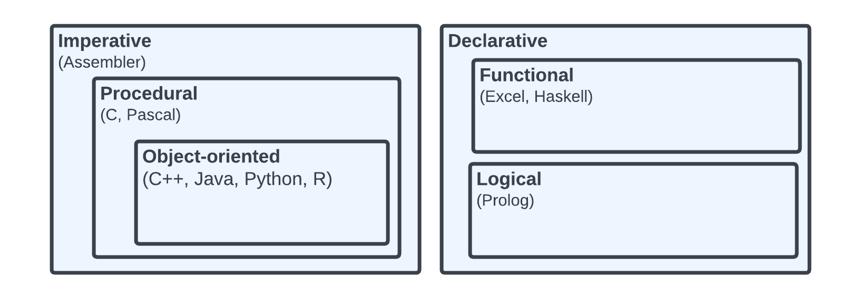
Programming Paradigms
Python is Object-oriented
Command driven, sequential (from top to bottom)
Structured in encapsulated procedures (e.g. functions) with local computation (e.g.local variables)
Data and procedures are stored in objects
Objects are encapsulated (own attributes and procedures) and can inherit others from other objects
Notes:
Imperative. Command-driven: Commands for the computer to perform that change a program's state through statements that explicitly modify mutable data.
Sequential execution: Steps are executed in sequence, and the state or the outcome of one step can affect the execution of following steps. Code runs from top to bottom
Procedural
Structured approach: Programs are structured into procedures or subroutines that can be called from other parts of the program, leading to more organized and modular code.
Local and global data: While global variables can be accessed by any part of the program, local variables within functions to limit side effects.
Object Oriented
Based on objects: OOP programs are designed around objects, which are instances of classes. These objects contain both data, in the form of fields (often known as attributes or properties), and procedures, known as methods.
Encapsulation: Objects hide their internal state and require that all interaction be done through their own methods, protecting them from unexpected external changes and making the code easier to maintain.
Inheritance: Classes can inherit characteristics (data and methods) from other classes, making it easy to create and maintain related classes without redundant code.

Slide 19
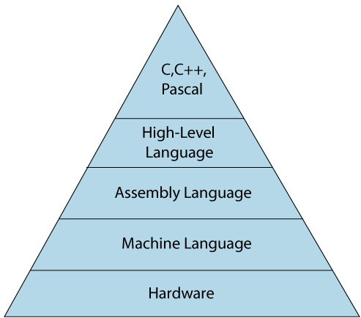
Programming Paradigms
Python is Object-oriented
Command driven, sequential (from top to bottom)
Structured in encapsulated procedures (e.g. functions) with local computation (e.g. local variables)
Data and procedures are stored in objects
Objects are encapsulated (own attributes and procedures) and can inherit others from other objects
Python is an interpreter language
Notes:
Interpreter
Compiler -> translate to assembly language which steers machine language commands (machine instructions specific to the target machine's CPU architecture)
Hardware -> switches transistors on and off (write and read data in memory)

Slide 20
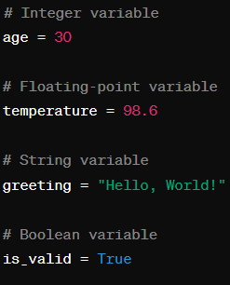
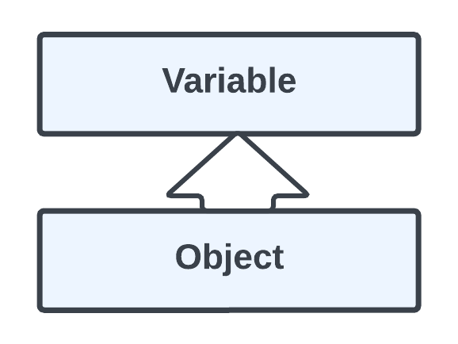
Variables
Variable: location in memory
Object: Group of variables
Notes:
We see later that an object is an instance of a class

Slide 21

Variables
Variable: location in memory
Object: Group of variables
Limited set of built-ins, most functionality through imported modules
Built-in data types: list, tuple, set, dictionary, string, function, object
Numpy (external) to work with arrays and matrices
Scipy (external) for stats, linear algebra, signal processing and more
Information and Operations in those Modules and code in general is structured (mainly classes, functions)

Slide 22

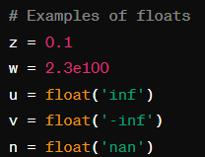
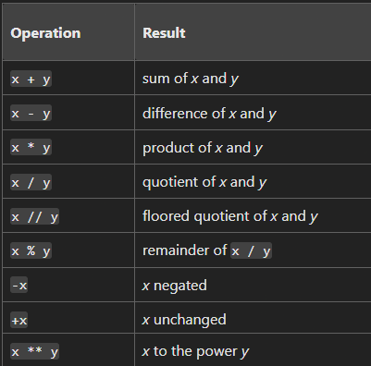
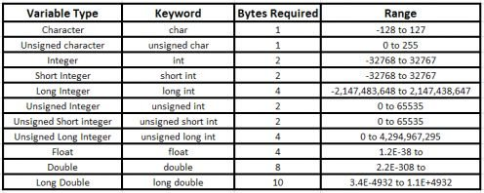
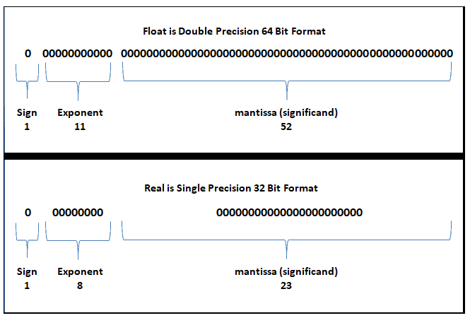
Primitive Data Types: Numerical
Numeric Types
Integer (int): Whole numbers, positive or negative, without decimals.
Float (float): Floating-point numbers, which include decimal points.
Complex (complex): Complex numbers which have a real part and an imaginary part, denoted as 3x + y.
Arithmetic Operations
Mathematical calculations on numerical data

Slide 23


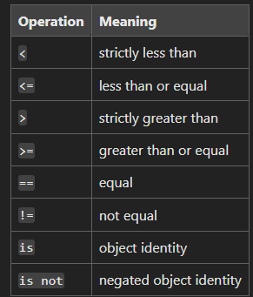
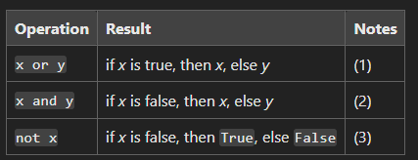
Primitive Data Types: Strings, Booleans, None
Strings, Booleans, None
Boolean (bool): Represents truth values: True and False. A subdefinition of int, where True and False correspond to 1 and 0, respectively.
String (str): A sequence of Unicode characters.
None (None): Represents the absence of a value: 'empty', or 'no value here'.
Numeric Types
Comparison and Logical Operations
Compare two values or combine conditional statements (returns a Boolean)

Slide 24

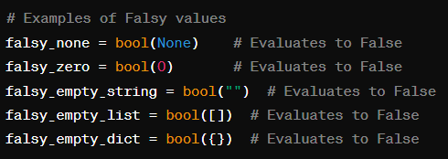

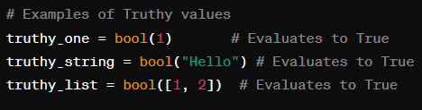


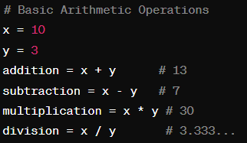
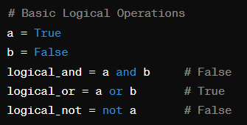
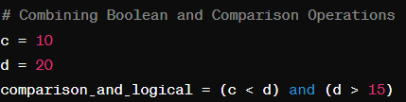


Convert between data types
Strings, Booleans, None
Numeric Types
Examples: Numerical and Bool.
Comparison and Logical Operations

Slide 25
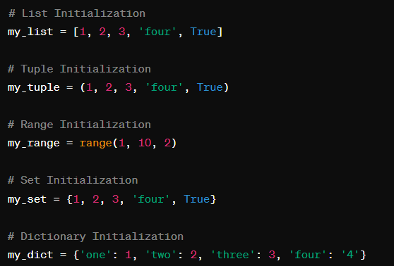
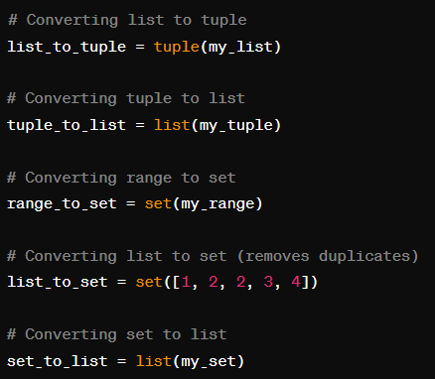
(Build-in) Data Structures
Strings, Booleans, None
Numeric Types
Sequence Types
List (list): An ordered and mutable sequence of items.
[ x, y ]
2. Tuple (tuple): An ordered and immutable sequence of items.
= ( x , y )
Comparison and Logical Operations
Sets and Mapping Structures
1. Set (set): An unordered and mutable collection of unique elements.
{ x , y }
2. Dictionary (dict): A collection of key-value pairs.
{ “x” : x , “y” : y }

Slide 26
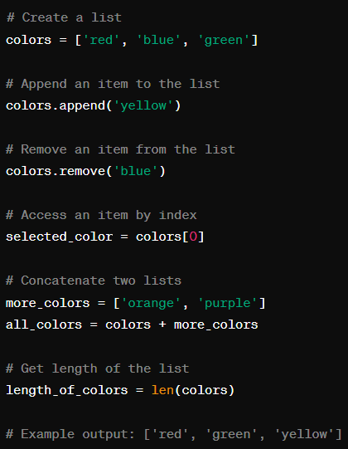
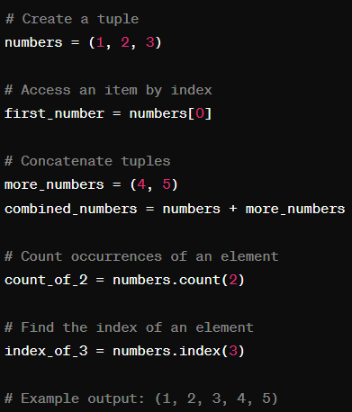
Examples: Lists, Tuples, Sets, Dict
Strings, Booleans, None
Numeric Types
Comparison and Logical Operations

Slide 27
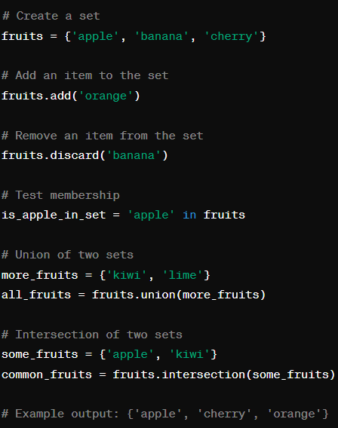
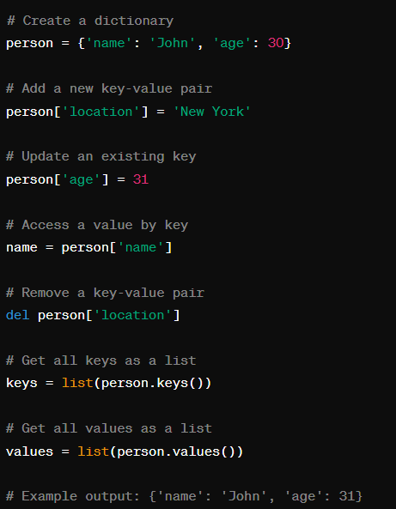
Examples: Lists, Tuples, Sets, Dict
Strings, Booleans, None
Numeric Types
Comparison and Logical Operations

Slide 28
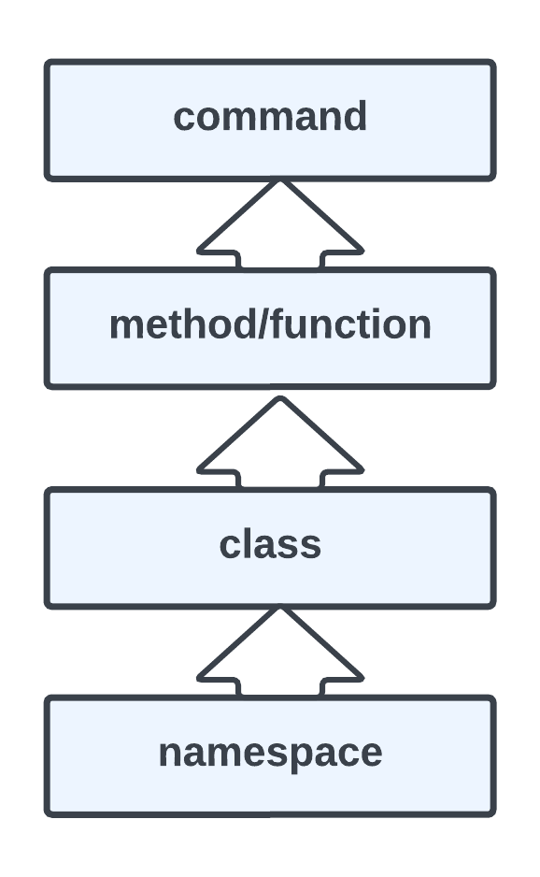
Structure, Structure, Structure!
Command: change something in memory
Method/Function: Group of commands that belong together
Class: Group of method/functions that belong together
Namespace: Group of classes that belong together

Slide 29
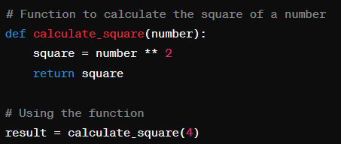

Methods/Functions
A group of commands that belong together (common goal or task)
Typically manipulating the state of an object

Slide 30
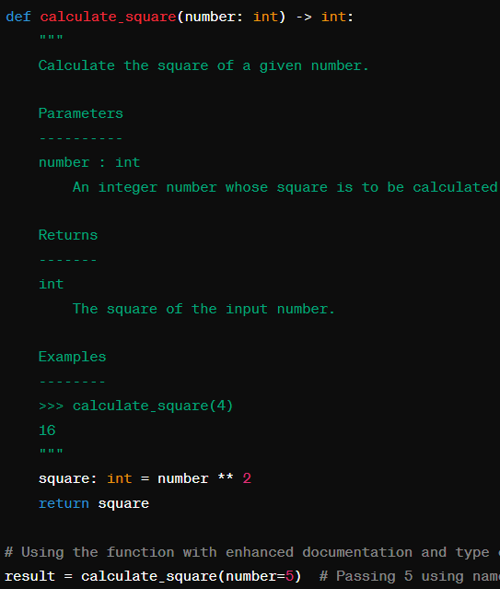
Methods/Functions
A group of commands that belong together (common goal or task)
Typically manipulating the state of an object

Slide 31
Methods/Functions
Functions header:
def + name, arguments, typing, ‘:’ etc.
Function body
Commands or other function calls (mind the indentation)
Function call
Function name ( calculate_square( ) ), arguments (number) (optional), parameter (an integer)
Why?
Modularity: Break down complex problems into smaller, manageable parts. Code Reuse: Can be used repeatedly. No need to write the same code multiple times.
Encapsulation: Introduces local variables, that cannot be accesses outside of the function for memory efficiency and errors.
Parameterization: Execute the same code with different inputs, leading to more flexible and dynamic programs.
Maintainability: Easier to maintain: Changes made in a single function are propagated wherever the function is used.
Build-in and external modules manipulate variables and objects with functions!
Notes:
Why?
Modularity: Break down complex problems into smaller, manageable parts. Divide and conquer: Break down a problem into subproblerms and address those, solving the problem. Complex code easier to understand and manage: focus on high level aspects or low level aspects of a problem.
Code Reuse: Can be used repeatedly. No need to write the same code multiple times,
This does not only save time but also reduces errors and redundancies in your codebase
3.Parameterization: Execute the same code with different inputs, leading to more flexible and dynamic programs.
4.Maintainability: Easier to maintain: Changes made in a single function are propagated wherever the function is used.
This localized updating reduces the chances of introducing bugs when modifications are made.

Slide 32
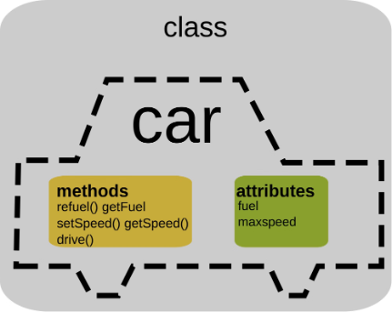
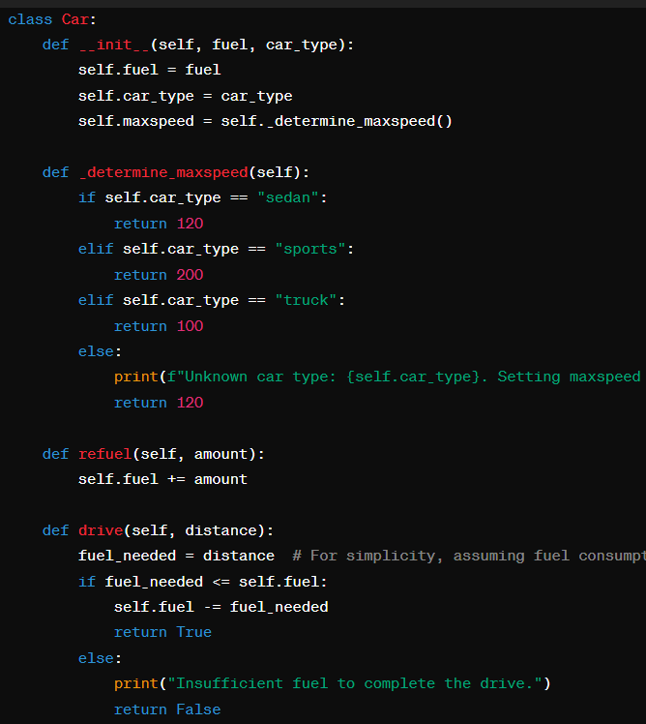
Classes
A group of methods that belong together (common goal or task)
Typically create an abstract description of a concept (e.g. cars)
Initializing a class with parameters creates an instance of the class ( = object)
Notes:
Why?
Modularity: Break down complex problems into smaller, manageable parts. Divide and conquer: Break down a problem into subproblerms and address those, solving the problem. Complex code easier to understand and manage: focus on high level aspects or low level aspects of a problem.
Code Reuse: Can be used repeatedly. No need to write the same code multiple times,
This does not only save time but also reduces errors and redundancies in your codebase.
Maintainability: Functions make programs easier to maintain. Changes made in a single function are propagated wherever the function is used. This localized updating reduces the chances of introducing bugs when modifications are made.
Testing and Debugging: Functions can be isolated and tested independently from the rest of the program. This makes it easier to pinpoint bugs and verify the functionality of specific parts of the code.
Parameterization: Functions enable parameterized programming, meaning you can execute the same code with different inputs, leading to more flexible and dynamic programs.

Slide 33
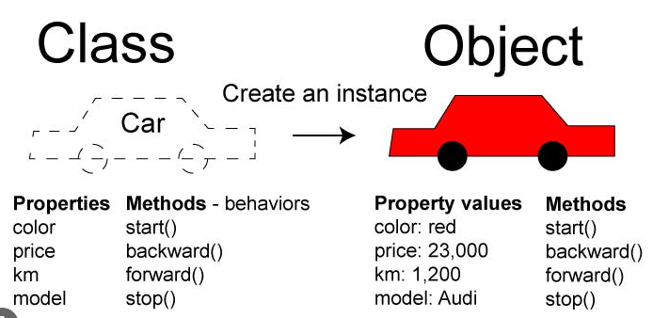
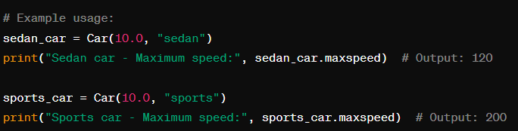

Classes
A group of methods that belong together (common goal or task)
Typically create an abstract description of a concept (e.g. cars)
Initializing a class with parameters creates an instance of the class ( = object)
Notes:
Why?
Modularity: Break down complex problems into smaller, manageable parts. Divide and conquer: Break down a problem into subproblerms and address those, solving the problem. Complex code easier to understand and manage: focus on high level aspects or low level aspects of a problem.
Code Reuse: Can be used repeatedly. No need to write the same code multiple times,
This does not only save time but also reduces errors and redundancies in your codebase.
Maintainability: Functions make programs easier to maintain. Changes made in a single function are propagated wherever the function is used. This localized updating reduces the chances of introducing bugs when modifications are made.
Testing and Debugging: Functions can be isolated and tested independently from the rest of the program. This makes it easier to pinpoint bugs and verify the functionality of specific parts of the code.
Parameterization: Functions enable parameterized programming, meaning you can execute the same code with different inputs, leading to more flexible and dynamic programs.

Slide 34
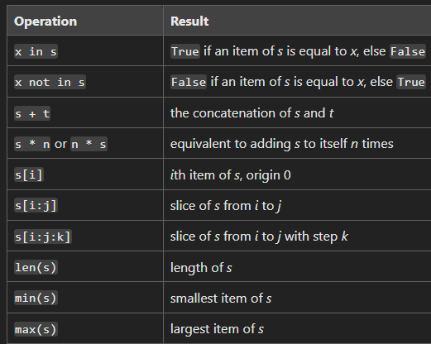
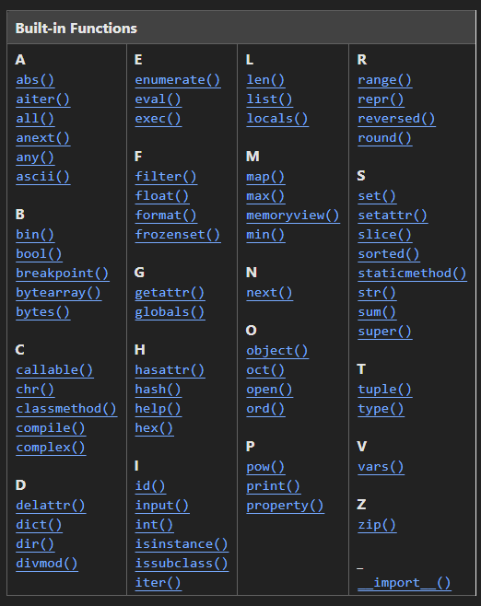
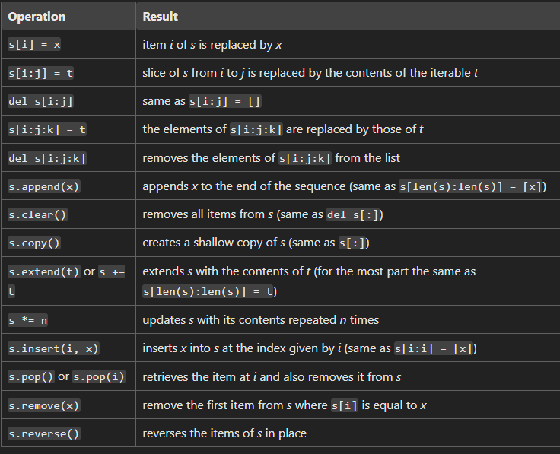
(Build-in) Modules contain Sets of Classes/Functions
Operations on sequencing objects

Slide 35

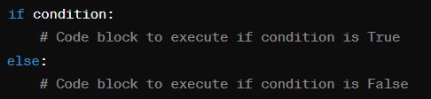
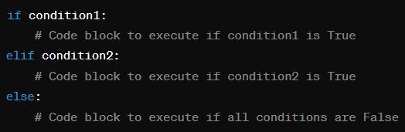
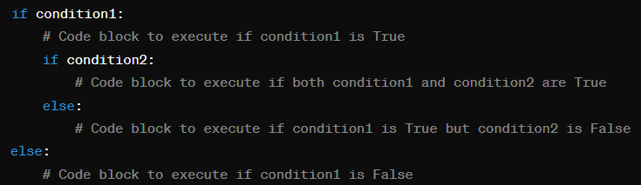


Control Flow: If Statements, While and For Loops
1
If Statements
Conditional. Evaluates Truth statement (logical). Enters the code block only if True.
if [condition]: [do something]
if [condition]: [do something], else: [do something else].
if [condition]: [do something], elif: [next condition], else: [do something else].
Var = if [condition]: [do something] else: [do something else].
Ternary operation
Complex statements
Notes:
If statement: They allow you to execute different blocks of code based on whether a particular condition is true or false.

Slide 36


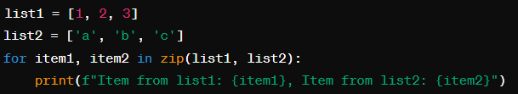
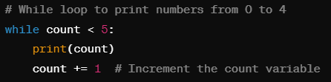
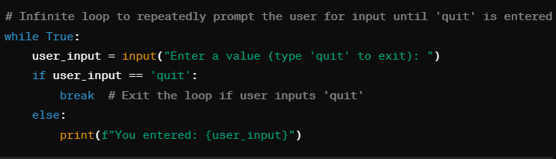
Control Flow: If Statements, While and For Loops
2
While and For Loops
For loop. Iterate over a sequence, such as a list, tuple, or string.
for [variable] in [sequence]: [do something].
While loop. Executes the code block until the statement is False.
while [statement]: [do something].
Control flow keywords: break, continue, pass
Notes:
Few cases in which while True is used.

Slide 37
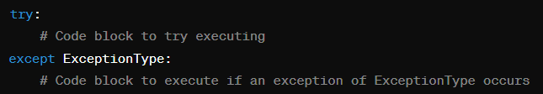
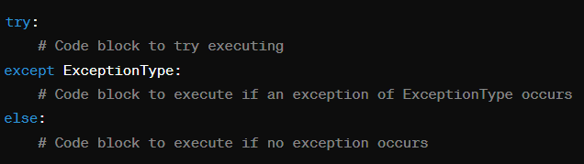
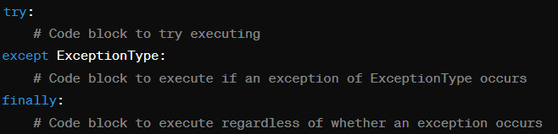

Control Flow: Try catch, with
1
Try catch
Executes the code block, if an error (type) occurs, except is executed. Finally is always executed.
try [do something]: except [do something]
try [do something]: except [do something], finally: [do something else].
try [do something]: except [do something], except [do something]
Notes:
If statement: They allow you to execute different blocks of code based on whether a particular condition is true or false.

Slide 38


Control Flow: Try catch, with
2
With
The expression evaluates to a context manager object, which is responsible for managing the resource.
with [expression]:
with [expresion] as [variable]:
Notes:
If statement: They allow you to execute different blocks of code based on whether a particular condition is true or false.

Slide 39

Data handling
lists, numpy arrays, dictionaries, objects
pandas for convenient data storage, access and visualization

Slide 40

Data handling
lists, numpy arrays, dictionaries, objects
pandas for convenient data storage, access and visualization
Covered in tutorial:
pandas.Series and pandas.Dataframe
data indexing filtering
loading & writing data
data visualization
data processing

Slide 41
Data visualization
matplotlib
pandas + seaborn
pandas + ggplot
bokeh
mayavi

Slide 42

Data visualization
matplotlib
pandas + seaborn
pandas + ggplot
bokeh
mayavi
Covered in tutorial:
seaborn styles and context
distribution plots
density estimation plots
joint plots

Slide 43

Machine learning tools
Sklearn
NLTK
Gensim
Deep learning: tensorflow, pytorch, chainer

Slide 44
Neuroscience tools
pyMVPA
nipype
nilearn
pyCortex
nipy

Slide 45
Things that make your life easier.
(Naming) Give variables names that allow you (and others!) to understand what they contain. The same holds for methods and classes. Don’t name them ‘thing1’, ‘thing2’, ‘foo’, ‘blub’, ‘wibblewobble’ or other nonsense.
(Debugging) Use the debugger for understanding your what goes on in your code and not print statements! Try to understand your error messages!
(Hot-keys) Learn some relevant hot-keys. You will thank me later.
(Search for help) Besides Stackoverflow, ChatGPT is your best friend. Don’t simply outsource thinking to generate solutions. Use it as a tool to understand libraries, data structures and programming in general. (To avoid compatibility Issues) Use Linux for Deep Learning frame-works, like pytorch and tensorflow (don’t forget to install cuda and cudnn). For example, use: conda install pytorch torchvision torchaudio pytorch-cuda=11.8 -c pytorch -c nvidia

Slide 46

PyCharm Hot-Keys

Slide 47

Sources
Jupyter cheat sheet
Jupyter cheat sheet II
Jupyter tips & tricks
Pandas cheat sheet
Pandas tutorials
KDnuggets intro to Pandas
Seaborn cheat sheet
Visualization with seaborn
Seaborn docs

