Slide 1
Pong deepRL
Julia Immiora, Hannah Sheahan, Zilong
Notes:
We chose a project that would combine some of the skills that we’ve been introduced to over the last few weeks into a cohesive unit that tackles a very important problem - and that problem is how to play pong.

Slide 2
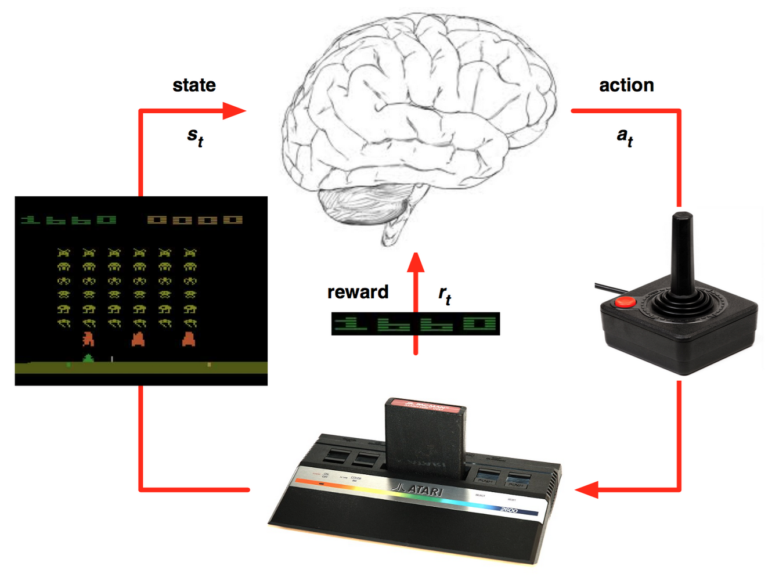
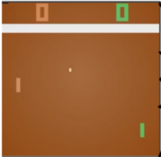
Problem statement
Goal: win as many points as you can in each episode (we play to 21)
Notes:
Pong as a game, is really pretty simple. One player (usually a human) controls one paddle moving up or down, and a computer or atari chip controls the other. Then each player tries to hit the ball past the other player, and if they do they get a point. So we play games up to 21 points and we try to win as many games as possible. And of course we can play again and again as much as we like.
As it turns out, pong is a Markov decision process and can be tackled well with a reinforcement learning agent - which can replace our human agent here represented by a brain. At each timestep t, the brain or agent chooses an action, which moves their paddle and impacts the pong environment, we might get a reward, the screen updates and we view it. Because we want to desig something that does this task end-to-end, we will use a deep RL agent that can take the image as raw pixels and choose actions based on that.

Slide 3
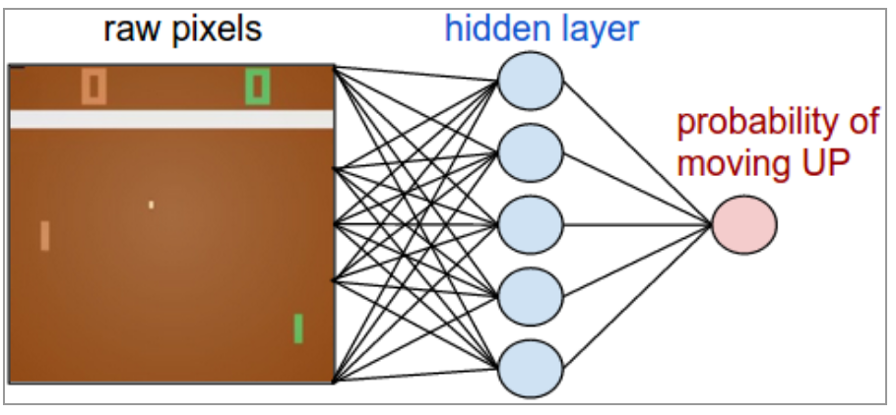
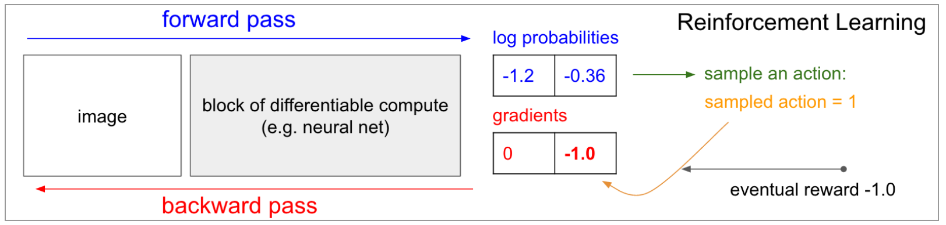
Learning policy: policy gradient
Learn policy function directly from trajectories made on the current policy
Network produces p(action)
Choose action as a sample from p(action)
Rollout/repeat x 10 matches
Add to gradient of p(actions|image) that gave +1 rewards and reduce gradients for -1 rewards.

Slide 4
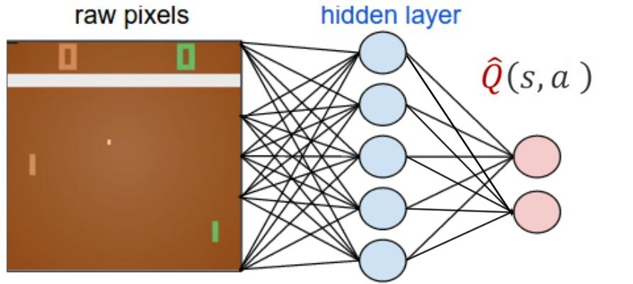
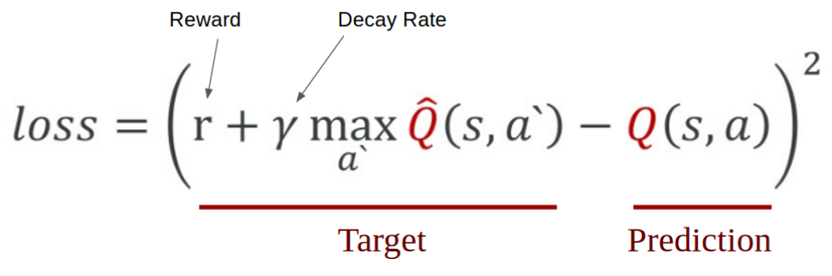
Learning policy: deep Q-learning
Q-function approximator is a neural net. Use memory replay to recall previously experienced state-action pairs.
Take action (ε-greedy)
Record experience (image, action, reward)
Run for a few games until episode finished
Recall a random selection of experiences
Update the Q-network weights using the difference between estimated and experienced values
Notes:
DQN is a form of Q-learning with function approximation (using a neural network), which means it tries to learn a state-action value function Q (given by a neural network in DQN) by minimizing temporal-difference errors, i.e. trying to make the value Q(s,a) close to r+γmaxa′Q(s′,a′) after observing a transition (s,a,r,s′)
, where the actions can be chosen arbitrarily (the algorithm is off-policy), typically using a greedy or epsilon-greedy policy based on the current Q function.

Slide 5
Outline
Best model performance
Comparison of various RL models
GPU vs CPU training

Slide 6
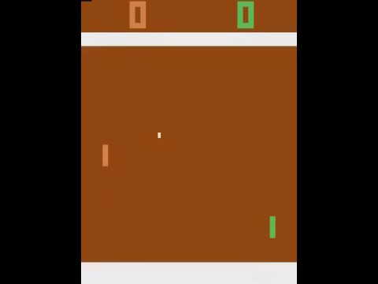
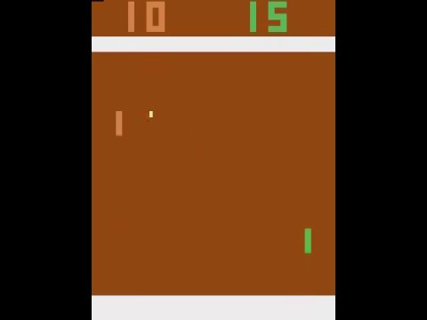
Best model performance
MLP, 1 hidden layer, 200 units, relu
Before training
After training

Slide 7
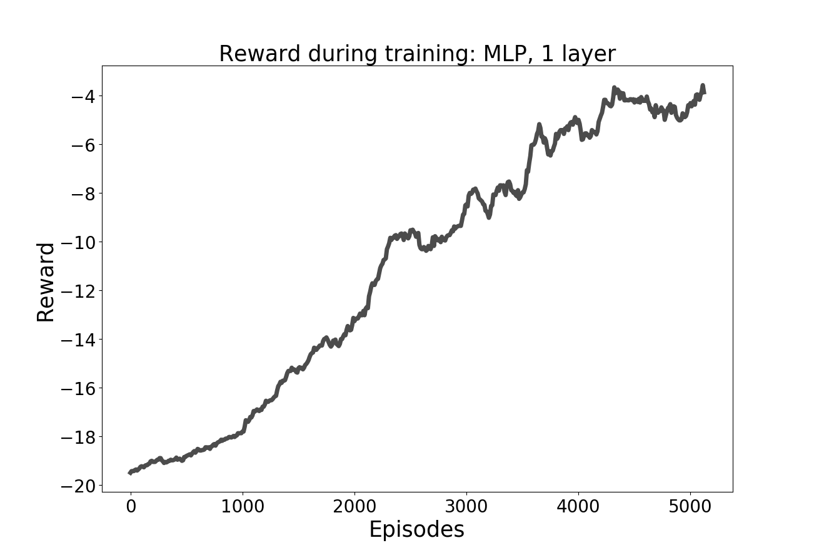
Best model

Slide 8
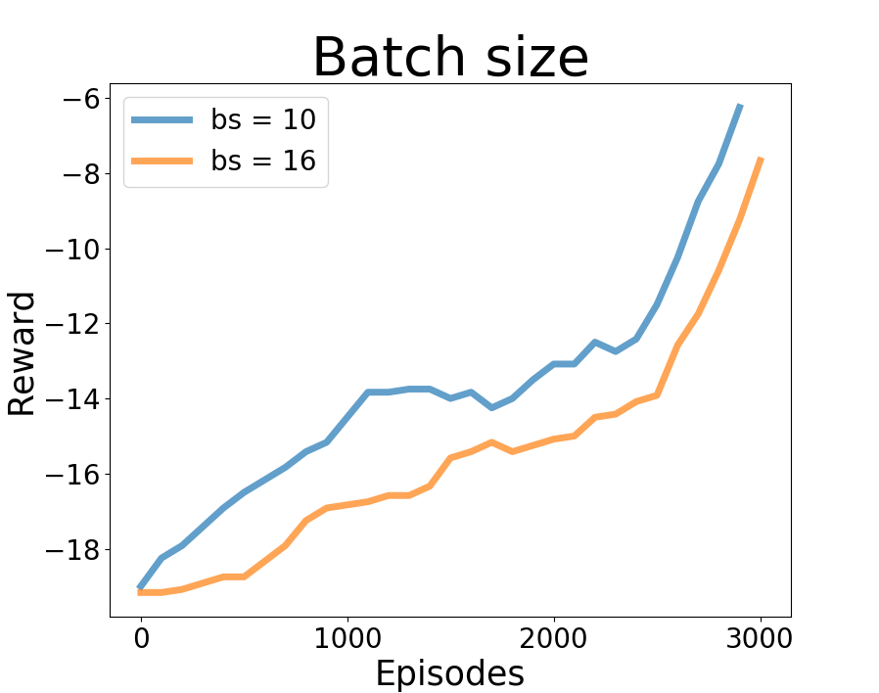
Model comparison
More frequent updates lead to better learning*

Slide 9
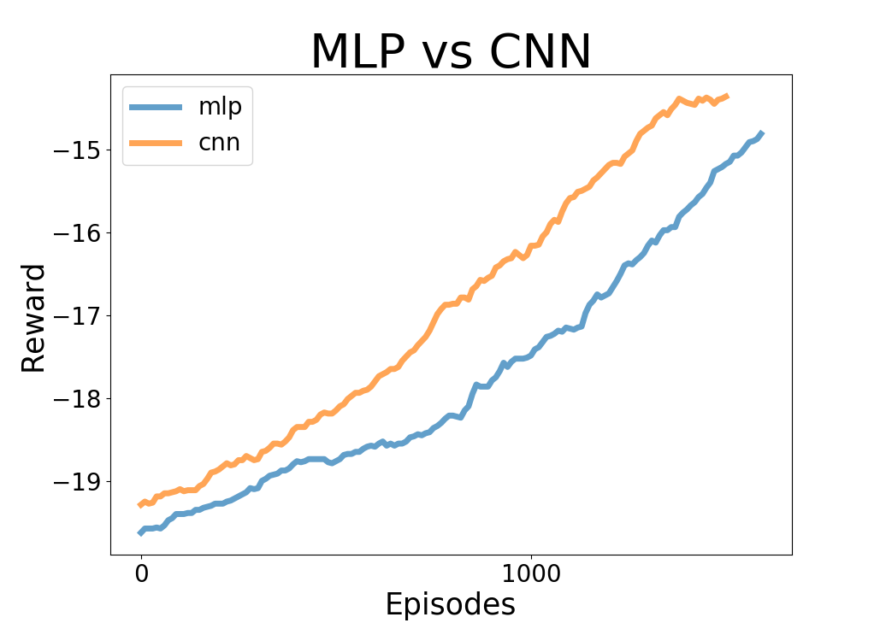
Model comparison
More frequent updates lead to better learning*
Simpler model converges more gradually*

Slide 10
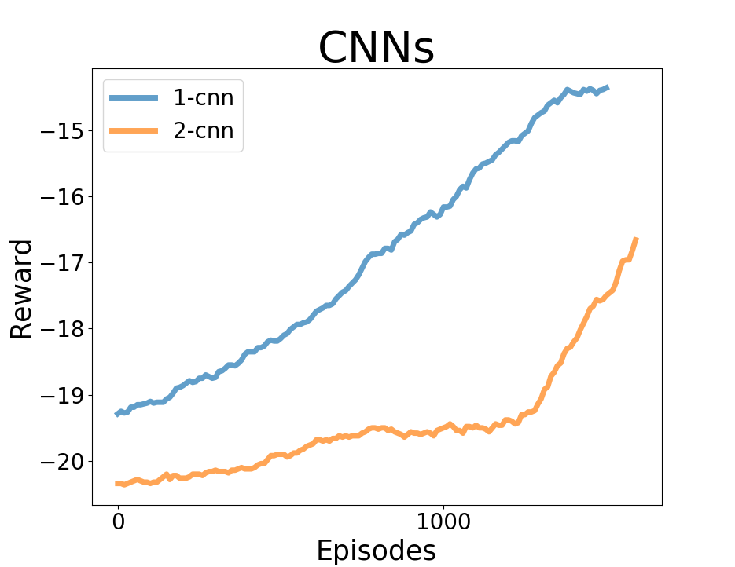
Model comparison
More frequent updates lead to better learning*
Simpler model converges more gradually*
CNN converges faster than MLP*

Slide 11
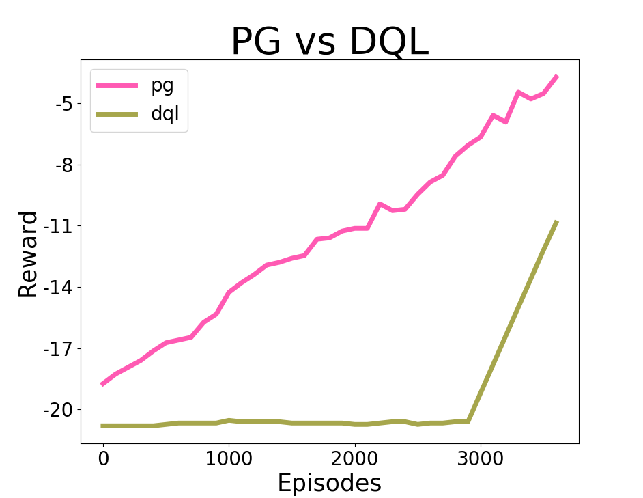
Model comparison
More frequent updates lead to better learning*
CNN converges faster than MLP*
Simpler model converges more gradually*
PG learns faster and more gradually than DQL

Slide 12
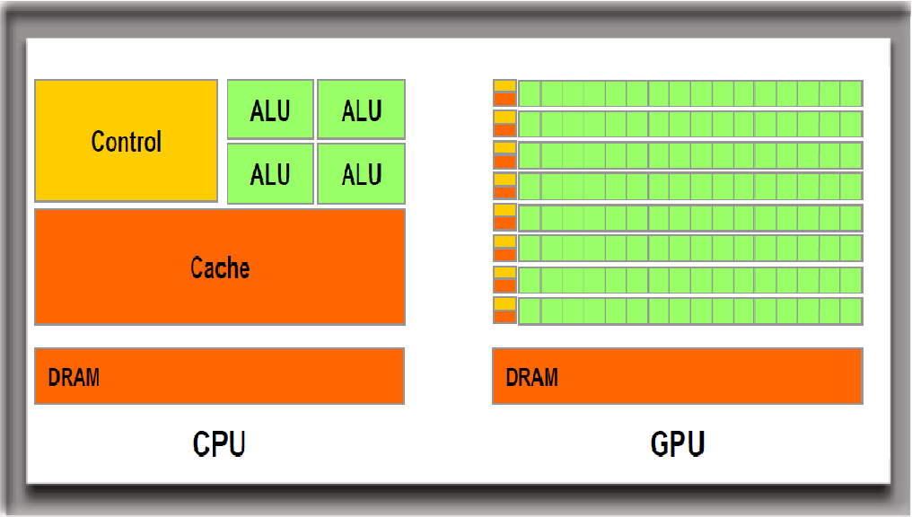
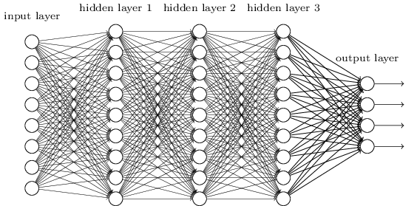
GPU vs CPU training
Remove tensorflow, theano, keras
Install cuda, cudnn
Conda install tensorflow-gpu
Conda install keras
Pip install gym
Pip install atari_py
Conda install libgcc, cmake, …...
Notes:
Deep learning involves huge amount of matrix multiplications and other operations which can be massively parallelized and thus sped up on GPU-s.
A single GPU might have thousands of cores while a CPU usually has no more than 12 cores. Although GPU cores are slower than CPU cores, they more than make up for that with their large number and faster memory if the operations can be parallelized. Sequential code is still faster on CPUs.

Slide 13
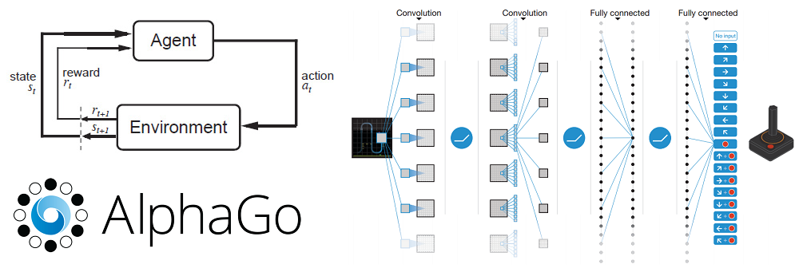
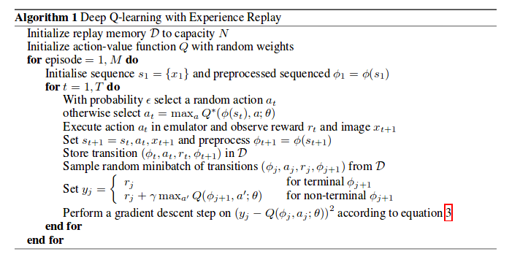
GPU vs CPU training
 | GPU | CPU
MLP 1 hidden layer | ~10h | ~5h
CNN 1 layer | ~10h | ~7h
CNN 2 layer | ~11h | ~12h
Conjectures:
1, Q value dependence
2, small network(shallow)
3, network bandwidth between cpu and gpu
4, ...
Notes:
Comparing training time after the same model is launched on both GPU and CPU. However current updation of Q value is dependent on the previous Q value. So the RL net can not be parallized like pure feedforward neural network. There are some conjectures that why this could happen. First is the Q value or policy gradient dependence, second is the network size is small, we only use a shalow network here. Third the network bandwidth may be a problem. After the action was calculated on the GPU, it will be transfered back to the CPU for the agent to update the environment.

Slide 14
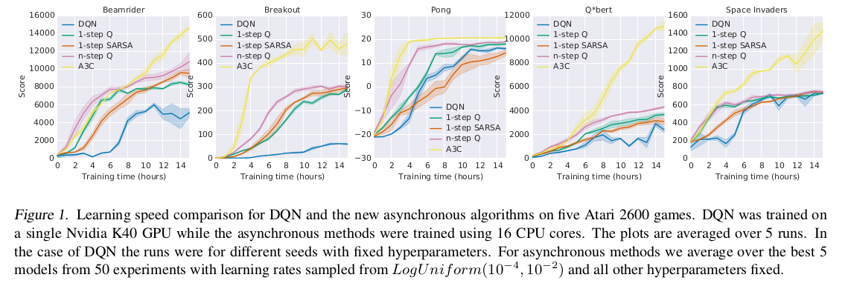
GPU vs CPU training
1, Large training batch size.
2, Prioritized DQN (Schaul et al. 2015)
3, Double-DQN (van Hasselt et al., 2015)
4, Dueling Double DQN (Wang et al., 2015)
5, A3C (Mnih et al.,2016)
Notes:
Prioritized DQN (Schaulet al., 2015) makes better use of the replay memory by more frequently selecting frames associated with significant experiences.
Double-DQN (van Hasselt et al., 2015) separates the estimate of thevalue function from the choice of actions (policy)

Slide 15
Future work
Multi-agent environments
Training deeper models
Transfer to other games

Slide 16
Batch normalization issues
Plot mean and var prior to activation per iteration
Tune momentum
Alternative regularization

