Slide 2







Target Layer
Protection Method
Criteria Layer
Landmark Age
Landmark Size
Number of Visitors
Protection Costs
Solution Layer
On-Site Protection
Relocation Protection

Slide 3
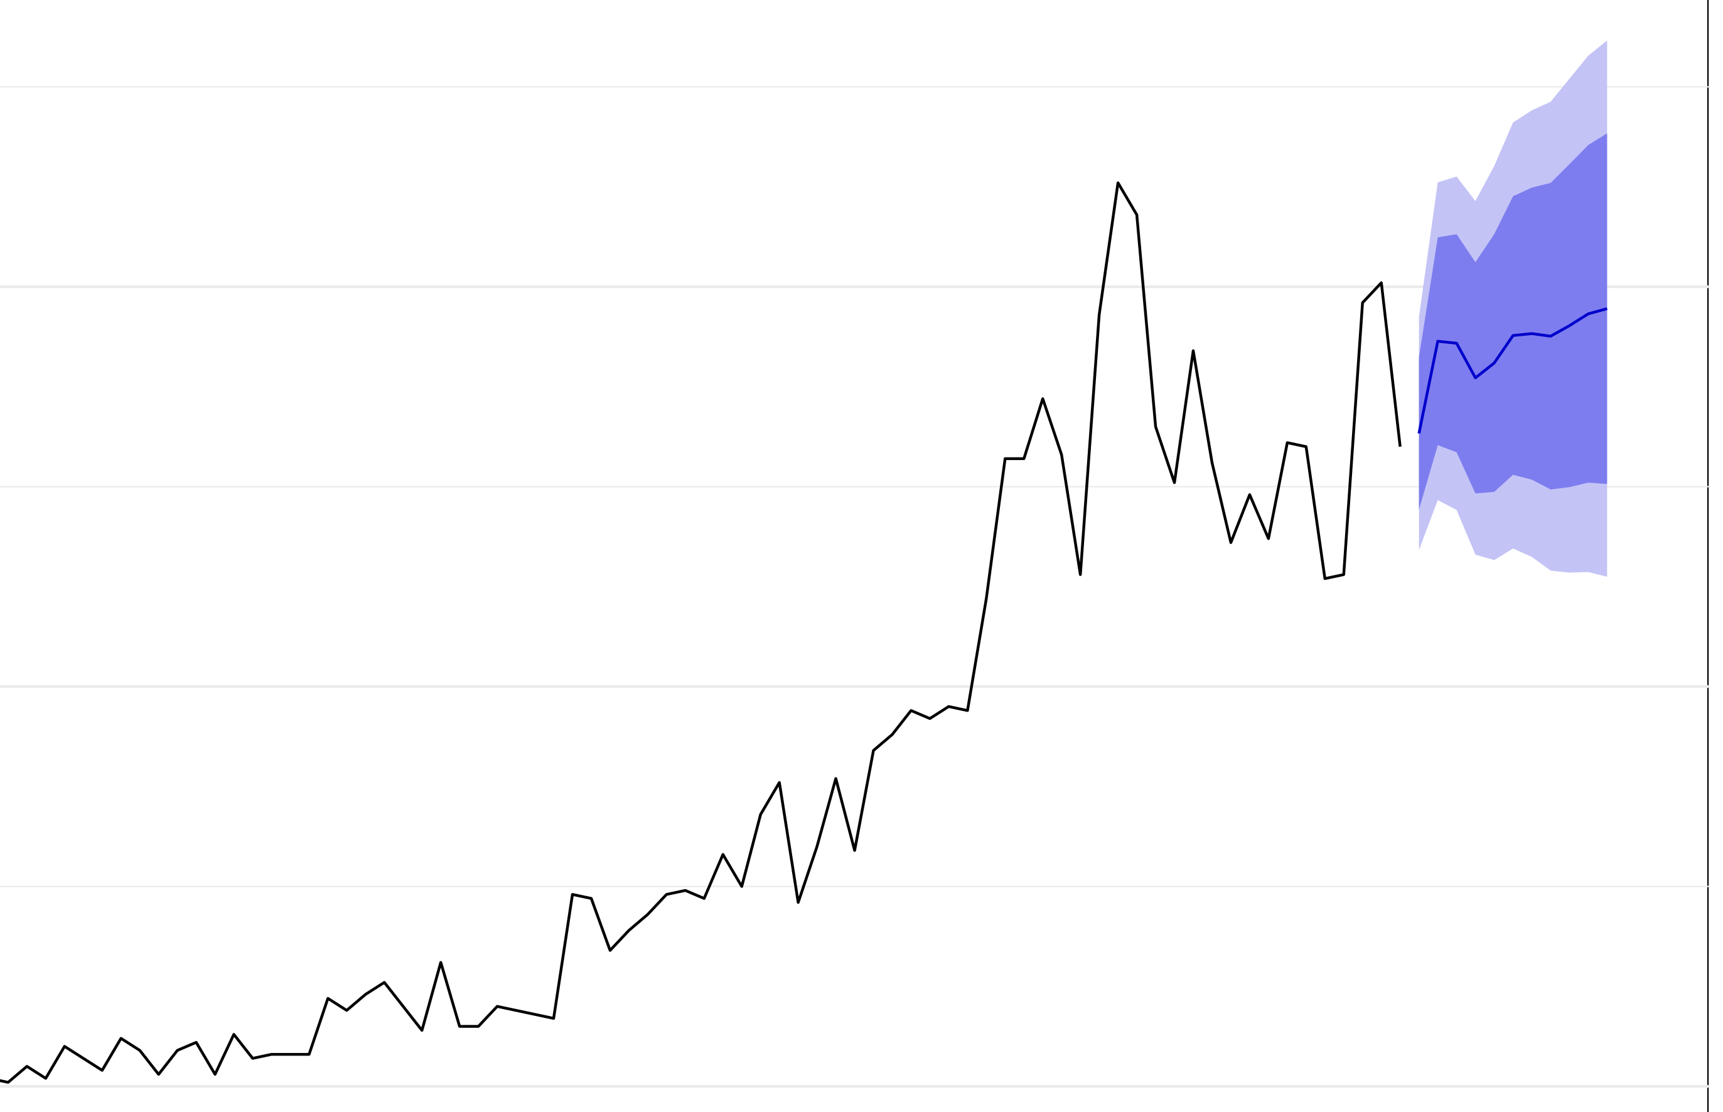
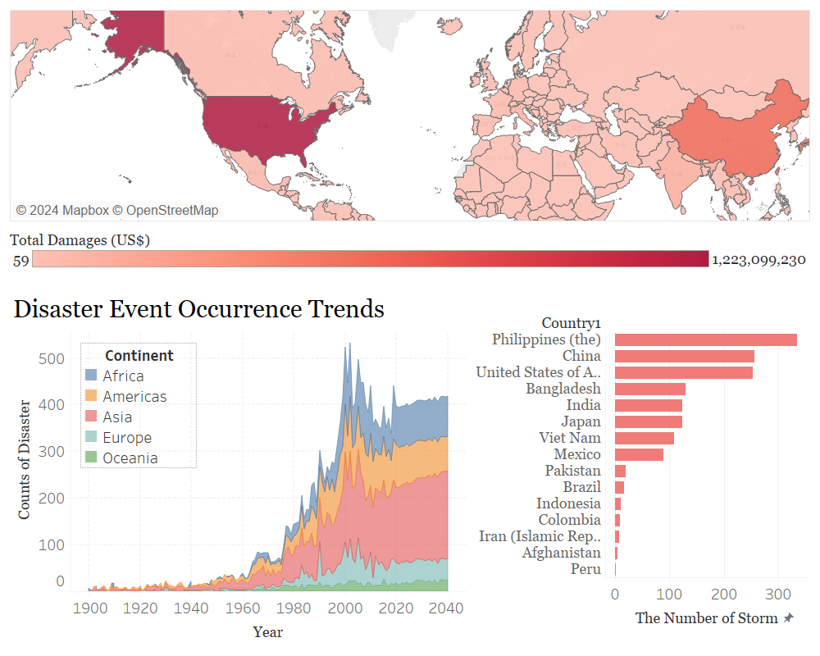




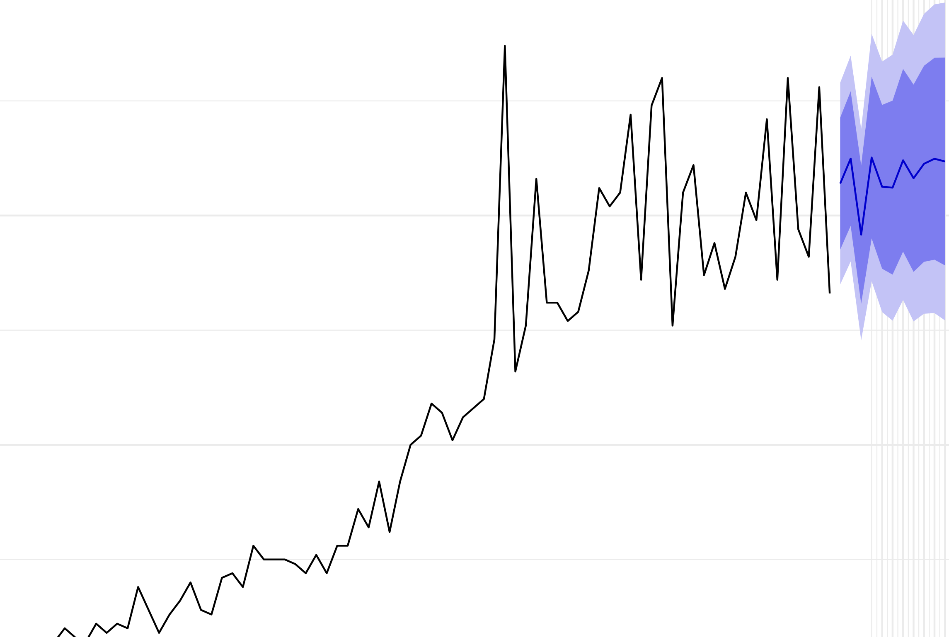
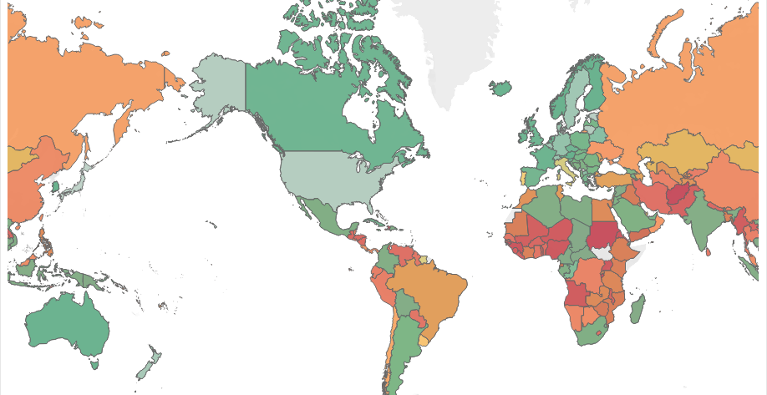
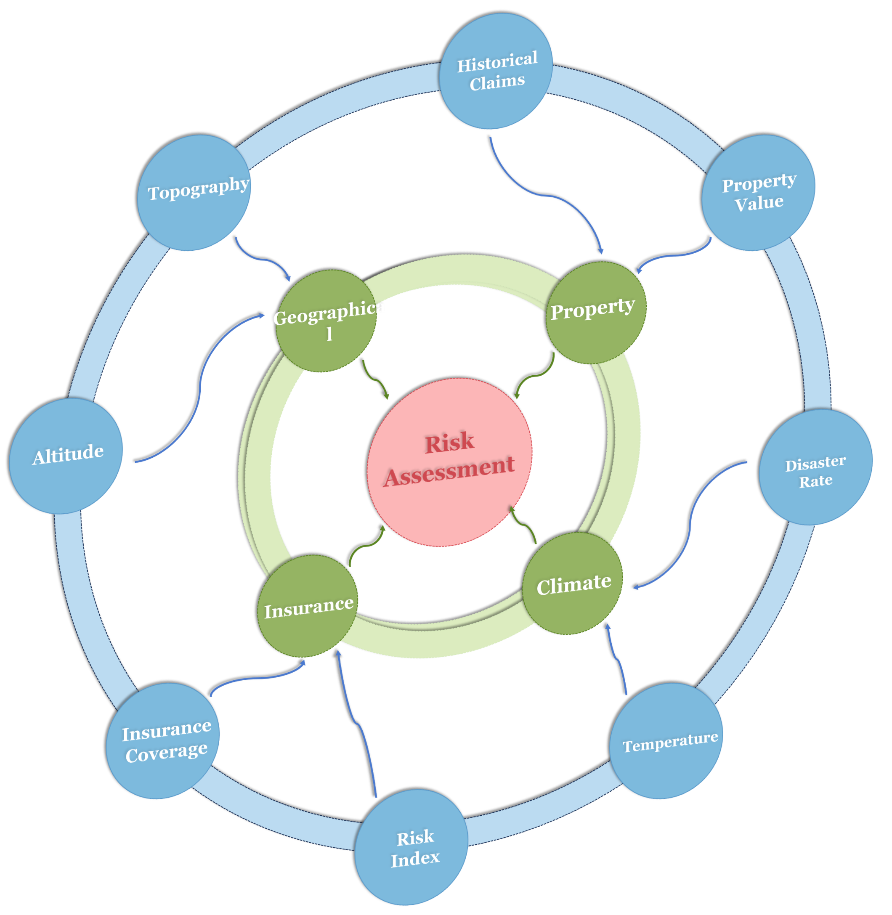




1
2
3
4
Insurance Company
Extreme Weather
Weather
Insurance
Data Collection And Analysis
ARIMA
Evaluation
Real-estate Company
Risk Index Analysis
Risk Assessment
GLM Model
Target Layer
Criteria Layer
Solution Layer
On-Site
Protection
Protection Costs
Landmark Size
Protection Method
Relocation
Protection
Community
Number of Visitors
Landmark Age
AHP MODEL
Linear Programming Model

