Slide 1



GIGACHADS
TAP IN EMERGENCY

Slide 2

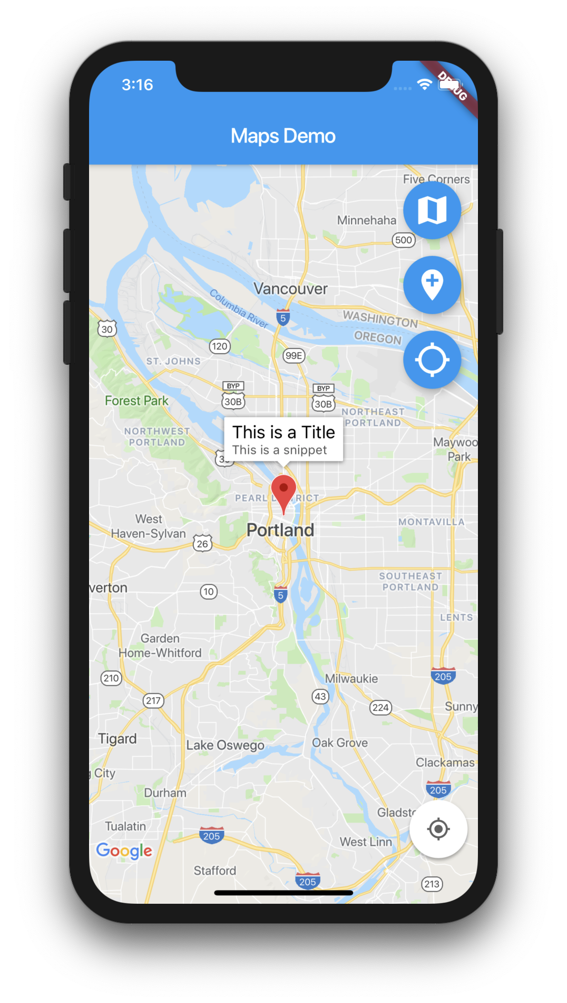
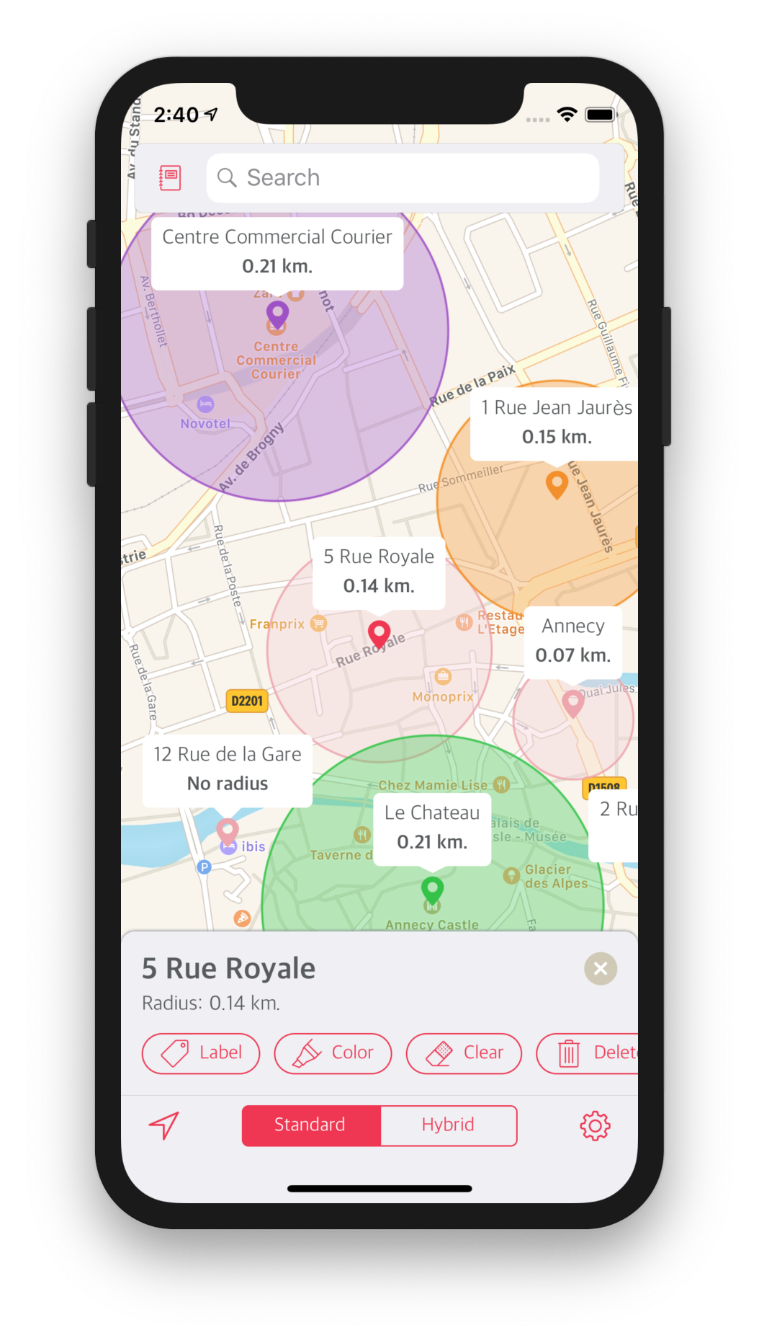

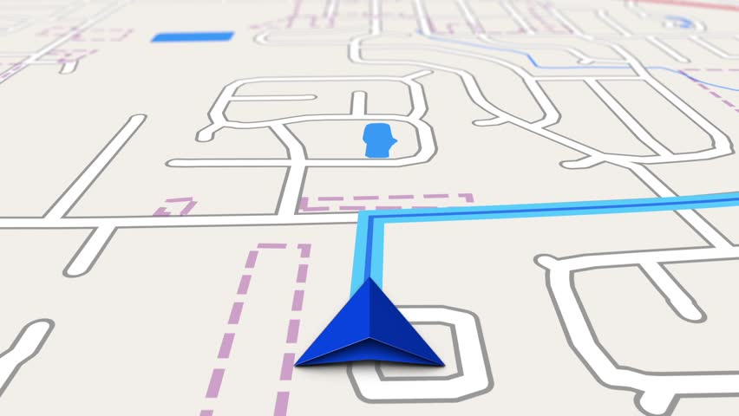


PROPOSED SOLUTION
PROBLEM STATEMENT
- ONE TAP SOLUTION FOR EMERGENCIES
Application
The product will be an application with a user friendly interface.
One Tap
A single tap will enable the user to view all the emergency services like
Hospitals
Fire fighters
Public Security and pinpoint the exact location using Geocoding and Search API.
Given Radius
The user can select the radius (e.g. 5-10 km) within which he/she wants to view the emergency services.
Best Route
If you select a particular service, the app will provide you with the best possible route with the use of Routing API and Public Transit API.

Slide 3

TECH STACK
Map Rendering | Geocoding & Search | Routing | HERE Studio
Map Rendering Services like Map Image API and Map Tile API will be used to render map tiles and image that are optimized for desktop and mobile devices. | To accurately pinpoint the geo-coordinates, addresses and Places/POIs on the map | To complete complex journeys more efficiently to the required emergency service. | To customize map if needed.
LANGUAGES
JAVA, XML, HTML, CSS, JAVASCRIPT
PLATFORM
ANDROID STUDIO

