Slide 1
Facial Emotion Detection
Course: IT3320E - Deep Learning
Group Members: Nguyen Thai Anh Minh, Dang Trung Anh, Pham Duc Duy, Bui Cong Minh
Supervisor: Ph.D. Than Quang Khoat

Slide 2
Table of contents
01
02
03
04
Introduction
Methods
Problem statement and the dataset
2 methods: Custom CNN and ResNet18
Results
Conclusion
Comparison and analysis
Summary and recommendation

Slide 3
01
Introduction

Slide 4
Problem statement
Context
Human emotion recognition is critical for social interaction, robotics, and human-computer interface
Deep learning approaches leads to a breakthrough in the field of emotion identification and becomes an interesting research topic
Objective
Develop and compare deep learning models to classify facial expressions into different categories
Approaches
A custom-designed CNN trained from scratch
Transfer Learning using ResNet18

Slide 5
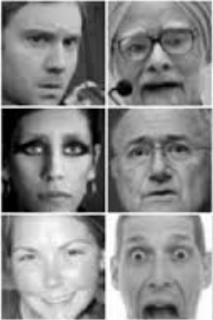
Dataset: FER-2013
Overview: 35,887 grayscale images, 48x48-pixel resolution
Classes: Angry, Disgust, Fear, Happy, Sad, Surprise, Neutral
Challenges:
  Variability: Significant differences in pose, illumination, and image quality
  Class Imbalance: "Disgust" is significantly underrepresented compared to "Happy" or "Neutral"

Slide 6
02
Methodologies

Slide 7
1. Custom CNN model
Preprocessing:
  Pixel values normalized to range [-1, 1] using mean 0.5 and standard deviation 0.5 for stability
  Data Augmentation: Random flipping, rotations, and cropping applied to the training set
Handling Imbalance:
  Strategy: Weighted Random Sampling
  Why: Instead of modifying the loss function, this adjusts sampling probability
  → Minority classes are seen more frequently in batches.
  → More stable gradients than Class-Weighted Loss

Slide 8
1. Custom CNN model
Architecture:
Spatial size ↓ (48 → 24 → 12 → 6)
Channel depth ↑ (1 → 32 → 64 → 128 → 256)
Final classification via Global Average Pooling + Fully Connected layer
Key Components:
Blocks 1-3: Conv2D + BatchNorm + ReLU + MaxPool
Block 4: Deep semantic extraction with Dropout to prevent overfitting
Classification: Used Global Average Pooling (GAP) instead of flattening
Advantage: GAP reduces parameters significantly (only ~0.58M total params), minimizing overfitting risks

Slide 9
1. Custom CNN model
Block | Layers | Output Shape | Parameters
Input | - | 1 x 48 x 48 | -
Block 1 | 2 × Conv + BN + ReLU + MaxPool | 32 × 24 × 24 | 9.7K
Block 2 | 2 × Conv + BN + ReLU + MaxPool | 64 x 12 x 12 | 55.7K
Block 3 | 2 × Conv + BN + ReLU + MaxPool | 128 x 6 x 6 | 221.7K
Block 4 | Conv + BN + ReLU + Dropout | 256 x 6 x 6 | 295.7K
GAP + FC | Global Avg Pool + Linear | 7 | 1.8K
Total |  |  | 584.807K

Slide 10
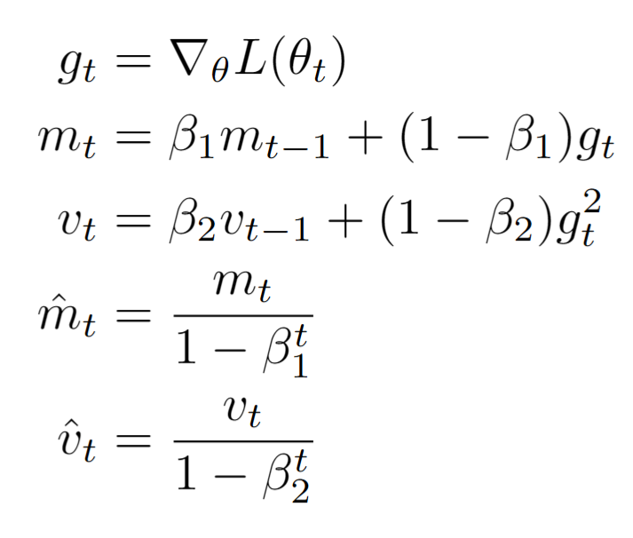
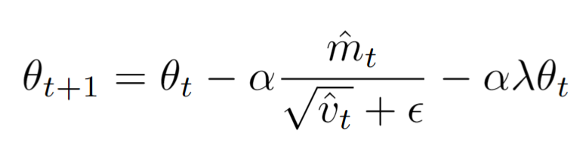
1. Custom CNN model
Optimizer: AdamW
An improved variant of the Adam optimizer
Advantages:
Decoupled weight decay
Better generalization
Converges faster in early training

Slide 11
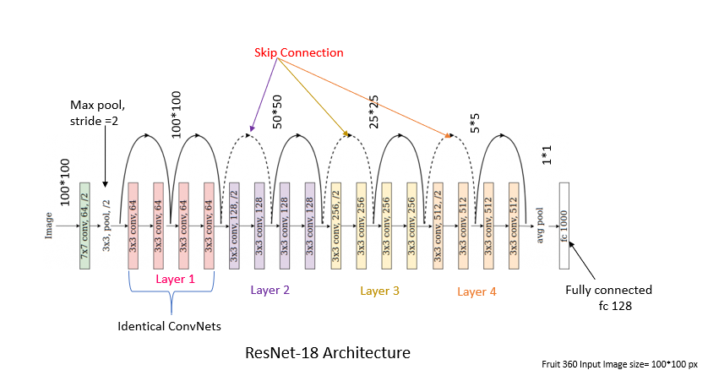
2. Transfer Learning (ResNet18)
Using a ResNet18 model pre-trained on the ImageNet dataset

Slide 12
2. Transfer Learning (ResNet18)
Input Adaptation (Crucial Step):
FER-2013 images (48x48 grayscale) were resized to 224x224
Converted to 3-channel RGB (duplicated channels) to match ImageNet pre-training
Normalized using ImageNet mean/std statistics
    mean = (0.485, 0.456, 0.406), std = (0.229, 0.224, 0.225)
Architecture Modification:
Replaced the original fully connected layer with a new head for 7 emotion classes

Slide 13
2. Transfer Learning (ResNet18)
Two-Stage Training:
Frozen Backbone: Train only the classification head with a higher learning rate to adapt to new classes
Fine-Tuning: Unfreeze the backbone and train end-to-end with a lower learning rate to adjust deep features without catastrophic forgetting
Additions: Used Label Smoothing and Test-Time Augmentation (TTA) for robustness

Slide 14
Experimental Setup
Metrics: Accuracy, Precision, Recall, F1-Score, and Confusion Matrix
Macro-Averaging: Used to ensure minority classes (like Disgust) are weighted equally in evaluation

Slide 15
03
Results

Slide 16
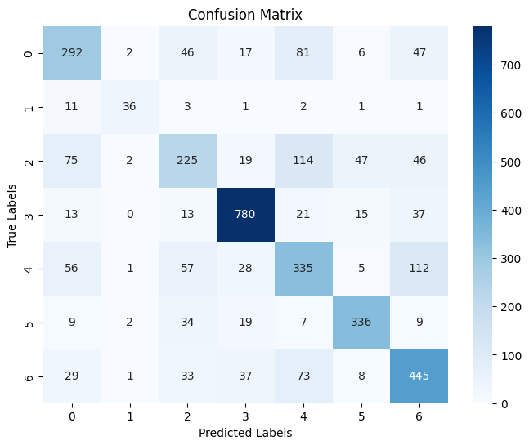
Group’s CNN Model’s result
Class | Precision | Recall | F1-score | Support
Angry | 0.6021 | 0.5947 | 0.5984 | 491
Disgust | 0.8182 | 0.6545 | 0.7273 | 55
Fear | 0.5474 | 0.4261 | 0.4792 | 528
Happy | 0.8657 | 0.8874 | 0.8764 | 879
Sad | 0.5292 | 0.5640 | 0.5460 | 594
Surprise | 0.8038 | 0.8077 | 0.8058 | 416
Neutral | 0.6385 | 0.7109 | 0.6727 | 626
Accuracy |  |  | 0.6824 | 3589
Macro Avg | 0.6864 | 0.6636 | 0.6723 | 3589
Weighted Avg | 0.6796 | 0.6824 | 0.6793 | 3589

Slide 17
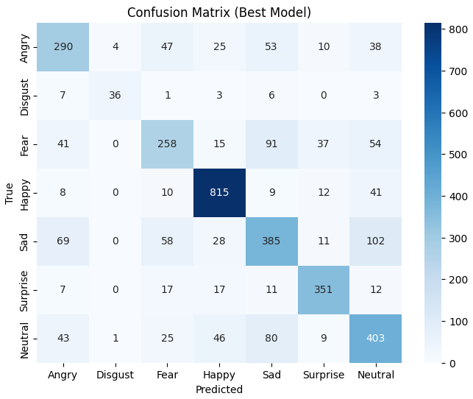
ResNet18’s result
Class | Precision | Recall | F1-score | Support
Angry | 0.6267 | 0.6210 | 0.6223 | 467
Disgust | 0.8780 | 0.6429 | 0.7423 | 56
Fear | 0.6202 | 0.5202 | 0.5658 | 496
Happy | 0.8588 | 0.9106 | 0.8839 | 895
Sad | 0.6063 | 0.5896 | 0.5978 | 653
Surprise | 0.8163 | 0.8458 | 0.8308 | 415
Neutral | 0.6172 | 0.6639 | 0.6397 | 607
Accuracy |  |  | 0.7072 | 3589
Macro Avg | 0.7172 | 0.6848 | 0.6975 | 3589
Weighted Avg | 0.7038 | 0.7072 | 0.7042 | 3589

Slide 18
Analysis
Comparison:
ResNet18 outperformed the Custom CNN in Accuracy, Macro F1, and Weighted F1
Transfer learning provided better generalization, specifically helping with the class imbalance issue
Error Analysis:
Both models struggle to distinguish between "Fear" and "Sad," often confusing them with "Neutral" or "Angry“
However, ResNet18 reduced these misclassifications compared to the custom model

Slide 19
04
Conclusion

Slide 20
Conclusion
Summary:
Transfer Learning (ResNet18) is more effective than training from scratch for FER-2013
  Leveraging pre-trained features compensates for limited data and low resolution, providing robust performance even on minority classes
Recommendation: For practical applications with limited/imbalanced data, ResNet18 is the superior choice

Slide 21
References
[1] Than Quang Khoat. IT3320E - Deep Learning Lecture Slides. Hanoi University of Science and Technology, 2025.
[2] M. Sambare. FER2013: Facial Expression Recognition 2013 Dataset. https://www.kaggle.com/datasets/msambare/fer2013.
[3] PyTorch: An Open-Source Deep Learning Framework. https://pytorch.org/
[4] GeeksforGeeks. Deep Learning Tutorial. https://www.geeksforgeeks.org/deep-learning/deep-learning-tutorial/, 2025.

Slide 22
Thank you for listening
Do you have any questions?

